Slide 1
Budgeteer Budgeting and Savings System
CS 470
Team 8 – The Drop Tables
Nick, Jack, Sasha, Max

Slide 2

Introduction
Goal: Develop a budgeting and savings application that could be used by a bank to help their customers better manage and track their spending
Project is based on the final project for the Software Engineering Capstone (CS 451R) course

Slide 3
Desired Functionality
Create and view budgets and spending for multiple accounts
Create and edit budgets to track spending by transaction type
Comparison between budgeting and actual spending
Provide a visual (graphical) representation of budgeting and actual spending

Slide 4
Two-Fork Design
Network Database
Local Database
Fully functional proof of concept
Production implementation
Our product, our servers.
The best product.
Expendable test environment
Future development into custom products
Deployment to future custom products.
Product development

Slide 5
Application Architecture
Network Architecture
Local Architecture
Three-Tier
Data
Microsoft SQL Server
Business Logic
C#
ASP. NET
Client
HTML/CSS/JavaScript
Bootstrap Framework
Two-Tier -> Three-Tier
Data
PostgreSQL Server on localhost
Client
HTML/CSS/JavaScript
Bootstrap Framework
*Third tier would be requisite going forward to link the two local tiers

Slide 6
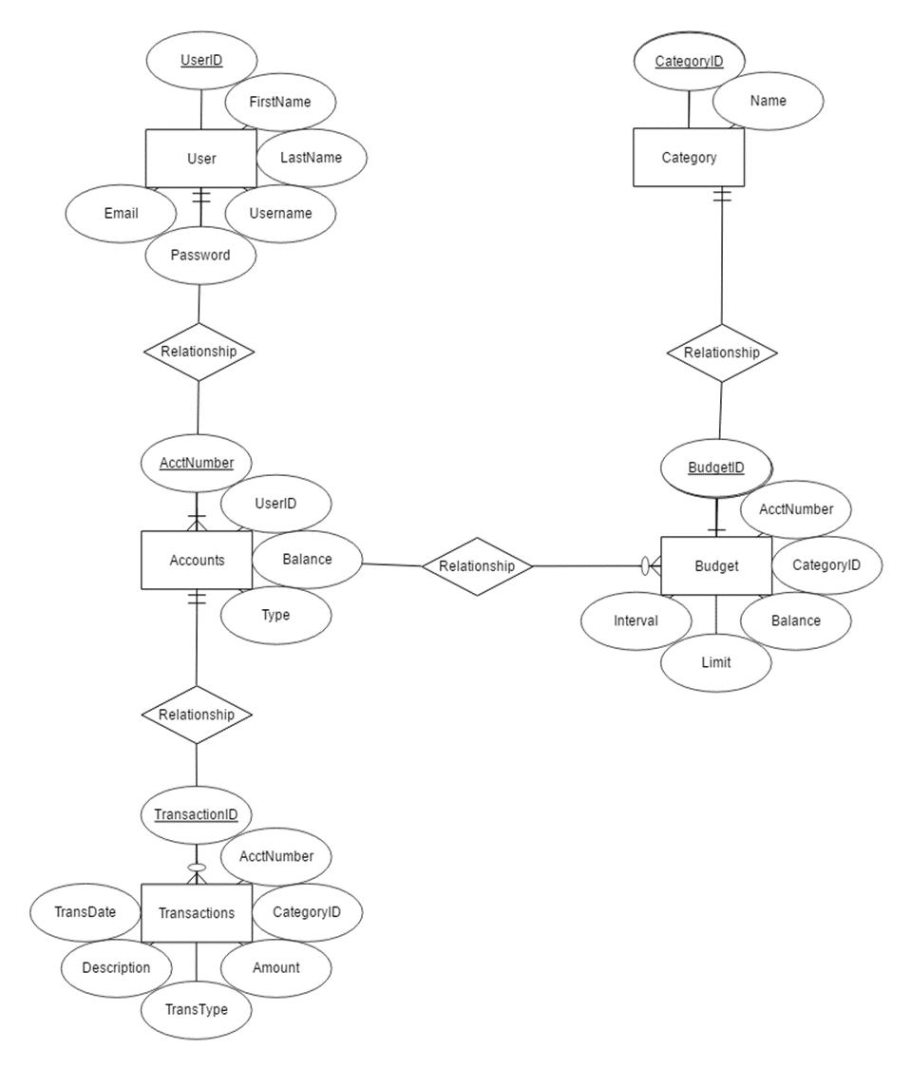
ER Diagram
Five Entities: User, Account, Transaction, Budget, and Category
1 to N relationship between User and Account
1 to N relationship between Account and Transaction
1 to N relationship between Account and Budget
1 to 1 relationship between Budget and Category

Slide 7
Local Implementation

Slide 8
CREATE TABLE bank.users(
user_id integer NOT NULL,
user_first_name text COLLATE pg_catalog."default",
user_last_name text COLLATE pg_catalog."default",
user_username text COLLATE pg_catalog."default",
user_email text COLLATE pg_catalog."default",
user_password text COLLATE pg_catalog."default",
CONSTRAINT user_id_pkay PRIMARY KEY (user_id)
)
TABLESPACE pg_default;
Schema Creation:
User Table

Slide 9
CREATE TABLE bank.transactions(
transaction_id integer NOT NULL,
account_number integer NOT NULL,
category_id integer NOT NULL,
amount integer DEFAULT 0 NOT NULL,
transaction_type text COLLATE pg_catalog."default",
description text COLLATE pg_catalog."default",
transaction_date date,
CONSTRAINT transaction_id_pkey PRIMARY KEY (transaction_id),
CONSTRAINT account_number_fk FOREIGN KEY (account_number)
REFERENCES bank.accounts (account_number) MATCH SIMPLE
ON UPDATE NO ACTION
ON DELETE NO ACTION,
CONSTRAINT category_id_fk FOREIGN KEY (category_id)
REFERENCES bank.transaction_category (category_id) MATCH SIMPLE
ON UPDATE NO ACTION
ON DELETE NO ACTION
)
TABLESPACE pg_default;
Schema Creation: Transaction Table

Slide 10
CREATE TABLE bank.accounts(
account_number integer NOT NULL,
user_id integer NOT NULL,
balance integer DEFAULT 0 NOT NULL,
account_type text COLLATE pg_catalog."default",
CONSTRAINT account_number_pkey PRIMARY KEY (account_number),
CONSTRAINT account_user_id_fk FOREIGN KEY (user_id)
REFERENCES bank.users (user_id) MATCH SIMPLE
ON UPDATE NO ACTION
ON DELETE NO ACTION
)
TABLESPACE pg_default;
Schema Creation: Account Table

Slide 11
Schema Creation: Category Table
CREATE TABLE bank.transaction_category(
category_id integer NOT NULL,
name text COLLATE pg_catalog."default",
CONSTRAINT category_pkey PRIMARY KEY (category_id)
)
TABLESPACE pg_default;

Slide 12
CREATE TABLE bank.budget(
budget_id integer NOT NULL,
account_number integer NOT NULL,
category_id integer NOT NULL,
balance integer DEFAULT 0 NOT NULL,
budget_limit integer DEFAULT 500 NOT NULL,
budget_interval integer DEFAULT 30 NOT NULL,
CONSTRAINT budget_id_pkey PRIMARY KEY (budget_id),
CONSTRAINT account_number_fk FOREIGN KEY (account_number)
REFERENCES bank.accounts (account_number) MATCH SIMPLE
ON UPDATE NO ACTION
ON DELETE NO ACTION
)
TABLESPACE pg_default;
Schema Creation: Budget Table

Slide 13
from xlrd import open_workbook
wb = open_workbook('umkcprojectdata.xlsx')
values = []
for s in wb.sheets():
#print 'Sheet:',s.name
for row in range(1, s.nrows):
col_names = s.row(0)
col_value = []
for name, col in zip(col_names, range(s.ncols)):
value = (s.cell(row,col).value)
try : value = str(int(value))
except : pass
col_value.append((name.value, value))
values.append(col_value)
file = open("query.txt","w")
def get_account_type(account_type):
if account_type == "Checking":
return 1
if account_type == "Savings":
return 2
if account_type == "Credit Card":
return 3
def is_null(string):
if string == "":
return "NULL"
else:
return string
from xlrd import open_workbook
wb = open_workbook('umkcprojectdata.xlsx')
values = []
for s in wb.sheets():
#print 'Sheet:',s.name
for row in range(1, s.nrows):
col_names = s.row(0)
col_value = []
for name, col in zip(col_names, range(s.ncols)):
value = (s.cell(row,col).value)
try : value = str(int(value))
except : pass
col_value.append((name.value, value))
values.append(col_value)
file = open("query.txt","w")
def get_account_type(account_type):
if account_type == "Checking":
return 1
if account_type == "Savings":
return 2
if account_type == "Credit Card":
return 3
def is_null(string):
if string == "":
return "NULL"
else:
return string
Normalization

Slide 14
Database Implementation

Slide 15
from xlrd import open_workbook
wb def is_null(string):
if string == "":
return "NULL"
else:
return string
def get_transaction_type_id(transaction_type): if transaction_type == "DR": return 2 e
from xlrd import o
return string
def get_transaction_type_id(transaction_type): if transaction_type == "DR": return 2 elif transac #file.close()
Network Implementation

Slide 16
Budget Queries
Query Description | SQL Statement
Get the budgets for an account | SELECT * FROM Budget WHERE AcctNumber = X
Get the category name for a transaction | SELECT Name FROM Transaction AS T JOIN Category AS C ON T.CategoryID = C.CategoryID
Get the balance of a budget | SELECT Balance FROM Budget WHERE Name = N
Set the balance of a budget | UPDATE Budget SET Balance = X Where Name = N
Set the limit of a budget | UPDATE Budget SET Limit = L WHERE Name = N
Set the interval of a budget | UPDATE Budget SET Interval = I Where Name = N

Slide 17
Transaction Queries
Query Description | SQL Statement
Get all transactions that occurred within a certain time period | SELECT * FROM Transactions WHERE AcctNumber = num AND TransDate >= d1 AND TransDate <= d2
Get all transactions of a specific type that occurred within a certain time period | SELECT * FROM Transactions WHERE CategoryID = X AND TransDate >= d1 AND TransDate <= d2

Slide 18
Graph Queries
Query Description | SQL Statement
Get the sum of all transactions of the same type for a given period | SELECT SUM(Amount) as Total FROM Transactions WHERE CategoryID = X AND TransDate >= d1 AND TransDate <= d2
Get the amount budgeted for a transaction type for a given period | SELECT Balance, Interval FROM Budgets WHERE BudgetID = X

Slide 19

Future Scope
Implement a user interface screen to categorize transactions
Enable users to re-categorize previous transactions
Trigger notifications to be sent when x% of budget limit is reached.

Slide 20
User Interface Demonstration & Class Questions

