Slide 1
Budgeteer Budgeting and Savings Application
CS 470
Group 8 – The Drop Tables
Nick, Jack, Sasha, Max

Slide 2
Introduction
Goal: To develop a budgeting and savings application that could be used by a bank to help their customers better manage and track their spending
Based on the final project for the Software Engineering Capstone (CS451R) course

Slide 3
Desired Functionality
Create and view budgets and spending for multiple accounts
Create and edit budgets to track spending by transaction type
Comparison between budgeting and actual spending
Provide a visual (graphical) representation of budgeting and actual spending

Slide 4
Two-Fork Design
Network Database:
Fully functional proof of concept
Production implementation
Our product, our servers.
The best product.
Our database project has two divergent paths with the same destination. Intended goals were:
Local Database:
Expendable test environment
Future development into custom products
Deployment to future custom products.
Product development

Slide 5
Network Architecture
Local Architecture
3-tier
Data
Microsoft SQL Server
Transfer
C# - Data abstraction layer
ASP .NET
Client
HTML/CSS/JavaScript
Bootstrap Framework
2-tier -> 3-tier
Data
PostgreSQL server on localhost
Client
HTML/CSS/JavaScript
Bootstrap Framework
Third tier would be requisite going forward to link the two local tiers.
Notes:
-Nick- then -Jack-

Slide 6
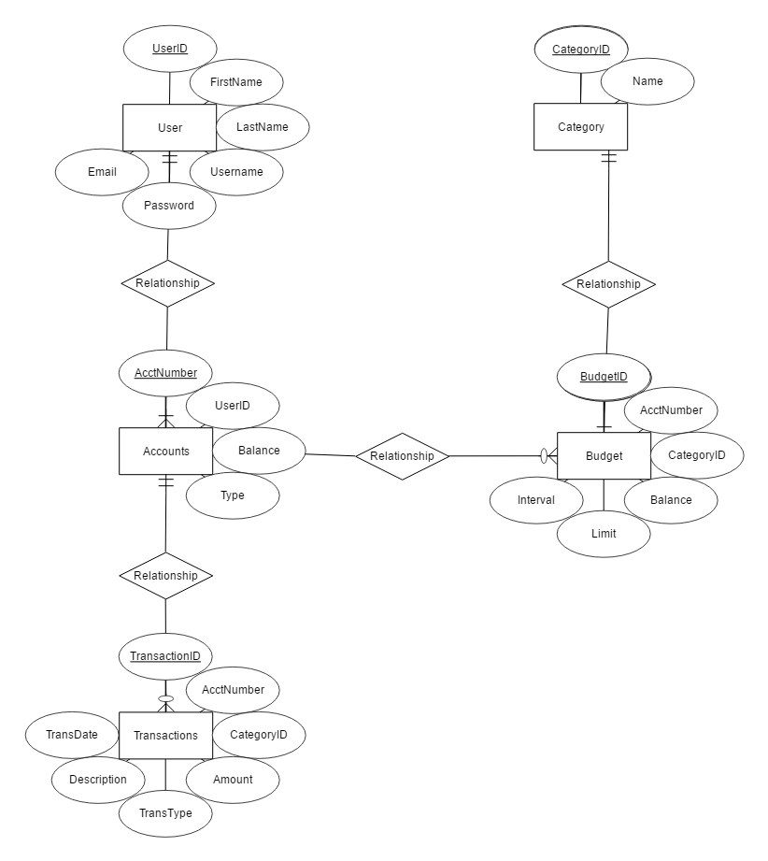
ER Diagram
Notes:
-Sasha-
Five Entities: User, Account, Transaction, Budget, and Category
1 to N relationship between User and Account
1 to N relationship between Account and Transaction
1 to N relationship between Account and Budget
1 to 1 relationship between Budget and Category

Slide 7
Local Implementation

Slide 8
Local Schema Creation
CREATE TABLE bank.users(
user_id integer NOT NULL,
user_first_name text COLLATE pg_catalog."default",
user_last_name text COLLATE pg_catalog."default",
user_username text COLLATE pg_catalog."default",
user_email text COLLATE pg_catalog."default",
user_password text COLLATE pg_catalog."default",
CONSTRAINT user_id_pkay PRIMARY KEY (user_id)
)
TABLESPACE pg_default;
CREATE TABLE bank.accounts(
account_number integer NOT NULL,
user_id integer NOT NULL,
balance integer DEFAULT 0 NOT NULL,
account_type text COLLATE pg_catalog."default",
CONSTRAINT account_number_pkey PRIMARY KEY (account_number),
CONSTRAINT account_user_id_fk FOREIGN KEY (user_id)
REFERENCES bank.users (user_id) MATCH SIMPLE
ON UPDATE NO ACTION
ON DELETE NO ACTION
)
TABLESPACE pg_default;
CREATE TABLE bank.transactions(
transaction_id integer NOT NULL,
account_number integer NOT NULL,
category_id integer NOT NULL,
amount integer DEFAULT 0 NOT NULL,
transaction_type text COLLATE pg_catalog."default",
description text COLLATE pg_catalog."default",
transaction_date date,
CONSTRAINT transaction_id_pkey PRIMARY KEY (transaction_id),
CONSTRAINT account_number_fk FOREIGN KEY (account_number)
REFERENCES bank.accounts (account_number) MATCH SIMPLE
ON UPDATE NO ACTION
ON DELETE NO ACTION,
CONSTRAINT category_id_fk FOREIGN KEY (category_id)
REFERENCES bank.transaction_category (category_id) MATCH SIMPLE
ON UPDATE NO ACTION
ON DELETE NO ACTION
)
TABLESPACE pg_default;
CREATE TABLE bank.transaction_category(
category_id integer NOT NULL,
name text COLLATE pg_catalog."default",
CONSTRAINT category_pkey PRIMARY KEY (category_id)
)
TABLESPACE pg_default;
CREATE TABLE bank.budget(
budget_id integer NOT NULL,
account_number integer NOT NULL,
category_id integer NOT NULL,
balance integer DEFAULT 0 NOT NULL,
budget_limit integer DEFAULT 500 NOT NULL,
budget_interval integer DEFAULT 30 NOT NULL,
CONSTRAINT budget_id_pkey PRIMARY KEY (budget_id),
CONSTRAINT account_number_fk FOREIGN KEY (account_number)
REFERENCES bank.accounts (account_number) MATCH SIMPLE
ON UPDATE NO ACTION
ON DELETE NO ACTION
)
TABLESPACE pg_default;
Notes:
-Jack-

Slide 9
Local Normalization
""" def get_transaction_type_id(transaction_type): if transaction_type == "DR": return 2 elif transaction_type == "CR": return 1 """ for item in values: print("INSERT INTO Accounts" + " (account_type, account_number, trans_date, trans_type, amount, description, category_ID),") print("VALUES(", item[0][1], ",", #Account type item[1][1], ",",#Account # item[2][1],",",#Processing Date item[3][1],",",#transaction type item[4][1], ",",#amount item[5][1], ",",#description item[6][1], ")") #Category ID print("") """ file.write("INSERT INTO Accounts" + " (account_type, account_number, trans_date, trans_type, amount, description, category_ID),") string = "VALUES(" + str(item[0][1])#Account type + str(item[1][1]) #Account # + str(item[2][1])#Processing Date + str(item[3][1])#transaction type + str(item[4][1]) #amount + str(item[5][1]) #description + str(item[6][1]) + ")" #Category ID file.write(string) file.write("") """ #file.close()
from xlrd import open_workbook
wb = open_workbook('umkcprojectdata.xlsx')
values = []
for s in wb.sheets():
#print 'Sheet:',s.name
for row in range(1, s.nrows):
col_names = s.row(0)
col_value = []
for name, col in zip(col_names, range(s.ncols)):
value = (s.cell(row,col).value)
try : value = str(int(value))
except : pass
col_value.append((name.value, value))
values.append(col_value)
file = open("query.txt","w")
"""
def get_account_type(account_type):
if account_type == "Checking":
return 1
if account_type == "Savings":
return 2
if account_type == "Credit Card":
return 3
"""
def is_null(string):
if string == "":
return "NULL"
else:
return string
"""
Notes:
-Sasha-

Slide 10
Database Implementation

Slide 11
Network impl
""" def get_transaction_type_id(transaction_type): if transaction_type == "DR": return 2 e
from xlrd import open_workbook
wb def is_null(string):
if string == "":
return "NULL"
else:
return string
"""
Notes:
-Sasha-

Slide 12
Network Important Things
""" def get_transaction_type_id(transaction_type): if transaction_type == "DR": return 2 elif transac #file.close()
from xlrd import o
return string
"""
Notes:
-Sasha-

Slide 13
Database Queries - Budget
Query Description | SQL Statement
Get the budgets for an account | SELECT * FROM Budget WHERE AcctNumber = X
Get the category name for a transaction | SELECT Name FROM Transaction AS T JOIN Category AS C ON T.CategoryID = C.CategoryID
Get the balance of a budget | SELECT Balance FROM Budget WHERE Name = N
Set the balance of a budget | UPDATE Budget SET Balance = X Where Name = N
Set the limit of a budget | UPDATE Budget SET Limit = L WHERE Name = N
Set the interval of a budget | UPDATE Budget SET Interval = I Where Name = N

Slide 14
Database Queries - Transaction
Query Description | SQL Statement
Get all transactions that occurred within a certain time period | SELECT * FROM Transactions WHERE AcctNumber = num AND TransDate >= d1 AND TransDate <= d2
Get all transactions of a specific type that occurred within a certain time period | SELECT * FROM Transactions WHERE CategoryID = X AND TransDate >= d1 AND TransDate <= d2

Slide 15
Database Queries – Graph Data
Query Description | SQL Statement
Get the sum of all transactions of the same type for a given period | SELECT SUM(Amount) as Total FROM Transactions WHERE CategoryID = X AND TransDate >= d1 AND TransDate <= d2
Get the amount budgeted for a transaction type for a given period | SELECT Balance, Interval FROM Budgets WHERE BudgetID = X

Slide 16
Future Scope
Interface to categorize transactions, as well as ability to re-categorize previous transactions
Trigger notifications to be sent when x% of budget limit is reached.

