Slide 1
CSCI 205 – FINAL PROJECT
Eben Blaisdell, Xeniya Tsoktoyeva, Jack Hall-Tipping, and Matt O’Donnell

Slide 2
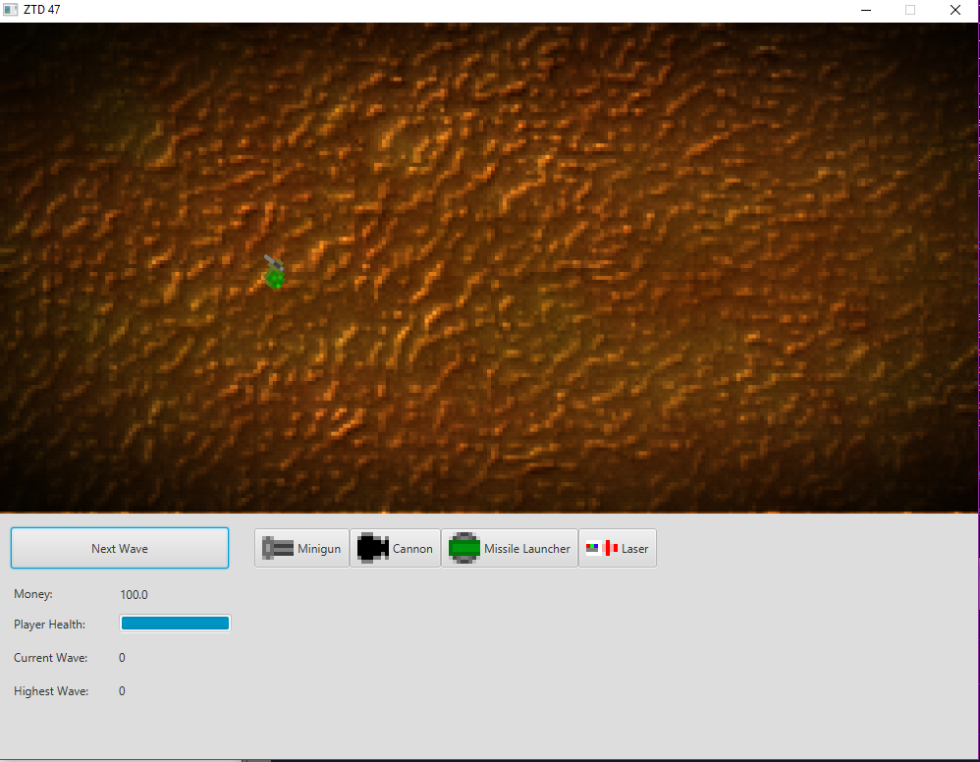
OR ZOMBIE TOWER DEFENSE 47

Slide 3
OVERVIEW
We wanted to use Java, JUnit, and JavaFX to make our own tower defense game
We additionally utilized Trello to keep track of our agile development process and GitLab for version control

Slide 4
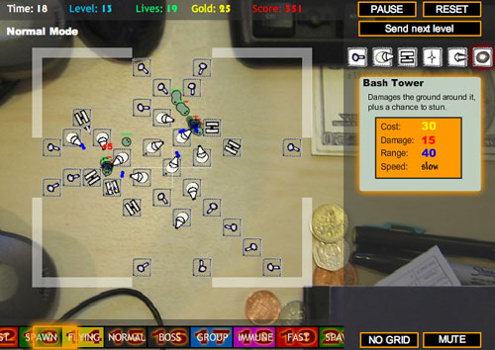
WHAT IS A TOWER DEFENSE GAME (OUR PROBLEM DOMAIN)?
A strategy game where the user tries to defend the player/the players territories by eliminating enemy attackers, often done so by using defensive structures
To the right is Desktop Tower Defense, a flash game in the late 2000s¹
¹ https://upload.wikimedia.org/wikipedia/en/0/0c/Screenshot_Desktop_Tower_Defense_01.jpg

Slide 5
WHY DID WE WANT TO CREATE A TOWER DEFENSE GAME (OUR MOTIVATION)?
We all had interests in expanding our Java and JavaFX abilities and thought creating a game would be a fun, effective way to do so
We all were familiar with tower defense games
We wanted to take something we knew and add our creativity to it

Slide 6
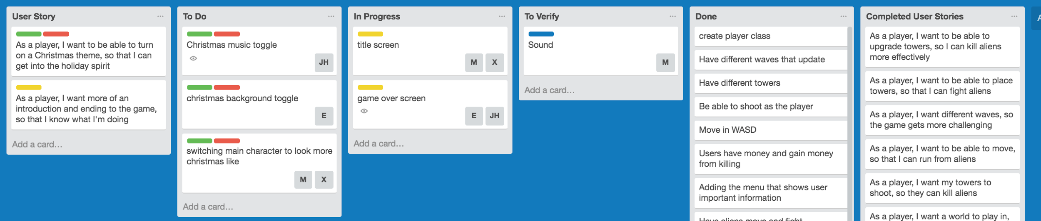
OUR SCRUM EXPERIENCE PT. 1
Trello

Slide 7
OUR SCRUM EXPERIENCE PT. 2
We designed our user stories to start as the most basic MVP layout and gradually shift into key features the user would want in a complex game
Our user stories ranged from very basic to more complex as we progressed
For example, in the beginning, our first story was: As a Player, I want a world to play in, so I can play a game. This was very easy to create.
An example of a more complex one was: As a Player, I want to be able to player different and better towers, so that I can kill aliens more effectively. This took more time than earlier user stories
We learned that sometimes user stories can vary in completion time and sometimes the time it takes to complete some is much longer than anticipated

Slide 8
OUR SCRUM EXPERIENCE PT. 3
We all have different backgrounds with agile development and more broadly, software development in general
We worked well at accomplishing tasks and stories because we had a broad range of knowledge, so we were able to effectively divide tasks to complete our project
Because some members were better at some things than others, we focused more on progression than learning – given more time it would have been interesting to develop our weaknesses further

Slide 9
DESIGN AND IMPLEMENTATION PT. 1
We used a MVC approach, so our Model, View, and Controller were very crucial classes
We tried our best to maximize inheritance. For example, both Players and Enemy's extended our Mob class, so Mob was a very important class
Most classes in our Model were also a viewobject

Slide 10
DESIGN AND IMPLEMENTATION PT. 2
We had difficulty testing pieces of our project. For example, we were not able to get JUnit to mesh nicely with JavaFX. The trouble came because most of our classes take in or depend on images, and JUnit had trouble loading the images.
We tried many routes, but were unable to get around this problem with JUnit. In the future we could refactor so that each class didn’t have an image associated with it to test it better, or use a different testing suite
The solution was to create tests without JUnit by a series of print statements and exceptions

Slide 11
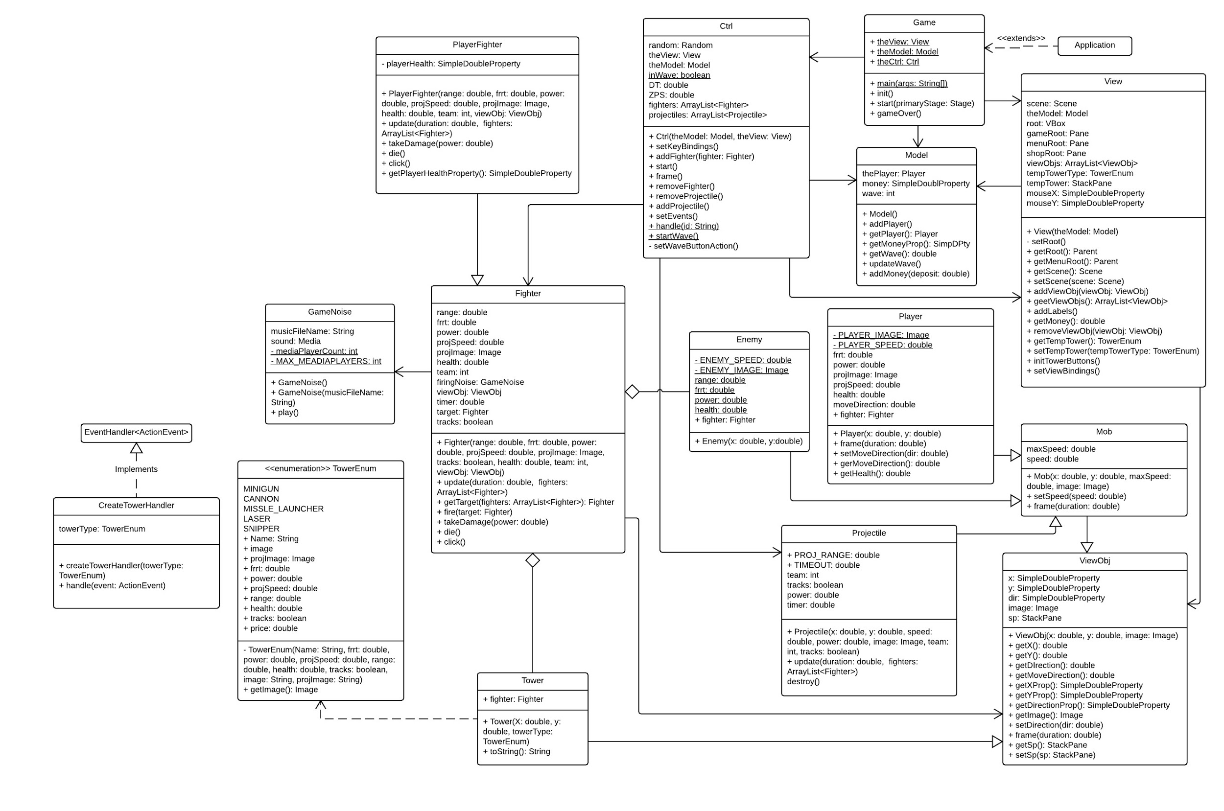
INHERITANCE & STRUCTURE
Fighter aggregation
Double inheritance
View Object Mob Hierarchy
Fighter Class
Player Fighter

Slide 12
SOUND THREADING
Sound was causing game lag
Also breaking the game
Solution = Threading

Slide 13
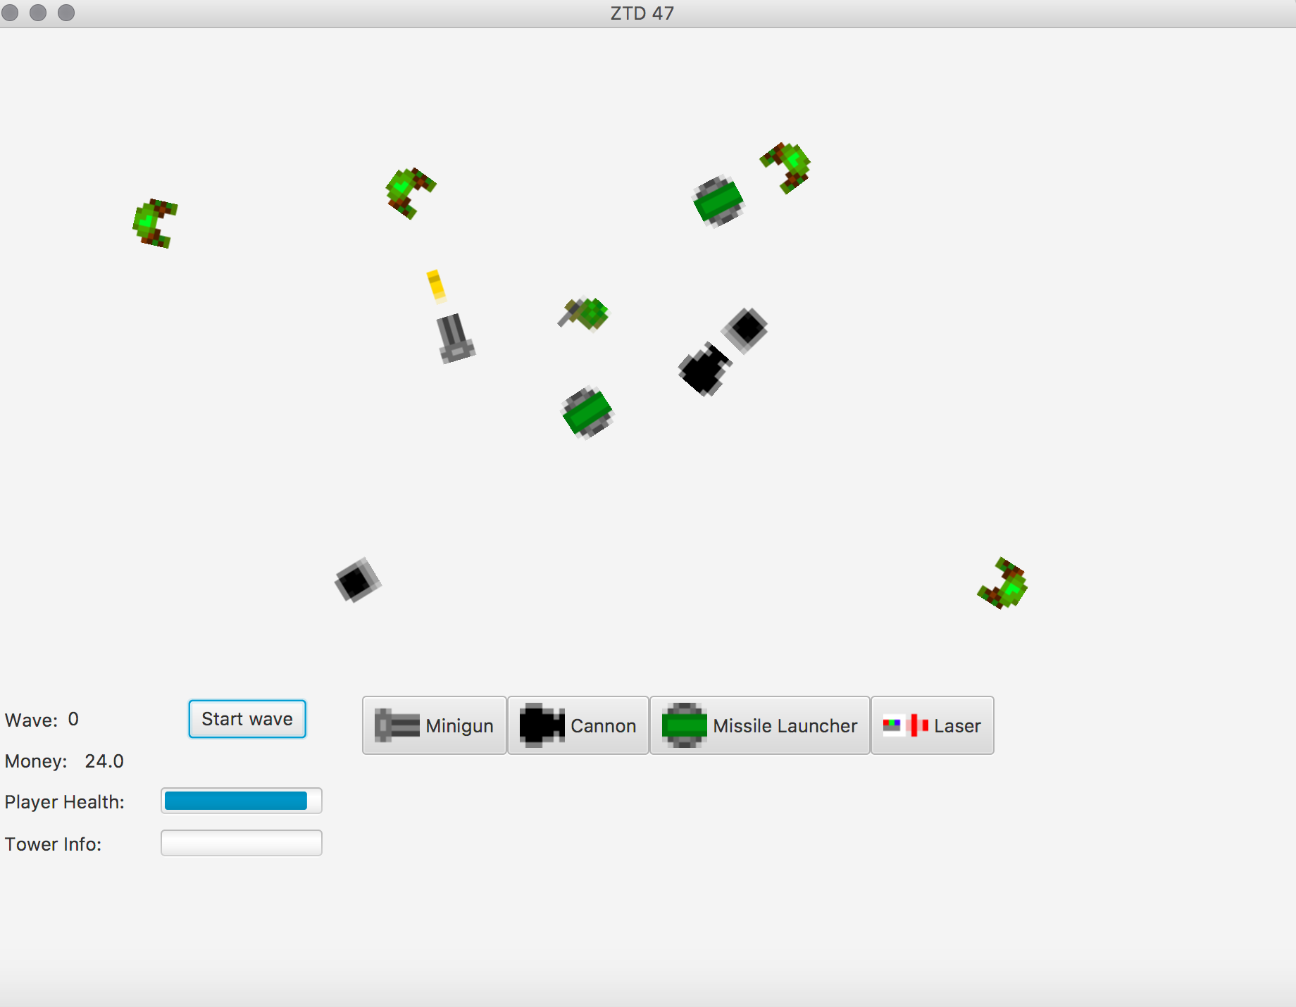
USER INTERFACE

Slide 14
DEMONSTRATION

Slide 15
CONCLUSION
We enjoyed working together as a team and played off our strengths
Given more time, we wanted to expand the game, such as upgrading towers and having more rigid paths the aliens have to follow
We also wanted to add a Christmas theme!!
We decided to not do a “grid system” so towers are freely placed, but to make it more difficult in verson 2.0 there should be a max number of towers per area, etc.

