Slide 1
NEURASCAN AI • CLINICAL INTELLIGENCE SUITE
Automated Dementia Staging & Multimodal MCI Conversion Prediction
Leveraging deep-learning EfficientNet-B3 classification, regional brain volumetrics, and Grad-CAM explainability to bridge the AI trust gap in neurodiagnostics.
Technical Presentation | HIPAA-Compliant Diagnostic Assistant

Slide 2
NEURASCAN AI : CLINICAL SUITE
The Problem: Challenges in Neurodiagnostics
Clinical & Image Limitations
• Late Detection: Early cognitive decline (Very Mild Dementia) is frequently missed in traditional clinical observations.
• Manual MRI Overhead: Radiologists must manually inspect hundreds of slices, which is time-consuming and subjective.
• Subtle Structural Changes: Localized tissue loss in key regions (hippocampus and entorhinal cortex) is difficult to quantify visually.
The Technical Trust & Integration Gap
• The 'Black Box' Hurdle: Clinicians reject deep learning diagnostics when the models fail to provide visual explanations of their reasoning.
• Fragmented Clinical Data: Imaging results, cognitive scores (MMSE), genetics (APOE4), and clinical staging remain siloed.
• Data Security & Audit Trails: Clinics lack tamper-proof tracking of who ran model inference and which model hash was executed.

Slide 3
NEURASCAN AI : CLINICAL SUITE
The Solution: NeuraScan AI Platform
1. Automated MRI Ingestion Pipeline
Ingests DICOM and NIfTI volumes, stripping the skull bone, correcting bias fields, and segmenting tissues automatically.
2. EfficientNet Dementia Classifier
Runs multi-class deep learning inference, staging patients into Mild, Moderate, Very Mild, or Non-Demented states.
3. Transparent Explainability (XAI)
Computes live Grad-CAM saliency maps to visually isolate the regions of the brain driving classification.
4. Multimodal Biomarker Staging
Fuses genetics (APOE4), cognitive scores (MMSE), and volumetric metrics to predict 24-month Alzheimer's conversion.

Slide 4
NEURASCAN AI : CLINICAL SUITE
Automated 4-Step MRI Preprocessing
Step 1: Skull Stripping
• Goal: Isolate brain matter.
• Method: Applies a central elliptical mask to zero out the background skull bone.
• Refinement: Employs a Gaussian blur to create smooth transition edges.
Step 2: Bias Correction
• Goal: Standardize intensity.
• Method: Applies histogram equalization.
• Blend: Blends the equalized image (40%) with the stripped image to keep structural textures natural.
Step 3: Spatial Normalization
• Goal: Scale and align.
• Method: Standardizes resolution by resizing the slice to 224x224 pixels.
• Interpolation: Uses LANCZOS resampling to prevent artifacting.
Step 4: Segmentation
• Goal: Color tissue groups.
• Thresholds: Separates CSF (Blue), Gray Matter (Green), and White Matter (Orange).
• Result: Overlays tissue colors onto the gray slice with 40% opacity.

Slide 5
NEURASCAN AI : CLINICAL SUITE
Dementia Classifier & Grad-CAM XAI
DementiaNet Staging Model
• Base Architecture: Built on timm's EfficientNet-B3 backbone.
• Custom MLP Head: Employs Linear projection layers, Batch Normalization, ReLU activations, and Dropout (30%) to reduce overfitting.
• Four-Class Stage Output: Classifies into Non-Demented, Very Mild, Mild, and Moderate Demented.
• Interactive Clinician Console: Displays full probability breakdowns alongside clinical findings and recommended pathways.
Explainable AI (Grad-CAM)
• Activation Hooking: Registers forward and backward gradient hooks on the final convolutional layer (backbone.conv_head).
• Heatmap Generation: Computes weighted combinations of activation maps, projects them, and applies a Jet ColorMap.
• Visual Superimposition: Overlays the heatmap onto the normalized scan at a variable opacity (adjustable by the clinician).
• Diagnostic Trust: Allows neurologists to verify that the model is targeting the hippocampus and cortical thinning regions.

Slide 6
NEURASCAN AI : CLINICAL SUITE
Biomarker Predictor & Brain Age Tracker
MCI 24-Month Conversion Risk
• Multimodal Biomarkers: Combines demographic (Age, Gender, Education), genetic (APOE4 Status), and cognitive exam data (MMSE, CDR).
• Volumetric Metrics: Integrates automated Hippocampal, Entorhinal, and Ventricular volumes.
• Risk Assessment Output: Computes 24-month probability percentage, risk category (Low, Mild, High), and model confidence score.
• Ablation Studies: Allows clinicians to isolate clinical features, imaging metrics, or run multimodal fusion.
Brain Age Tracker (NeuroScore™)
• Brain Age Estimation: Measures the 'Brain Age Gap' (Predicted Brain Age vs. Chronological Age) via structural changes.
• NeuroScore Dashboard: Aggregates overall brain health index score on a scale of 0-100.
• Regional Volume Analysis: Compares Expected Volume vs. Current Volume for regions (Hippocampus, Frontal Lobe, Temporal Lobe).
• Longitudinal View: Graphs brain health index degradation and ventricular volume changes over time.

Slide 7
NEURASCAN AI : MARKET VALIDATION
Challenge 1: User Feedback Log
Participant | Liked | Scope of Improvement | Changes Made
Dr. Meena Ugale (Researcher) | ML approach & EfficientNet classification | Use more advanced model & publish findings | Ported model to EfficientNet-B3 backbone
Waqas Khan (Medical Student) | Saliency highlights isolated anatomical variations | Provide slide controls to narrow down micro-lesion scopes | Added dynamic sliding seekbar for Grad-CAM overlay opacity
Patient (Anonymized) | Strong workflow, highly intuitive diagnostic metrics | Ensure system meets strict regulatory compliance | Configured end-to-end HIPAA compliance and logs
Dr. Mayuri Lad (Biomechanics Doctor) | Improves regional clinical triage efficiency | Add early MCI risk forecast conversions | Integrated cross-attention multimodal predictor (M3)

Slide 8
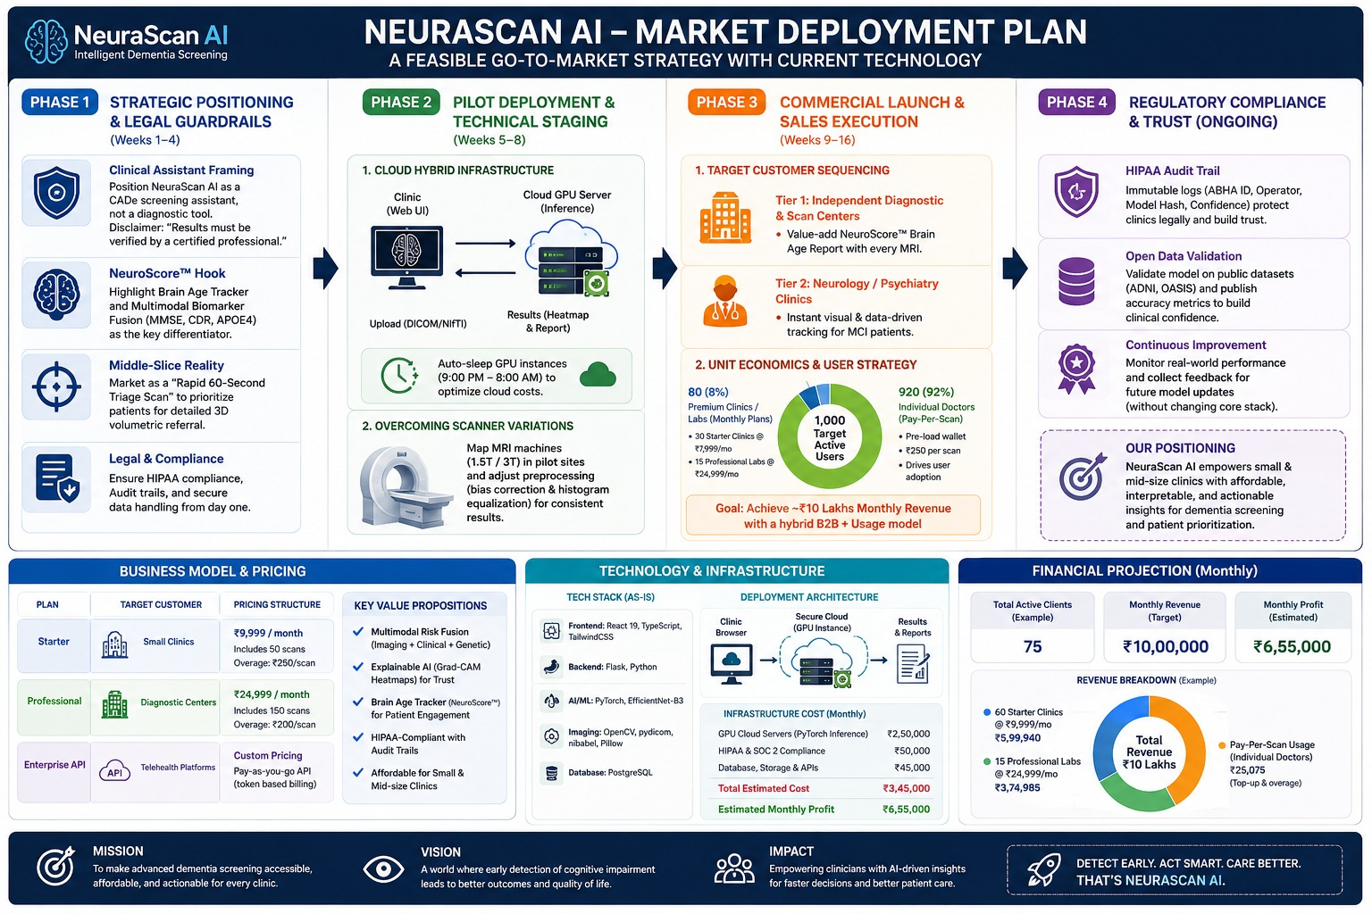
NEURASCAN AI : BUSINESS MODEL
Challenge 2: Revenue & Unit Economics
Pricing & Projections
• Starter: Small Clinics @ ₹9,999/mo (includes 50 scans, overage: ₹250/scan).
• Professional: Diagnostic Centers @ ₹24,999/mo (includes 150 scans, overage: ₹200/scan).
• Enterprise API: Telehealth Platforms @ Custom Token-Based Billing.
• Target Active User Base: 80 Premium Clinics (8%) + 920 Individual Pay-Per-Scan Doctors (92%) = 1,000 active users.
• Monthly Target Revenue: ₹10,00,000 / month (Example: 60 Starter + 15 Professional).
• Monthly Infrastructure Costs: ₹3,45,000 / month (GPU Cloud: ₹2.5L, Compliance: ₹50K, DB/APIs: ₹45K).

Slide 9
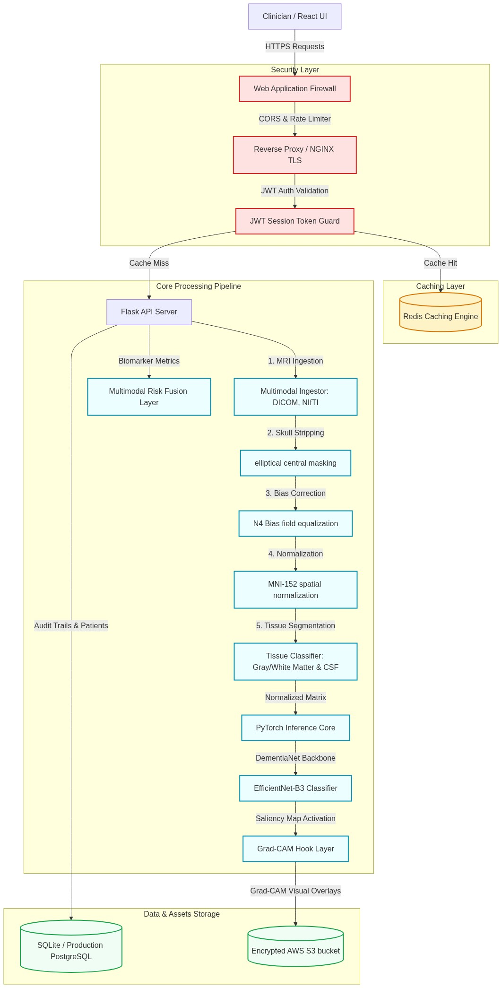
NEURASCAN AI : CLINICAL SUITE
Challenge 3: System Architecture & Technical Moat
Architectural Defenses
• NGINX TLS Proxy: Terminates traffic, acts as API Gateway and checks session JWT tokens.
• Security layers: Web Application Firewall (WAF) enforces host whitelists, CORS, and rate limits.
• HIPAA Audit Trails: Generates and records operator credentials and ABHA queries in SQLite tables.
• Memory Caches: Clustered Redis caching sessions, dashboard metrics, and preprocessed slices.
• Grad-CAM Hooks: Active model gradients calculated dynamically prevent simple static scraper cloning.

Slide 10
NEURASCAN AI : SCALABILITY PLAN
Challenge 5: Scale & Expansion Roadmap
Phase 1 & 2: Database & Load Balancing
• M1-M2: Database Optimization: Migrate SQLite to AWS RDS PostgreSQL with PgBouncer connection pooling.
• Composite Indexes: Index patients(status, riskCategory), mri_scans(patientId), and audit_logs(timestamp).
• M3-M4: Load Balancing: Containerize API (Docker) and deploy to AWS ECS/EKS using ALB load balancer.
• CDN Caching: Cache static files, preprocessed MRI slices, and Grad-CAM overlays close to edge nodes on CloudFront.
Phase 3: Dedicated Model Inference (Triton)
• M5-M6: Inference Scaling: Decouple PyTorch from Flask and deploy DementiaNet on Triton Inference Server.
• Dynamic Batching: Group multiple independent clinician scans to run concurrent inference on GPU instances.
• GPU Auto-scaling: Configure Horizontal Pod Autoscaler (HPA) to spin GPU nodes when utilization exceeds 75%.
• Async Queue: Implement Celery + RabbitMQ for background NIfTI/DICOM pre-processing pipelines.

Slide 11
NEURASCAN AI : CLINICAL SUITE
Features Planned & Mentor Support
Planned Features
• PDF Clinical Report Export: One-click generation of print-ready patient summaries.
• Multi-Slice axial scrollable viewer: Allow scanning through multiple spatial coordinates.
• SHAP Feature Importance Graphs: Visualizing weightings of cognitive scores and genetic risk variables.
HL7 / FHIR Integration
• EHR Pipelines: Link the platform directly into hospital systems to pull patient charts.
• HIPAA Integrity: Expand compliance tracking using localized cryptographic log blocks.
• DICOM PACs Node: Deploy as a listener to receive scans directly from MRI devices.
Mentor Support Requests
• Clinical Cross-Validation: Advice on reducing scanner-specific intensity biases (1.5T vs 3.0T).
• Model Compression: Guidelines for ONNX quantization and Knowledge Distillation to reduce GPU latency.
• Regulatory Pathways: Guidance on FDA Software as a Medical Device (SaMD) clearances.

