Slide 1
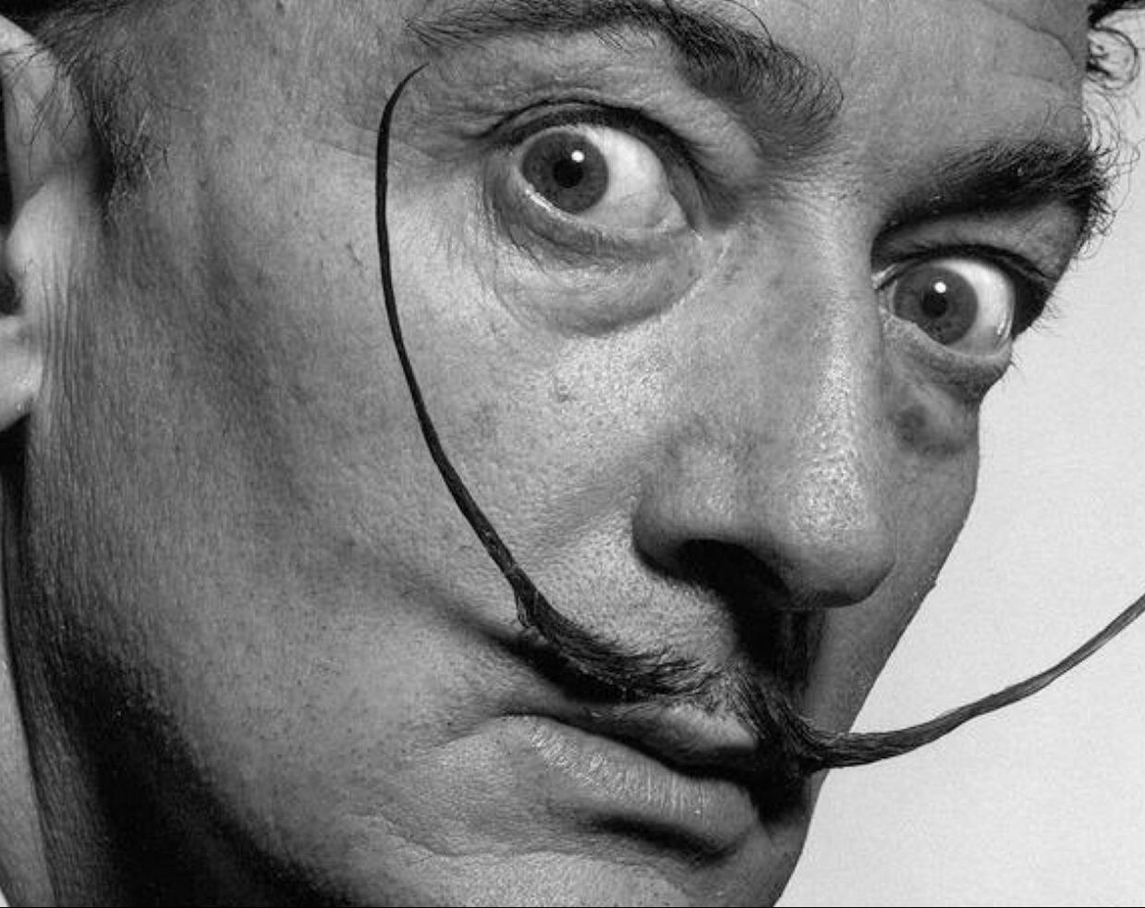
The machine we call SALVADOR DALÍ
By Jacqueline Hennecke
Notes:
Art History Background

Slide 2
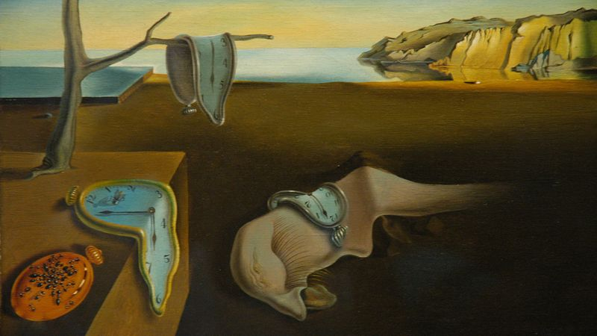
Notes:
If you know him, you know this

Slide 3
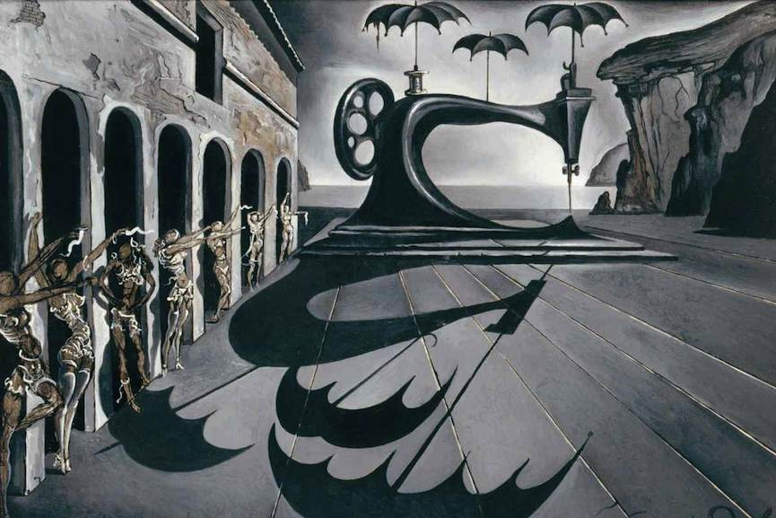
Notes:
Dali was a surrealist "a linking of two realities that by all appearances have nothing to link them, in a setting that by all appearances does not fit them.”
A fascination with science and machines that was intellectual, professional, and probably sexual

Slide 4
MACHINES
Timekeeper
Brand Manager
Inventor

Slide 5
CLOCKS
The collapse of a fixed cosmic order
The Past, Present, and Future

Slide 6
Notes:
The Persistence of Memory
Unstructuring time, breaking down machinery
The past (memory, mountains) is intertwined with the present (dreams) and the future (anxiety and decay)
Not rejecting linear time completely – the mirror shows that these two realities: objective reality and the non-objective reality (delirium of interpretation and reality of the mind), are balanced

Slide 7
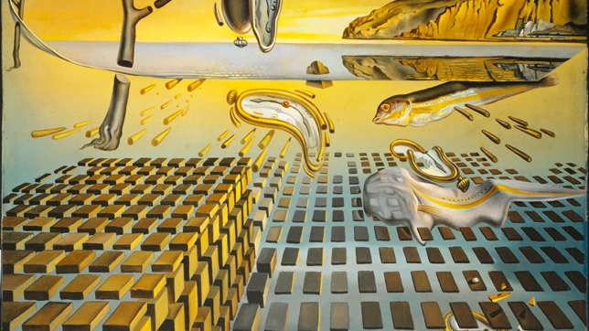
Notes:
These represent the breakdown of matter into atoms, a revelation in the age of quantum mechanics. Behind the bricks, the horns receding into the distance symbolise atomic missiles, highlighting that despite cosmic order, humanity could bring about its own destruction.
Dalí symbolized and marked his loss of interest in surrealism with The Disintegration of the Persistence of Memory as his interest in nuclear physics and religion led him elsewhere.^{[3]}
The atomic bomb was his favorite “food for thought”

Slide 8
A BRAND

Slide 9
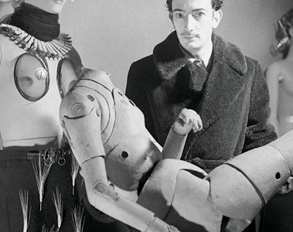
Behavior – The Case of the Bonwit Teller
“These are some of the privileges that an artist with temperament seems to enjoy.”
- Salvador Dalí’s Judge

Slide 10
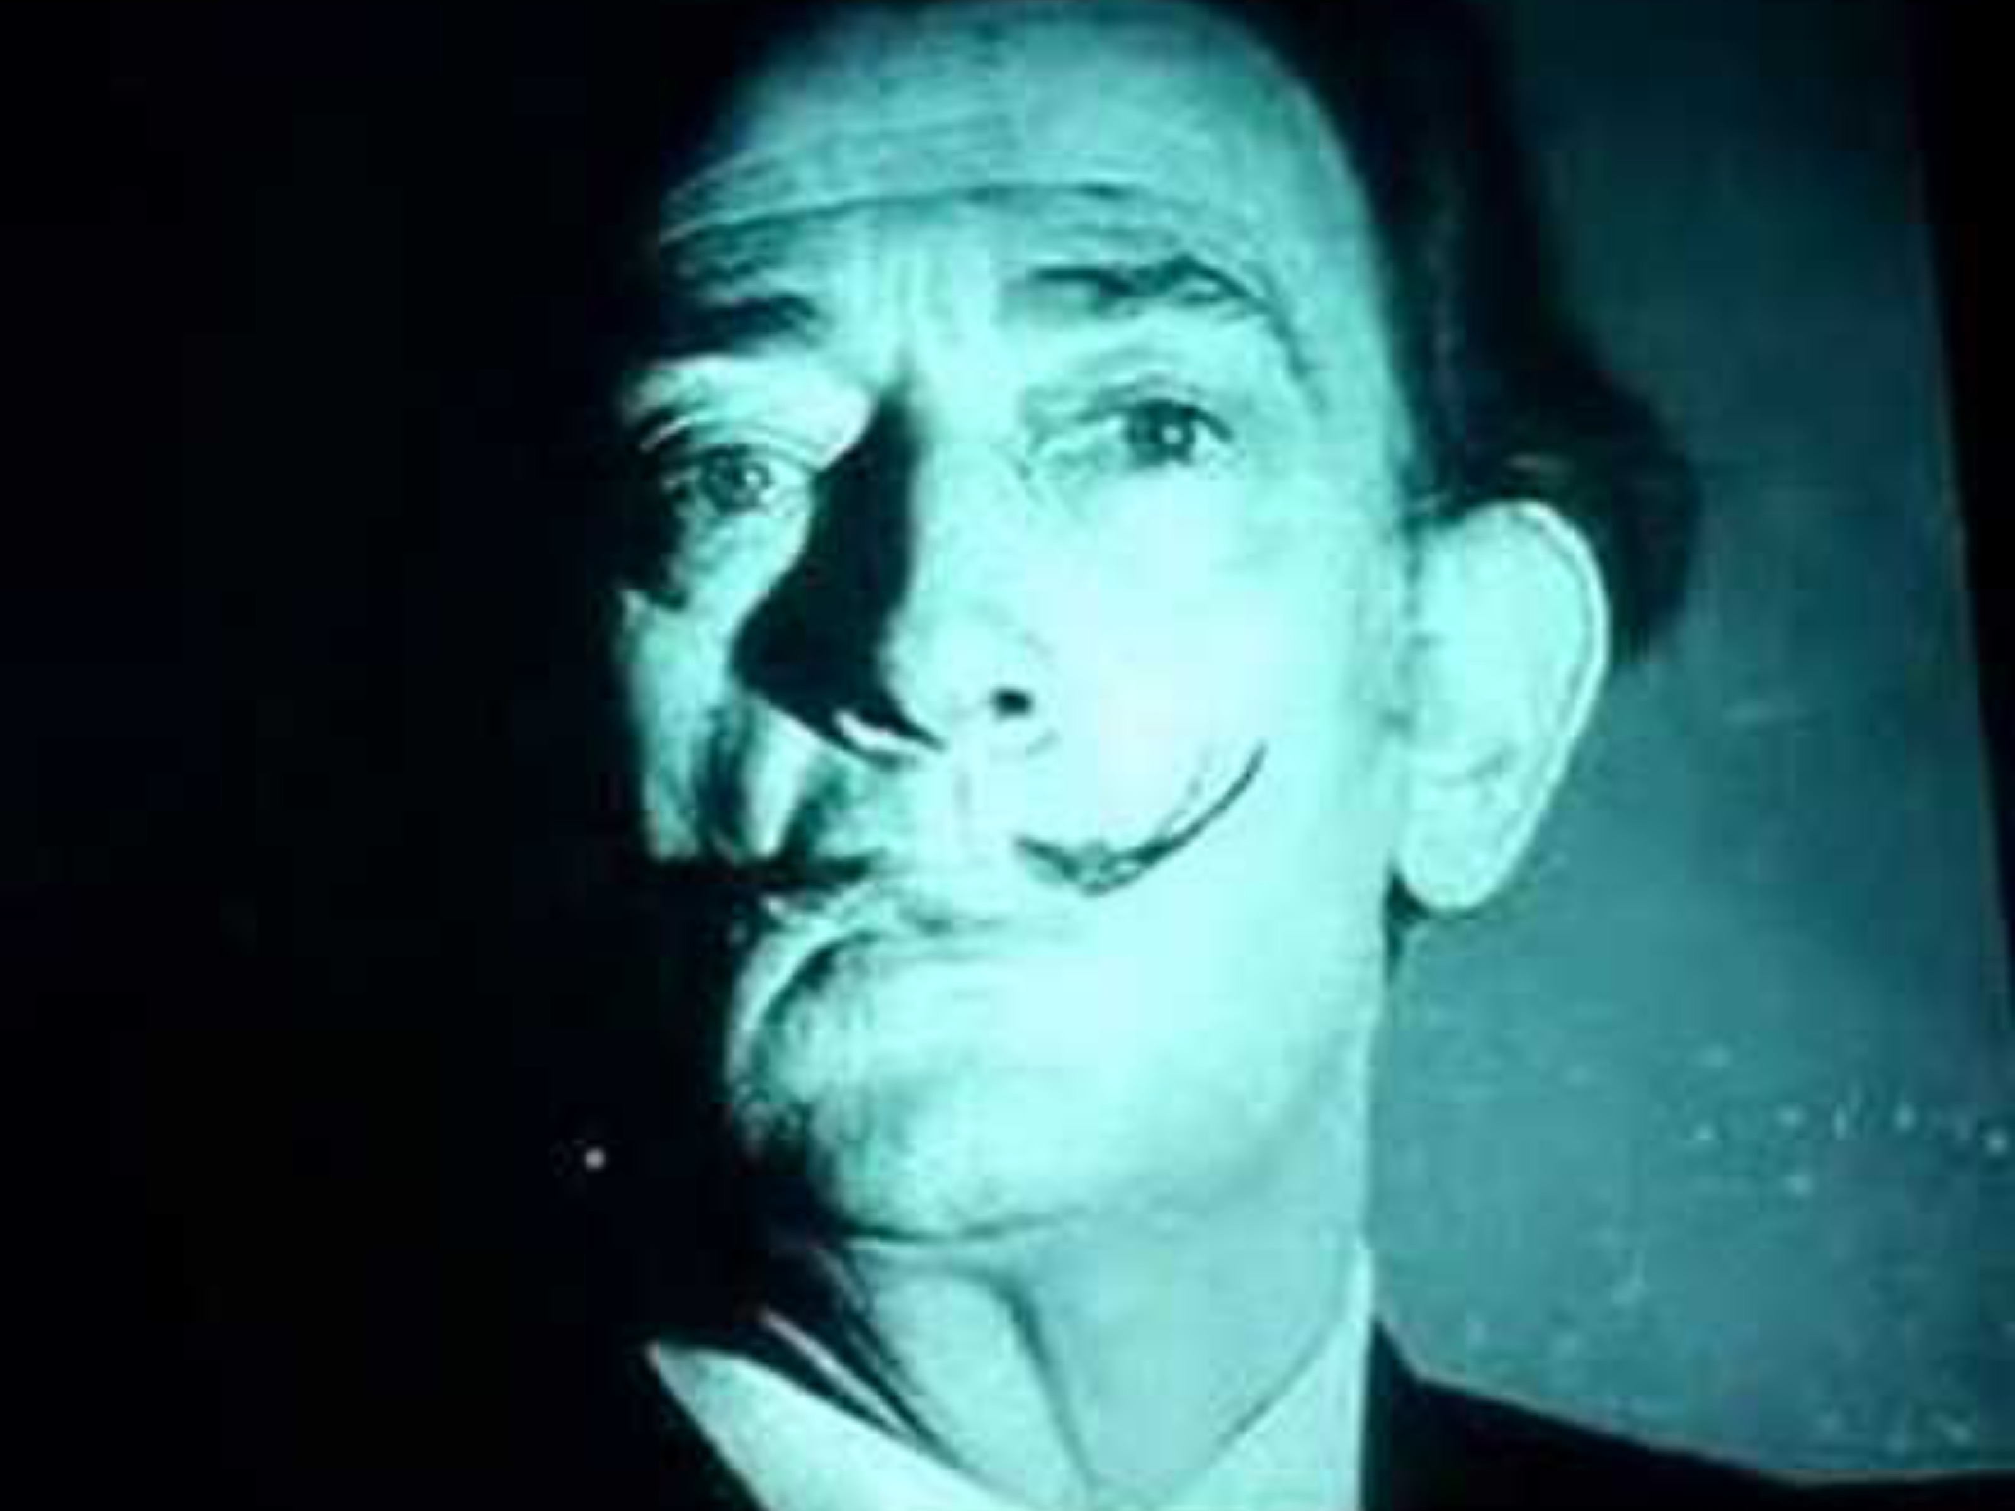
a MACHINE-LIKE character
Notes:
https://youtu.be/MYrPJozmSdg?si=LSrqw8FOk1nSEaqx

Slide 11

a MACHINE-LIKE character
“Each morning after breakfast I like to start the day by earning twenty thousand dollars.”
Avida Dollars
Notes:
Commitment to writing his signature over and over and over – 1800 sheets an hour, creating $72,000 worth of signatures per hour

Slide 12
a MACHINE-LIKE character
“What is important is to spread confusion, not eliminate it.”
Avida Dollars
Notes:
Within a year, he’d created 17,000 sheets of paper. Within five, speculations were up to 350,000 signatures. Fraud cases exploded.
By this point, all speculations that he still belonged to eh surrealist community had long been dispelled. His nickname “avida dollars” was given to him by the former leader of the surrealist movement as a criticism that he sold out.

Slide 13
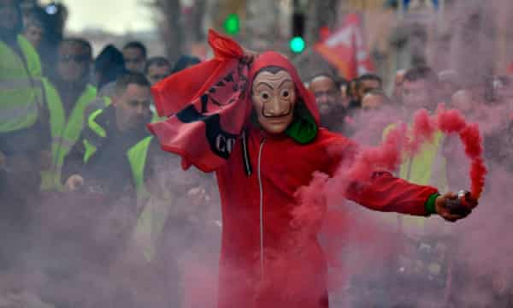
anti-government protest in France, 2019
Notes:
Despite selling out, his brand became so successful that he became the face of revolution and socialism.
Money Heist and an anti-government protest in France 2019

Slide 14
AN INVENTOR

Slide 15
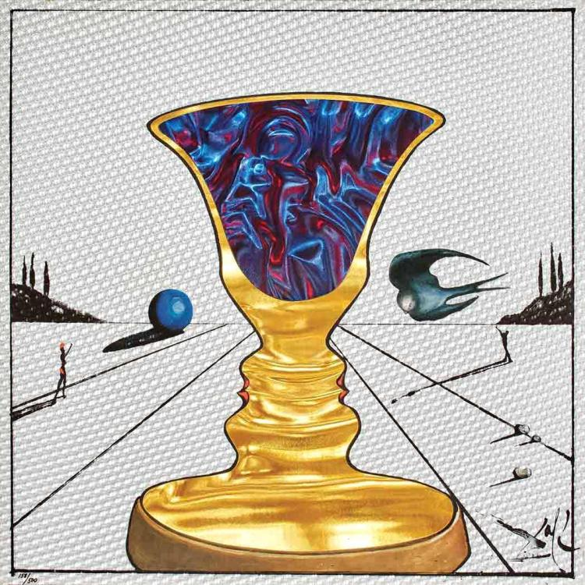
The Inventor
Materials
Film
Animation
Notes:
Rowlux

Slide 16
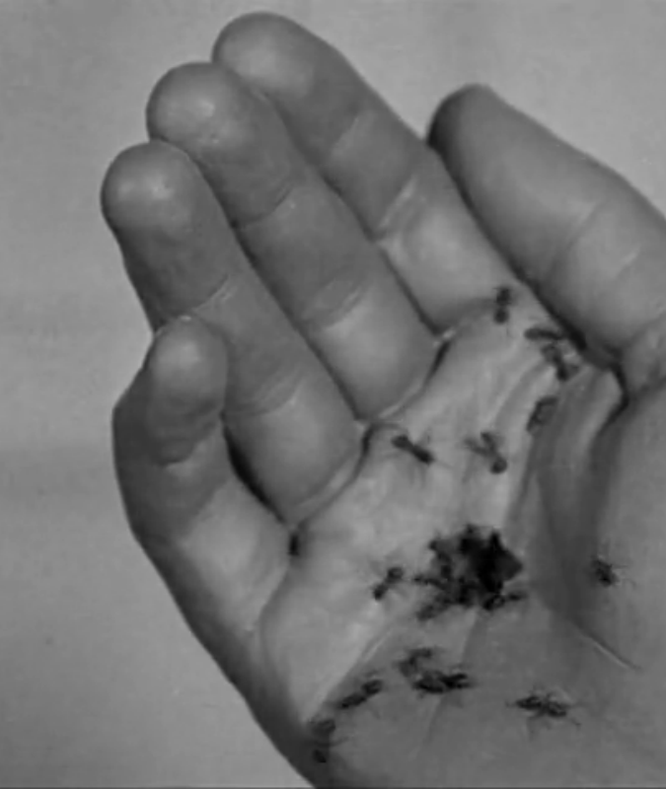
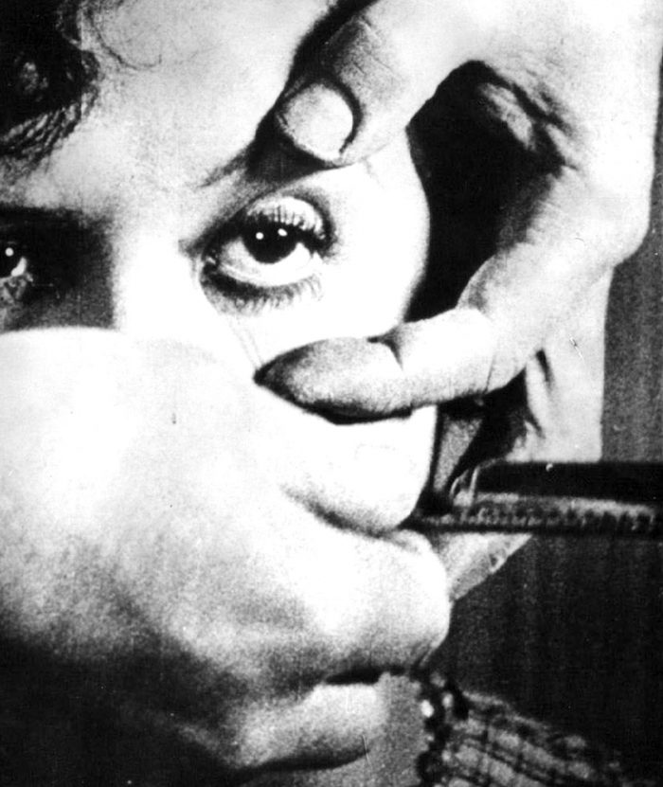
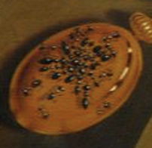

Un Chien Andalou
The Past (Persistence of Memory)
The present (Cronenberg and David Lynch)

Slide 17
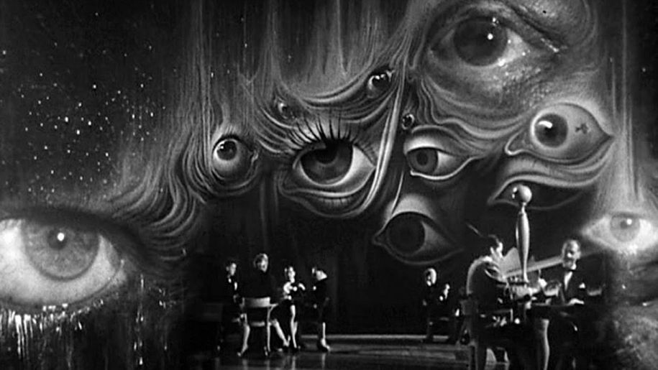
Spellbound Alfred Hitchcock

Slide 18

ANIMATION
Notes:
https://www.youtube.com/watch?v=FIYH5XSSD2k

Slide 19
MACHINES
Timekeeper
Brand Manager
Inventor

