Slide 1

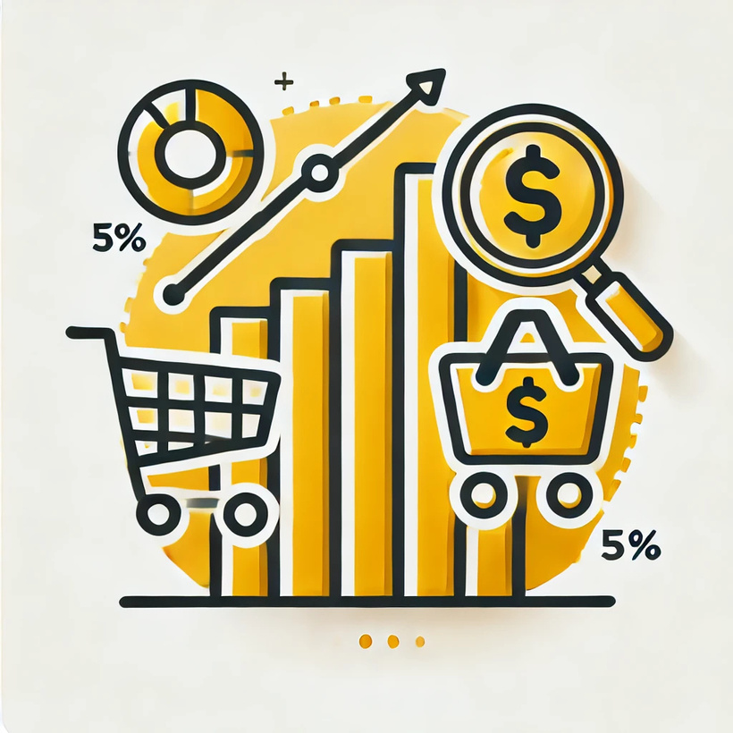
Maximizing Revenue with Top-Selling Insights & Customer Trends
Presented by: Viet An Nguyen
Date of presentation: 22/02/2024

Slide 2
Table of contents
Maximizing Revenue with Top-Selling Insights & Customer Trends
Purpose Statement (What are we talking about?)
Technology used
Data source & overview
Data Insights
Actionable plans

Slide 3
What are we talking
about?

Slide 4
Objective
Identify top-selling products, analyze the impact of purchase methods, uncover correlations between catalog sales and high-value items, and detect bundled buying behaviors to optimize sales strategies.

Slide 5
Technology used

Slide 6


Python
Process and analyze data by cleaning, performing EDA, identifying variable relationships, and using machine learning to predict wine purchases.
Power BI
Create interactive visualizations and dashboards to analyze customer purchasing behavior and highlight key trends for decision-making.

Slide 7
Data Source &
Overview

Slide 8
Data Source
Sourced from SCA Programming School (publicly available on GitHub), this dataset contains customer marketing data, offering insights into purchasing behavior.

Slide 9
Data Overview
Data includes demographics, purchase behavior, and marketing metrics, requiring data cleaning and preprocessing before analysis.
The dataset supports EDA, and correlation analysis for machine learning modeling to identify factors influencing product purchases amounts.

Slide 10
Data Cleaning

Slide 11

Data Cleaning

Slide 12
Data Insights

Slide 13
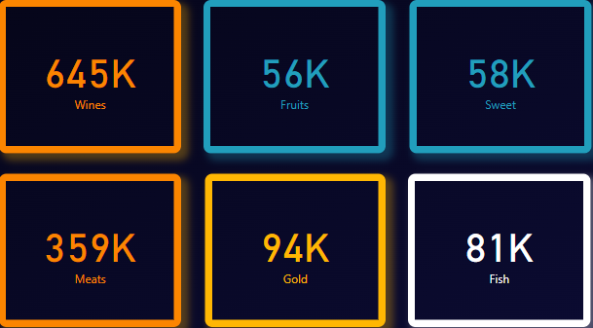
Top-selling products

Slide 14
Top-selling products

Slide 15
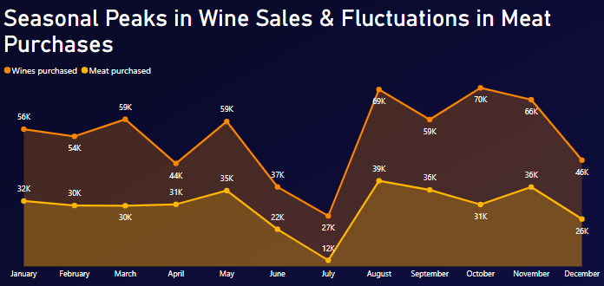
Wine purchases show strong seasonal peaks in July, October, and November, while meat purchases remain relatively stable with a significant drop in July.

Slide 16
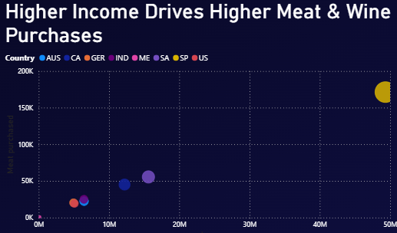
Higher-income countries purchase more meat and wine, with the largest bubble (likely top 3 - Singapore (SP), Australia (SA), Canada (CA)) leading in both categories.

Slide 17
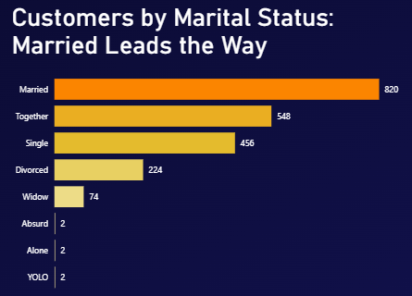
Married customers form the largest group, followed by those in a relationship ("Together"), while unconventional categories like "YOLO" and "Absurd" have minimal representation.

Slide 18
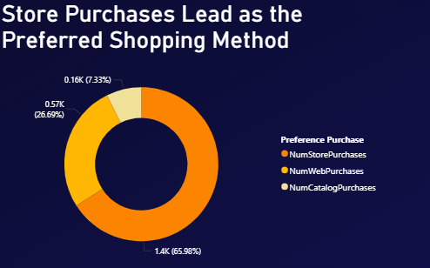
Store purchases dominate customer preference (65.98%), followed by web purchases (26.69%), while catalog purchases are the least preferred (7.33%).

Slide 19
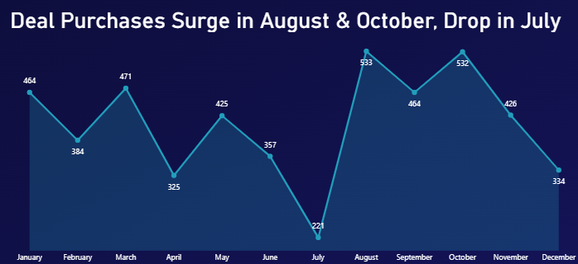
Deal purchases fluctuate throughout the year, with a sharp decline in July (221) followed by a peak in August (533) and October (532).

Slide 20
Actionable Plans

Slide 21
Leverage Seasonal Peaks for Promotions
Wine & Meat Campaigns:
June: Pre-summer promotions to boost wine & meat sales before July dip.
Oct-Nov: Holiday deals to maximize wine sales.
Deal Purchase Timing:
July: Launch exclusive summer promotions to offset deal purchase dip.
Aug & Oct: Extend major discounts to maximize peak activity.

Slide 22
Targeted Marketing Based on Demographics & Income
Personalized campaigns for married customers, who form the largest group.
Geographically optimized promotions: Focus high-value product ads (wine, gold) on high-income regions.

Slide 23
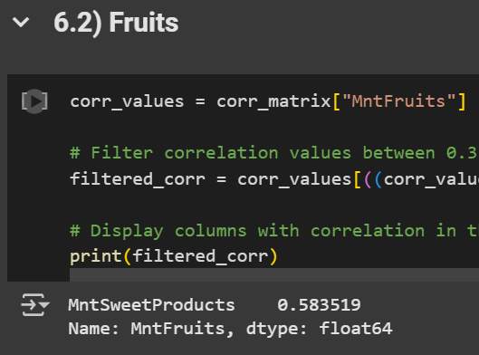
Encourage Bundled Purchases

Slide 24
Encourage Bundled Purchases
Customers who spend more on fruits also tend to spend more on sweet products, with a moderate positive correlation (0.5835), indicating a potential purchasing pattern.

Slide 25
Encourage Bundled Purchases
Product Placement: Position sweet products near fruits in stores or online to drive impulse purchases.
Bundled Promotions: Offer discounted fruit & sweet product bundles to boost cross-category sales.

Slide 26
Optimize Purchase Channels & Sales Strategy
Enhance in-store promotions (since store purchases dominate).
Boost digital marketing & web-based deals to capture more online buyers.
Revamp catalog offers with exclusive discounts to increase engagement.

Slide 27

Optimize Purchase Channels & Sales Strategy
Enhance in-store promotions (since store purchases dominate).
Boost digital marketing & web-based deals to capture more online buyers.
Revamp catalog offers with exclusive discounts to increase engagement.
Lets take a look at a small experiment!!! Analysis section

Slide 28
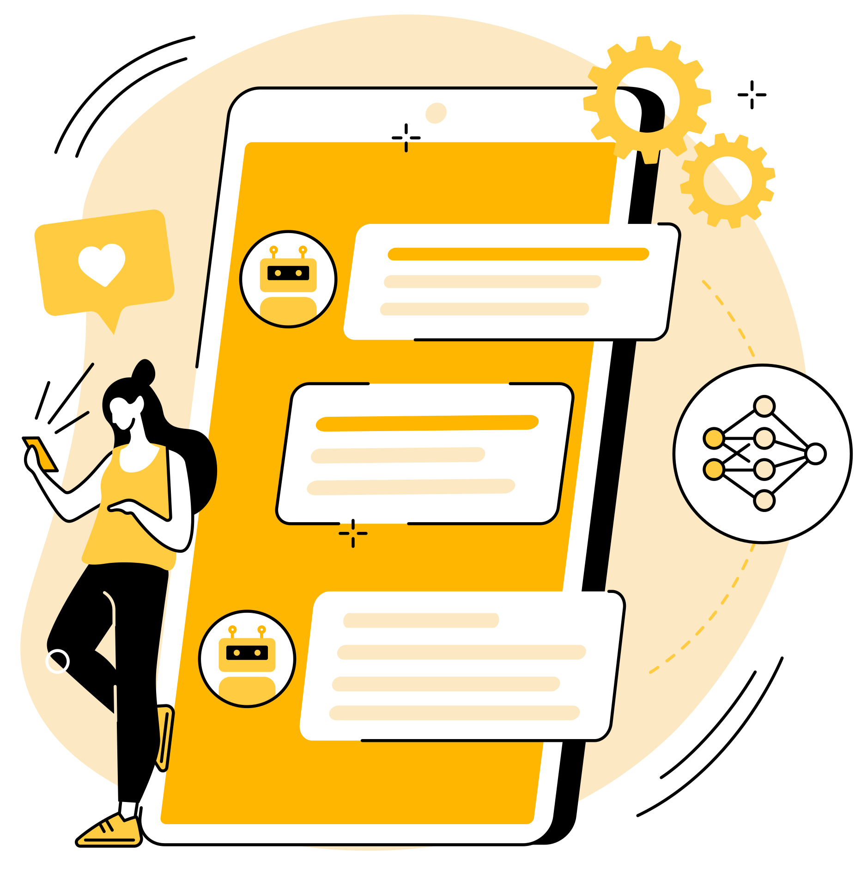
Thank you for your attention

