Slide 1
A Bilingual and Emotion-capable Conversational Chatbot for Educational Recommendation in the Metaverse
Xu, Wai Fan (Zoey) (3035802885)
Tsoi, Jackie Chung Wing (3035444891)
Chow, Lok Hang (Rocky) (3035914963)

Slide 2
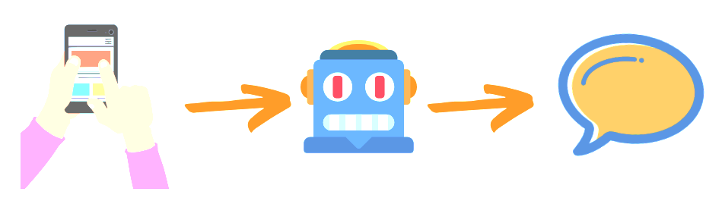









Introduction
Q & A
What is the requirement of MDASC
Program recommendation
What program can I study if I want to learn computer science?
Casual talk
How are you?
Chatbot
English & Cantonese?
Emotion detection?
Programs/courses recommendation?
Problems
Chatbot User Input
Speech to text process
Emotion detection
Dialogue Classification & Dialogue Generation
Q&A
Program recommendation
Chatbot Response
Text-to-Speech
Casual talk
Q&A system
Recommender system
Our solution
Rocky
Zoey
Jackie

Slide 3
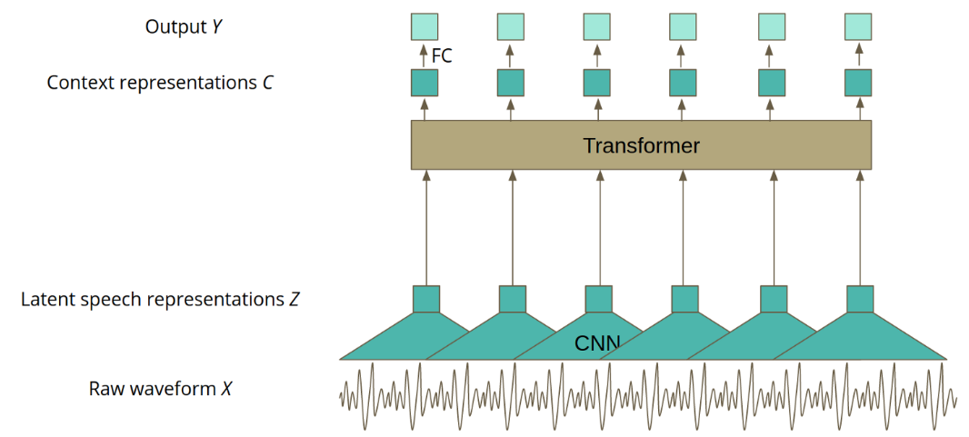
Speech-to-Text – Models & Research Method
ASR Using Wav2Vec 2.0
Model Architecture
Raw audio as input -> CNN to extract features
Transformer
Connectionist Temporal Classification Algo.
Pros & Cons
Fine-tune on pre-trained SSL Wav2vec2: achieved satisfactory results with small amount of labelled data
Easy Implementation on Cantonese
Huge model size
LibriSpeech (English) | High recording quality, US English accents
 | 1,000 hours | 2,484 speakers
Common Voice (English) | Crowd-sourced Data
 | 2,275 hours | 83,790 speakers
Common Voice (zh-HK) | Crowd-sourced Data
 | 104 hours | 2,907 speakers
Avg. Inferencing Time
Word Error Rate (Eng)
Character Error Rate (Canto)
Notes:
Both model have nice model implementation API.
MFCC describe only the large structure of the spectrum, extensive knowledge on how human perceives speech)
a good SR system should be capable to recognize speeches from different users even under adverse conditions. A good dataset for ASR model train
Common Voice: randomly picked 10 audio from the testing set 5 out of them are low quality, even human may not recognize it correctly

Slide 4

Speech-to-Text – Preliminary Results
English Speech-to-Text Models
Cantonese Speech-to-Text Models
 | LibriSpeech |  | Common Voice 6.1
 | Avg. Inference Time (s) | WER (%) | Avg. Inference Time (s) | WER (%)
Wav2Vec2 (LibriSpeech) | 0.025 | 3.38 | 0.032 | 43.18
Wav2Vec2-XLSR (Common Voice) | 0.055 | 6.62 | 0.062 | 21.46
Google | 0.9 | 12.09 | 0.84 | 41.28
 | Common Voice 6.1 |  | Common Voice 10.0
 | Avg. Inference Time (s) | CER (%) | Avg. Inference Time (s) | CER (%)
Wav2Vec2-XLSR (CV 6.1) | 0.089 | 14.39 | 0.088 | 12.68
Wav2Vec2-XLSR (CV 10.0) | 0.090 | 11.21 | 0.086 | 15.70
Google | 0.59 | 10.09 | 0.62 | 9.25
Key Findings
Google perform worst on all metrices
Fine-tune on LibriSpeech: perform best on high-quality testing set, worst on noisy testing set
Fine-tune on CV: 3% higher WER on high-quality testing set, perform a lot better when facing noisy input (more robust model)
Key Findings
Fine-tune on CV: resulted similar performance ~13.5% CER
Google: takes more inferencing time, perform better on both testing set
Google >>>> Our Canto. Model: preserves the overall meaning of the input audio more

Slide 5
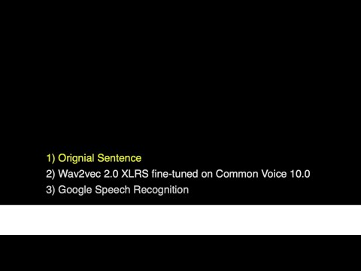

Slide 6
Emotion Detection – Current Research & Research Method
Pre-trained Self-supervised Learning Model
Current Research
Researchers released many forms of Self-supervised learning (SSL) models that pre-train on a large amount of unlabeled text
Fine-tuning the pre-trained SSL model to perform different downstream tasks can boost the performance of the downstream tasks that are short of supervised data
Research Gap
Lack of research focusing on Cantonese NLP or Speech Processing tasks
Identify which existing SSL model is better on performing Emotion Detection tasks in Cantonese for our Chatbot
CAVES
ESD
- 10 Native Cantonese Speakers
- 3385 Recordings
- 6 Basic Emotions + Neutral
- 10 Native English Speakers
- 17.5k Recordings
- 4 Emotions + Neutral
Cantonese
Audio
Single Label for Each Input Sentence/ Audio (Happy, Sad, Surprise, Anger, Neutral)
Fine-tune a set of pre-trained SSL models for text and speech with a sequence classification head on top (Cross-Entropy Loss)
Compare the model performance on inferencing time, accuracy and macro f1-score
English
Audio
- Collected from Chinese Blog
- 33.2k Sentences
- 8 Emotion (Intensity: 0 - 1.0)
Ren-CPCs
GoEmotion
- English Reddit Comments
- 58k Recordings
- 6 Emotions + Neutral
Chinese
Text
English
Text
(*Translated to Cantonese via Microsoft Bing)
6

Slide 7




Emotion Detection – Preliminary Results
English Model (Text)
Cantonese Model (Text)
Key Findings
DeBERTa-V3 (Eng), RoBERTa (Canto): highest acc. & macro F1
~0.7x acc. rate:
“Why you beat other children”
Pre-trained Model | Inf. Time | Acc. | F1 (Macro)
BERT | 3.43s | 0.707 | 0.633
ALBERT | 4.03s | 0.693 | 0.613
RoBERTa | 3.48s | 0.704 | 0.642
DistilBert | 2.53s | 0.701 | 0.641
DeBERTa-V3 | 4.42s | 0.714 | 0.650
Electra | 2.15s | 0.700 | 0.640
XLNet | 4.42s | 0.691 | 0.632
Pre-trained Model | Inf. Time | Acc. | F1 (Macro)
BERT | 3.77s | 0.726 | 0.650
ALBERT | 3.74s | 0.647 | 0.563
RoBERTa | 3.74s | 0.739 | 0.662
DistilBert | 2.3s | 0.647 | 0.535
DeBERTa-V3 | 4.12s | 0.717 | 0.629
Electra | 3.74s | 0.721 | 0.623
XLNet | 5.26s | 0.704 | 0.622
Key Findings
WavLM (Eng), Hubert (Canto): highest acc. & macro F1
~0.9x acc. rate: acoustic features of different emo. are less ambiguous
Audio Data Augmentation can protect the model from adverse examples
English Model (Audio)
Cantonese Model (Audio)
(*w/ audio data augmentation)
(*w/ audio data augmentation)
Pre-trained Model | Inf. Time | Acc. | F1 (Macro)
Wav2Vec 2.0 | 30.6s | 0.93 | 0.929
Hubert | 30.9s | 0.899 | 0.9
WavLM | 27.6s | 0.931 | 0.931
Pre-trained Model | Inf. Time | Acc. | F1 (Macro)
Wav2Vec 2.0 | 4.2s | 0.900 | 0.900
Hubert | 5.12s | 0.948 | 0.948
WavLM | 4.65s | 0.897 | 0.895
Notes:
Fine-tuned on the same setting ←

Slide 8
Dialogue Classification & Generation – Current Research
seq2seq
End-to-end + seq2seq
Rasa + DIET
Model highlights
Recurrent neural network which reads the input sequence one token at a time, and predicts the output sequence
Intent Network (LSTM +CNN)
Belief Trackers (DST)
Database Operator
Policy Network
Generation Network
DIET: Dual Intent and Entity Transformer
Multi-task transformer
Joint model for both named entity recognition and intent classification
Outperform fine-tuned BERT
Pros & Cons
Pros: Simple and general, can use intensive open-domain data to achieve good performance
Cons: Generate safe but useless responses, also not able to interact with database
Pros: Balanced approach of end-to-end (hard to extract feature) and seq2seq (playing too safe).
Cons: Dialogue State Tracking needs separate training based on slot values, also hard to embed with other components in our project.
Pros: Open-source Rasa architecture with pipeline design that can be customized, also fast to train.
Cons: End-to-end performance not that satisfactory, need a lot sentences for same question

Slide 9
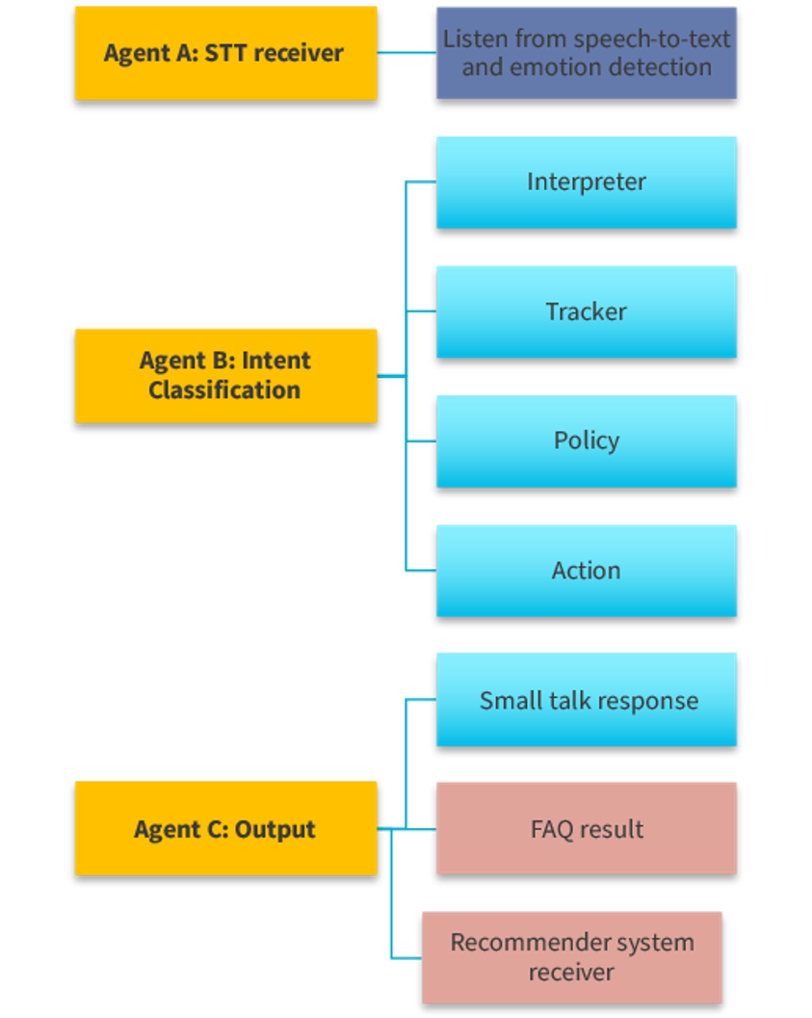
Our Model: Multiagent-based System
Multiagent architecture
Agent B: customized RASA pipeline (DIET Classifier)
Interpreter: NLU process
Tracker: conversation history
Policy: predict next action of chatbot
Action: generate output to user
Training data for classifier:
Data use | Data source | Link
Q & A | HKU Science program websites | Refer to our recommender system
Small talks knowledge base | Personality Chat Datasets | https://github.com/microsoft/botframework-cli/blob/main/packages/qnamaker/docs/chit-chat-dataset.md
Enrichment of data | Chatito | https://github.com/rodrigopivi/Chatito

Slide 10
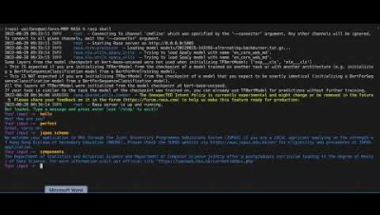


Preliminary results
Interactive
conversation
demo…

Slide 11
Ontology-based Recommender and Q&A System
Current Research & Problems
Conventional Recommenders
Ontology-based Recommenders
Common recommender types:
Content-based filtering (CBF)
Collaborative filtering (CF)
Hybrid filtering
Filtering using neural networks e.g. NCF (He et al. 2017)
Problems
New user cold start problem
Unable to provide flexibility
Ontology profile matching is often used to tackle the new user cold start problem (Jeevamol et al. 2021)
Hybrid filtering with ontology (Ibrahim et al. 2019)
Shortcomings
Confidential datasets
Long data collection period
Interactive Recommenders
NLP Models for Text Similarity and Relevance
Main idea: Recommender + Chatbot
Interactive CF (Zhao et al. 2013)
Q&R algorithm (Christakopoulou et al. 2018)
E-A-R model (Lei et al. 2020)
Goal-oriented models (Wu et al. 2019, Liu et al. 2020)
Problems
Each requires a different, large dataset
The deep models do not value-add
Query-question (q-Q) matching and query-answer (q-A) matching (Sakata et al. 2019)
Word embedding models e.g. Word2Vec and GloVe
Transformer-based models e.g. BERT

Slide 12
Ontology-based Recommender and Q&A System
Our Model & Experiment Design
Chatbot
Ontology-based Recommender
Admission related recommendations
Course related recommendations
Career related recommendations
Q&A System
Query-question similarity
Query-answer relevance
Student profile
Student query
matching
Top Profile Match
CBF/CF
Final Recommendation
matching
q-Q similarity
q-A relevance
Final Answer
+
=
+
=
HKU info profile
Questions & Answers
Recommendation Database
Q&A Database

Slide 13

Ontology-based Recommender and Q&A System
Preliminary Results
Ontology-based Recommender
Q&A System
Current Progress
Current Progress
Recommendation Database
Admission related recommendations
Course related recommendations
Career related recommendations
Query-Answer (q-A) Relevance
Q&A Database
Crawlers on FAQ pages on HKU websites
Query-Question (q-Q) Similarity
Model | Pre-trained On | Accuracy | F1-score
BERT | Large English corpus | 0.829 | 0.700
RoBERTa | Large English corpus | 0.914 | 0.847
RoBERTa | SQuAD 2.0 | 0.886 | 0.842
MPNet | 1B sentence pairs | 0.838 | 0.712
Word2Vec
GloVe
FastText
BERT
"Online Job Postings" Kaggle dataset
Crawlers on JUPAS and non-JUPAS admission websites
Crawlers on course websites from Faculty of Science and Department of Computer Science
Next Steps
Next Steps
Conduct CV on existing and future models
Combine q-Q and q-A models
Test out traditional Q&A models
Construct student and HKU ontology profiles
Build recommender based on ontology
Collect user ratings
Generate test data
Compare existing and future models

Slide 14
Conclusion & Future Work
Conclusion
Prospective and current students in different time-zone will enter the Metaverse at any time, any moment
An interactive Chatbot which can talk to users with all questions and concerns 24/7 is required
In the first stage of our project:
Decided the core part and pipeline of our Human-like Chatbot
Data were collected and pilot experiments were done on different subparts
Future Work
1. Self-created Testing Dataset
Simulate the real-world conversation environment with the educational chatbot
Test and evaluate the performance on every core parts
2. Emotion Detection & TTS
All the training datasets are not collected in conversation situations
Models need to be fine-tuned –detect emotion in conversation environment
Implement text-to-speech model
3. Recommender & Q&A system
Construct ontology profiles and ontology-based recommender
Collect student ratings of our recommendations via questionnaires
Continue model training to arrive at the best Q&A model
4. NLU & Dialog Generation
Enrich the program data
To have more story paths & provide more actions
Connect with other parts of our chatbots

Slide 15
THANKS!
Q&A Time

Slide 16
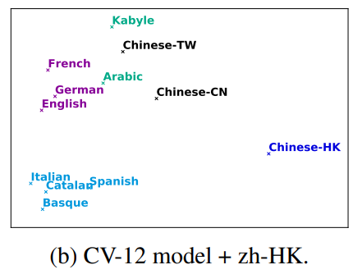
English and Cantonese Wav2Vec 2.0 ASR model
 | No. of hours | File Size | Number of Voices
LibriSpeech - Eng | 1,000 hrs | 58G | 2,484
Common Voice 6.1 - Eng | 2181 hrs | 56G | 83,790
Common Voice 10.0 - Cantonese | 129 hrs | 3G | 2,907
Visualization of language similarities learned by the XLSR model, Cantonese is isolated from other languages
difference in acoustic features in Cantonese from English makes the model perform worse in Cantonese speech recognition
Amount of training data and number of voices is not enough (>10x less then English Corpus)
Most of the ASR models were designed for English. The model architecture that fit English well may not fit Cantonese well

Slide 17
Different Between Training with Audio Augmentation vs without
Adverse Conditions | WavLM (w/o data aug.) | WavLM (w/ data aug.)
Background Noise | 0.783 | 0.898
Colored Noise | 0.74 | 0.848
Impulse Response | 0.797 | 0.91
Pitch Shift | 0.742 | 0.83
Volume Gain | 0.894 | 0.92
Shifting the Audio | 0.781 | 0.836

Slide 18
Cantonese Text Emotion Detection – Confusion Matrix
Sentences | Happy | Sad | Surprise | Anger
可是刚要上楼梯时，由于我走得比较慢，排在第二的谢翔小朋友抢先踏上了楼梯，我本来也没在意，可排在第一的刘丹却一把拉住了谢翔，警告他说：“谢翔你排哪里？ | 0 | 0 | 0.3 | 0.3
Confusion Matrix (Fine-tuned RoBERTa Model)
 | Happy | Sad | Surprise | Anger | Neutral
Happy | 333 | 66 | 10 | 17 | 41
Sad | 50 | 636 | 8 | 28 | 38
Surprise | 6 | 13 | 35 | 8 | 14
Anger | 9 | 51 | 3 | 85 | 12
Neutral | 28 | 50 | 11 | 8 | 248
Sentence_Cantonese | label | Emo class
而家好了，我終於如願以償。 | 0 | Happy
 |  | Class Intensity in Original Dataset
 |  | Happy | Sad | Surprise | Anger
Class Label of Processed Dataset | Happy |  | 0.016 | 0.023 | 0.0019
 | Sad | 0.0085 |  | 0.0093 | 0.023
 | Surprise | 0.055 | 0.067 |  | 0.024
 | Anger | 0.0065 | 0.11 | 0.028

Slide 19
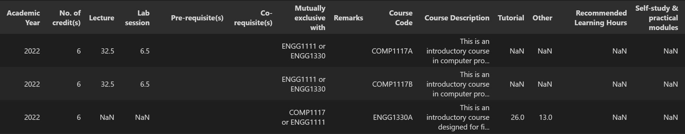
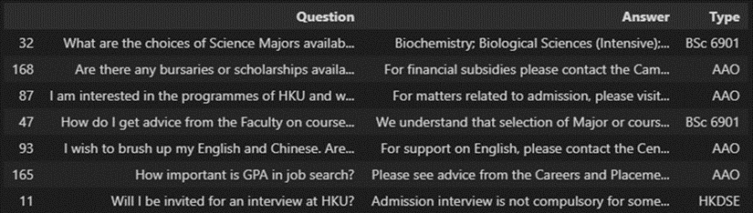
Ontology-based Recommender and Q&A System
Crawlers & Databases
Recommendation Type |  | Crawled Website(s)
(Type 2) Admission Requirements for HKU departments or majors | JUPAS (for local students) | https://www.jupas.edu.hk/en/programme/hku/ and sub-websites listed
 | Non-JUPAS (for international students) | https://admissions.hku.hk/apply/international-qualifications
(Type 3) Specific HKU curriculum or course | Faculty of Science | https://webapp.science.hku.hk/sr4/servlet/enquiry
 | Department of Computer Science | https://www.cs.hku.hk/programmes/course-offered
Recommendation Type | Crawled Website(s)
BSc 6901 Bachelor of Science – curriculum related Q&A | https://www.scifac.hku.hk/prospective/ug/6901-bsc/faq#On-Admission
BASc Bachelor of Arts & Sciences – curriculum related Q&A | https://www.socsc.hku.hk/basc/prospective-students/faq/
AAO – admission related Q&A | https://aao.hku.hk/faq/
General HKU undergraduate – admission Q&A | https://admissions.hku.hk/faqs

