Slide 1
StarlingX Project Overview
Learn, Try, Get Involved!

Slide 2
Let Me Introduce StarlingX
Top-level OpenStack Foundation pilot project
Software stack providing high performance, low latency, and high availability for Edge Cloud applications
Frequent releases
https://git.starlingx.io/
http://mirror.starlingx.cengn.ca/mirror/starlingx/release/
Growing community
Inviting users, operators and developers to try out the software and participate in the community

Slide 3
Project Overview

Slide 4
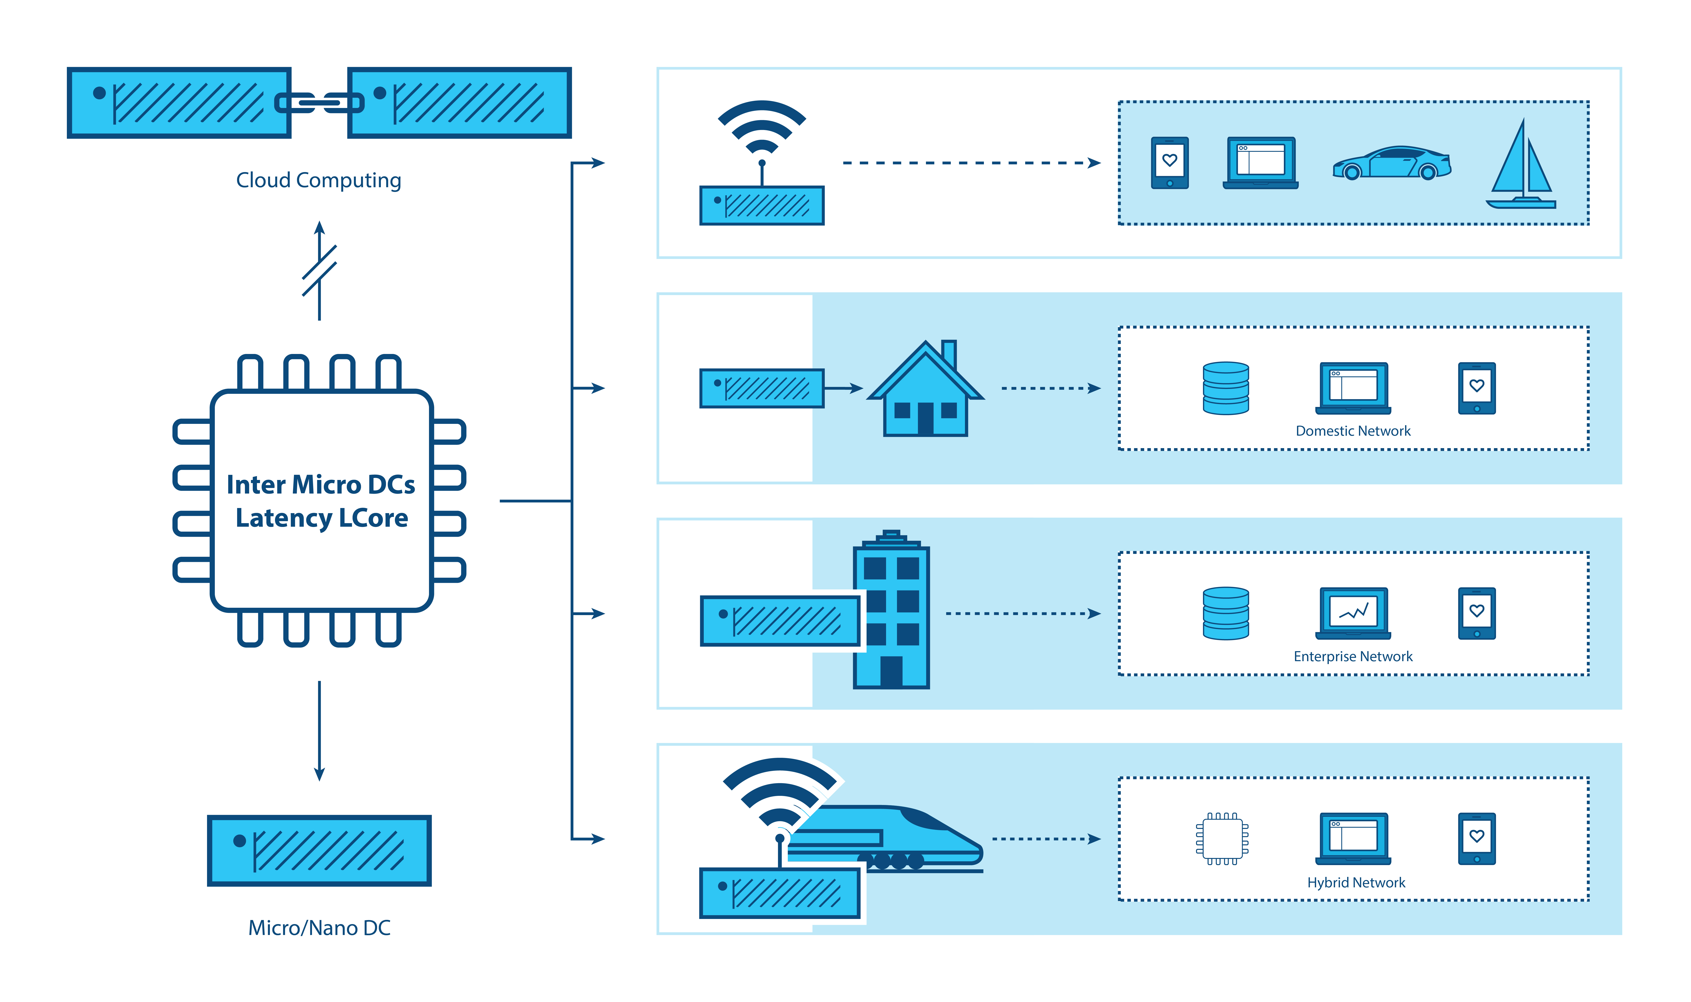
What Is Driving Edge Computing?
Latency
Bandwidth
Security
Connectivity
“WHERE” MATTERS
~100ms
~10-40ms
< 5ms
< 1-2ms
Notes:
For over a decade, centralized cloud computing has been considered a standard IT delivery platform. Though cloud computing is ubiquitous, emerging requirements and workloads are beginning to expose some limitations. While the standard Cloud data center model works extremely well for millions of applications, there are other applications which can greatly benefit by moving computing resources out of the datacenter and closer to the Edge of the network where decreased latency and higher performance provides significant value. Few developers seriously considered the requirements needed to support resource-constrained nodes reachable only over unreliable or bandwidth-limited network connections, or thought about the needs of applications that demand very high bandwidth, low latency, or widespread compute capacity across many sites. That is all starting to change as more and more use cases for Edge Computing are emerging.

Slide 5

Intent of the StarlingX Project
Re-Configure Proven Cloud Technologies for Edge Compute
Orchestrate system-wide
Deploy and manage Edge clouds, share configurations
Simplify deployment to geographically dispersed, remote Edge regions
OpenStack
Transportation
Energy
Kubernetes
Manufacturing
Retail
Ceph
Video
Smart cities
QEMU/KVM
Healthcare
Drones
*Other names and brands may be claimed as the property of others
Notes:
Technology companies have now spent a couple decades evolving Cloud computing to its current state of robustness. Linux blazed a trail of open source success. And newer technologies have spun out of the creative energies that vibrant open source communities can foster. This is apparent where new Cloud deployments use hypervisors and virtual machines with containers under an umbrella of orchestration.
StarlingX takes these successful open source Cloud components and makes them a viable platform in the somewhat different arena of the distributed Edge. Re-configuring these strengths, it must also take into account geographic dispersion, low overhead communications, and the need to manage very large hardware deployments.
It needs to be Cloud-like in many aspects, but it has to be simple to deploy, distribute and manage.
This is the goal of the project we call StarlingX.

Slide 6
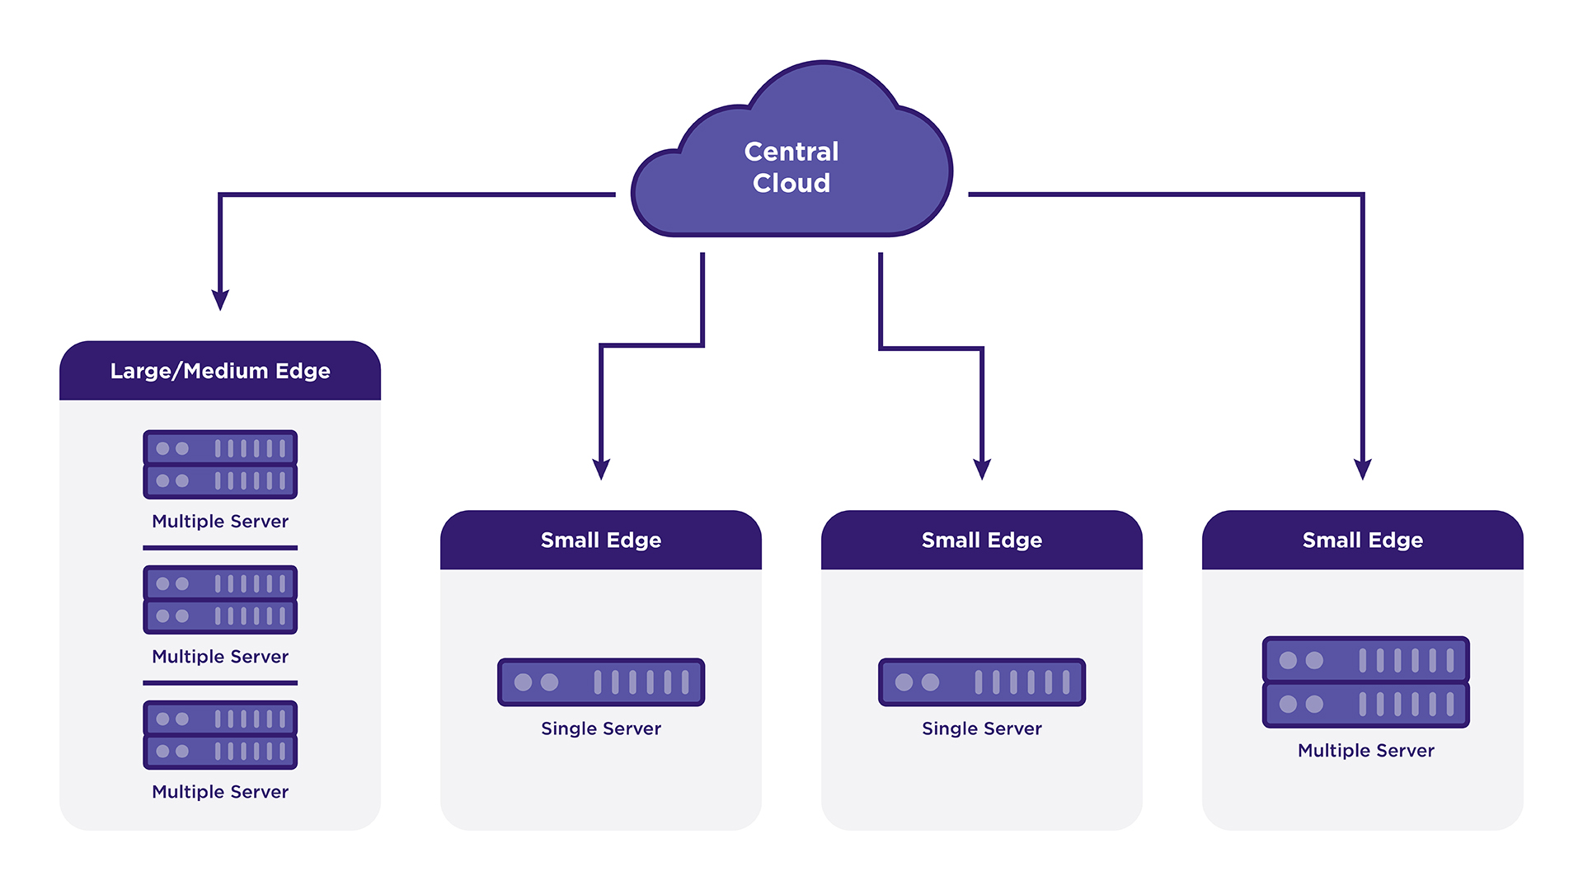
StarlingX Edge Deployments
Geographically distributed multi-region deployment,
Central Datacenter providing Orchestration and Synchronization Services,
Geographically distributed Edge Sites of various sizes

Slide 7
StarlingX Edge Use Cases
On-premises clouds for
Industrial Automation
Hospitals
Transportation and Rail
Central Office clouds for
vRAN
Local data centers
uCPE
Multi-Access Edge computing (MEC)
IIoT and VCS (Vehicle Cloud Services) clouds for
Smart cities
Autonomous vehicles with V2X (Vehicle-to-Any) communication models

Slide 8
StarlingX Technology

Slide 9
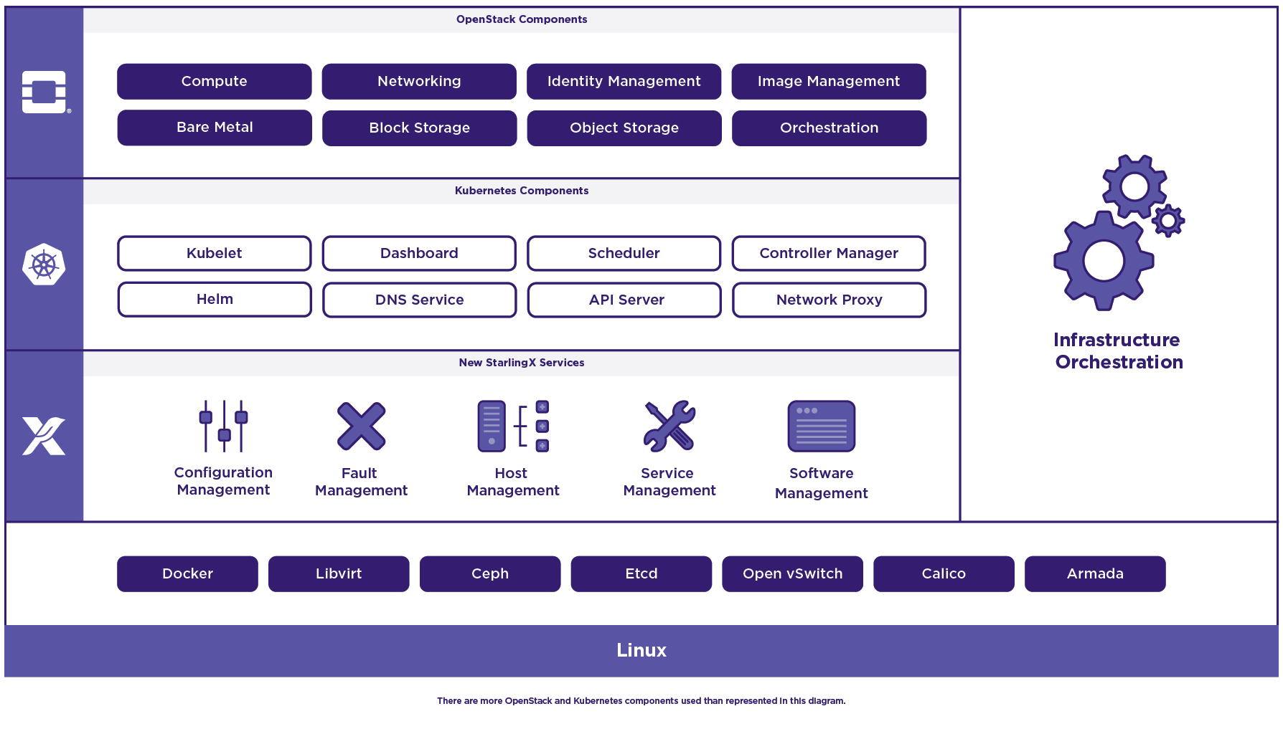
StarlingX – Edge Virtualization Platform
StarlingX provides a deployment-ready, scalable, highly reliable Edge infrastructure software platform
Services from the StarlingX virtualization platform focus on
Easy deployment
Low touch manageability
Rapid response to events
Fast recovery
A complete edge orchestration platform for bare metal, VM and container workloads
*Other names and brands may be claimed as the property of others
Notes:
StarlingX is a complete Cloud infrastructure software stack for the Edge used by the most demanding applications in industrial IOT, telecom and other use cases.
It is based on mature production software deployed in mission critical applications. We have just newly open sourced StarlingX code for Edge implementations in scalable solutions that can be productized now. It uses both OpenStack components as well as a number of proven open source building blocks to create its complete offering.
Tested and released as a complete stack, StarlingX provides a deployment-ready, scalable and highly reliable software platform to build mission critical Edge clouds.
Its unique project services include configuration, fault, service, software and host management to ensure high availability of user applications.
The StarlingX virtualization platform is designed to build up your Edge cloud quickly, manage it easily, respond and recover extremely fast.

Slide 10
StarlingX 3.0
A hardened cloud-native platform integrating OpenStack and Kubernetes on dedicated physical servers
Containerized OpenStack services based on the Train release
Closely aligned with the current OpenStack code base
As StarlingX integrates the Train release the platform no longer carries any out-of-tree patches
Kubernetes-based edge sites for containerized workloads
Containerized Application Workloads
Containerized OpenStack
Kubernetes + OpenStack
Container platform
StarlingX Infrastructure (flock)
Physical Servers

Slide 11
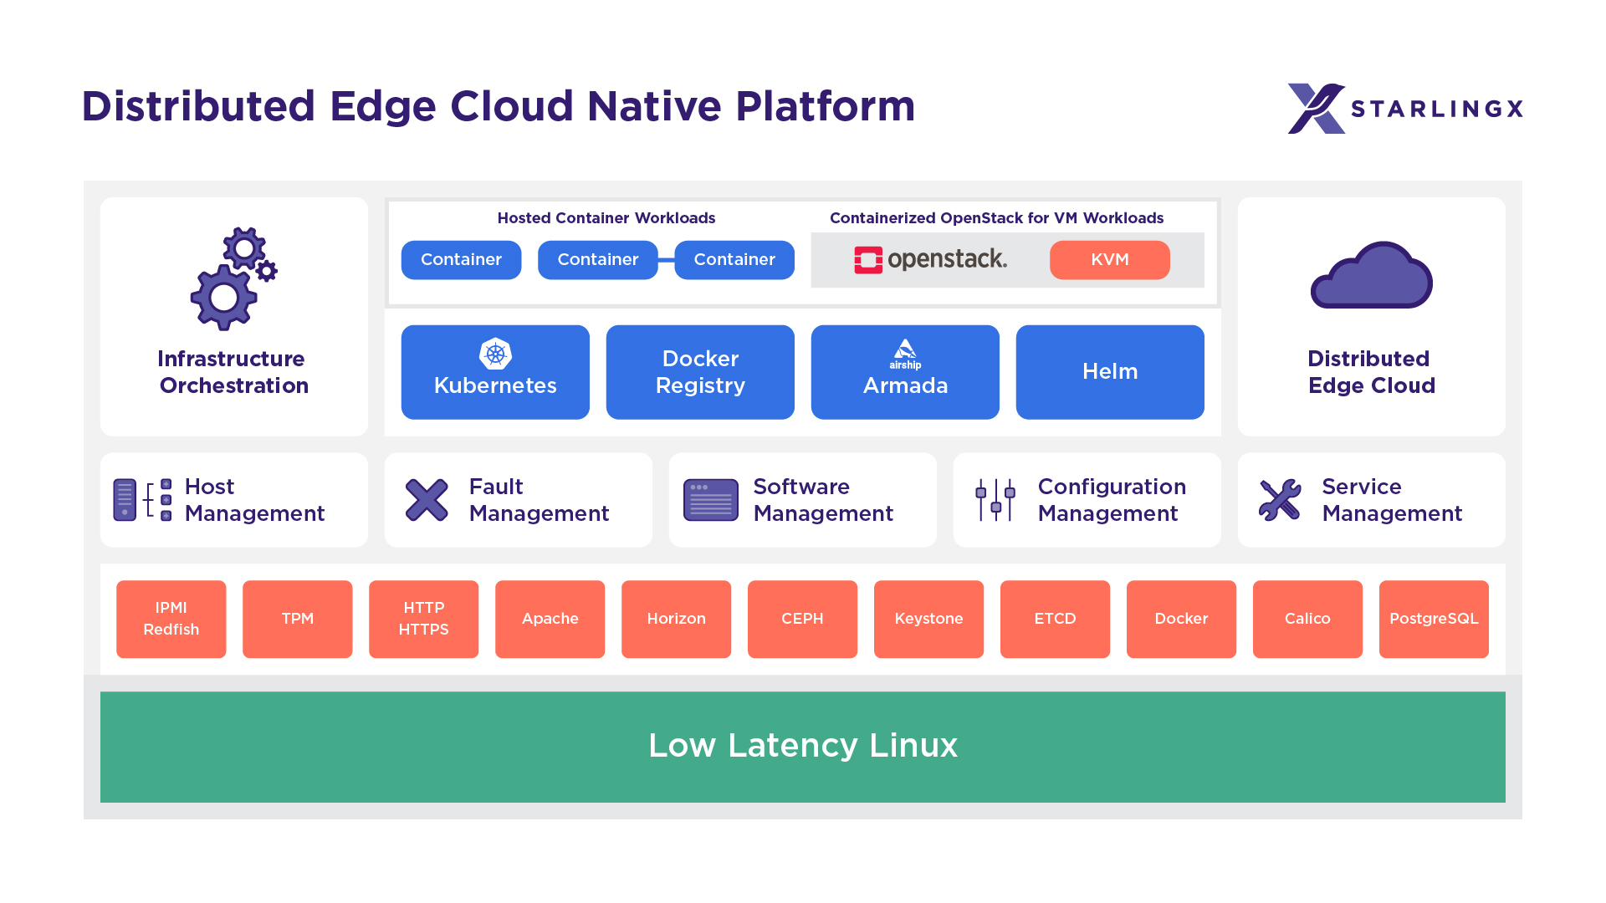
StarlingX Software Architecture

Slide 12
StarlingX – Deployment Models
Scalable deployment models from 1-100 servers addressing the wide range of edge use cases
Focus on minimizing the infrastructure footprint
One & two server solution overhead
2 cores/server
Frame level solution
2 server master implementation
1 core overhead/worker node
Storage
Integrated CEPH for one & two node solutions
Co-located CEPH on master nodes for small frame level deployments
Dedicated CEPH storage nodes for larger configurations

Slide 13
Infrastructure Management
“The Flock”

Slide 14
Configuration Management
Manages installation
Auto-discover new nodes
Manage installation parameters (i.e. console, root disks)
Bulk provisioning of nodes through XML file
Nodal Configuration
Node role, role profiles
Core, memory (including huge page) assignments
Network Interfaces and storage assignments
Inventory Discovery
CPU/cores, SMT, processors, memory, huge pages
Storage, ports
GPUs, storage, Crypto/compression H/W
CLI
Horizon
Automation
REST API
System Inventory
(Conductor)
System Inventory
(Agents)
Puppet Resources
Hardware Resources
Puppet Resources
Hardware Resources
SQL DB
Puppet Manifests
Controllers
All Hosts
System Configuration and Setup

Slide 15
Host Management
Full life-cycle management of the host
Detects and automatically handles host failures and initiates recovery
Monitoring and fault reporting for
Cluster connectivity, critical process failures
Resource utilization thresholds, interface states
H/W fault / sensors, host watchdog
Activity progress reporting
Interfaces with board management (BMC)
For out of band reset
Power-on/off
H/W sensor monitoring
Host Management
Configuration Management
Node Maintenance
(Agent / Client)
Process Monitor
Fault Management
Interface Monitor
Service Management
Resource Monitor
Sensor Monitor
Infrastructure Orchestration
Hardware
BMC
Vendor Neutral Host Management

Slide 16
Service Management
High availability manager
Redundancy model can be N+M or N across multiple nodes
Currently 1+1 HA Controller Cluster
Uses multiple messaging paths to avoid split-brain communication failures
Up to 3 independent communication paths
LAG can also be configured for multi-link protection of each path
Messages are authenticated using HMAC SHA-512 if configured / enabled on an interface-by-interface basis
Active or passive monitoring of services
Allows for specifying the impact of a service failure
ACTIVE
STANDBY
Service Management
(SM)
Service Management
(SM)
Infrastructure Services
Infrastructure Services
Cluster Services
Cluster Services
StarlingX
Controller Node - 0
StarlingX
Controller Node - 1
High Availability for Critical Infrastructure
Notes:
Active or Passive Monitoring of Services
Passive Monitoring is done through periodic auditing and registering for asynchronous process deaths
Active Monitoring is a messaging based challenge and response of a service in addition to the passive monitoring functionality
Services managed by using LSB (Linux Standard Base) or OCF (Open Cluster Framework) compliant scripts
Supports different Service Dependency configurations
Service State Dependency (e.g. X can’t be in the enabled state unless Y is in the enabled state)
Service Action Dependency (e.g. X can’t run the enable action until Y is in the enabled state)
Asynchronous process death notification Polling/Monitoringdetection of process death
FasterFailover performance (on order of 1-2 seconds) Failover times on order of ~5 seconds
Allow for specifying recovery escalation actions per service.
Not supported.
Support for option to restart a service without restarting dependent processes.
Not supported.
Support for restart of ‘Service Manager’ without impacting monitoredservices.
Restartof Pacemaker tears down all services.

Slide 17
Fault Management
Framework for infrastructure services via API
Set, clear and query customer alarms
Generate customer logs for significant events
Maintains an Active Alarm List
Provides REST API to query alarms and events
Support for alarm suppression
Operator alarms
On platform nodes and resources
On hosted virtual resources
Operator logs - Event List
Logging of set/clear of alarms
Related to platform nodes and resources
Related to hosted virtual resources
CLI
Horizon
SNMP
Configuration Management
Fault Management
Host Management
FM REST API
SNMP
Fault Management
(Manager)
Service Management
SQL DB
Infrastructure Orchestration
Fault Alarming and Logging

Slide 18
Software Management - in progress
Automated deploy of software updates for security and/or new functionality
Integrated end-to-end rolling upgrade solution
Automated, low number of steps
No additional hardware required for upgrade
Rolling upgrade across nodes
In-service and reboot required patches supported
Reboot required for kernel replacement etc.
VM live migration is used for patches that require reboot
Manages upgrades of all software
Host OS changes
New / upgraded StarlingX service software
New / upgraded OpenStack software
CLI
Horizon
Software Management
(Controller)
Software Management
(Agent)
Infrastructure Orchestration
Software Update
(Service Scripts)
RPMS
Controllers
All Hosts
Software Upgrades and Patching
Notes:
Been doing this for 5 releases incuding skipping releases
Kilo->Mitaka
Newton->Pike

Slide 19
Container Platform

Slide 20
Kubernetes Cluster Software Components
Kubernetes Master
API Server
Docker Registry
Full infrastructure and cluster orchestration
Security and Policy
Control Plane
Armada
Scheduler
Ingress LB
Helm
Controller Manager
ETCD
Kubernetes Worker (kubelet)
CRI-O
containerd
Flexible ecosystem of base OS
Evolution to other container runtimes
Kernel and Accelerated networking
CRI
Docker
Application Containers
Worker Nodes
CNI
Calico
Multus
SRIOV
Other
Device
Plugins
SRIOV
GPU
FPGA
QAT
Runtime
App/Service
Base OS
runc
nvidia
kata
Host Abstraction
Host OS
Current
cgroups
namespaces
overlayfs
drivers
Future

Slide 21
Kubernetes Deployment Architecture
Active
Standby
Kubernetes deployed in a highly available configuration
Deployed in a 1:1 service model
All-in-One Simplex/Duplex deployments supported using same service management
Requests directed to actives instances via cluster floating IP address
DRBD backed file system for redundant persistent storage
Service availability and activity managed by Service Management (SM)
Handles HA sparing of individual services
Actively monitors host, service and network availability
Mitigates split-brain scenarios
Kubernetes Master
Kubernetes Master
kube-apiserver
kube-apiserver
kube-controller-manager(s)
kube-controller-manager(s)
cluster-ip
cluster-ip
Kubernetes Worker
Kubelet
Docker
Notes:
Split brain results in pods on the controller without the floating IP being marked as NodeLost because the kube-apiserver does not hear from the kubelet. This is handled the same way as a node failure.

Slide 22
Cluster Persistent Storage
Ceph uniquely delivers object, block, and file storage in one unified system
Highly scalable and highly available deployment with distributed Ceph monitors and Object Storage Devices (OSD) for data replication
Automatic cluster storage deployment and replication
Unified storage solution for all deployments: AIO-SX/DX, Standard, Multi-cloud
Fully managed Ceph Cluster Map (hyper-scale)
Kubernetes persistent storage provided by Ceph's RADOS Block Devices (RBD) provisioner
Persistent Volumes (PVs) and Claims (PVCs)
Default Storage Class
OpenStack backend storage solution for services: Glance, Cinder, Swift, Nova
Kubernetes Cluster
controller node
controller node
Controller Services
Controller Services
Ceph Monitor
Ceph Monitor
worker nodes
storage node
Pod
Pod
Pod
Ceph Monitor
worker services
Ceph OSDs
compute nodes
storage nodes
GUEST VM
GUEST VM
GUEST VM
compute services
Ceph OSDs

Slide 23
Kubernetes Cluster Networking
Calico provides a pure L3 fabric solution for interconnecting containers
Calico leverages the Linux kernel for routing and policy enforcement
Calico leverages Border Gateway Protocol (BGP) for control plane
Calico leverages Open Standards and is a full Open Source network solution
Calico is highly scalable, and is operator and policy friendly:
No overlay, no tunnelling, no VRF tables (no overhead) – pure routing
Access Controls enforced through L3/L4 security policies
Kubernetes Cluster
Calico Control Plane
Pod A
Pod B
Ingress Gateway
Calico
APP
APP
Egress Gateway
Kernel (Network Policy Enforcement)
Public
Kernel (Network Routing)

Slide 24
Kubernetes Accelerated Networking
Multus, SR-IOV, DPDK
Kubernetes managed accelerated network devices (via Device and CNI plugins)
Containers bind the driver to the Virtual Function (VF) or DPDK devices directly
No host routing or switching is involved for SRIOV and provides the best direct IO
Worker Node
Worker Node
Compute or Bare Metal Node
Pod1
Pod2
Pod3
Pod4
APP
APP
APP
APP
Native or Virtualized
APP
ETH0
ETH0
ETH1
ETH0
ETH0
ETH1
Host Routing
Host Routing
NIC1
VF1
VF2
NIC1
VF1
NIC1

Slide 25
Additional Capabilities
Local replicated docker image registry
Integration with openstack keystone
Local docker image registry authentication
Authentication/authorization of k8s API
Huge Page support
Enables pods to allocate and consume huge pages from pre-allocated host pool
Kubernetes CPU manager static policy
Enables applications to reserve exclusive CPUs in their pod spec

Slide 26

Application Management
Helm
Helm Charts help you define, install, and upgrade even the most complex Kubernetes application.
Template based approach to Kubernetes configuration
System and User overrides combined to provide final deployment configuration
Armada
Manages the dependencies between multiple Helm Charts and expression of those relationship
Static and default configuration attributes
Application
Curated software bundle of Armada manifest and Helm Charts
Application lifecycle coordinated by Configuration Management
User uploads, applies / removes application with single command operations
Controller Node
.tar.gz
Armada Manifest
Armada
Helm
Configuration
Application
Helm Charts & Overrides
Configuration Management
Kubernetes
DB
Registry

Slide 27
OpenStack

Slide 28


OpenStack Deployment
OpenStack is deployed as a containerized Kubernetes application
OpenStack control plane running in pods
OpenStack virtual machines running on host
Leverages Kubernetes’ strengths to manage, scale and update the OpenStack services
Deployed using Helm (using OpenStack-Helm charts) and Armada (orchestrator for deploying Helm charts from OpenStack Airship).
StarlingX provides application APIs to install and configure the containerized OpenStack application
Application tarball contains helm charts and armada manifest for StarlingX
Automatic generation of helm configuration values based on system configuration
User can easily customize helm configuration of OpenStack Services
Notes:
Application
Curated software bundle of Armada manifest and Helm Charts
Application lifecycle coordinated by Configuration Management
User uploads, applies / removes application with single command operations

Slide 29
Supported OpenStack Services
Configuration optimized and system validated within StarlingX
Keystone, Nova, Neutron, Glance, Cinder, Horizon, Heat, Barbican, Ironic
Telemetry
Ceilometer, Gnocchi, Panko, Aodh

Slide 30
Day 2 Configuration Changes
Configuration changes can be applied after the application has been deployed
Update the helm chart overrides
system helm-override-update …
Reapply the application
system application-apply …
Only charts impacted by the configuration change will be updated

Slide 31
Distributed Cloud

Slide 32
Distributed Cloud Overview
Introduced in StarlingX 3.0
Heterogeneous Distribution of Kubernetes and OpenStack Clouds
Central Cloud (System Controller)
Hosting shared services
System-wide infrastructure orchestration functions
Remote, geographically dispersed edge clouds
Communication with the System Controller node through REST APIs/L3
Running a control plane for autonomous operation
In line with the Distributed Control Plane reference architecture model defined by the OSF Edge Computing Group

Slide 33
Distributed Cloud - System Controller
Centralized deployment of container platform on sub-clouds
Automated and declarative configuration
Sub-cloud health monitoring and management
Synchronized User Authentication & Authorization with Keystone
Centralized Docker registry for infrastructure and applications
Centralize Horizon dashboard - single pane of glass
Configuration portal for shared platform data
DNS, NTP/PTP, API Firewall, SNMP, Remote Logging, …
Glance image caching in edge clouds

Slide 34
Community and Contributing

Slide 35
Principles
The StarlingX project follows the “four opens,”
Open Collaboration
Open Design
Open Development
Open Source
Technical decisions will be made by technical contributors and a representative Technical Steering Committee.
The community is committed to diversity, openness, encouraging new contributors and leaders to rise up.

Slide 36
Sub-project Structure
Main sub-projects
New functionality and services
Supporting sub-projects
Supporting services, test and infrastructure
Sub-project team structure
1 Team Lead
1 Project Lead
Core Reviewers
Contributors
Technical Steering Committee
StarlingX Main Sub-projects
Config
Distributed Cloud
Flock Services
StarlingX Supporting Sub-projects
Docs
Build
Distro: OpenStack
Distro: non-OpenStack
Test
Security
Containers
Networking
Releases
MultiOS

Slide 37
Governance Roles
Contributor
Someone who made a contribution in the past 12 months
Code, test or documentation
Serving in a leadership role
Can run and vote for elected positions
Core Reviewer
Active contributors to a sub-project, appointed by fellow core reviewers
Responsible for reviewing changes and specifications
Can approve code and documentation changes

Slide 38
Governance Roles
Technical Lead
Per sub-project
Core Reviewer with additional duties
Helps guiding the technical direction of a sub-project
Project Lead
Sub-project level coordination work
Tracks and communicates progress and priorities
Sub-project ambassador

Slide 39
Governance Bodies
Technical Steering Committee (TSC)
Responsible for overall project architectural decisions
Managing the sub-project life-cycle
Making final decisions if sub-project Core Reviewers, Technical Leads or Project Leads disagree
The TSC currently consists of 6 members; the next TSC election will be held during the first half of 2020

Slide 40
Get Involved
Code and documentation are available through git
git.starlingx.io
Apache 2 license
IRC: #starlingx@Freenode
Mailing List for daily discussions
http://lists.starlingx.io/cgi-bin/mailman/listinfo/starlingx-discuss

Slide 41
Where to Contribute?
Bugs are tracked in Launchpad
https://bugs.launchpad.net/starlingx
New ideas are introduced in the specs repository
https://git.openstack.org/cgit/openstack/stx-specs/
Design and implementation work is tracked in StoryBoard
https://storyboard.openstack.org/#!/project_group/86
Further information about sub-teams and processes
https://wiki.openstack.org/wiki/StarlingX

Slide 42
Community
You do not need to be an Individual Member of the OpenStack Foundation in order to contribute, but if you want to vote in the annual OpenStack Foundation Board of Directors election, you may join: openstack.org/join
If you are contributing on behalf of an employer, they will need to sign a corporate contributor license agreement, which now covers all projects hosted by the OpenStack Foundation (same model such as Apache and CNCF)

Slide 43
Communication
#starlingx@Freenode, IRC channel for online discussions
Mailing Lists: lists.starlingx.io
Email: info@starlingx.io
Weekly meetings:
Zoom calls
https://wiki.openstack.org/wiki/Starlingx/Meetings
Twitter handle: @StarlingX
Notes:
You have an opportunity to get involved in several ways:
Stay updated with the mailing list
Attend the community meetings
Try out the code. Please do try out the code.
And also, join us as a member company at any level

Slide 44
Thank You!

