Slide 1

Gerrit Training for StarlingX Docs Reviewers
Session Goals
Describe the review process flow and roles/responsibilities
Show the gerrit user interface
Hands-on edits of practice reviews

Slide 2
Review Process Flow
Gerrit review is created with documentation changes.
A prime/technical person is assigned as a reviewer. Prime may delegate to another team member.
Prime or delegate gives +1 when they approve the technical content.
(Optional) Docs team may assign Validation prime as reviewer. Prime may delegate to another team member. Validation prime or delegate gives +1 when they approve the technical content.
Docs approvers give +2 and +1/Workflow the review to merge it.
After merge, if Validation finds any issues, they open a Launchpad item. The Docs team makes a new review and the process starts from Step 1 above.

Slide 3
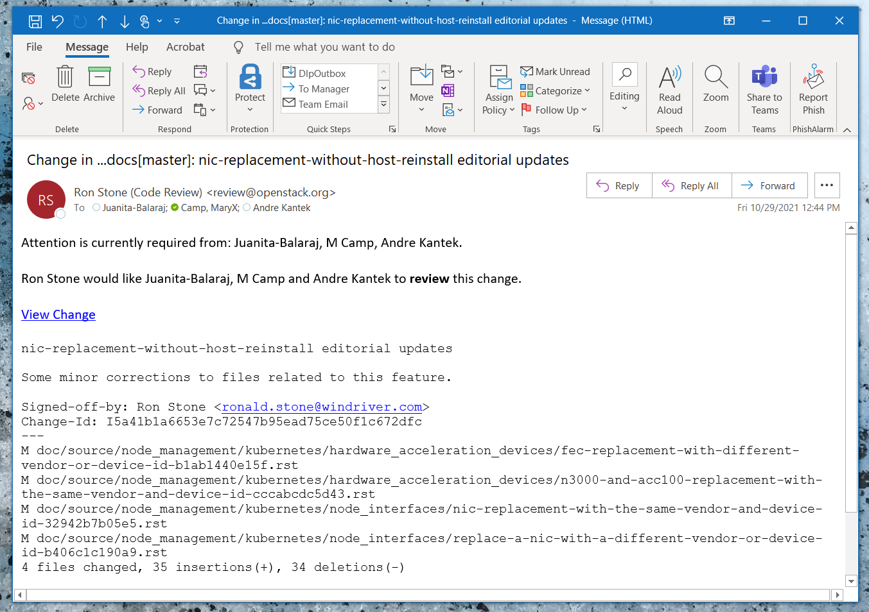
Review Assignment Email
System sends an email when you’re assigned to a gerrit review.
Includes review overview and link to View Change.

Slide 4
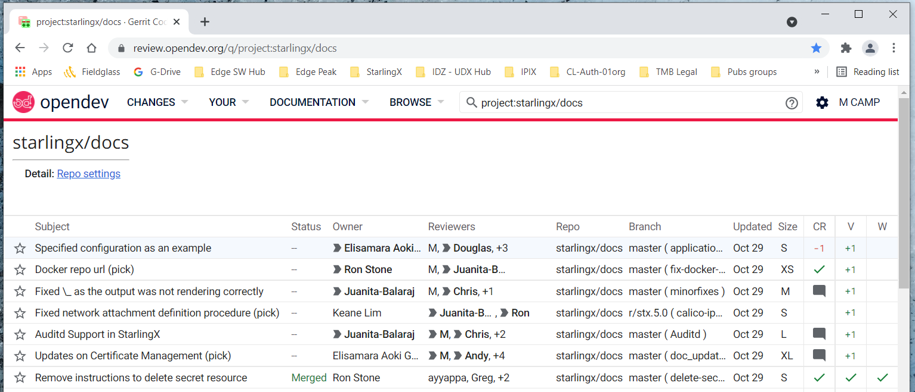
Gerrit User Interface
Gerrit link for docs repo: https://review.opendev.org/q/project:starlingx/docs
Log in with Ubuntu One information
Top-level view after logging in (all reviews).

Slide 5
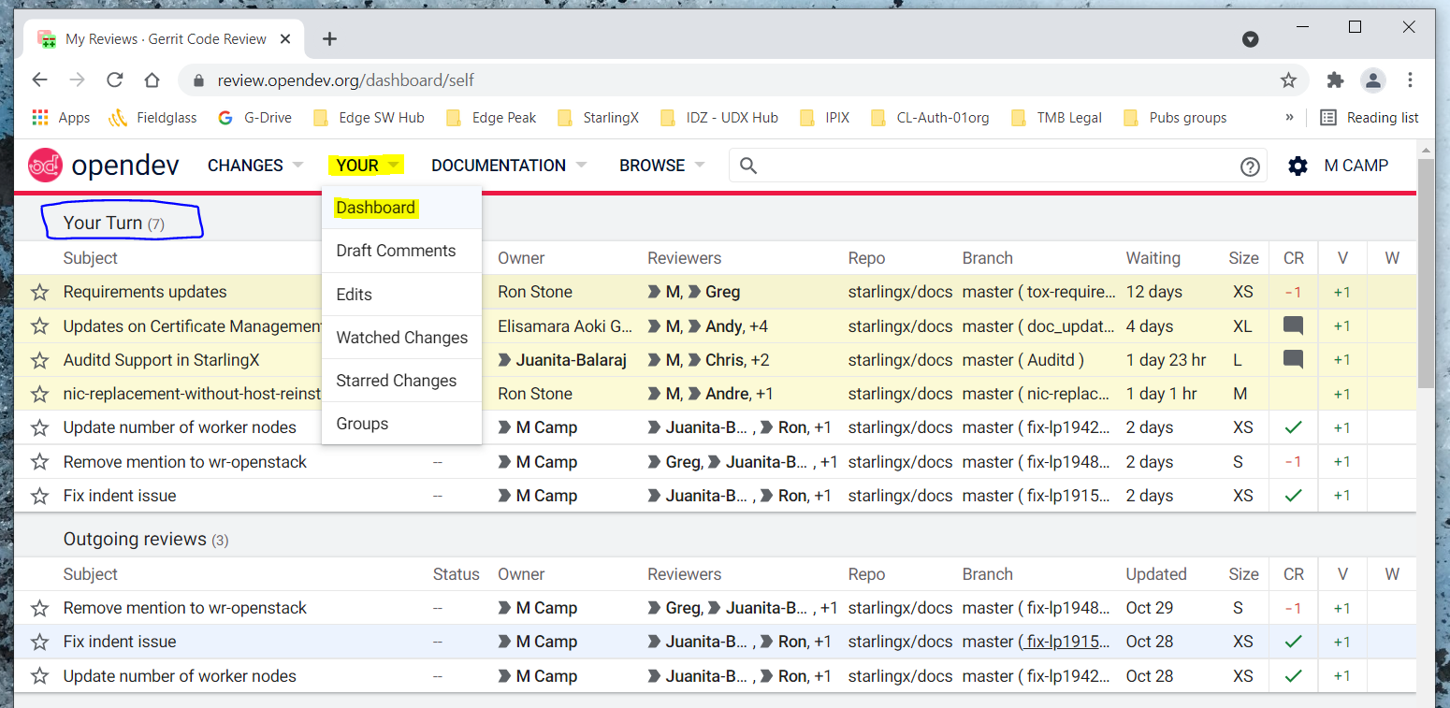
Gerrit User Interface
Your > Dashboard
Your Turn section lists reviews that you’ve been tagged in. Oldest reviews are at the top.

Slide 6
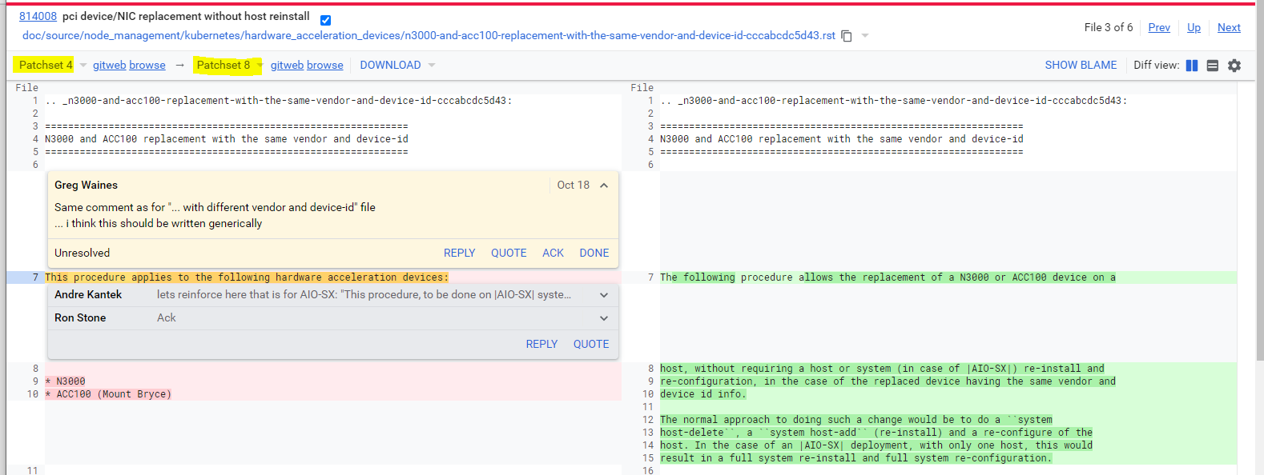
Example Review
Docs team will mark comments as Done when a new patch set is submitted.
Use the Reply button if you have a response to someone else’s comment.
You must add a Reply at the top of the interface to save your feedback.
Screenshot below is from this review (merged): https://review.opendev.org/c/starlingx/docs/+/814008

Slide 7
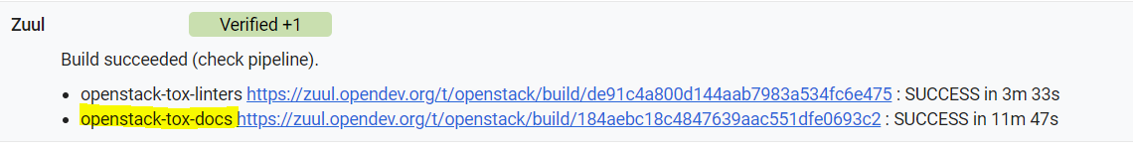
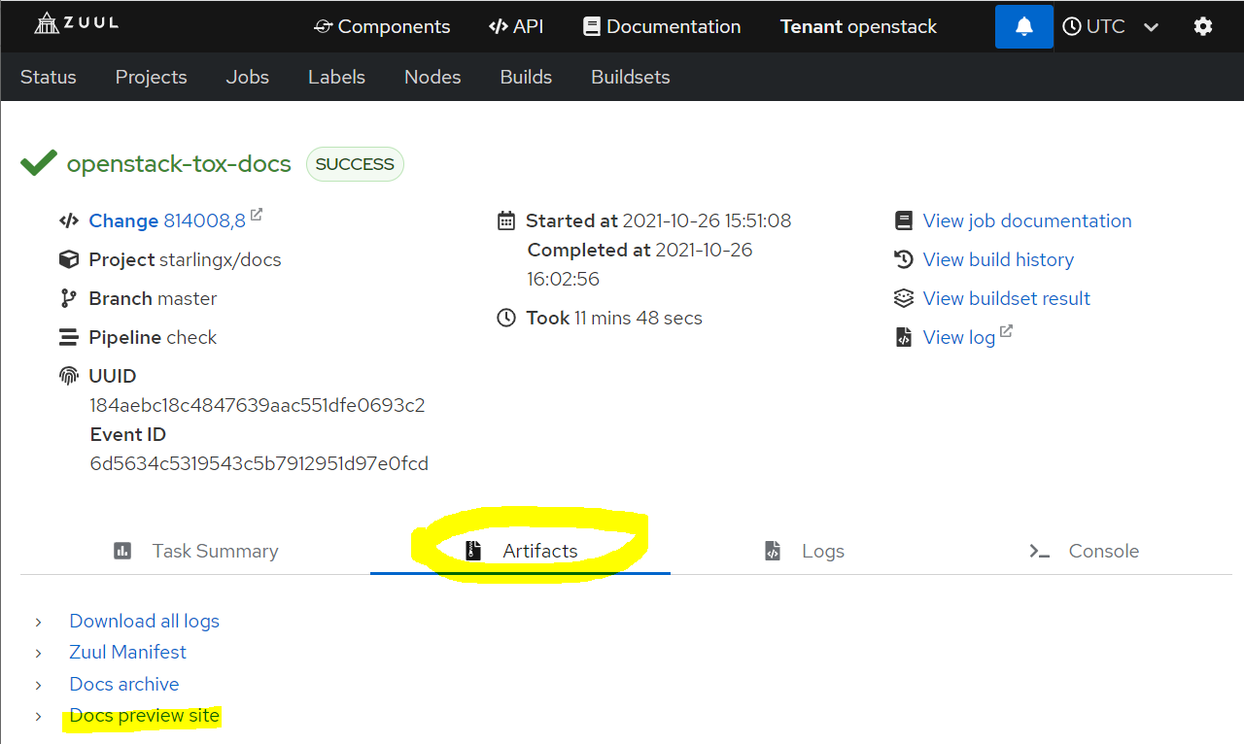
View HTML Output
Scroll to the bottom of the review where the comments are. In the line Zuul Verified+1, click anywhere to expand the line.
Right-click the link for openstack-tox-docs to open a Zuul jobs window in a new tab.
In the Zuul window, click the Artifacts tab, then Docs preview site
Browse to the updated doc files using the filenames in the review.
RST Notes
RST files can be tricky to review in the native format due to the tags that are used.
Viewing HTML is especially helpful for guides with conditions or includes, such as Installation Guides.
We use RST substitutions for acronyms, such as |OAM| or for product-specific usage, such as |prod|.
If you see .. include or .. only: partner
this shows where text is repeated from another location or processed differently. It’s best to view the HTML so you can read the full content.
See the Documentation Contributor Guide’s RST quick reference section for more information.

Slide 8
Hands-On Practice
Open a browser window and go to: https://review.opendev.org/c/starlingx/docs/+/817483
Review the comments and compare different patch sets.
View the HTML output.
Reply to a comment and add your own comment.
Sandbox
Sandbox git repo that can be used to practice git commands and upload a patch for review
House rules: https://docs.openstack.org/contributors/code-and-documentation/sandbox-house-rules.html
Using Gerrit: https://docs.openstack.org/contributors/code-and-documentation/using-gerrit.html#gerrit
Test patch can be used to practice using the Gerrit User Interface: https://review.opendev.org/q/project:opendev/sandbox
Questions
If you have any follow-up questions, you are welcome to come to the Docs meeting.
You can also send email to the community mailing list.

