Slide 1


Institute of Theoretical Chemistry – González Research Group
Acedemic Weekend 2014, 8th to 11th May
Obertraun im Salzkammergut
cooperative programming & file management
Andrea*s Jackie Klaura
<jackie@diebin.at>
(powered by free software)

Slide 2
What we'll see and what not a.k.a. “Overview”
Short intro into Version Control Systems (VCS)
Which VCS are there and why GIT?
Basics of GIT
Some examples
And now?
Notes:
Für Bezugnahme auf Basistext (Pielke):
4 Rollen von Science in Policy & Politics:
- Pure Scientist
- Science Arbiter
- Issue Advocate
- Honest Broker of Policy Alternatives
Abortion Politics & Tornado Politics
(see Chart on last slides)
Für Queer-Verweis bei Vergleichsstudie später:
Bogner Alexander (2007). Was heißt “Politisierung von Expertise”? In: Österreichische Zeitschrift für Politikwissenschaft (ÖZP). 36 (3). pp. 319-335

Slide 3
Version Control Systems (VCS)
Storing different versions of files
Switching between those versions
Sharing and cooperating with others
Creating alternate copies (branches)
Well suited for cooperative programming projects
Also suited to personal file management
Or other cooperative projects
Even as a dropbox replacement ;)

Slide 4

Version Control Systems (VCS)

Slide 5

Version Control Systems (VCS)

Slide 6
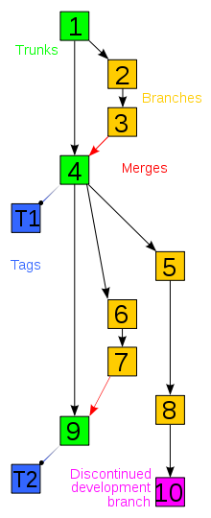
Version
Control
Systems
(VCS)
Branching

Slide 7
Why git? Distributed VCS
Most VCS are centralized: e.g. CVS, SVN
git is distributed
  whole repository on your local machine
  much faster transactions
  scales well for fast projects (e.g. linux kernel)
Git was developed 2005
It is free software
There are services like github.com

Slide 8

Why git? Distributed VCS

Slide 9

Basics of GIT

Slide 10
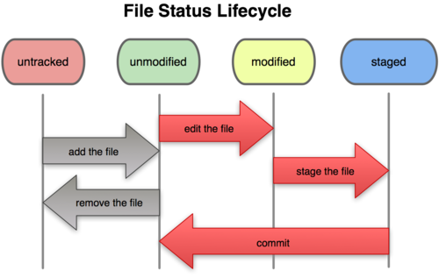
Basics of GIT

Slide 11
Some examples
goto: terminal
for those fancying the auto-didactic style (… and sweet little octo-cats) :
goto: http://try.github.com/

Slide 12
and now
git tutorials & documents: http://www.git-scm.com/documentation
?
(powered by free software)

