Slide 1

GeoStar BackEnd System

Slide 2
Functionality
User Management
User Authentication for front-end (API)
Setup user event group
Maintain user event group
Record the GPS position information of users (API)
Determine the latest position of users
Inquire the latest position of user in specific event group(API)

Slide 3
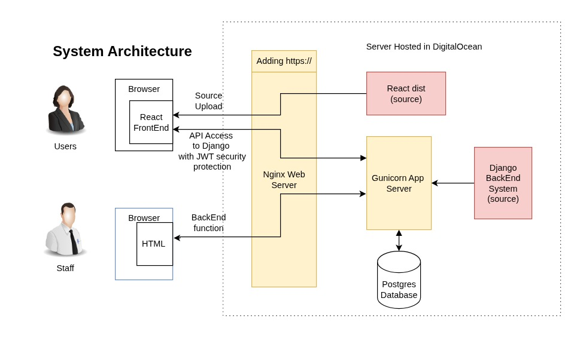

Slide 4
Demo

Slide 5
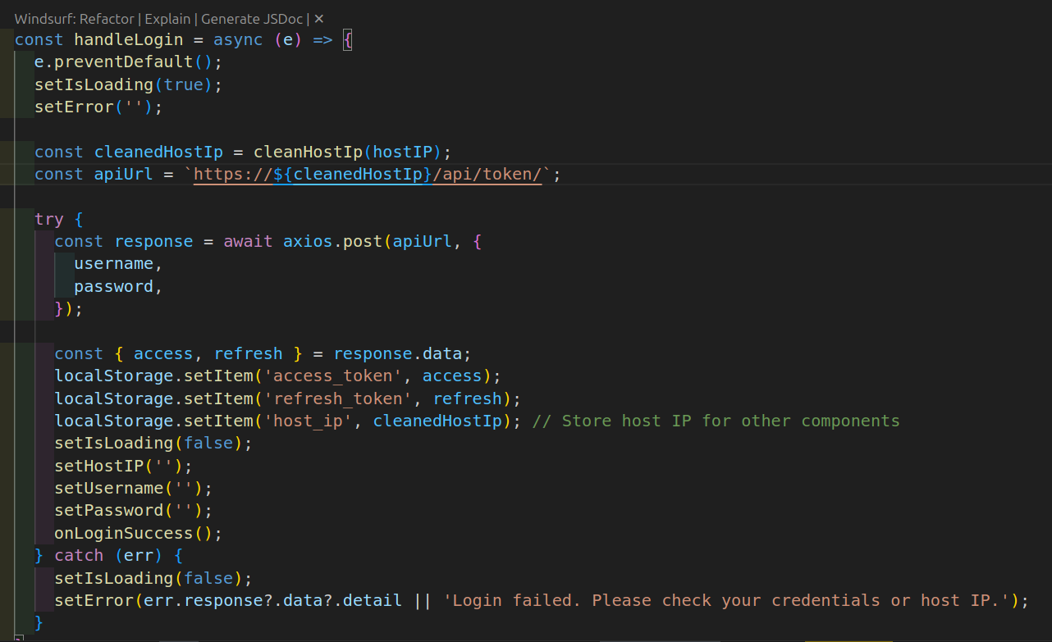
Front-end Login

Slide 6
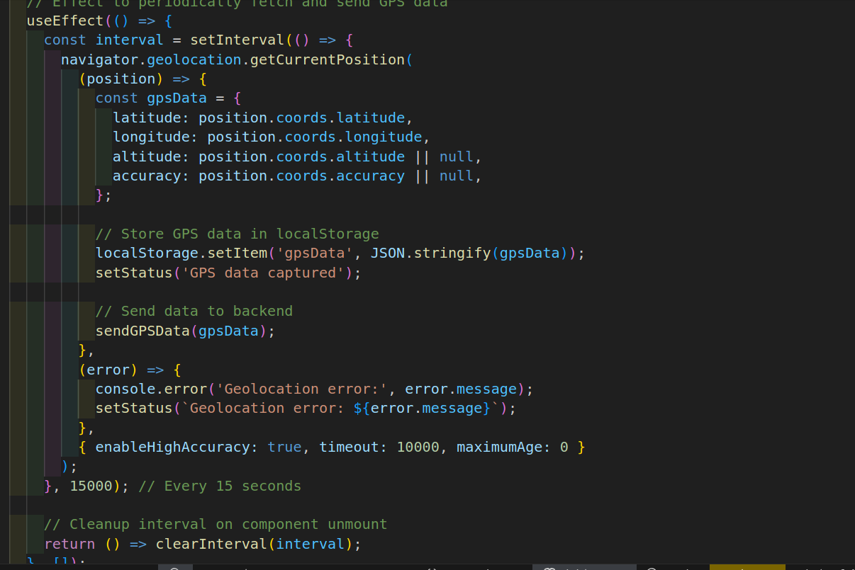
Front-end Capturing Geo Location

Slide 7
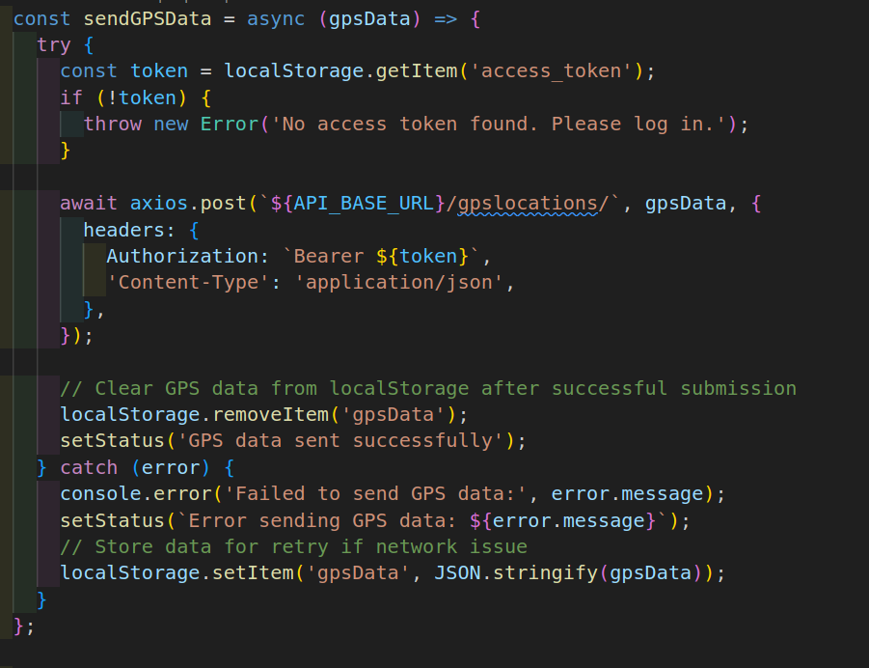
Front-End Sending

Slide 8
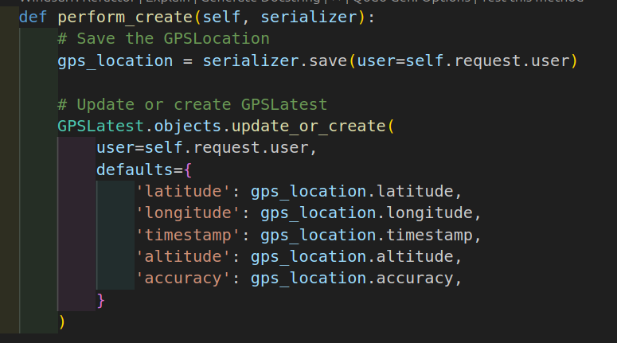
Back-End Receiving (in Django)

Slide 9
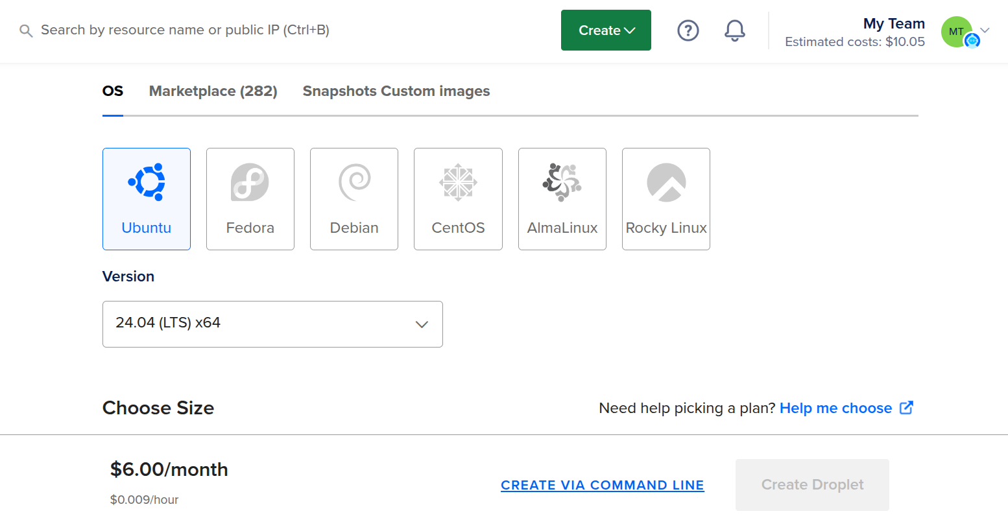
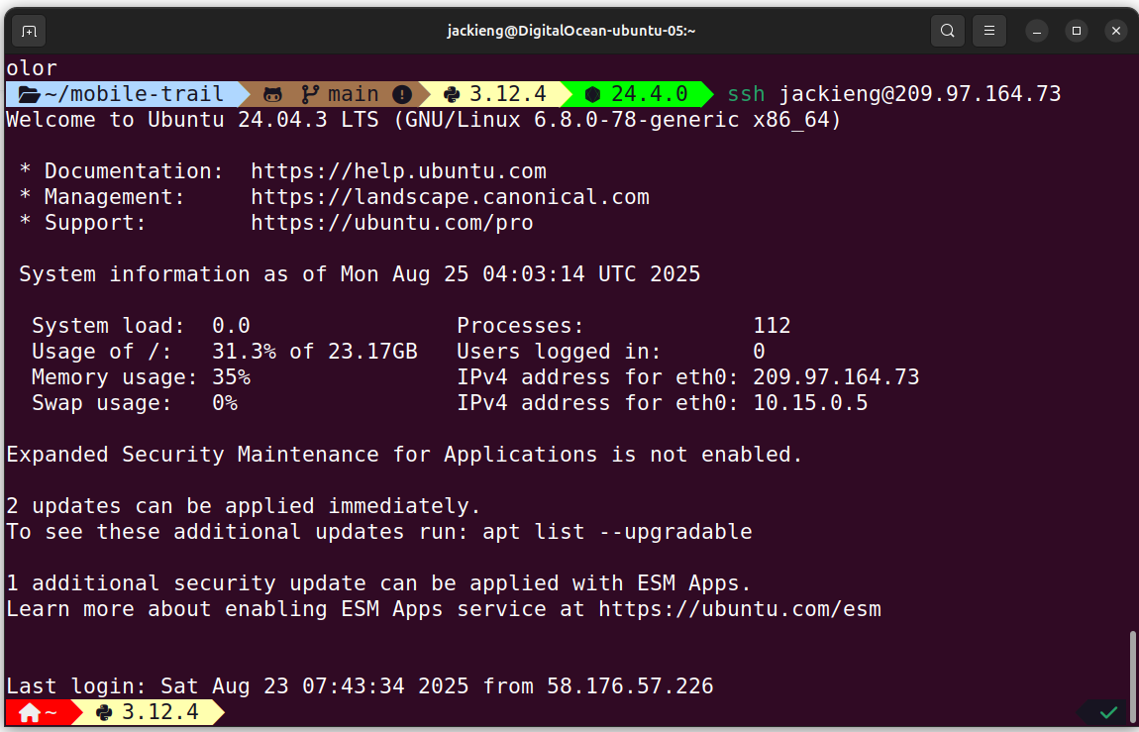
Web Hosting – DigitalOcean

Slide 10
Thank You

