Slide 1
Scope Insensitivity & Charitable Giving
Ethan Nguyen-Tu, Jackie Chambers, Isabel Knofczynski, Pete Rowlett
ECON4803: Behavioral Economics
Dr. Whitney Buser

Slide 2
What is Scope Insensitivity?
A common cognitive bias that occurs when people make judgments that show no concern to the number - or scope - of the things they are evaluating

Slide 3
Purpose
Explore how scope insensitivity affects decision-making about charitable giving
Test the effect of a framing treatment on people’s ability to overcome scope insensitivity
Notes:
Introduction
a. Why is this topic important?
b. How were you motivated to study this topic?
c. What is the base experiment you are replicating (if any)?

Slide 4
Literature Review: Scope Insensitivity
Past literature shows that people are consistently insensitive to scope in altruistic contexts.
The reasons for scope insensitivity are not fully understood.
Emotional Response (Dickert et al., 2012)
Unaffected by scope (Dunn & Ashton-James, 2008; Dunn et al., 2008)
‘Warm Glow’ Effect (Baron & Green, 1996)
‘Collapse of Compassion’ (Cameron & Payne, 2011)
Real-world Limitations
Budget constraints (Baron & Green, 1996)
Irrationality
‘Psychophysical numbing’ (Fetherstonhaugh et al., 1997)
Marginal utility (Dickert et al., 2015)
Scope sensitivity varies by group.
Cultural Norms (Kogut et al., 2015)
Numeracy (Dickert et al., 2018)
Self-Focus (Chang & Hung, 2018)
Notes:
People are consistently insensitive to scope in altruistic contexts. (Hsee & Rottenstreich, 2004; Hasford et al., 2015; Kogut & Harel, 2021).
People are scope insensitive even when they expect not to be Dunn et al 2008
Cultural norms: people from collectivist cultures are more sensitive to scope, people with better numeracy / more numerate people are more sensitive / self focused people are less sensitive

Slide 5
Literature Review: What makes people more scope sensitive?
Increasing tangibility (Imas & Lowenstein, 2018)
Identifiable victims (Kogut et al., 2015)
Teaching people to notice scope insensitivity can cause participants to decrease giving to identifiable victims (Small et al., 2007)
Relying on calculation (Hsee & Rottenstreich, 2004; Hasford et al., 2015)
Combining statistics & emotional info decreases donations (Erlandsson et al. 2016)
Caring about the issue (Bateman et al., 2005)
‘Unit asking’ (Hsee et al., 2013)
Notes:
Calculation over emotions specifically for #3

Slide 6
Contribution to Literature
Finds scope insensitivity bias in donations, consistent with the vast majority of the literature
Investigates scope insensitivity for both human and nonhuman animals, which occurs in fewer studies (Desvousges et al. 2010)
Mixes order of options to control for order effects, which may have caused issues in other studies (Bateman et al. 2004; Carson & Mitchell 1995)
Controls for demographic variables

Slide 7
Hypothesis
Participants who complete a math activity are less affected by scope insensitivity. Their valuations will change in a way that is closer to proportional than the valuations of those who complete a grammar activity.

Slide 8
Experimental Design & Methodology
Created a three-part Qualtrics survey:
Activity: Math (intervention) & Grammar (control)
Contingent Valuation Questions: 3 groups of 3 open-ended questions that evaluated people’s willingness to save the lives of birds, turtles, and humans with small, medium, and large scope; 6 different versions were used that swapped the placement of the scope questions
Demographic Questions (age, gender, ethnicity, education, etc.)
Released survey to GATech clubs and organizations, Reddit survey collection subreddits, and various discord communities
No personal identifiers were collected
Participants were randomly distributed between activities and form types
Notes:
What independent and dependent variables will you record from your experiments?
How do you define each?
Do you potentially have any confounding variables that should be addressed?
What methods will you use to record these data?
Do you anticipate any issues in getting clean data?
Methodology
a. What did you do to organize your experiment?
i. Materials
ii. Methods of contacting participants
b. Sampling Methods
i. How did you control for bias/selection issues?
ii. How are your Control/Experiment groups defined?
c. Please include full text of sample questions, interviews. Or any other materials
used with participants.
d. Description of how you complied with IRB standards
e. Description of how you complied with Covid standards

Slide 9
Contingent Valuation Questions Example
Everything on a separate page
Background Info/Prompt:
“At least 102 species of birds are known to have been harmed by the BP oil spill [in 2010], including black skimmers, brown pelicans, clapper rails, common loons, laughing gulls, northern gannets and several species of tern” (krüg). Consider a hypothetical scenario in which birds are dying due to oil spills, but your donation would guarantee the lives of many birds.
3 Questions of Increasing Scope:
How much would you be willing to pay (in US dollars) to prevent oil spills with certainty and therefore save the lives of around 2,000 birds?
How much would you be willing to pay (in US dollars) to prevent oil spills with certainty and therefore save the lives of around 20,000 birds?
How much would you be willing to pay (in US dollars) to prevent oil spills with certainty and therefore save the lives of around 200,000 birds?

Slide 10
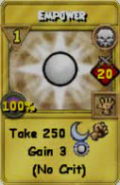
Sample Overview
Sample size is 77 participants
includes both paid and unpaid participants
Most paid participant responses could not be identified because the survey was designed to be anonymous, but confirmation of having completed the survey and payment did occur
Data collection spanned a month from 10/18/22 to 11/18/22

Slide 11
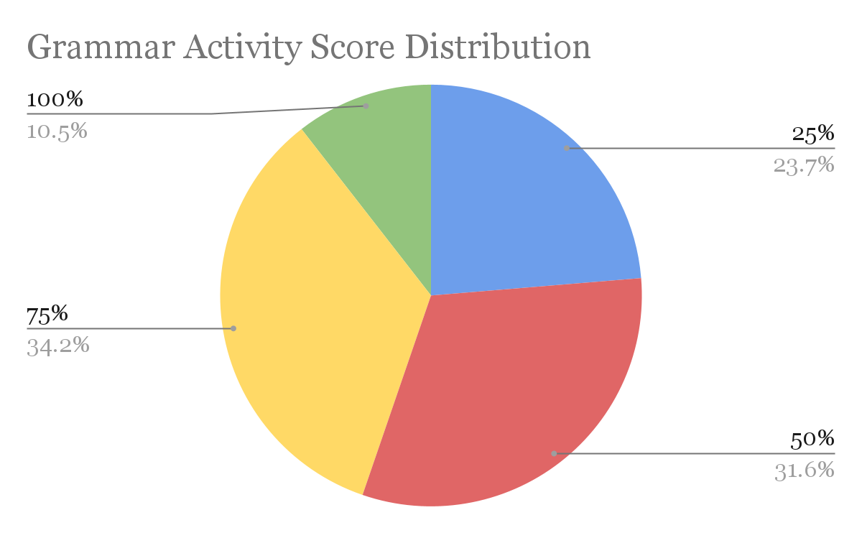
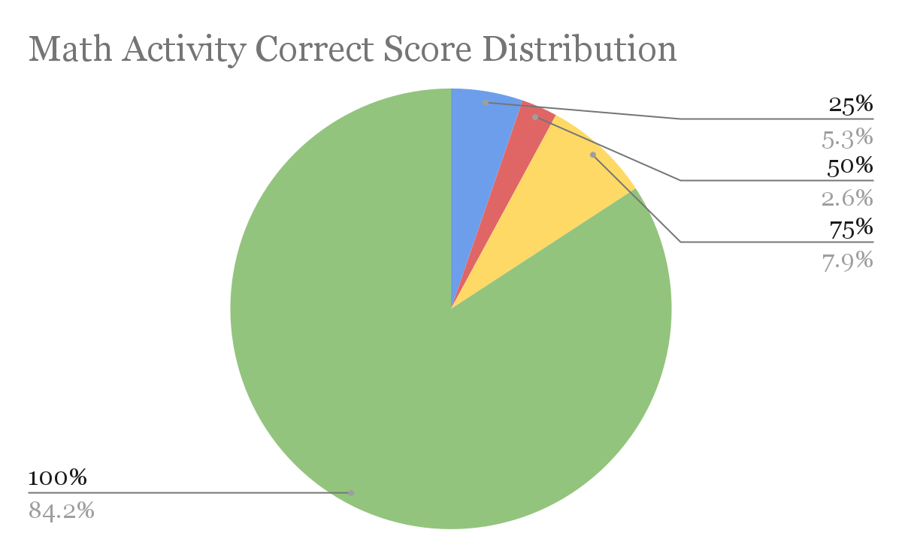
Intervention Score
39 participants received the Math Activity (Intervention)
38 participants received the Grammar Activity (Control)
Math Activity participants scored 32% on average higher (90% avg. score) than Grammar Activity participants (58% avg. score)
Notes:
Results
a. Include summary stats
i. Demographic description of sample
ii. Sample size and characteristics
b. Present any statistical differences in control and experiment groups: A rigorous
statistical comparison is required. You may use any statistical tools you have
learned thus far in your academic career. Regression is not expected but may be
included if thoroughly explained for students who are unfamiliar.
c. Visual presentation of data to easily show results is required.

Slide 12
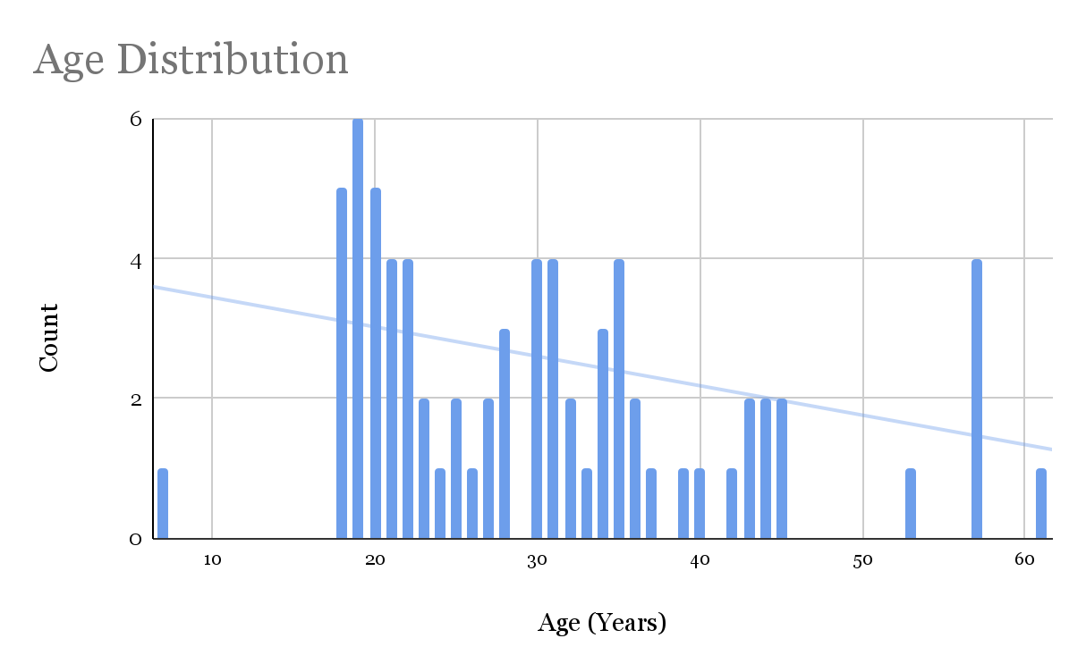
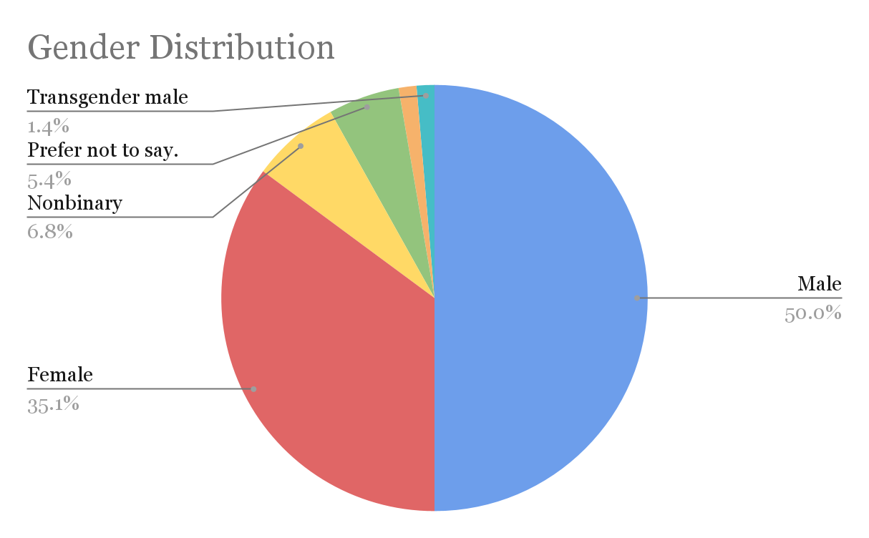
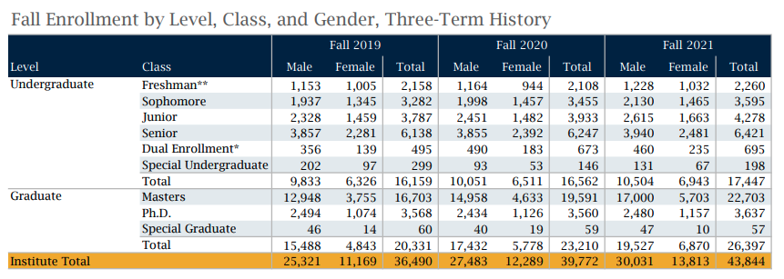
Sample Age and Gender
Average age is approximately 31 years
Gender is majority Male (50.0%) with 35.1% Female
GATech has a gender distribution of 68.50% Male and 31.50% Female (Fall 2021
The U.S. has a gender distribution of 49.5 percent male and 50.47 percent female
Notes:
Results
a. Include summary stats
i. Demographic description of sample
ii. Sample size and characteristics
b. Present any statistical differences in control and experiment groups: A rigorous
statistical comparison is required. You may use any statistical tools you have
learned thus far in your academic career. Regression is not expected but may be
included if thoroughly explained for students who are unfamiliar.
c. Visual presentation of data to easily show results is required.
GATech Gender Distribution Fall 2021
30031 Male - 68.50%
13813 Female - 31.50%
43844 Total

Slide 13
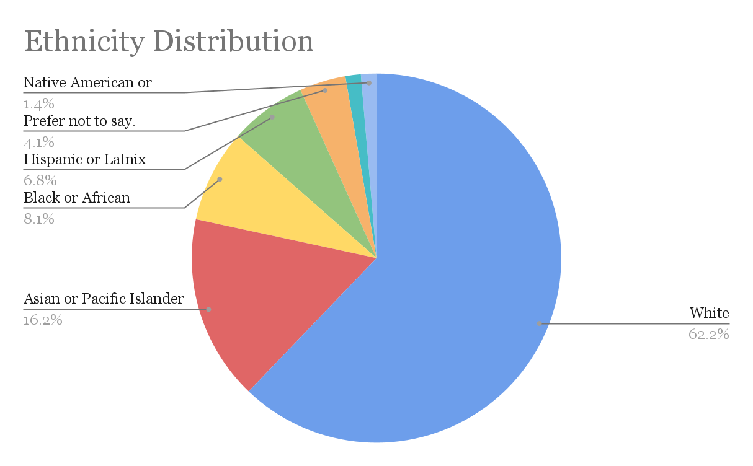
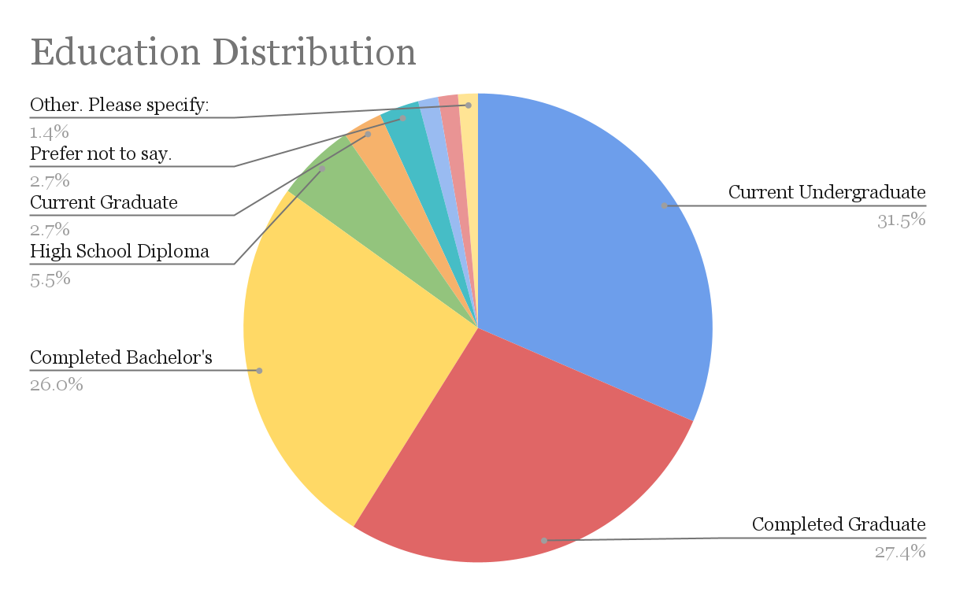
Sample Ethnicity and Education
Majority White ethnicity
91% higher education (Undergraduate and above)
63.3% of U.S. people age 25 and older have higher education (some college or more)
Notes:
Results
a. Include summary stats
i. Demographic description of sample
ii. Sample size and characteristics
b. Present any statistical differences in control and experiment groups: A rigorous
statistical comparison is required. You may use any statistical tools you have
learned thus far in your academic career. Regression is not expected but may be
included if thoroughly explained for students who are unfamiliar.
c. Visual presentation of data to easily show results is required.

Slide 14
Analysis Overview
Clean the data
Import survey results into excel
Remove invalid responses
Pre-calculations: determine accuracy scores and important averages
‘accuracy_bird’, ‘accuracy_turtle’, ‘accuracy_human’
Found by calculating each participant’s per life value, calculating the absolute value difference of per life values between increasing scope questions, and averaging the differences for each question group
‘accuracy_score’ - the sum of the three calculated question group accuracy variables
Determine variables for regression
Dependent variable(s): ‘accuracy_score’, ‘accuracy_bird’, ‘accuracy_turtle’, ‘accuracy_human’
Independent variable: ‘math_activity’
Explanatory variables: see next slide
Run regressions and joint-significance tests
Notes:
How will you statistically test your data to determine your results?
Regression to determine variables that have a strong relationship with participants’ scope-scaling accuracy
How will you present your results so that they are clear?
Screenshots of STATA output tables that have compelling results - NO COMPELLING RESULTS

Slide 15
Explanatory Variables
activity_score
Form type variables: ‘msl’, ‘slm’, ‘lsm’, ‘lms’, ‘mls’
age
gender
race/ethnicity
education
income
essential spending: ‘ess_spend’
non-essential spending: ‘noness_spend’
‘charity_past’
‘charity_future’
Notes:
Describe each variable and why it could have a strong enough relationship with our dependent variable to be statistically significant

Slide 16
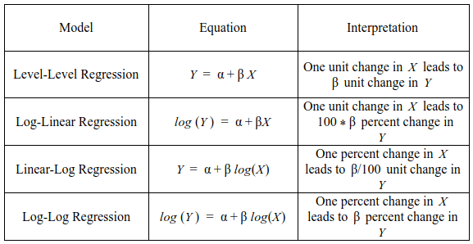
Regression
Basic Multivariable Linear Regression Model
y = β₁x₁+β₂x₂+β₃x₃+... β_{n}x_{n}+ ε
where, y = accuracy score
x_{n} = the nth independent variable
β_{n} = the nth coefficient
ε = error
https://www.kdnuggets.com/2017/10/learn-generalized-linear-models-glm-r.html/2
Notes:
Briefly explain the what a regression is - Line of best fit - R^2 values
Most things in nature are not linear. Logarithms often fit data points more accurately, so we tested different models to find the one with the lowest adjusted-R^2 value
No outputs from Stata due to results not being significant

Slide 17
Results
After multiple regressions testing for joint significance with different models: linear-linear, linear-log, log-linear and log-log,
It has been concluded that there is no significance between:
Overall accuracy score,
Accuracy score for the bird-related questions,
Accuracy score for the turtle-related questions, &
Accuracy score for the human-related questions
and the Math activity, considering the other explanatory variables of interest as well

Slide 18
Descriptive Statistics: Per-Life Valuations
 | Mean | Median | Mode | Minimum | Maximum
Bird | $9.63 | $.01 | $0 | $0 | $500
Turtle | $152.49 | $.50 | $.50 | $0 | $25,000
Human | $74,737 | $5 | $0 | $0 | $10,000,000
Notes:
Lots of people are unwilling to donate anything
There is a very wide range of values that people are willing to donate
People value humans > turtles > birds
People are insensitive to scope in the way that we expected: per-life valuations are higher for small vs medium or large in all but 2 cases (in parentheses)
The grammar activity valuations are consistently much larger than the math ones: we don’t have a good explanation for this but it may be driven by some very large answers in the grammar responses (3 or 4 of these)
We also see that people value turtles more than birds and humans more than turtles or birds

Slide 19
Calculated Accuracy Scores
 | Grammar Activity | Math Activity
Bird | 7.24 | .356
Turtle | 351 | 4.83
Human | 144,478 | 562
Overall | 144,863 | 568
Larger scores corresponds with more discrepancy between an individual’s answers, meaning they were less sensitive to scope. A score of 0 would indicate perfect sensitivity to scope.
Notes:
This does show math people being more ‘accurate’ and mores sensitive to scope

Slide 20
Limitations
Since the Grammar Activity was more difficult than the Math Activity, it serves as an imperfect control to compare with
Frustration from knowing fewer correct answers may affect willingness to pay
Non-Response Bias - More participants who received the grammar activity chose to not complete the survey compared with participants who received the math activity
Our results cannot be generalized to the United States population due to a disproportionate number of young people, men, and people with some higher education
Incomplete/Insufficient responses result in not meeting the Central Limit Theorem’s requirement of 30 minimum responses for approximately normal distribution
Results from comparisons between the 6 different form types might not accurately reflect the true nature of the differences
Notes:
What will be anticipated limitations of your study?
Conclusion
a. What do results indicate?
b. What are the policy implications of your results?
c. Are there any nudges that may be implemented to get better human behavior
based on these results?

Slide 21
Final Notes
In conclusion, we can not confidently say that our math intervention led to statistically significant results.
Areas of future research include:
Ensuring similar difficulty levels between the control activity and treatment activity
Testing different control activities - physical fitness, meditation, etc
Increasing sample size
Alternate wording of survey questions to decrease confusion
Hypotheticals and self-reported guesses are unreliable
Notes:
Does my gut agree with this conclusion? Personally, yes.
Not all people understand hypothetical scenarios the same way. For example, some people reported a willingness to donate millions of $, but probably doesn’t currently or ever will have millions to donate

Slide 22
Bibliography
(n.d.). Table 2 Sample data for binary logistic regression [Review of Table 2 Sample data for binary logistic regression]. In KDNuggets. Retrieved November 22, 2022, from https://www.kdnuggets.com/2017/10/learn-generalized-linear-models-glm-r.html/2
Baron, J., & Greene, J. (1996). Determinants of insensitivity to quantity in valuation of public goods: Contribution, warm glow, budget constraints, availability, and prominence. Journal of Experimental Psychology: Applied, 2(2), 107.
Bateman, I. J., Cole, M., Cooper, P., Georgiou, S., Hadley, D., & Poe, G. L. (2004). On visible choice sets and scope sensitivity. Journal of environmental economics and management, 47(1), 71-93.
Bateman, I. J., Cooper, P., Georgiou, S., Navrud, S., Poe, G. L., Ready, R. C., Riera, P., Ryan, M., & Vossler, C. A. (2005). Economic valuation of policies for managing acidity in remote mountain lakes: Examining validity through scope sensitivity testing. Aquatic Sciences, 67(3), 274–291. https://doi.org/10.1007/s00027-004-0744-3
Cameron, C. D., & Payne, B. K. (2011). Escaping affect: how motivated emotion regulation creates insensitivity to mass suffering. Journal of personality and social psychology, 100(1), 1.
Carson, R. T., & Mitchell, R. C. (1995). Sequencing and nesting in contingent valuation surveys. Journal of environmental economics and Management, 28(2), 155-173.
Chang, H. H., & Hung, I. W. (2018). Mirror, Mirror on the Retail Wall: Self-Focused Attention Promotes Reliance on Feelings in Consumer Decisions. Journal of Marketing Research, 55(4), 586–599. https://doi.org/10.1509/jmr.15.0080
Chang, Hannah H, and Pham, Michel Tuan. “Affective Boundaries of Scope Insensitivity.” Journal of Consumer Research, Volume 45, Issue 2, August 2018, Pages 403–428, https://doi.org/10.1093/jcr/ucy007 Published 05 March 2018.
Czajkowski, M., & Hanley, N. (2009). Using Labels to Investigate Scope Effects in Stated Preference Methods. Environmental and Resource Economics, 44(4), 521–535. https://doi.org/10.1007/s10640-009-9299-z
Desvousges, W., Johnson, F. R., Dunford, R., Boyle, K., Hudson, S., & Wilson, K. N. (2010). Measuring Nonuse Damages Using Contingent Valuation: An Experimental Evaluation of Accuracy. https://doi.org/10.3768/rtipress.2009.bk.0001.1009

Slide 23
Bibliography
Dickert, S., Kleber, J., Peters, E., & Slovic, P. (2011). Numeracy as a precursor to pro-social behavior: The impact of numeracy and presentation format on the cognitive mechanisms underlying donation decisions. Scholarsbank.uoregon.edu. http://hdl.handle.net/1794/22050
Dickert, S., Västfjäll, D., Kleber, J., & Slovic, P. (2012). Valuations of human lives: normative expectations and psychological mechanisms of (ir)rationality. Synthese, 189(S1), 95–105. https://doi.org/10.1007/s11229-012-0137-4
Dickert, S., Västfjäll, D., Kleber, J., & Slovic, P. (2015). Scope insensitivity: The limits of intuitive valuation of human lives in public policy. Journal of Applied Research in Memory and Cognition, 4(3), 248-255.
Duffin, Erin. (2022, September 30). Total population in the United States by gender from 2010 to 2027. Statista. https://www.statista.com/statistics/737923/us-population-by-gender/#:~:text=Projection%20estimates%20calculated%20using%20the,US%20Census%20data%20for%202021.
Dunn, E. W., & Ashton-James, C. (2008). On emotional innumeracy: Predicted and actual affective responses to grand-scale tragedies. Journal of Experimental Social Psychology, 44(3), 692–698. https://doi.org/10.1016/j.jesp.2007.04.011
Erlandsson, A., Västfjäll, D., Sundfelt, O., & Slovic, P. (2016). Argument-inconsistency in charity appeals: Statistical information about the scope of the problem decrease helping toward a single identified victim but not helping toward many non-identified victims in a refugee crisis context. Journal of Economic Psychology, 56, 126–140. https://doi.org/10.1016/j.joep.2016.06.007
Fetherstonhaugh, D., Slovic, P., Johnson, S., & Friedrich, J. (1997). Insensitivity to the value of human life: A study of psychophysical numbing. Journal of Risk and uncertainty, 14(3), 283-300.
Harel, I., & Kogut, T. (2021). The Effect of the Number and Identification of Recipients on Organ-Donation Decisions. Frontiers in Psychology, 12. https://doi.org/10.3389/fpsyg.2021.794422
Hasford, J., Farmer, A., & Waites, S. F. (2015). Thinking, feeling, and giving: the effects of scope and valuation on consumer donations. International Journal of Research in Marketing, 32(4), 435-438.
Hsee, C. K., & Rottenstreich, Y. (2004). Music, pandas, and muggers: on the affective psychology of value. Journal of Experimental Psychology: General, 133(1), 23.

Slide 24
Bibliography
Hsee, C. K., Zhang, J., Lu, Z. Y., & Xu, F. (2013). Unit Asking. Psychological Science, 24(9), 1801–1808. https://doi.org/10.1177/0956797613482947
Imas, A., & Loewenstein, G. (2018, May). Is altruism sensitive to scope? The role of tangibility. In AEA Papers and Proceedings (Vol. 108, pp. 143-47).
Kogut, T., Slovic, P., & Västfjäll, D. (2015). Scope insensitivity in helping decisions: Is it a matter of culture and values?. Journal of Experimental Psychology: General, 144(6), 1042.
Krüg, Kris. “A Deadly Toll.” Center for Biological Diversity, https://www.biologicaldiversity.org/programs/public_lands/energy/dirty_energy_development/oil_and_gas/gulf_oil_spill/a_deadly_toll.html. Accessed 23 September 2022.
Lipponen, Matilda. “How can I help save Sea Turtles from Plastic Pollution?” Projects Abroad, 12 July 2022, https://www.projects-abroad.org/blog/how-we-can-help-save-sea-turtles/. Accessed 23 September 2022.
Serebrisky, Denise. “Pediatric Asthma: A Global Epidemic - PMC.” NCBI, 22 January 2019, https://www.ncbi.nlm.nih.gov/pmc/articles/PMC7052318/. Accessed 23 September 2022.
Small, D. A., Loewenstein, G., & Slovic, P. (2007). Sympathy and callousness: The impact of deliberative thought on donations to identifiable and statistical victims. Organizational Behavior and Human Decision Processes, 102(2), 143–153. https://doi.org/10.1016/j.obhdp.2006.01.005
United States Census Bureau. (2022, February 24). Census Bureau releases New Educational Attainment Data. Census.gov. Retrieved November 22, 2022, from https://www.census.gov/newsroom/press-releases/2022/educational-attainment.html#:~:text=In%202021%2C%20the%20highest%20level,college%20but%20not%20a%20degree.
“Scope insensitivity: failing to appreciate the number of those who need our help.” Effective Altruism Forum. https://forum.effectivealtruism.org/s/B79ro5zkhndbBKRRX/p/NmDrpKdmjr. Published 22 August 2022.

Slide 25
Appendices

Slide 26
Descriptive Statistics: Per-Life Valuations
 |  | Mean | Median | Mode | Minimum | Maximum
 | Small | $14.17 | $.03 | $0 | $0 | $500
Bird | Medium | $7.89 | $.10 | $.001 | $0 | $500
 | Large | $6.83 | $.001 | $.001 | $0 | $500
 | Small | $365 | $1.25 | $100 | $0 | $25,000
Turtle | Medium | $75.67 | $.50 | $5 | $0 | $5,000
 | Large | $16.93 | $.10 | $.05 | $0 | $1,000
 | Small | $144,044 | $50 | $100 | $0 | $10,000,000
Human | Medium | $78,744 | $5 | $5 | $0 | $5,000,000
 | Large | $1,421 | $.62 | $.25 | $0 | $50,000

