Slide 1
Cyber threat intelligence to protect our data
Jackie Ore
Miami Dade College
Bachelors in Cybersecurity - Grad Expected Dec 2023
ShellHacks 2022

Slide 2

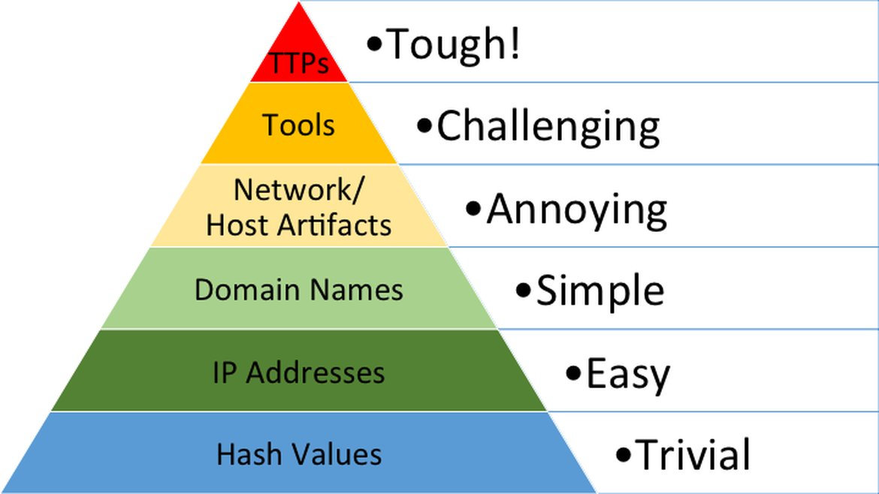
How MITRE can help us fight bad actors

Slide 3
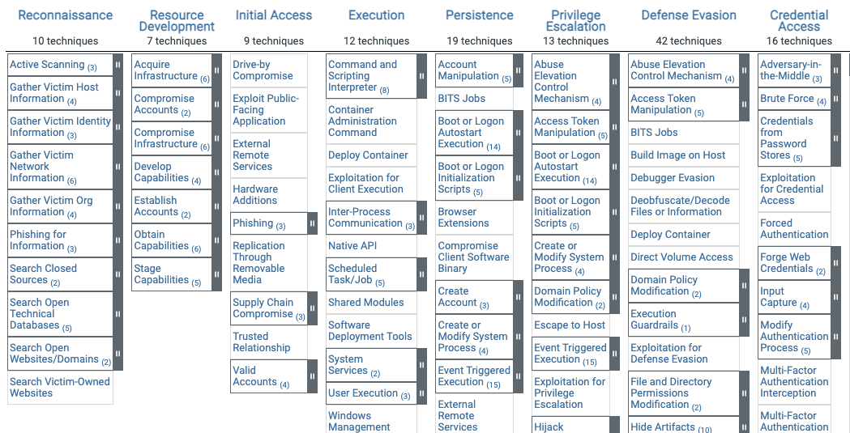
Tactics : the bad actor’s technical goals
Techniques: how the goals are achieved

Slide 4
What are we protecting?
Scenario:
Capital One Banking website - new update roll out for Spring 2023
Using the MITRE framework lets build a internal tool to create a visual threat modeling view of our current internal controls.
Asking the questions:
Do we have enough coverage in various techniques?
How can we show the (financial) value of threat intelligence?
We can then create an internal copy of the MITRE framework, link the tags to see where there is current coverage.
We can also add to an open source attack path GUI and give it a corresponding weight(%) to

Slide 5
Threat Modeling @ Capital One
Using labels we create metadata that we can then analyze and match against the current MITRE framework.
As internal teams build controls on assets they will evaluate that control/policy and tag the corresponding MITRE id(s) and sub-technique(s).
EXAMPLE
Banking Credentials
#t15557.001
Browser Compatibility
#t1021.004
Session cookies
#t1606.001

Slide 6
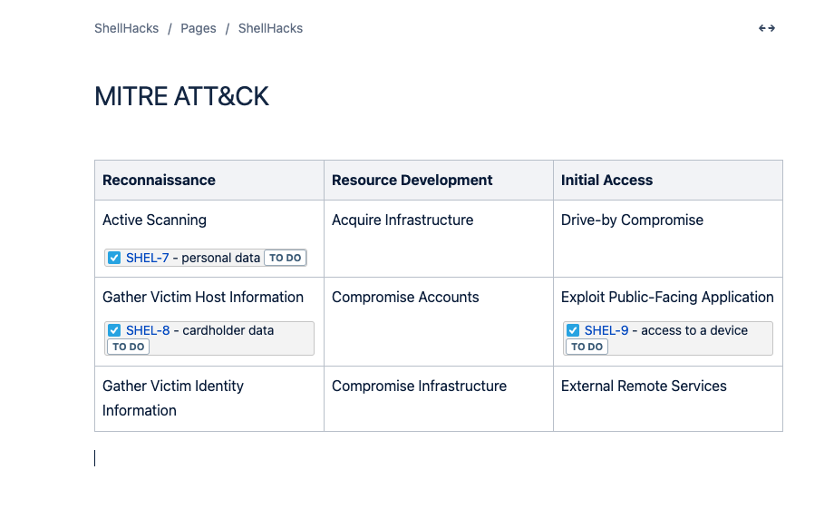
Company internal page where you’d link tags to framework
Here using JIRA #labels to a Confluence page

Slide 7
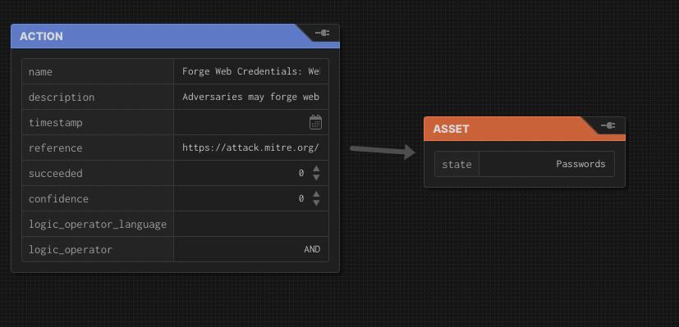
https://github.com/center-for-threat-informed-defense/attack-flow
Current open source GUI threat modeling is in early in development.
I would add a field to add weight(%) of likelihood based on Capital One past data or value($$) to the attack vector based on internal governance.
Value . … $30K
Weight /Likelihood . 45%

Slide 8
