Slide 1

VALUE STREAM MAPPING
VSM
JACKIE SCOTT
MODULE 5.2
9/9/24

Slide 2
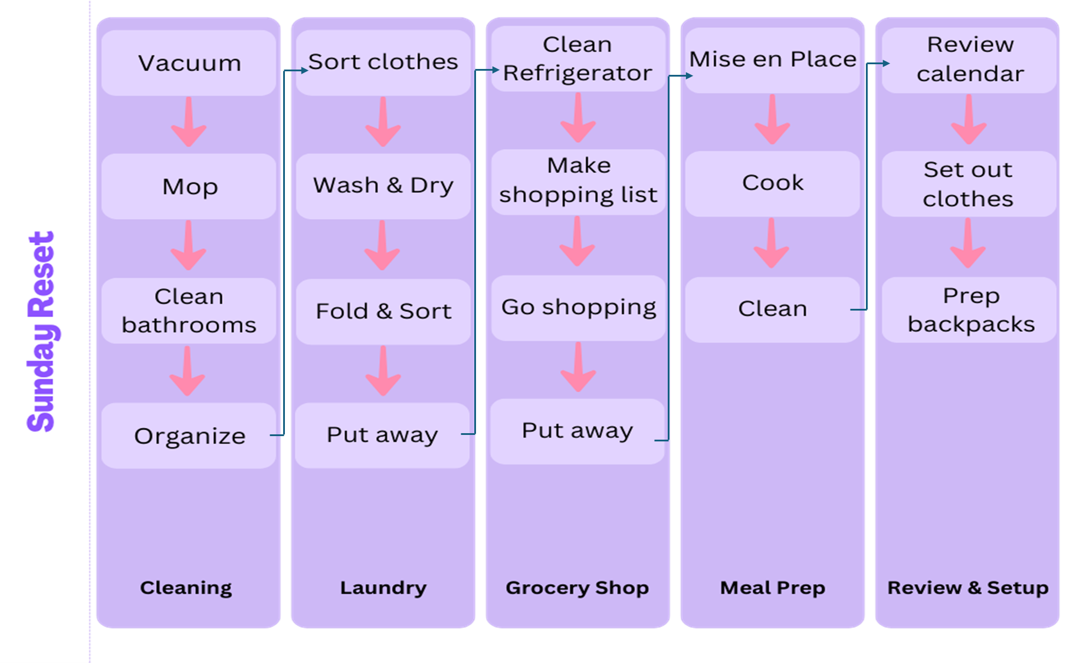
VSM

Slide 3
ANALYZING LEAN METRICS
Estimated Average Flow Time
Cleaning | 120 mins
Laundry | 180 mins
Grocery Shopping | 100 mins
Meal Prep | 95 mins
Review & Setup | 30 mins
Estimated Cycle Time | 8.45 hrs

Slide 4
OPTIMIZE
MY
PROCESSES
Governance
Models
Workflow
Orchestration
To avoid missing steps or supplies, I can make a checklist for each task and set reminders for key points. This will help keep everything on track and make sure nothing gets overlooked.
Eliminating Waste
I can overlap tasks to make things run smoother. While the laundry is washing, I can clean the house or prep meals. Cleaning the fridge and making a shopping list while waiting for the laundry to dry can also save time. Moving meal prep to the end of the routine ensures it doesn’t interfere with other tasks, making everything flow better.
I can cut down on time by starting laundry first and using that time to tackle cleaning tasks. Preparing my grocery list and cleaning out the fridge the day before will help speed up shopping. Also, investing in a meal prep service or pre-cut ingredients can trim down the 95 minutes I spend on meal prep.

Slide 5
WORKS CITED
Lance KnightLance Knight is the President and Chief Operating Officer of ConnectALL. His responsibilities include sales. (2020, October 29). 3 easy steps for using VSM in everyday life. ConnectALL. https://www.connectall.com/3-easy-steps-for-using-vsm-in-everyday-life/

Slide 6
THANK YOU

