Slide 1

THE
TECHNOLOGY
VALUE STREAM
JACKIE SCOTT
MODULE 1
8/13/24

Slide 2
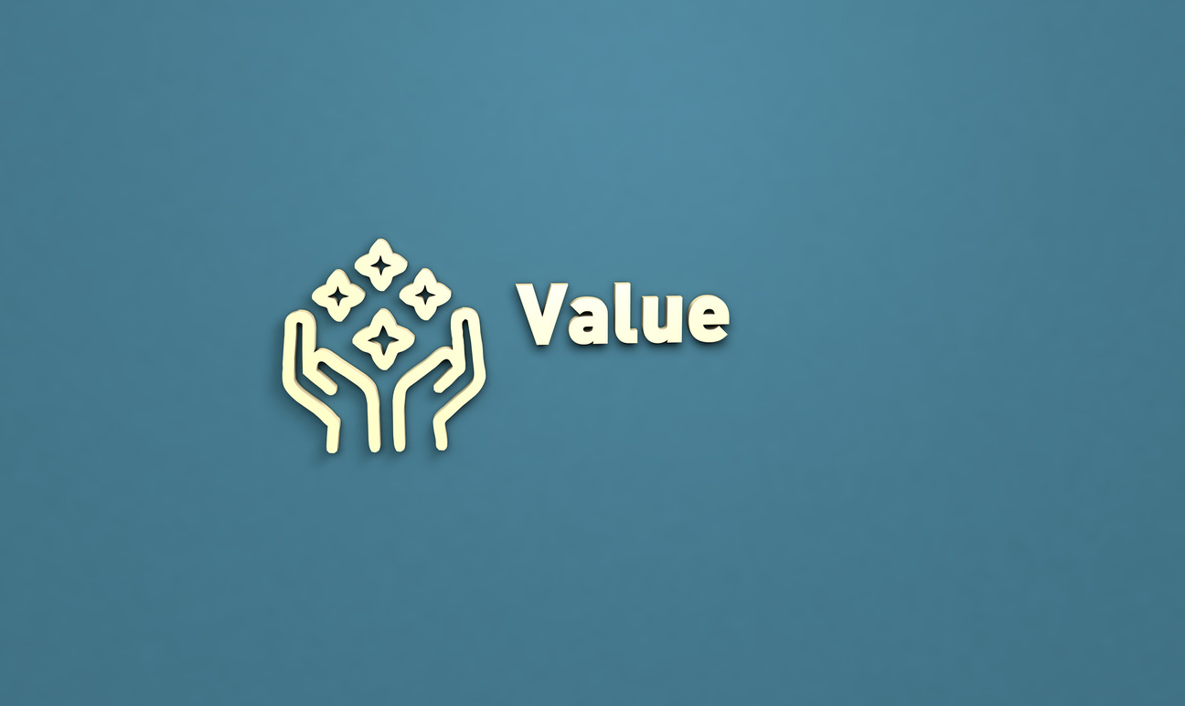
VALUE STREAM
The value stream process is required to convert a business hypothesis into a technology-enabled service or a feature that delivers value to the end user. This involves any activities required to deliver a working product, from the initial idea through development, testing, deployment, and delivery. The end goal of the value stream is to minimize waste and delays, ensuring that the final product delivers maximum value to the customer as efficiently as possible.

Slide 3
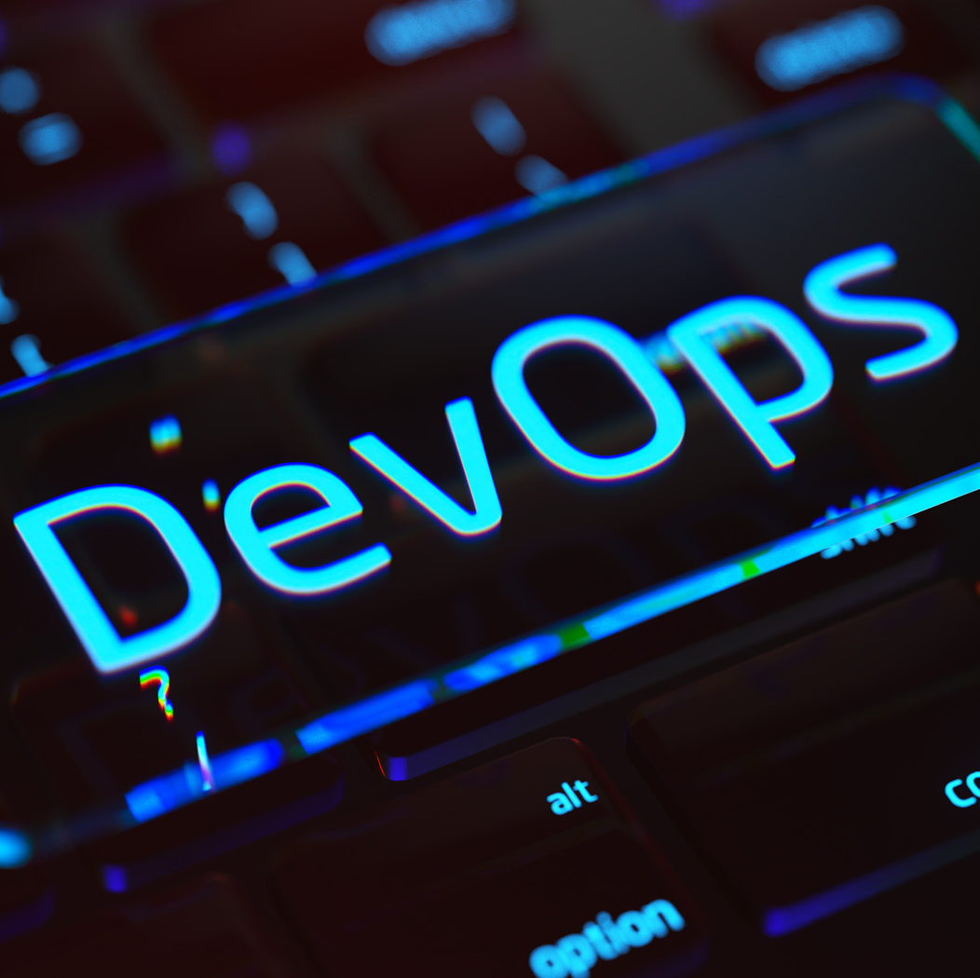
UNDERSTANDING VALUE IN VALUE STREAM
Value is any good, service, or product that can be delivered to a customer.
Identifying and delivering value is crucial to have an effective value stream.

Slide 4
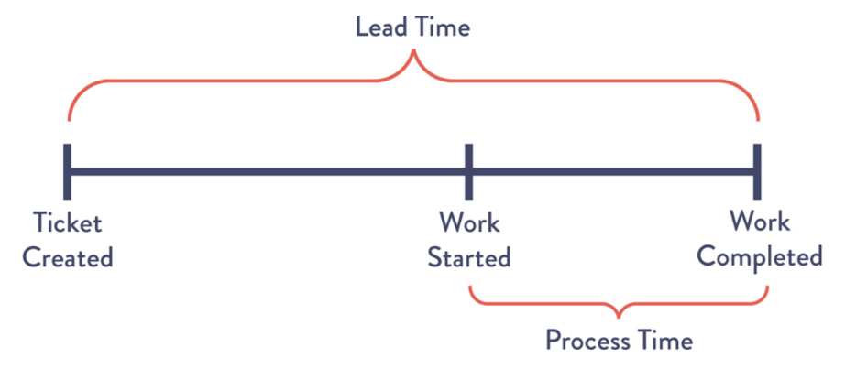
LEAD TIME VS PROCESSING TIME
What is Lead Time?
Lead time is commonly used to help measure performance in the value stream. It is the total time it takes for a request to be fulfilled. Starting from when the request is made until that request is delivered.
What is Processing Time?
A way to measure efficiency. While part of lead time, processing time only measures actual working time.

Slide 5
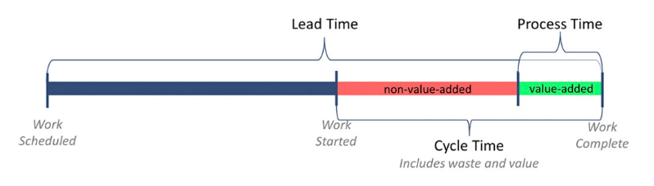
LEAD TIME VS PROCESSING TIME
WHAT’S THE DIFFERENCE?
Lead time measures all phases. This gives a holistic view of how it takes to deliver or complete a task. While processing time only focuses on the actual productive work involved. This is where value is added.

Slide 6
THE COMMON SCENARIO: DEPLOYMENT LEAD TIMES REQUIRING MONTHS
LONG DEPLOYMENT LEAD TIMES
It can often extend to several months, especially when there is a large or complex organizations
SYSTEM COMPLEXITY
Involves tightly integrated, monolithic systems.
TESTING
BOTTLENECKS
Limited testing environments and reliance on manual testing.
APPROVAL
DELAYS
Multiple stages of approvals can add to delays.

Slide 7
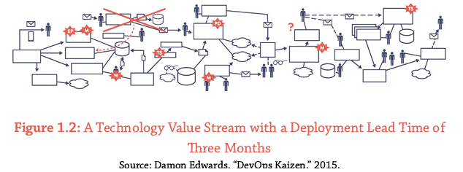
THE COMMON SCENARIO: DEPLOYMENT LEAD TIMES REQUIRING MONTHS
IMPACT ON THE VALUE STREAM:
1
End-of-Project Issues:
Problems are often found when merging development changes, leading to development failures.
2
Extended Troubleshooting:
Identifying and fixing issues can take days or even weeks.
3
Poor Customer Outcomes:
Delays and failures can result in negative experiences for customers or end users.

Slide 8
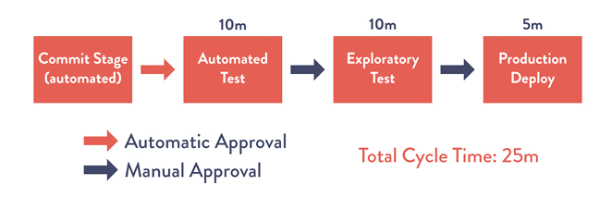
OUR DEVOPS IDEAL: DEPLOYMENT LEAD TIMES OF MINUTES
A Technology Value Stream with a Lead Time of Minutes

Slide 9





OUR DEVOPS IDEAL: DEPLOYMENT LEAD TIMES OF MINUTES
GOAL:
Reduce Deployment lead times from months to minutes.
DEVOPS APPROACH:
ADVANTAGES:
Provides Continuous Feeback Loop: Developers receive fast and continuous feedback, allowing quick code implementation.
Small Code Changes: Frequent and incremental code is updated to a version control repository.
Automated Testing & Deployment: Helps ensure code reliability before any deployment to production.
High Confidence in Deployments
Small teams working independently reduce errors
Failures are small and contained
Problems can be quickly detected and corrected.

Slide 10
WORKS CITED
BLOGS, P. (2019, DECEMBER 27). VALUE STREAMS IN SOFTWARE: A DEFINITION AND DETAILED GUIDE. HTTPS://WWW.PLUTORA.COM/BLOG/VALUE-STREAMS-IN-SOFTWARE-GUIDE
KAUFMAN GLOBAL. (2020, FEBRUARY 27). LEAD TIME - KAUFMAN GLOBAL: THE TIME FROM JOB SCHEDULE TO JOB COMPLETE. HTTPS://WWW.KAUFMANGLOBAL.COM/GLOSSARY/LEAD-TIME/
KIM, G., DEBOIS, P., WILLIS, J., HUMBLE, J., & ALLSPAW, J. (2015). THE DEVOPS HANDBOOK HOW TO CREATE WORLD-CLASS AGILITY, RELIABILITY, AND SECURITY IN TECHNOLOGY ORGANIZATIONS. IT REVOLUTION PR.
LAWRENCE, C. (2023, APRIL 11). LEAD TIME – A KEY METRIC IN DEVOPS: HUMANITEC. RSS. HTTPS://HUMANITEC.COM/BLOG/LEAD-TIME-A-KEY-METRIC-IN-DEVOPS

Slide 11
THANK
YOU!

