Slide 1
Just Culture
What are the barriers or challenges to implementing a just culture?
Jackie Scott Module 9.2 9/27/24

Slide 2

Just Culture
Just Culture is about creating an environment where professionals feel safe reporting concerns, errors, and near-misses without the fear of punishment. The main focus is on how to learn from mistakes rather than placing blame.

Slide 3
Just Culture Challenges
Fear of
Punishment
Fear of Punishment: Causes hesitation to report errors or near-misses if disciplinary action is feared, undermining openness.
Lack of Leadership: Without strong leadership, a Just Culture cannot be effectively promoted or sustained.
Lack of Trust: Employees are less likely to report errors if they don’t trust that they will be treated fairly.
Lack of Resources: Proper training and reporting systems are essential to maintaining a Just Culture. Without these, implementation is difficult.
Culture
Lack of
Leadership
Lack of
Trust
Lack of
Resources

Slide 4

Fear of Punishment
In creating a just culture, one challenge is overcoming the fear of punishment. When people are afraid of facing disciplinary actions for reporting errors or near-misses, it hinders transparency and accountability.
Hesitancy to Report: Employees may not report errors if they believe they will face punishment or disciplinary action.
Impact on Transparency: This puts a strain on the efforts to build an open and transparent environment, which is important for safety and to learn from mistakes.
Leadership Mindset: Traditionally, management approaches often put importance on control, compliance, and punishment, which discourages reporting and promotes silence.
The Bad Apple Theory (Dekker, 2011): Dr. Sidney Dekker argues that blaming individuals for errors (the “bad apple” theory) is flawed, as human error often reflects system design flaws rather than individual failings.

Slide 5
Lack of Leadership
A commitment from leadership is critical for Just Culture. Leaders must be involved in creating an environment and held accountable for building a culture of support and transparency.
Barrier to Just Culture: Without leadership making a commitment, efforts to build a culture of transparency and accountability will struggle to be implemented (Reason, 2000).
Leadership’s Role: Leaders play a critical role in shaping the organization’s values, and their involvement is vital in creating a safe and open environment.
Accountability: Holding leaders accountable for driving safety initiatives and modeling transparent behaviors is key to creating a sustainable Just Culture (Reason, 2000).

Slide 6
Lack of Trust
When employees do not feel confident that their reports of errors will be handled fairly, they are less likely to report anything.
Reporting: Employees may be reluctant to report errors or near-misses if they lack trust in their leaders or peers to manage the information fairly or appropriately. (Vincent, 2016).
Transparency: Trust is built through open communication and transparency about the causes of mistakes and how they are addressed.
Involvement: Involving employees helps in creating a Just Culture and builds trust, resulting in encouraging a more open and honest reporting environment (Vincent, 2016).

Slide 7
Lack of Resources
Tools such as training, a reporting system, and reviewing incidents are needed to build a culture of transparency. A lack of resources can impede the development of Just Culture.
Support: Organizations should have training, error-tracking systems, and roles like Just and Learning Ambassadors or Freedom to Speak Up Guardians to support employees and hold everyone accountable (Hofmann & Jones, 2018).
Success: Defining expectations, offering support and training, monitoring progress, and rewarding achievements are crucial steps in successfully implementing a Just Culture.

Slide 8
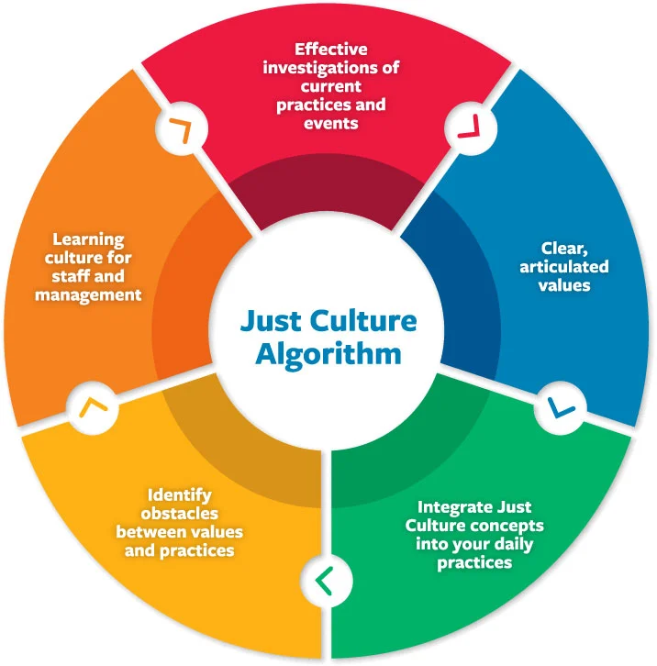
Conclusion
Implementing a Just Culture involves overcoming several challenges. A lack of leadership, distrust in the organization, and inadequate resources are all things that can hinder the development of a transparent environment. To overcome these barriers, organizations need to have strong leadership, build trust with communication, and have resources. The Just Culture Algorithm provides a structured approach to finding a balance in accountability and learning.

Slide 9
Works Cited
Ingram, C. (2023, January 18). Breaking down barriers: Realising a just culture in healthcare organizations. LinkedIn. https://www.linkedin.com/pulse/breaking-down-barriers-realising-just-culture-chris-ingram/
Just/accountable culture. At a Glance - CPS Services. (n.d.). https://www.centerforpatientsafety.org/just-accountable-culture
Kim, Gene, et al. The DevOps Handbook How to Create World-Class Agility, Reliability, and Security in Technology Organizations. It Revolution Pr, 2015.
Safety Management Systems Safety Management Systems. (2023, August 25). What are the benefits and challenges of implementing a just culture for error management?. How to Implement a Just Culture for Error Management. https://www.linkedin.com/advice/0/what-benefits-challenges-implementing-8f

Slide 10
Thank you

