Slide 1


Jack Burnett
Notes:
Attribution: <a href="https://www.textstudio.com/">Font generator</a>

Slide 2
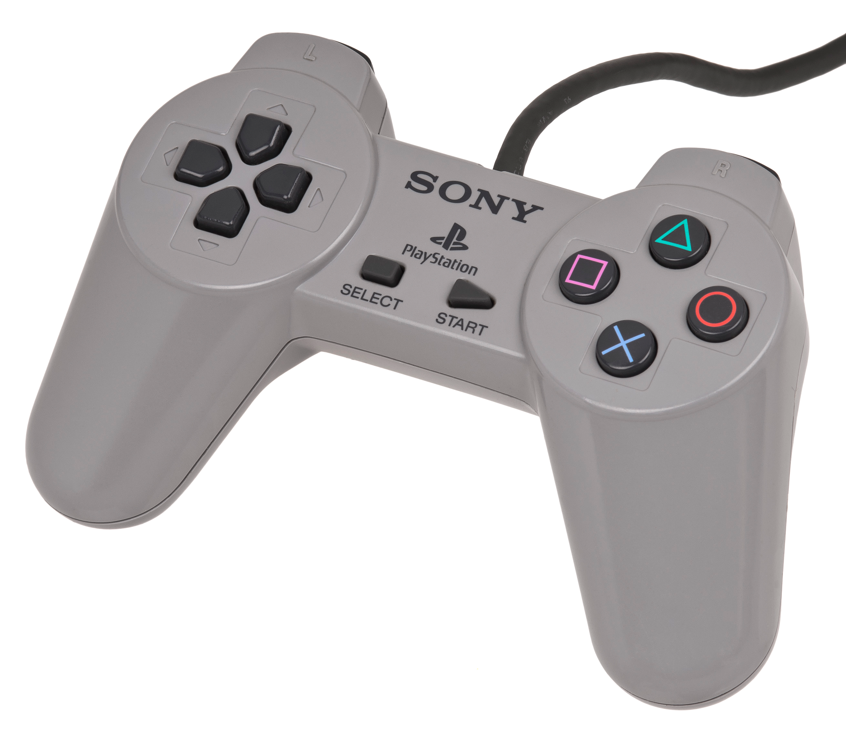
Before Playing Spyro…
…You need a controller
Notes:
And this is where our problems already begin.
Image from: https://en.wikipedia.org/wiki/PlayStation_controller

Slide 3

Which is
Where the
Troubles Begin

Slide 4
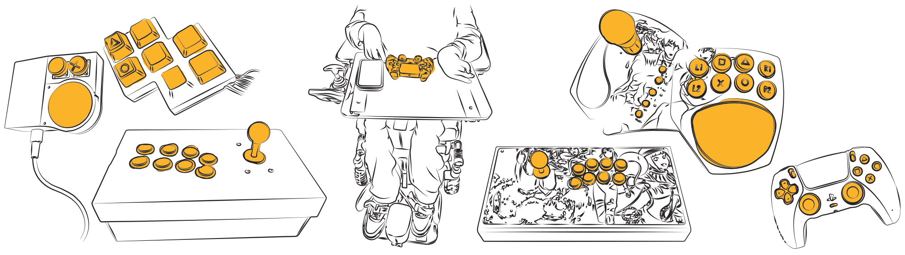
One Controller Doesn't Fit Everyone
Multiple papers and reports show controllers aren’t suitable for everyone
We found that people also express their identity through their controllers
And found that, generally, people want their customised controllers
Notes:
From upcoming CHI/CHI Play publication

Slide 5

So? Players Can Just Make Their Own Controllers

Slide 6
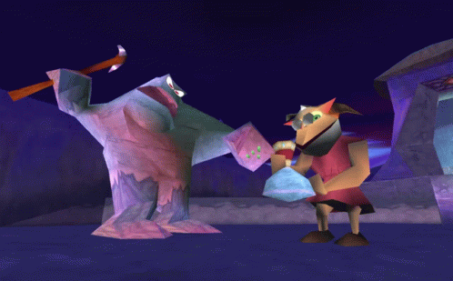
WRONG

Slide 7
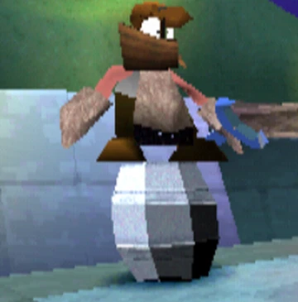
Custom Hardware is HARDware
Players especially suffer from:
Lack of technical expertise
Fragmented online communities/information
Lack of suitable tools for novices
And the usual hardware dev issues
Which means that Players
have to become Engineers
And in Spyro,
engineers are the enemy
Notes:
From upcoming CHI/CHI Play publication

Slide 8

Players then rely on engineers!
Either through:
Long, multi-month co-design
Rapid, intense sprints
Supportive maker culture
Notes:
Upcoming DIS Paper, and Design for One

Slide 9


So Maybe We Try Democratisation?
What if we create tools that automate the hard parts?
  Without replacing the user
What would these tools look like?
  How much do we automate?
  How much do we teach?
  How much do we leave alone?
Where does AI fit in?
Notes:
Hodges: Democratisation and Long Tail of Hardware Papers
Upcoming

Slide 10
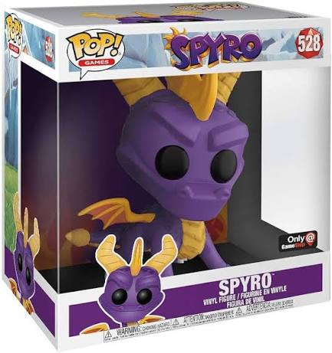
But tools we create, could create standards
Standards are useful
  They make hardware compatible, reduce complexity for developers, and establish a baseline for accessibility.
But standards can become barriers.
  Standards decide what is supported and the extent of customisation.
And controllers aren't one-size-fits-all.
  Players' needs vary, and often develop solutions that were never anticipated.
Notes:
Accessibility Paradox (CHI Play ‘26)

Slide 11
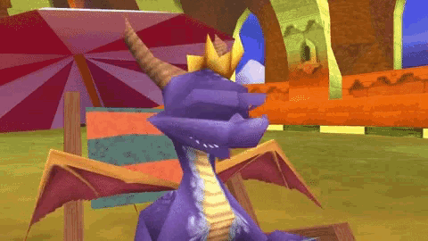
Let’s Take a Step Back and Enjoy Some Spyro

Slide 12
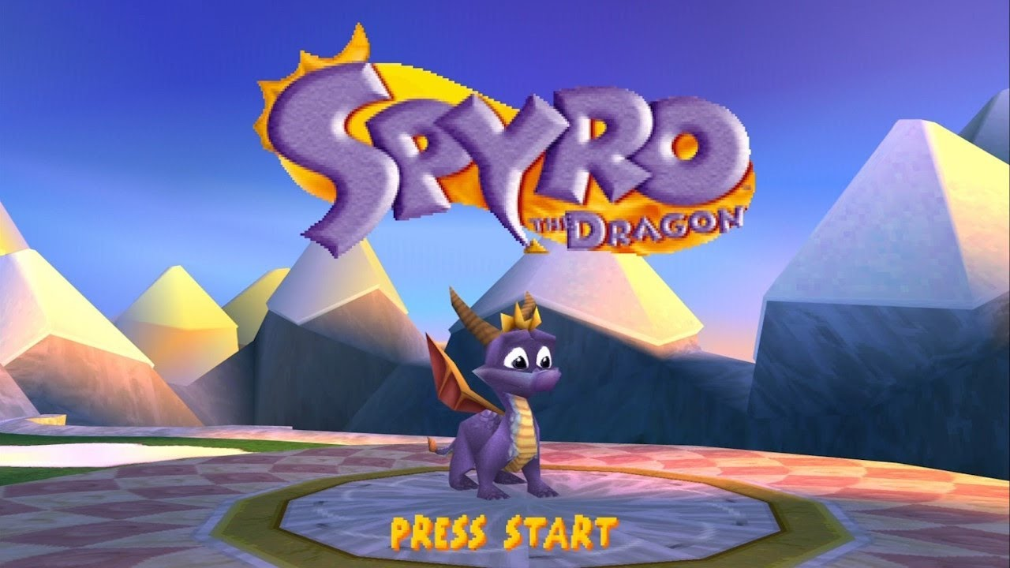

Slide 13
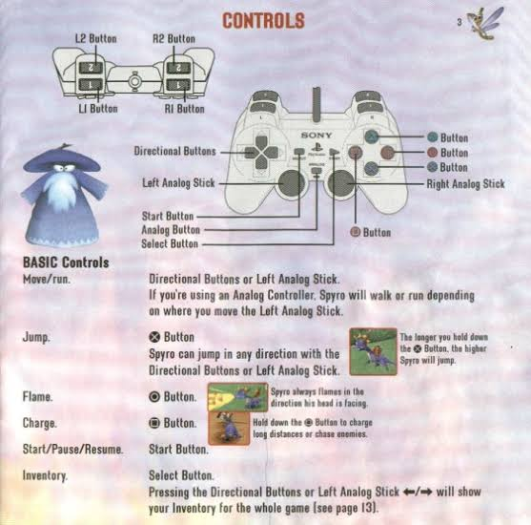
So You Open Your Manual To See How to Play
And you realise that every button has an action
For some, this is unproblematic
But imagine…

Slide 14
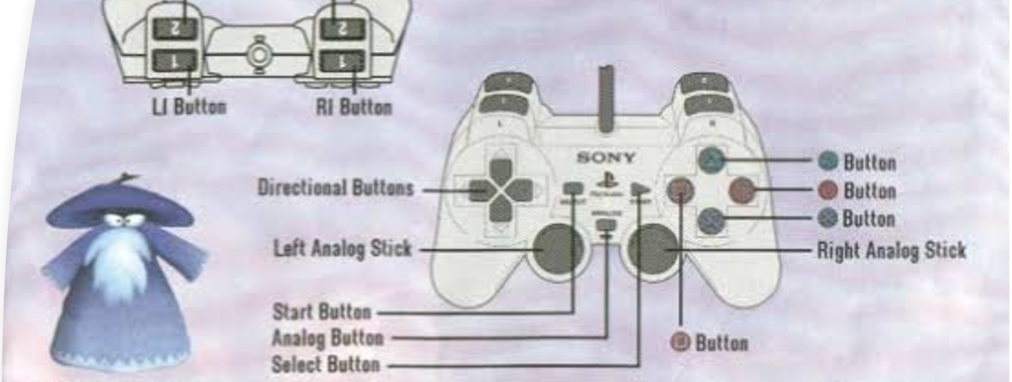
…a player with only one hand
They would need:
  To move with left stick and press A/B/X/Y at the same time
  To be able to use LB and RB while moving too
  What if they want camera control?
Notes:
What would this player need?

Slide 15
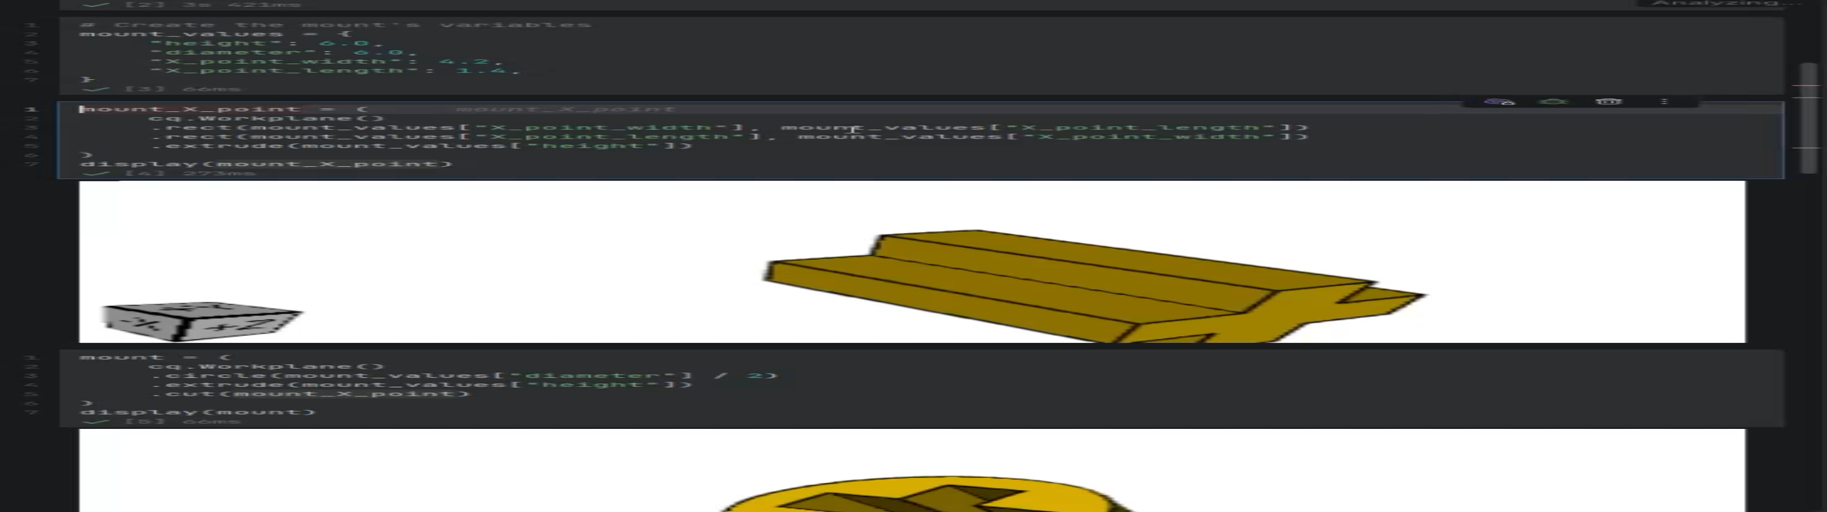
The idea to solve this…
…Parameterisation?
I am currently trying to build every part of a controller as a set of parameters
IT IS A PAINFUL PROCESS
Notes:
https://jackjburnett.github.io/assets/jupyter/Pro2CadQueryModel.ipynb

Slide 16

But first, we need to understand the scope of controller parameters
Notes:
Before even starting to understand how much to automate, we must know how to automate all of it

Slide 17
What Parameters Could There Be?
What is the scope of potential inputs?
What forms can inputs take?
What form can a controller take?
How much space does each input need?
What configurations conflict?
Before thinking of how to simplify these for players

Slide 18
And it’s not even that simple
How do we resolve all the following into one parameter space?

Slide 19

And that’s ignoring the fact that we have an underlying PCB to parameterise

Slide 20
And on top of that, we also need to test what we make

Slide 21
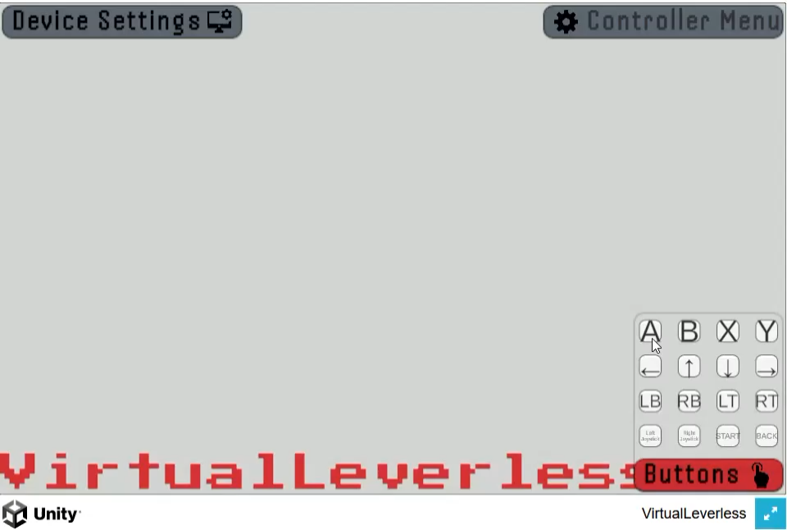
Actually, I’ve Started to Resolve That

Slide 22
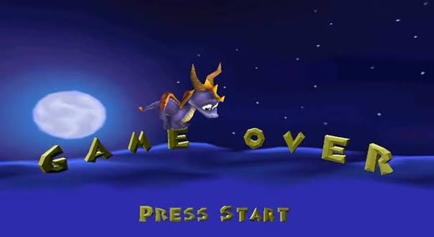
All This Just to Play Spyro

Slide 23
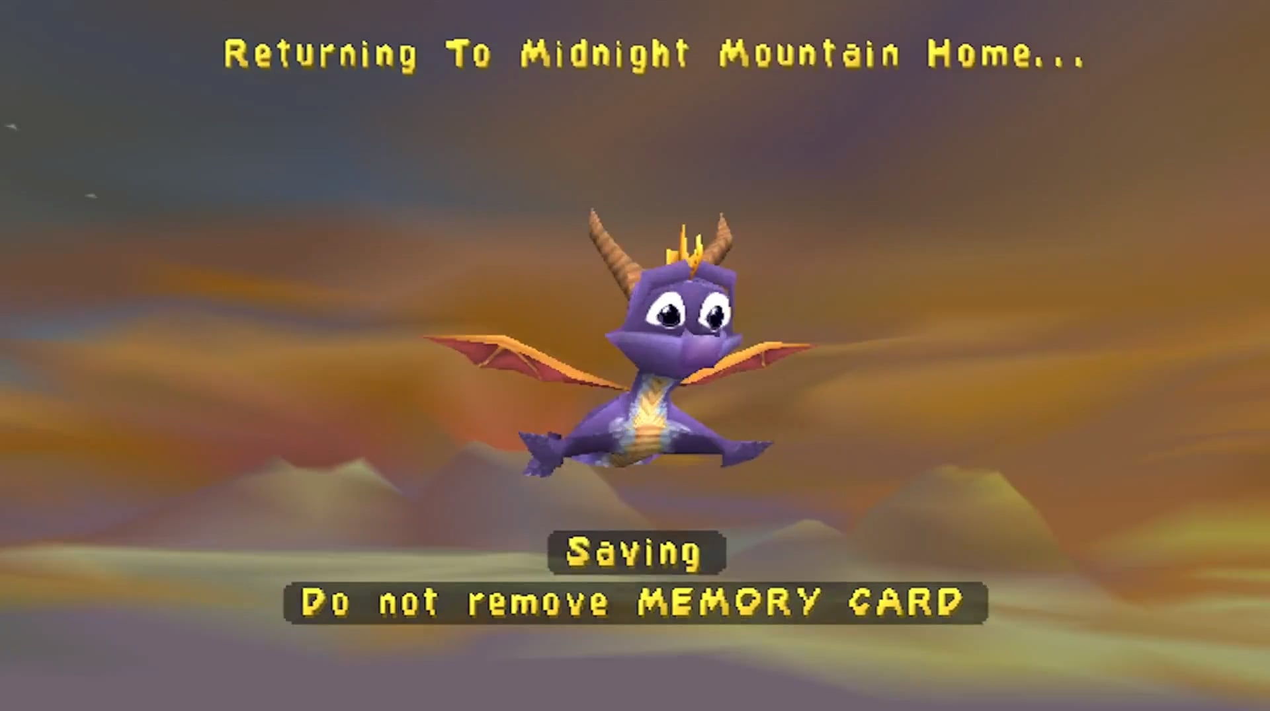

Slide 24

So, What Have I Actually Done So Far?
Complained
Co-designed two accessible controllers to explore the process
Interviewed custom makers and people who want to make
Created a virtual tool for layout exploration
  With a BLE Dongle for console use
Parameterised enclosures for Hitbox controllers
Began parameterising Joystick controllers
Started creating tools for parameterisation of PCBs

Slide 25
What Do I Need Help With?
Finding people who want to create a controller for the first time
Breaking the tools
People telling me where I’m going wrong
And to be shown cool controllers that break the parameter space!!!!

