Slide 1




The
Accessibility Paradox
Platform Standardisation and the Legitimacy of Play
Jack Burnett, University of Bristol
Authors wish to acknowledge and thank the financial support of the UK Research and Innovation (UKRI) [Grant ref EP/S022937/1] and the University of Bristol.
Notes:
Hi, I'm Jack Burnett from the University of Bristol, and this is talk is on The Accessibility Paradox

Slide 2
THE PROMISE OF STANDARDISATION
HARDWARE
INPUTS
Defines which devices can connect.
Defines how players can interact.
CERTIFICATION
ACCESSIBILITY
Defines what platforms approve.
Establishes baseline expectations for access.
Notes:
Modern games increasingly exist within platform ecosystems
Platforms rely on shared standards for Hardware, Inputs, Certification, and Accessibility.
These shared standards create consistent and predictable play experiences, which have significant benefits for accessibility.
Standards establish baseline expectations and reduce fragmentation, but they also establish which forms of interaction platforms recognise and support;
and that creates a tension: what happens to players whose access depends on something outside of those standards? Or is later excluded by them?

Slide 3

A LIVED EXAMPLE:
Kain the Tormented Gamer
Notes:
To see what that means in practice, we’re going to consider the lived experience of a friend of mine, Kain the Tormented Gamer.

Slide 4
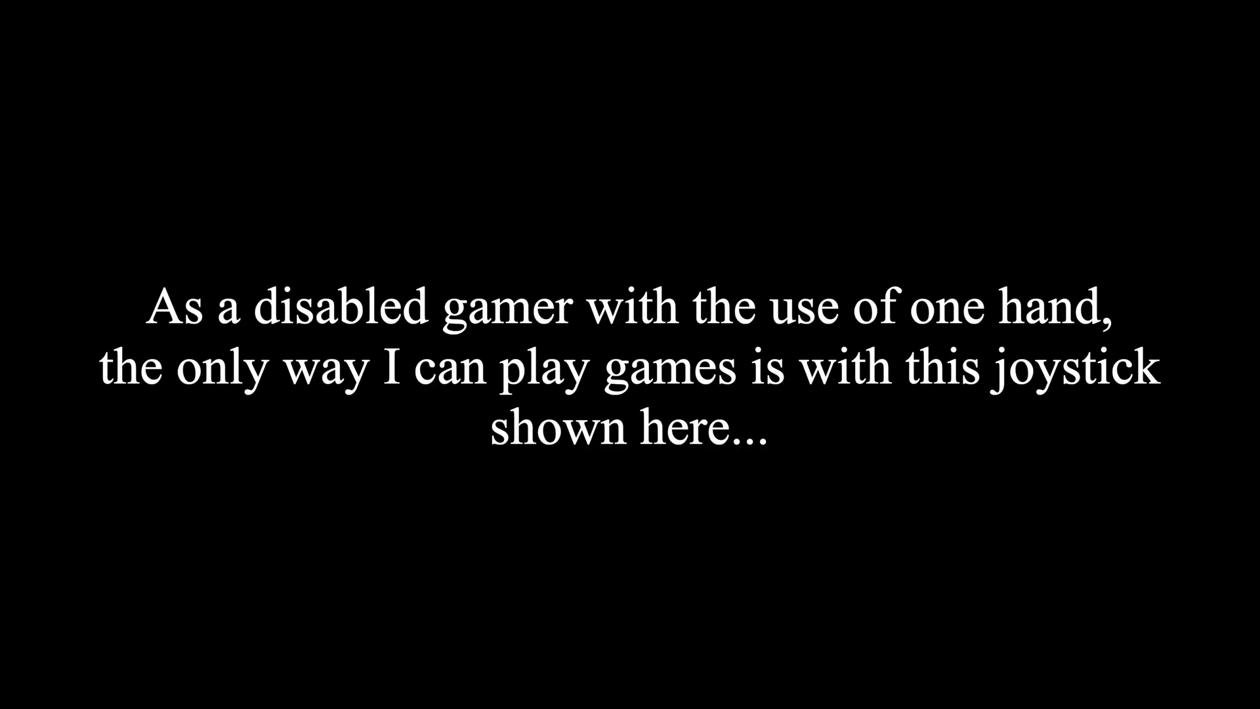
KAIN’S CONTROLLER
Notes:
So, Kain uses a particular controller, that we’re going to see in this video.
https://www.youtube.com/watch?v=XcYVrdkKuBE

Slide 5
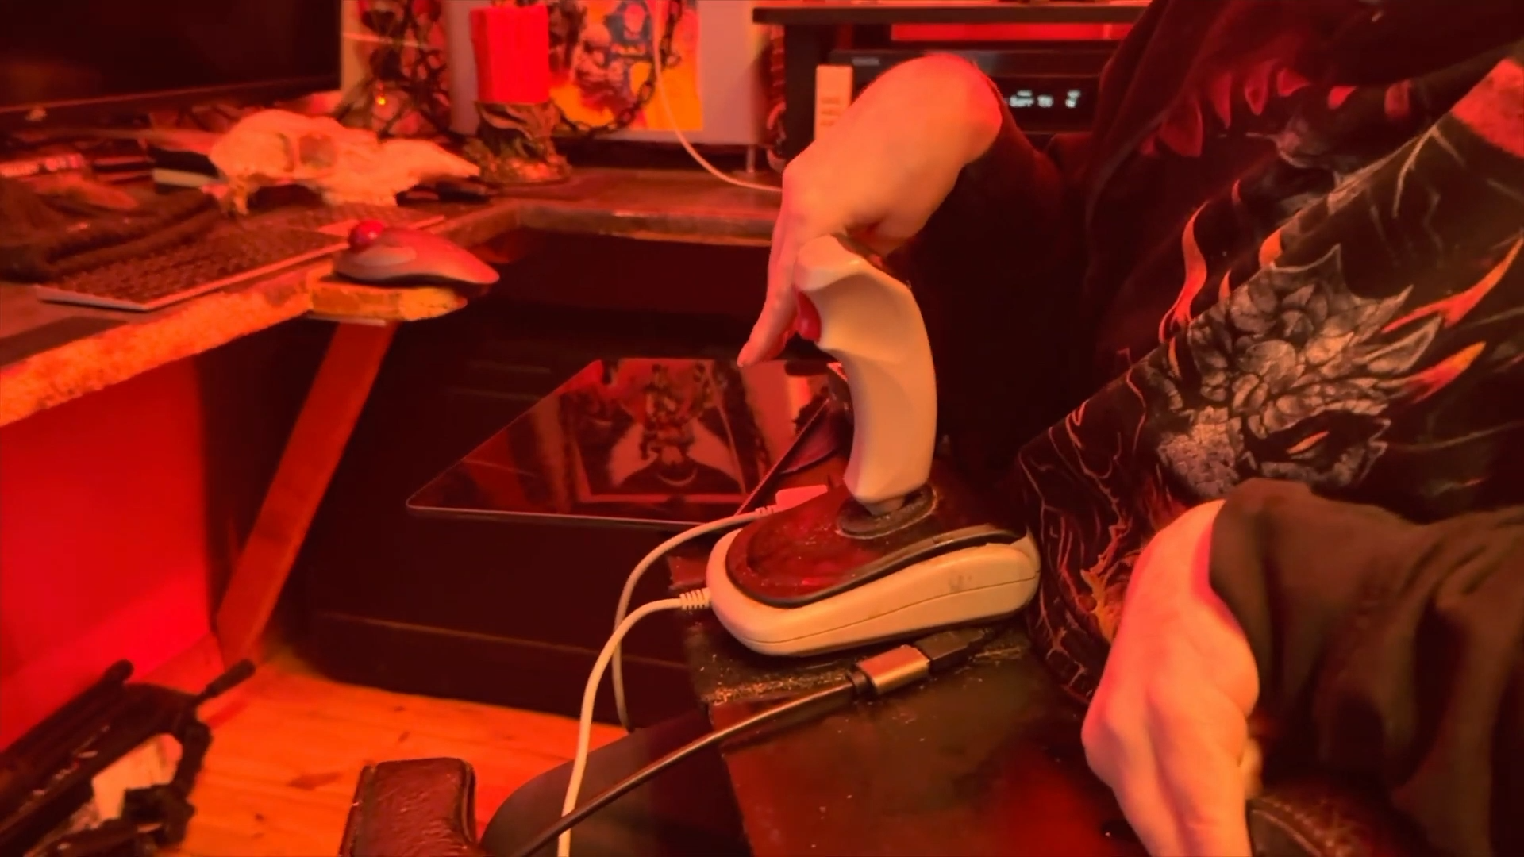
KAIN’S SETUP
Notes:
But using Kain's controller isn't as easy as just plugging it in.
https://www.youtube.com/watch?v=XcYVrdkKuBE

Slide 6
WHEN ACCESS CHANGES
NEED
CHANGE
LOCKOUT
Used the same controller since PS1, as alternatives aren’t suitable
Compatibility changes with console generations and system updates
Changes prevent Kain from gaming, as the legitimacy of his controller is contested
Notes:
Kain has used this type of controller since the original PlayStation, and despite trying alternatives, none have offered the same level of access.
But each new console generation, and some platform updates, can require changes to this configuration, such as new adapters or third-party workarounds.
When those workarounds aren't available, Kain is completely locked out of play.
And even when they are, functionality can be lost.
Kain's accessibility needs haven't changed, but whether the platform recognises his way of playing as legitimate has.

Slide 7
BEYOND ONE PLAYER
Notes:
And Kain isn't alone.

Slide 8
WHEN COMPATIBILITY CHANGES
SETUP
CONSOLE COMPATIBILITY
PLAY
CHANGE TO STANDARDS
SETUP
CONSOLE COMPATIBILITY
PLAY
Adapts to player needs
Can change with standards
Depends on continued access
Source: Bunting, G. (2022), Ars Technica
Notes:
In an article for Ars Technica, Geoffrey Bunting documented disabled PlayStation players who relied on third-party controllers and adapters.
It found that when PlayStation changed its compatibility requirements, some previously working accessibility setups could no longer be used, akin to Kain’s experience.
https://arstechnica.com/gaming/2022/11/how-the-ps5s-dualsense-controller-is-failing-disabled-players
https://www.reddit.com/r/playstation/comments/q36k4h/playstation_5_versions_of_games_can_only_be/

Slide 9
WHEN ACCESSIBILITY LOOKS LIKE CHEATING
Controller Setup
Remove reWASD
Enables one-handed play
Reduced access and play experience
reWASD Setup
Keep reWASD
Apex Enforcement
Combines and remaps inputs
Cannot play Apex
with friends
Source: r/disabledgamers community account (2024)
Notes:
And as highlighted in a post on r/disabledgamers, a player with limited use of his right hand uses reWASD to combine a controller and a footswitch.
While the setup would enable him to engage in play, the use of reWASD prevents him from playing Apex Legends itself.
https://www.reddit.com/r/disabledgamers/comments/1fhcpa8/my_son_has_limited_use_of_his_right_hand_he_uses/

Slide 10
WHO DECIDES?
Macros and Input Software
Accessibility Reduce inaccessible inputs Remap controls around player needs |  | Automation Automate gameplay actions Create unintended advantages
 | ANTI-CHEAT
ACCESS TO PLAY CAN BE BLOCKED
Sources: r/apexlegends community discussion (2024); EA, Apex Legends Anti-Cheat Update, r/H1Z1 community discussion (2015)
Notes:
This isn't a new tension. A decade-old post on r/H1Z1 described a player reportedly banned for using a macro to accommodate a disability.
Yet macros can also automate gameplay and provide competitive advantages.
So, who has the authority to decide which ways of playing are recognised as legitimate?
https://www.ea.com/games/apex-legends/apex-legends/news/breach-anti-cheat-update
https://www.reddit.com/r/h1z1/comments/36nq17/my_friend_was_banned_for_using_a_macro_that_helps/

Slide 11
A CHAIN OF DEPENDENCY
PLAYERS
DEVELOPERS
PLATFORM HOLDERS
Notes:
There is also a chain of dependency caused by platformisation and standards.
Players rely on developers for accessibility, but developers themselves rely on platform holders to approve the technologies and interactions they support.
Platform decisions can determine which accessibility solutions are available, even when developers and players want to support them.

Slide 12
STANDARDS AS A GUARANTEE
Technologies
New ways to enable access
Configurations
Adapted around individual needs
STANDARDS
Controllers
Baseline
Different ways to interact
Notes:
These experiences reveal what I call the accessibility paradox of platform standardisation.
The same standards that support accessibility can also constrain the adaptations some players rely upon.
The answer isn't to abandon standards, but standards should provide a baseline for accessibility, not define the boundary of legitimate play.
And we can’t remove all restrictions either, as competitive integrity still matters, so we need methods to prevent harmful behaviour without enforcing a particular form of play.

Slide 13
WHO GETS TO DECIDE WHAT ACCESSIBLE PLAY LOOKS LIKE?
Accessibility is also a question of authority.
Notes:
Accessibility, then, is more than a technical challenge. It is also a question of authority.
The question is no longer only how we make games accessible, but who has the authority to decide which ways of playing are recognised as legitimate.

Slide 14
QUESTIONS FOR CHI PLAY

Slide 15
In the reWASD scenario, a player relied on software to remap their controls because they could not use a conventional controller, but that same software can also automate actions, potentially providing an unfair advantage.
Should competitive PC Platforms allow it?

Slide 16
Should accessibility exemptions be built into platform policies, and who should be responsible for approving them?
AND
How much freedom do developers actually have to support unconventional accessibility solutions within platform requirements?

