Slide 1
ELECTRONIC DEVICES
1

Slide 2
Atomic Structure:
UNIT I - INTRODUCTION TO SEMICONDUCTOR PHYSICS
Atomic structure refers to the structure of atom comprising of a nucleus (center) in which the protons (positively charged) and neutrons (neutral) are present.
The negatively charged particles called electrons revolve around the center of the nucleus.
Protons (positively charged), neutrons(neutral), Electrons (Negatively charged)
Atomic weight = no of protons + no of neutrons.
Atomic number = no of protons / no of electrons in atom
2

Slide 3
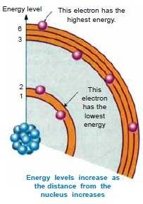
tiny particles - electrons
Negatively charged particle have negligible mass
Electron:
Important properties:
Charge of electrons, e = 1.602 *10^-19 coulomb Mass of electrons, m = 9.0*10^ -31kg
Energy of an electron:
2 types
kinetic energy due to its motion
Potential energy due to charge on the nucleus
Total energy = K.E+P.E
Energy of electron increases as its distance from the nucleus increases.
Last orbits electron possess very high energy as compared to electron in the inner orbits.
3

Slide 4
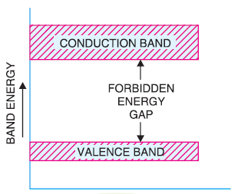
Energy band description
Bands are classified into 2 types
1.Valance Band
energy possessed by valence electron.
Conduction band:
energy possessed by free electron.
Forbidden energy gap:
Separation between conduction band and valance band on the energy level diagram.
4

Slide 5
Classification of Solids
Classification based on:
valance electrons
2.Free electrons
3.Forbidden energy gap
Valance electron: determines the metal, non-metal, solids, gas, and electrical properties of a material based on outermost valance electron.
Electrical conductivity of material are classified into
conductor
insulator
semi-conductor
Free Electrons valance electrons which are Loosely attached to the
nucleus
5

Slide 6
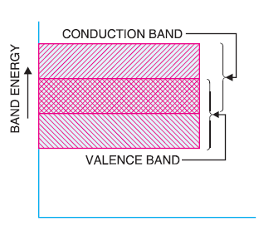
Classification of Solids
Conductor
It is a material that easily conducts electrical current.
It has large number of free electrons loosely bound to the atoms.
These loosely bound valance electrons can easily break away from their atoms and become free electrons.
Forbidden energy gap does not exist.
Examples : Copper, Gold, Silver
6

Slide 7
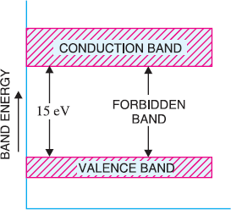
Classification of Solids
Insulator
It is a material that does not conduct electrical current under normal condition.
It has no free electrons.
The valance electrons are tightly bound to the atoms.
Forbidden energy gap > 5eV.
Examples : Paper, rubber, glass etc.,
7

Slide 8
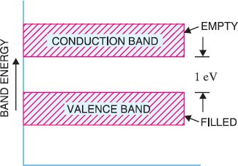
Classification of Solids
Semiconductor
Semiconductors are the materials that possess the property of electrical conductivity less than conductors.
A semiconductor in its pure state is neither a good conductor nor a good isolator.
It has very few free electrons.
Forbidden energy gap very small (1eV).
Examples : Silicon, Germanium, Arsenic etc.,
8

Slide 9
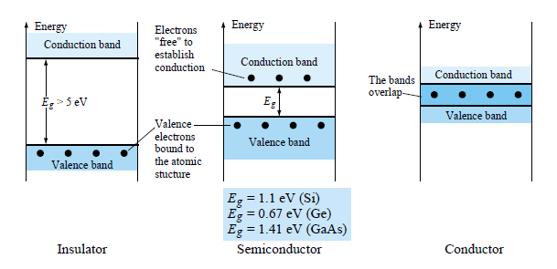
Classification of Solids
9

Slide 10
Comparison Chart
Parameter | Conductor | Semiconductor | Insulator
Forbidden Energy Gap | Not Exist | Small (1eV) | Large (>5eV)
Resistivity | Low | Moderate | High
Flow of current | Due to movement of free electrons. | Due to movement of electrons and holes. | Almost negligible but only due to free electrons.
Charge carriers in conduction band | Completely filled | Partially filled | Completely vacant
Charge carriers in valence band | Almost vacant | Partially filled | Completely filled
Example | Copper, Aluminium, graphite etc. | Silicon, Germanium, arsenic etc. | Paper, rubber, glass, plastic etc.
Applications | Conducting wires, Transformers, in electrical cords etc. | Diodes, transistors, opto couplers etc. | Sports equipment, home appliances etc.
3
NEC – 19EC31C ELECTRONIC DEVICES

Slide 11
Semiconductor Materials
Semiconductors are the group of materials having conductivities between those of metals and insulators.
Two general classifications of semiconductors are
Elemental semiconductors (found in group IV of the periodic table)
Compound Semiconductors (formed from special combinations of group III and group V elements).
Elemental Semiconductors
Si – Silicon Ge - Germanium
A portion of the Periodic Table
III | IV | V
5) B | 6) C
13) Al | 14) Si | 15) P
31) Ga | 32) Ge | 33) As
49) In |  | 51) Sb
Compound Semiconductors
AlP – Aluminium Phospide AlAs – Aluminium Arsenide GaP – Gallium Phospide GaAs – Gallium Arsenide InP – Indium Phospide
11

Slide 12
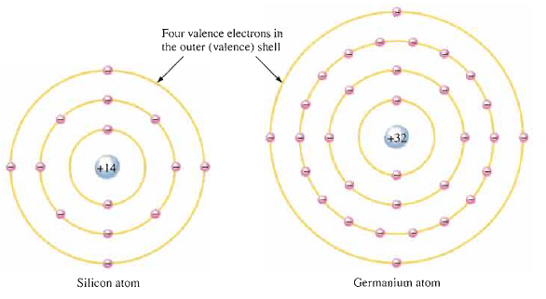
Semiconductor Materials
Silicon is by far the most commonly used semiconductor used in integrated circuits.
The Valance electrons in Ge are in the fourth shell, while in silicon are in third shell closer to the nucleus.
This means that the Ge valance electrons are at higher levels than in silicon and require a smaller amount of energy to escape from the atom. This makes Ge more unstable at high temperatures.
Two elements or “binary” compound semiconductors- GaAs, GaP
Three element or “ternary” compound semiconductors – AlGaAs
12

Slide 13
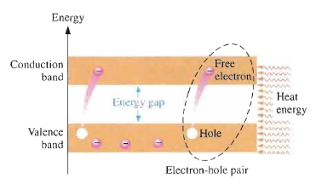
Classification of Semiconductors
Types of Semiconductor
Intrinsic Semiconductor
Extrinsic Semiconductor
P-type
N-type
Intrinsic Semiconductor
A pure semiconductor is called intrinsic semiconductor.
At room temperature, some of the valence electron acquire sufficient (thermal) energy to jump from VB-CB becoming free electrons (also called conduction electrons).
When an electron jumps to the CB, a vacancy left in the VB within the crystal. This is called a hole.
For every electron raised to the CB by external energy, there is one hole left in VB creating an electron hole pair.
13

Slide 14
Extrinsic Semiconductor
Semiconductor materials do not conduct well and are of limited value in their intrinsic state.
This is because of the limited number of free electrons in the CB and holes in the VB.
Hence intrinsic silicon must be modified by increasing the no. of free electrons or holes to increase its conductivity.
This is done by adding impurities to the intrinsic material.
The conductivity of silicon and Germanium can be drastically increased by the controlled addition of impurities to the intrinsic semiconductor material. This process is called doping.
Two types of Extrinsic Semiconductor are n-type and p-type.
14

Slide 15
.
Thank you

