Slide 1
Gene Expression Data Analysis and Visualization
Final Project
AS.410.671.82.FA17
Jack Zhan

Slide 2
Background
Multiple myeloma (MM) is an incurable clonal plasma cell malignancy
Characterized by the accumulation of clonal plasma cells in the bone marrow
The introduction of the proteasome inhibitor bortezomib has improved clinical outcome of MM patients
Carfilzomib is a second generation proteasome inhibitor that is used for relapsed/refractory MM patients with bortezomib resistance
Determined that the majority of the MM cells that became resistant to bortezomib also exhibited resistance to carfilzomib
Determine the underlying mechanisms of proteasome inhibitor resistance in MM and identify novel agents that will enhance therapeutic efficacy of this class of anti-MM drugs

Slide 3
Introduction
GDS5826 dataset looking at multiple myeloma cell lines
Comparing gene expression of cells with an acquired resistance to chemotherapeutic agent carfilzomib and cells without
There are two cell lines: KMS-11, KMS-34
Total of 12 samples:
  3 KMS-11 with carfilzomib resistance, 3 KMS-11 without resistance
  3 KMS-34 with carfilzomib resistance, 3 KMS-34 without resistance
Results provide insight into the molecular mechanisms underlying the acquisition of proteasome inhibitor resistance in MM

Slide 4
List of Samples in Data
GSM1692587 = KMS-11/Cfz multiple myeloma cells resistant to 12 nM carfilzomib
GSM1692588 = KMS-11/Cfz multiple myeloma cells resistant to 12 nM carfilzomib
GSM1692589 = KMS-11/Cfz multiple myeloma cells resistant to 12 nM carfilzomib
GSM1692590 = KMS-34/Cfz multiple myeloma cells resistant to 12 nM carfilzomib
GSM1692591 = KMS-34/Cfz multiple myeloma cells resistant to 12 nM carfilzomib
GSM1692592 = KMS-34/Cfz multiple myeloma cells resistant to 12 nM carfilzomib
GSM1692593 = KMS-11 multiple myeloma cells
GSM1692594 = KMS-11 multiple myeloma cells
GSM1692595 = KMS-11 multiple myeloma cells
GSM1692596 = KMS-34 multiple myeloma cells
GSM1692597 = KMS-34 multiple myeloma cells
GSM1692598 = KMS-34 multiple myeloma cells

Slide 5
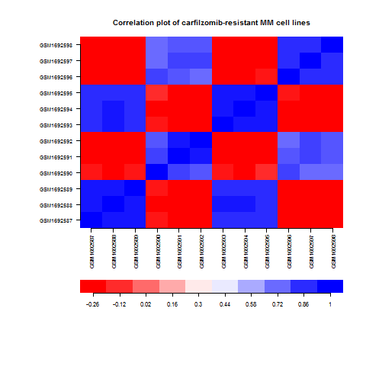
Correlation Plot
Initial correlation plot on the data to determine relationships between sample
Plot shows that there is strong correlation between samples of the same cell line
Very little correlation between carfilzomib resistant samples

Slide 6
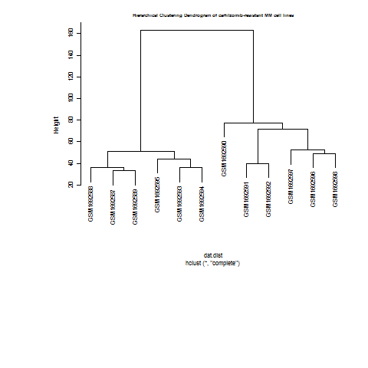
Hierarchical Clustering Plot
Hierarchical Clustering Plot confirms that there is a lot of noise in the data resulting in strong correlations within cell lines and weak correlations between carfilzomib resistant samples

Slide 7
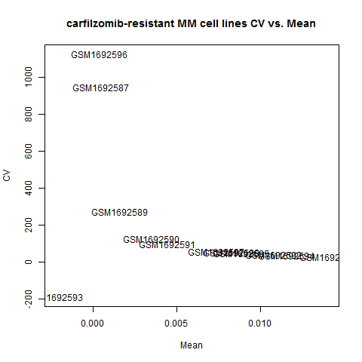
CV vs. Mean
The following CV vs Mean plot was used to identify possible outliers in data
GSM1692593 is an outlier and should be removed

Slide 8
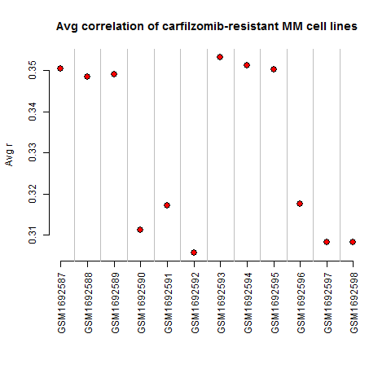
Average CV Plot
The following average CV plot was used to identify additional outliers in data
No additional outliers were identified

Slide 9
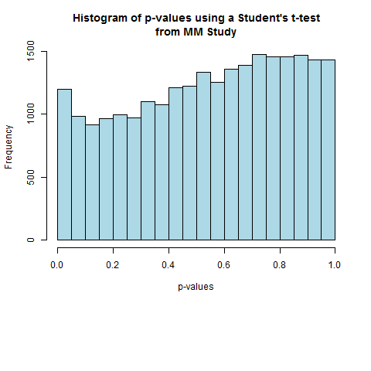
P Values
P values were calculated using a student-t two sample test
The two factors used were samples that were carfilzomib resistant and samples that were not carfilzomib resistant

Slide 10
Data Filtering
Data was first filtered by removing sample GSM1692593
Next genes with an average expression less than the mean were removed
I was considering using the Bonferroni correction of P<0.05/ total number of probesets, however only 1 gene fit this criteria
Went with p<0.001. This left me with a total of 61 genes which I believe is a good number of genes to work with.

Slide 11
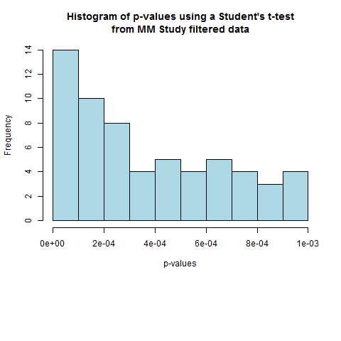
P Values
Recalculated the p values after filtering and confirmed that only genes with a p value<0.001 remained

Slide 12
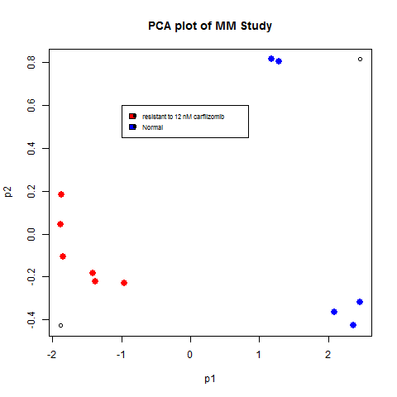
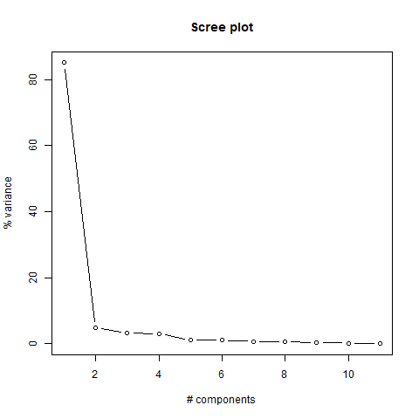
PCA Pot
PCA plot and Scree plot was created on the filtered data
There is about a 90% variance between the first two components.

Slide 13
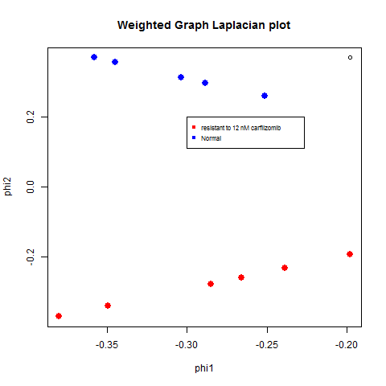
Laplacian Plot
Calculated and plot a two-dimensional embedding of the weighted graph Laplacian

Slide 14
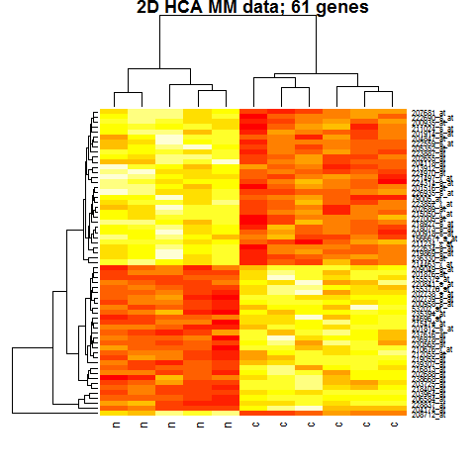
HCA Heat Map
The following is an HCA heat map of the 61 genes.
The two sample categories are correctly clustered
Shows distinct correlation between the genes and sample

Slide 15
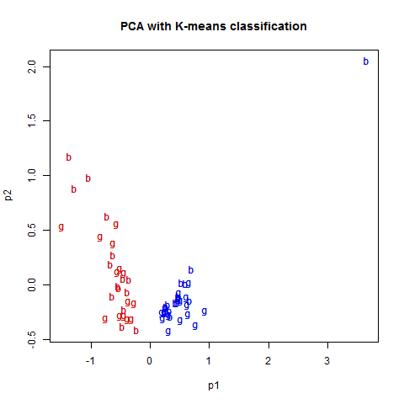
PCA and Kmeans Clustering
For this plot I maThere were no noticed correlation between the genes in the study
de the first 30 genes “b” and the last 31 genes “g”
You can see 1 outlier gene in the second cluster

Slide 16
Rightmost 5 genes
 | 205352_at | 202655_at | 214463_x_at | 236330_at | 208712_at
Gene Name | serpin family I member 1 | mesencephalic astrocyte derived neurotrophic factor | histone cluster 1 | CDNA FLJ42688 fis | cyclin D1
GO Terms | serine-type endopeptidase inhibitor activity, central nervous system development, negative regulation of endopeptidase activity, peripheral nervous system development, regulation of cell adhesion extracellular exosome, extracellular space GO:0004867,GO:0007417,GO:0010951,GO:0007422,GO:0030155,GO:0070062,GO:0005615 | growth factor activity poly(A) RNA binding biological_process response to unfolded protein extracellular region Nucleus GO:0008083, GO:0044822, GO:0008150, GO:0006986, GO:0005576, GO:0005634 | DNA binding,histone binding,poly(A) RNA binding,protein binding,protein domain specific binding,protein heterodimerization activity CENP-A containing nucleosome assembly,DNA replication-dependent nucleosome assembly,DNA replication-independent nucleosome assembly,DNA-templated transcription, initiation,beta-catenin-TCF complex assembly,cellular protein metabolic process,chromatin silencing at rDNA,double-strand break repair via nonhomologous end joining,gene silencing by RNA,negative regulation of gene expression, epigenetic,negative regulation of megakaryocyte differentiation, nucleosome assembly,positive regulation of gene expression, epigenetic, protein heterotetramerization, telomere capping, telomere organization, extracellular exosome, extracellular matrix,extracellular region,membrane,nuclear chromosome,nuclear chromosome, telomeric region,nucleoplasm,nucleosome,nucleosome,nucleus,protein complex GO:0003677,GO:0042393,GO:0044822,GO:0005515,GO:0019904,GO:0046982,GO:0034080,GO:0006335,GO:0006336,GO:0006352,GO:1904837,GO:0044267,GO:0000183,GO:0006303,GO:0031047,GO:0045814,GO:0045653,GO:0006334,GO:0045815,GO:0051290,GO:0016233,GO:0032200,GO:0070062,GO:0031012,GO:0005576,GO:0016020,GO:0000228,GO:0000784,GO:0005654,GO:0000786,GO:0000786,GO:0005634,GO:0043234 | NA | cyclin-dependent protein serine/threonine kinase regulator activity,enzyme binding,histone deacetylase binding,proline-rich region binding,protein binding,protein complex binding,protein kinase activity,protein kinase binding,transcription corepressor activity,transcription factor binding G1/S transition of mitotic cell cycle,G1/S transition of mitotic cell cycle,Leydig cell differentiation,canonical Wnt signaling pathway,cell division,cellular response to DNA damage stimulus,endoplasmic reticulum unfolded protein response,fat cell differentiation,lactation,liver regeneration,mammary gland alveolus development,mammary gland epithelial cell proliferation,mitotic G1 DNA damage checkpoint,negative regulation of Wnt signaling pathway,negative regulation of cell cycle arrest,negative regulation of epithelial cell differentiation,negative regulation of transcription from RNA polymerase II promoter,positive regulation of G2/M transition of mitotic cell cycle,positive regulation of cell cycle,positive regulation of cyclin-dependent protein serine/threonine kinase activity,positive regulation of mammary gland epithelial cell proliferation,positive regulation of protein phosphorylation,protein phosphorylation,re-entry into mitotic cell cycle,response to UV-A,response to X-ray,response to calcium ion,response to corticosterone,response to drug,response to estradiol,response to estrogen,response to ethanol,response to iron ion,response to leptin,response to magnesium ion,response to organonitrogen compound,response to vitamin E,transcription, DNA-templated bicellular tight junction,cyclin-dependent protein kinase holoenzyme complex,cytosol,intracellular,membrane,nucleoplasm,nucleoplasm,nucleus,transcriptional repressor complex GO:0016538,GO:0019899,GO:0042826,GO:0070064,GO:0005515,GO:0032403,GO:0004672,GO:0019901,GO:0003714,GO:0008134,GO:0000082,GO:0000082,GO:0033327,GO:0060070,GO:0051301,GO:0006974,GO:0030968,GO:0045444,GO:0007595,GO:0097421,GO:0060749,GO:0033598,GO:0031571,GO:0030178,GO:0071157,GO:0030857,GO:0000122,GO:0010971,GO:0045787,GO:0045737,GO:0033601,GO:0001934,GO:0006468,GO:0000320,GO:0070141,GO:0010165,GO:0051592,GO:0051412,GO:0042493,GO:0032355,GO:0043627,GO:0045471,GO:0010039,GO:0044321,GO:0032026,GO:0010243,GO:0033197,GO:0006351,GO:0005923,GO:0000307,GO:0005829,GO:0005622,GO:0016020,GO:0005654,GO:0005654,GO:0005634,GO:0017053
Location | Chromosome 3 NC_000003.12 | Chromosome 3 NC_000003.12 | Chromosome 6 NC_000006.12 | NA | Chromosome 11 NC_000011.10

Slide 17
Leftmost 5 genes
 | 228837_at | 204174_at | 206584_at | 203964_at | 218404_at
Gene Name | transcription factor 4 | arachidonate 5-lipoxygenase activating protein | lymphocyte antigen 96 | N-myc and STAT interactor | sorting nexin 10
GO Terms | DNA binding,E-box binding,RNA polymerase II core promoter proximal region sequence-specific DNA binding,RNA polymerase II core promoter proximal region sequence-specific DNA binding,TFIIB-class transcription factor binding,bHLH transcription factor binding,identical protein binding,protein C-terminus binding,protein binding,protein heterodimerization activity,protein heterodimerization activity,protein heterodimerization activity,protein homodimerization activity,transcription factor activity, TFIIB-class binding,transcription factor activity, sequence-specific DNA binding,transcription factor activity, sequence-specific DNA binding, RNA polymerase recruiting,transcriptional activator activity, RNA polymerase II core promoter proximal region sequence-specific binding,DNA-templated transcription, initiation,positive regulation of neuron differentiation,positive regulation of neuron differentiation,positive regulation of transcription from RNA polymerase II promoter,positive regulation of transcription from RNA polymerase II promoter,positive regulation of transcription, DNA-templated,protein-DNA complex assembly,transcription initiation from RNA polymerase II promoter,nuclear chromatin,nucleus,transcription factor complex,transcription factor complex, GO:0003677,GO:0070888,GO:0000978,GO:0000978,GO:0001093,GO:0043425,GO:0042802,GO:0008022,GO:0005515,GO:0046982,GO:0046982,GO:0046982,GO:0042803,GO:0001087,GO:0003700,GO:0001011,GO:0001077,GO:0006352,GO:0045666,GO:0045666,GO:0045944,GO:0045944,GO:0045893,GO:0065004,GO:0006367,GO:0000790,GO:0005634,GO:0005667,GO:0005667 | arachidonic acid binding,enzyme activator activity,protein N-terminus binding,protein binding,cellular response to calcium ion,leukotriene biosynthetic process,leukotriene metabolic process,lipoxin metabolic process,lipoxygenase pathway,positive regulation of catalytic activity,protein homotrimerization,endoplasmic reticulum,endoplasmic reticulum membrane,integral component of membrane,membrane,nuclear envelope,nuclear envelope,nuclear membrane, GO:0050544,GO:0008047,GO:0047485,GO:0005515,GO:0071277,GO:0019370,GO:0006691,GO:2001300,GO:0019372,GO:0043085,GO:0070207,GO:0005783,GO:0005789,GO:0016021,GO:0016020,GO:0005635,GO:0005635,GO:0031965 | coreceptor activity,lipopolysaccharide receptor activity,protein binding,I-kappaB kinase/NF-kappaB signaling,MyD88-dependent toll-like receptor signaling pathway,MyD88-independent toll-like receptor signaling pathway,TRIF-dependent toll-like receptor signaling pathway,apoptotic signaling pathway,cell surface receptor signaling pathway,cellular defense response,detection of lipopolysaccharide,inflammatory response,innate immune response,lipopolysaccharide-mediated signaling pathway,necroptotic process,negative regulation of MyD88-independent toll-like receptor signaling pathway,positive regulation of lipopolysaccharide-mediated signaling pathway,positive regulation of tumor necrosis factor production,response to lipopolysaccharide,toll-like receptor 4 signaling pathway,toll-like receptor 4 signaling pathway,endosome membrane,extracellular space,intrinsic component of plasma membrane,lipopolysaccharide receptor complex,plasma membrane, GO:0015026,GO:0001875,GO:0005515,GO:0007249,GO:0002755,GO:0002756,GO:0035666,GO:0097190,GO:0007166,GO:0006968,GO:0032497,GO:0006954,GO:0045087,GO:0031663,GO:0070266,GO:0034128,GO:0031666,GO:0032760,GO:0032496,GO:0034142,GO:0034142,GO:0010008,GO:0005615,GO:0031226,GO:0046696,GO:0005886 | protein binding,transcription cofactor activity,JAK-STAT cascade,inflammatory response,interferon-gamma-mediated signaling pathway,negative regulation of innate immune response,negative regulation of interferon-alpha biosynthetic process,negative regulation of interferon-beta biosynthetic process,positive regulation of protein K48-linked ubiquitination,regulation of nucleic acid-templated transcription,transcription from RNA polymerase II, promoter,cytoplasm,nucleoplasm, GO:0005515,GO:0003712,GO:0007259,GO:0006954,GO:0060333,GO:0045824,GO:0045355,GO:0045358,GO:1902524,GO:1903506,GO:0006366,GO:0005737,GO:0005654 | 1-phosphatidylinositol binding,ATPase binding,protein binding,cilium assembly,endocytosis,endosome organization,osteoclast differentiation,protein localization to centrosome,protein localization to cilium,protein transport,vesicle organization,colocalizes_with centrosome,endoplasmic reticulum,extrinsic component of endosome membrane,nucleus, GO:0005545,GO:0051117,GO:0005515,GO:0042384,GO:0006897,GO:0007032,GO:0030316,GO:0071539,GO:0061512,GO:0015031,GO:0016050,GO:0005813,GO:0005783,GO:0031313,GO:0005634
Location | Chromosome 18 NC_000018.10 | Chromosome 13 NC_000013.11 | Chromosome 8 NC_000008.11 | Chromosome 2 NC_000002.12 | Chromosome 7 NC_000007.14

Slide 18
Conclusion
Goal was to determine the underlying mechanisms of proteasome inhibitor resistance in MM and identify novel agents that will enhance therapeutic efficacy of this class of anti-MM drugs
Through the analysis I have identified a bunch of genes that are involved in protein and RNA binding.
The researchers identified SQSTM1 and KLF4 contributing to carfilzomib resistance, however those gene probes were not found in the 61 probes with a p<0.001.

