Slide 1
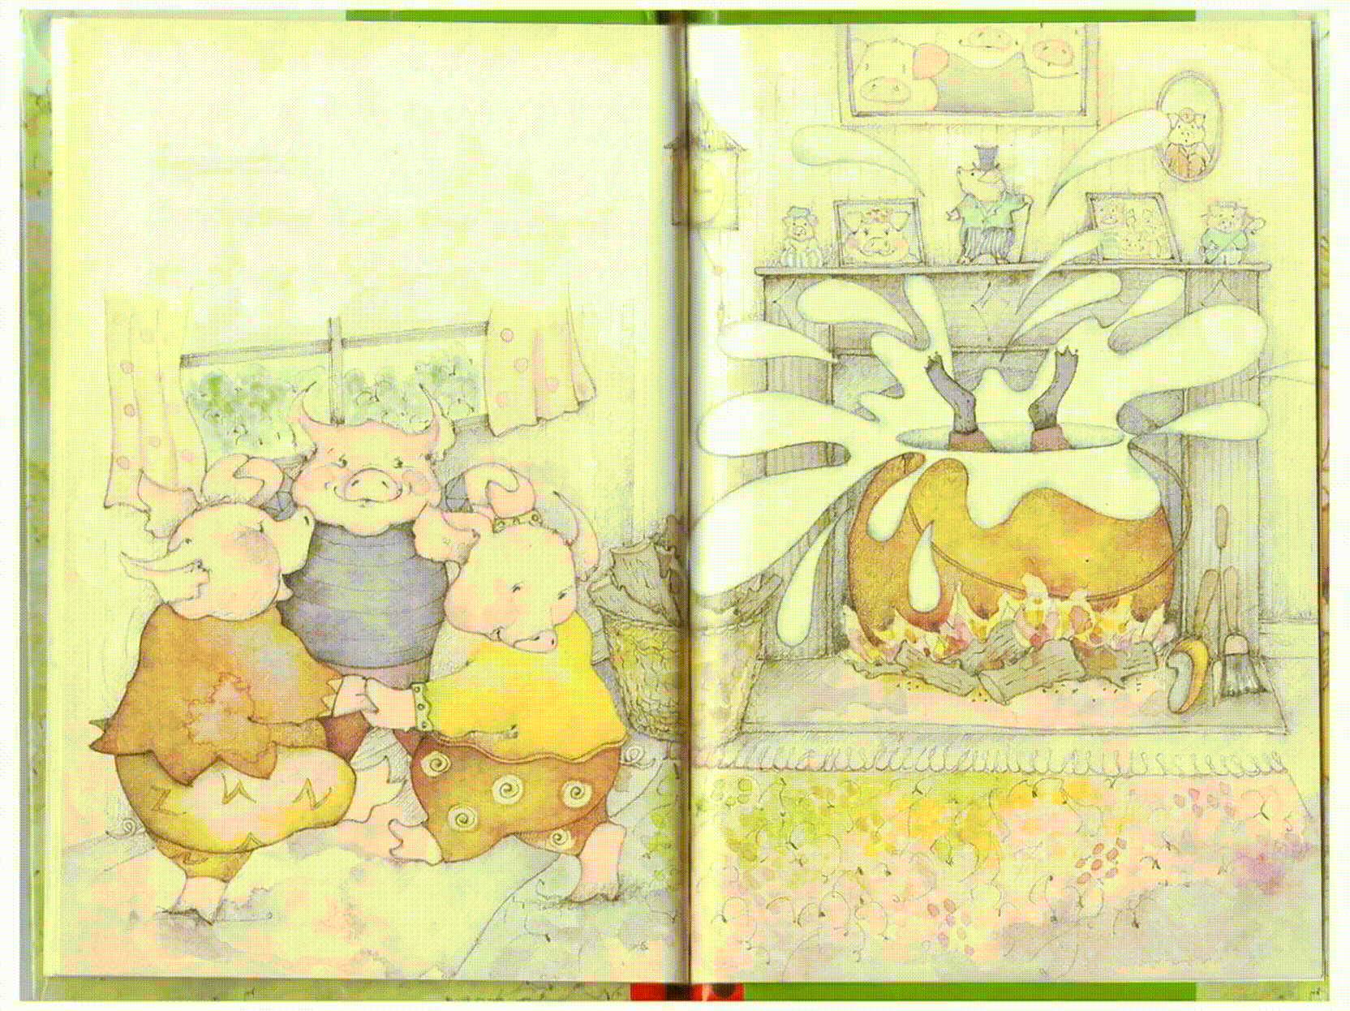
Live StoryBook
Turning old kindergraden storybooks
into living, narrated, animated e-books
Koo Ho Yin Jack
EduPlay AI Innovation Ltd
Powered by QwenWork · Wan2.7 · Qwen TTS
Notes:
Pitch transcript — Slide 1 (0:00–0:30)
Today I want to present an Alibaba Cloud usecase “Live StoryBook”. Turning old kindergraden storybooks into living, narrated, animated e-books.
I am Jack from Eduplay, a startup that focus on children early education.
To be extremely clear, this product has no relation to my company. However, my job inspired me to make this product.

Slide 2
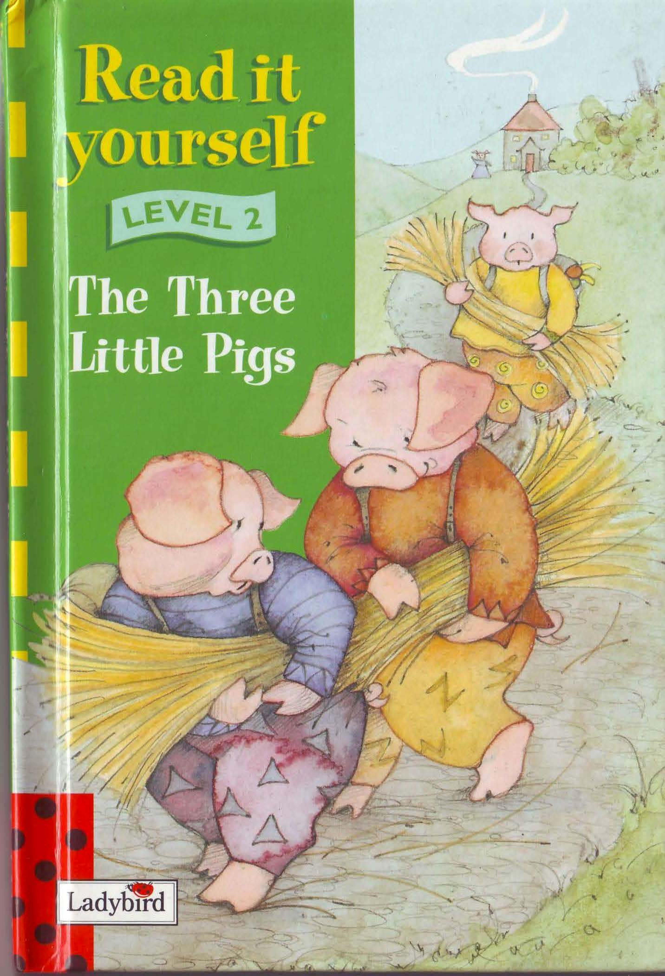
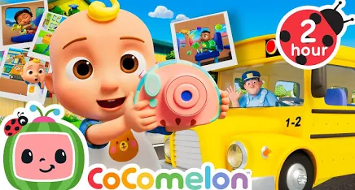
The Problem
Great storybooks are going to waste.
Static & silent
Old story book is well-written but boring — it can't speak, move, or react to a child.
Rise of short video
Short video from tic toks and Youtube are overtaking the focus of the children, despite their poor quality
The opportunity
Can we reuse these old story books?
Notes:
Pitch transcript — Slide 2 (0:30–1:30)
I don’t know you agree or not? I think old story book are very well-written. They have many meaningful pronunciation tactics to teach children new English words. However, compared to tic toks or Youtubes, there are too boring. These cause many great storybooks going to waste. This makes me wonder. Is it possible for us to reuse thise old storybook and make it into a much more entertaining e-books?

Slide 3

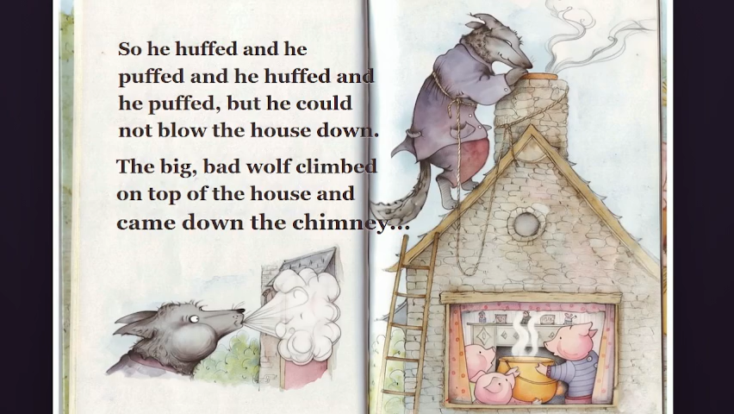
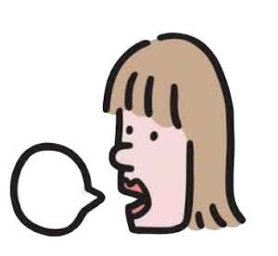
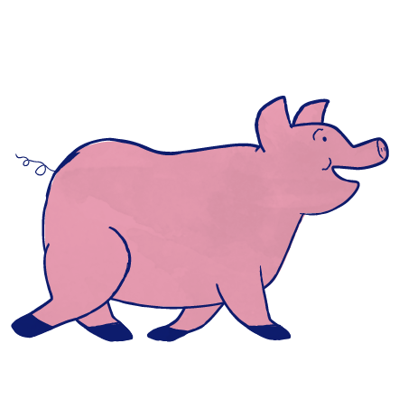
Our Solution
Scan a kindergarten storybook PDF → get a live audio e-book with animation.
1. Upload
2. Narrate
3. Animate
Notes:
Pitch transcript — Slide 3 (1:30–2:30)
Our solution is a fully automated pipeline. You upload a scanned kindergarten storybook as a PDF. The app narrates the page aloud in a warm, child-friendly voice, and it animates the page into a short looping clip so the characters and scenery come alive.

Slide 4
System Design — where Alibaba Cloud Model Studio is used
Alibaba Model Studio
Coding
QwenWork
Detect story text
Qwen3-VL grounding
Animation
Wan2.7 i2v
VoiceOver
qwen3-tts-flash
Notes:
Pitch transcript — Slide 4 (2:30–3:30)
This is the system design of our product, showcasing which part involves the use of Alibaba Cloud product.
All the coding is done by QwenWork.

Slide 5
See it in action
Example: “The Three Little Pigs” — a scanned spread animated by Wan2.7 with Qwen narration.
Notes:
Pitch transcript — Slide 5 (3:30–4:15)
And here's the product itself.

