Slide 1
Churn analysis
Jack last 01/10/2025

Slide 2
Approach
Data Preparation → Collected 7,043 telecom customer records; cleaned missing values, encoded categorical variables, and engineered features (e.g., tenure groups, contract type).
Exploratory Analysis → Used summary statistics and visualizations to uncover churn patterns across demographics, payment methods, and contract types.
Modeling & Evaluation → Built and tuned machine learning models (Random Forest, Logistic Regression) to predict churn, achieving 80% accuracy and 0.84 AUC.
Insights & Strategy → Identified high-risk segments (e.g., month-to-month, electronic check users, senior citizens) and quantified potential revenue loss to guide retention strategies.

Slide 3
Data overview
Dataset size: 7,043 telecom customer records
Variables:
Demographics → gender, age, senior citizen status
Services → internet, phone, streaming, add-ons
Account details → tenure, contract type, payment method
Billing → monthly charges, total charges
Target variable: Churn (Yes/No)

Slide 4
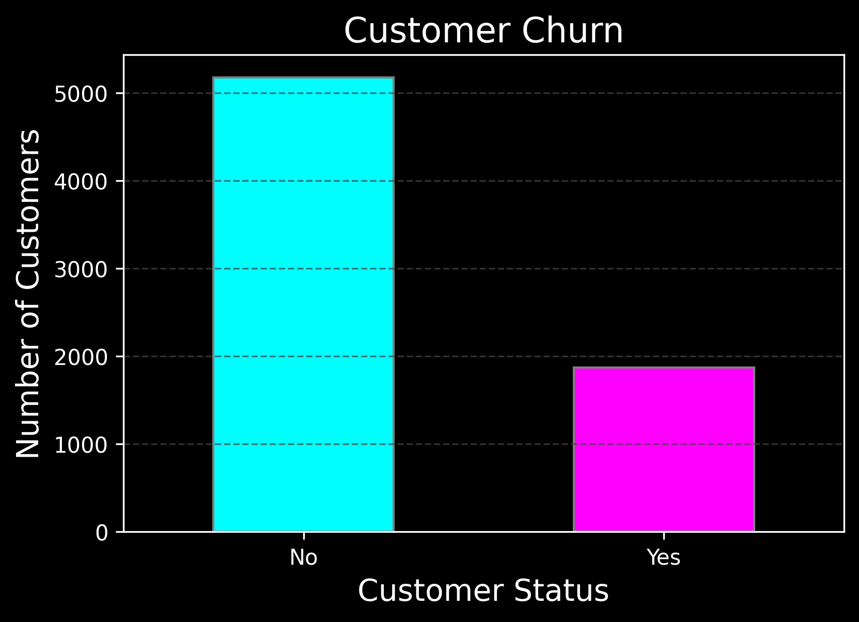
Overall churners
Out of 7,043 customers, 1,869 (26.54%) left the service.

Slide 5
Demographics

Slide 6
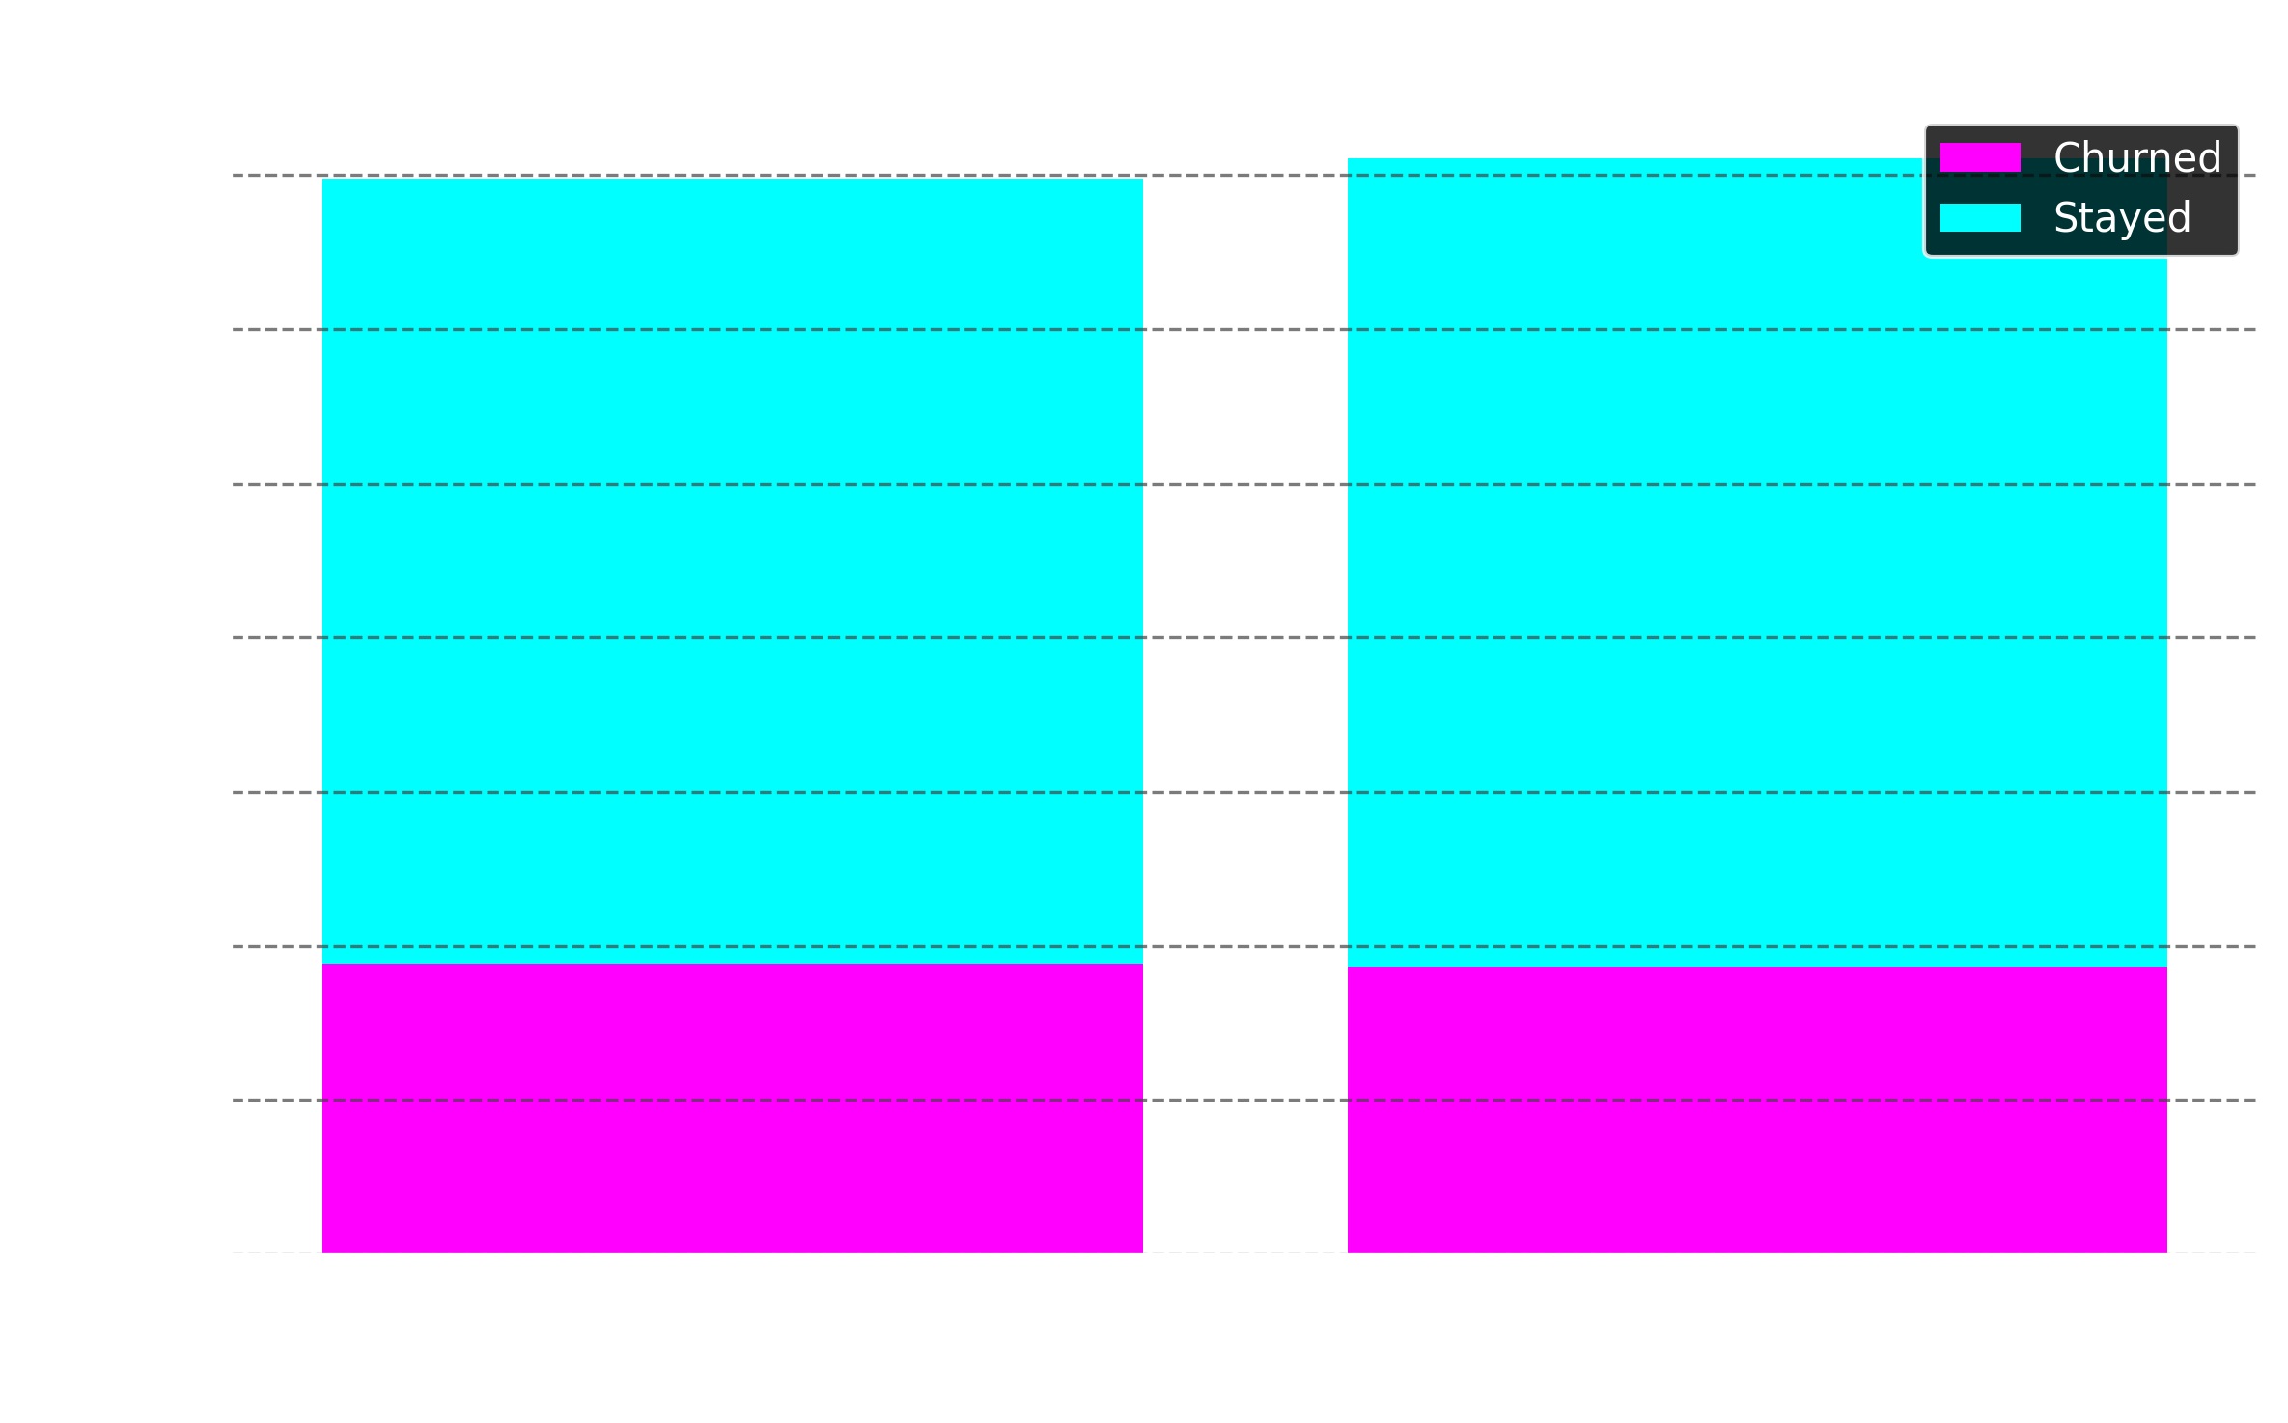
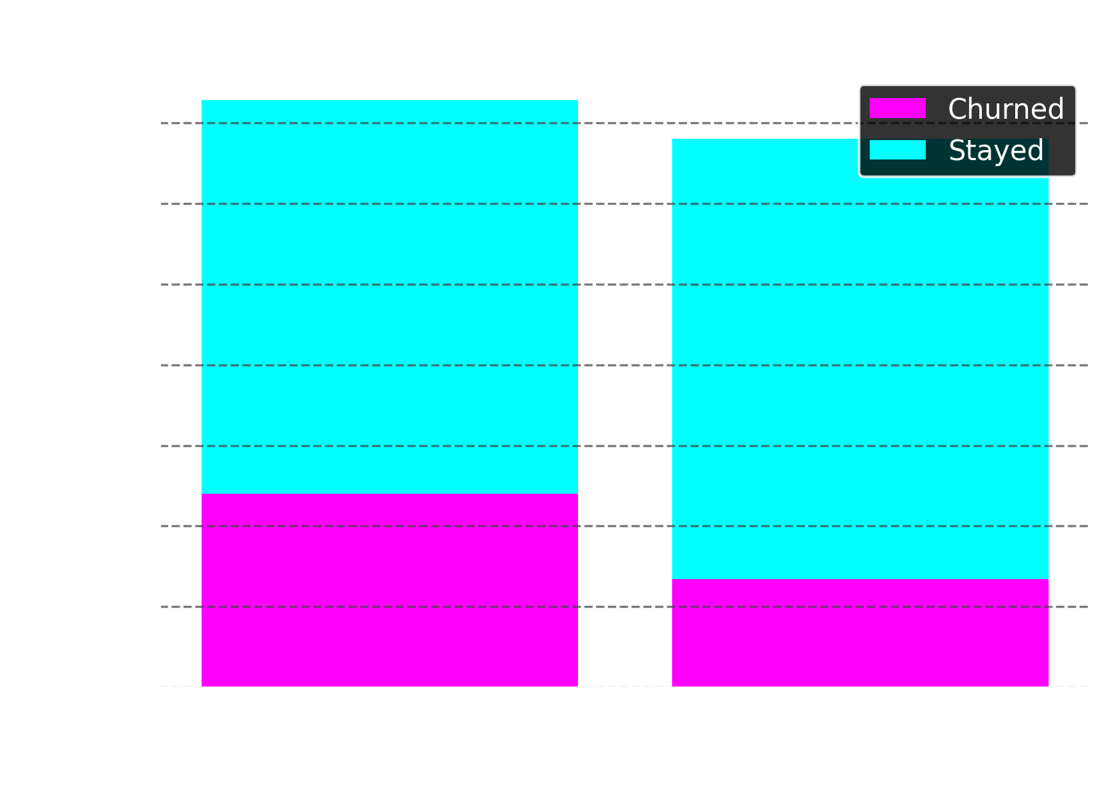
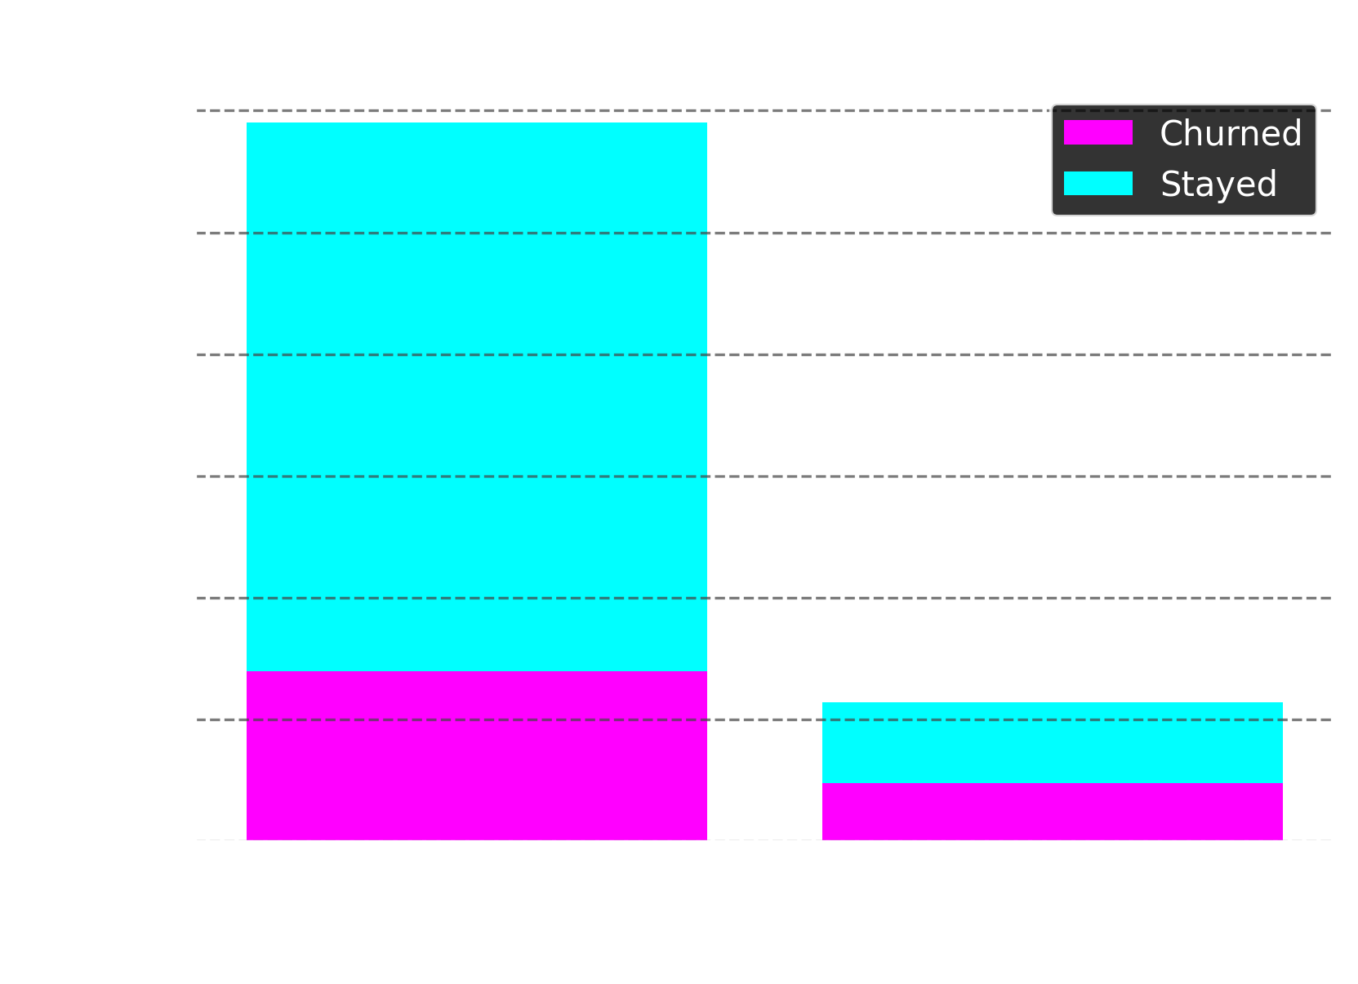
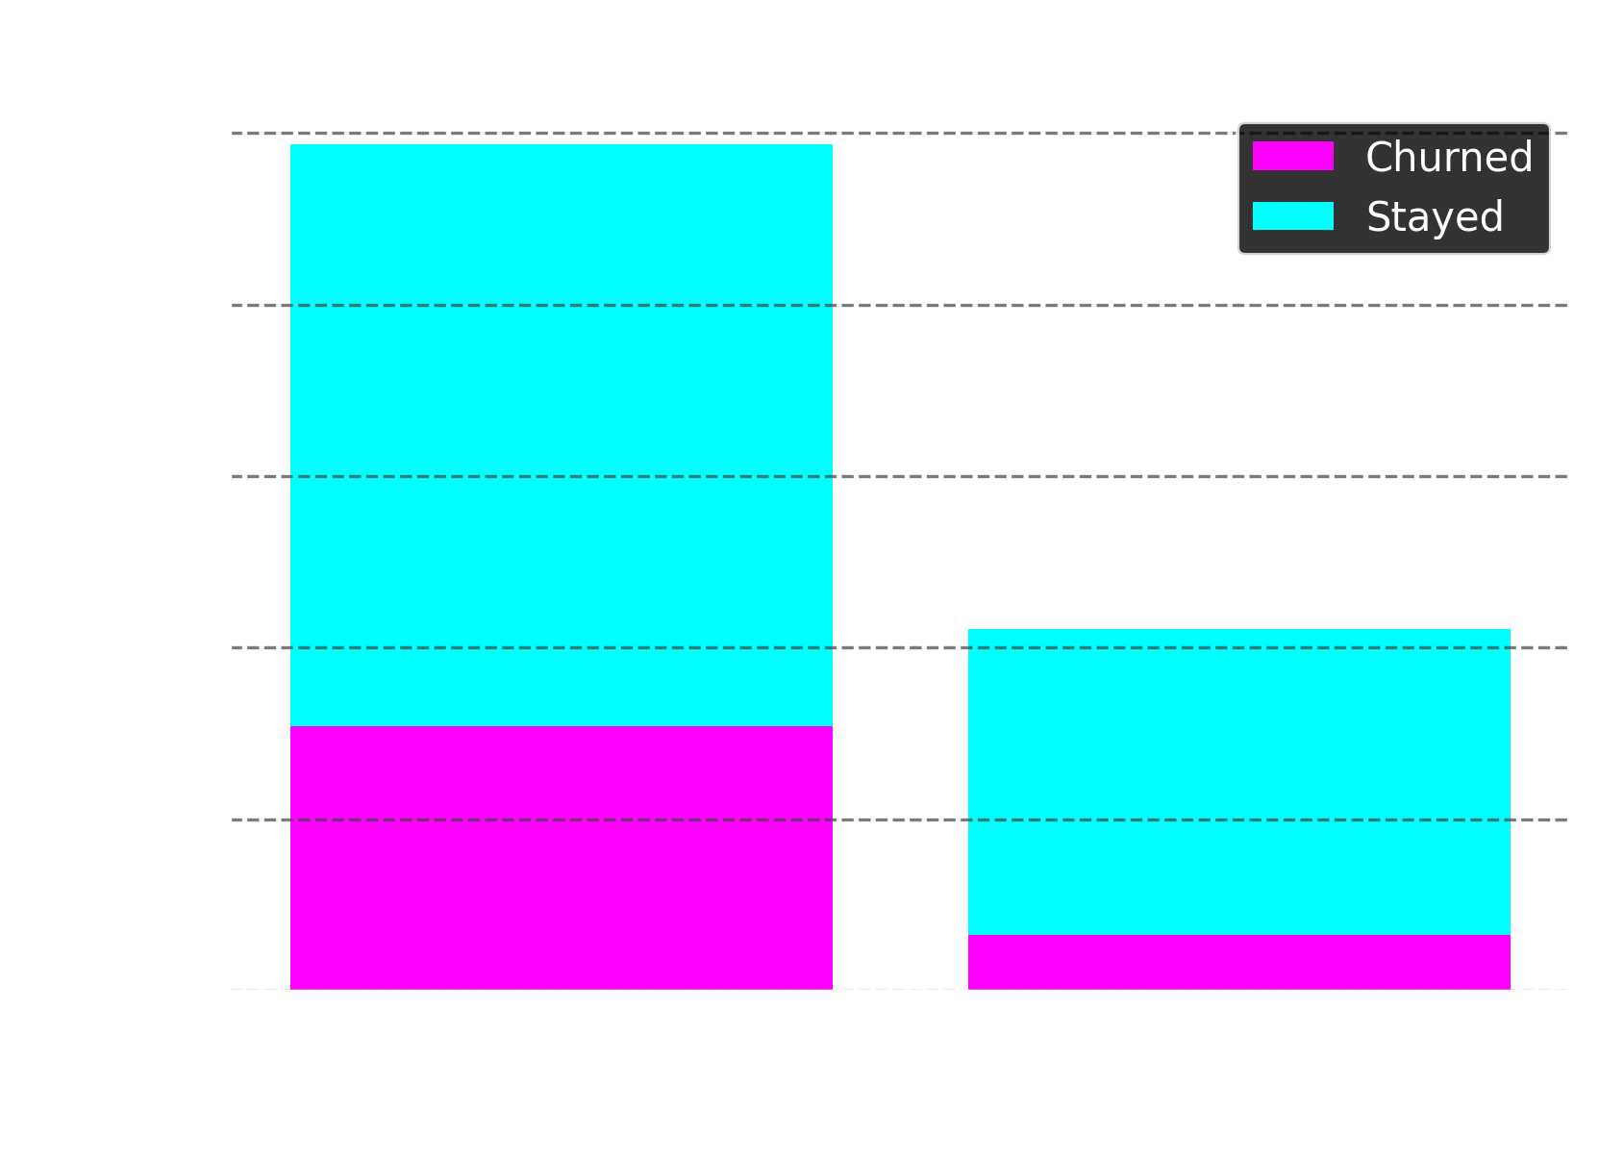

Slide 7
Insights
Gender: Male and female customers show similar churn behaviour, with 26.92% of females and 26.16% of males churning.
Senior Citizens: Senior citizens are far more likely to churn, with a rate of 41.68%, compared to only 21.61% of non-seniors.
Partner Status: Customers with a partner are more likely to stay, with a churn rate of just 19.66%, compared to 32.96% for those without a partner.
Dependents: Customers with dependents churn at a much lower rate of 15.45%, versus 31.28% for those without dependents.

Slide 8
Pricing and payment

Slide 9
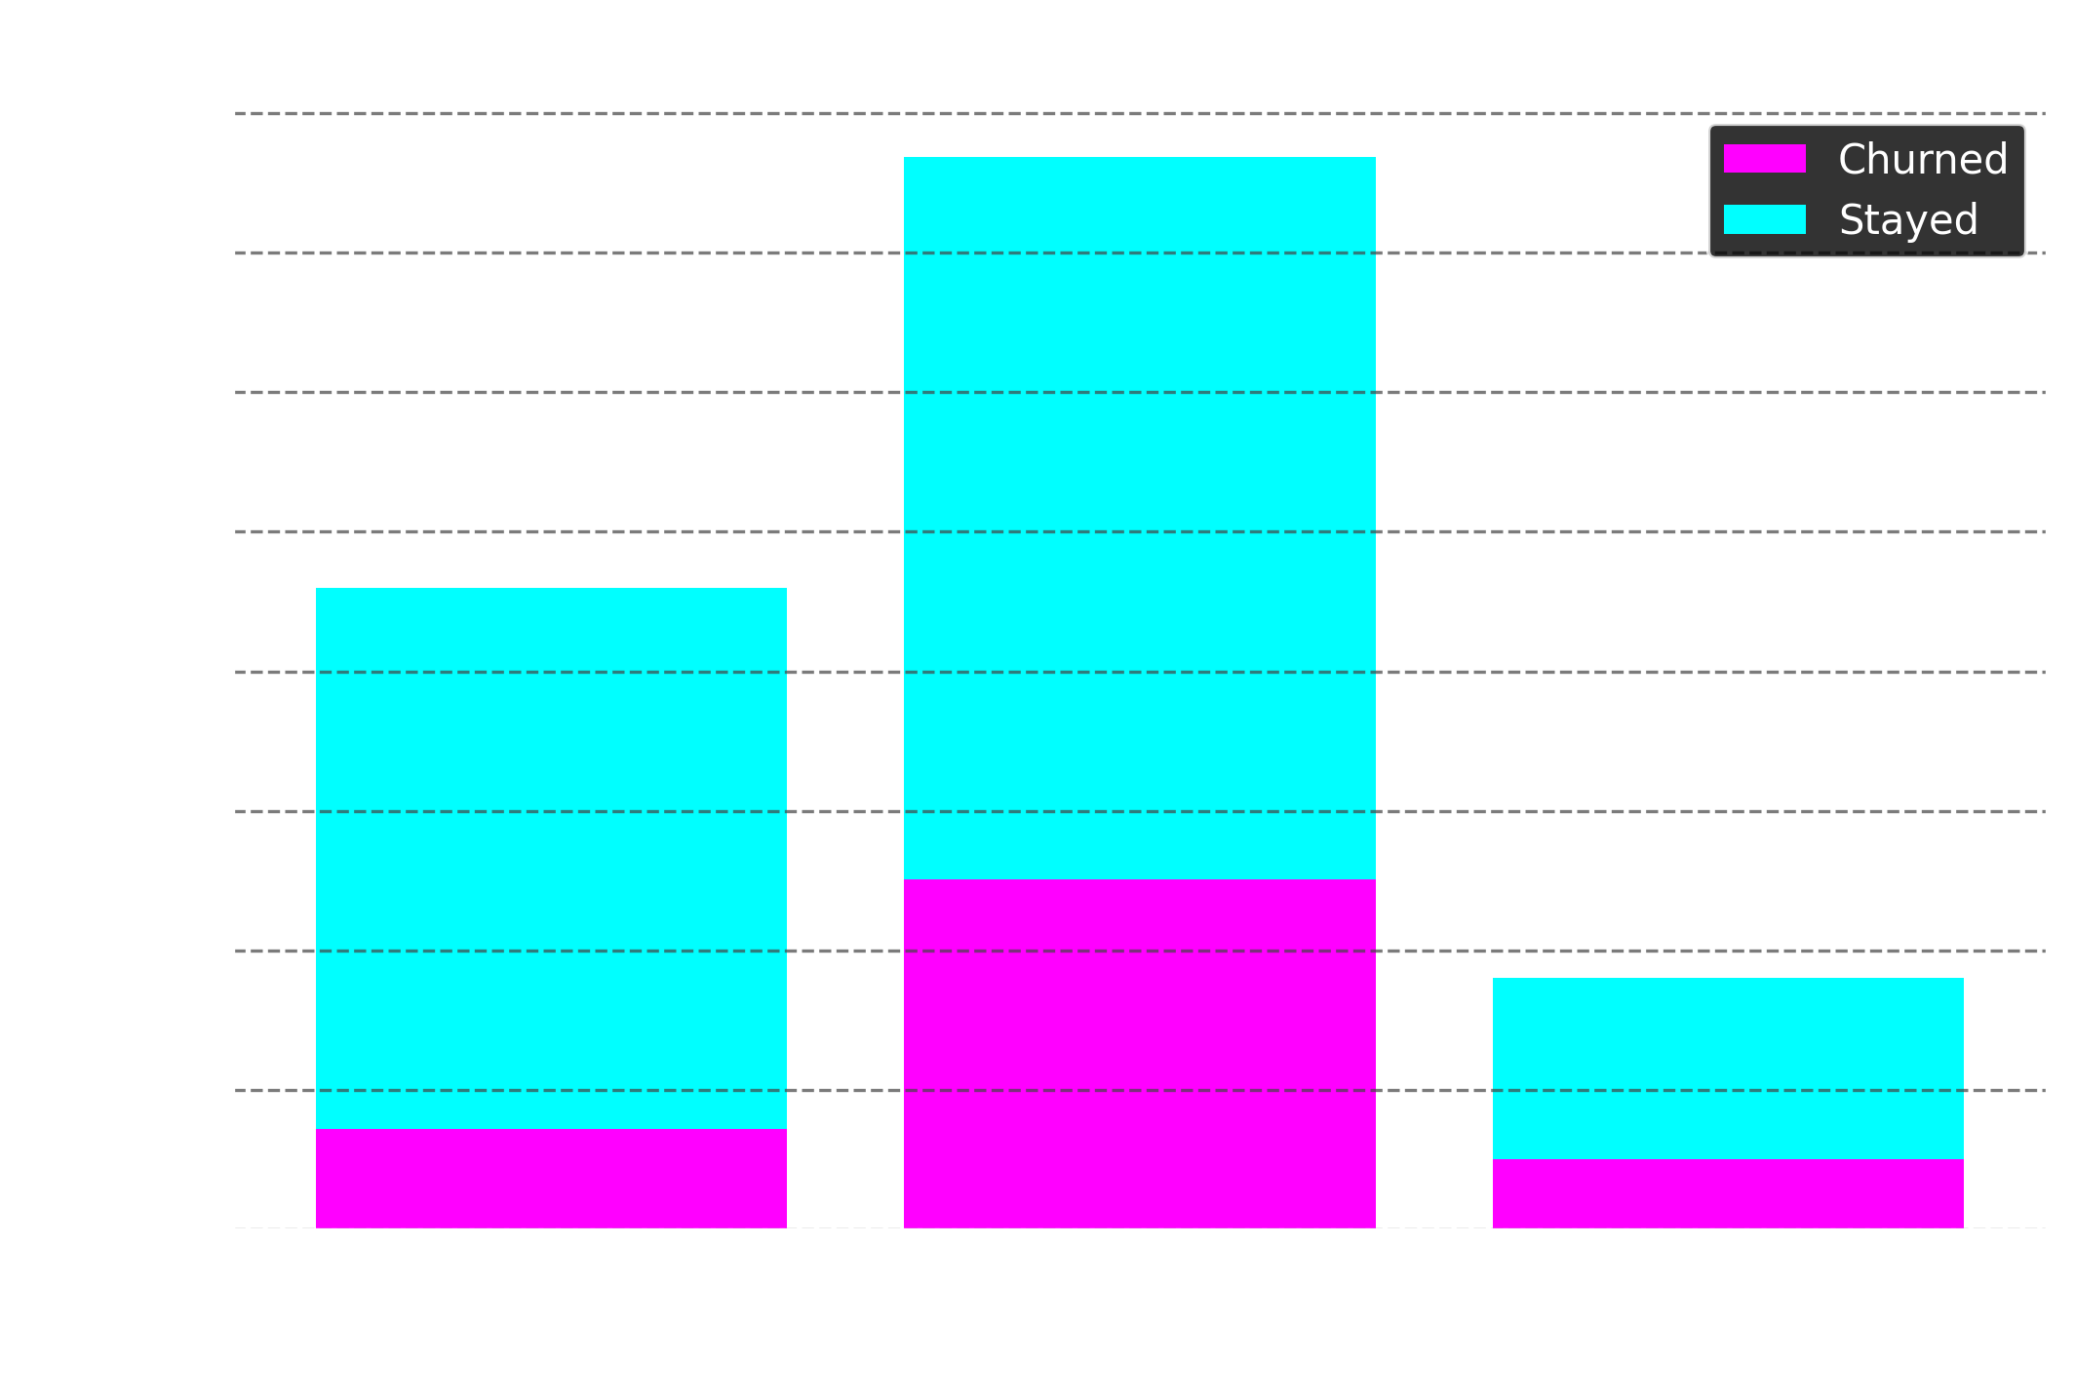
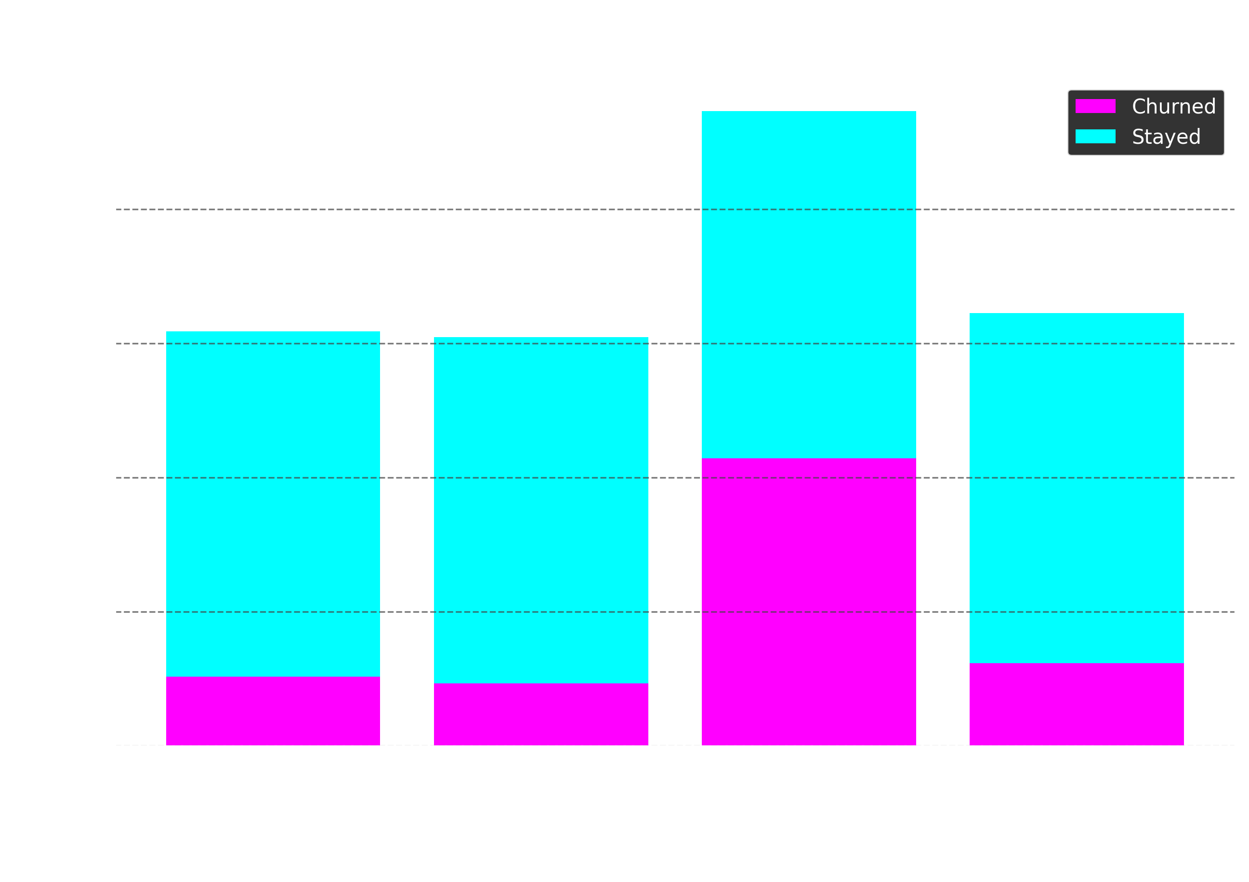
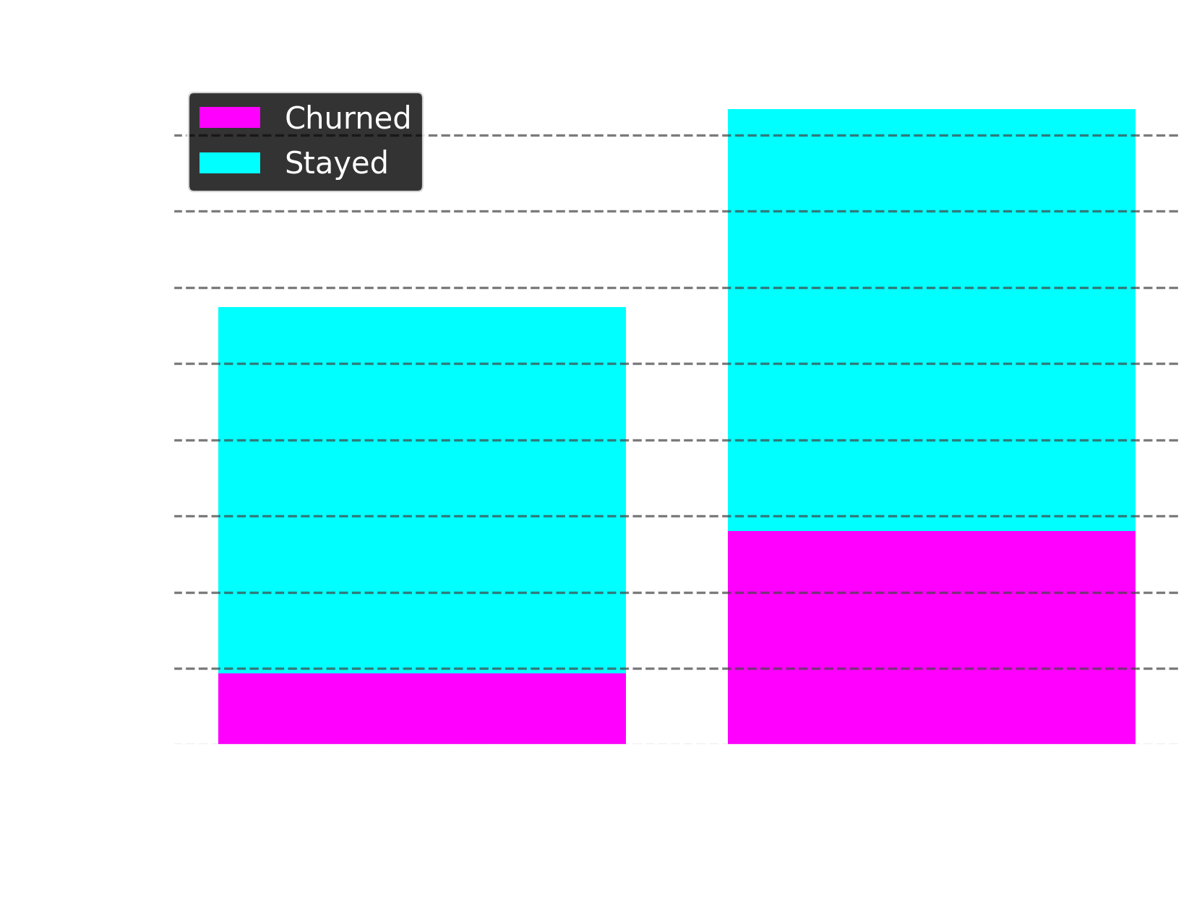

Slide 10
Insights
Monthly Charges:
Customers paying $50–$100 churn the most at 32.67%.
Customers paying over $100 churn at 28.05%.
Customers paying $50 or less churn the least at 15.7%.
Payment Method:
Automatic payments (Bank transfer: 16.71%, Credit card: 15.24%) have the lowest churn.
Manual payments churn more (Electronic check: 45.29%, Mailed check: 19.11%).
Paperless Billing:
Customers with paperless billing churn at 33.57%.
Customers without paperless billing churn at only 16.57%.

Slide 11
Contracts and services

Slide 12
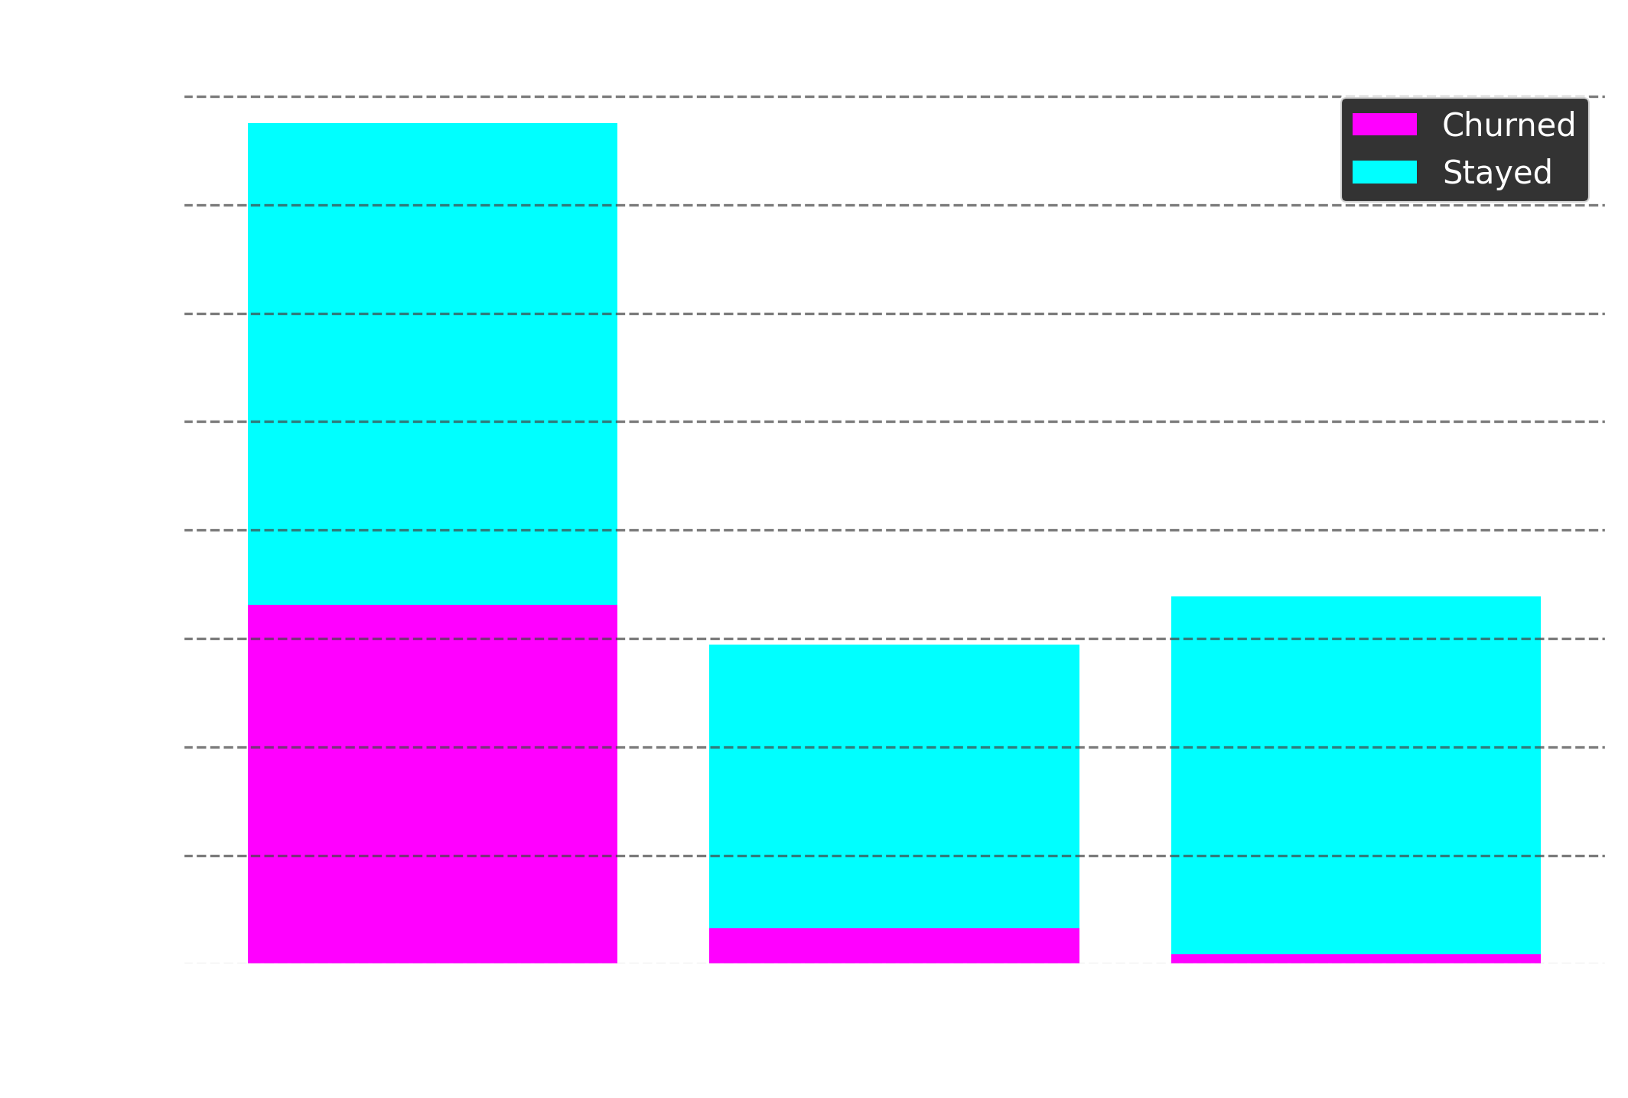
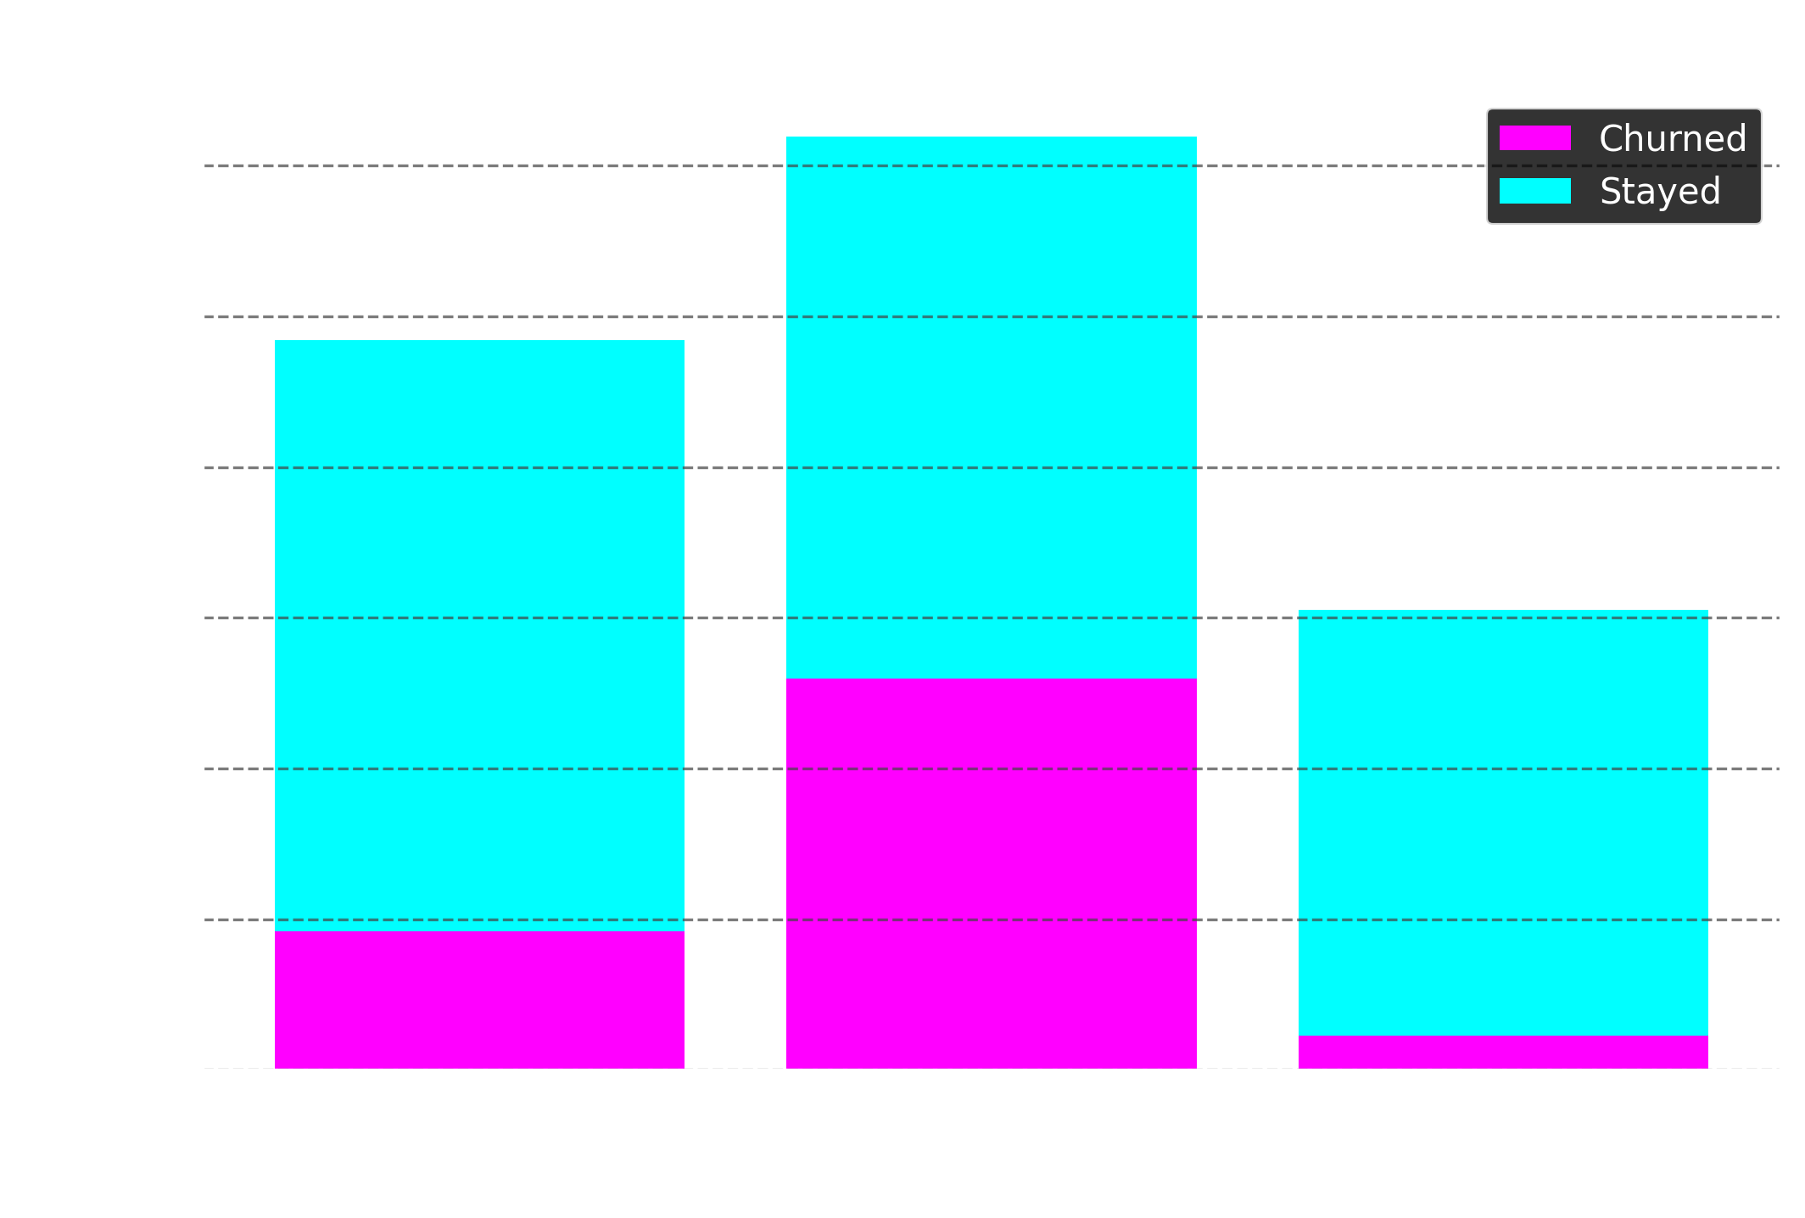

Slide 13
Insights
Contract Type:
Month-to-month contracts have by far the highest churn at 42.71%.
One-year contracts churn much less at 11.27%.
Two-year contracts have the lowest churn at just 2.83%.
Internet Service:
Fibre optic users churn the most at 41.89%.
DSL users churn at 18.96%.
Customers with no internet service churn the least at 7.4%.

Slide 14
Entertainment services

Slide 15
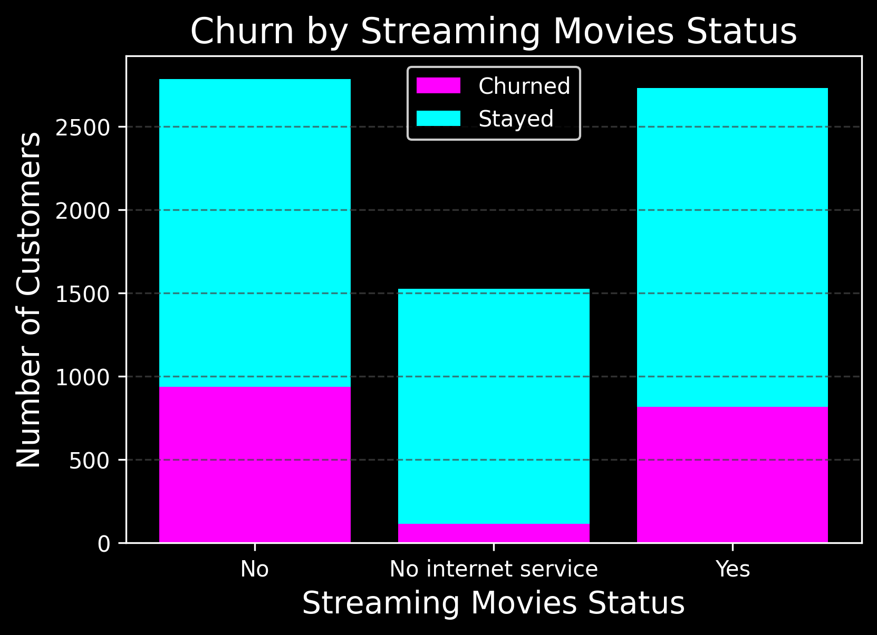


Slide 16
Insights
TV & Movie Streaming Churn Patterns:
Customers without TV or movie streaming have the highest churn at 33.5%.
Customers without internet service churn the least at 7.4%, showing a clear divide between connected vs. unconnected users.
Customers with TV, movie, or both subscriptions churn slightly less than those without any subscriptions(30%), indicating similar behavior across these subscription types.
Overall, churn rates for TV and movie services are nearly identical, suggesting these categories behave almost interchangeably in the dataset.

Slide 17
Financial impact

Slide 18
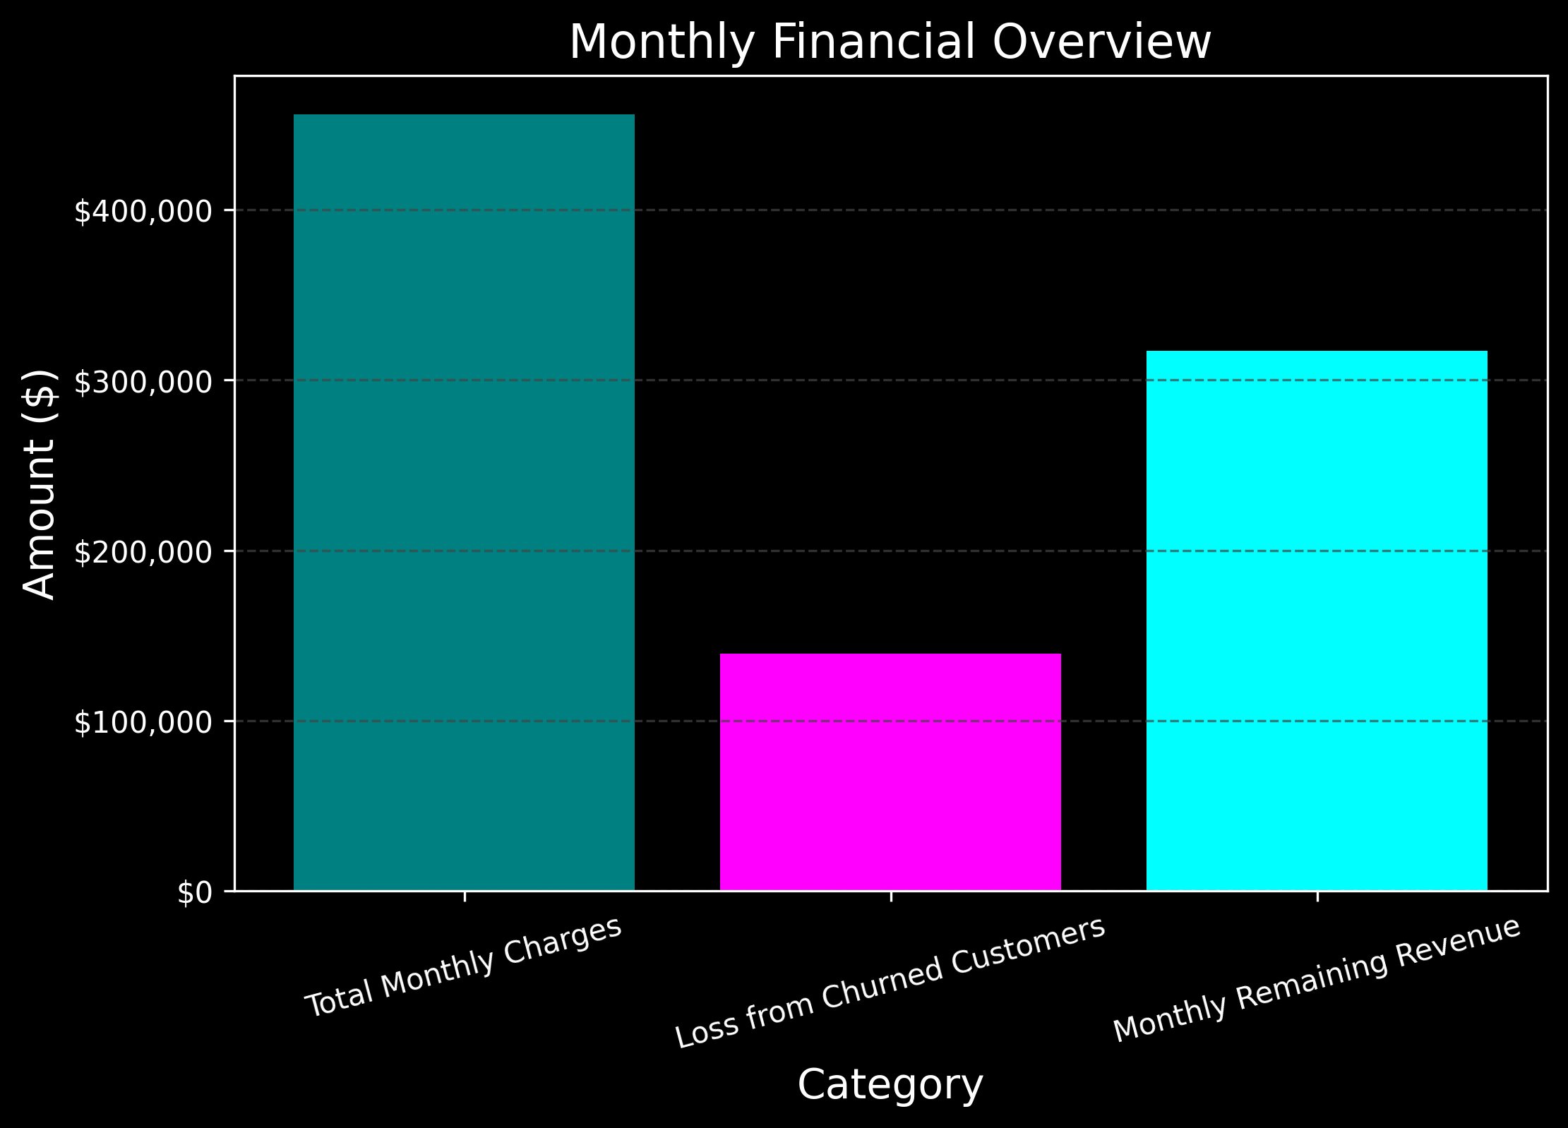
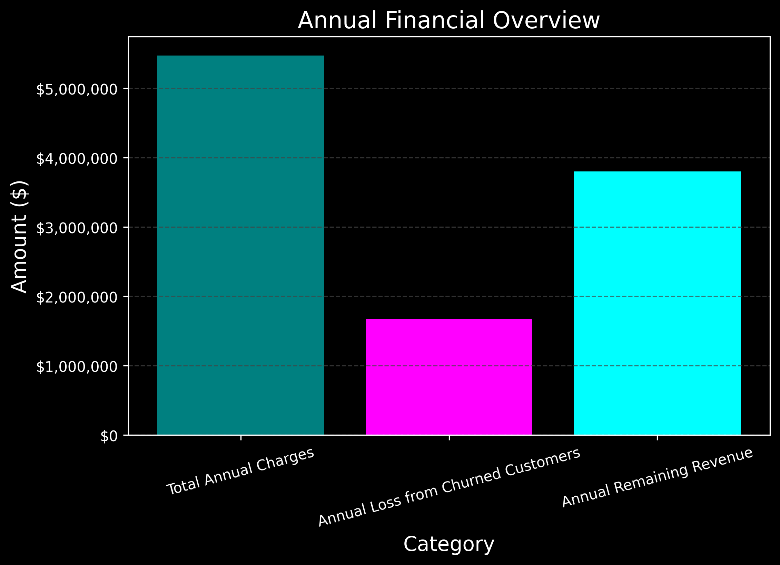

Slide 19
Insights
Monthly Revenue:
Without churn: $456K
Lost to churn: $139K
Remaining after churn: $316K
Yearly Revenue:
Without churn: $5.4M
Lost to churn: $1.6M
Remaining after churn: $3.8M

Slide 20
Machine learning model

Slide 21
80%
Our machine learning model was able to predict customer churn with an accuracy of 80%, correctly identifying the characteristics of customers most likely to leave. This means that in 8 out of 10 cases, the model successfully distinguished between customers who stayed and those who churned. While this is not a perfect prediction rate, it provides a reliable foundation for identifying at-risk customers and offers valuable direction for potential retention strategies.

Slide 22
HIGH-RISK CUSTOMER IDENTIFICATION
Our model identified 109 high-risk customers, representing 7.7% of the test group. These customers account for a potential $8,743 in monthly revenue at risk, which scales to approximately $104,922 annually. On average, high-risk customers have monthly charges of $80.22 and a short tenure of 3.4 months, highlighting that newer customers with higher bills are more likely to churn.

Slide 23
Recommendations
Target high-risk customers New customers with high monthly charges (avg. $80.22, tenure 3.4 months) churn fastest — especially seniors (41.7% churn) and fibre users (41.9% churn).
Develop retention incentives Offer early discounts, loyalty perks, or personalized outreach in the first 3 months. This is critical for seniors, customers without partners/dependents, and those paying by electronic check (45% churn).
Leverage predictive modeling Use the ML model (80% accuracy) to proactively flag at-risk customers. Cross-reference with demographics (senior status, contract type, billing method) for targeted interventions.
Unify TV & Movie strategy Churn rates differ by < 0.1% — treat them as one segment to simplify retention campaigns.
Quantify the financial upside With ~$105K annual revenue at risk, churn reduction initiatives could significantly increase profitability.

Slide 24
Closing statement
By combining demographic insights with predictive modelling, we can not only understand who is most likely to churn, but act early to prevent it — turning a $105K risk into a major opportunity for growth.

