Slide 1
Voice Health Analysis: Predicting Health Status from Audio Features
Machine Learning Approach to Voice-Based Health Classification

Slide 2
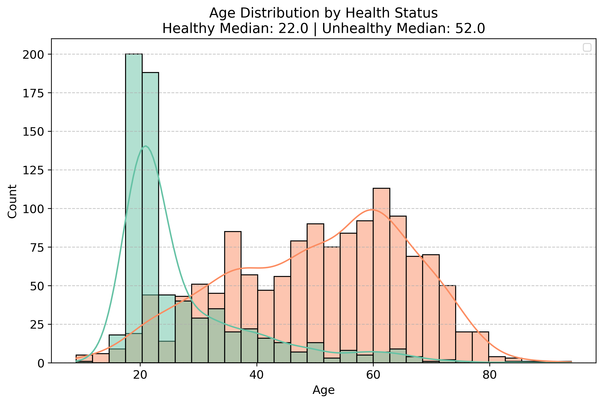
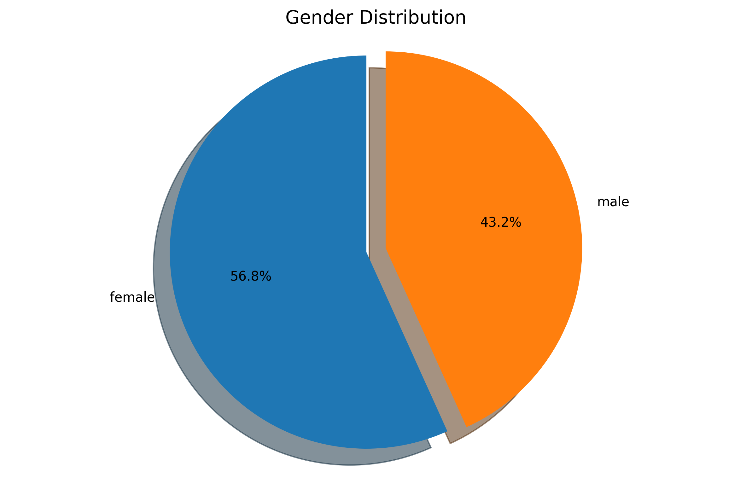
Age and gender distribution
30-year age gap between healthy (median: 22) and unhealthy (median: 52) groups, presenting a significant confounding variable.
2,037 voice recordings with roughly balanced gender representation (57% female, 43% male).

Slide 3
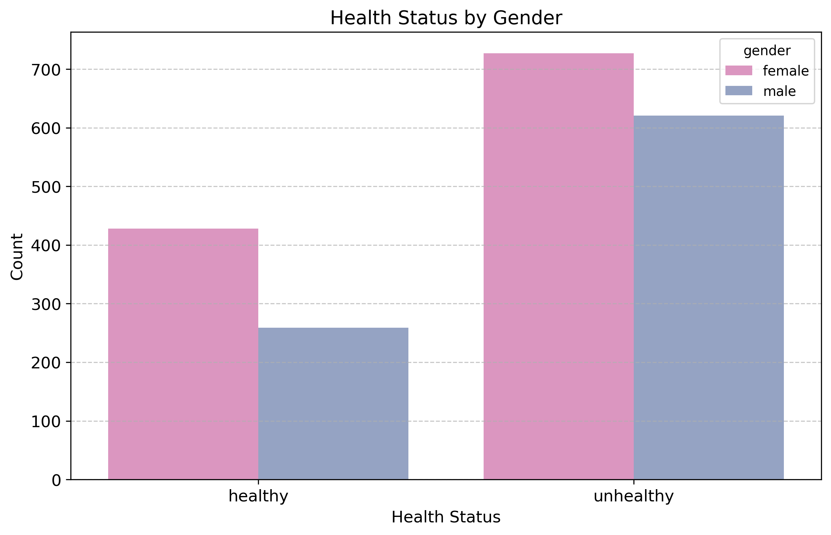
Health status by gender
Both males and females show similar distribution patterns, with approximately twice as many unhealthy individuals compared to healthy across each gender group.

Slide 4
Key Discriminator: Spectral Centroid
What It Measures:
Voice brightness / center of spectral mass - think of it as the 'color' of the voice

Slide 5
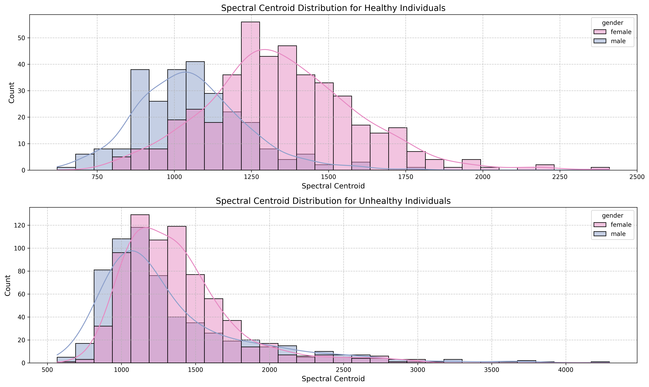
🔍 Main Finding: Unhealthy voices are significantly darker
📉 Female drop: 1250 Hz → 1100 Hz (150 Hz decrease)
📉 Male drop: 1050 Hz → 950 Hz (100 Hz decrease)
🎯 Convergence effect: Unhealthy voices become less gender-distinct

Slide 6
Rolloff: Indicator of Vocal Instability
What It Measures:
Frequency below which 85% of voice energy is contained - indicates breathiness and vocal stability

Slide 7
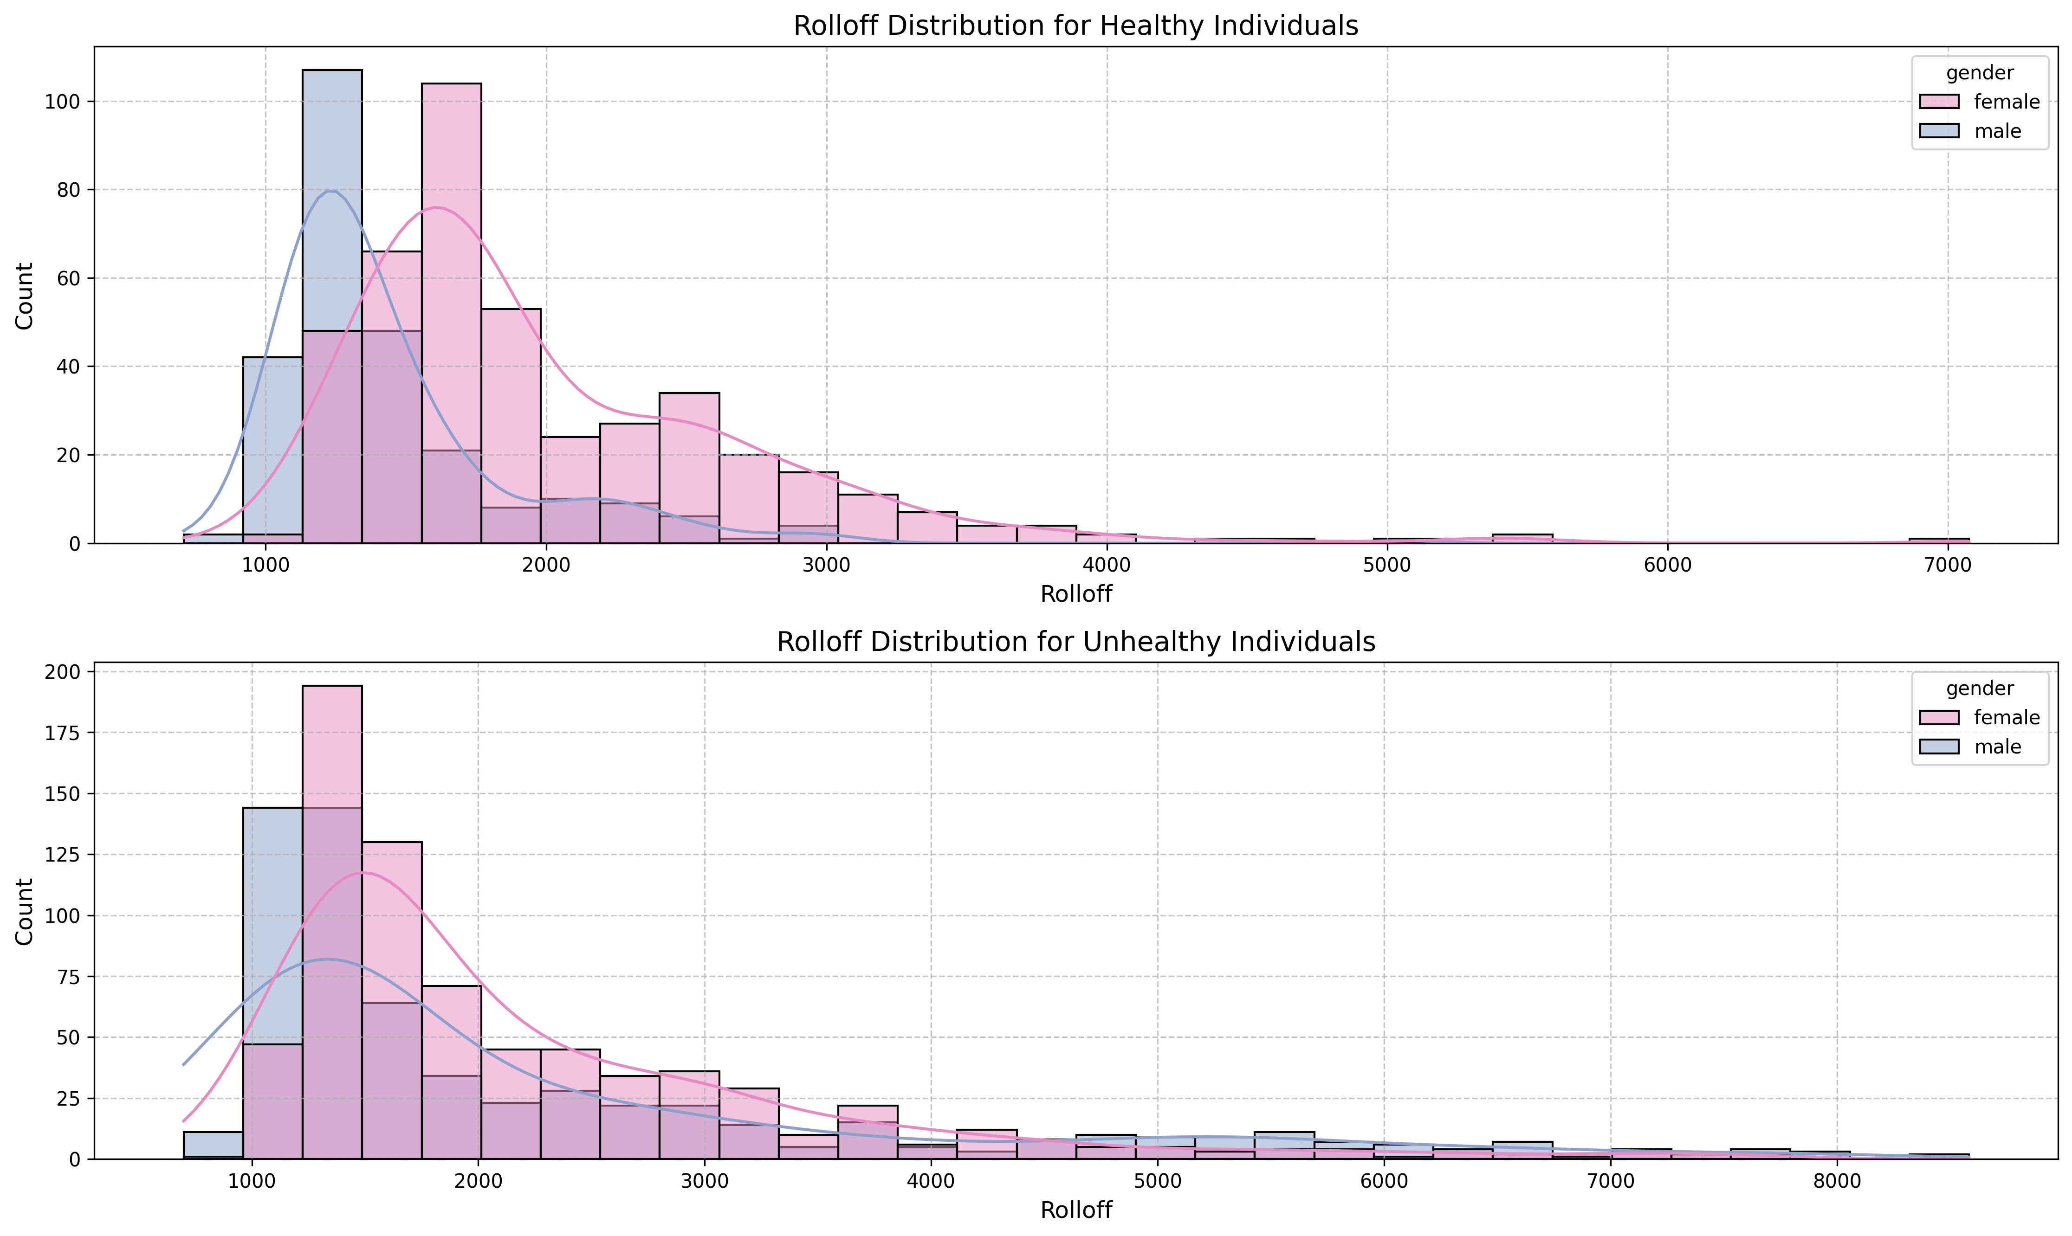
✅ Healthy voices: Tight, consistent patterns
  Males: 1100-1300 Hz (narrow range)
  Females: Similar stability
⚠️ Unhealthy voices: Extreme variability
  Males: 1000-8000 Hz range (8x spread!)
  Suggests vocal fatigue, instability, breathiness
🚹 Gender effect: Males show dramatic changes, females stable

Slide 8
Feature Diversity: MFCC Correlation Matrix
What It Measures:
Mel-Frequency Cepstral Coefficients - capture voice characteristics the way human ears perceive sound

Slide 9
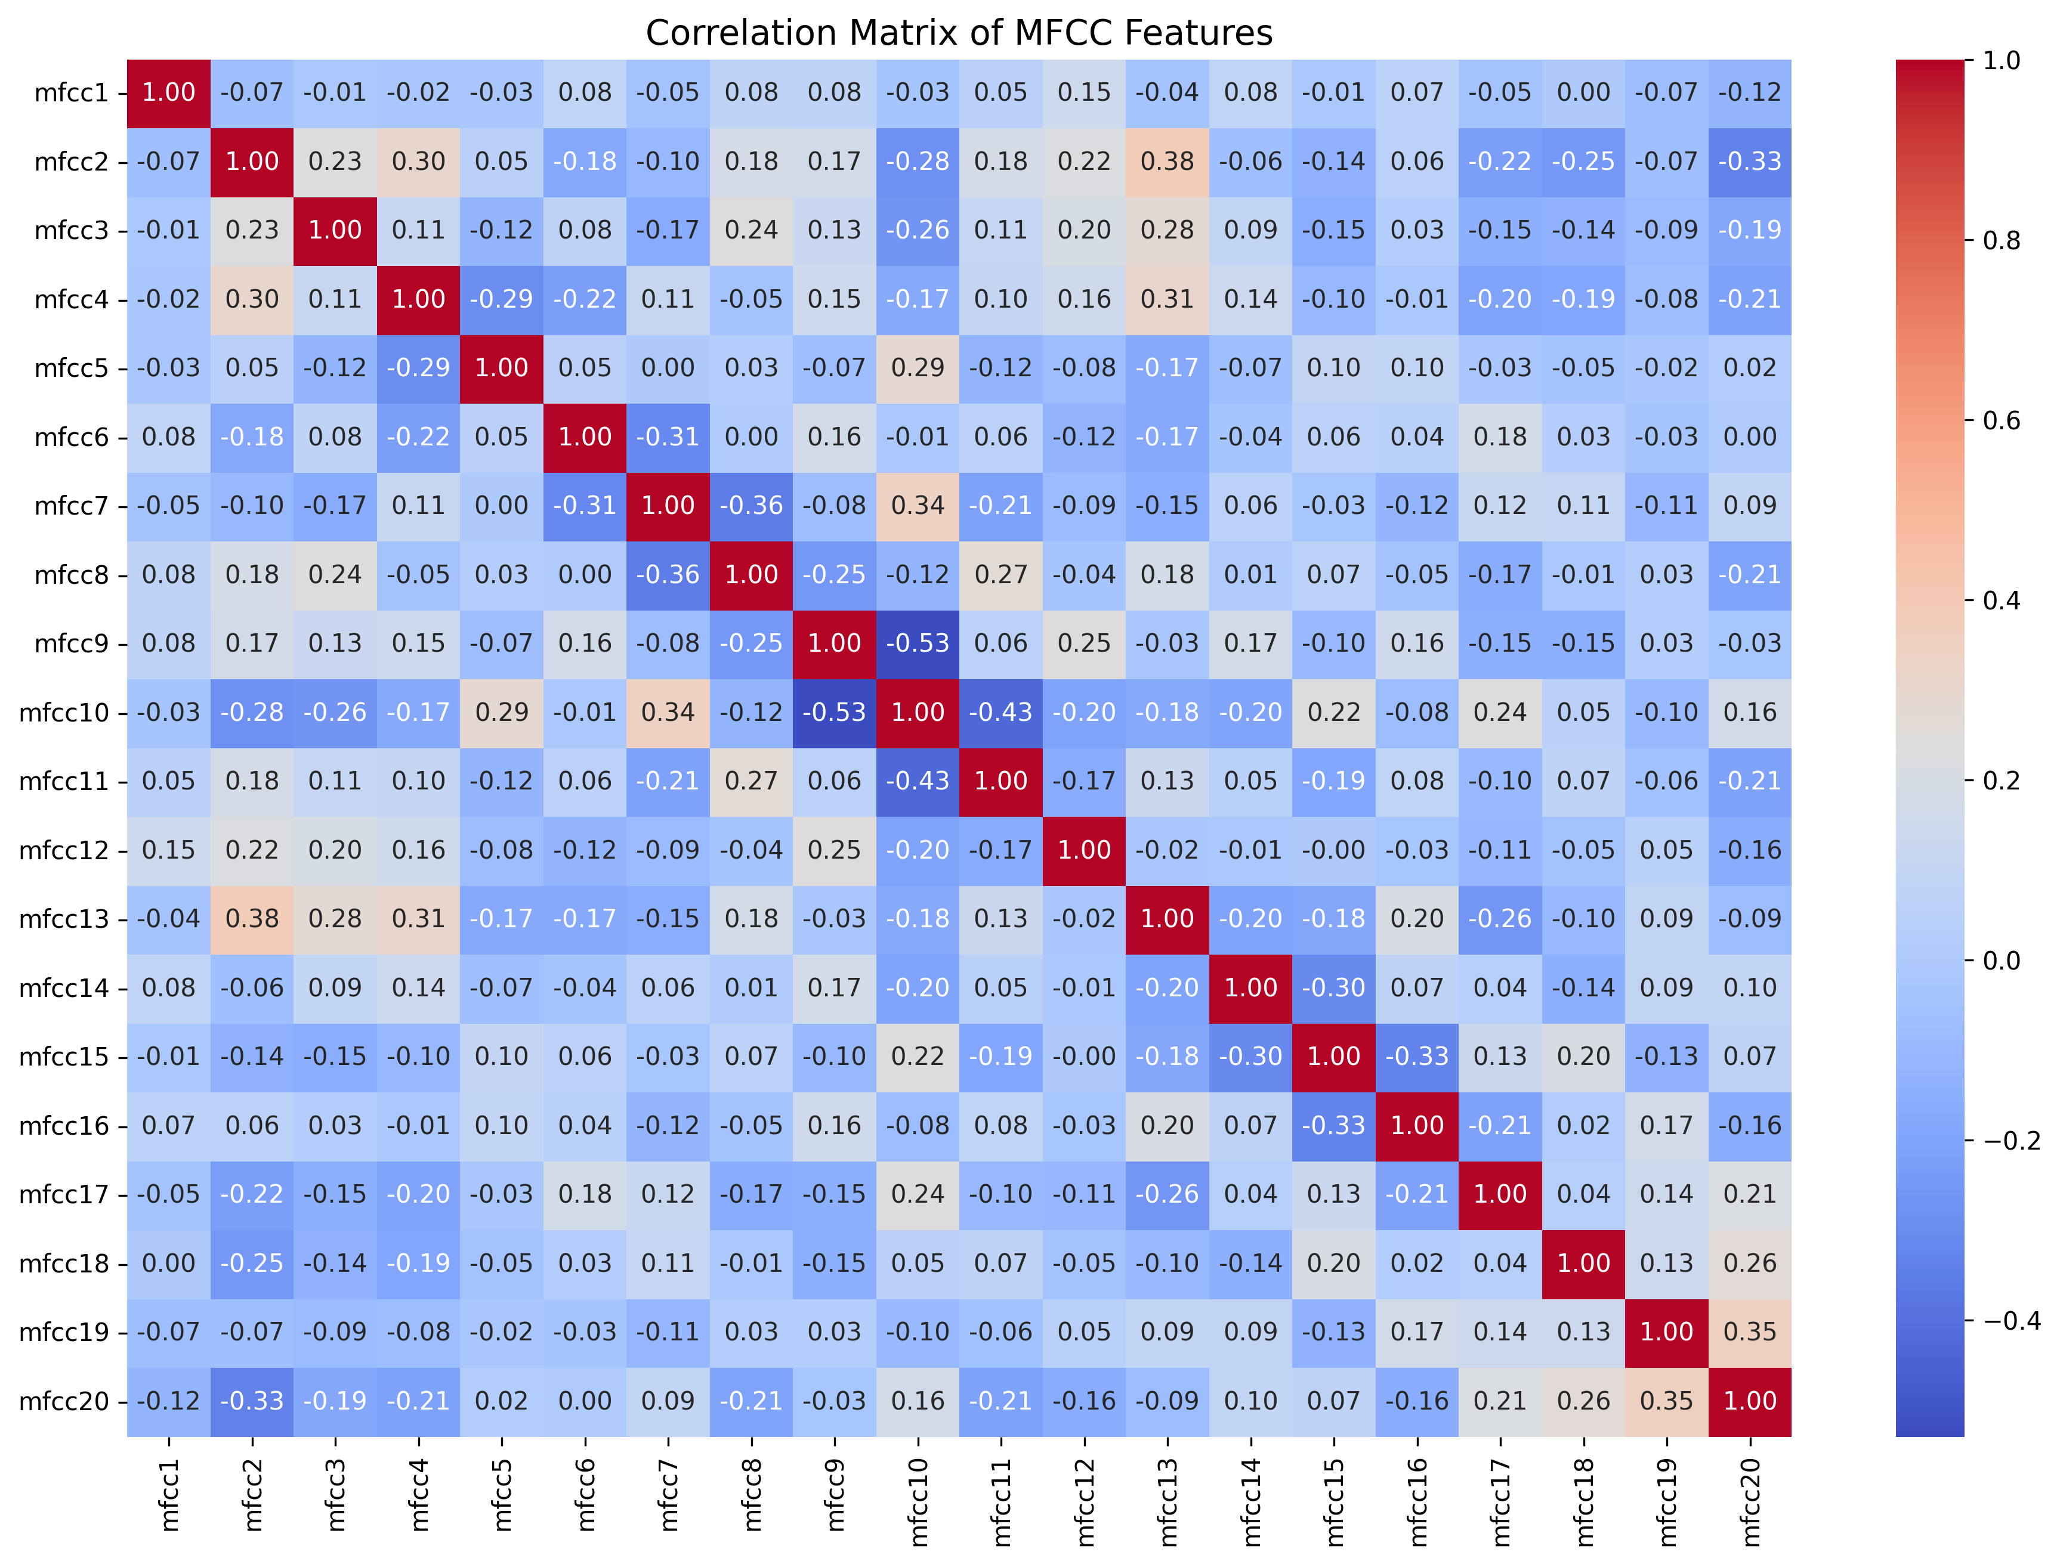
🎵 20 MFCC features (mfcc1-mfcc20)
✅ Low correlations (mostly < 0.4)
  Each feature captures unique information
  No redundancy issues
💡 Why it matters:
  Diverse features = better model performance
  No multicollinearity problems

Slide 10
Machine Learning Results & Key Takeaways

Slide 11
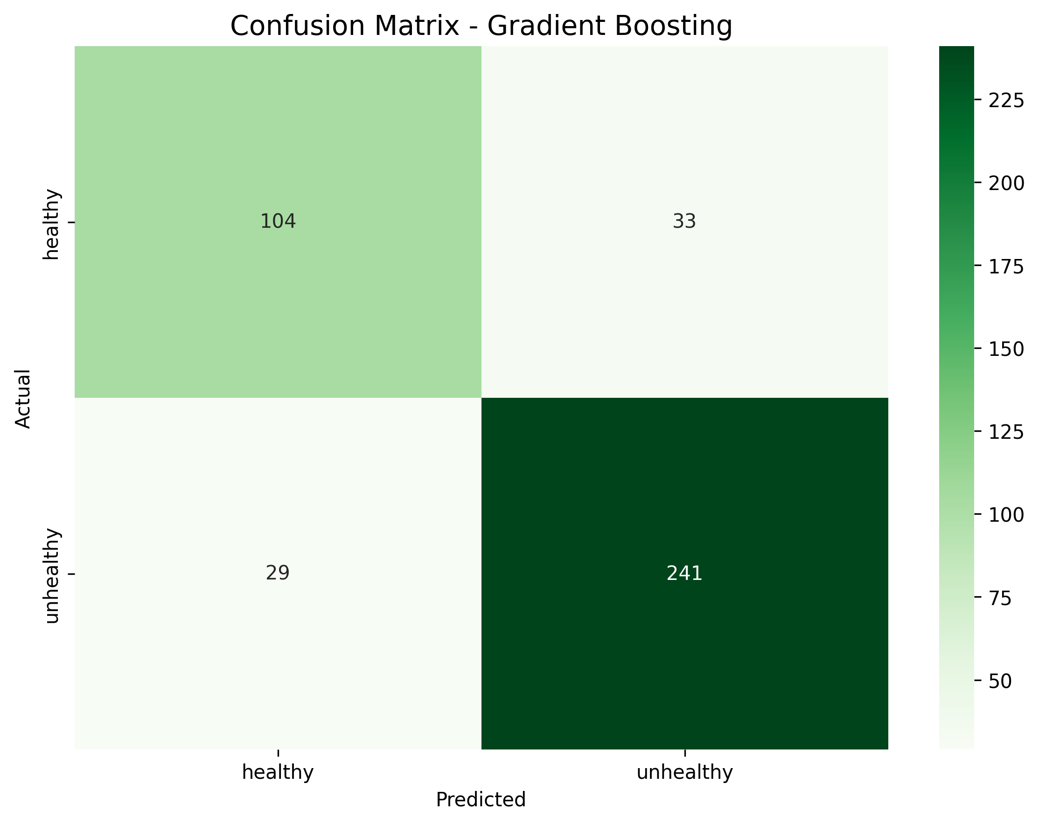
Best Model: Gradient Boosting
🎯 Accuracy: 85%
📊 Best features: Spectral centroid, rolloff, age

Slide 12
Key Findings
🎤 Voice Patterns
Spectral centroid strongest predictor
Rolloff shows extreme variability
MFCCs capture nuanced differences
⚠️ Challenges
Age confounding (30-year gap)
Class imbalance (66/34 split)
Gender-specific effects

Slide 13
🔮 Recommendations
Age-matched validation needed
Gender-specific models
Control for demographic variables

Slide 14
Voice features show promising discriminative power, but age remains the elephant in the room

