Slide 1

Team Name : (your team)
Team Leader Name :
Problem Statement : Rank the top 100 of 100,000 candidates for one nuanced Senior AI Engineer JD with recruiter-grade judgment — not keyword matching — avoiding keyword-stuffer traps and ~80 planted honeypots. Project: Lighthouse — a reasoning-first, explainable candidate ranker.

Slide 2
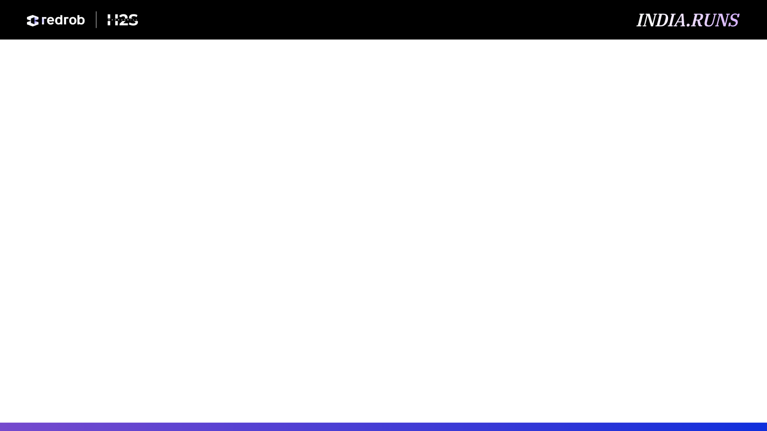
The Problem
• 100,000 candidates; genuine Senior-AI-Engineer fits are rare — only 0.78% even have an AI-ish title.
• Seeded traps: keyword-stuffers (an Accountant listing 9 AI skills), plain-language Tier-5s (real systems, no buzzwords), behavioral twins, and ~80 honeypots (subtly impossible profiles).
• The provided sample_submission ranks the stuffers #1–20 — the exact wrong answer. >10% honeypots in the top-100 = disqualification.
• Scoring is NDCG@10-heavy: the top-10 must be right. The real task is reasoning about the gap between what the JD says and what it means.

Slide 3
Solution Overview
• Lighthouse — an offline-LLM-augmented hybrid ranker: recruiter-grade, reasoning-first, fully explainable.
• Five fit components (semantic + role-coherence + career-evidence + experience + skill-trust), gated by JD hard-negatives and a behavioral modifier, with honeypots zeroed.
• Reads career evidence & semantics, not keywords — surfaces plain-language Tier-5s and sinks keyword-stuffers.
• Every pick ships a grounded, no-hallucination reason.
• CPU-only, < 5 min, no API at rank-time — production-shaped, not a GPT-per-candidate demo.
• Live Discovery surface: paste JD prose → auto-facets (or preset chips), then look-alike search across the 100K — recruiter-grade exploration, not a static list.

Slide 4
JD Understanding & Candidate Evaluation
• Must-haves: production embeddings/retrieval, vector/hybrid search ops, ranking-eval (NDCG/MRR/MAP), strong Python. Ideal 6–8 yrs, 4–5 applied-ML at product (not services) cos, shipped a ranking/search/recsys system.
• 8 hard-negative gates: services-only, outside-India & won't-relocate (no visa), research-only, CV/speech-only w/o NLP, LangChain-only-recent, title-chasers, non-engineering current role, unbacked-expertise (≥5 expert-skill claims absent from every role — the stuffer trap). Dampen, don't annihilate.
• Signal priority: career-history evidence > job title > listed skills. Behavioral signals decide actual availability.
• Claude (offline) parsed the JD into a static committed rubric — read at rank-time with no API call.

Slide 5
Ranking Methodology
• Retrieve: precomputed bge-small embeddings over clean per-candidate text blobs (100K). (A BM25 lexical index is built offline — optional, not loaded at rank-time.)
• Score, each in [0,1]: semantic_fit (cosine vs JD facets, top-4 blend), role_coherence (taxonomy+semantic), career_evidence (built ranking/search at product cos; recency-weighted, 4-yr half-life), experience_fit (soft 6–8 curve), trust_skills (proficiency×duration×endorsements×assessment, +AI/ML certs).
• Combine: weighted base (role_coherence 0.26 & career_evidence 0.24 lead) × Π(8 gates) × behavioral modifier [0.80–1.12] (activity, response-rate, recruiter-saves/views, open-to-work lift); honeypots → 0.
• final = base × gates × behavior. Order by score desc; ties → candidate_id ascending; take top 100.

Slide 6
Explainability & Data Validation
• Deterministic, fact-grounded reasoning per candidate — cites real years, title, named skills, employers, signal values, and names honest gaps (e.g., '120-day notice; Toronto-based — relocation risk').
• Zero hallucination: every term traces to the candidate's own profile (enforced by tests). Variation by dominant factor; tone tracks the rank band.
• Honeypot/anomaly detector (explainable rules): ≥3 advanced/expert skills with 0 months, date contradictions, tenure overflowing experience, invalid education — flags 0.042% of the pool, no false positives on real profiles.
• Schema-tolerant parsing; sentinels (-1 github/offer, empty assessments — 60–76% of pool) treated as neutral, never penalized. Fully seeded/deterministic.

Slide 7
End-to-End Workflow
• Phase 1 — Offline precompute (network OK, no time limit): JD →(Claude)→ jd_rubric.json; candidates → text blobs → bge-small embeddings (fp16) + BM25; Claude → eval labels. Artifacts committed.
• Phase 2 — Rank-time (CPU, no network, < 5 min): load artifacts → score 5 components → gates × behavioral → honeypot zero → sort/tie-break → top-100 → grounded reasoning → submission.csv.
• Single reproduce command: python rank.py --candidates ./data/candidates.jsonl --out ./submission.csv → passes the official validator.

Slide 8
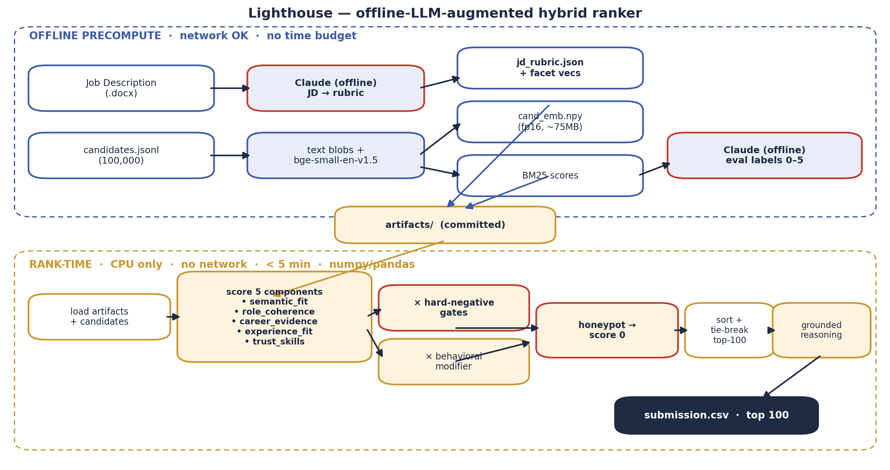
System Architecture

Slide 9
Results & Performance
• Label-INDEPENDENT evidence (no trust in our labels needed):
– 0 honeypots in the top-100 (audited over full 100K; DQ threshold >10%). All 100/100 hold an AI/ML/IR/DS/Search/NLP title — 0 non-technical; the sample_submission instead ranks HR/Accountants at #1–20.
– Trap resistance: the keyword baseline puts 13/32 keyword-stuffers in its top-25; Lighthouse admits 0. Remove the anti-trap stack and honeypots climb (median rank 209→143).
– Live demo sample (100): the actual top 80 from the 100K submission + 10 keyword-stuffers + 10 honeypots. Ranks 1-80 byte-identical to the submission (real engineers, score 0.93-1.00); ranks 81-90 = stuffers with NON-TECHNICAL badge (≈40× lower score); ranks 91-100 = honeypots, every one scoring 0.0. The live Space is an in-browser replay of the official ranking.
• Directional only (self-labeled — NOT absolute accuracy): vs keyword baseline composite 0.998 vs 0.553. Labeler & ranker share assumptions, so a ~perfect NDCG@10 = internal consistency, not validated accuracy — the gap + ablation deltas are the signal. A blind human-label harness ships for an independent check.
• Constraints met: rank step CPU-only, no network, ~45 s (well under the 5-min budget) over 100K; embeddings precomputed (~75 MB fp16); 127 tests green, lint+mypy clean.

Slide 10
Technologies Used
• sentence-transformers BAAI/bge-small-en-v1.5 — small, CPU-friendly, strong retrieval quality; precomputed so rank-time needs no model.
• rank_bm25 — optional offline lexical index; precomputed but never loaded at rank-time (ranking is semantic + deterministic features).
• numpy / pandas — the entire rank step: fast, deterministic, dependency-light (fits the 5-min / 16 GB / CPU box).
• Claude (offline only) — JD→rubric parsing and eval labeling; never called at rank-time, no candidate data sent to any API.
• pytest (127 tests), FastAPI + vanilla JS/anime.js animated UI (HF Spaces sandbox), python-pptx + matplotlib (this deck).

Slide 11
• GitHub: https://github.com/jacklachan/lighthouse-indiaruns
• Live sandbox (HF Spaces): https://huggingface.co/spaces/Auenchanters/lighthouse
• Reproduce: pip install -r requirements.txt → python precompute.py → python rank.py → python validate_submission.py submission.csv
• Demo video: [placeholder — add link before submission]
• AI use: Claude offline for JD parsing + eval labeling + coding assistant; no candidate data hit any API at rank-time (see submission_metadata.yaml).
Github video etc

Slide 12


