Slide 1


INDIA'S BIGGEST MARKET SCAM — EXPOSED
FRAUD EXPOSED
RAJESH EXPORTS LTD
VALCAMBI SA
₹15.15 LAKH CRORE REVENUE SCAM
How India's Top Gold Exporter Allegedly Fabricated 99% of Its Revenue
SEBI Interim Order | June 3, 2026 | A VedasVision Compliance Insight

Slide 2
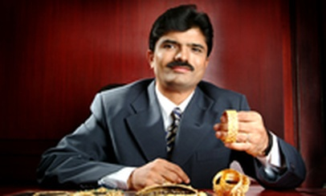
WHO IS RAJESH EXPORTS?
The company that claimed to be India's largest gold exporter
🏢 Founded
1995 | Bengaluru, Karnataka
📈 Listed
BSE 531500 & NSE RAJESHEXPO
🌍 Key Asset
Valcambi SA — World's largest gold refinery
📊 Reported Rev FY25
₹4.23 LAKH CRORE (consolidated)
RAJESH MEHTA — Chairman & MD
✅ Actual Verified
~₹423 Cr — only 0.1% of claimed
🏦 LIC Stake
10.79% — YOUR insurance premium
📉 Stock fall
80%+ in 3 years
Rajesh Exports Limited
⚡ Post-order
Lower circuit ₹78 on Jun 3, 2026
⚠️ Harshad Mehta = ₹4,000 Cr | Rajesh Exports = ₹15,15,000 Cr → 3,787× BIGGER

Slide 3
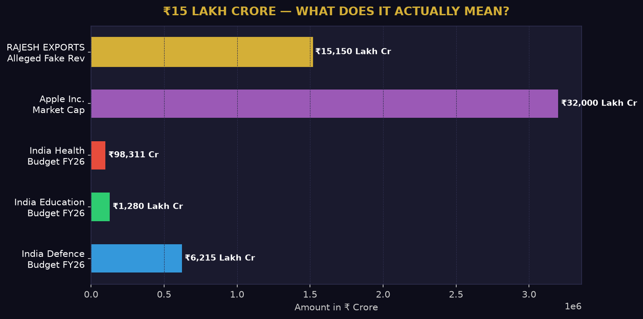
₹15 LAKH CRORE — WHAT DOES THIS NUMBER MEAN?
Put the alleged fraud in perspective — it's bigger than India's entire defence + education + health budget combined

Slide 4
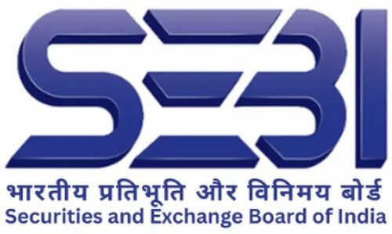
HOW THE SCAM UNRAVELED
One shareholder complaint → 2-year investigation → India's biggest alleged fraud
Shareholder complaint to SEBI: Trade receivables unpaid for 2+ years. (If sales are real — why is the payment not coming?)
MARCH 2024
SEBI launches formal investigation. Forensic auditor BDO India appointed. Company asked for ERP access, books, journal entries, subsidiary records.
OCT 2024
Company refuses cooperation: No ERP access. Auditors don't get working papers. Cites Swiss data protection laws to block Valcambi records.
ONGOING
SEBI Interim Order: Rajesh Mehta BANNED from markets. 99% revenue misrepresentation confirmed. ₹12,726 Cr shareholder wealth destroyed.
JUN 3,2026

Slide 5
THE SHELL COMPANY WEB
4 layers — the middle layer NEVER audited, yet booked ₹15 lakh crore
REL — Rajesh Exports Limited
LISTED IN INDIA | NSE/BSE
REL Singapore Pte Ltd
100% Subsidiary | NO Operations
GGR — Global Gold Refineries AG
BAB AL Rayan Jewellery LLC
NEVER AUDITED ⚠️ Fraud booked here
CEASED Operations
Valcambi SA
REAL Refinery — Balerna, Switzerland
THE CORE FRAUD
GGR — between REL Singapore and Valcambi — was NEVER independently audited. Yet REL booked ₹15 lakh crore revenue at this level. Valcambi (KPMG audited) reported ₹423 Cr. The gap between them = ₹15 lakh crore of alleged fake revenue.

Slide 6

THE REVENUE ILLUSION
How ₹15.15 Lakh Crore was manufactured — the dry-cleaner trick
WHAT REL REPORTED
ACTUALLY VERIFIED
FY21
₹2.02 Lakh Crore
Valcambi SA (KPMG) 5-Year Revenue:
FY22
₹3.31 Lakh Crore
~₹3,000 Cr
FY23
₹3.28 Lakh Crore
FY24
₹2.38 Lakh Crore
vs ₹15.15 LAKH CRORE reported
Valcambi Gold Bar
FY25
₹4.23 Lakh Crore
WHY THE GAP?
TOTAL
₹15.22 Lakh Crore
Valcambi refines gold → earns a PROCESSING FEE only. REL booked the FULL MARKET VALUE of ALL gold processed as their 'revenue'. Like a drycleaner counting ₹10 lakh suit value as sales instead of ₹500 fee.

Slide 7
PAISA KAHAN GAYA? — THE COMPLETE MONEY TRAIL
Follow every rupee from company accounts to personal F&O bets
RAJESH EXPORTS LTD (REL)
Listed company | ₹15L Cr revenue claimed
RAJESH MEHTA PERSONAL ACCOUNT
GGR (Switzerland)
₹339 Cr+ moved — NO board approval
₹15L Cr fake revenue booked here
DERIVATIVES TRADING (F&O)
ELEST EV COMPANY
AFFLUENCE SECURITIES
High-risk personal bets with company money
₹215 Cr net outflow undisclosed related party
₹11,487 Cr fake sales+purchases 'We have NO such client'
PERSONAL LOSS
CAPITAL GONE
FAKE REVENUE
Booked back into company accounts
₹215 Cr never fully returned
Company looks bigger than reality
NET RESULT: Investors lost ₹12,726 Cr of wealth | LIC lost thousands of crores | Stock crashed 85%
All while company reported record revenues and management claimed everything was fine.

Slide 8
THE AFFLUENCE SECURITIES SCAM
How company money funded the promoter's personal F&O bets
THE SETUP
REL books: ₹11,487 Cr SALES + ₹11,488 Cr PURCHASES with 'Affluence Shares & Stocks Pvt Ltd' (FY22-FY24). SEBI contacted Affluence. Reply: 'We have NO client named Rajesh Exports. These transactions NEVER happened.'
STEP 1
STEP 2
STEP 3
STEP 4
REL funds to Mehta's PERSONAL account ₹339 Cr+ No board approval
Personal DERIVATIVES TRADES (F&O) High-risk bets with company funds
Trade amounts booked as fake Sales + Purchases in REL via 'Affluence'
Revenue inflated. Fund diversion hidden from all investors/board.
RAJESH MEHTA
Shareholder wealth destroyed: ₹12,726 Crore | Stock: −80% in 3 years
UAE COMPLIANCE LINK
CBUAE & FATF DNFBP: ANY fund transfer from company to director/promoter personal account MUST have board approval AND be disclosed as related-party transaction. Undisclosed fund flows = AML red flag = regulatory action (fines, licence suspension, criminal referral).

Slide 9
THE MISSING MINES & MYSTERY MILLIONS
₹10,547 crore in 'assets' — zero documentation
AFRICA GOLD MINES
ELEST EV COMPANY — SILENT DRAIN
FY23: ₹1,035 Cr investment in 'gold mines in Africa' (no mine name, no location given)
Elest = lithium-ion battery & EV startup Directly related to the Rajesh group
FY25: Same 'investment' became ₹10,547 Cr — 10× jump in 2 years, zero explanation
₹565.88 Cr transferred FROM REL → Elest over FY21–FY26
Only ₹350.03 Cr returned → NET OUTFLOW: ₹215.85 Cr — gone
SEBI demanded: Ownership docs, location, valuation report — company provided NOTHING
NEVER disclosed as related-party transaction to investors or SEBI
Company said it 'cannot locate its earlier response' — their own words to SEBI
Jan 1, 2025: REL stake in ACC Energy Storage 100% → 51%; Elest got 49% SAME DAY ₹147 Cr flowed — partly reversed same day
SEBI conclusion: These assets may be COMPLETELY FICTITIOUS — fake asset inflation
Company's own MD & CFO: 'WE WERE UNAWARE of these transactions'

Slide 10
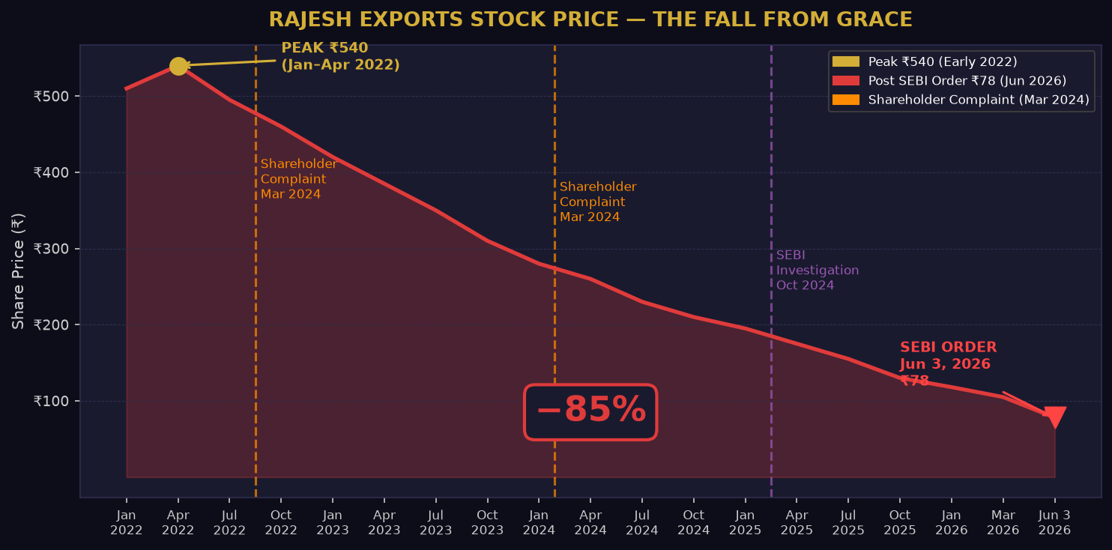
THE MARKET KNEW — STOCK FELL 85% IN 3 YEARS
Investors who held Rajesh Exports since 2022 lost 85% of their money

Slide 11
10 RED FLAGS THAT WERE ALWAYS VISIBLE
Any careful investor could have spotted these years before SEBI
1
99% REVENUE OVERSEAS
2
RECEIVABLES PILING UP
Nearly all from Swiss/Singapore subs — no Indian visibility
Unpaid 2+ years — classic sign of fake/non-existent sales
3
GGR NEVER AUDITED
4
AUDITORS BLOCKED ACCESS
₹15L Cr revenue booked — ZERO independent audit of that entity
No ERP, no journal dump, no subsidiary records provided
5
ONE ENTITY = 99% SALES
6
ASSETS 10× W/O PROOF
All revenue in promoter-controlled entities — circular
Africa mines ₹1,035 → ₹10,547 Cr — no ownership docs
7
FUNDS W/O BOARD APPROVAL
8
STOCK FELL 85% IN 3 YRS
₹339+ Cr to personal account — no sanction trail
Market sensed trouble long before retail investors
9
MD/CFO UNAWARE OF DEALS
10
RPT NOT DISCLOSED
Management ignorant of own entity's large transactions
Elest transactions completely hidden — earnings management

Slide 12
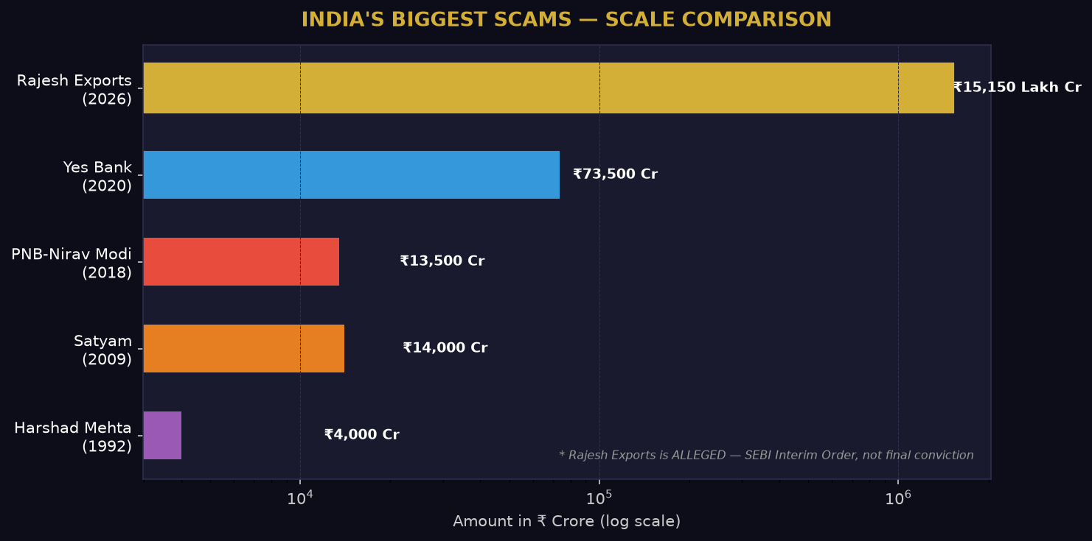
INDIA'S BIGGEST SCAMS — WHERE DOES RAJESH EXPORTS RANK?
Scale comparison — alleged amount only, SEBI interim order not final conviction
HARSHAD MEHTA 1992
SATYAM 2009
NIRAV MODI 2018
YES BANK 2020
RAJESH EXPORTS 2026
₹4,000 Cr Banking securities fraud
₹14,000 Cr Accounts manipulation
₹13,500 Cr PNB letters of credit
₹73,500 Cr NPA masking fraud
₹15.15 LAKH Cr Revenue misrepresentation *alleged

Slide 13

LIC: THE BIGGEST QUESTION MARK
India's largest insurer held 10.79% — funded by your insurance premiums
WHAT PROPER DUE DILIGENCE MUST INCLUDE
✅ Verify revenue AT SUBSIDIARY LEVEL — not just consolidated numbers
✅ Demand independent audit of ALL material overseas entities (GGR was the key miss)
✅ Cross-check trade receivables aging — >90 days = mandatory red flag
LIC — Life Insurance Corporation of India
✅ Confirm 3rd-party transactions by contacting counterparties DIRECTLY
LIC's EXPOSURE
10.79%
✅ Validate all disclosed assets with ownership docs and independent valuation
✅ Screen related-party disclosures against actual banking fund flows
At peak: ₹2,000+ Cr Post-crash: massive loss All = public premiums
✅ Scrutinize revenue concentration >50% in any single entity or region
✅ Monitor promoter personal financial activity vs company account flows
✅ Request ERP/system access — refusal is itself a major red flag
SEBI — Issued Interim Order Jun 3, 2026

Slide 14
COMPLIANCE LESSONS FOR UAE GOLD INDUSTRY
Direct application for gold traders, refiners & dealers in the UAE
REVENUE RECOGNITION
SUBSIDIARY AUDIT TRAIL
Refiners book PROCESSING FEE only — NOT full market value of client gold. Rajesh Exports' core fraud was booking gross gold value as revenue.
Every overseas entity in your group must be independently audited. Consolidated numbers without subsidiary verification = fraud hiding place.
Gold Refining
RELATED PARTY TRANSPARENCY
TRADE RECEIVABLES MONITORING
CBUAE, DMCC & DIFC require full RPT disclosure. Board-approved + disclosed = compliant. Hidden = regulatory action.
Outstanding receivables >90 days = escalation to compliance/board. This exact trigger exposed the Rajesh Exports fraud.
COUNTERPARTY VERIFICATION (AML)
ASSET DOCUMENTATION
Independently verify ALL counterparties confirm their transactions. Fake Affluence entries would FAIL a basic FATF CDD check.
Gold inventory, mining assets, collateral claims MUST have ownership docs, independent valuations, third-party confirmation — no assertion without evidence.

Slide 15
THE NUMBERS AT A GLANCE
Everything you need to remember — in one slide
₹15.15 Lakh Crore
99%
₹12,726 Cr
₹339 Cr+
Revenue allegedly misrepresented (FY21–25)
Of consolidated revenue that could NOT be verified
Shareholder wealth destroyed
Diverted to promoter's personal derivatives account
₹10,547 Cr
₹11,487 Cr
₹215 Cr
10.79%
'Africa gold mines' — zero documentation
Fake Affluence sales (they denied everything)
Net outflow to Elest EV (undisclosed related party)
LIC's stake — public money at risk

Slide 16
KEY TAKEAWAYS
Rajesh Exports = India's largest alleged revenue fraud — ₹15.15 lakh crore over 5 years (bigger than Harshad Mehta by 3,787×)
4-layer offshore structure: REL → REL Singapore → GGR → Valcambi. Middle entity GGR was NEVER independently audited
Affluence Securities: promoter moved ₹339 Cr to personal account, bet on F&O, booked losses as company sales
Africa mines: ₹1,035 Cr → ₹10,547 Cr in 2 years — ZERO ownership documentation, possibly completely fictitious
Basic due diligence (receivable aging + counterparty verification + subsidiary audit) could have exposed this years earlier
UAE gold industry: gross gold value ≠ refiner revenue — only the processing/refining fee is your income
LIC's 10.79% loss shows no institution is immune — compliance cannot rely on someone else to catch fraud
Follow VedasVision for weekly Compliance & Gold Industry insights | Share this with your team — knowledge protects your business

