Slide 1
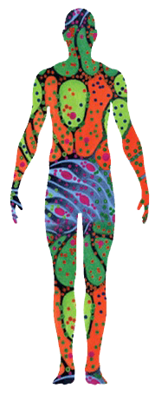
Integrating and Interpreting Single-Cell Datasets
Jack Lasota
Pittsburgh Supercomputing Center (PSC)
Carnegie Mellon University / University of Pittsburgh
Notes:
Hello everyone! My name is Jack Lasota and this summer I’ve been working at the Pittsburgh Supercomputing center. My project is on how we process, analyze, and integrate single-cell RNA-seq data within the HuBMAP framework. This included raw data handling, open source python-based toolkits like Scanpy, and approaches to align and interpret datasets across organs and tissue types.

Slide 2
Project Overview & Background

Slide 3

Pittsburgh Supercomputing Center (PSC)
Jointly operated by Carnegie Mellon University & University of Pittsburgh.
Provides high-performance computing and networking for university, government, and industry researchers.
Powers computation-heavy research in:
Data analytics, machine learning, AI & deep learning.
Biomolecular simulation and scientific discovery.
Premier supercomputers include Bridges-2 & Anton.
Notes:
At the Pittsburgh Supercomputing Center, tools like Bridges-2 allow us to process large single-cell datasets quickly and reliably.

Slide 4
From Raw Data to Integration: Project Goals & Tools
Objective: Create and utilize pipelines to process and output large-scale biological data, along with providing accessible tools for its interpretation.
Standardization: Uniformly process data so results are comparable across datasets and tissue types.
Tools: Use Python (Jupyter notebook), along with open-source tools such as Scanpy (Python toolkit), and AnnData (Python data structure).
Environment: All computation is run in high-performance UNIX environments.
Products: Strive for outputs that are clean, structured datasets ready to be explored, visualized, or annotated.
Notes:
Objective: The overarching goal of my project is to make large biological datasets easier to analyze and interpret. This requires that we {objective}. This meant standardization, using consistent processing across tissue types, and preparing everything for visualization and annotation.
Standardization: This preparation involved standardization or cleaning the data. It must be {standardization}. Once we get a readable file...
Tools: I used python, particularly jupyter notebook. Scanpy = open-source Python toolkit for analyzing single-cell gene expression data, particularly scalable to large datasets. While, AnnData is an open-source Python data structure (and accompanying I/O toolkit) designed for efficiently handling annotated data matrices, and is the core data structure used by Scanpy.

Slide 5
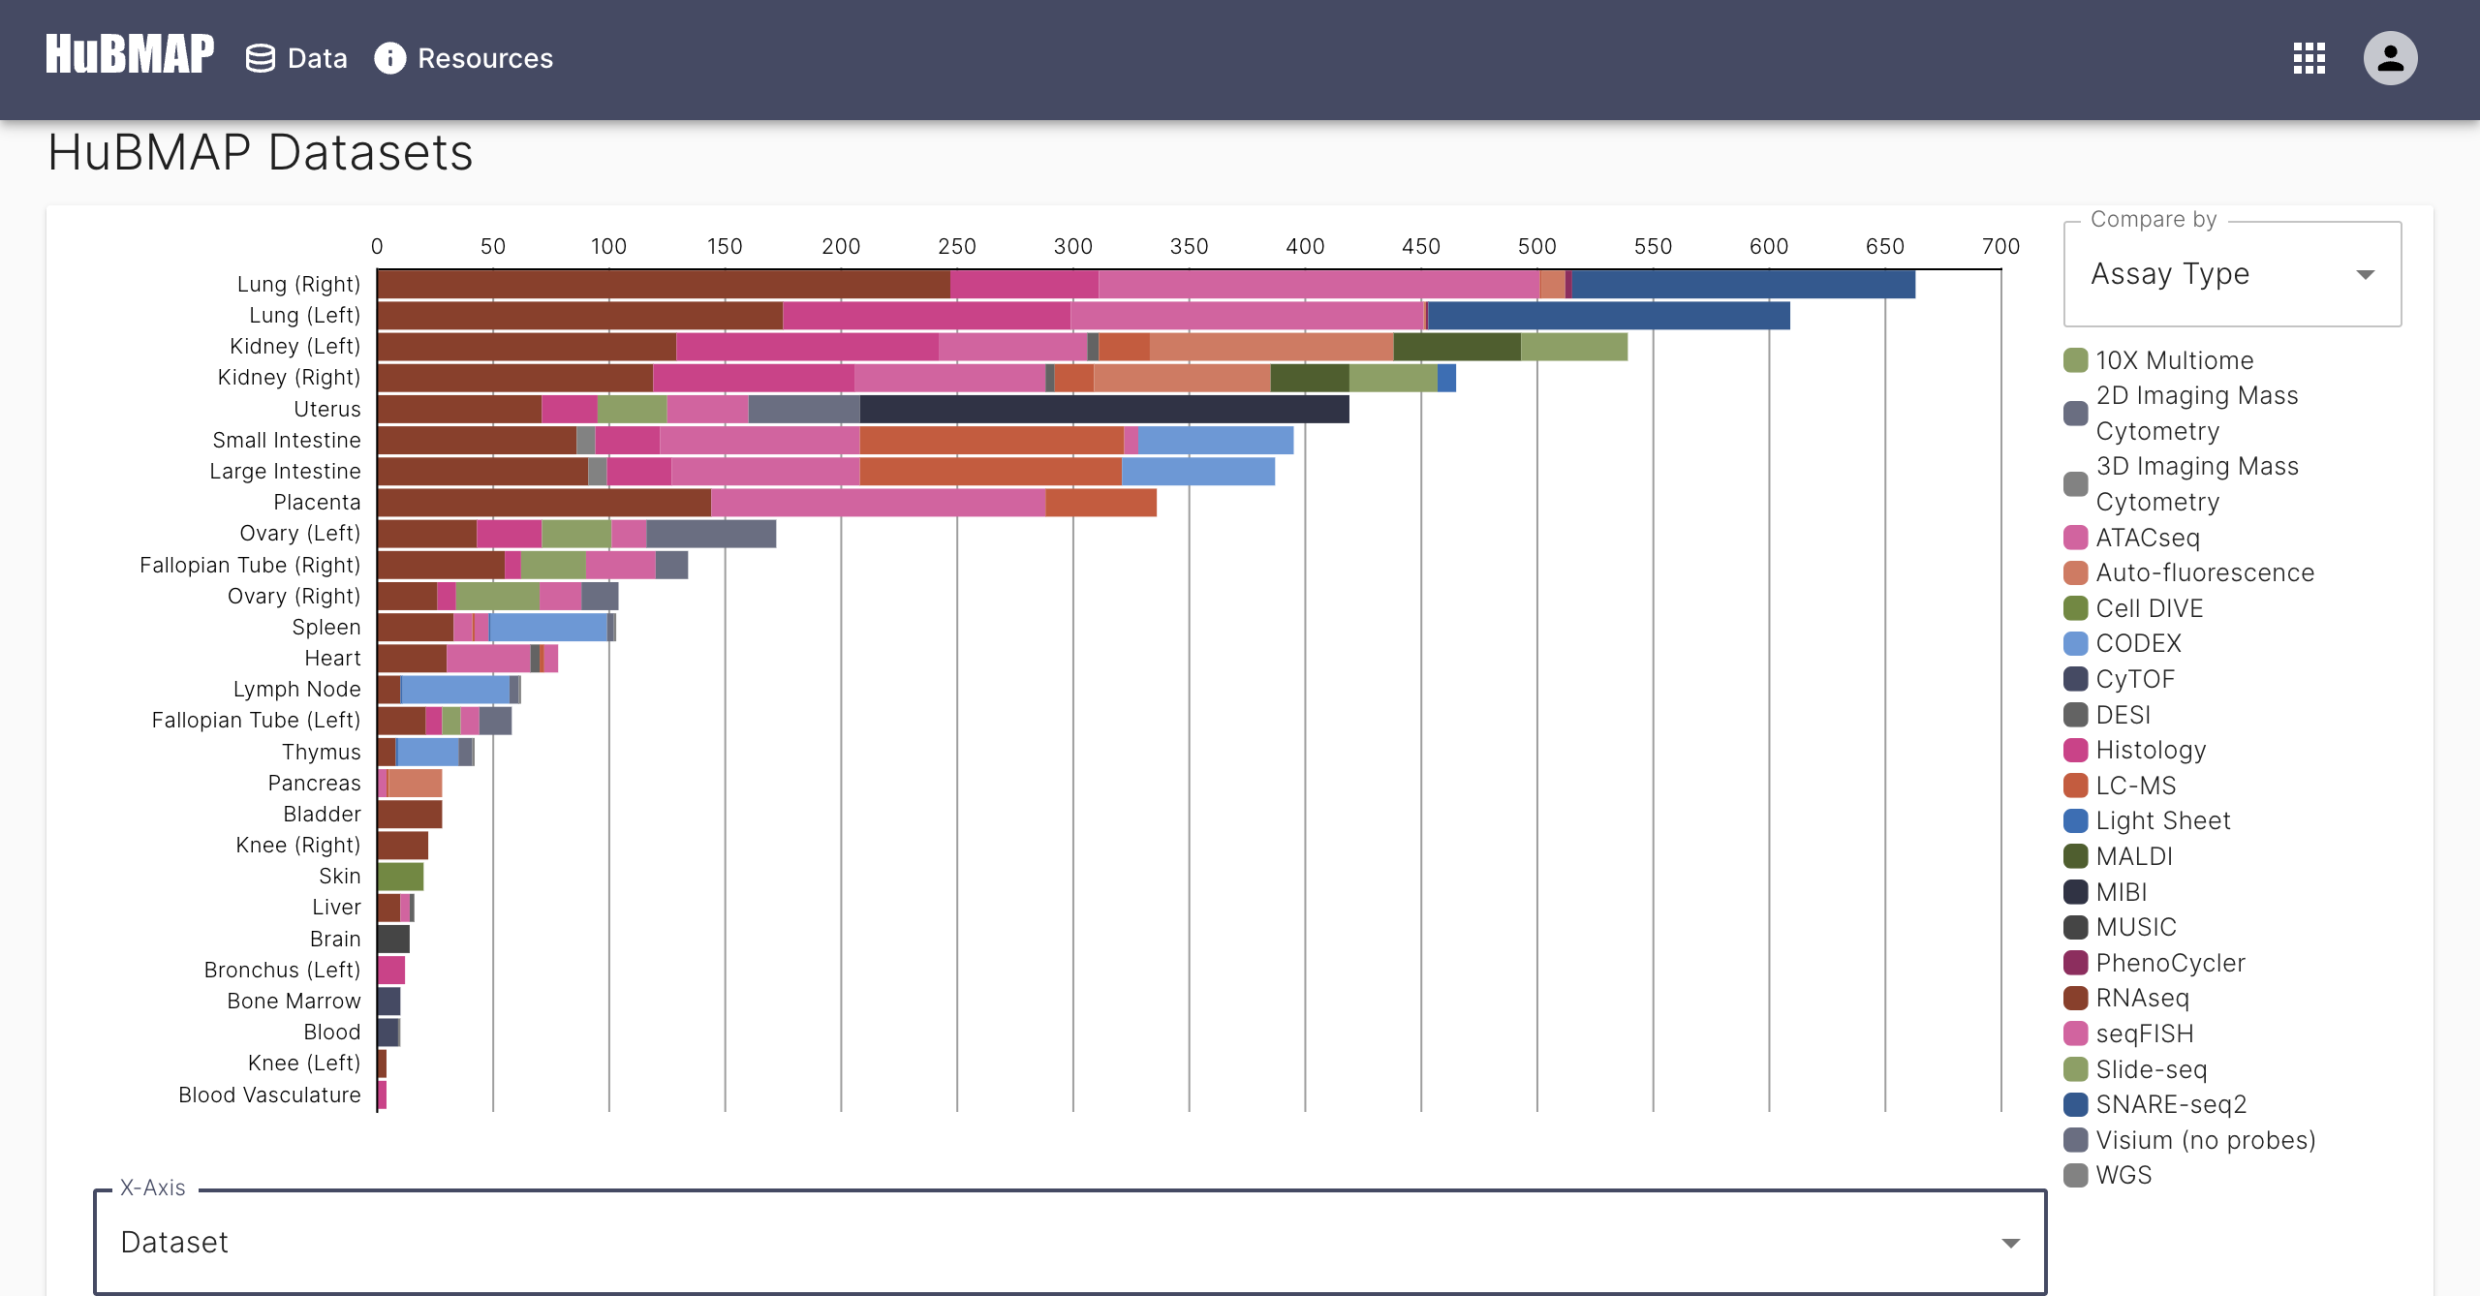
HuBMAP Consortium Data Portal
Data Portal: Centralized access to datasets with tools for analysis and visualization.
Discovery: Search or browse by organ, cell type, or molecule.
Visualization: Interactive tools for spatial and single-cell data.
Access: Download raw and processed datasets.
Notes:
The HuBMAP Portal provides access to datasets across tissue types, even allowing comparison by various modalities, such as assay type. It lets researchers search and browse spatial and single-cell data, compare data across organs, and download datasets in raw or processed forms.
Behind the scenes, creating such an interactive and user-friendly platform requires significant effort — from cleaning/standardizing the data to representing it in a way that’s both readable and meaningful to users.

Slide 6
Sequencing Pipelines and Data Interpretation

Slide 7
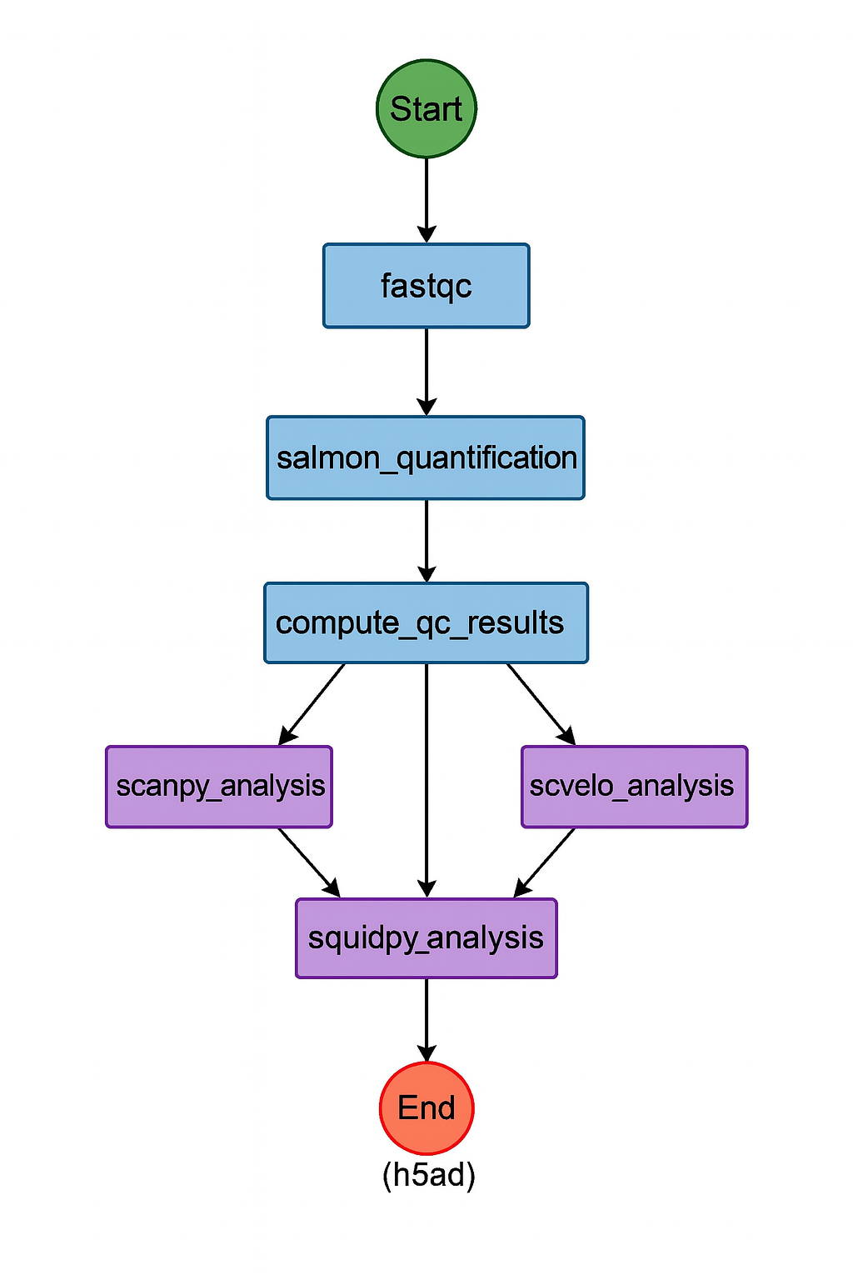
Pipeline Operation
Datasets were processed from raw FASTQ format using the Salmon-Alevin pipeline, enabling rapid quality control, quantification, initial analysis, and even filtering of low-quality cells and genes.
This workflow produces clean, high-quality datasets in h5ad format, ready for integration and further exploration in a Jupyter notebook.
Pipelines like this are essential for transforming raw sequencing data into readable, structured formats suitable for interpretation and analysis.
Notes:
This pipeline processes raw single-cell RNA-seq data starting from FASTQ format, using the Salmon-Alevin workflow for rapid quality control, quantification, and initial analysis. The result is a clean, high-quality .h5ad file—ideal for visualization and interpretation within a Jupyter notebook.
Each step in the diagram represents a node in the pipeline, where data is sequentially processed or analyzed:
Start: Initiates the workflow
fastqc: Performs quality checks on raw FASTQ files
salmon_quantification: Quantifies gene expression using the Salmon-Alevin tool
compute_qc_results: Aggregates quality metrics from fastqc and other steps
scanpy_analysis: Handles filtering, normalization, PCA, clustering, and embedding
scvelo_analysis (optional): Performs RNA velocity analysis
squidpy_analysis (optional): Enables spatial transcriptomics analysis
End: All outputs converge here, producing a structured .h5ad file
Color legend for the diagram:
Green – Input/initiation
Blue – QC and quantification
Purple – Analysis modules
Red – Final output

Slide 8
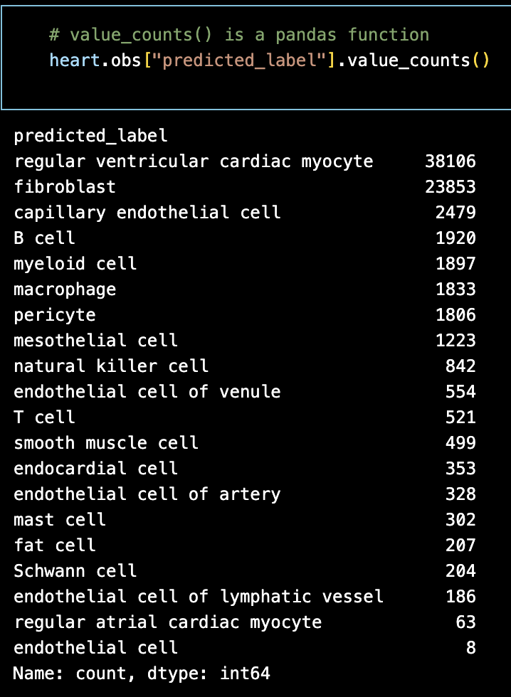
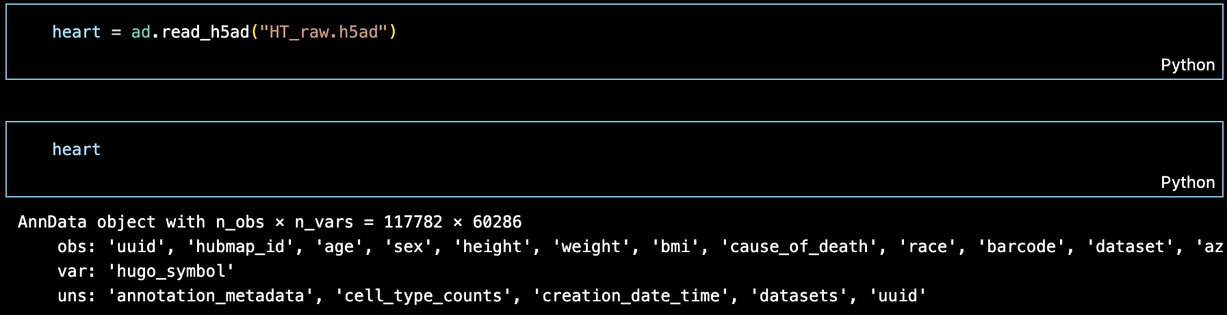
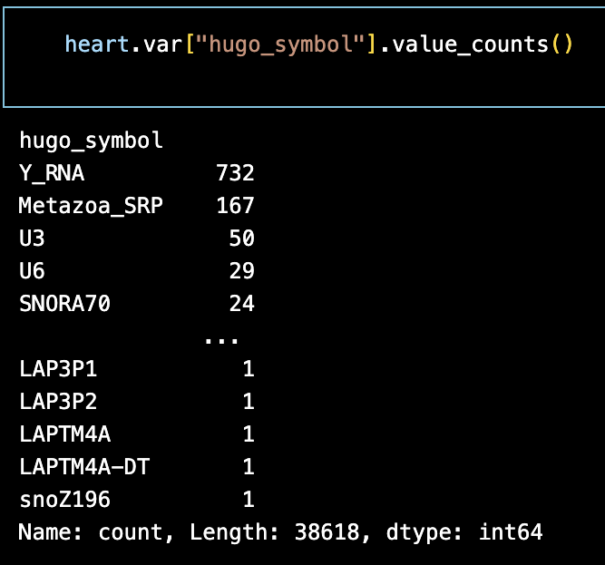
Raw Heart Data - scRNAseq
z
HuBMAP raw heart data was read using the AnnData, which provides tools for interpreting and working with complex biological datasets.
The pandas library enables targeted analysis of specific data points.
Notes:
Once we receive our h5ad files, we can start our analysis. Here we begin with raw heart data (includes unfiltered low-quality cells and genes), We load it into Python using AnnData, which helps us track our metadata, counts, and analysis results together. {n_obs x n_vars} As you can see in the first image, there is a large volume of cells x genes in the dataset. Additionally, the pandas library can be utilitzed for target analysis of specific data point.
n_obs = cells
n_vars = genes

Slide 9
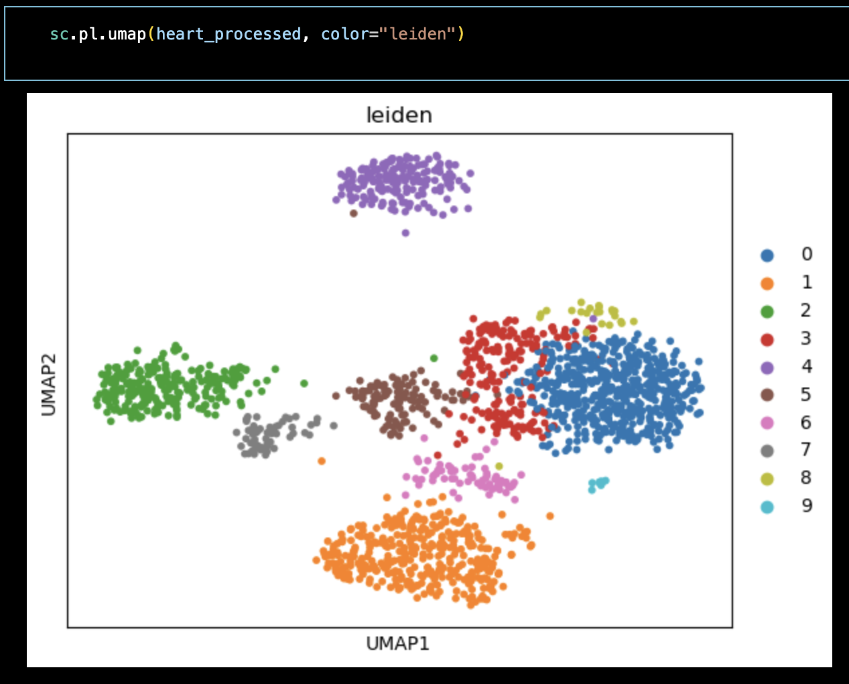
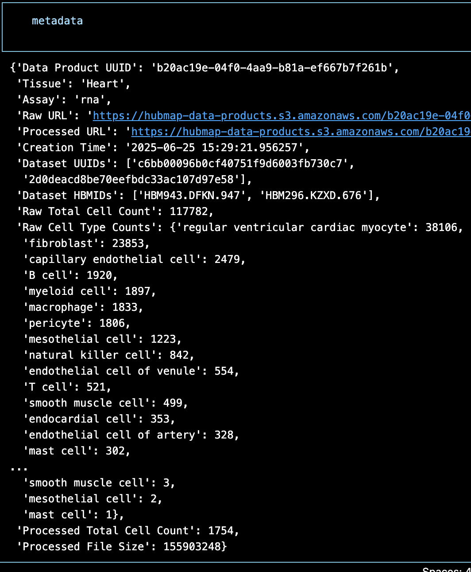
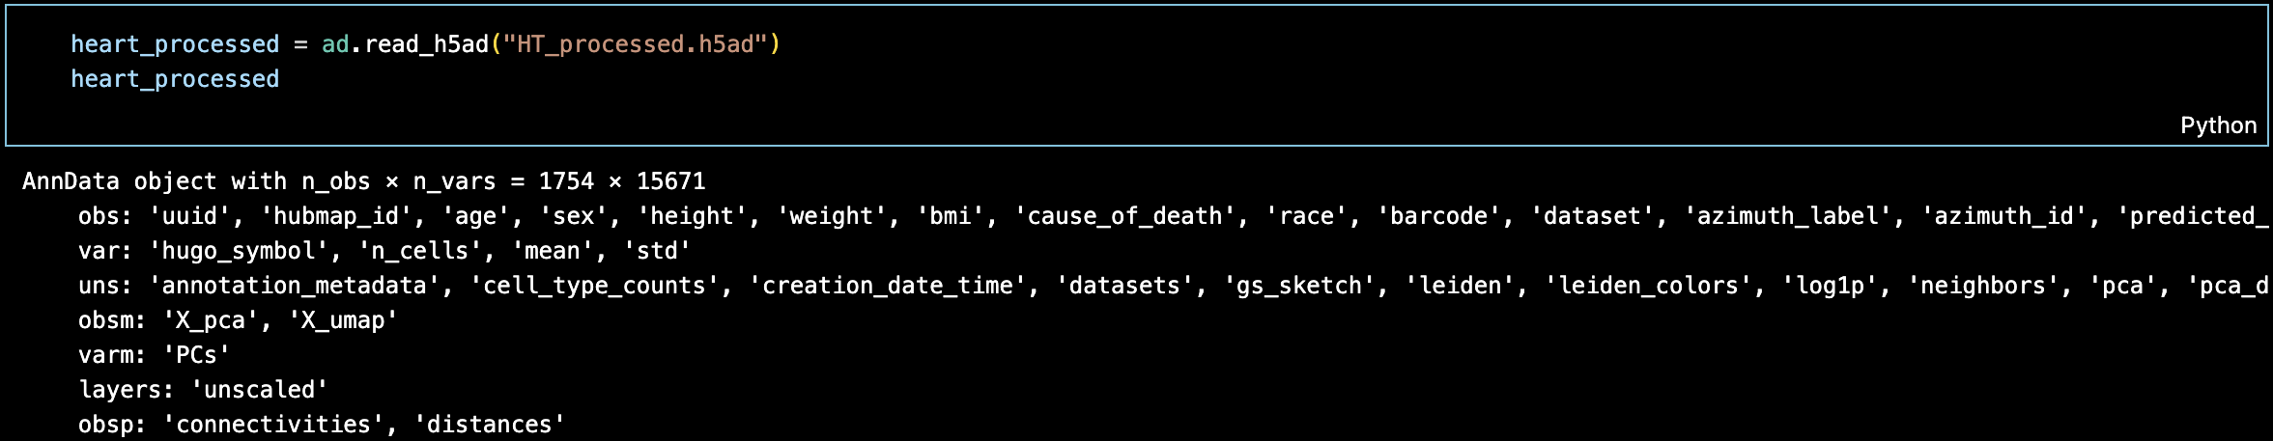
Processed Heart Data – Pipeline Results
After filtering low-quality cells and weakly expressed genes, about 99% of cells and 75% of genes were filtered out.
Pipeline utilized Leiden clustering, viewed with UMAPs plotted by scanpy.
Metadata gives an overview of the data set.
Notes:
After filtering, we retain only high-quality data. Using AnnData in the same fashion, looking at the cells x genes (obs x vars) we can see ~99% of cells and 75% of genes have been filtered.
We use Scanpy to perform clustering, (in this case with the Leiden algorithm) visualizing cell clusters using UMAPs.
Metadata can then be extracted and utilized in other areas, for example…

Slide 10
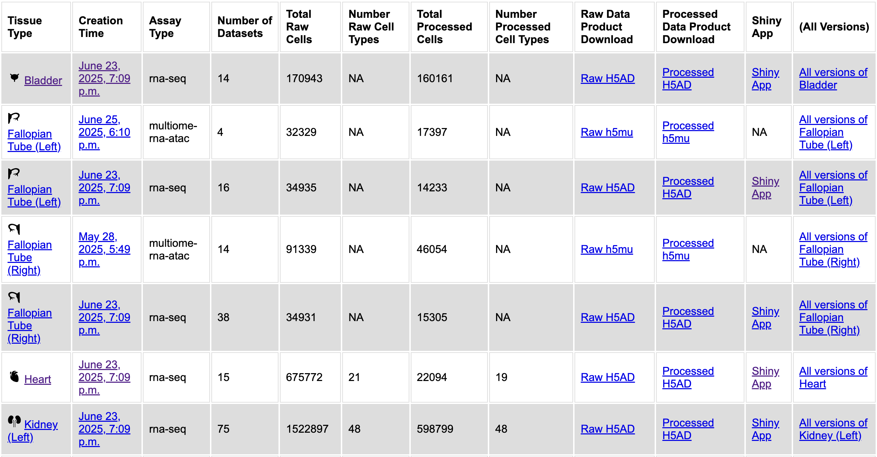
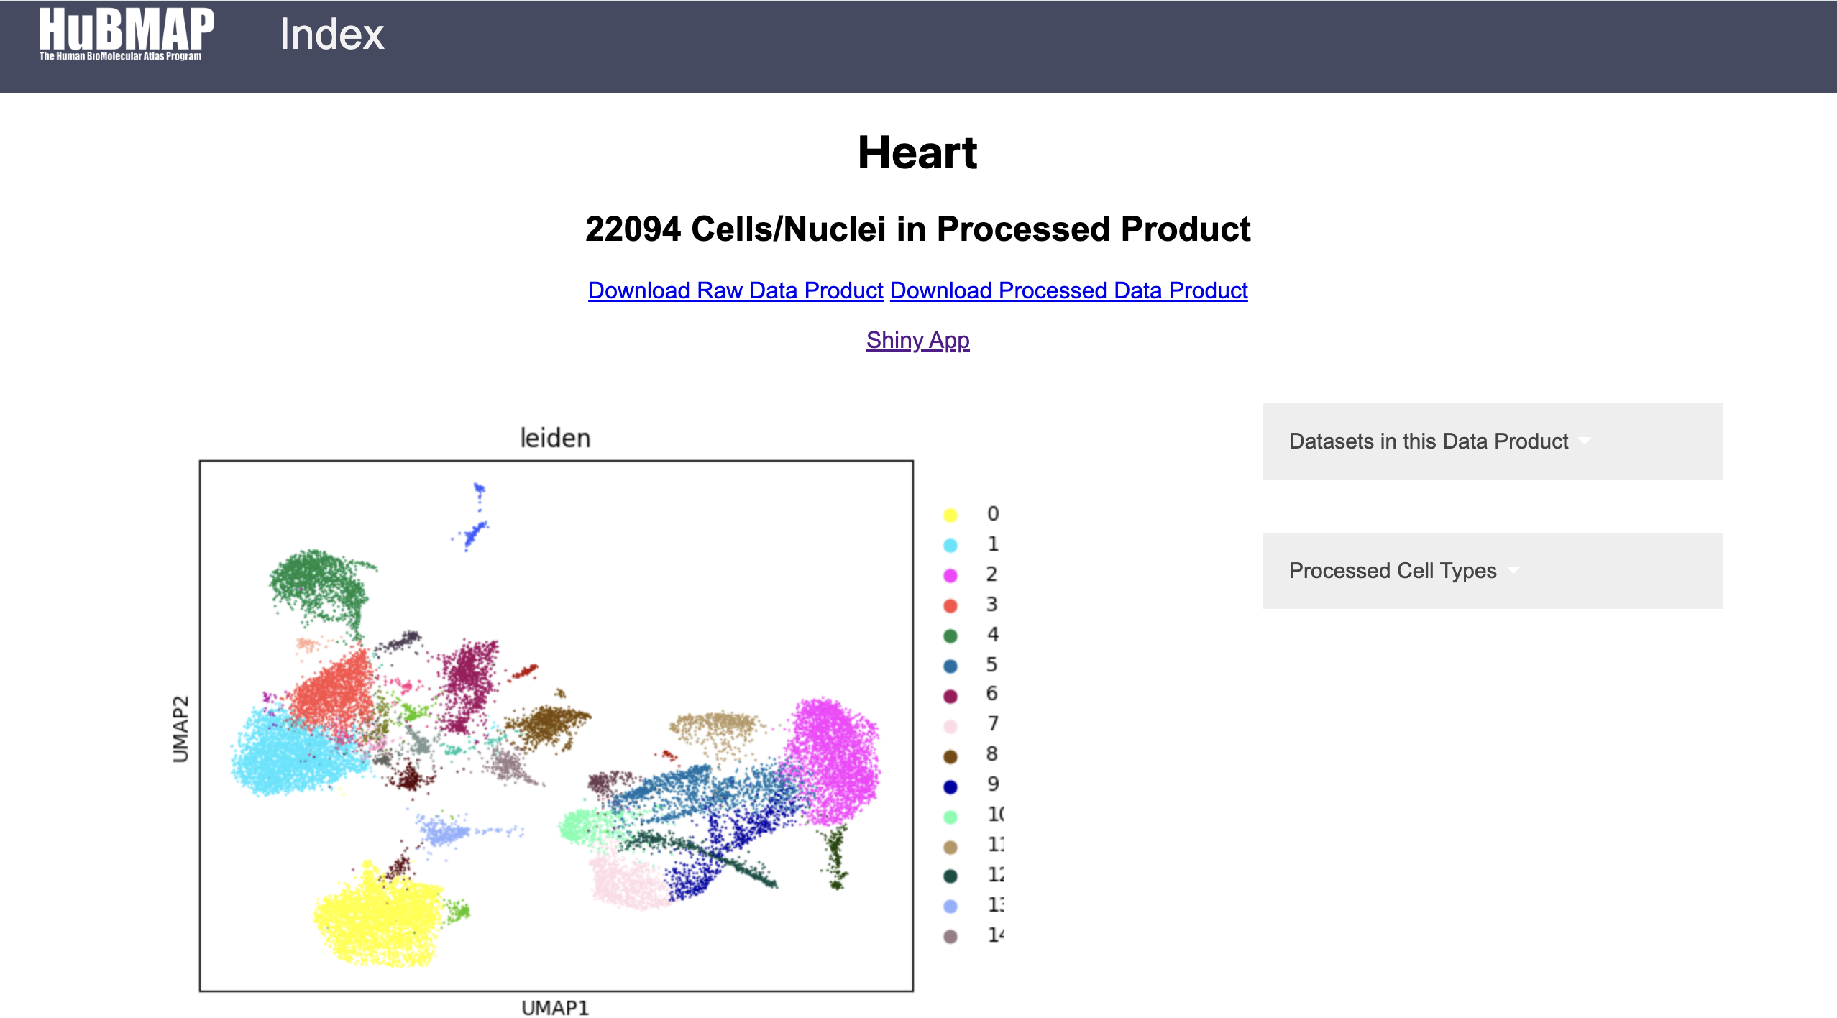
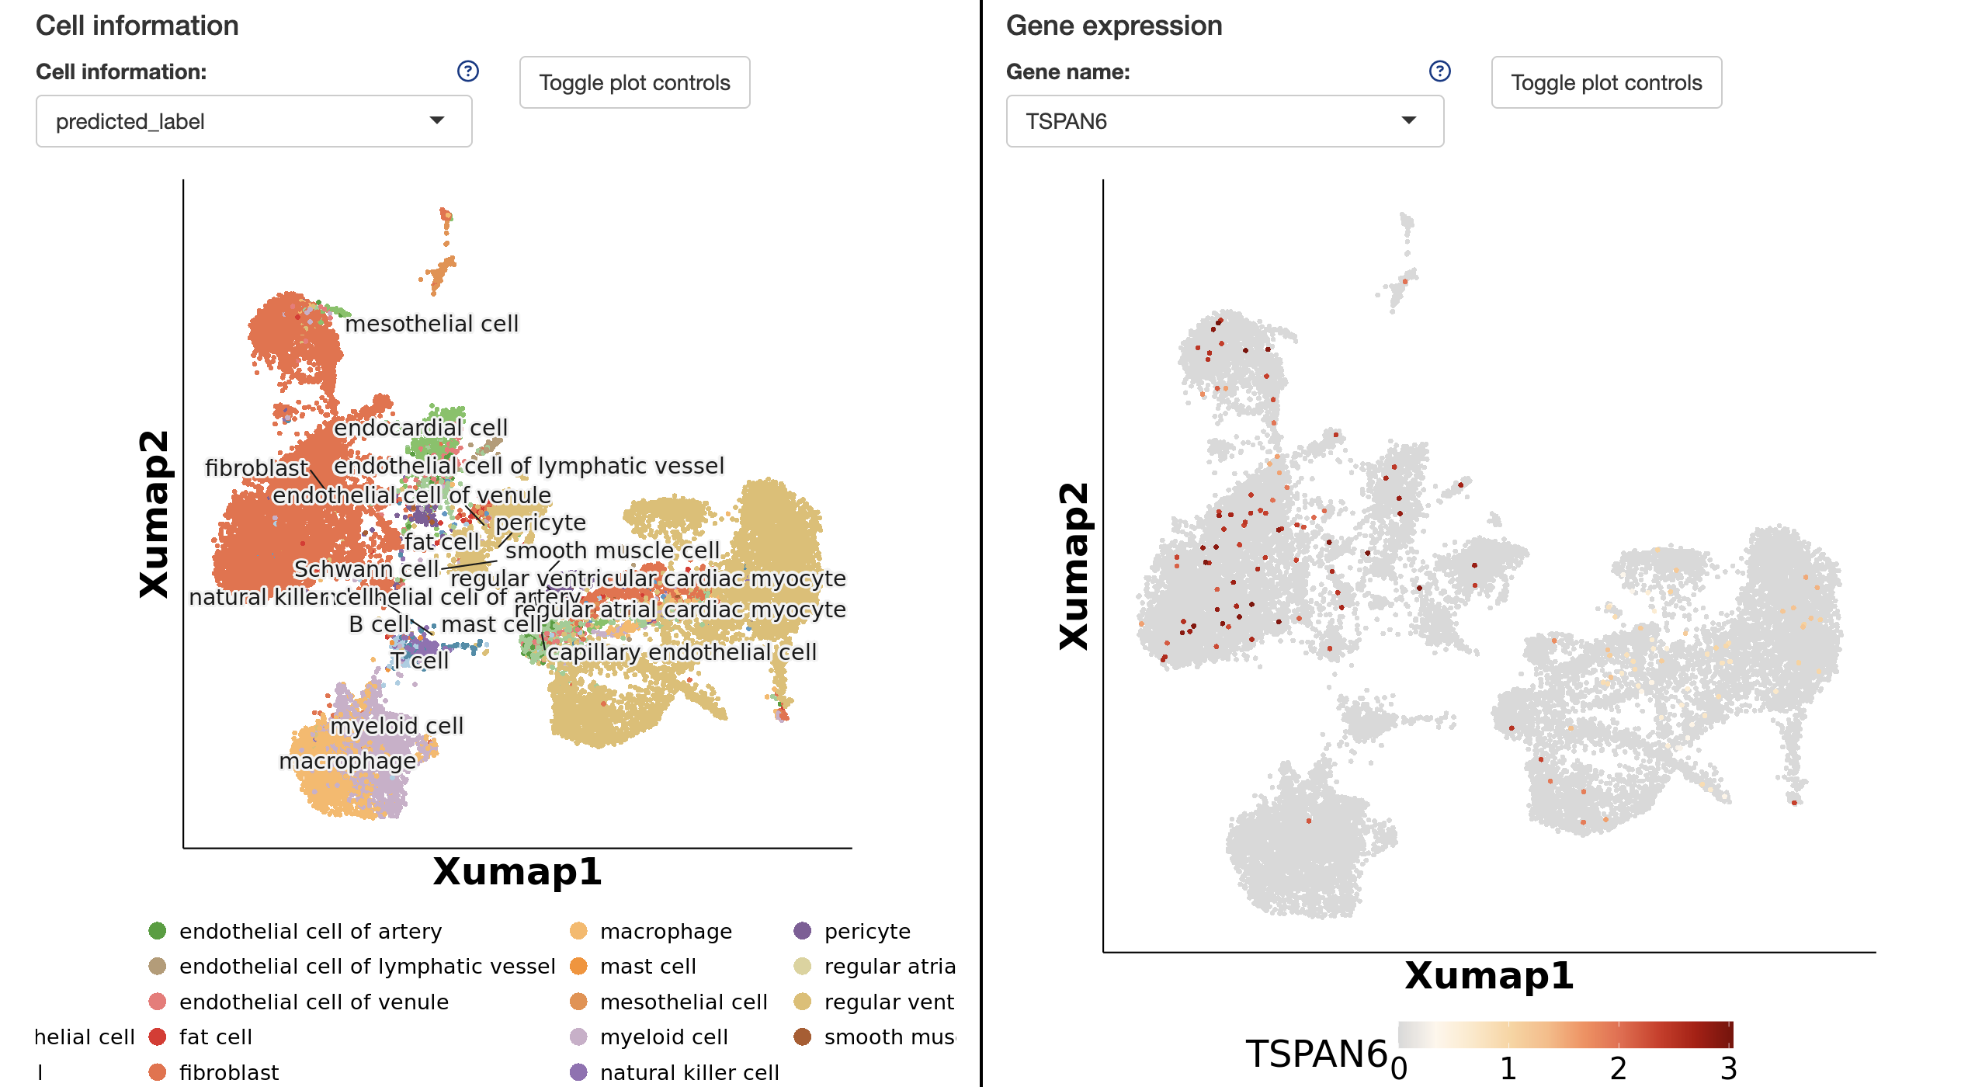
User Interface
Metadata is integrated into the user interface, with tissue type overviews provided. Shiny app enables both gene and cell-level insights/comparisons.
Notes:
In the top left, we see our metadata transformed into a friendly portal…which allows researchers to explore tissue types, gene expression levels, and cell-type-specific patterns.
If we click on a particular organ, we can utilize tools like ShinyApp to visualize cell and gene information
As shown in the bottom left, the shiny app directly uses UMAPs like the ones we were able to output in our processed data!

Slide 11
Leveraging Scanpy for Standardized Single-Cell Analysis
Notes:
Scanpy is our main toolkit for single-cell analysis. Allows us to go from raw data to interpretable clusters and annotations.

Slide 12
Scanpy Pre-processing vs. Integration
Pre-processing of data:
Filters low-quality cells and genes.
Normalizes data and visualizes gene/cell counts.
Identifies highly variable genes.
Computes Principal Component Analysis (PCA) to capture major variation.
Data integration:
Aligns multiple datasets in a shared feature space.
Projects new cells into existing PCA/UMAP embeddings.
Transfers annotations (e.g., cell types) from reference to new data.

Slide 13
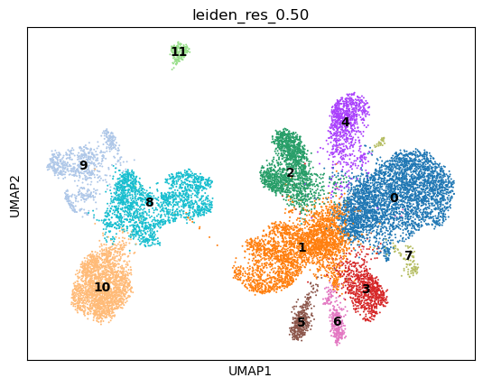
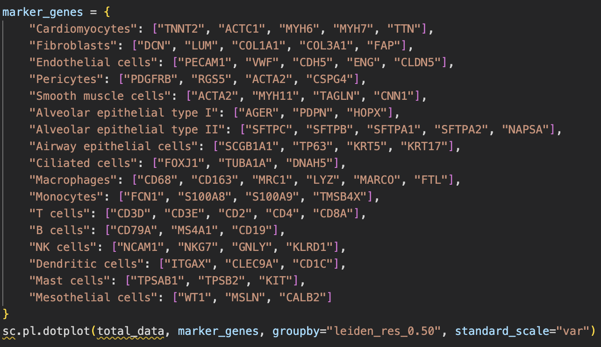
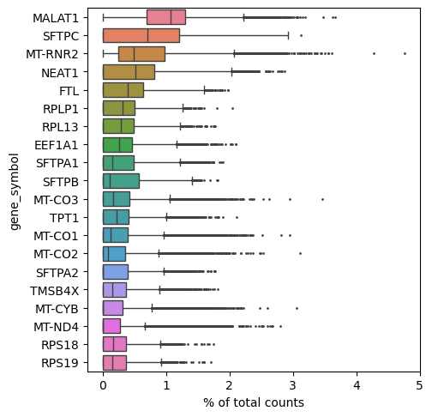
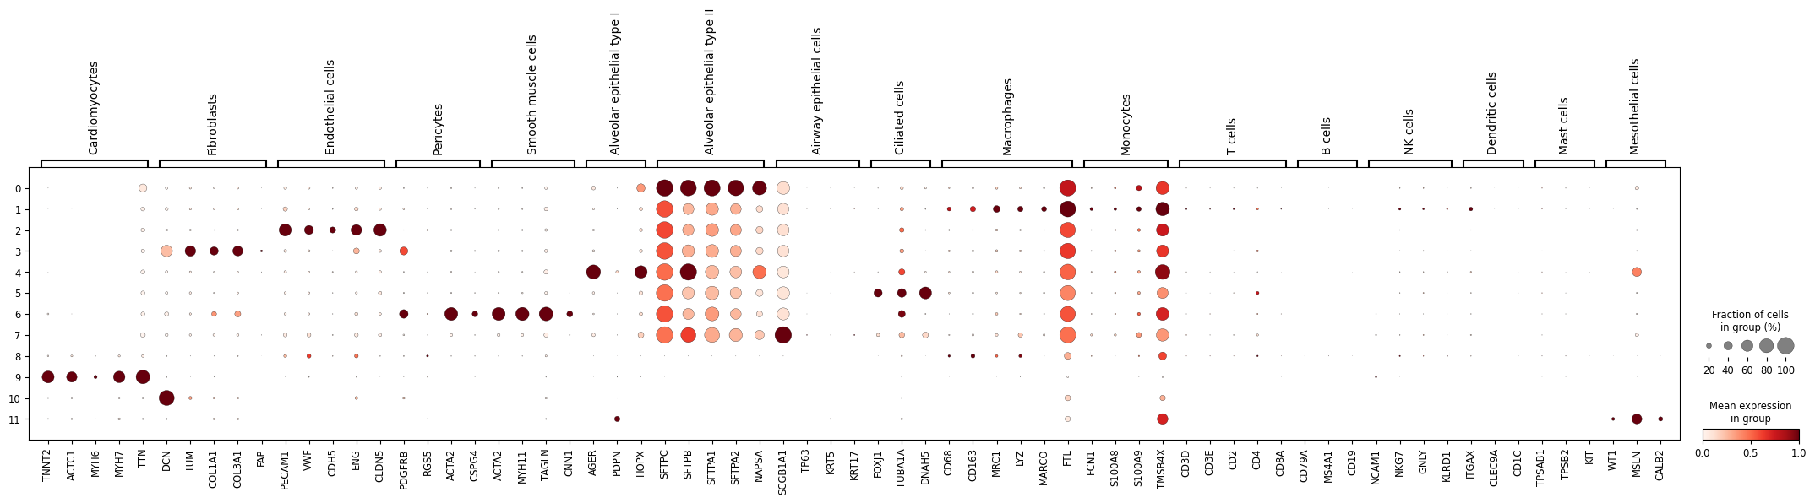
Scanpy pre-processing: Heart and Kidney
Notes:
This slide walks through the key steps of the Scanpy pre-processing pipeline, applied to heart and kidney single-cell datasets. I’ll go step by step, following the typical Scanpy workflow used to prepare data for analysis.
Quality Control (QC)
We begin by filtering out low-quality cells and genes. For example, we remove cells with too few total counts or a high percentage of mitochondrial genes, which are often stressed or dying cells.
Normalization and Log Transformation
We then normalize the total counts per cell to make them comparable across the dataset. After normalization, we apply a log1p transformation, which stabilizes variance across genes and makes the data more suitable for downstream analysis.
Highly Variable Gene Selection
Next, we identify the most highly variable genes — these are the ones that carry the most biological signal. In the figure on the left, you can see a plot showing the top variable genes throughout the dataset.
Clustering with Leiden Algorithm
Then, we use the Leiden algorithm to identify groups of similar cells — what we call clusters.
Visualization with UMAP
Finally, we visualize the data using UMAP. On the right, you see clusters labeled 0 through 11. Clusters 0–7 are kidney-derived, while 8–11 are from heart tissue
Biological Interpretation:
Using known marker genes and the highly expressed genes identified earlier, I grouped them by cell type. This let me analyze mean expression (shown by color darkness), prevalence (indicated by dot size), and organ-specific differences — all before even performing integration. Scanpy’s preprocessing allows us to apply the same standardized workflow across different tissues, like heart and kidney. This produces interpretable, comparable data structures that make it easier to analyze and visualize biological patterns, even before performing formal integration.

Slide 14
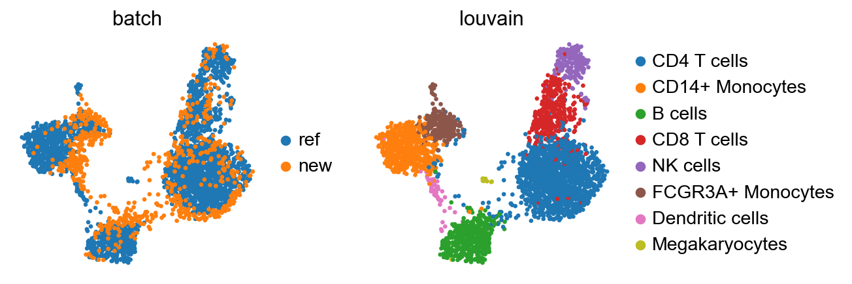
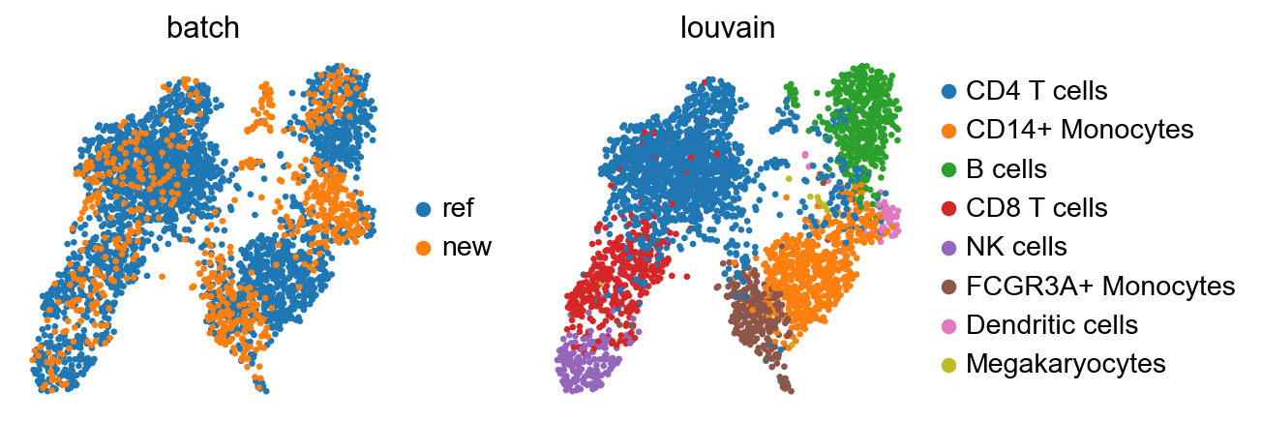
Scanpy – Data Integration with Ingest + BBKNN
Purpose: To map new single-cell data (Peripheral Blood Mononuclear Cells) onto a reference dataset while correcting for batch effects across datasets.
Ingest Mapping:
New cells are projected into the reference UMAP and inherit its clustering and annotations.
Some separation remains (e.g., in monocytes), but key cell types like T and B cells mix well, indicating partial batch alignment.
BBKNN Mapping:
BBKNN corrects batch effects by rebuilding the neighbor graph, improving mixing across datasets.
Monocytes and dendritic cells integrate well, but the Megakaryocyte cluster is lost.
Notes:
This slide demonstrates how we can integrate new single-cell data into an existing reference using two complementary methods in Scanpy: Ingest and BBKNN. The goal is to map new single-cell data (Peripheral Blood Mononuclear Cells) onto a reference dataset while correcting for batch effects across datasets What Are Batch Effects?
These are technical differences that introduce unwanted variation in the data. Our goal is to reduce these so we can focus on true biological differences.
Ingest: Fast, reference-based projection. Preserves structure and annotations. Similar cell types (e.g., CD4/CD8 T cells, B cells) align well, but some batch effects remain (e.g., monocytes).
BBKNN: Rebuilds the neighbor graph for deeper batch correction. Monocytes and dendritic cells mix better, but rare populations (like megakaryocytes) may be lost.
Key Point: Ingest is annotation-aware and fast for similar datasets. BBKNN offers stronger correction across batches, with some trade-offs in resolution.
Biological Interpretation:
These two approaches serve different purposes: • Ingest is fast and annotation-aware — best when your new data closely matches the reference. • BBKNN is more powerful for aligning across batches but may sacrifice rare cell resolution.
Together, these tools help us merge multiple datasets in a biologically meaningful way

Slide 15
Acknowledgements
Thank you to the HuBMAP HIVE teams, particularly the CMU Tools Component team and the PSC IEC team for their guidance, technical support, and the tools that enabled my research. They have been instrumental in helping me explore, analyze, and interpret the complex biological data I used throughout this project.
I want to give a special thanks to:
Matt Ruffalo (CMU): Principal Investigator, Systems Scientist
Penny Cuda (CMU): Research Programmer, HIVE Tools Component
Xiang Li (PSC): Senior Bioinformatics Support Specialist

