Slide 1

Developing Pipelines for Processing Large HuBMAP Data Sets
Jack Lasota
Pittsburgh Supercomputing Center (PSC)
Carnegie Mellon University / University of Pittsburgh

Slide 2
Overview
Outline, Background of HubMap (or PSC/Ruffalo lab?) (~2)
Quick tour of HuBMAP Consortium Portal (~2)
Data processing pipeline (~2 Penny on scRNAseq, one workflow, one on results?)
User interface

Slide 3
Outline
Pittsburgh Supercomputing Center (PSC) - Joint center of Carnegie Mellon & University of Pittsburgh, providing advanced high performance computer resources for interdisciplinary research.
HuBMAP Tool Development – Developed pipelines for standardized processing of HuBMAP data:
Single-cell sequencing (scRNA-seq, ATAC-seq)
Imaging data (segmentation, stitching)
Spatial transcriptomics/proteomics (CODEX, seqFISH)
Downstream analysis of image-based data
All tools created are publicly available and integrated into the HuBMAP website, providing a user-friendly interface to interact with complex biological data.

Slide 4
HuBMAP Consortium Portal

Slide 5
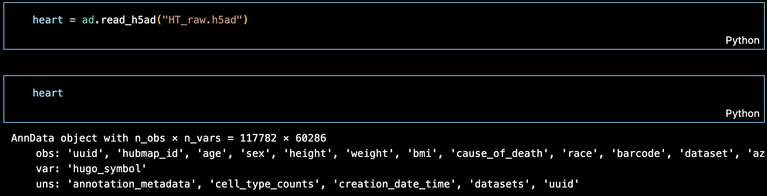
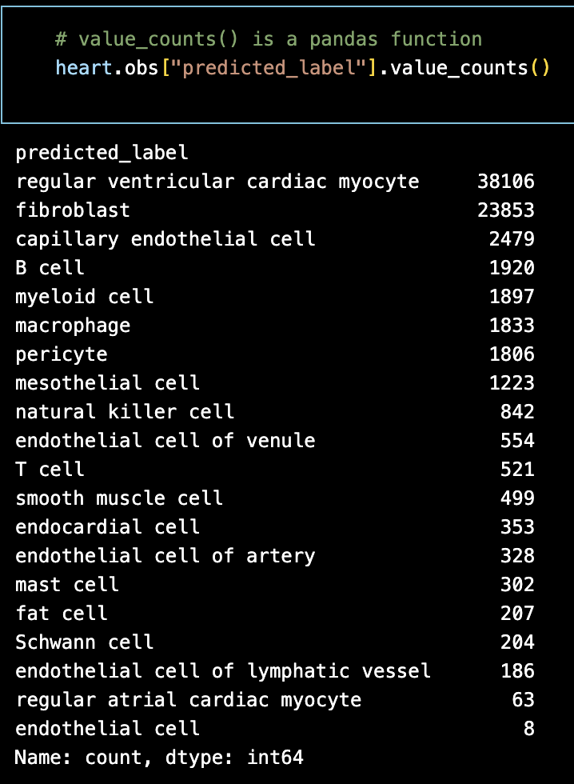
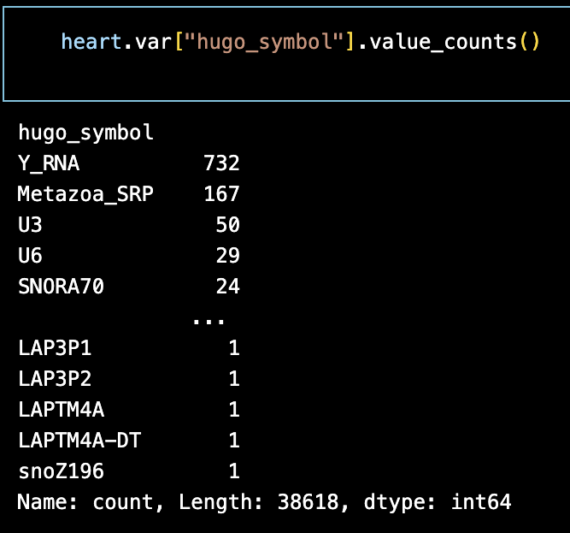
Raw Heart Data - scRNAseq
AnnData provides essential tools for interpreting and working with complex biological datasets.
HuBMAP raw heart data was read using the AnnData Python package
Pre-processed data: cells(n_obs) x genes(n_vars) = 117782 x 60286
The pandas library enables targeted analysis of specific data points.
We can summarize or visualize the distribution of cell or gene types by label.
Revealing the composition of cells and genes is helpful with comparison before and after pipeline processing

Slide 6
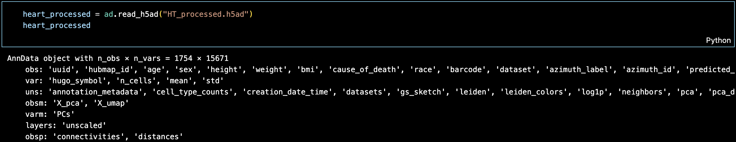
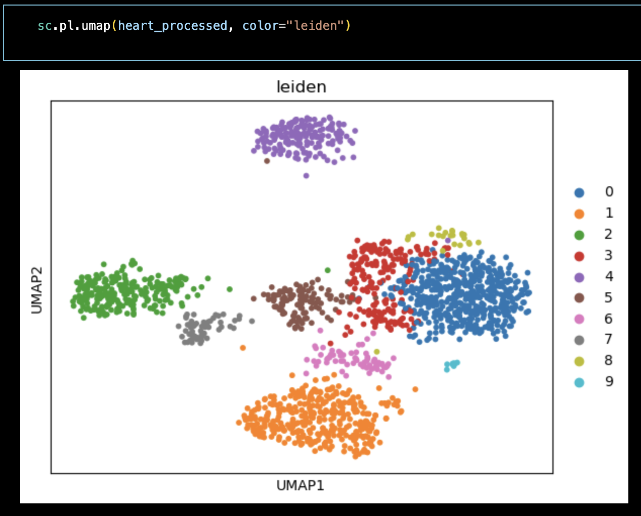
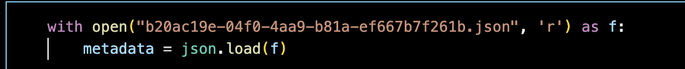
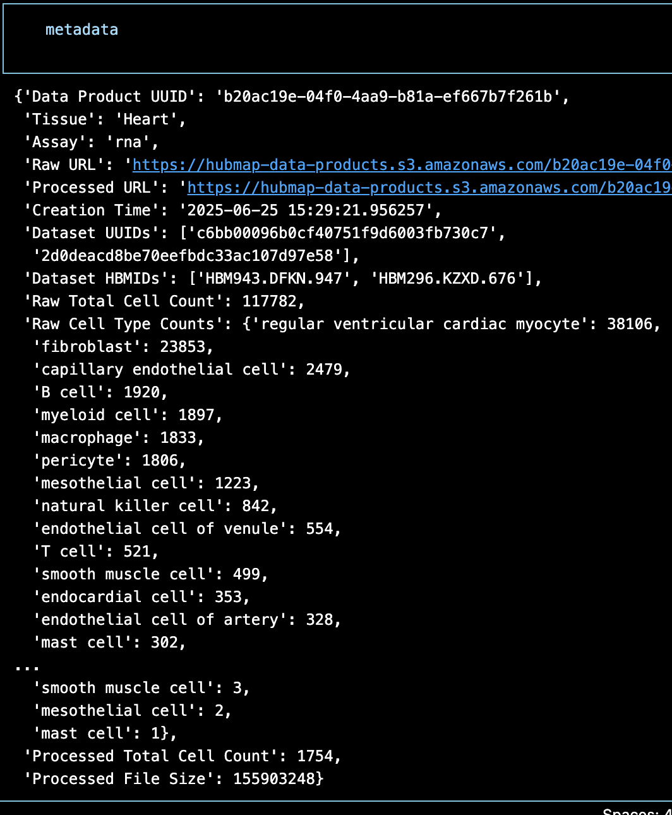
Processed Heart Data – Pipeline Results
Processed data is read llike the raw data, using the AnnData Python package.
Processed data: cells(n_obs) x genes(n_vars) = 1754 x 15671
About 99% of cells and 75% of genes were filtered.
This particular pipeline utilizes Leiden clustering which groups cells based on shared features.
These clusters can then be viewed using a UMAP.
Furthermore, metadata can be extracted using json, providing an overview of the data set.

Slide 7
Heart Data Website Integration

Slide 8
Team
Nick Nystrom (PI, PSC): PSC Chief Scientist Jonathan C. Silverstein (PI, Pitt): Professor and CRIO, DBMI

