Slide 1
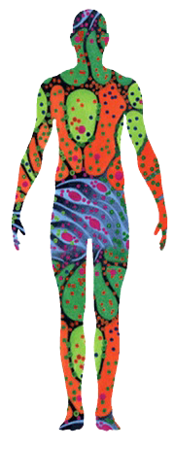
HuBMAP Data Processing Pipelines
Jack Lasota
Pittsburgh Supercomputing Center (PSC)
Carnegie Mellon University / University of Pittsburgh

Slide 2
Overview
Outline, Background of HubMap (or PSC/Ruffalo lab?) (~2)
Quick tour of HuBMAP Consortium Portal (~2)
Data processing pipeline (~2 Penny on scRNAseq, one workflow, one on results?)
User interface

Slide 3
Introduction
Objective: Develop pipelines to process large-scale biological data sets, and and deliver accessible, user-friendly tools and spatial maps through open interfaces.
Standardization: HuBMAP pipelines uniformly process multimodal data collected across diverse tissue mapping centers.
Analysis Tools: Python (Jupyter Notebooks) and domain-specific libraries enable interpretation of both raw and processed data.
Execution Environment: Pipelines are run on UNIX-based systems for robust, high-throughput computing.
Consolidation: HuBMAP data products compile all datasets for a given assay type and tissue across sources. RNA-seq products include both raw gene count matrices and processed data with normalization, filtering, dimensionality reduction, and clustering.

Slide 4
HuBMAP Consortium Portal

Slide 5
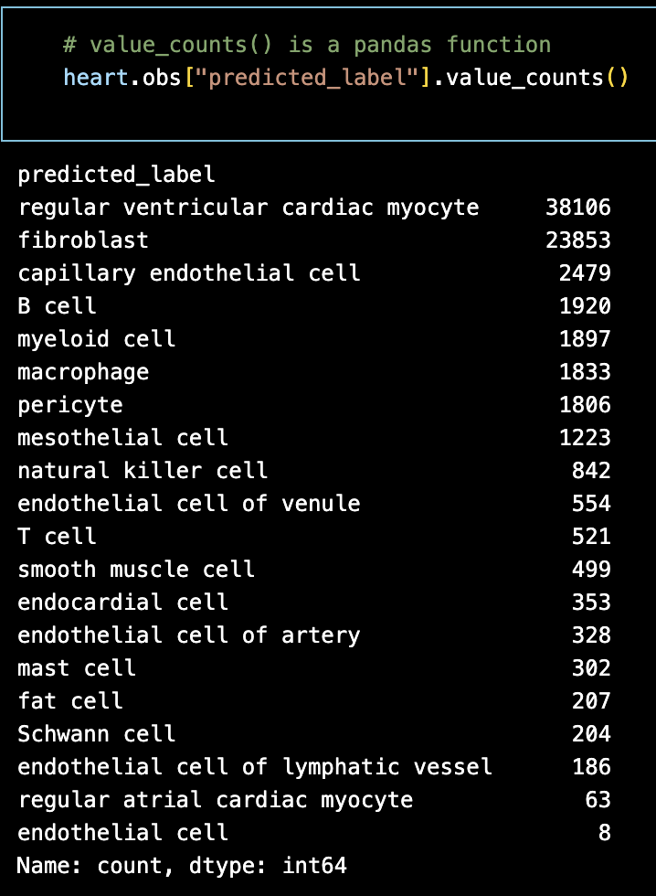
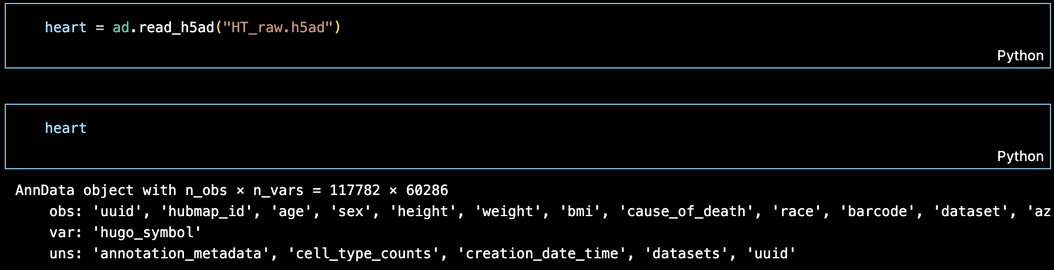
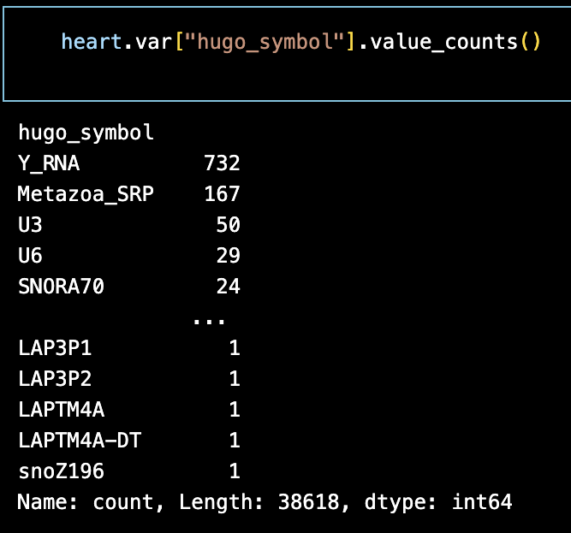
Raw Heart Data - scRNAseq
z
HuBMAP raw heart data was read using the AnnData Python package, which provides tools for interpreting and working with complex biological datasets.
The pandas library enables targeted analysis of specific data points.

Slide 6
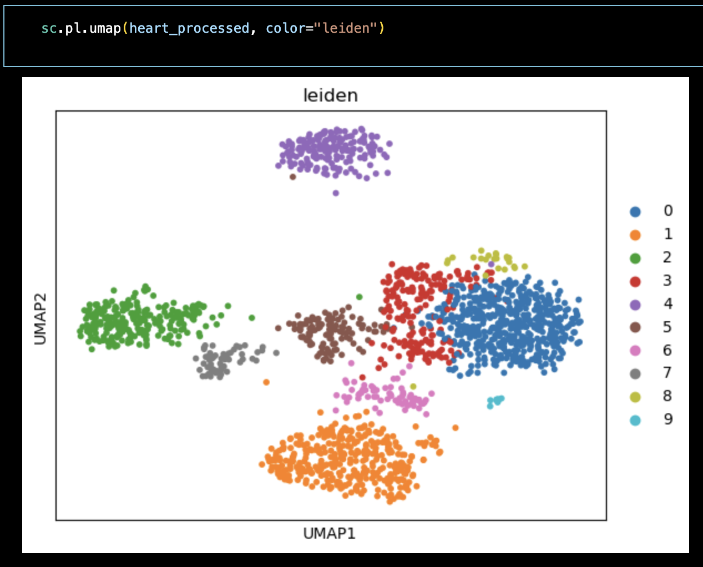
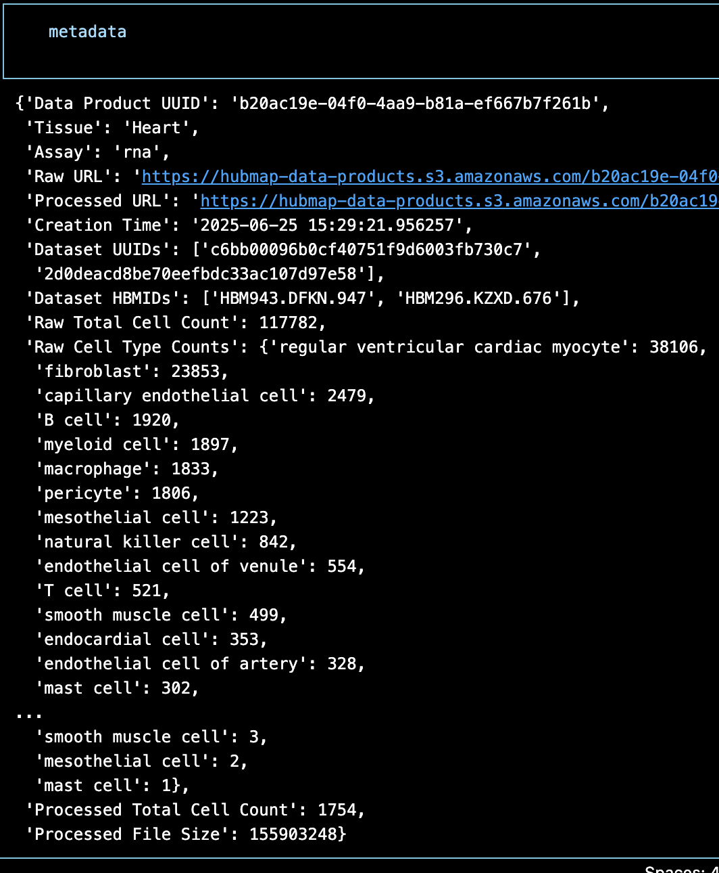
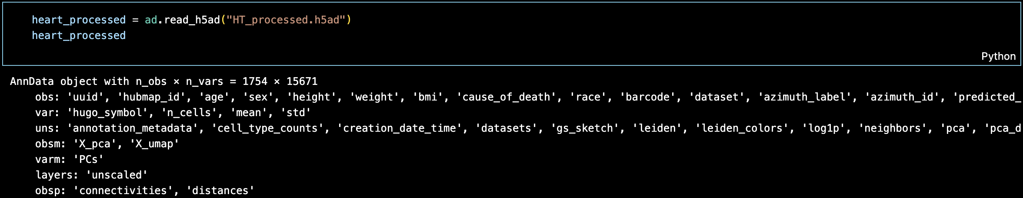
Processed Heart Data – Pipeline Results
After processing, about 99% of cells and 75% of genes were filtered out.
Pipeline utilizes Leiden clustering, viewed with UMAPs.
Metadata gives an overview of the data set.

Slide 7
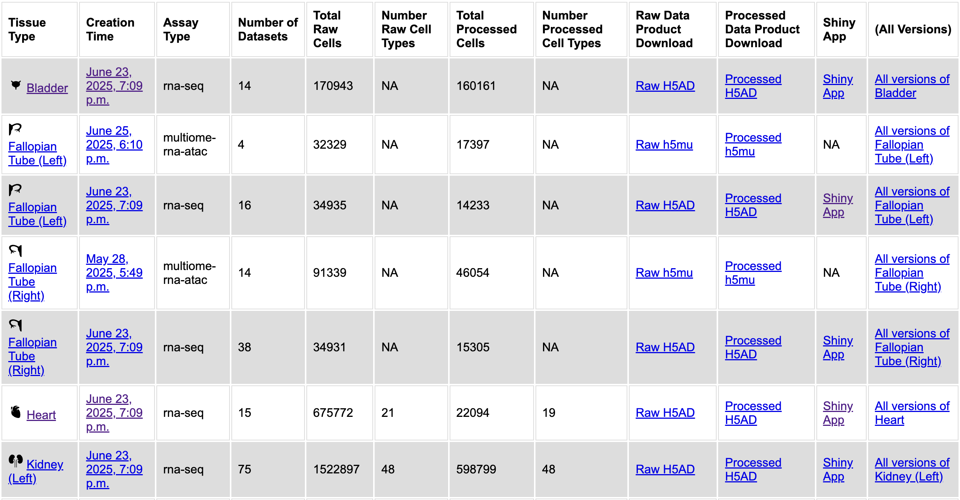
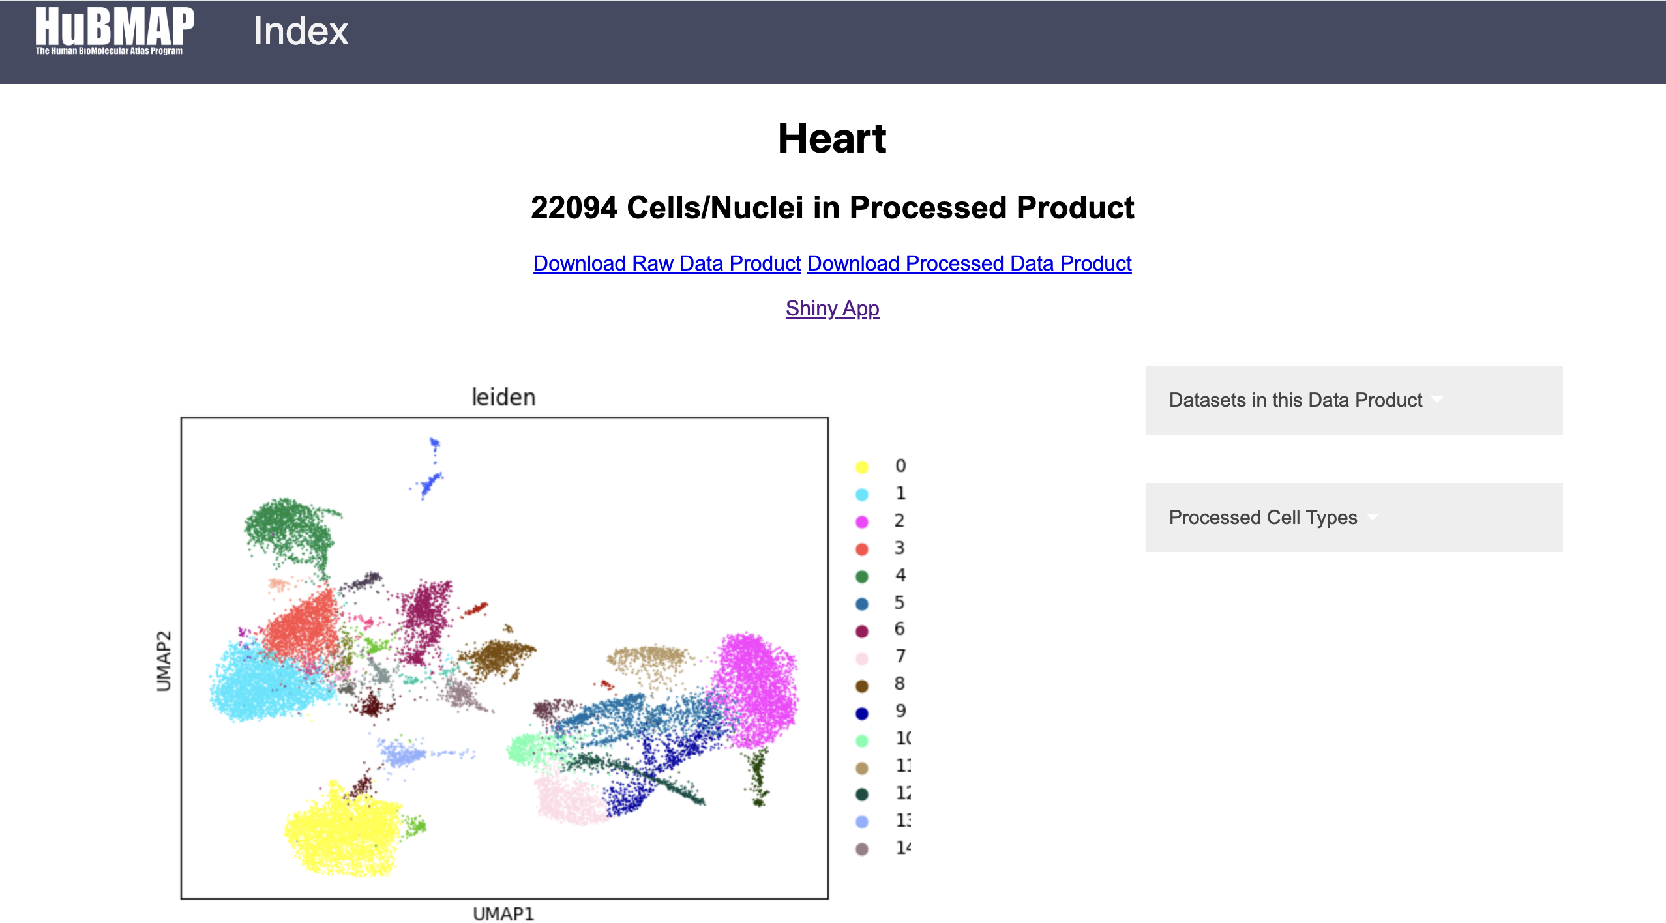
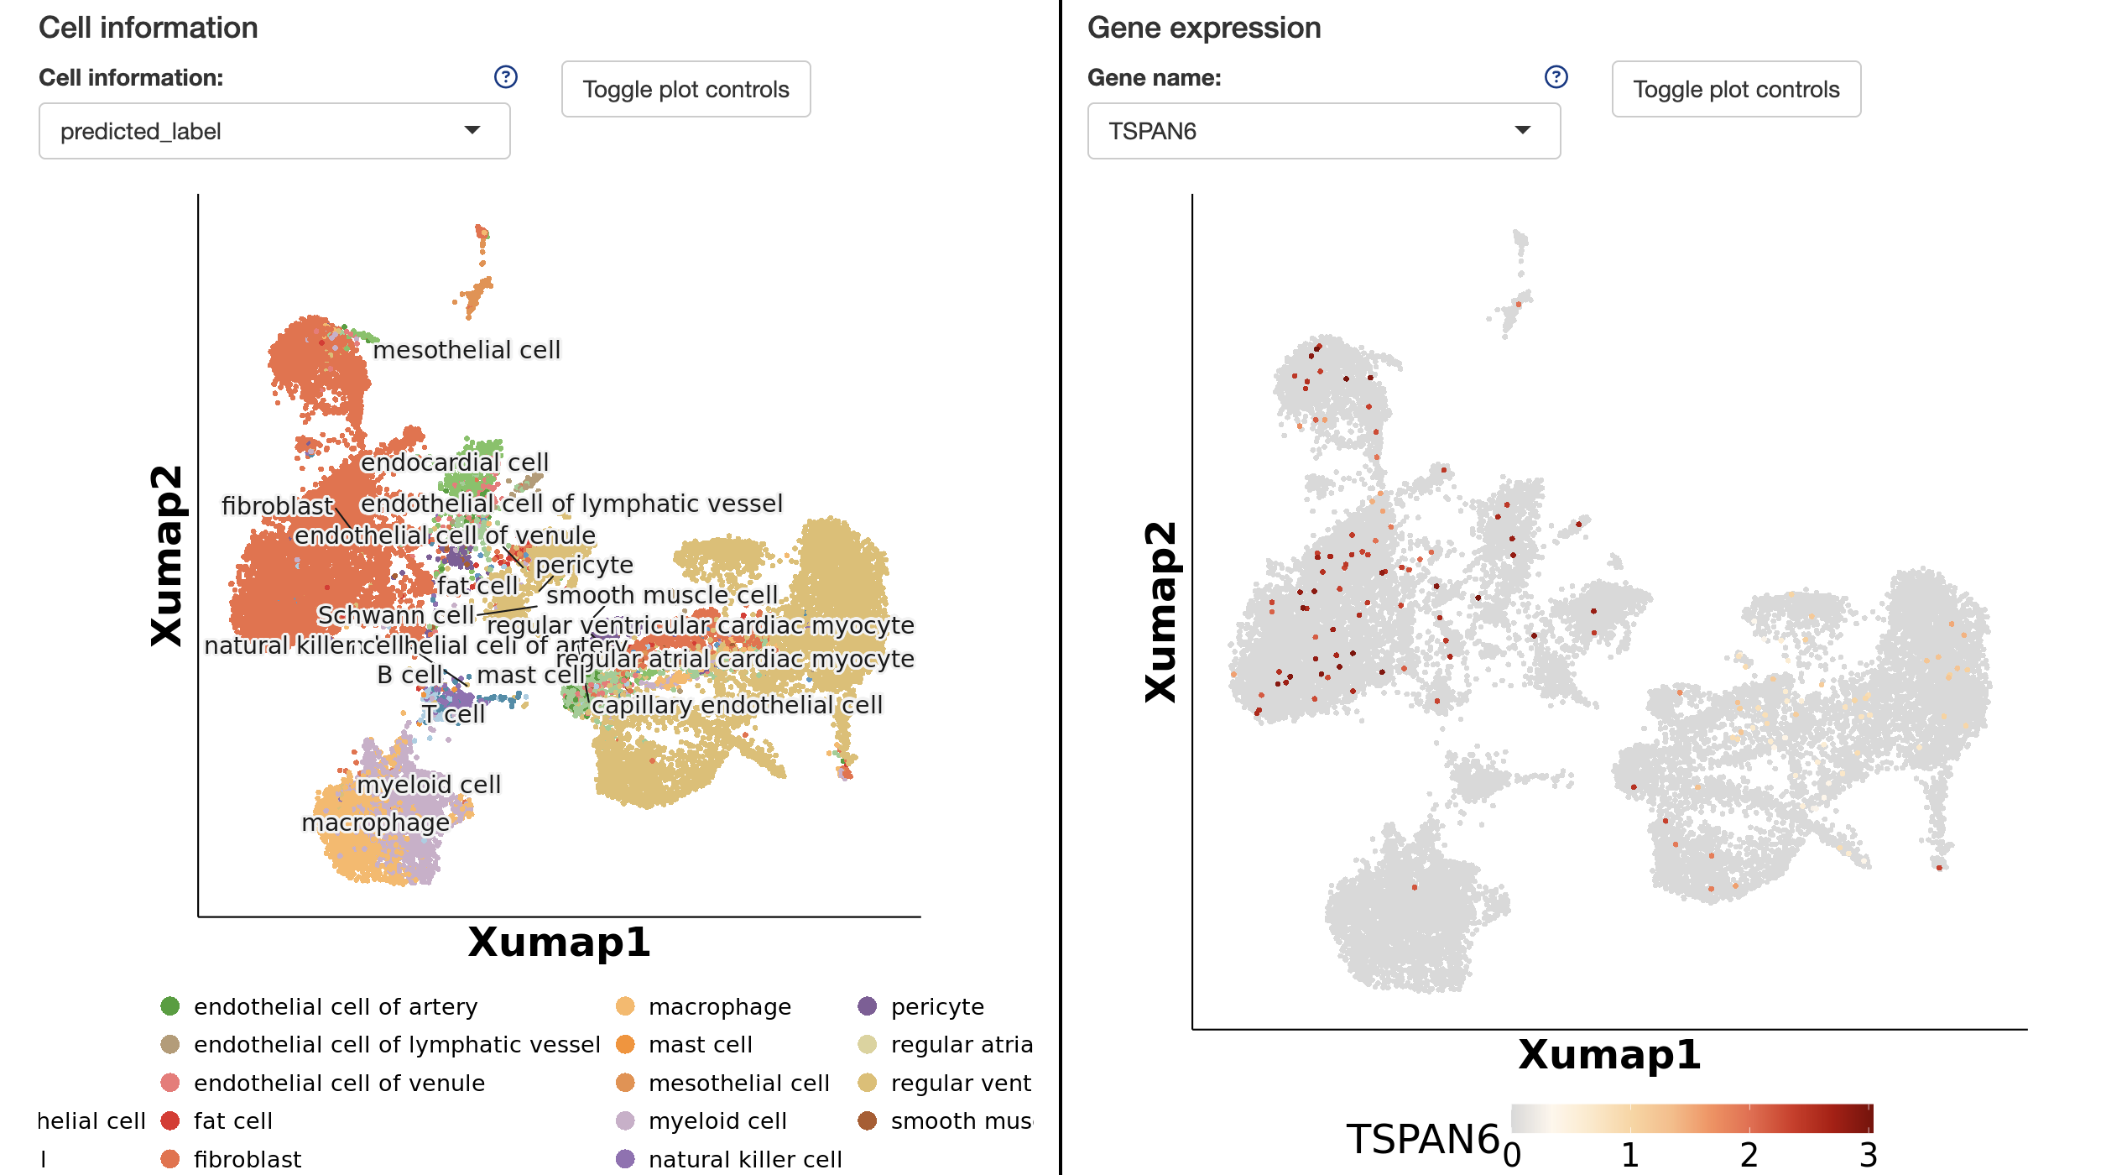
User Interface
Metadata is integrated into the user interface, with tissue type overviews provided. Shiny app enables both gene and cell-level insights/comparisons.

Slide 8
Team
Nick Nystrom (PI, PSC): PSC Chief Scientist Jonathan C. Silverstein (PI, Pitt): Professor and CRIO, DBMI

