Slide 1
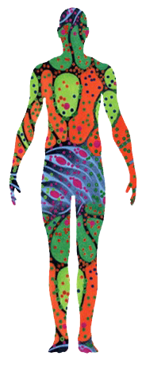
HuBMAP Internship – Jack Lasota
Phil Blood
Alex Ropelewski
Pittsburgh Supercomputing Center (PSC)
Carnegie Mellon University
Jonathan Silverstein
Bill Shirey
Department of Biomedical Informatics (DBMI)
University of Pittsburgh

Slide 2
Agenda
Welcome, Background of HubMap (~2)
Quick tour of HuBMAP Consortium Portal (~2)
Data processing pipeline (~2 Penny on scRNAseq, one workflow, one on results?)
TBD

Slide 3
Outline

Slide 4
Team
Nick Nystrom (PI, PSC): PSC Chief Scientist Jonathan C. Silverstein (PI, Pitt): Professor and CRIO, DBMI

