Slide 1

Character Recognition
in context
Aidan Holloway-Bidwell and Jack Lightbody • CS328, Anna Rafferty, SP’16

Slide 2

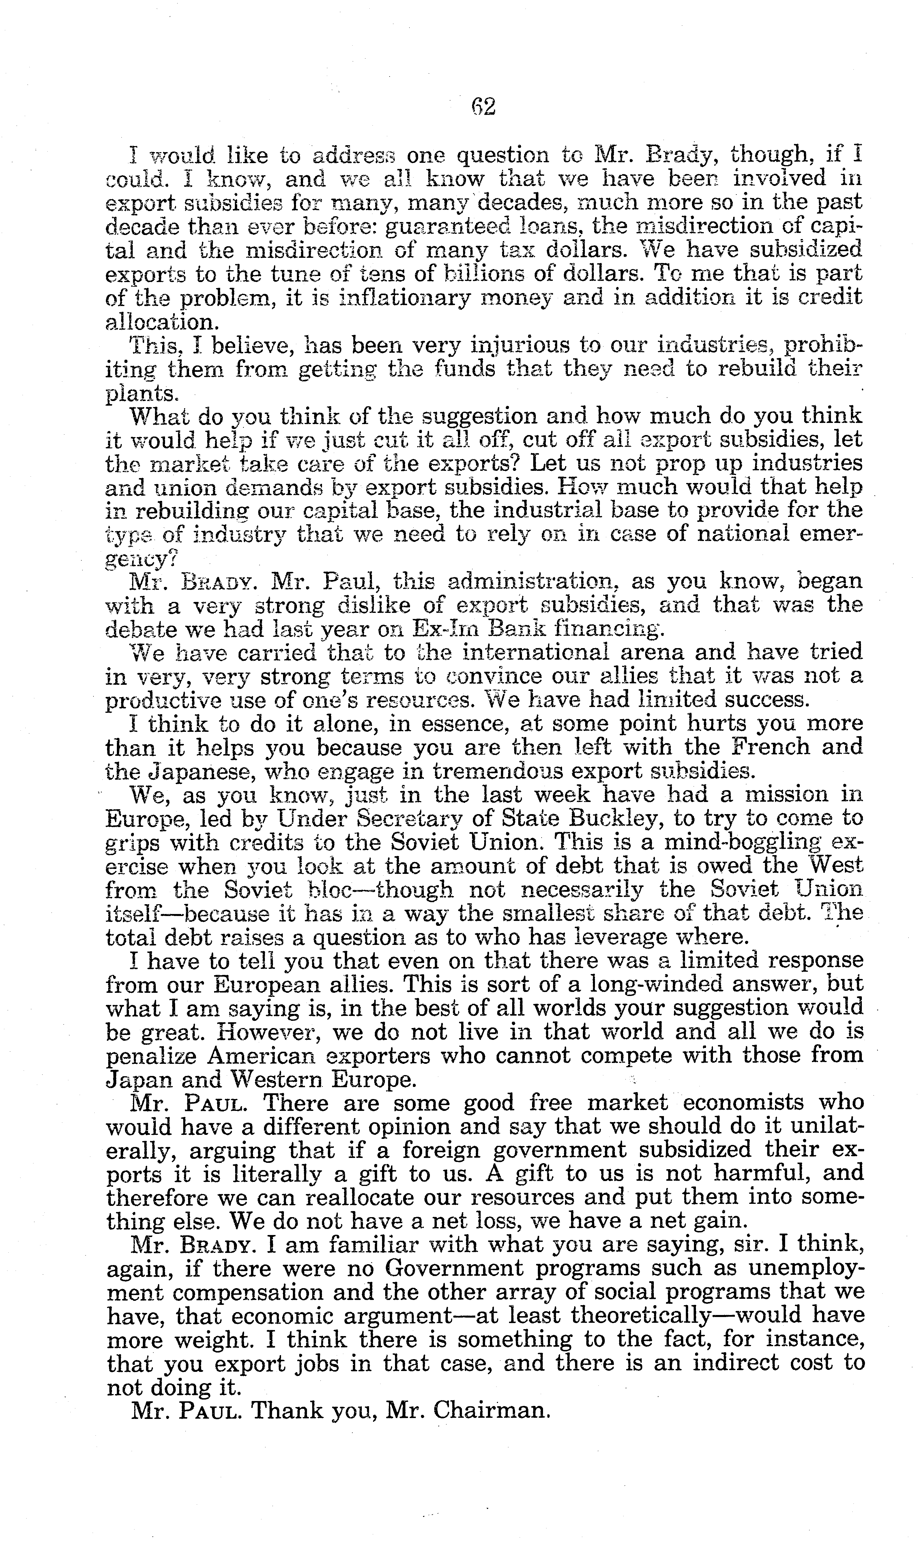
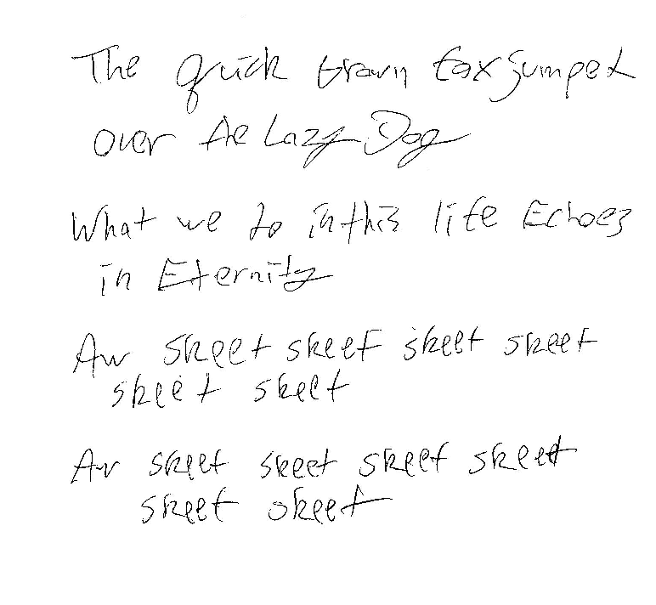
Applications
Scanning text documents to editable format
Real-time handwritten input
Natural language processing

Slide 3


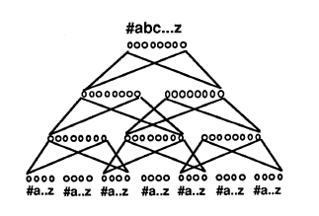
Background
Simple character recognition using pixel values and NNs
We did this in assignment 6
Can perform well on identifying digits…how about English characters?
NETtalk (Sejnowski and Rosenberg, 1986)
Speech generation program
Trained on informal continuous human speech (learns context)
Pittman, 1991
Experimented with 3 approaches to character recognition NNs
Image input
Stroke input
Context

Slide 4


Neural Networks
Three Different Networks
Pixel Values Only
Context Only
Combined
(Pittman’s NN)
A
A
?
A

Slide 5
Pixel Values Only
Tan Activation Function =
dTan =
Pixel values average of pixel + pixel below
Trained on 17,384 examples, 30 iters, 3 hidden
12% Correct

Slide 6
Context Only
Input is previous and following 2 characters of target character
Train on “clean” input [0,0,0…0,1,0…0,0,0] for context letter values
Pixel values average of pixel + pixel below
Trained on 41,700 examples, 50 iters, 10 hidden nodes
7% Correct
With 50 iters and 3 hidden nodes: 10% correct

Slide 7
Combined
Same methodology as context only, except using outputs from pixel value network for target character.
Will weigh in pixel values as well as context to determine character identity.

Slide 8

Conclusions

Slide 9
Sources
Pittman, James A. "Recognizing Handwritten Text." Proceedings of the SIGCHI Conference on Human Factors in Computing Systems Reaching through Technology - CHI '91 (1991): n. pag. Web.
Taskar, Ben, and Rob Kassel. OCR Dataset. N.d. Raw data. N.p.

