Slide 1

Character Recognition
in context
Aidan Holloway-Bidwell and Jack Lightbody • CS328, Anna Rafferty, SP’16

Slide 2

Applications
Scanning text documents to editable format
Real-time handwritten input
Natural language processing

Slide 3
Background
Similarity to multilayer network PS6 but with more variance
Pittman paper
NETTalk

Slide 4
Neural Network
Three Different Networks
Pixel Values Only
Context Only
Combined

Slide 5
Pixel Values Only
Tan Activation Function =
dTan =
Pixel values average of pixel + pixel below
Trained on 17,384 examples
12% Correct

Slide 6
Context Only
Input was previous and following 2 characters
7% Correct

Slide 7
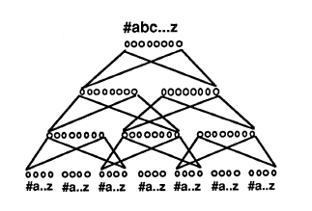
Combined

Slide 8
Conclusions

