Slide 1
Welcome
Notes:
Use Code Highlighter: https://romannurik.github.io/SlidesCodeHighlighter/
Dark (design), Courier Prime,

Slide 2
About Me
Using Django since 2018
PSF Contributing member
Lead dev for a Django-based commercial application for utilities districts
Part of HTMX community since 2020

Slide 3
Server-Side is Dead!
Long Live Server-Side (+ HTMX)
Jack Linke
Notes:
Use Code Highlighter: https://romannurik.github.io/SlidesCodeHighlighter/
Dark (design), Courier Prime,

Slide 4
Web 2.0
Dynamic content
User-generated
Interactive & ‘social’
Web server & database on the back-end, serving html
Notes:
I started web programming at the turn of the millennium, back in the early days of web 2.0. JavaScript was very young. AJAX - the ability to use JavaScript asynchronously to do things like form submissions or updating part of a page without a full page refresh - wasn’t even a thing yet. CSS still felt very experimental. Interactivity and dynamic content were somewhat new, and in those days everything was done on the server-side often in PERL or PHP. We were creating cool database-backed web applications that felt powerful! A website wasn’t just a static page of text and images, it could respond to your inquiries and return customized content.
Sadly, while I continued programming and other technical work, life took me away from web programming for the most part for a decade and a half. When I got back into developing for the web in 2018, the environment was completely different. Half the internet running on JavaScript, separate teams working on front-end and back-end, complicated workflows and APIs, and layer upon layer of frameworks to allow dynamic, interactive websites.
So, in some ways in 2018 I was brand new to web development all over again – but I remembered (perhaps with rose-colored glasses) that web development was in many ways much more straightforward 20 years prior.
Does modern web development have to be super complicated?

Slide 5
The current state

Slide 6




Django templates
How to apply interactivity?
  Vanilla JavaScript
  jQuery
  Single-Page Applications
  Use Vue directly
Notes:
The approach over the past decade has been to offload much of the work to the frontend. Pass a bunch of XML or JSON to a JavaScript framework, and let it do the work of manipulating the content.
But this can be very confusing for those new to Django. Nothing in the Django docs tells you what to

Slide 7
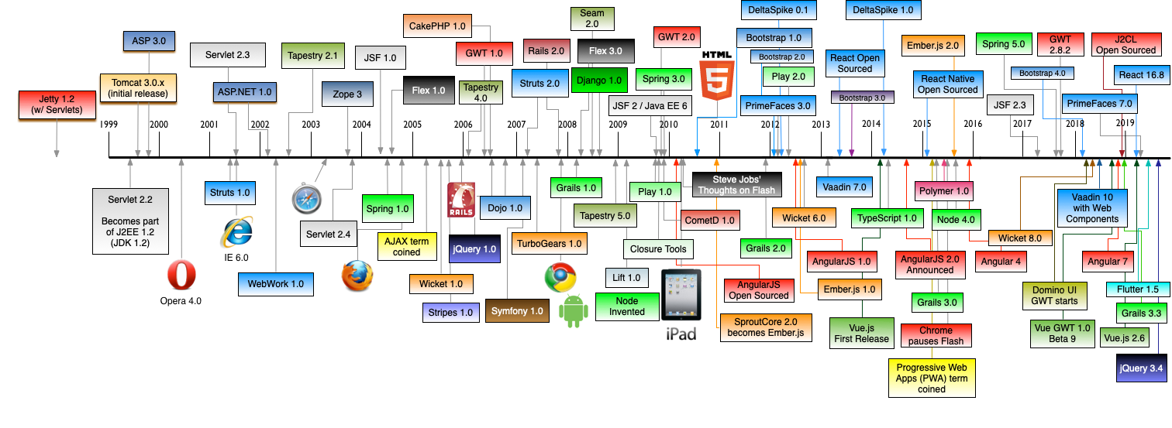
Frameworks for days
https://github.com/mraible/history-of-web-frameworks-timeline/
Notes:
https://github.com/mraible/history-of-web-frameworks-timeline/
Most of the tools in this image are at least in part focused on the front-end
Keep in mind this image has not been updated in two years - a lot of new frameworks and tools have come out in just that time

Slide 8
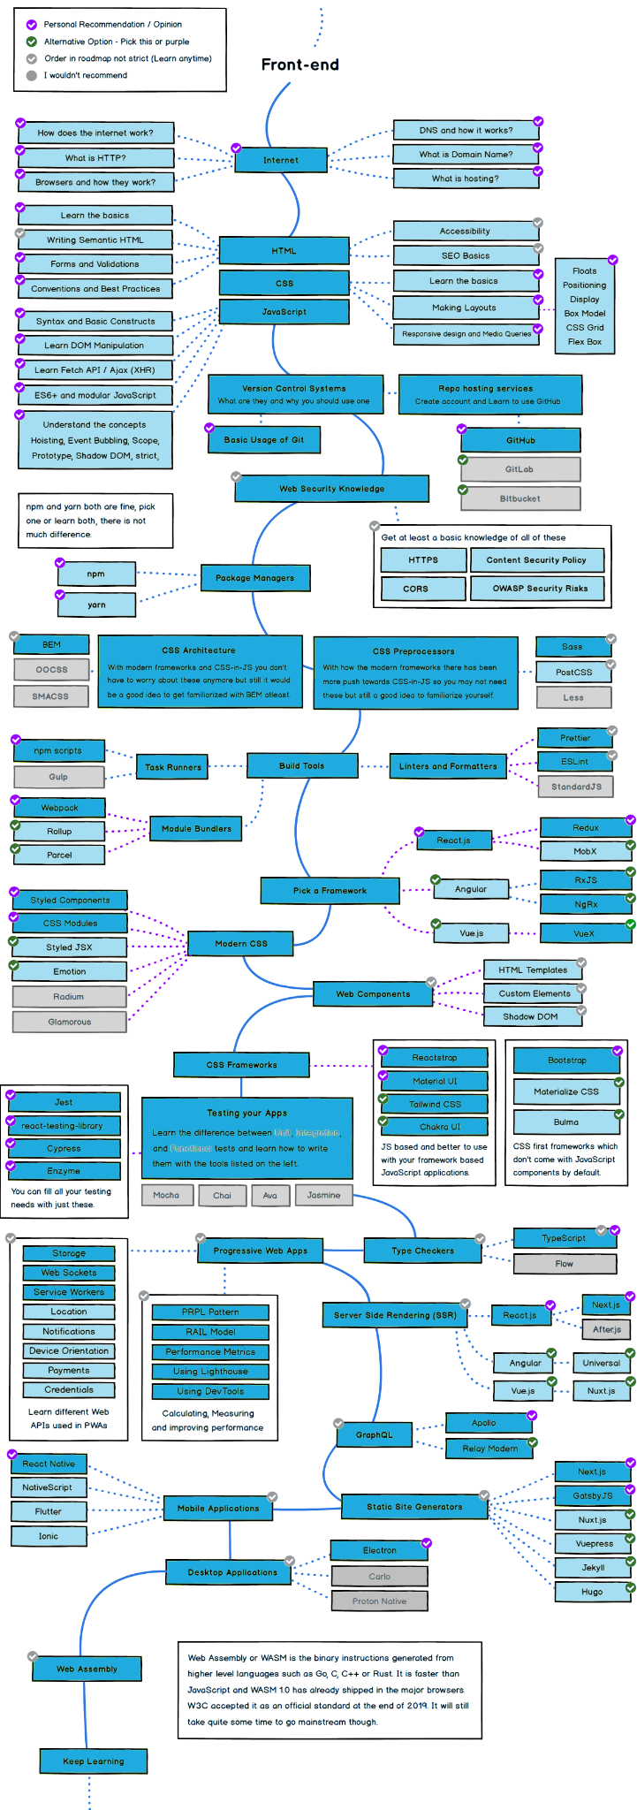
Front-End Development Roadmap
https://www.decipherzone.com/blog-detail/front-end-developer-roadmap-2021
Notes:
https://www.decipherzone.com/blog-detail/front-end-developer-roadmap-2021
Using HTMX, you can ignore nearly half of the items in this image for the majority of web-based applications

Slide 9
Django templates
So, what is the ‘standard’ Django approach for modern front-end development?
Notes:
The approach over the past decade has been to offload much of the work to the frontend. Pass a bunch of XML or JSON to a JavaScript framework, and let it do the work of manipulating the content.
But this can be very confusing for those new to Django. Nothing in the Django docs tells you what to

Slide 10
Django templates
So, what is the ‘standard’ Django approach for modern front-end development?
? ? ?
Notes:
Django was created and initially came to popularity at a time when server-side was still very much the norm. Over the past decade there have been so many single-page-app & JavaScript frontend frameworks and tools and options that it really throws newbies to Django for a loop, and makes older django folks feel like they've got to figure a bunch of new stuff out.
There's no 'standard' approach to the front end other than the built-in templating, and lots of people have felt that that approach was outdated.
The approach over the past decade has been to offload much of the work to the frontend. Pass a bunch of XML or JSON to a JavaScript framework, and let it do the work of manipulating the content.
But this can be very confusing for those new to Django. Nothing in the Django docs tells you what to do to get the interactivity we’re talking about

Slide 11
One potential approach - HTMX is...
An extension to existing HTML
Backend agnostic (bring-your-own-backend)
Focused - does a few things very well
Allows you to access
AJAX, CSS Transitions, WebSockets and Server Sent Events
Directly in your HTML
Small - 11 kB
Notes:
HTMX lets us stick to what django is good at - server-side stuff, mainly - without feeling like we're losing out on the modern world. It kind of brings the django project back full circle to its origins, but with the power of the best parts of 2021 web technology.

Slide 12
Feature and approach walkthroughs
Notes:
So, how do we get from the traditional django template approach to a more modern approach with HTMX while sidestepping all of those javascript frameworks and tool we discussed earlier? Let’s take a look at a few examples.

Slide 13
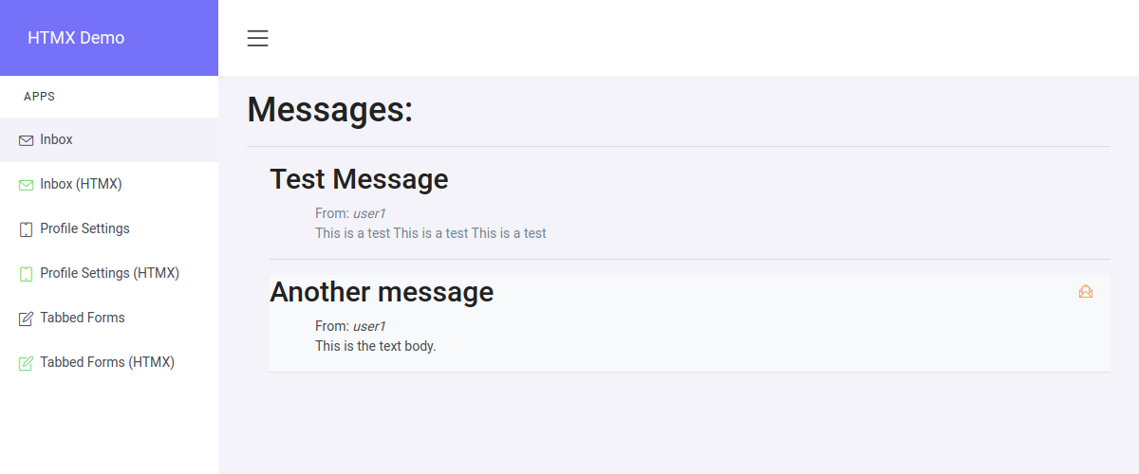
Inbox functionality (marking read, archive)

Slide 14
Inbox functionality (marking read, archive)
def inbox(request):
template = "messaging/inbox.html"
if request.method == "POST":
message_id = request.POST.get('item')
message = get_object_or_404(Message, id=message_id)
if message.to_user == request.user:
message.mark_read()
messages = Message.objects.filter(to_user=request.user)
context = {'messages': messages}
return TemplateResponse(request, template, context)
def inbox_htmx(request):
template = "messaging/inbox_htmx.html"
if request.method == "POST":
message_id = request.POST.get('item')
message = get_object_or_404(Message, id=message_id)
if message.to_user == request.user:
message.mark_read()
template = "messaging/fragments/message_fragment.html"
context = {'message': message}
return TemplateResponse(request, template, context)
messages = Message.objects.filter(to_user=request.user)
context = {'messages': messages}
return TemplateResponse(request, template, context)

Slide 15
Inbox functionality (marking read, archive)
<form method="POST">
{% csrf_token %}
<input type="hidden" name="item" value="{{ message.id }}">
<button
class="btn mb-1 ml-2 btn-rounded btn-outline-light"
type="submit"
title="Mark Read">
<i class="icon-envelope-letter menu-icon text-warning"></i>
</button>
</form>
<div class="ml-4 {% if not message.read_at %} bg-light{% endif %}" id="li_list_{{ message.id }}">
...
<input type="hidden" name="item" value="{{ message.id }}">
<span
data-hx-post="{% url 'messaging:inbox_htmx' %}"
data-hx-swap="outerHTML"
data-hx-target="#li_list_{{ message.id }}"
data-hx-include="[name='item']"
class="btn mb-1 ml-2 btn-rounded btn-outline-light" type="submit" title="Mark Read">
<i class="icon-envelope-letter menu-icon text-warning"></i>
</span>
...
</div>

Slide 16
Inbox functionality (marking read, archive)
Uses the same template fragment for
  Initial display of each message
  Swapped content
Swapped content replaces original content
{% for message in messages %}
{% include "messaging/fragments/message_fragment.html" %}
{% endfor %}

Slide 17
Inbox functionality (marking read, archive)
Demo

Slide 18
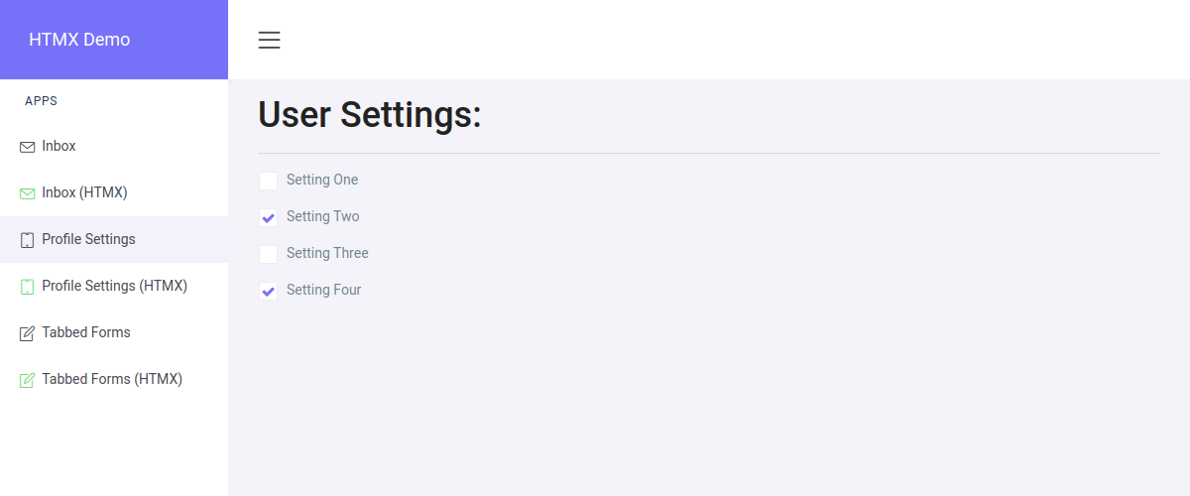
One-click settings changes

Slide 19
One-click settings changes
Initial example uses ajax
Includes small amount of _hyperscript for animation
Example of returning HTML directly from view vice fragment
Loading the response to different location (div)

Slide 20
One-click settings changes
<div class="custom-control custom-switch col-lg-3 mt-3 mb-1">
<form method="POST">
<input type="checkbox"
class="form-check-input"
{% if request.user.setting_one == True %}checked{% endif %}
name="set_value"
id="setting_one">
<label class="form-check-label" for="setting_one">Setting One</label>
{% csrf_token %}
</form>
</div>
$("#setting_one").click(function(){
var csrfToken = $( "input[name='csrfmiddlewaretoken']");
$.ajax({
url: '{% url "users:settings" %}',
type: "POST",
dataType: "json",
data: {
'settings':'setting_one',
'csrfmiddlewaretoken':csrfToken.val()
},
cache: false
}).done(function(data) {
if (data.result === true){
alert(data.message);
}
});
});
Notes:
This is probably pretty straightforward if you’ve worked with ajax before, but might be a bit intimidating if you’re now versed in JavaScript.
We have a standard form with a checkbox, and when the checkbox is checked or unchecked, we pass the value ‘setting_one’ to the user:settings view for processing.

Slide 21
One-click settings changes
<div class="custom-control custom-switch col-lg-3 mt-3 mb-1">
<form method="POST">
<input type="checkbox"
class="form-check-input"
{% if request.user.setting_one == True %}checked{% endif %}
name="set_value"
id="setting_one"
data-hx-post="{% url "users:settings_htmx" %}"
data-hx-trigger="click"
data-hx-target="#setting_one_response">
data-data-hx-include="[name='settings']"
<label class="form-check-label" for="setting_one">Setting One</label>
<input type="hidden" name="settings" value="setting_one">
</form>
<div id="setting_one_response"></div>
</div>
Notes:
In the HTMX version, we can skip any special JavaScript, and just add a few extra bits to the html for the checkbox itself.
We are posting the value of a hidden input named ‘settings’ to the user:settings_htmx view when the checkbox received a ‘click’ event. The html we get back will go to the setting_one_response div

Slide 22
One-click settings changes
def settings(request):
template = "users/settings.html"
context = {}
if request.method == "POST":
user = request.user
setting_value = request.POST.get('settings')
# Set/un-set settings booleans
if setting_value == "setting_one":
request.user.toggle_setting_one()
# ...
return TemplateResponse(request, template, context)
Notes:
So what do the views look like?
In the traditional approach, if the request method is POST, we toggle the setting.

Slide 23
One-click settings changes
def settings_htmx(request):
# ...
if setting_value == "setting_one":
request.user.toggle_setting_one()
successful_toggle = True
# ...
if successful_toggle:
return HttpResponse(
(
'<div _="on load wait 2s then remove me" '
' class="alert alert-success alert-dismissible fade show" '
' role="alert">'
'<i class="icon-like menu-icon text-success"></i>'
'</div>'
),
status=200,
content_type="text/html",
)
return TemplateResponse(request, template, context)
Notes:
In the HTMX version, we do the same thing, but we are also returning a chunk of HTML to display a success alert, and using a bit of _hyperscript to remove it after 2 seconds.

Slide 24
One-click settings changes
Demo
Notes:
Here you can see the end results. Interactivity with just a few changes to our HTML and update to return some HTML form the view.
This same method can be used for any other type of instantly-updating settings using select boxes, text input, etc.

Slide 25
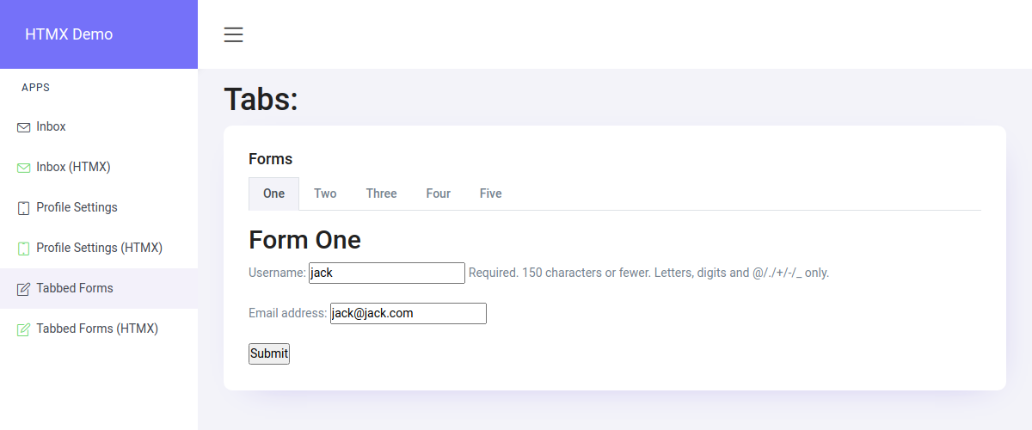
Forms in multiple tabs
Notes:
The last example we’ll look at is a case where you want to display multiple independent forms on the same page. Each form is designed to submit separately from the others.

Slide 26
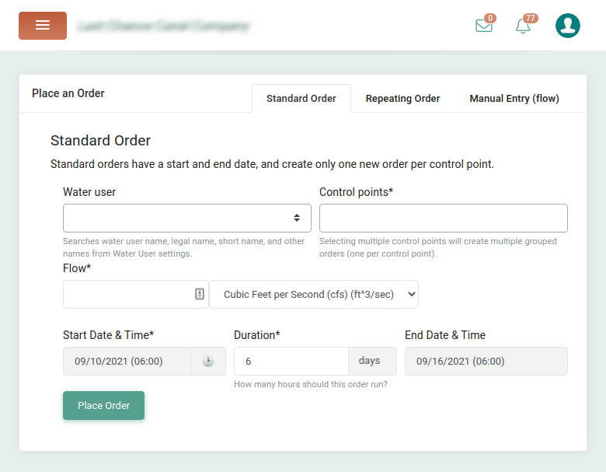
Forms in multiple tabs
A pattern I use often
  Profile settings
  Tenant configuration
  Order forms variations
Notes:
It’s a use-case that I see a lot in my own projects. Here is an example where I have three different forms for specifying water order requests at an irrigation company. Each form is somewhat different, but putting each in tabs makes it easy for the irrigation company to see all of the order form options on one page.
You might use this sort of thing anywhere that you need lots of profile settings, tenant configurations, or variations on order forms.

Slide 27
Forms in multiple tabs
class FormOne(forms.Form):
username = forms.CharField(max_length=100)
email = forms.EmailField(max_length=100)
... additional forms
Notes:
To demonstrate here I’m using a very simple form, duplicated for each tab. In reality, there would be different forms, potentially with many fields.

Slide 28
Forms in multiple tabs
<div class="default-tab">
<ul class="nav nav-tabs mb-3" role="tablist">
<li class="nav-item">
<a class="nav-link active" data-toggle="tab" href="#one">One</a>
</li>
... remaining tabs
</ul>
<div class="tab-content">
<div class="tab-pane fade show active" id="one" role="tabpanel">
<h2>Form One</h2>
<div class="p-t-15">
<form method="post">
{% csrf_token %}
{{ form_one.as_p }}
<input type="submit" value="Submit" name="submit_one">
</form>
</div>
</div>
... remaining tab contents
</div>
</div>
Notes:
In the traditional approach to the template we load each form into each tab on the page.

Slide 29
Forms in multiple tabs
def tabs_view(request):
template = "tabs/tabs.html"
context = {}
post_data = request.POST or None
# Set defaults
form_one = FormOne(
prefix="form_one",
initial={
"username": request.user.username,
"email": request.user.email
}
)
form_two = FormTwo(
prefix="form_two",
initial={
"username": request.user.username,
"email": request.user.email
}
)
# ... remaining forms
context = {
"form_one": form_one,
"form_two": form_two,
# ... remaining forms
}
return TemplateResponse(request, template, context)
Notes:
And in the view, we check to see which form was intended for processing by checking the name of the submit button associated with that form.

Slide 30
Forms in multiple tabs
Issues with the traditional approach
  Prefixes
  Long views
  All content must load each time (e.g. selects)
Notes:
We also have to prefix each form so that they don’t all end up with the same id in the resulting html output to the template.
For multiple forms, these views can get long and complex.
One other potential issue is the amount of content that is loaded in a view like this. If you have select boxes with many options in each of the forms, for instance, the page may take a surprisingly long time to load.

Slide 31
Forms in multiple tabs
def tabs_view(request):
template = "tabs/tabs.html"
context = {}
post_data = request.POST or None
# Set defaults
form_one = FormOne(
prefix="form_one",
initial={
"username": request.user.username,
"email": request.user.email
}
)
# ... remaining forms
if request.method == 'POST':
# For each form, if the submit button name is in the POST,
# process and save that form
if "submit_one" in request.POST:
form_one = FormOne(
post_data, prefix="form_one"
)
if form_one.is_valid():
context["success"] = "Success!"
context = {
"form_one": form_one,
"form_two": form_two,
# ... remaining forms
}
return TemplateResponse(request, template, context)
Notes:
I’ve highlighted here the points made before about having to prefix each form so that it is uniquely identifiable in the browser. It doesn’t look so bad with only the two tabs shown here, but it quickly gets a bit overwhelming as the content within the view increases.

Slide 32
Forms in multiple tabs
HTMX Approach
  Multiple tabs, one div for content
  On-load, populate div with tab 1 content
  Each tab’s content loads independently
Notes:
With HTMX, we can split things up a bit. In this case we are using a separate template and view for each tab. While that might seem like more work, it is incredibly easier to troubleshoot and to read through and understand which bits of code do what.
We use a single div for the content of all the tabs, loading the content for each tab separately as needed.
When the page initially loads up, we insert the content for the first tab, and when any tab is selected, we make a request to the associated view for that tab’s contents.

Slide 33
Forms in multiple tabs
Tab Contents in separate *.html
<div id="formDiv">
<h2>Form One</h2>
<p>
<h3 class="text-success">{{ success }}</h3>
</p>
<form
data-hx-post="{% url 'tabs:form_one' %}"
data-hx-target="#formDiv"
data-hx-swap="outerHTML">
<div>
{{ form_one.as_p }}
</div>
<input type="submit" value="Submit">
</form>
</div>
<div
id="tabs"
data-hx-get="{% url 'tabs:form_one' %}"
data-hx-trigger="load delay:100ms"
data-hx-target="#tabContent"
data-hx-swap="innerHTML">
</div>
<li class="nav-item">
<a href="#"
data-toggle="tab"
role="tab"
data-hx-get="{% url 'tabs:form_one' %}"
data-hx-target="#tabContent"
data-hx-swap="innerHTML"
class="nav-link active">One
</a>
</li>
... remaining tabs
<div class="tab-pane fade show active" id="tabContent" role="tabpanel">
Load...
</div>
Notes:
Here’s the update with HTMX. We have the base template for the view on the left, and one of the tab fragment templates on the right.
That first div on the left loads the contents of tabs:form_one into the tabContent div 100ms after the page loads.
Each tab also has htmx attributes to do a get request for the contents of that tab when clicked. Those contents, shown in the fragment on the right, are then loaded into the tabContent div.
The form inside each fragment performs a POST of the form to the view associated with the tab.

Slide 34
Forms in multiple tabs
def tabs_htmx_view(request):
template = "tabs/tabs_htmx.html"
context = {}
return TemplateResponse(request, template, context)
def form_one_htmx_view(request):
template = "tabs/fragments/form_one.html"
context = {}
form_one = FormOne(
initial={
"username": request.user.username,
"email": request.user.email
}
)
if request.method == 'POST':
form_one = FormOne(request.POST)
if form_one.is_valid():
context["success"] = "Success!"
context["form_one"] = form_one
return TemplateResponse(request, template, context)
Notes:
Here are the views themselves. The top one, tabs_htmx_view, loads up the main content. Almost nothing to it.
Then we have a view for each tab that displays the form on a GET request, and processes its individual form on a POST request.

Slide 35
Forms in multiple tabs
Demo
Notes:
And here’s what it looks like. Again, this is a very basic example, and can be expanded considerably.
Keep in mind that these three basic examples only scratch the surface of what can be quickly implemented in HTMX without the need to heavy frameworks and learning new programming languages.

Slide 36
Lazy Data Popovers
(in maps, datatables, etc)
Notes:
So, having looked at a few examples of using HTMX, let’s close out with some tips, best practices, and resources.

Slide 37
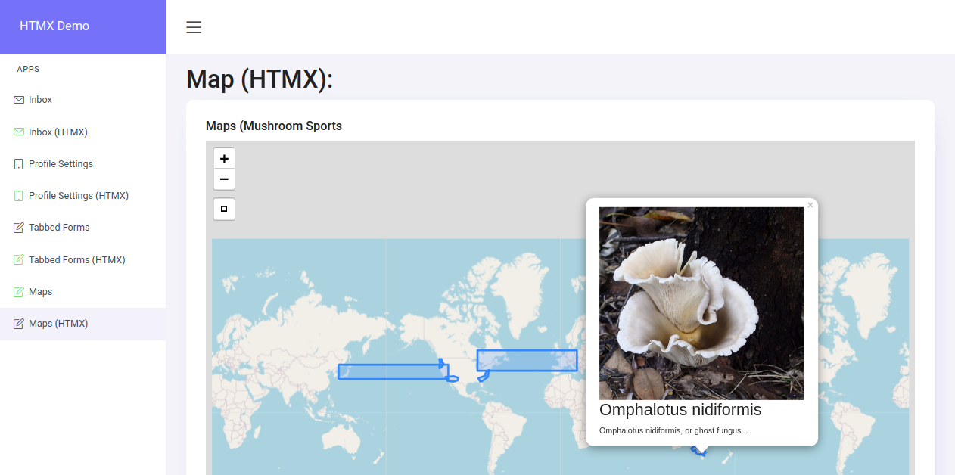
Lazy Data Popovers

Slide 38
Lazy Data Popovers
urlpatterns = [
path('', TemplateView.as_view(template_name='maps/map.html'), name='map'),
path(
'Data.geojson',
GeoJSONLayerView.as_view(model=MushroomSpot, properties=('title', 'description', 'picture_url', 'id')),
name='data'
),
]

Slide 39
Lazy Data Popovers
<script>
var dataurl = '{% url "maps:data" %}';
window.addEventListener("map:init", function (event) {
var map = event.detail.map;
// Download GeoJSON data with Ajax
fetch(dataurl)
.then(function(resp) {
return resp.json();
})
.then(function(data) {
L.geoJson(data, {
onEachFeature: function onEachFeature(feature, layer) {
var props = feature.properties;
var content = `<img width="300" src="${props.picture_url}"/><h3>${props.title}</h3><p>${props.description}</p>`;
layer.bindPopup(content);
}
}).addTo(map);
});
});
</script>

Slide 40
Lazy Data Popovers
Initial Approach
  All data for the map features & popovers loaded with initial page
Notes:
With HTMX, we can split things up a bit. In this case we are using a separate template and view for each tab. While that might seem like more work, it is incredibly easier to troubleshoot and to read through and understand which bits of code do what.
We use a single div for the content of all the tabs, loading the content for each tab separately as needed.
When the page initially loads up, we insert the content for the first tab, and when any tab is selected, we make a request to the associated view for that tab’s contents.

Slide 41
Lazy Data Popovers
urlpatterns = [
path('htmx', TemplateView.as_view(template_name='maps/map_htmx.html'), name='map_htmx'),
path(
'Data.geojson',
GeoJSONLayerView.as_view(model=MushroomSpot, properties=('title', 'description', 'picture_url', 'id')),
name='data'
),
path("<mushroom_id>/", mushroom_data, name="mushroom_data"),
]

Slide 42
Lazy Data Popovers
def mushroom_data(request, mushroom_id):
template = "maps/fragments/data.html"
context = {}
try:
mushroom = MushroomSpot.objects.get(id=mushroom_id)
context["mushroom"] = mushroom
except MushroomSpot.DoesNotExist:
pass
return TemplateResponse(request, template, context)

Slide 43
Lazy Data Popovers
<script>
var dataurl = '{% url "maps:data" %}';
function layerOnClick() {
htmx.process(document.body);
}
window.addEventListener("map:init", function (event) {
var map = event.detail.map;
// Download GeoJSON data with Ajax
fetch(dataurl)
.then(function(resp) {
return resp.json();
})
.then(function(data) {
L.geoJson(data, {
onEachFeature: function onEachFeature(feature, layer) {
var props = feature.properties;
var content = `
<div data-hx-get="/maps/${props.id}/"
data-hx-trigger="load"
data-hx-target="#data-div-${props.id}"
data-hx-swap="outerHTML">
</div>
<div style="width: 600px" id="data-div-${props.id}"></div>
`;
layer.bindPopup(content);
layer.on('click', layerOnClick);
}}).addTo(map);
});
});
</script>
# Popover contents in separate html file
{% load static %}
<div style="width: 600px">
<img width="300" src="{{ mushroom.picture_url }}"/>
<h3>{{ mushroom.title }}</h3>
<div style="width: 500px">
{{ mushroom.description }}
</div>
</div>

Slide 44
Lazy Data Popovers
HTMX Approach
  Load the map features, but only load the content for each popover when the associated map feature has been clicked.
Notes:
With HTMX, we can split things up a bit. In this case we are using a separate template and view for each tab. While that might seem like more work, it is incredibly easier to troubleshoot and to read through and understand which bits of code do what.
We use a single div for the content of all the tabs, loading the content for each tab separately as needed.
When the page initially loads up, we insert the content for the first tab, and when any tab is selected, we make a request to the associated view for that tab’s contents.

Slide 45
Lazy Data Popovers
Demo
Notes:
And here’s what it looks like. Again, this is a very basic example, and can be expanded considerably.
Keep in mind that these three basic examples only scratch the surface of what can be quickly implemented in HTMX without the need to heavy frameworks and learning new programming languages.

Slide 46
Tips, best practices, and resources

Slide 47
CSRF Tokens - Inline
Cross-Site Request Forgery
“An attack that forces an end user to execute unwanted actions on a web application in which they're currently authenticated”
Django has built-in support
  Provides a token from back-end
  Compares to submitted POST information
Notes:
But how do we include CSRF tokens with out requests, when with HTMX we aren’t necessarily POSTing content that’s wrapped in a form?

Slide 48
CSRF Tokens - Inline
<div id="htmx-test-div"
data-hx-post="{% url 'save-like' %}"
data-hx-headers='{"X-CSRFToken": "{{ csrf_token }}"}'
data-hx-target="#htmx-test-div"
data-hx-include="[name='my-data']"
data-hx-swap="outerHTML">
<input type="hidden" value="Some Value to POST" name="my-data">
</div>

Slide 49
CSRF Tokens - JavaScript Snippet
<script>
// htmx csrf script
document.body.addEventListener('htmx:configRequest', (event) => {
event.detail.headers['X-CSRFToken'] = '{{ csrf_token }}';
})
</script>

Slide 50

More Views

Slide 51


Complimentary JS Libraries
_Hyperscript
  Built by creator of HTMX
  Designed to work alongside HTMX
  Speculative
Alpine.js
  Lightweight & focused

Slide 52
django-htmx
Developed by Adam Johnson
Provides:
  Debug Handler when settings.DEBUG is True
  Boolean for determining if partial or full refresh
  Many other useful utilities
def my_view(request):
if request.htmx:
template_name = "partial.html"
else:
template_name = "complete.html"
return render(template_name, ...)
Notes:
https://github.com/adamchainz/django-htmx
Django-htmx is a django package developed by Adam Johnson. Among other things, django-htmx provides…
- A debug error handler when debug is set to True in your Django application
- A method for easily determining whether a request was made from HTMX or is a standard full-page request
- A bunch of other useful utilities that you’ll probably find useful when working with both Django and HTMX.
Conveniently, Adam also includes an example app demonstrating the various tools in the package.

Slide 53
Additional Resources
htmx.org
awesome-htmx
  https://github.com/rajasegar/awesome-htmx
HTMX Discord
  https://htmx.org/discord
r/htmx on Reddit
Thomas Güttler’s Best Practices
  https://github.com/guettli/django-htmx-fun
Notes & code for this presentation
  https://github.com/jacklinke/htmx-talk-2021

Slide 54
Thank you
Jack Linke
@JackDLinke jacklinke.com

