Slide 1
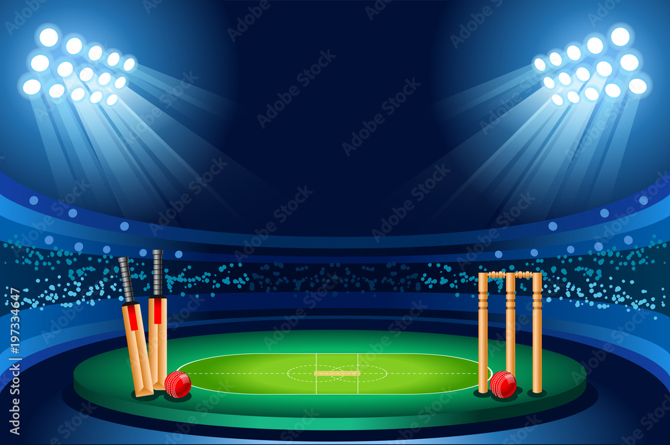
IPL Match Winner Prediction using Machine Learning
Name-Jacklin Mary
Batch-FEB-2025
Date-7/7/2025

Slide 2
Introduction
Overview Of The Problem:
Predicting The Outcome Of IPL Matches Is Challenging Due To Multiple Influencing Factors.
Dataset:
Historical IPL Match Records Including Team Names, Toss Decisions, Match Results, Etc.
Objective:
Build Machine Learning Models To Predict The Winning Team Of An IPL Match.

Slide 3
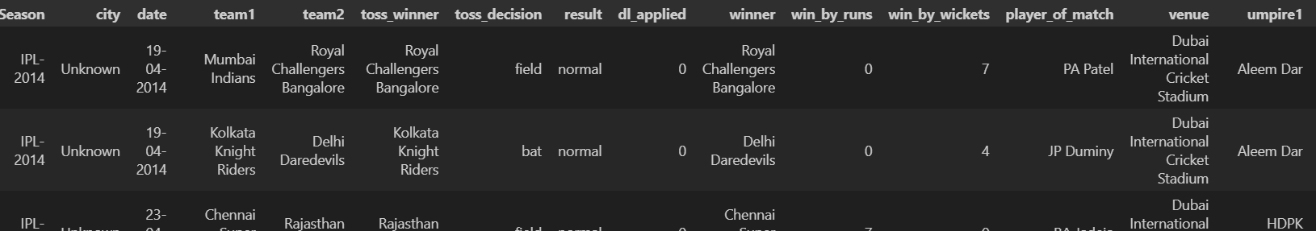
Data Understanding
Dataset Description:
Data source: IPL match winner prediction
Total Rows: 756
Total Columns: 18
Key Columns:
team1, team2, toss_winner, toss_decision, venue, winner
win_by_runs, win_by_wickets, dl_applied, umpire1, etc
Sample Data Rows:

Slide 4
Data Cleaning
Cleaning Steps:
Removed Rows With Null Values In Non-essential Columns
Replaced Missing Values Using Mode Strategies
Changed datatype of date column
Renamed team names (same team with different franchise).
City name filled using venues
Encoding:
Converted Categorical Columns Using Label Encoding And One-hot Encoding

Slide 5
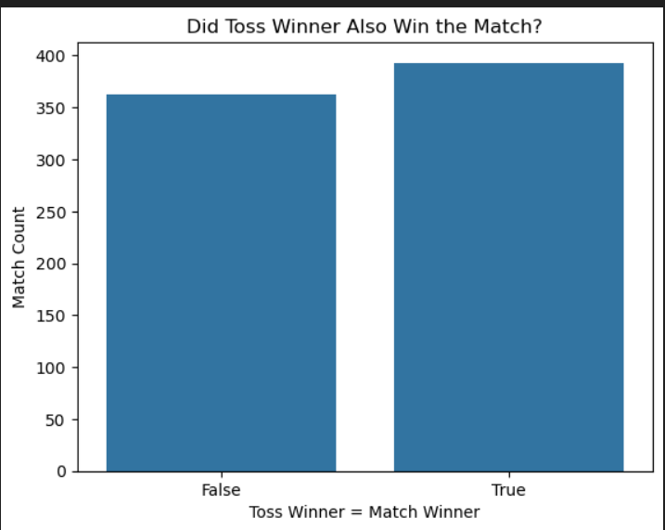
Exploratory Data Analysis (EDA)
Teams that win the toss do have a slightly higher chance of winning the match, but it's not a dominant factor.
The outcome is fairly balanced, suggesting that while toss plays a role (strategy, pitch reading), match performance matters more.

Slide 6
Insights
Teams that win the toss and choose to field have a slightly higher chance of winning the match.
choice to bat first usually correlates with larger victory margins
Toss Winners Win The Match In ~50–55% Of Cases, Indicating A Mild Advantage
Some Teams Consistently Outperform Others (E.G., Mumbai Indians, Chennai Super Kings)
Large Wins By Runs Usually Come From Teams Batting First, While Large
Some Teams Have Significantly Higher Win Rates
Home Venue Plays A Potential Role In Outcome

Slide 7
Modeling Process
Models Used:
Logistic Regression
Decision Tree
Random Forest
K-Nearest Neighbors (KNN)
Support Vector Machine (SVM)
Naive Bayes
XGBoost
Hyperparameter Tuning:
Used Grid Search For Optimal Parameters
Focused On Parameters Like Max_depth, N_estimators, Learning_rate

Slide 8
Evaluation Metrics:
Accuracy
Precision
Recall
F1-Score

Slide 9
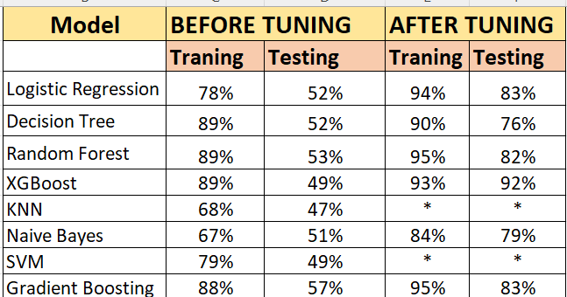
Model Comparison

Slide 10
Best Model
Best Model:
XGBoost Classifier
Justification:
Best performance in accuracy and F1 score
Generalized well across test data
Handled categorical features effectively

Slide 11
Conclusion
Improvements Made:
Hyperparameter tuning improved model accuracy
Outlier removal and feature encoding enhanced results
Future Enhancements:
Add player statistics, pitch and weather conditions
Use ensemble or stacked models
Try deep learning for more complex patterns

