Slide 1
4483/8995 CAPSTONE PROJECT PRESENTATION
Rice Research Overview
Yanlong Su
u3059571
TUTORIAL GROUP – Friday 8:30

Slide 2
Table of Contents
Introduction
Dataset Details
EDA (Exploratory Data Analysis) Outcomes
PDA (Predictive Data Analytics) Outcomes
Implementation and Deployment
References/Bibliography

Slide 3
Introduction
Rice MSC Dataset
MSC stands for Morphological, Shape, and Colour
Colour is not modelled in this research
Feature extraction via Image processing technique

Slide 4
2. Dataset Details
There are five rice varieties: Arborio, Basmati, Ipsala, Jasmine, Karacadag
106 features in total; includes morphological, shape, and colour traits.
12 morphological and 4 shape
90 colour features
5 most effective and specific features were found: roundness, compactness, shape factor 3, aspect ratio and eccentricity.

Slide 5
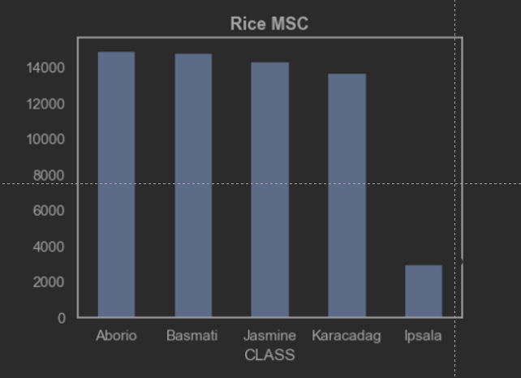
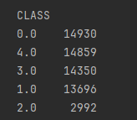
3. EDA (Exploratory Data Analysis) Outcomes
Amount of sample after outlier is removed.
Ipsala variety is deviated significantly from other rice samples
No mean of quality

Slide 6
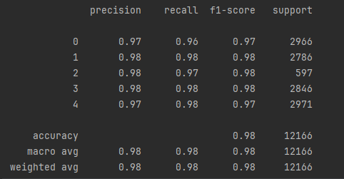
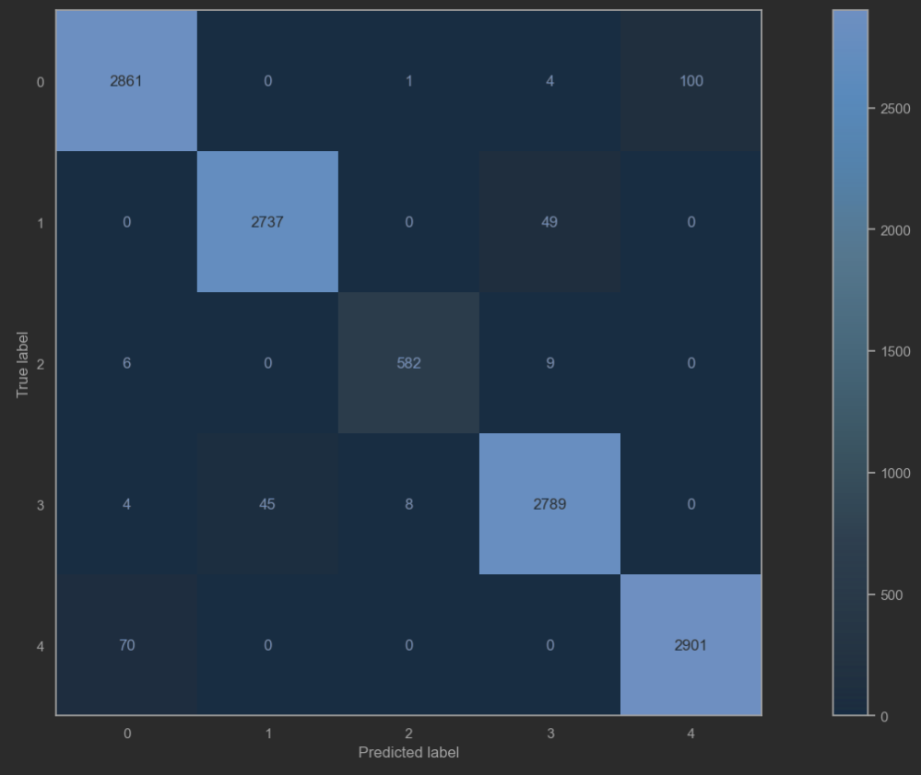
4. PDA (Predictive Data Analysis) Outcomes
Above: Classification report
The accuracy of classification is around 98% for 5 varieties of rice
Confusion report
The matrix suggests that the model is generally performing well

Slide 7
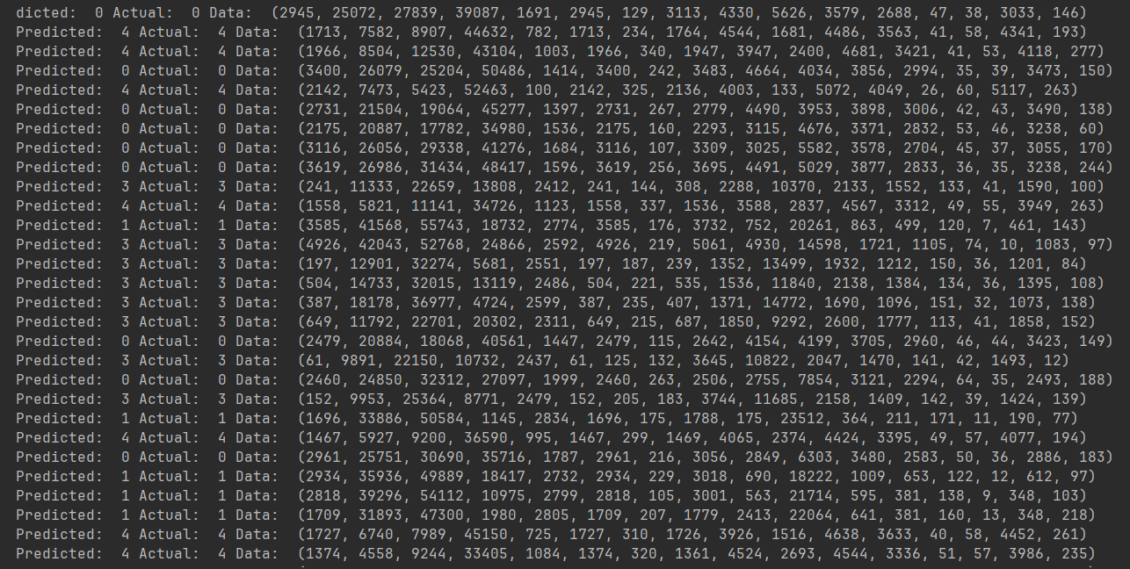
4. PDA (Predictive Data Analysis) Outcomes
Classification report
Prediction report: prediction equals actual figure

Slide 8
5. Implementation and Deployment
Streamlit will be used to implement and deploy the model
The model has not been finalized yet

Slide 9
References /Bibilography
K. M., C. I., and T. Y.S., “Classification of rice varieties with deep learning methods,” 2021. https://doi.org/10.1016/j.compag.2021.106285
C. I. and K. M., “Determination of Effective and Specific Physical Features of Rice Varieties by Computer Vision In Exterior Quality Inspection,” 2021. https://doi.org/10.15316/SJAFS.2021.252
C. I. and K. M., “Identification of Rice Varieties Using Machine Learning Algorithms,” 2022. https://doi.org/10.15832/ankutbd.862482
C. I and K. M., “Classification of Rice Varieties Using Artificial Intelligence Methods,” 2019. https://doi.org/10.18201/ijisae.2019355381

