Slide 1

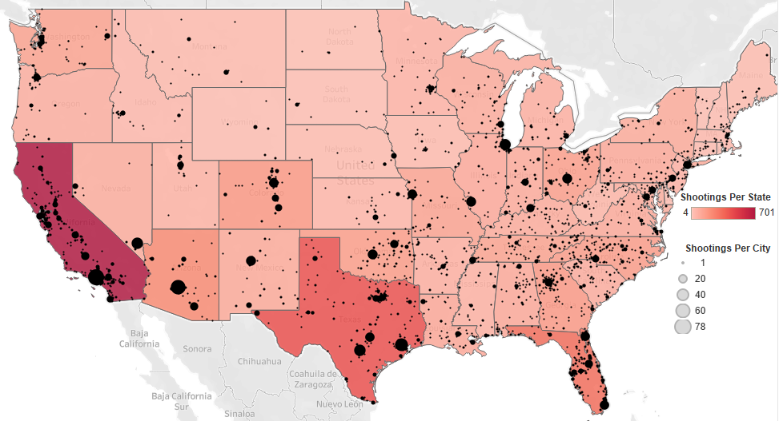
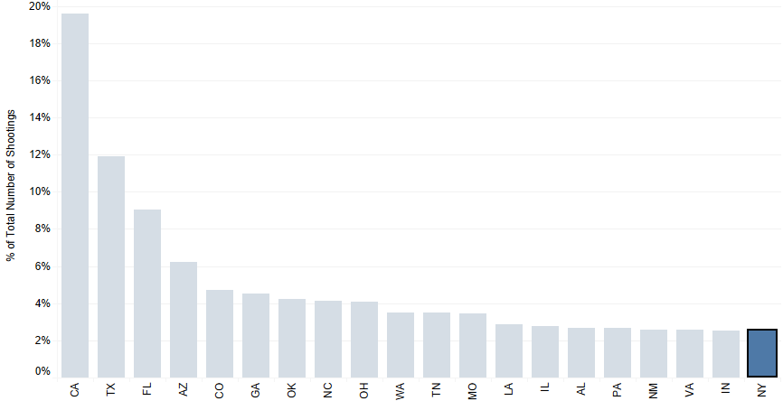
The NYPD as a Model for Policing
Police executives around the country should communicate with the New York Police Department to attempt to replicate some of the strategies they have used to limit shooting deaths.
Geographic Dispersion of Police Shootings
Despite containing the largest city in the entire country, New York has a relatively low number of police shootings compared to states of similar size.
Top 20 States By Total Number of Police Shootings
New York ranks 20th in number of police shootings despite being the 4th most populous state in America
Key Insights/Takeaways
New York comprises roughly 6% of the U.S. population but only accounts for 2.51% of the police shootings.
NYC contains a high level of socioeconomic and ethnic diversity but has still managed to outperform police departments around the country.
Further investigation should be done to determine what New York, and particularly NYC, is doing differently from other police forces.
Additional Data Source: https://www.census.gov/data/tables/time-series/demo/popest/2010s-state-total.html

Slide 2

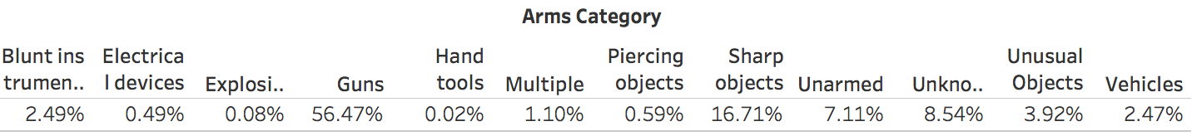


The NYPD as a Model for Policing
Police executives around the country should communicate with the New York Police Department to attempt to replicate some of the strategies they have used to limit shooting deaths.
New York State
U.S. Aggregate Data
95.56% of police shooting victims were armed
The percentage of police shooting victims that were unarmed is more than 50% higher than the same proportion in New York State
In the United States as a whole, <65% of shooting victims were considered an attack threat level
4 out of 5 shooting victims were classified as an attack threat level
Whether it is through better training programs, stronger leadership, a culture of greater trust between citizens and cops, or some other factor, it is clear that New York is leading the nation in terms of reducing overall shootings per capita and ensuring lethal force is only used in situations where it is justifiable.

Slide 3
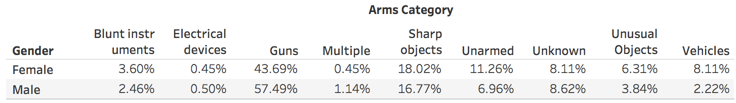
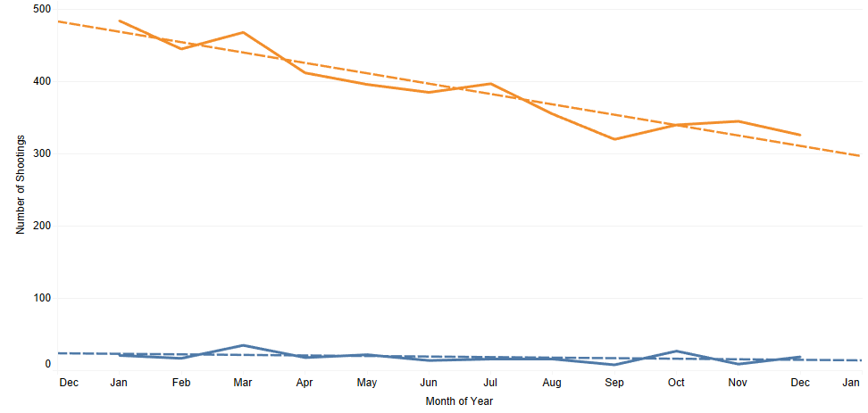

Gender and Change Over Time Analysis
Police departments should investigate differences in the use of lethal force by gender and the observable change over time to better understand how situations are being deescalated.
95%
Although men are killed by police at a much greater rate than women, a greater percentage of females who are killed are unarmed.
This is a curious discovery since much of the gender difference is likely attributed to males being more menacing or violent.
of people shot by the police are males
Why is there such a large discrepancy in shootings by gender if women are almost twice as likely to be unarmed?
Trend Analysis Takeaways
While shootings of males steadily decrease over the course of the year, females are killed by police at a fairly constant rate.
Although the dataset contains shootings from Jan 2016, it is difficult to understand this decline over the rest of the year.
Police departments should conduct research to determine if their use of force policies are being applied inconsistently over time or if there is some other cause for these trends.
Regression analysis indicates that estimated shootings decrease by more than 14 people per month for men and that this relationship is statistically significant with a p-value of <.001

