Slide 1

Markov Decision Processes and ARIMA models to analyze and predict Ice Hockey player’s performance
Carles Sans Fuentes
Presented by Carles Sans Fuentes

Slide 2

Introduction to the Hockey Project
Master thesis Project
Objective
Data
Methodology
Results- Disccusion- Criticism
Thesis presentation

Slide 3


THE MAIN OBJECTIVE OF ICE HOCKEY IS TO SCORE MORE GOALS THAN YOUR OPPONENT ON AN ICE RINK
Master thesis Project - Introduction to the Hockey Project
Events
Metrics
^{Goal}
^{Goals, +/-}
All measures are quite simple and straight forward
How reliable are these measures?
^{Penalty}
^{Faceoff}
How can I create a more reliable and complex measure to see player’s evaluation by match through time ?
^{Shot}
^{Fenwick, Corsi…}
^{Takeaway}
Focus of the project
^{Others}
Sources:
Image ref: http://pngimg.com/download/26505
http://www.nhl.com/nhl/en/v3/ext/rules/2018-2019-NHL-rulebook.pdf
Thesis presentation
Notes:
tthealarmturnsred withprobability0.2,andonceitdoes,itreturnsto greenwithprobability0.1.Theactionspaceisdeﬁnedas{move left,move right,look alarm} and when moving the probability of reaching the target location is 0.8 while the robot stays in the same location with probability 0.2. The reward for reaching the current goal is 0.3 for a corridor length of 3.

Slide 4

IT IS CRUCIAL FOR ICE HOCKEY TEAMS TO UNDERSTAND GAME DYNAMICS TO IMPROVE THEIR PLAYING PERFORMANCE
Master thesis Project - Introduction to the Hockey Project
Common statistics for ice hockey¹
1
2
3
4
+/-
Corsi
Fenwick
PDO
A player is given +1 if he is on the field while his team scores and -1 if the other team scores.
The difference on scores received by that player is his evaluation
Shot attempts (SAT) is the sum of shots on goal, missed shots and blocked shots.
Used to approximate puck possession – the length of time a player's team controls the puck
Unblocked shot attempts (USAT) is a variant of Corsi that counts only shots on goal and missed shots; blocked shots are not included.
It is viewed as having a stronger correlation to scoring chances
PDO, ( SPSV%) is the sum of a team's shooting percentage and its save percentage.
PDO is usually measured at even strength,
is often viewed as a proxy for how lucky a team is.
Formula
+/- = GoalTeam FOR – GoalTeam AGAINST
Corsi = Shot attempts FOR – Shot Attempts AGAINST
Fenwick = Shot attempts FOR – Shot Attempts AGAINST
PDO = Shooting Percentage + Save Percentage
All measures are quite simple and straight forward
How reliable are these measures?
How can I create a more reliable and complex measure to see player’s evaluation by match through time ?
Focus of the project
Understanding players’ performance and finding successful scoring strategies are key elements to improve team’s performance and optimize asset management
Sources:
https://en.wikipedia.org/wiki/Analytics_(ice_hockey)
Thesis presentation
Notes:
Corsi: Measured as either a ratio (like plus-minus) of shot attempts for less shot attempts against, or as a percentage.
most players will have a Corsi For percentage between 40 and 60. A player or team ranked above 55% is often considered "elite"
PDO: According to Wilson, a player or team with a PDO over 102 is "probably not as good as they seem", while a player or team below 98 likely is better than they appear.

Slide 5
Introduction to the Hockey Project
Master thesis Project
Objective
Data
Methodology
Results- Disccusion- Criticism
Thesis presentation

Slide 6
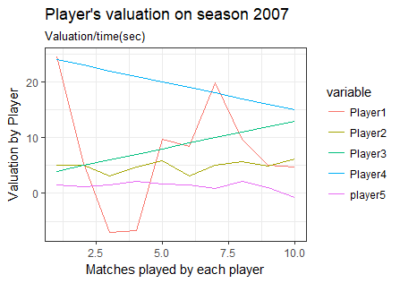
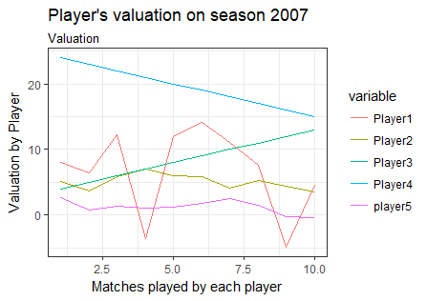
THE OBJECTIVE OF THE THESIS IS BEING ABLE TO EVALUATE PLAYERS THROUGH TIME TO HIRE/FIRE/MAINTAIN THEM
Master thesis Project - Objective
1
Can a MDP/RL be used to evaluate actions under certain time-series events ?
Illustrative
2
How can I store time series data for the usage of a MDP?
3
Can I predict player’s performance based on their performances in the previous matches ?
Illustrative
4
Is there a way to use MDPs to create a metric that evaluates players for hiring/maintaining/ﬁring purposes?
Thesis presentation
Notes:
tthealarmturnsred withprobability0.2,andonceitdoes,itreturnsto greenwithprobability0.1.Theactionspaceisdeﬁnedas{move left,move right,look alarm} and when moving the probability of reaching the target location is 0.8 while the robot stays in the same location with probability 0.2. The reward for reaching the current goal is 0.3 for a corridor length of 3.

Slide 7
Introduction to the Hockey Project
Master thesis Project
Objective
Data
Methodology
Results- Disccusion- Criticism
Thesis presentation

Slide 8

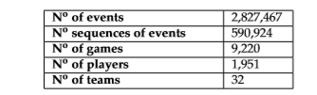
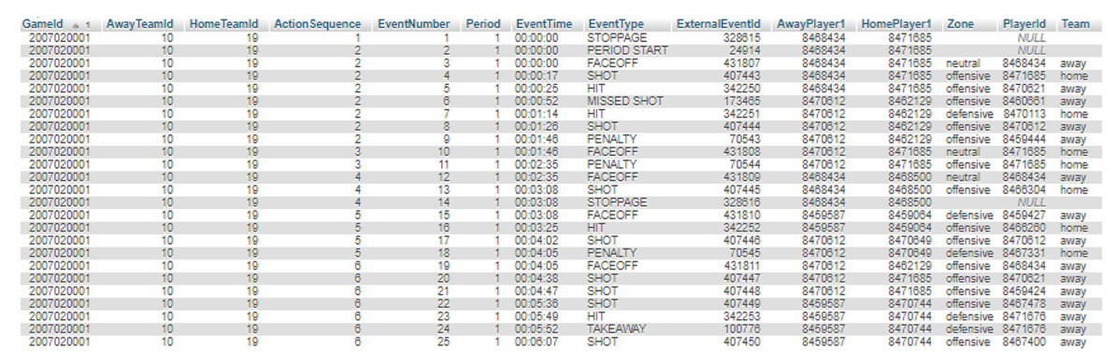
THE DATA USED IS A NHL RELATIONAL DATASET CONTAINING COMPLETE 2007-2014 SEASONS
Master thesis Project - Data
Relational database with 2,827,467 play-by-play events recorded by the NHL
Extraction of the main table in the SQL database
MP Analysis
Thesis presentation
Notes:
The NHL dataset is a relational database with 2,827,467 play-by-play events recorded by the NHL, containing complete 2007-2014 seasons (i.e. regular season and playoff games) and the ﬁrst 512 games of the 2014-2015 regular season. General information about the dataset is displayed in Table 3.1 As shown in table 3.2, each event can either be an Action Event or an Start/End event. An Action Event represents those events performed by players, whereas Start/End events areeventsthatstoptimenotperformedbyplayers. Eachtimeeventiscontinuousofanother time event. That means we have a time series dataset.Additionally, each event which has an action associated Zone in which the event occurs (Home, Neutral, Away) and which team performs that event (Home or Away team).

Slide 9
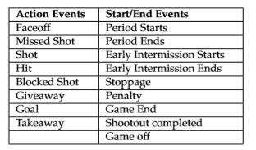
DISPLAY OF ACTION EVENTS AND START/ END EVENTS
Master Thesis – Definition of start /End Markers
Start / End markers are those events in the right column of the table adding faceoffs and shots as starting markers and goals as ending markers
Thesis presentation
Notes:
Stanley Milgram (August 15, 1933 – December 20, 1984) was an American social psychologist, best known for his controversial experiment on obedience conducted in the 1960s during his professorship at Yale.^{[4]} Milgram was influenced by the events of the Holocaust, especially the trial of Adolf Eichmann, in developing the experiment.
After earning a Ph.D. in social psychology from Harvard University, he taught at Yale, Harvard, and then for most of his career as a professor at the City University of New York Graduate Center, until he died in 1984. His small-world experiment while at Harvard led researchers to analyze the degree of connectedness, including the six degrees of separation concept. Later in his career, Milgram developed a technique for creating interactive hybrid social agents (cyranoids), which has since been used to explore aspects of social- and self-perception.
He is widely regarded as one of the most important figures in the history of social psychology. A Review of General Psychology survey, published in 2002, ranked Milgram as the 46th-most-cited psychologist of the 20th century.^{[5]}
sent letters to just under 300 randomly selected people in Nebraska and Kansas, asking them to help ensure that the letter made its way to a "target person" - a named stockbroker in Boston.
Participants were asked not to send the letter directly to the stockbroker. Instead, everyone was allowed to send it only to someone whom they knew on first-name terms and who they thought might know the stockbroker.
Twenty-nine per cent of the parcels eventually reached the stockbroker. Amazingly, given the tens of millions of people in America, there tended to be just six people linking the initial volunteer and the target person - thus giving rise to the popular notion that we are all maybe connected by just six degrees of separation.

Slide 10
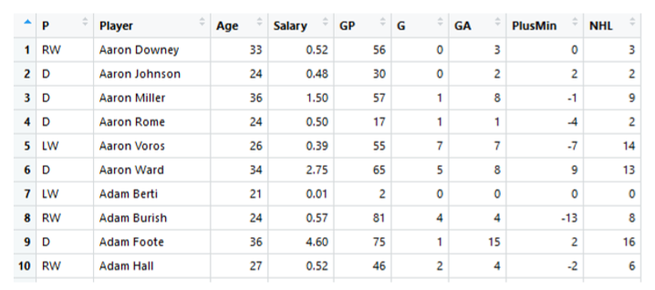
THE DATA SCRAPPED CONTAINS YEAR STATISTICAL METRICS FOR THE NHL PLAYERS
Master thesis Project - Data
Metrics | Description
GP | The nº of games played
G | The nº of goals performed
GA | The nº of goals assisted
Points (NHL) | Points = GA+ G
PlusMin | the plus minus (+/-) measure
General performance metrics for all ice hockey players that have played during a season
Extraction of the main table in the SQL database
Thesis presentation
Notes:
The NHL dataset is a relational database with 2,827,467 play-by-play events recorded by the NHL, containing complete 2007-2014 seasons (i.e. regular season and playoff games) and the ﬁrst 512 games of the 2014-2015 regular season. General information about the dataset is displayed in Table 3.1 As shown in table 3.2, each event can either be an Action Event or an Start/End event. An Action Event represents those events performed by players, whereas Start/End events areeventsthatstoptimenotperformedbyplayers. Eachtimeeventiscontinuousofanother time event. That means we have a time series dataset.Additionally, each event which has an action associated Zone in which the event occurs (Home, Neutral, Away) and which team performs that event (Home or Away team).

Slide 11
Introduction to the Hockey Project
Master thesis Project
Objective
Data
Methodology
Results- Disccusion- Criticism
Thesis presentation

Slide 12

THERE EXIST DIFFERENT MARKOV MODELS FOR DIFFERENT APPROACHES AND OBJECTIVES
Master thesis Project – Theory
NO CONTROL
OVER ACTIONS
CONTROL
OVER ACTIONS
Charactheristics
MP
HMM
MDP
Finite number of states
Probabilistic transitions between states
Controllable actions in each state
Next state determined only by
the current state (Markov property)
The current action
We’re unsure which state we’re in: The current states emits an observation
Focus of the project
In MPDs, we have control over the actions and the states are completely observable
Sources:
(1) http://www.pomdp.org/tutorial/
Thesis presentation
Notes:
Stanley Milgram (August 15, 1933 – December 20, 1984) was an American social psychologist, best known for his controversial experiment on obedience conducted in the 1960s during his professorship at Yale.^{[4]} Milgram was influenced by the events of the Holocaust, especially the trial of Adolf Eichmann, in developing the experiment.
After earning a Ph.D. in social psychology from Harvard University, he taught at Yale, Harvard, and then for most of his career as a professor at the City University of New York Graduate Center, until he died in 1984. His small-world experiment while at Harvard led researchers to analyze the degree of connectedness, including the six degrees of separation concept. Later in his career, Milgram developed a technique for creating interactive hybrid social agents (cyranoids), which has since been used to explore aspects of social- and self-perception.
He is widely regarded as one of the most important figures in the history of social psychology. A Review of General Psychology survey, published in 2002, ranked Milgram as the 46th-most-cited psychologist of the 20th century.^{[5]}
sent letters to just under 300 randomly selected people in Nebraska and Kansas, asking them to help ensure that the letter made its way to a "target person" - a named stockbroker in Boston.
Participants were asked not to send the letter directly to the stockbroker. Instead, everyone was allowed to send it only to someone whom they knew on first-name terms and who they thought might know the stockbroker.
Twenty-nine per cent of the parcels eventually reached the stockbroker. Amazingly, given the tens of millions of people in America, there tended to be just six people linking the initial volunteer and the target person - thus giving rise to the popular notion that we are all maybe connected by just six degrees of separation.

Slide 13
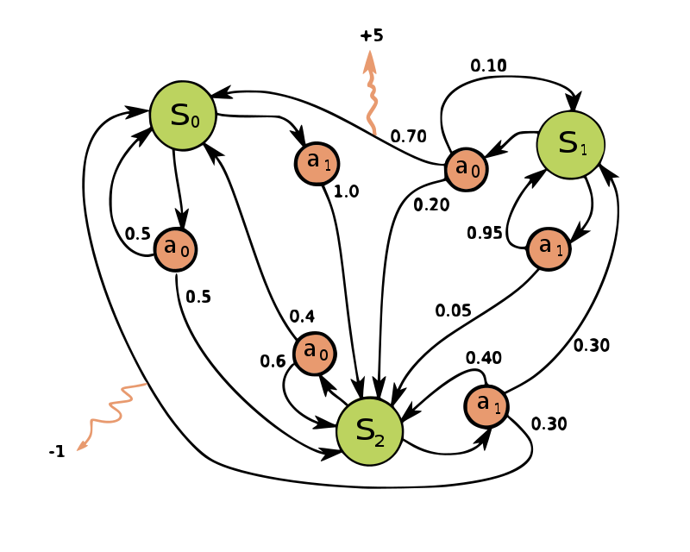
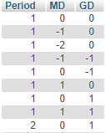
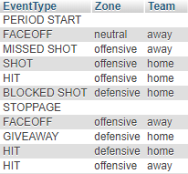
EXAMPLE OF A MARKOV DECISION PROCESS
Master thesis Project – Theory
Parts of a MDP
States
Transitions
Actions
Rewards
Parts of our MDP
Context
Transitions
Events/Actions
Rewards
What is the best action to take under a state ?
What are the combination of states and actions that are nearer to the event GOAL?
Context
Events/Actions
The transitions between states are calculated by knowing how many times after a certain action and state happen a specific other state P(s’ | s, a).
Sources:
(1) By waldoalvarez - Own work, CC BY-SA 4.0, https://commons.wikimedia.org/w/index.php?curid=59364518
Thesis presentation
Notes:
Stanley Milgram (August 15, 1933 – December 20, 1984) was an American social psychologist, best known for his controversial experiment on obedience conducted in the 1960s during his professorship at Yale.^{[4]} Milgram was influenced by the events of the Holocaust, especially the trial of Adolf Eichmann, in developing the experiment.
After earning a Ph.D. in social psychology from Harvard University, he taught at Yale, Harvard, and then for most of his career as a professor at the City University of New York Graduate Center, until he died in 1984. His small-world experiment while at Harvard led researchers to analyze the degree of connectedness, including the six degrees of separation concept. Later in his career, Milgram developed a technique for creating interactive hybrid social agents (cyranoids), which has since been used to explore aspects of social- and self-perception.
He is widely regarded as one of the most important figures in the history of social psychology. A Review of General Psychology survey, published in 2002, ranked Milgram as the 46th-most-cited psychologist of the 20th century.^{[5]}
sent letters to just under 300 randomly selected people in Nebraska and Kansas, asking them to help ensure that the letter made its way to a "target person" - a named stockbroker in Boston.
Participants were asked not to send the letter directly to the stockbroker. Instead, everyone was allowed to send it only to someone whom they knew on first-name terms and who they thought might know the stockbroker.
Twenty-nine per cent of the parcels eventually reached the stockbroker. Amazingly, given the tens of millions of people in America, there tended to be just six people linking the initial volunteer and the target person - thus giving rise to the popular notion that we are all maybe connected by just six degrees of separation.

Slide 14
THE METHODOLOGY AND SCOPE OF THE PROJECT CONTAINS PART FROM [ROUTLEY,2015] STUDY AND A NEW PART
Master thesis Project - Methodology
DATA
1
Creation of two context variables
Scrapping the players statistics
2
AD-tree definition
Definition of states/literals
Context variables
Actions and Events
AD-TREE
Definition of play sequence
Sequence of states
Implemen-tation structure
The Nodes Table
The Edges Table
The Node Information Table
The Rewards’ Table
MDP
3
Execution of the value iteration algorithm
4
CREATION OF METRICS
Impact measure
definition
Direct Impact
Direct Impact / time (in hours)
Collective Impact
Collective Impact / time (in hours)
Analysis of the metrics created
Comparison with scrapped metrics
5
Estimation of the best ARIMA (p,d,q) models to fit model the data on the new metrics
Estimation of the ARIMA parameter values for those ARIMA (p,d,q) models and forecasting players’ performance
ARIMA
Analysis of the results
Methodology applied
Thesis presentation
Notes:
Stanley Milgram (August 15, 1933 – December 20, 1984) was an American social psychologist, best known for his controversial experiment on obedience conducted in the 1960s during his professorship at Yale.^{[4]} Milgram was influenced by the events of the Holocaust, especially the trial of Adolf Eichmann, in developing the experiment.
After earning a Ph.D. in social psychology from Harvard University, he taught at Yale, Harvard, and then for most of his career as a professor at the City University of New York Graduate Center, until he died in 1984. His small-world experiment while at Harvard led researchers to analyze the degree of connectedness, including the six degrees of separation concept. Later in his career, Milgram developed a technique for creating interactive hybrid social agents (cyranoids), which has since been used to explore aspects of social- and self-perception.
He is widely regarded as one of the most important figures in the history of social psychology. A Review of General Psychology survey, published in 2002, ranked Milgram as the 46th-most-cited psychologist of the 20th century.^{[5]}
sent letters to just under 300 randomly selected people in Nebraska and Kansas, asking them to help ensure that the letter made its way to a "target person" - a named stockbroker in Boston.
Participants were asked not to send the letter directly to the stockbroker. Instead, everyone was allowed to send it only to someone whom they knew on first-name terms and who they thought might know the stockbroker.
Twenty-nine per cent of the parcels eventually reached the stockbroker. Amazingly, given the tens of millions of people in America, there tended to be just six people linking the initial volunteer and the target person - thus giving rise to the popular notion that we are all maybe connected by just six degrees of separation.

Slide 15
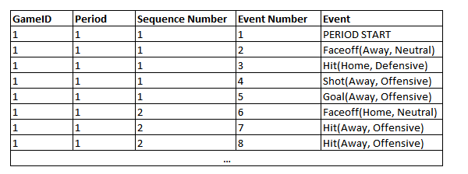
A STATE IS COMPOSED OF A CONTEXT VARIABLES AND PLAYING SEQUENCES
Master thesis Project - Methodology
Intuition
Is the Pr(Scoring | MD =1) == Pr(Scoring | MD =-1)?
Is the Pr(Scoring | GD =3) == Pr(Scoring | GD = -1)?
Is the Pr(Scoring | shot ) == Pr(Scoring | takeaway)?
Composition¹
Illustration
Context
Atmosphere x that defines where the events are happening.
ManPower Differential (MD): Home_Players- AwayPlayers
Goal Differentia (GD)l: Home_Goals - AwayGoals
Period (P): Time in which the match is happening
Action
An action with position and Team Information, in the form of a(T,Z)²
Action (a):
Zone (Z): associated Zone in which the action is performed (Offensive, Neutral or Defensive)
Teams (T): team performing the action (Home, Away)
Play sequence
State or Literal³
Combination of context ‘x’ and sequences of actions being playing sequences ‘h’, such that:
s = <x,h>
Sources:
[Routley, 2015]
[Levesque, 1998]
[Littman, 1994]
Thesis presentation
Notes:
Stanley Milgram (August 15, 1933 – December 20, 1984) was an American social psychologist, best known for his controversial experiment on obedience conducted in the 1960s during his professorship at Yale.^{[4]} Milgram was influenced by the events of the Holocaust, especially the trial of Adolf Eichmann, in developing the experiment.
After earning a Ph.D. in social psychology from Harvard University, he taught at Yale, Harvard, and then for most of his career as a professor at the City University of New York Graduate Center, until he died in 1984. His small-world experiment while at Harvard led researchers to analyze the degree of connectedness, including the six degrees of separation concept. Later in his career, Milgram developed a technique for creating interactive hybrid social agents (cyranoids), which has since been used to explore aspects of social- and self-perception.
He is widely regarded as one of the most important figures in the history of social psychology. A Review of General Psychology survey, published in 2002, ranked Milgram as the 46th-most-cited psychologist of the 20th century.^{[5]}
sent letters to just under 300 randomly selected people in Nebraska and Kansas, asking them to help ensure that the letter made its way to a "target person" - a named stockbroker in Boston.
Participants were asked not to send the letter directly to the stockbroker. Instead, everyone was allowed to send it only to someone whom they knew on first-name terms and who they thought might know the stockbroker.
Twenty-nine per cent of the parcels eventually reached the stockbroker. Amazingly, given the tens of millions of people in America, there tended to be just six people linking the initial volunteer and the target person - thus giving rise to the popular notion that we are all maybe connected by just six degrees of separation.

Slide 16
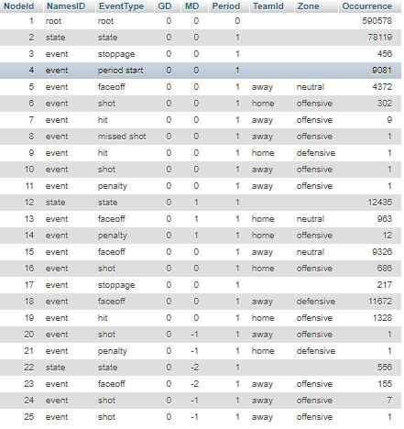
A SEQUENCE OF STATES CONSTITUTES THE MAIN METRIC FOR CALCULATING THE POSTERIOR IMPACT OF AN ACTION
Master thesis Project - Methodology
Definition¹
Illustration
Playing sequence
Sequences of events
First event: a start marker
(Possible) Next events: action
(Possible) Last event: End Event
If all has happened, then it is a completed sequence
State
If the sequence h is empty, it is purely a context node
Else, it is a s <x,h> state node
Sources:
[Routley, 2015]
Thesis presentation
Notes:
Stanley Milgram (August 15, 1933 – December 20, 1984) was an American social psychologist, best known for his controversial experiment on obedience conducted in the 1960s during his professorship at Yale.^{[4]} Milgram was influenced by the events of the Holocaust, especially the trial of Adolf Eichmann, in developing the experiment.
After earning a Ph.D. in social psychology from Harvard University, he taught at Yale, Harvard, and then for most of his career as a professor at the City University of New York Graduate Center, until he died in 1984. His small-world experiment while at Harvard led researchers to analyze the degree of connectedness, including the six degrees of separation concept. Later in his career, Milgram developed a technique for creating interactive hybrid social agents (cyranoids), which has since been used to explore aspects of social- and self-perception.
He is widely regarded as one of the most important figures in the history of social psychology. A Review of General Psychology survey, published in 2002, ranked Milgram as the 46th-most-cited psychologist of the 20th century.^{[5]}
sent letters to just under 300 randomly selected people in Nebraska and Kansas, asking them to help ensure that the letter made its way to a "target person" - a named stockbroker in Boston.
Participants were asked not to send the letter directly to the stockbroker. Instead, everyone was allowed to send it only to someone whom they knew on first-name terms and who they thought might know the stockbroker.
Twenty-nine per cent of the parcels eventually reached the stockbroker. Amazingly, given the tens of millions of people in America, there tended to be just six people linking the initial volunteer and the target person - thus giving rise to the popular notion that we are all maybe connected by just six degrees of separation.

Slide 17
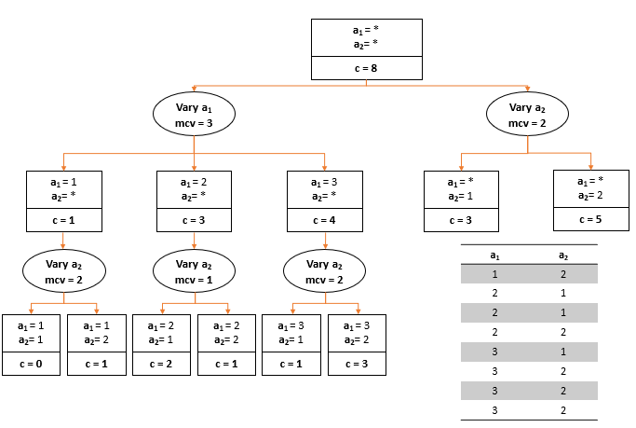
AN AD-TREE IS USED TO SUMMARIZE RELATIONS OF EVENTS THAT HAPPEN SEQUENTIALLY IN A DATABASE
Master thesis Project – Theory
AD-TREE
Definition
and
Objective²
Machine learning method to summarize relations of events that happen sequentially in a database. Their main purpose was establishing associative rules to extract some general rules based on support and conﬁdence.
Relevant
Info
^{Literal}
Attribute-value pair such as “event =shot”.
L is all possible combinations of literals in the database
^{Assoc. rule}
S1->S2. S1 will refer to the ﬁrst event, being the antecedent, and S2 to the conditional event, called the consequent (e.g. S1 event = shot and S2 being event = goal)
We can understand a time series data set as a compound of rules, each literal associated by time with the following literal
^{Support measure}
Number of records in the database that match all the attribute-value pairs in S (E.g. Count S1,S2)
The more times an association occurs, the higher its support and signiﬁcance.
^{Conf. measure}
Conf(S1,S2) = support(S1,S2)/support(S1)
The higher the measure, the stronger and the more probable an assoc. is
Data Structure
^{AD nodes}
AnADnoderepresentsa query and stores the number of times that query happens.
^{vary nodes}
Each ADnode, has child-nodes called "vary nodes" These "vary nodes" do not store counts but group ADnodes with one only feature. It can also contain the most common value (mcv).
Sources:
(1) http://www.pomdp.org/tutorial/
Thesis presentation
Notes:
Stanley Milgram (August 15, 1933 – December 20, 1984) was an American social psychologist, best known for his controversial experiment on obedience conducted in the 1960s during his professorship at Yale.^{[4]} Milgram was influenced by the events of the Holocaust, especially the trial of Adolf Eichmann, in developing the experiment.
After earning a Ph.D. in social psychology from Harvard University, he taught at Yale, Harvard, and then for most of his career as a professor at the City University of New York Graduate Center, until he died in 1984. His small-world experiment while at Harvard led researchers to analyze the degree of connectedness, including the six degrees of separation concept. Later in his career, Milgram developed a technique for creating interactive hybrid social agents (cyranoids), which has since been used to explore aspects of social- and self-perception.
He is widely regarded as one of the most important figures in the history of social psychology. A Review of General Psychology survey, published in 2002, ranked Milgram as the 46th-most-cited psychologist of the 20th century.^{[5]}
sent letters to just under 300 randomly selected people in Nebraska and Kansas, asking them to help ensure that the letter made its way to a "target person" - a named stockbroker in Boston.
Participants were asked not to send the letter directly to the stockbroker. Instead, everyone was allowed to send it only to someone whom they knew on first-name terms and who they thought might know the stockbroker.
Twenty-nine per cent of the parcels eventually reached the stockbroker. Amazingly, given the tens of millions of people in America, there tended to be just six people linking the initial volunteer and the target person - thus giving rise to the popular notion that we are all maybe connected by just six degrees of separation.

Slide 18
AN AD-TREE IS CREATED TO COUNT REPETITION OF EVENTS AND POTENTIAL TRANSITIONS (i)
Master thesis Project - Methodology
The Node’s table
Explanation
AD-tree table with all the variables related to s <x,h>
NodeId is added to each Node working as a unique key for each node
Occurrence, standing for how many times each state event happens in the whole dataset,
Thesis presentation
Notes:
Stanley Milgram (August 15, 1933 – December 20, 1984) was an American social psychologist, best known for his controversial experiment on obedience conducted in the 1960s during his professorship at Yale.^{[4]} Milgram was influenced by the events of the Holocaust, especially the trial of Adolf Eichmann, in developing the experiment.
After earning a Ph.D. in social psychology from Harvard University, he taught at Yale, Harvard, and then for most of his career as a professor at the City University of New York Graduate Center, until he died in 1984. His small-world experiment while at Harvard led researchers to analyze the degree of connectedness, including the six degrees of separation concept. Later in his career, Milgram developed a technique for creating interactive hybrid social agents (cyranoids), which has since been used to explore aspects of social- and self-perception.
He is widely regarded as one of the most important figures in the history of social psychology. A Review of General Psychology survey, published in 2002, ranked Milgram as the 46th-most-cited psychologist of the 20th century.^{[5]}
sent letters to just under 300 randomly selected people in Nebraska and Kansas, asking them to help ensure that the letter made its way to a "target person" - a named stockbroker in Boston.
Participants were asked not to send the letter directly to the stockbroker. Instead, everyone was allowed to send it only to someone whom they knew on first-name terms and who they thought might know the stockbroker.
Twenty-nine per cent of the parcels eventually reached the stockbroker. Amazingly, given the tens of millions of people in America, there tended to be just six people linking the initial volunteer and the target person - thus giving rise to the popular notion that we are all maybe connected by just six degrees of separation.

Slide 19
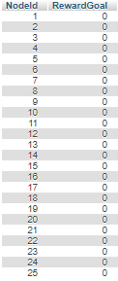
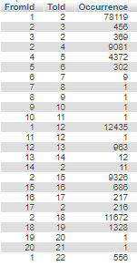
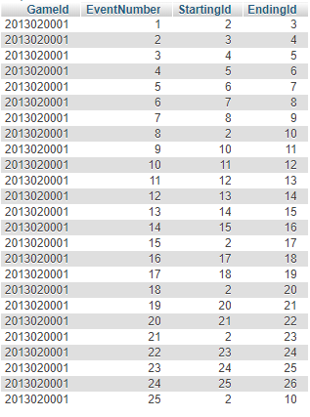
AN AD-TREE IS CREATED TO COUNT REPETITION OF EVENTS AND POTENTIAL TRANSITIONS (ii)
Master thesis Project - Methodology
The Reward table
The edges table
The node_info table
Expla-nation
It stores the rewards given to actions.
Receiving a Goal gives a reward of -1,
Scoring a goal = +1,
Else, 0
It stores the links between nodes in the dataset and its occurrence.
The Variables FromId and ToId refers to the link created between two nodes
It stores the original pair of unique keys from the original table with the matching NodeId
Thesis presentation
Notes:
Stanley Milgram (August 15, 1933 – December 20, 1984) was an American social psychologist, best known for his controversial experiment on obedience conducted in the 1960s during his professorship at Yale.^{[4]} Milgram was influenced by the events of the Holocaust, especially the trial of Adolf Eichmann, in developing the experiment.
After earning a Ph.D. in social psychology from Harvard University, he taught at Yale, Harvard, and then for most of his career as a professor at the City University of New York Graduate Center, until he died in 1984. His small-world experiment while at Harvard led researchers to analyze the degree of connectedness, including the six degrees of separation concept. Later in his career, Milgram developed a technique for creating interactive hybrid social agents (cyranoids), which has since been used to explore aspects of social- and self-perception.
He is widely regarded as one of the most important figures in the history of social psychology. A Review of General Psychology survey, published in 2002, ranked Milgram as the 46th-most-cited psychologist of the 20th century.^{[5]}
sent letters to just under 300 randomly selected people in Nebraska and Kansas, asking them to help ensure that the letter made its way to a "target person" - a named stockbroker in Boston.
Participants were asked not to send the letter directly to the stockbroker. Instead, everyone was allowed to send it only to someone whom they knew on first-name terms and who they thought might know the stockbroker.
Twenty-nine per cent of the parcels eventually reached the stockbroker. Amazingly, given the tens of millions of people in America, there tended to be just six people linking the initial volunteer and the target person - thus giving rise to the popular notion that we are all maybe connected by just six degrees of separation.

Slide 20
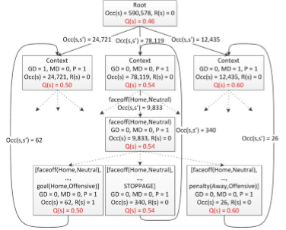


GRAPHICAL EXAMPLE OF A STATE
Master Thesis – Definition of start /End Markers
State s = < x, h > ,
where x is context and h play sequence
Context
Play sequence
Sources:
[Routley, 2015]
Thesis presentation
Notes:
Stanley Milgram (August 15, 1933 – December 20, 1984) was an American social psychologist, best known for his controversial experiment on obedience conducted in the 1960s during his professorship at Yale.^{[4]} Milgram was influenced by the events of the Holocaust, especially the trial of Adolf Eichmann, in developing the experiment.
After earning a Ph.D. in social psychology from Harvard University, he taught at Yale, Harvard, and then for most of his career as a professor at the City University of New York Graduate Center, until he died in 1984. His small-world experiment while at Harvard led researchers to analyze the degree of connectedness, including the six degrees of separation concept. Later in his career, Milgram developed a technique for creating interactive hybrid social agents (cyranoids), which has since been used to explore aspects of social- and self-perception.
He is widely regarded as one of the most important figures in the history of social psychology. A Review of General Psychology survey, published in 2002, ranked Milgram as the 46th-most-cited psychologist of the 20th century.^{[5]}
sent letters to just under 300 randomly selected people in Nebraska and Kansas, asking them to help ensure that the letter made its way to a "target person" - a named stockbroker in Boston.
Participants were asked not to send the letter directly to the stockbroker. Instead, everyone was allowed to send it only to someone whom they knew on first-name terms and who they thought might know the stockbroker.
Twenty-nine per cent of the parcels eventually reached the stockbroker. Amazingly, given the tens of millions of people in America, there tended to be just six people linking the initial volunteer and the target person - thus giving rise to the popular notion that we are all maybe connected by just six degrees of separation.

Slide 21

EXAMPLE OF HOW THE AD-TREE WOULD BE DISPLAYED GRAPHICALLY WITH OCCURRENCES AND REWARDS
Master Thesis – Definition of start /End Markers
Occurrences
Occurrences
Reward
Sources:
[Routley, 2015]
Thesis presentation
Notes:
Stanley Milgram (August 15, 1933 – December 20, 1984) was an American social psychologist, best known for his controversial experiment on obedience conducted in the 1960s during his professorship at Yale.^{[4]} Milgram was influenced by the events of the Holocaust, especially the trial of Adolf Eichmann, in developing the experiment.
After earning a Ph.D. in social psychology from Harvard University, he taught at Yale, Harvard, and then for most of his career as a professor at the City University of New York Graduate Center, until he died in 1984. His small-world experiment while at Harvard led researchers to analyze the degree of connectedness, including the six degrees of separation concept. Later in his career, Milgram developed a technique for creating interactive hybrid social agents (cyranoids), which has since been used to explore aspects of social- and self-perception.
He is widely regarded as one of the most important figures in the history of social psychology. A Review of General Psychology survey, published in 2002, ranked Milgram as the 46th-most-cited psychologist of the 20th century.^{[5]}
sent letters to just under 300 randomly selected people in Nebraska and Kansas, asking them to help ensure that the letter made its way to a "target person" - a named stockbroker in Boston.
Participants were asked not to send the letter directly to the stockbroker. Instead, everyone was allowed to send it only to someone whom they knew on first-name terms and who they thought might know the stockbroker.
Twenty-nine per cent of the parcels eventually reached the stockbroker. Amazingly, given the tens of millions of people in America, there tended to be just six people linking the initial volunteer and the target person - thus giving rise to the popular notion that we are all maybe connected by just six degrees of separation.

Slide 22
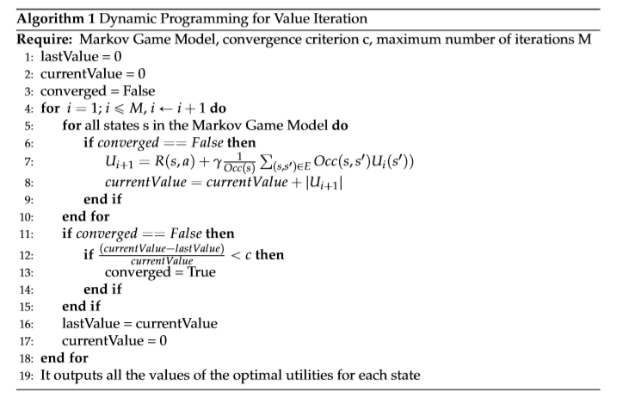
A MARKOV DECISION PROCESS IS USED TO GET THE UTILITY OF EACH STATE
Master thesis Project - Methodology
Intuition
Since I know the transition probabilities for each state stored in the MDP, the calculation of the utility values is done following this pseudocode, which gives the Pr() associated to score in each state.
Intuition
Explanation of the pseudocode¹
Occurrences of state s:
Occ(s)
Occurrences of state s immediately followed by state s’:
Occ(s,s’)
Transition probability
T(s,s’ |a) = Occ(s,s’) / Occ(s)
convergence of 0.0001
max iterations = 100000
Sources:
(1) [ Richard S. Sutton and Andrew G. Barto, 1998]
Thesis presentation
Notes:
Stanley Milgram (August 15, 1933 – December 20, 1984) was an American social psychologist, best known for his controversial experiment on obedience conducted in the 1960s during his professorship at Yale.^{[4]} Milgram was influenced by the events of the Holocaust, especially the trial of Adolf Eichmann, in developing the experiment.
After earning a Ph.D. in social psychology from Harvard University, he taught at Yale, Harvard, and then for most of his career as a professor at the City University of New York Graduate Center, until he died in 1984. His small-world experiment while at Harvard led researchers to analyze the degree of connectedness, including the six degrees of separation concept. Later in his career, Milgram developed a technique for creating interactive hybrid social agents (cyranoids), which has since been used to explore aspects of social- and self-perception.
He is widely regarded as one of the most important figures in the history of social psychology. A Review of General Psychology survey, published in 2002, ranked Milgram as the 46th-most-cited psychologist of the 20th century.^{[5]}
sent letters to just under 300 randomly selected people in Nebraska and Kansas, asking them to help ensure that the letter made its way to a "target person" - a named stockbroker in Boston.
Participants were asked not to send the letter directly to the stockbroker. Instead, everyone was allowed to send it only to someone whom they knew on first-name terms and who they thought might know the stockbroker.
Twenty-nine per cent of the parcels eventually reached the stockbroker. Amazingly, given the tens of millions of people in America, there tended to be just six people linking the initial volunteer and the target person - thus giving rise to the popular notion that we are all maybe connected by just six degrees of separation.

Slide 23

THE IMPACT MEASURE IS THE BASIS FOR POSTERIOR EVALUATION OF THE DATA
Master thesis Project - Methodology
BASIC MEASURE¹
MAIN METRICS
DERIVATED METRICS
Impact of state (s, a):
The difference of Utility values between the following state and the previous state.
Direct Impact:
The sum of impacts for each player
Direct Impact /time :
The sum of impacts divided by time played for each player
Collective Impact:
Collective valuation of players actions in the rink
Collective Impact/time:
Collective valuation of players actions in the rink divided by time played for each player
For each match in Regular Season
GENERAL DATA ANALYSIS
General Regressions of the measures to Salary
Quantile plots
Histograms of players valuation
Sources:
[Routley, 2015]
Thesis presentation
Notes:
Stanley Milgram (August 15, 1933 – December 20, 1984) was an American social psychologist, best known for his controversial experiment on obedience conducted in the 1960s during his professorship at Yale.^{[4]} Milgram was influenced by the events of the Holocaust, especially the trial of Adolf Eichmann, in developing the experiment.
After earning a Ph.D. in social psychology from Harvard University, he taught at Yale, Harvard, and then for most of his career as a professor at the City University of New York Graduate Center, until he died in 1984. His small-world experiment while at Harvard led researchers to analyze the degree of connectedness, including the six degrees of separation concept. Later in his career, Milgram developed a technique for creating interactive hybrid social agents (cyranoids), which has since been used to explore aspects of social- and self-perception.
He is widely regarded as one of the most important figures in the history of social psychology. A Review of General Psychology survey, published in 2002, ranked Milgram as the 46th-most-cited psychologist of the 20th century.^{[5]}
sent letters to just under 300 randomly selected people in Nebraska and Kansas, asking them to help ensure that the letter made its way to a "target person" - a named stockbroker in Boston.
Participants were asked not to send the letter directly to the stockbroker. Instead, everyone was allowed to send it only to someone whom they knew on first-name terms and who they thought might know the stockbroker.
Twenty-nine per cent of the parcels eventually reached the stockbroker. Amazingly, given the tens of millions of people in America, there tended to be just six people linking the initial volunteer and the target person - thus giving rise to the popular notion that we are all maybe connected by just six degrees of separation.

Slide 24
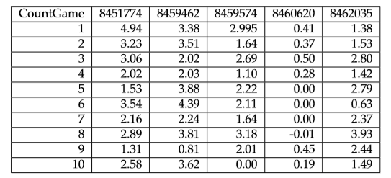
THE ESTIMATION OF THE BEST ARIMA (p,d,q) MODELS HAS BEEN DONE USING MLE FOR EACH PLAYER AND METRIC
Master thesis Project - Methodology
Illustrative
For each year player for seasons 2007-2008 and 2008-2009, fit the best arima model using MLE
1
ARIMA models
1,0,0
1,0,0
0,0,0
0,0,0
0,0,2
2
Count the models that happen more
ARIMA models | Count
1,0,0 | 2
0,0,0 | 2
0,0,2 | 1
Selection of most frequent models
3
Select those which happen more frequently (over 2% of the total number of counts)
Selected ARIMA models
1,0,0
0,0,0
Thesis presentation
Notes:
Stanley Milgram (August 15, 1933 – December 20, 1984) was an American social psychologist, best known for his controversial experiment on obedience conducted in the 1960s during his professorship at Yale.^{[4]} Milgram was influenced by the events of the Holocaust, especially the trial of Adolf Eichmann, in developing the experiment.
After earning a Ph.D. in social psychology from Harvard University, he taught at Yale, Harvard, and then for most of his career as a professor at the City University of New York Graduate Center, until he died in 1984. His small-world experiment while at Harvard led researchers to analyze the degree of connectedness, including the six degrees of separation concept. Later in his career, Milgram developed a technique for creating interactive hybrid social agents (cyranoids), which has since been used to explore aspects of social- and self-perception.
He is widely regarded as one of the most important figures in the history of social psychology. A Review of General Psychology survey, published in 2002, ranked Milgram as the 46th-most-cited psychologist of the 20th century.^{[5]}
sent letters to just under 300 randomly selected people in Nebraska and Kansas, asking them to help ensure that the letter made its way to a "target person" - a named stockbroker in Boston.
Participants were asked not to send the letter directly to the stockbroker. Instead, everyone was allowed to send it only to someone whom they knew on first-name terms and who they thought might know the stockbroker.
Twenty-nine per cent of the parcels eventually reached the stockbroker. Amazingly, given the tens of millions of people in America, there tended to be just six people linking the initial volunteer and the target person - thus giving rise to the popular notion that we are all maybe connected by just six degrees of separation.

Slide 25
THE SELECTED ARIMA MODELS ARE USED TO ESTIMATE THE PARAMETER VALUES OF EVERY 5 OBSERVATIONS AND FORECAST THE FOLLOWING ONE
Master thesis Project - Methodology
Illustrative
Match nº | 1 | 2 | 3 | 4 | 5 | 6 | 7 | 8
Player1 | 3.2 | 5.4 | 4.5 | 7.3 | 4.2 | 0 | 3.4 | 4.5
Player2 | 1.2 | 4 | 3 | 4.6 | NotPlayed | 6.5 | 1.2 | 1.2
Match nº | 1 | 2 | 3 | 4 | 5 | 6
Player1 | 3.2 | 5.4 | 4.5 | 7.3 | 4.2 | 0
Player1 | 5.4 | 4.5 | 7.3 | 4.2 | 0 | 3.4
Player1 | 4.5 | 7.3 | 4.2 | 0 | 3.4 | 4.5
Player2 | 1.2 | 4 | 3 | 4.6 | 6.5 | 1.2
Player2 | 4 | 3 | 4.6 | 6.5 | 1.2 | 1.2
Estimate parameter values using the previous chosen ARIMA (p,d,q) models to forecast the 6th value
Values kept to compare with the forecast
Thesis presentation
Notes:
Stanley Milgram (August 15, 1933 – December 20, 1984) was an American social psychologist, best known for his controversial experiment on obedience conducted in the 1960s during his professorship at Yale.^{[4]} Milgram was influenced by the events of the Holocaust, especially the trial of Adolf Eichmann, in developing the experiment.
After earning a Ph.D. in social psychology from Harvard University, he taught at Yale, Harvard, and then for most of his career as a professor at the City University of New York Graduate Center, until he died in 1984. His small-world experiment while at Harvard led researchers to analyze the degree of connectedness, including the six degrees of separation concept. Later in his career, Milgram developed a technique for creating interactive hybrid social agents (cyranoids), which has since been used to explore aspects of social- and self-perception.
He is widely regarded as one of the most important figures in the history of social psychology. A Review of General Psychology survey, published in 2002, ranked Milgram as the 46th-most-cited psychologist of the 20th century.^{[5]}
sent letters to just under 300 randomly selected people in Nebraska and Kansas, asking them to help ensure that the letter made its way to a "target person" - a named stockbroker in Boston.
Participants were asked not to send the letter directly to the stockbroker. Instead, everyone was allowed to send it only to someone whom they knew on first-name terms and who they thought might know the stockbroker.
Twenty-nine per cent of the parcels eventually reached the stockbroker. Amazingly, given the tens of millions of people in America, there tended to be just six people linking the initial volunteer and the target person - thus giving rise to the popular notion that we are all maybe connected by just six degrees of separation.

Slide 26
Introduction to the Hockey Project
Master thesis Project
Objective
Data
Methodology
Results- Disccusion- Criticism
Thesis presentation

Slide 27
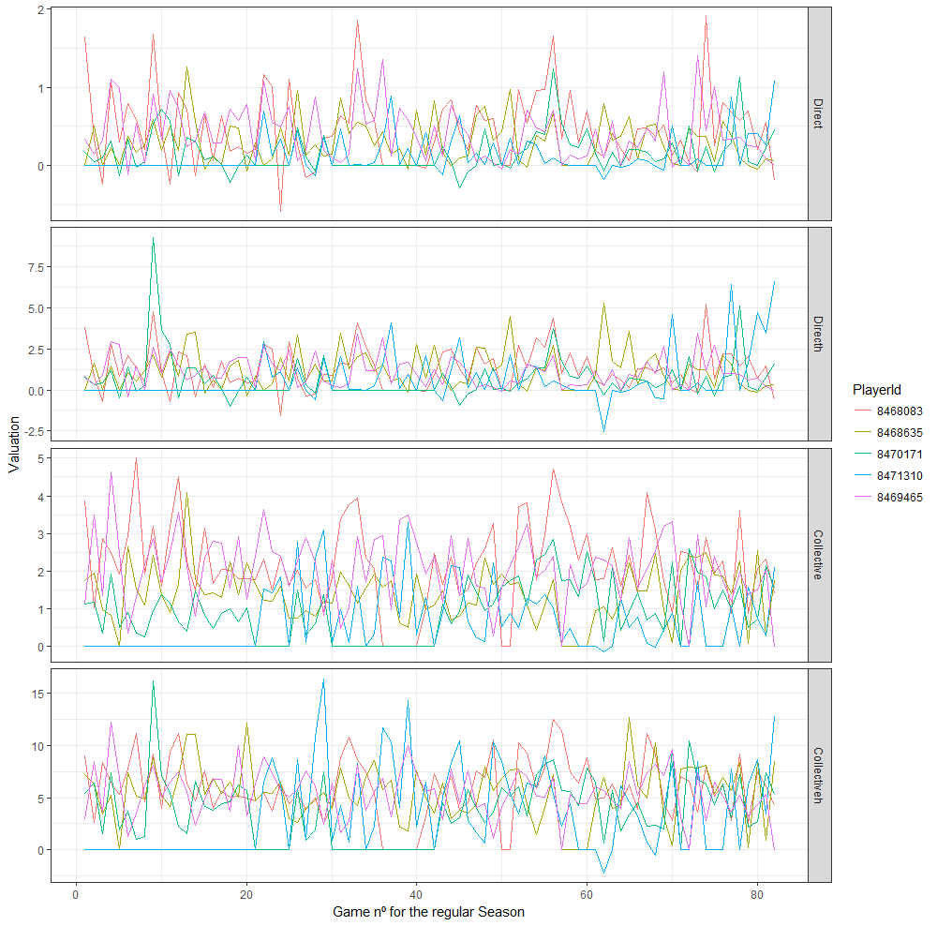
PLAYER’S VALUATION SEEMS QUITE RANDOM ACROSS THE LEAGUE, AND IN SOME CASES, IT EVEN LOOKS LIKE SOME NOISE ACROSS THE MEAN
Master thesis Project - Results
Figure 5.1: Example of ﬁve players valuation through the regular season
Thesis presentation
Notes:
Stanley Milgram (August 15, 1933 – December 20, 1984) was an American social psychologist, best known for his controversial experiment on obedience conducted in the 1960s during his professorship at Yale.^{[4]} Milgram was influenced by the events of the Holocaust, especially the trial of Adolf Eichmann, in developing the experiment.
After earning a Ph.D. in social psychology from Harvard University, he taught at Yale, Harvard, and then for most of his career as a professor at the City University of New York Graduate Center, until he died in 1984. His small-world experiment while at Harvard led researchers to analyze the degree of connectedness, including the six degrees of separation concept. Later in his career, Milgram developed a technique for creating interactive hybrid social agents (cyranoids), which has since been used to explore aspects of social- and self-perception.
He is widely regarded as one of the most important figures in the history of social psychology. A Review of General Psychology survey, published in 2002, ranked Milgram as the 46th-most-cited psychologist of the 20th century.^{[5]}
sent letters to just under 300 randomly selected people in Nebraska and Kansas, asking them to help ensure that the letter made its way to a "target person" - a named stockbroker in Boston.
Participants were asked not to send the letter directly to the stockbroker. Instead, everyone was allowed to send it only to someone whom they knew on first-name terms and who they thought might know the stockbroker.
Twenty-nine per cent of the parcels eventually reached the stockbroker. Amazingly, given the tens of millions of people in America, there tended to be just six people linking the initial volunteer and the target person - thus giving rise to the popular notion that we are all maybe connected by just six degrees of separation.

Slide 28
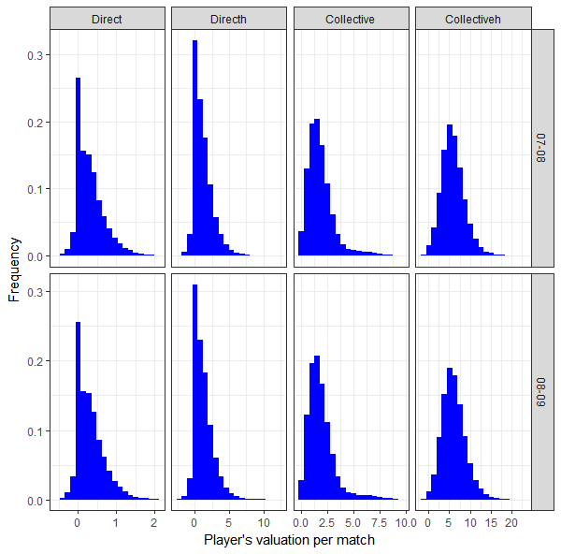
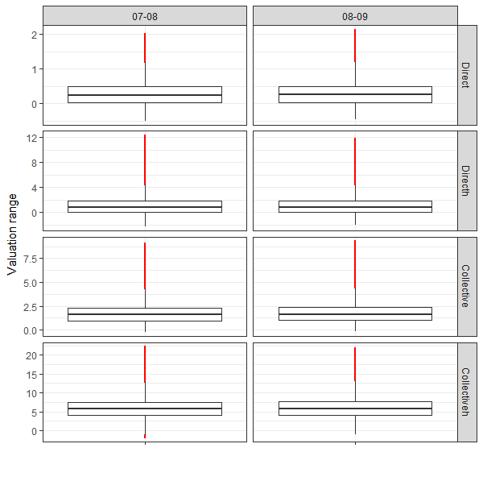
THE DISTRIBUTIONS OF PLAYER’S PERFORMANCE FOR BOTH SEASONS ARE REALLY SIMILAR
Master thesis Project - Results
a) Histogram distribution of player’s performance values in matches
b) Box plot distribution of player’s valuation in matches. The box encloses values from Q1´1.5(Q3´Q1) to Q3+1.5(Q3´Q1),where Q1 and Q3 are the 25% and 75% quantiles respectively
Figure 5.2: Distribution of the 99.8% player’s performance values in matches during regular seasons 2007-2008 and 2008-2009 per metric (excluding 0.01% tails).
Thesis presentation
Notes:
Stanley Milgram (August 15, 1933 – December 20, 1984) was an American social psychologist, best known for his controversial experiment on obedience conducted in the 1960s during his professorship at Yale.^{[4]} Milgram was influenced by the events of the Holocaust, especially the trial of Adolf Eichmann, in developing the experiment.
After earning a Ph.D. in social psychology from Harvard University, he taught at Yale, Harvard, and then for most of his career as a professor at the City University of New York Graduate Center, until he died in 1984. His small-world experiment while at Harvard led researchers to analyze the degree of connectedness, including the six degrees of separation concept. Later in his career, Milgram developed a technique for creating interactive hybrid social agents (cyranoids), which has since been used to explore aspects of social- and self-perception.
He is widely regarded as one of the most important figures in the history of social psychology. A Review of General Psychology survey, published in 2002, ranked Milgram as the 46th-most-cited psychologist of the 20th century.^{[5]}
sent letters to just under 300 randomly selected people in Nebraska and Kansas, asking them to help ensure that the letter made its way to a "target person" - a named stockbroker in Boston.
Participants were asked not to send the letter directly to the stockbroker. Instead, everyone was allowed to send it only to someone whom they knew on first-name terms and who they thought might know the stockbroker.
Twenty-nine per cent of the parcels eventually reached the stockbroker. Amazingly, given the tens of millions of people in America, there tended to be just six people linking the initial volunteer and the target person - thus giving rise to the popular notion that we are all maybe connected by just six degrees of separation.

Slide 29
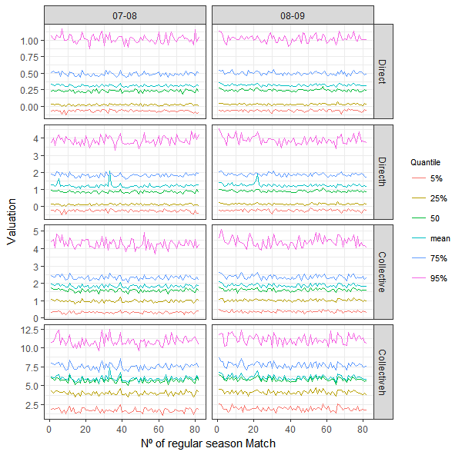
PLAYERS’ RANGE OF PERFORMANCE THROUGH SEASON IS QUITE STABLE
Master thesis Project - Results
Figure 5.3: Quantile analysis of players’ valuation in matches during regular seasons 20072008 and 2008-2009.
Thesis presentation
Notes:
Stanley Milgram (August 15, 1933 – December 20, 1984) was an American social psychologist, best known for his controversial experiment on obedience conducted in the 1960s during his professorship at Yale.^{[4]} Milgram was influenced by the events of the Holocaust, especially the trial of Adolf Eichmann, in developing the experiment.
After earning a Ph.D. in social psychology from Harvard University, he taught at Yale, Harvard, and then for most of his career as a professor at the City University of New York Graduate Center, until he died in 1984. His small-world experiment while at Harvard led researchers to analyze the degree of connectedness, including the six degrees of separation concept. Later in his career, Milgram developed a technique for creating interactive hybrid social agents (cyranoids), which has since been used to explore aspects of social- and self-perception.
He is widely regarded as one of the most important figures in the history of social psychology. A Review of General Psychology survey, published in 2002, ranked Milgram as the 46th-most-cited psychologist of the 20th century.^{[5]}
sent letters to just under 300 randomly selected people in Nebraska and Kansas, asking them to help ensure that the letter made its way to a "target person" - a named stockbroker in Boston.
Participants were asked not to send the letter directly to the stockbroker. Instead, everyone was allowed to send it only to someone whom they knew on first-name terms and who they thought might know the stockbroker.
Twenty-nine per cent of the parcels eventually reached the stockbroker. Amazingly, given the tens of millions of people in America, there tended to be just six people linking the initial volunteer and the target person - thus giving rise to the popular notion that we are all maybe connected by just six degrees of separation.

Slide 30
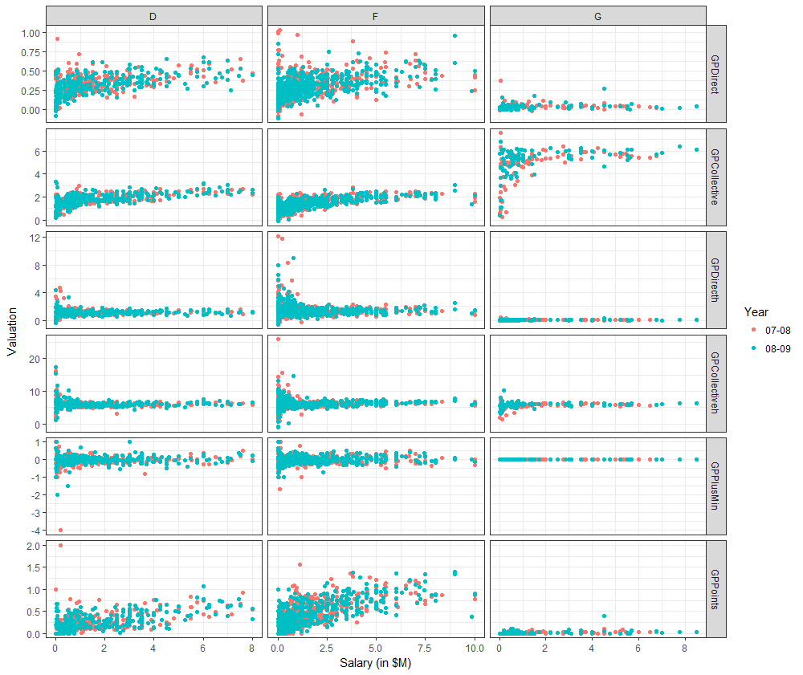
THERE EXIST SOME LINEAR DEPENDENCE BETWEEN THE DIRECT, COLLECTIVE AND THE POINTS METRICS PER GAME PLAYED ON SALARY
Master thesis Project - Results
Seems there is linear dependence
Figure 5.4: Dependence between players’ valuation metrics on salary (Valuation„ Salary) based on players general position.
Thesis presentation
Notes:
Stanley Milgram (August 15, 1933 – December 20, 1984) was an American social psychologist, best known for his controversial experiment on obedience conducted in the 1960s during his professorship at Yale.^{[4]} Milgram was influenced by the events of the Holocaust, especially the trial of Adolf Eichmann, in developing the experiment.
After earning a Ph.D. in social psychology from Harvard University, he taught at Yale, Harvard, and then for most of his career as a professor at the City University of New York Graduate Center, until he died in 1984. His small-world experiment while at Harvard led researchers to analyze the degree of connectedness, including the six degrees of separation concept. Later in his career, Milgram developed a technique for creating interactive hybrid social agents (cyranoids), which has since been used to explore aspects of social- and self-perception.
He is widely regarded as one of the most important figures in the history of social psychology. A Review of General Psychology survey, published in 2002, ranked Milgram as the 46th-most-cited psychologist of the 20th century.^{[5]}
sent letters to just under 300 randomly selected people in Nebraska and Kansas, asking them to help ensure that the letter made its way to a "target person" - a named stockbroker in Boston.
Participants were asked not to send the letter directly to the stockbroker. Instead, everyone was allowed to send it only to someone whom they knew on first-name terms and who they thought might know the stockbroker.
Twenty-nine per cent of the parcels eventually reached the stockbroker. Amazingly, given the tens of millions of people in America, there tended to be just six people linking the initial volunteer and the target person - thus giving rise to the popular notion that we are all maybe connected by just six degrees of separation.

Slide 31
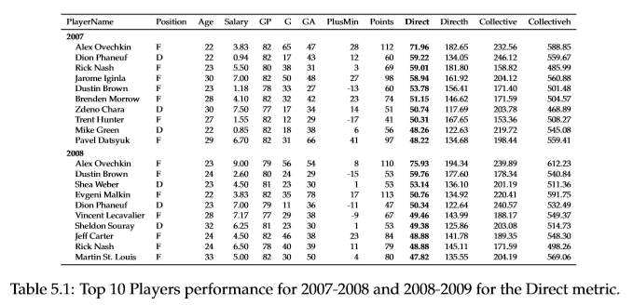
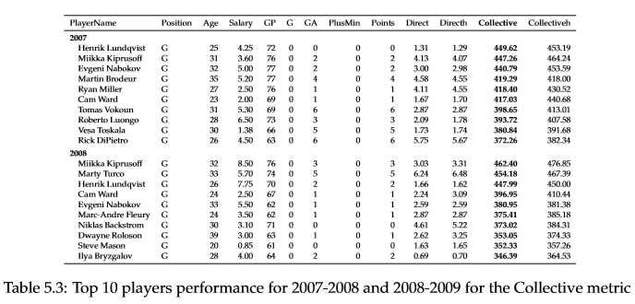
TOP 10 PLAYERS PERFORMANCE FOR EACH METRIC
Master thesis Project - Results
Thesis presentation
Notes:
Stanley Milgram (August 15, 1933 – December 20, 1984) was an American social psychologist, best known for his controversial experiment on obedience conducted in the 1960s during his professorship at Yale.^{[4]} Milgram was influenced by the events of the Holocaust, especially the trial of Adolf Eichmann, in developing the experiment.
After earning a Ph.D. in social psychology from Harvard University, he taught at Yale, Harvard, and then for most of his career as a professor at the City University of New York Graduate Center, until he died in 1984. His small-world experiment while at Harvard led researchers to analyze the degree of connectedness, including the six degrees of separation concept. Later in his career, Milgram developed a technique for creating interactive hybrid social agents (cyranoids), which has since been used to explore aspects of social- and self-perception.
He is widely regarded as one of the most important figures in the history of social psychology. A Review of General Psychology survey, published in 2002, ranked Milgram as the 46th-most-cited psychologist of the 20th century.^{[5]}
sent letters to just under 300 randomly selected people in Nebraska and Kansas, asking them to help ensure that the letter made its way to a "target person" - a named stockbroker in Boston.
Participants were asked not to send the letter directly to the stockbroker. Instead, everyone was allowed to send it only to someone whom they knew on first-name terms and who they thought might know the stockbroker.
Twenty-nine per cent of the parcels eventually reached the stockbroker. Amazingly, given the tens of millions of people in America, there tended to be just six people linking the initial volunteer and the target person - thus giving rise to the popular notion that we are all maybe connected by just six degrees of separation.

Slide 32
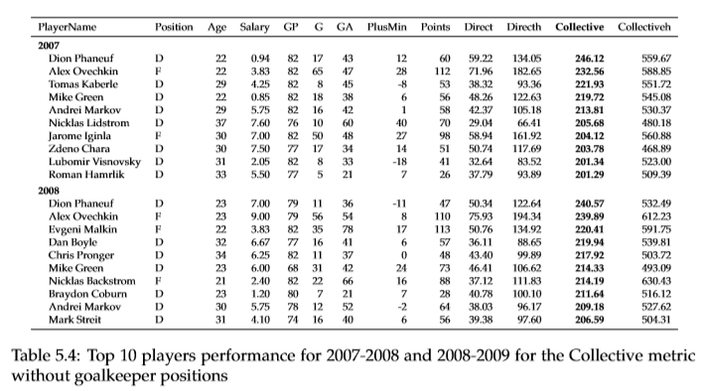
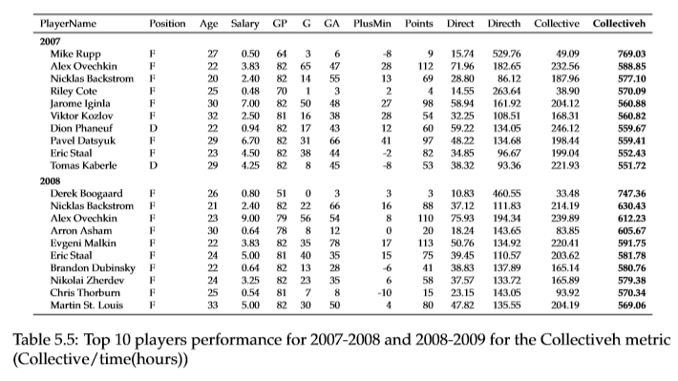
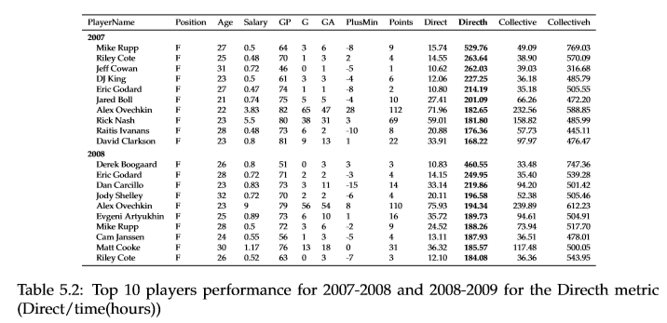
TOP 10 PLAYERS PERFORMANCE FOR EACH METRIC (II)
Master thesis Project - Results
Thesis presentation
Notes:
Stanley Milgram (August 15, 1933 – December 20, 1984) was an American social psychologist, best known for his controversial experiment on obedience conducted in the 1960s during his professorship at Yale.^{[4]} Milgram was influenced by the events of the Holocaust, especially the trial of Adolf Eichmann, in developing the experiment.
After earning a Ph.D. in social psychology from Harvard University, he taught at Yale, Harvard, and then for most of his career as a professor at the City University of New York Graduate Center, until he died in 1984. His small-world experiment while at Harvard led researchers to analyze the degree of connectedness, including the six degrees of separation concept. Later in his career, Milgram developed a technique for creating interactive hybrid social agents (cyranoids), which has since been used to explore aspects of social- and self-perception.
He is widely regarded as one of the most important figures in the history of social psychology. A Review of General Psychology survey, published in 2002, ranked Milgram as the 46th-most-cited psychologist of the 20th century.^{[5]}
sent letters to just under 300 randomly selected people in Nebraska and Kansas, asking them to help ensure that the letter made its way to a "target person" - a named stockbroker in Boston.
Participants were asked not to send the letter directly to the stockbroker. Instead, everyone was allowed to send it only to someone whom they knew on first-name terms and who they thought might know the stockbroker.
Twenty-nine per cent of the parcels eventually reached the stockbroker. Amazingly, given the tens of millions of people in America, there tended to be just six people linking the initial volunteer and the target person - thus giving rise to the popular notion that we are all maybe connected by just six degrees of separation.

Slide 33
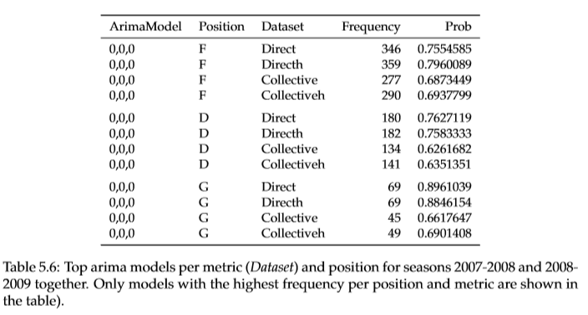
THE ARIMA (0,0,0) IS THE MOST FREQUENT MODEL, NOT MATTERING THE POSITION OF A PLAYER NEITHER THE METRIC
Master thesis Project - Results
Thesis presentation
Notes:
Stanley Milgram (August 15, 1933 – December 20, 1984) was an American social psychologist, best known for his controversial experiment on obedience conducted in the 1960s during his professorship at Yale.^{[4]} Milgram was influenced by the events of the Holocaust, especially the trial of Adolf Eichmann, in developing the experiment.
After earning a Ph.D. in social psychology from Harvard University, he taught at Yale, Harvard, and then for most of his career as a professor at the City University of New York Graduate Center, until he died in 1984. His small-world experiment while at Harvard led researchers to analyze the degree of connectedness, including the six degrees of separation concept. Later in his career, Milgram developed a technique for creating interactive hybrid social agents (cyranoids), which has since been used to explore aspects of social- and self-perception.
He is widely regarded as one of the most important figures in the history of social psychology. A Review of General Psychology survey, published in 2002, ranked Milgram as the 46th-most-cited psychologist of the 20th century.^{[5]}
sent letters to just under 300 randomly selected people in Nebraska and Kansas, asking them to help ensure that the letter made its way to a "target person" - a named stockbroker in Boston.
Participants were asked not to send the letter directly to the stockbroker. Instead, everyone was allowed to send it only to someone whom they knew on first-name terms and who they thought might know the stockbroker.
Twenty-nine per cent of the parcels eventually reached the stockbroker. Amazingly, given the tens of millions of people in America, there tended to be just six people linking the initial volunteer and the target person - thus giving rise to the popular notion that we are all maybe connected by just six degrees of separation.

Slide 34
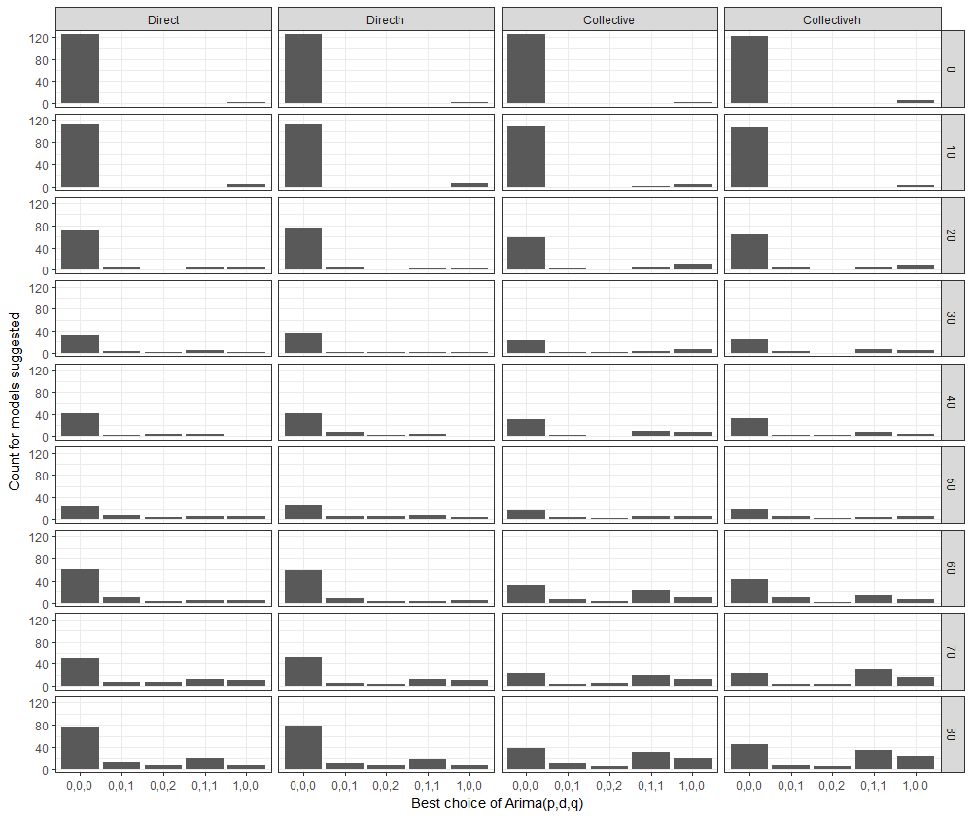
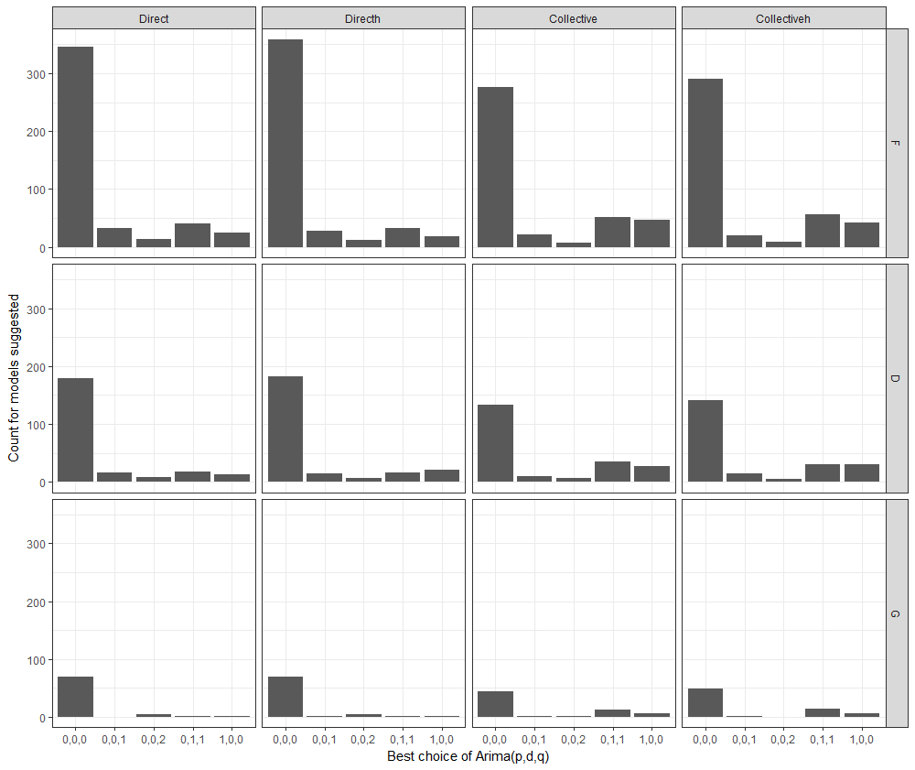
THE ARIMA (0,0,0) IS THE MOST FREQUENT MODEL NO MATTER THE Nº OF MATCHES OR THE POSITION OF A PLAYER
Master thesis Project - Results
Best model
a) Histogram distribution of the 98% most frequent arima models by position and metric.
b) Histogram distribution of the 98% most frequent arima models by range and metric.
Figure 5.5: Histogram distribution of the 98% most frequent arima models by range, position and metric.
Thesis presentation
Notes:
Stanley Milgram (August 15, 1933 – December 20, 1984) was an American social psychologist, best known for his controversial experiment on obedience conducted in the 1960s during his professorship at Yale.^{[4]} Milgram was influenced by the events of the Holocaust, especially the trial of Adolf Eichmann, in developing the experiment.
After earning a Ph.D. in social psychology from Harvard University, he taught at Yale, Harvard, and then for most of his career as a professor at the City University of New York Graduate Center, until he died in 1984. His small-world experiment while at Harvard led researchers to analyze the degree of connectedness, including the six degrees of separation concept. Later in his career, Milgram developed a technique for creating interactive hybrid social agents (cyranoids), which has since been used to explore aspects of social- and self-perception.
He is widely regarded as one of the most important figures in the history of social psychology. A Review of General Psychology survey, published in 2002, ranked Milgram as the 46th-most-cited psychologist of the 20th century.^{[5]}
sent letters to just under 300 randomly selected people in Nebraska and Kansas, asking them to help ensure that the letter made its way to a "target person" - a named stockbroker in Boston.
Participants were asked not to send the letter directly to the stockbroker. Instead, everyone was allowed to send it only to someone whom they knew on first-name terms and who they thought might know the stockbroker.
Twenty-nine per cent of the parcels eventually reached the stockbroker. Amazingly, given the tens of millions of people in America, there tended to be just six people linking the initial volunteer and the target person - thus giving rise to the popular notion that we are all maybe connected by just six degrees of separation.

Slide 35
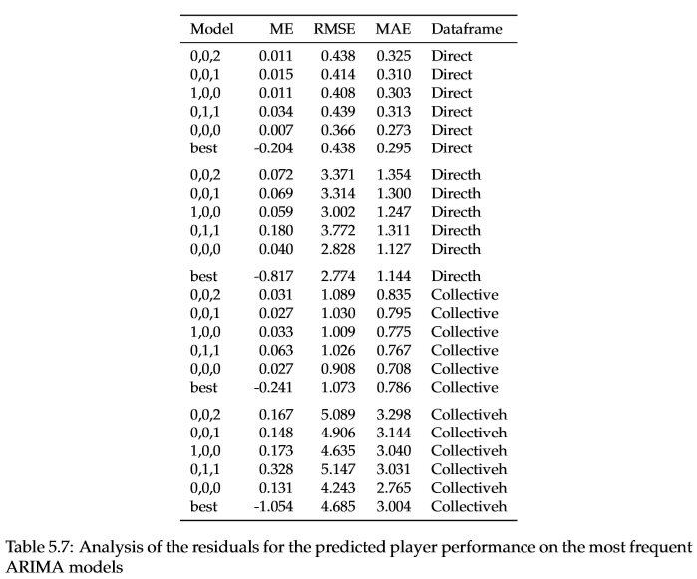
THE MODEL FORECASTING THE BEST IS THE ARIMA (0,0,0), IN OTHER WORDS, THE MEAN
Master thesis Project - Results
Best model
Best model
Best model
Best model
Thesis presentation
Notes:
Stanley Milgram (August 15, 1933 – December 20, 1984) was an American social psychologist, best known for his controversial experiment on obedience conducted in the 1960s during his professorship at Yale.^{[4]} Milgram was influenced by the events of the Holocaust, especially the trial of Adolf Eichmann, in developing the experiment.
After earning a Ph.D. in social psychology from Harvard University, he taught at Yale, Harvard, and then for most of his career as a professor at the City University of New York Graduate Center, until he died in 1984. His small-world experiment while at Harvard led researchers to analyze the degree of connectedness, including the six degrees of separation concept. Later in his career, Milgram developed a technique for creating interactive hybrid social agents (cyranoids), which has since been used to explore aspects of social- and self-perception.
He is widely regarded as one of the most important figures in the history of social psychology. A Review of General Psychology survey, published in 2002, ranked Milgram as the 46th-most-cited psychologist of the 20th century.^{[5]}
sent letters to just under 300 randomly selected people in Nebraska and Kansas, asking them to help ensure that the letter made its way to a "target person" - a named stockbroker in Boston.
Participants were asked not to send the letter directly to the stockbroker. Instead, everyone was allowed to send it only to someone whom they knew on first-name terms and who they thought might know the stockbroker.
Twenty-nine per cent of the parcels eventually reached the stockbroker. Amazingly, given the tens of millions of people in America, there tended to be just six people linking the initial volunteer and the target person - thus giving rise to the popular notion that we are all maybe connected by just six degrees of separation.

Slide 36
MAIN BULLETS FOR DISCUSSION
Master thesis Project - Results
General analysis
Estimation of the best arima models
Modelling and prediction
Distribution of players’ valuation on matches is really similar across years
Distributions skewed to the right
+/- metric not good to predict players salary
The direct and the points metrics are fairly dependent on players salary for forward and defender players
Collective metric outputs goalkeepers, which are the players that play the most
Metrics divided by time do not seem to have any impact on players performance on by game played
The best time series ARIMA model for forecasting players performance has proven to be an ARIMA (0,0,0) which is indeed the mean of all previous matches
The best time series ARIMA model for forecasting players performance has proven to be an ARIMA (0,0,0) which is indeed the mean of all previous matches
Sources:
[Routley, 2015]
Thesis presentation
Notes:
General analysis
Distribution of players’ valuation on matches. That means that the metrics are therefore usable for other years prediction.
It has also been commented the fact that the valuation distribution is skewed to the right, possibly meaning that players often perform between some ranges, and that there are few players who consistently may have some outstanding performances that are larger than the average of the players performance.
In ﬁgure 5.3, all metrics except the Collectiveh (Collective/time (hours)) have a clear separation between the mean and the median (the 50% quantile).
In ﬁgure 5.4, the PlusMinus measure does not seem to be a good metric to predict players Salary at all, since there is no dependence between salary and the metric values. This makes sense since the PlusMinus measure accounts for the number of goals that occur while a player is on the ﬁeld.
The Direct and the Points metrics seem to be fairly good to predict players Salary for Foward and Defender players.
Also, the Collective measure performs better for the prediction in general players performance. This might be misleading since the Collective measure takes into account the sum of all impact actions of players in the rink while that speciﬁc player is in the rink. Of course, if a player has been playing good through the season, that player will continue playing even more time since he is proven useful to the team. Also, this measure can be misleading and must be interpreted only between players playing in similar position and similar number of matches.
Since goalkeepers are the players who play most of the time, they are getting all impact actions of their teams and that is why their performances are the highest ones. Both Directh and Collectiveh seem to have some kind of logarithmic dependence, which could be interesting to predict players salary based on performances. Figure 5.4 shows that GPPoints, GPDirect and GPCollective are be able to capture the linear dependence between players’ performance and Salary for Forward and Defender players.
Nevertheless, metrics divided by time do not seem to have any impact on players performance. That makes sense, since the Games Played (GP) measure takes into account to some extent the time a player plays (e.g.the more matches a player plays, the more is playing).
Time series forecasting of metrics The best time series ARIMA model for forecasting players performance has proven to be an ARIMA (0,0,0) which is indeed the mean of all previous matches. In other words: based on my original dataset and on my impact measures, I cannot predict better than the mean. This means that players performance may not depend on the n previous matches as sometimes believed when people say that a player is on ﬁre for some consecutive matches but it just happens that player has normal ups and downs, non-related to n previous matches performances, but just on their average level performance through the whole season. This goes in line with the hot hands fallacy [19], which tries to proof that a person who experiences a successful outcome in a random event (e.g. a match) has not a greater chance of success in successive trials.

Slide 37
CRITICISM
Master thesis Project - Results
1
The deﬁnition of a state
Include new state variables such as
time remaining in the quarter,
duration of the possession until the moment of the action
2
The choice of the reward function
3
Only ARIMA models have been evaluated
Gaussian Processes or Neural Networks could be valuated
Sources:
[Routley, 2015]
Thesis presentation
Notes:
The deﬁnition of a state
In this thesis, I have assumed to have as state nodes the combination of 3 context variables (Manpower Differential, Goal Differential, Period) and actions associated with the Team (T) having the puck or winning the action and a categorical Zone (Z) in which the action is happening based on the team’s performing the action (i.e a(T,Z)).
It would be interesting to include new state variables such as a time remaining in the quarter, meaning that maybe when almost no time is left, the actions taken may have a lower impact on the scoring due to time pressure or duration of the possession until the moment of the action, meaning that the probability of scoring given that you have had the puck might differ when the length of the possession is signiﬁcantly different.
The choice of the reward function The choice of the reward value for actions in the markov decision process has not been discussedinthisarticlenorontheonesIhaveread. Nevertheless,itwouldbeinterestingtodoa studyoftheimpactofdifferentsetsofrewardsformorethanoneactionatatime,andseeing how that affects the impact of a speciﬁc actions and their change.
Time series forecasting In terms of time series modelling and prediction, only ARIMA models have been evaluated. Other models such as Neural Networks or Gaussian Processes could be tried to evaluate whethertherecouldbeageneralmodelthatcouldﬁtplayersevaluationbetterthanthemean.

Slide 38
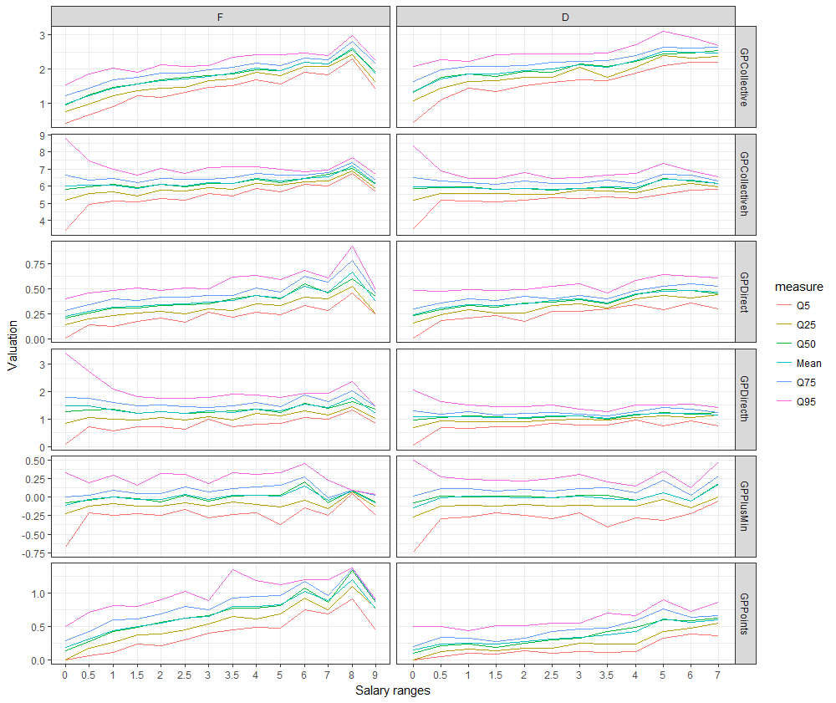
SUGGESTION FOR FURTHER RESEARCH
Master thesis Project - Results
Get a richer data set in terms of performing actions^{1,2} to have a better precision of the action’s impact and therefore of the player performance :
passes or pucks
zone variable
1
2
Trying new models
3
Rules on quantile analysis to decide whether a player would be ﬁred/hired/ maintained using different metrics.
Figure 6.1: Quantile distribution of the regression on players performance by game to Salary Range
Sources:
[Liu and Shultle, 2015]
[Schulte, Khademi, Gholami, Zhao, Javan, and Desaulniers, 2017]
Thesis presentation
Notes:
In the light of the results got and the shape of players performance, I sincerely do not think that any model would ﬁt signiﬁcantly well the data. Instead, I would try to get a richer data set in terms of performing actions. For instance, having passes or pucks in the action variable would enable to have a better precision of the action’s impact and therefore of the player performance as in [24], [25] or [15]. Also, the new dataset could have non-discretized or less discretized the Zone variable to quantify better the impact actions as in the latter papers above. As a matter of fact,Ihavenotgivenanyclearruletodecidewhethertohire/ﬁre/maintain a player. Some new research could involve quantile analysis to decide whether a player wouldbeﬁred/hired/maintained. Inﬁgure6.1,Ihavediscretizedthesalaryrangeofplayers suchthataspeciﬁcnumbergoesfromthatnumbertothenextoneonthex-axis(e.g. if0,from 0-0.5M). All players performance have been allocated in Salary ranges and then, for each discrete salary range, quantile performances are shown by position and range for several metrics. With that, a combination of metrics could be settled such that if a player appears to be over the 75% quantile for their speciﬁc range, then that player could be a potential hiring, and viceversa.

Slide 39
THE AIM OF THE PROJECT IS TO CREATE A TIME VALUATION MEASURE FOR TEAMS TO SEE POTENTIAL HIRINGS/ FIRINGS
Master thesis Project - Project Questions
[Routley, 2015] creates a general metric for players using a MDP with context variables (e.g. probability of goal/penalty events on each event)
My idea is to reproduce this part of the paper and create a time series measure valuation for players to see potential hirings/ firings
Innovative model
The MDP seems to be a good model to create a player’s valuation metric:
Model treatment decisions under uncertainty (which is the action that leaves you nearer to score?)
It rewards and penalizes each action on its context by how near the action player is to score
The AD-tree seems to be a good way to classify players actions.
It is impossible to calculate all possible combinations of events on a MDP
Need to narrow possible transitions between states
Has anyone studied your kind of problems?
Why did you choose a certain model ?
Among others:
[Barkell, 2017] , where a MDP is ﬁtted to evaluate which sequences of events are more prone to scores in rugby to ﬁnd the most effective rugby strategies
[Schuckers, 2013] gave a value to all events performed in ice hockey match as a measure to how nearer the possibility of a goal was in the following 20 seconds
Are there studies of similar problems?
Creation of a time series measure valuation for players to see potential hirings/ firings during a season
Usage of MDP to create a time-series measure performance
(Maybe) Usage of a this model in the Linköping Dataset
How does a MDP/RL is used to evaluate actions under certain time-series events ?
How can I store time series data for the usage of a MDP?
What is the MDP valuation of each player of the NHL league per match ?
Is there a way to use a MDP to create a metric for evaluation of players for hiring/maintaining/ﬁring?
What is new in your study?
What lessons can there be learnt ?
Thesis presentation
Notes:
For example, [Hauskrecht, 1997] mentions that for Ischemic Heart Disease, the 2 best ways to determine the true state of a patient’s condition are stress tests and angiograms, both of which are invasive and can be fatal.

Slide 40

Carles Sans Fuentes
732A64 Master thesis on Statistics and Machine Learning / Linköpings University carsa564@student.liu.se

