Slide 1

THE CREATION OF A VALUATION HOCKEY METRIC USING MARKOV DECISION PROCESSES
Carles Sans Fuentes
Presented by Carles Sans Fuentes
MDP Analysis

Slide 2

Introduction to the Hockey Project
Master thesis Project
Objective
Data
Methodology
Result
MDP Analysis

Slide 3
THE AIM OF THE PROJECT IS TO CREATE A TIME VALUATION MEASURE FOR TEAMS TO SEE POTENTIAL HIRINGS/ FIRINGS
Master thesis Project - Project Questions
[Routley, 2015] creates a general metric for players using a MDP with context variables (e.g. probability of goal/penalty events on each event)
My idea is to reproduce this part of the paper and create a time series measure valuation for players to see potential hirings/ firings
Innovative model
The MDP seems to be a good model to create a player’s valuation metric:
Model treatment decisions under uncertainty (which is the action that leaves you nearer to score?)
It rewards and penalizes each action on its context by how near the action player is to score
The AD-tree seems to be a good way to classify players actions.
It is impossible to calculate all possible combinations of events on a MDP
Need to narrow possible transitions between states
Has anyone studied your kind of problems?
Why did you choose a certain model ?
Among others:
[Barkell, 2017] , where a MDP is ﬁtted to evaluate which sequences of events are more prone to scores in rugby to ﬁnd the most effective rugby strategies
[Schuckers, 2013] gave a value to all events performed in ice hockey match as a measure to how nearer the possibility of a goal was in the following 20 seconds
Are there studies of similar problems?
Creation of a time series measure valuation for players to see potential hirings/ firings during a season
Usage of MDP to create a time-series measure performance
(Maybe) Usage of a this model in the Linköping Dataset
How does a MDP/RL is used to evaluate actions under certain time-series events ?
How can I store time series data for the usage of a MDP?
What is the MDP valuation of each player of the NHL league per match ?
Is there a way to use a MDP to create a metric for evaluation of players for hiring/maintaining/ﬁring?
What is new in your study?
What lessons can there be learnt ?
MDP Analysis
Notes:
For example, [Hauskrecht, 1997] mentions that for Ischemic Heart Disease, the 2 best ways to determine the true state of a patient’s condition are stress tests and angiograms, both of which are invasive and can be fatal.

Slide 4

THE MAIN OBJECTIVE OF ICE HOCKEY IS TO SCORE MORE GOALS THAN YOUR OPPONENT ON AN ICE RINK
Master thesis Project - Introduction to the Hockey Project
Ice hockey
Definition
and
Objective²
Two-team team sport played on an ice rink with 5 players plus a goalkeeper each team which objective is to score more goals than the opponent in 3 periods of 20 minutes.
Relevant
events
^{Penalty}
The player who occasioned it will sit in the penalty box for 2,4 or 5 minutes.
Manpower Differential (MD) between teams
^{Faceoff}
One player from each team stands at the face-off spot (see below) to await the drop of the puck
^{Giveaway}
Turnover: when the offensive player with the puck gets hit or makes a play (e.g. a pass) that causes their team to lose possession
^{Takeaway}
The same as a give away event seen from the point of view of the player that takes the puck
^{Others}
Icing, hit, missed shot, shot, goal, …
Sources:
Image ref: http://pngimg.com/download/26505
http://www.nhl.com/nhl/en/v3/ext/rules/2018-2019-NHL-rulebook.pdf
MDP analysis
Notes:
tthealarmturnsred withprobability0.2,andonceitdoes,itreturnsto greenwithprobability0.1.Theactionspaceisdeﬁnedas{move left,move right,look alarm} and when moving the probability of reaching the target location is 0.8 while the robot stays in the same location with probability 0.2. The reward for reaching the current goal is 0.3 for a corridor length of 3.

Slide 5


IT IS CRUCIAL FOR ICE HOCKEY TEAMS TO UNDERSTAND GAME DYNAMICS TO IMPROVE THEIR PLAYING PERFORMANCE
Master thesis Project - Introduction to the Hockey Project
Common statistics for ice hockey¹
1
2
3
4
+/-
Corsi
Fenwick
PDO
A player is given +1 if he is on the field while his team scores and -1 if the other team scores.
The difference on scores received by that player is his evaluation
Shot attempts (SAT) is the sum of shots on goal, missed shots and blocked shots.
Used to approximate puck possession – the length of time a player's team controls the puck
Unblocked shot attempts (USAT) is a variant of Corsi that counts only shots on goal and missed shots; blocked shots are not included.
It is viewed as having a stronger correlation to scoring chances
PDO, ( SPSV%) is the sum of a team's shooting percentage and its save percentage.
PDO is usually measured at even strength,
is often viewed as a proxy for how lucky a team is.
Formula
+/- = GoalTeam FOR – GoalTeam AGAINST
Corsi = Shot attempts FOR – Shot Attempts AGAINST
Fenwick = Shot attempts FOR – Shot Attempts AGAINST
PDO = Shooting Percentage + Save Percentage
All measures are quite simple and straight forward
How reliable are these measures?
How can I create a more reliable and complex measure to see player’s evaluation by match through time ?
Focus of the project
Understanding players’ performance and finding successful scoring strategies are key elements to improve team’s performance and optimize asset management
Sources:
https://en.wikipedia.org/wiki/Analytics_(ice_hockey)
MDP Analysis
Notes:
Corsi: Measured as either a ratio (like plus-minus) of shot attempts for less shot attempts against, or as a percentage.
most players will have a Corsi For percentage between 40 and 60. A player or team ranked above 55% is often considered "elite"
PDO: According to Wilson, a player or team with a PDO over 102 is "probably not as good as they seem", while a player or team below 98 likely is better than they appear.

Slide 6
Introduction to the Hockey Project
Master thesis Project
Objective
Data
Methodology
Result
MDP Analysis

Slide 7
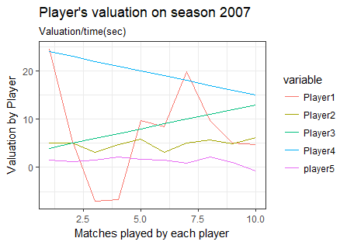
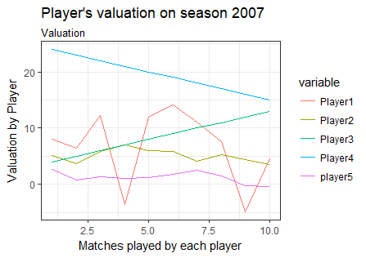
THE OBJECTIVE OF THE THESIS IS BEING ABLE TO EVALUATE PLAYERS THROUGH TIME TO HIRE/FIRE/MAINTAIN THEM
Master thesis Project - Objective
1
How does a MDP/RL is used to evaluate actions under certain time-series events ?
Illustrative
2
How can I store time series data for the usage of a MDP?
3
What is the MDP valuation of each player of the NHL league per match ?
Illustrative
4
Is there a way to use a MDP to create a metric for evaluation of players for hiring/maintaining/ﬁring?
MDP Analysis
Notes:
tthealarmturnsred withprobability0.2,andonceitdoes,itreturnsto greenwithprobability0.1.Theactionspaceisdeﬁnedas{move left,move right,look alarm} and when moving the probability of reaching the target location is 0.8 while the robot stays in the same location with probability 0.2. The reward for reaching the current goal is 0.3 for a corridor length of 3.

Slide 8
Introduction to the Hockey Project
Master thesis Project
Objective
Data
Methodology
Result
MDP Analysis

Slide 9
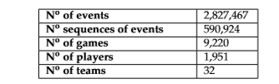

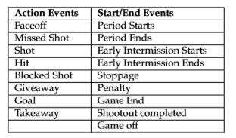


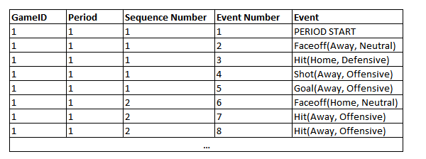
THE DATA USED IS A NHL RELATIONAL DATASET CONTAINING COMPLETE 2007-2014 SEASONS
Master thesis Project - Data
Relational database with 2,827,467 play-by-play events recorded by the NHL
An Action Event represents those events performed by players, whereas Start/End events are events that stop time not performed by players.
Time-series Datasets: each time event is continuous of another time event.
Each event has an action associated
Zone (Home, Neutral, Away)
Which team performs that event (Home or Away team).
MDP Analysis
Notes:
The NHL dataset is a relational database with 2,827,467 play-by-play events recorded by the NHL, containing complete 2007-2014 seasons (i.e. regular season and playoff games) and the ﬁrst 512 games of the 2014-2015 regular season. General information about the dataset is displayed in Table 3.1 As shown in table 3.2, each event can either be an Action Event or an Start/End event. An Action Event represents those events performed by players, whereas Start/End events areeventsthatstoptimenotperformedbyplayers. Eachtimeeventiscontinuousofanother time event. That means we have a time series dataset.Additionally, each event which has an action associated Zone in which the event occurs (Home, Neutral, Away) and which team performs that event (Home or Away team).

Slide 10
Introduction to the Hockey Project
Master thesis Project
Objective
Data
Methodology
Project Questions
MDP Analysis

Slide 11
THE METHODOLOGY AND SCOPE OF THE PROJECT CONTAINS PART FROM [ROUTLEY,2015] STUDY AND A NEW PART
Master thesis Project - Methodology
METHODOLOGY EXTRACTED FROM [ROUTLEY, 2015]
100% NEW PART OF THE PROJECT
0
1
1
2
3
MDP per event
1
4
Structure of variables
Ad-tree
Time series Data per match
Model for player evaluation
Creation of Context variables
MD, GD, Period
Decision of start end/marker events for playing sequences
Building of an AD-tree structure that stores all events and counts of events with potential transitions
Running the MDP to get goal reward for each event, and thus the probabilities of scoring at each event
Creation of the time series impact metric.
Direct Impact
PlusMinus Impact
Creation of the impact measure.
Transform Data into a time series matrix per season
Val/match *time(sec)
Val/match
This will enable to make an evaluation of players trough time
General evaluation of the metric
Forecast using ARIMA models
MDP Analysis
Notes:
Stanley Milgram (August 15, 1933 – December 20, 1984) was an American social psychologist, best known for his controversial experiment on obedience conducted in the 1960s during his professorship at Yale.^{[4]} Milgram was influenced by the events of the Holocaust, especially the trial of Adolf Eichmann, in developing the experiment.
After earning a Ph.D. in social psychology from Harvard University, he taught at Yale, Harvard, and then for most of his career as a professor at the City University of New York Graduate Center, until he died in 1984. His small-world experiment while at Harvard led researchers to analyze the degree of connectedness, including the six degrees of separation concept. Later in his career, Milgram developed a technique for creating interactive hybrid social agents (cyranoids), which has since been used to explore aspects of social- and self-perception.
He is widely regarded as one of the most important figures in the history of social psychology. A Review of General Psychology survey, published in 2002, ranked Milgram as the 46th-most-cited psychologist of the 20th century.^{[5]}
sent letters to just under 300 randomly selected people in Nebraska and Kansas, asking them to help ensure that the letter made its way to a "target person" - a named stockbroker in Boston.
Participants were asked not to send the letter directly to the stockbroker. Instead, everyone was allowed to send it only to someone whom they knew on first-name terms and who they thought might know the stockbroker.
Twenty-nine per cent of the parcels eventually reached the stockbroker. Amazingly, given the tens of millions of people in America, there tended to be just six people linking the initial volunteer and the target person - thus giving rise to the popular notion that we are all maybe connected by just six degrees of separation.

Slide 12

A STATE IS COMPOSED OF A CONTEXT VARIABLES AND PLAYING SEQUENCES
Master thesis Project - Methodology
Intuition
Is the Pr(Scoring | MD =1) == Pr(Scoring | MD =-1)?
Is the Pr(Scoring | GD =3) == Pr(Scoring | GD = -1)?
Is the Pr(Scoring | shot ) == Pr(Scoring | takeaway)?
Composition¹
Illustratition
Context
Atmosphere that defines where the events are happening.
ManPower Differential (MD): Home_Players- AwayPlayers
Goal Differentia (GD)l: Home_Goals - AwayGoals
Period (P): Time in which the match is happening
Playing sequence
An action with position and Team Information, in the form of a(T,Z)²
Action (a):
Zone (Z): associated Zone in which the action is performed (Offensive, Neutral or Defensive)
Teams (T): team performing the action (Home, Away)
State
Combination of Context ‘x’ and Playing sequence ‘h’, such that:
s = <x,h>
Sources:
[Routley, 2015]
[Levesque, 1998]
MDP Analysis
Notes:
Stanley Milgram (August 15, 1933 – December 20, 1984) was an American social psychologist, best known for his controversial experiment on obedience conducted in the 1960s during his professorship at Yale.^{[4]} Milgram was influenced by the events of the Holocaust, especially the trial of Adolf Eichmann, in developing the experiment.
After earning a Ph.D. in social psychology from Harvard University, he taught at Yale, Harvard, and then for most of his career as a professor at the City University of New York Graduate Center, until he died in 1984. His small-world experiment while at Harvard led researchers to analyze the degree of connectedness, including the six degrees of separation concept. Later in his career, Milgram developed a technique for creating interactive hybrid social agents (cyranoids), which has since been used to explore aspects of social- and self-perception.
He is widely regarded as one of the most important figures in the history of social psychology. A Review of General Psychology survey, published in 2002, ranked Milgram as the 46th-most-cited psychologist of the 20th century.^{[5]}
sent letters to just under 300 randomly selected people in Nebraska and Kansas, asking them to help ensure that the letter made its way to a "target person" - a named stockbroker in Boston.
Participants were asked not to send the letter directly to the stockbroker. Instead, everyone was allowed to send it only to someone whom they knew on first-name terms and who they thought might know the stockbroker.
Twenty-nine per cent of the parcels eventually reached the stockbroker. Amazingly, given the tens of millions of people in America, there tended to be just six people linking the initial volunteer and the target person - thus giving rise to the popular notion that we are all maybe connected by just six degrees of separation.

Slide 13
DISPLAY OF ACTION EVENTS AND START/ END EVENTS
Master Thesis – Definition of start /End Markers
Start / End markers are those events in the right column of the table adding faceoffs and shots as starting markers and goals as ending markers
MDP Analysis
Notes:
Stanley Milgram (August 15, 1933 – December 20, 1984) was an American social psychologist, best known for his controversial experiment on obedience conducted in the 1960s during his professorship at Yale.^{[4]} Milgram was influenced by the events of the Holocaust, especially the trial of Adolf Eichmann, in developing the experiment.
After earning a Ph.D. in social psychology from Harvard University, he taught at Yale, Harvard, and then for most of his career as a professor at the City University of New York Graduate Center, until he died in 1984. His small-world experiment while at Harvard led researchers to analyze the degree of connectedness, including the six degrees of separation concept. Later in his career, Milgram developed a technique for creating interactive hybrid social agents (cyranoids), which has since been used to explore aspects of social- and self-perception.
He is widely regarded as one of the most important figures in the history of social psychology. A Review of General Psychology survey, published in 2002, ranked Milgram as the 46th-most-cited psychologist of the 20th century.^{[5]}
sent letters to just under 300 randomly selected people in Nebraska and Kansas, asking them to help ensure that the letter made its way to a "target person" - a named stockbroker in Boston.
Participants were asked not to send the letter directly to the stockbroker. Instead, everyone was allowed to send it only to someone whom they knew on first-name terms and who they thought might know the stockbroker.
Twenty-nine per cent of the parcels eventually reached the stockbroker. Amazingly, given the tens of millions of people in America, there tended to be just six people linking the initial volunteer and the target person - thus giving rise to the popular notion that we are all maybe connected by just six degrees of separation.

Slide 14
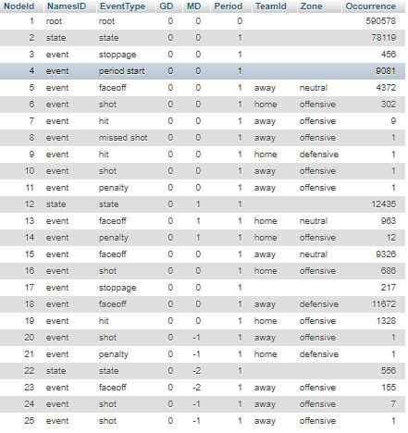
A SEQUENCE OF STATES CONSTITUTES THE MAIN METRIC FOR CALCULATING THE POSTERIOR IMPACT OF AN ACTION
Master thesis Project - Methodology
Definition¹
Illustration
Playing sequence
Sequences of events
First event: a start marker
(Possible) Next events: action
(Possible) Last event: End Event
If all has happened, then it is a completed sequence
State
If the sequence h is empty, it is purely a context node
Else, it is a s <h,s> state node
Sources:
[Routley, 2015]
MDP Analysis
Notes:
Stanley Milgram (August 15, 1933 – December 20, 1984) was an American social psychologist, best known for his controversial experiment on obedience conducted in the 1960s during his professorship at Yale.^{[4]} Milgram was influenced by the events of the Holocaust, especially the trial of Adolf Eichmann, in developing the experiment.
After earning a Ph.D. in social psychology from Harvard University, he taught at Yale, Harvard, and then for most of his career as a professor at the City University of New York Graduate Center, until he died in 1984. His small-world experiment while at Harvard led researchers to analyze the degree of connectedness, including the six degrees of separation concept. Later in his career, Milgram developed a technique for creating interactive hybrid social agents (cyranoids), which has since been used to explore aspects of social- and self-perception.
He is widely regarded as one of the most important figures in the history of social psychology. A Review of General Psychology survey, published in 2002, ranked Milgram as the 46th-most-cited psychologist of the 20th century.^{[5]}
sent letters to just under 300 randomly selected people in Nebraska and Kansas, asking them to help ensure that the letter made its way to a "target person" - a named stockbroker in Boston.
Participants were asked not to send the letter directly to the stockbroker. Instead, everyone was allowed to send it only to someone whom they knew on first-name terms and who they thought might know the stockbroker.
Twenty-nine per cent of the parcels eventually reached the stockbroker. Amazingly, given the tens of millions of people in America, there tended to be just six people linking the initial volunteer and the target person - thus giving rise to the popular notion that we are all maybe connected by just six degrees of separation.

Slide 15
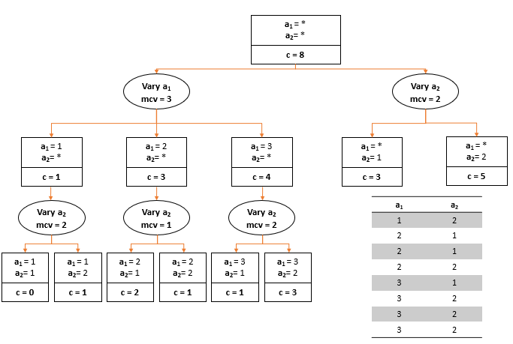
AN AD-TREE IS USED TO SUMMARIZE RELATIONS OF EVENTS THAT HAPPEN SEQUENTIALLY IN A DATABASE
Master thesis Project – Theory
AD-TREE
Definition
and
Objective²
Machine learning method to summarize relations of events that happen sequentially in a database. Their main purpose was establishing associative rules to extract some general rules based on support and conﬁdence.
Relevant
Info
^{Literal}
Attribute-value pair such as “event =shot”.
L is all possible combinations of literals in the database
^{Assoc. rule}
S1->S2. S1 will refer to the ﬁrst event, being the antecedent, and S2 to the conditional event, called the consequent (e.g. S1 event = shot and S2 being event = goal)
We can understand a time series data set as a compound of rules, each literal associated by time with the following literal
^{Support measure}
Number of records in the database that match all the attribute-value pairs in S (E.g. Count S1,S2)
The more times an association occurs, the higher its support and signiﬁcance.
^{Conf. measure}
Conf(S1,S2) = support(S1,S2)/support(S1)
The higher the measure, the stronger and the more probable an assoc. is
Data Structure
^{AD nodes}
AnADnoderepresentsa query and stores the number of times that query happens.
^{vary nodes}
Each ADnode, has child-nodes called "vary nodes" These "vary nodes" do not store counts but group ADnodes with one only feature. It can also contain the most common value (mcv).
Sources:
(1) http://www.pomdp.org/tutorial/
MDP Analysis
Notes:
Stanley Milgram (August 15, 1933 – December 20, 1984) was an American social psychologist, best known for his controversial experiment on obedience conducted in the 1960s during his professorship at Yale.^{[4]} Milgram was influenced by the events of the Holocaust, especially the trial of Adolf Eichmann, in developing the experiment.
After earning a Ph.D. in social psychology from Harvard University, he taught at Yale, Harvard, and then for most of his career as a professor at the City University of New York Graduate Center, until he died in 1984. His small-world experiment while at Harvard led researchers to analyze the degree of connectedness, including the six degrees of separation concept. Later in his career, Milgram developed a technique for creating interactive hybrid social agents (cyranoids), which has since been used to explore aspects of social- and self-perception.
He is widely regarded as one of the most important figures in the history of social psychology. A Review of General Psychology survey, published in 2002, ranked Milgram as the 46th-most-cited psychologist of the 20th century.^{[5]}
sent letters to just under 300 randomly selected people in Nebraska and Kansas, asking them to help ensure that the letter made its way to a "target person" - a named stockbroker in Boston.
Participants were asked not to send the letter directly to the stockbroker. Instead, everyone was allowed to send it only to someone whom they knew on first-name terms and who they thought might know the stockbroker.
Twenty-nine per cent of the parcels eventually reached the stockbroker. Amazingly, given the tens of millions of people in America, there tended to be just six people linking the initial volunteer and the target person - thus giving rise to the popular notion that we are all maybe connected by just six degrees of separation.

Slide 16
AN AD-TREE IS CREATED TO COUNT REPETITION OF EVENTS AND POTENTIAL TRANSITIONS (i)
Master thesis Project - Methodology
The Node’s table
Explanation
AD-tree table with all the variables related to s <x,h>
NodeId is added to each Node working as a unique key for each node
Occurrence, standing for how many times each state event happens in the whole dataset,
MDP Analysis
Notes:
Stanley Milgram (August 15, 1933 – December 20, 1984) was an American social psychologist, best known for his controversial experiment on obedience conducted in the 1960s during his professorship at Yale.^{[4]} Milgram was influenced by the events of the Holocaust, especially the trial of Adolf Eichmann, in developing the experiment.
After earning a Ph.D. in social psychology from Harvard University, he taught at Yale, Harvard, and then for most of his career as a professor at the City University of New York Graduate Center, until he died in 1984. His small-world experiment while at Harvard led researchers to analyze the degree of connectedness, including the six degrees of separation concept. Later in his career, Milgram developed a technique for creating interactive hybrid social agents (cyranoids), which has since been used to explore aspects of social- and self-perception.
He is widely regarded as one of the most important figures in the history of social psychology. A Review of General Psychology survey, published in 2002, ranked Milgram as the 46th-most-cited psychologist of the 20th century.^{[5]}
sent letters to just under 300 randomly selected people in Nebraska and Kansas, asking them to help ensure that the letter made its way to a "target person" - a named stockbroker in Boston.
Participants were asked not to send the letter directly to the stockbroker. Instead, everyone was allowed to send it only to someone whom they knew on first-name terms and who they thought might know the stockbroker.
Twenty-nine per cent of the parcels eventually reached the stockbroker. Amazingly, given the tens of millions of people in America, there tended to be just six people linking the initial volunteer and the target person - thus giving rise to the popular notion that we are all maybe connected by just six degrees of separation.

Slide 17
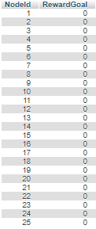
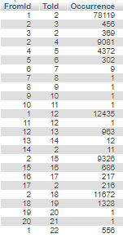
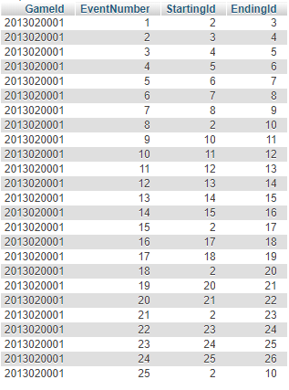
AN AD-TREE IS CREATED TO COUNT REPETITION OF EVENTS AND POTENTIAL TRANSITIONS (ii)
Master thesis Project - Methodology
The Reward table
The edges table
The node_info table
Explanation
It stores the rewards given to actions.
Receiving a Goal gives a reward of -1,
Scoring a goal = +1,
Else, 0
It stores the links between nodes in the dataset and its occurrence.
The Variables FromId and ToId refers to the link created between two nodes
It stores the original pair of unique keys from the original table with the matching NodeId
MDP Analysis
Notes:
Stanley Milgram (August 15, 1933 – December 20, 1984) was an American social psychologist, best known for his controversial experiment on obedience conducted in the 1960s during his professorship at Yale.^{[4]} Milgram was influenced by the events of the Holocaust, especially the trial of Adolf Eichmann, in developing the experiment.
After earning a Ph.D. in social psychology from Harvard University, he taught at Yale, Harvard, and then for most of his career as a professor at the City University of New York Graduate Center, until he died in 1984. His small-world experiment while at Harvard led researchers to analyze the degree of connectedness, including the six degrees of separation concept. Later in his career, Milgram developed a technique for creating interactive hybrid social agents (cyranoids), which has since been used to explore aspects of social- and self-perception.
He is widely regarded as one of the most important figures in the history of social psychology. A Review of General Psychology survey, published in 2002, ranked Milgram as the 46th-most-cited psychologist of the 20th century.^{[5]}
sent letters to just under 300 randomly selected people in Nebraska and Kansas, asking them to help ensure that the letter made its way to a "target person" - a named stockbroker in Boston.
Participants were asked not to send the letter directly to the stockbroker. Instead, everyone was allowed to send it only to someone whom they knew on first-name terms and who they thought might know the stockbroker.
Twenty-nine per cent of the parcels eventually reached the stockbroker. Amazingly, given the tens of millions of people in America, there tended to be just six people linking the initial volunteer and the target person - thus giving rise to the popular notion that we are all maybe connected by just six degrees of separation.

Slide 18
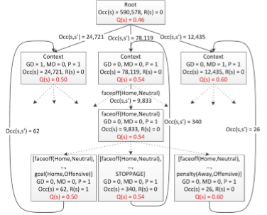


GRAPHICAL EXAMPLE OF A STATE
Master Thesis – Definition of start /End Markers
State s = < x, h > ,
where x is context and h play sequence
Context
Play sequence
Sources:
[Routley, 2015]
MDP Analysis
Notes:
Stanley Milgram (August 15, 1933 – December 20, 1984) was an American social psychologist, best known for his controversial experiment on obedience conducted in the 1960s during his professorship at Yale.^{[4]} Milgram was influenced by the events of the Holocaust, especially the trial of Adolf Eichmann, in developing the experiment.
After earning a Ph.D. in social psychology from Harvard University, he taught at Yale, Harvard, and then for most of his career as a professor at the City University of New York Graduate Center, until he died in 1984. His small-world experiment while at Harvard led researchers to analyze the degree of connectedness, including the six degrees of separation concept. Later in his career, Milgram developed a technique for creating interactive hybrid social agents (cyranoids), which has since been used to explore aspects of social- and self-perception.
He is widely regarded as one of the most important figures in the history of social psychology. A Review of General Psychology survey, published in 2002, ranked Milgram as the 46th-most-cited psychologist of the 20th century.^{[5]}
sent letters to just under 300 randomly selected people in Nebraska and Kansas, asking them to help ensure that the letter made its way to a "target person" - a named stockbroker in Boston.
Participants were asked not to send the letter directly to the stockbroker. Instead, everyone was allowed to send it only to someone whom they knew on first-name terms and who they thought might know the stockbroker.
Twenty-nine per cent of the parcels eventually reached the stockbroker. Amazingly, given the tens of millions of people in America, there tended to be just six people linking the initial volunteer and the target person - thus giving rise to the popular notion that we are all maybe connected by just six degrees of separation.

Slide 19

EXAMPLE OF HOW THE AD-TREE WOULD BE DISPLAYED GRAPHICALLY WITH OCCURRENCES AND REWARDS
Master Thesis – Definition of start /End Markers
Occurrences
Occurrences
Reward
Sources:
[Routley, 2015]
MDP Analysis
Notes:
Stanley Milgram (August 15, 1933 – December 20, 1984) was an American social psychologist, best known for his controversial experiment on obedience conducted in the 1960s during his professorship at Yale.^{[4]} Milgram was influenced by the events of the Holocaust, especially the trial of Adolf Eichmann, in developing the experiment.
After earning a Ph.D. in social psychology from Harvard University, he taught at Yale, Harvard, and then for most of his career as a professor at the City University of New York Graduate Center, until he died in 1984. His small-world experiment while at Harvard led researchers to analyze the degree of connectedness, including the six degrees of separation concept. Later in his career, Milgram developed a technique for creating interactive hybrid social agents (cyranoids), which has since been used to explore aspects of social- and self-perception.
He is widely regarded as one of the most important figures in the history of social psychology. A Review of General Psychology survey, published in 2002, ranked Milgram as the 46th-most-cited psychologist of the 20th century.^{[5]}
sent letters to just under 300 randomly selected people in Nebraska and Kansas, asking them to help ensure that the letter made its way to a "target person" - a named stockbroker in Boston.
Participants were asked not to send the letter directly to the stockbroker. Instead, everyone was allowed to send it only to someone whom they knew on first-name terms and who they thought might know the stockbroker.
Twenty-nine per cent of the parcels eventually reached the stockbroker. Amazingly, given the tens of millions of people in America, there tended to be just six people linking the initial volunteer and the target person - thus giving rise to the popular notion that we are all maybe connected by just six degrees of separation.

Slide 20

THERE EXIST DIFFERENT MARKOV MODELS FOR DIFFERENT APPROACHES AND OBJECTIVES
Master thesis Project – Theory
NO CONTROL
OVER ACTIONS
CONTROL
OVER ACTIONS
Charactheristics
MP
HMM
MDP
Finite number of states
Probabilistic transitions between states
Controllable actions in each state
Next state determined only by
the current state (Markov property)
The current action
We’re unsure which state we’re in: The current states emits an observation
Focus of the project
In MPDs, we have control over the actions and the states are completely observable
Sources:
(1) http://www.pomdp.org/tutorial/
MDP Analysis
Notes:
Stanley Milgram (August 15, 1933 – December 20, 1984) was an American social psychologist, best known for his controversial experiment on obedience conducted in the 1960s during his professorship at Yale.^{[4]} Milgram was influenced by the events of the Holocaust, especially the trial of Adolf Eichmann, in developing the experiment.
After earning a Ph.D. in social psychology from Harvard University, he taught at Yale, Harvard, and then for most of his career as a professor at the City University of New York Graduate Center, until he died in 1984. His small-world experiment while at Harvard led researchers to analyze the degree of connectedness, including the six degrees of separation concept. Later in his career, Milgram developed a technique for creating interactive hybrid social agents (cyranoids), which has since been used to explore aspects of social- and self-perception.
He is widely regarded as one of the most important figures in the history of social psychology. A Review of General Psychology survey, published in 2002, ranked Milgram as the 46th-most-cited psychologist of the 20th century.^{[5]}
sent letters to just under 300 randomly selected people in Nebraska and Kansas, asking them to help ensure that the letter made its way to a "target person" - a named stockbroker in Boston.
Participants were asked not to send the letter directly to the stockbroker. Instead, everyone was allowed to send it only to someone whom they knew on first-name terms and who they thought might know the stockbroker.
Twenty-nine per cent of the parcels eventually reached the stockbroker. Amazingly, given the tens of millions of people in America, there tended to be just six people linking the initial volunteer and the target person - thus giving rise to the popular notion that we are all maybe connected by just six degrees of separation.

Slide 21
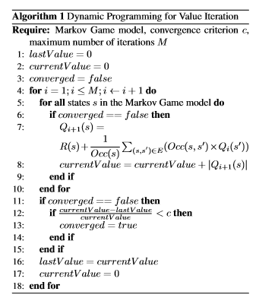
A MARKOV DECISION PROCESS IS USED TO GET THE PROBABILITIES OF EACH STATE
Master thesis Project - Methodology
Intuition
Since I know the transition probabilities for each state, the calculation of the q-values is done following this pseudocode, which gives the Pr() associated to score in each state.
Explanation of the psuedocode¹
Occurrences of state s:
Occ(s)
Occurrences of state s immediately followed by state s’:
Occ(s,s’)
Transition probability
T(s,s’) = Occ(s,s’) / Occ(s)
convergence of 0.0001
max iterations = 100000
MDP Analysis
Notes:
Stanley Milgram (August 15, 1933 – December 20, 1984) was an American social psychologist, best known for his controversial experiment on obedience conducted in the 1960s during his professorship at Yale.^{[4]} Milgram was influenced by the events of the Holocaust, especially the trial of Adolf Eichmann, in developing the experiment.
After earning a Ph.D. in social psychology from Harvard University, he taught at Yale, Harvard, and then for most of his career as a professor at the City University of New York Graduate Center, until he died in 1984. His small-world experiment while at Harvard led researchers to analyze the degree of connectedness, including the six degrees of separation concept. Later in his career, Milgram developed a technique for creating interactive hybrid social agents (cyranoids), which has since been used to explore aspects of social- and self-perception.
He is widely regarded as one of the most important figures in the history of social psychology. A Review of General Psychology survey, published in 2002, ranked Milgram as the 46th-most-cited psychologist of the 20th century.^{[5]}
sent letters to just under 300 randomly selected people in Nebraska and Kansas, asking them to help ensure that the letter made its way to a "target person" - a named stockbroker in Boston.
Participants were asked not to send the letter directly to the stockbroker. Instead, everyone was allowed to send it only to someone whom they knew on first-name terms and who they thought might know the stockbroker.
Twenty-nine per cent of the parcels eventually reached the stockbroker. Amazingly, given the tens of millions of people in America, there tended to be just six people linking the initial volunteer and the target person - thus giving rise to the popular notion that we are all maybe connected by just six degrees of separation.

Slide 22
THE IMPACT MEASURE IS THE BASIS FOR POSTERIOR EVALUATION OF THE DATA
Master thesis Project - Methodology
BASIC MEASURE¹
MAIN METRICS
DERIVATED METRICS
Impact of state ( s, a):
The difference of q_values between the following state and the previous state.
Impact:
The sum of impacts for each player
Direct Impact /time :
The sum of impacts divided by time played for each player
Plus Minus Impact:
Collective valuation of players actions in the rink
Plus Minus Impact/time:
Collective valuation of players actions in the rink divided by time played for each player
For each match in Regular Season
TIME SERIES ARIMA MODELLING
Taking most typical ARIMA models given nº of matches
Player’s valuation prediction based on ARIMA modelling for the first x played matches of that player and forecast n following matches with basic ARIMA (0,0,0) as a control model (the mean of the previous x matches)
GENERAL DATA ANALYSIS
General Regressions of the measures to Salary
Quantile plots
Histograms of players valuation
Sources:
[Routley, 2015]
MDP Analysis
Notes:
Stanley Milgram (August 15, 1933 – December 20, 1984) was an American social psychologist, best known for his controversial experiment on obedience conducted in the 1960s during his professorship at Yale.^{[4]} Milgram was influenced by the events of the Holocaust, especially the trial of Adolf Eichmann, in developing the experiment.
After earning a Ph.D. in social psychology from Harvard University, he taught at Yale, Harvard, and then for most of his career as a professor at the City University of New York Graduate Center, until he died in 1984. His small-world experiment while at Harvard led researchers to analyze the degree of connectedness, including the six degrees of separation concept. Later in his career, Milgram developed a technique for creating interactive hybrid social agents (cyranoids), which has since been used to explore aspects of social- and self-perception.
He is widely regarded as one of the most important figures in the history of social psychology. A Review of General Psychology survey, published in 2002, ranked Milgram as the 46th-most-cited psychologist of the 20th century.^{[5]}
sent letters to just under 300 randomly selected people in Nebraska and Kansas, asking them to help ensure that the letter made its way to a "target person" - a named stockbroker in Boston.
Participants were asked not to send the letter directly to the stockbroker. Instead, everyone was allowed to send it only to someone whom they knew on first-name terms and who they thought might know the stockbroker.
Twenty-nine per cent of the parcels eventually reached the stockbroker. Amazingly, given the tens of millions of people in America, there tended to be just six people linking the initial volunteer and the target person - thus giving rise to the popular notion that we are all maybe connected by just six degrees of separation.

Slide 23
Introduction to the Hockey Project
Master thesis Project
Objective
Data
Methodology
Results
MDP Analysis

Slide 24
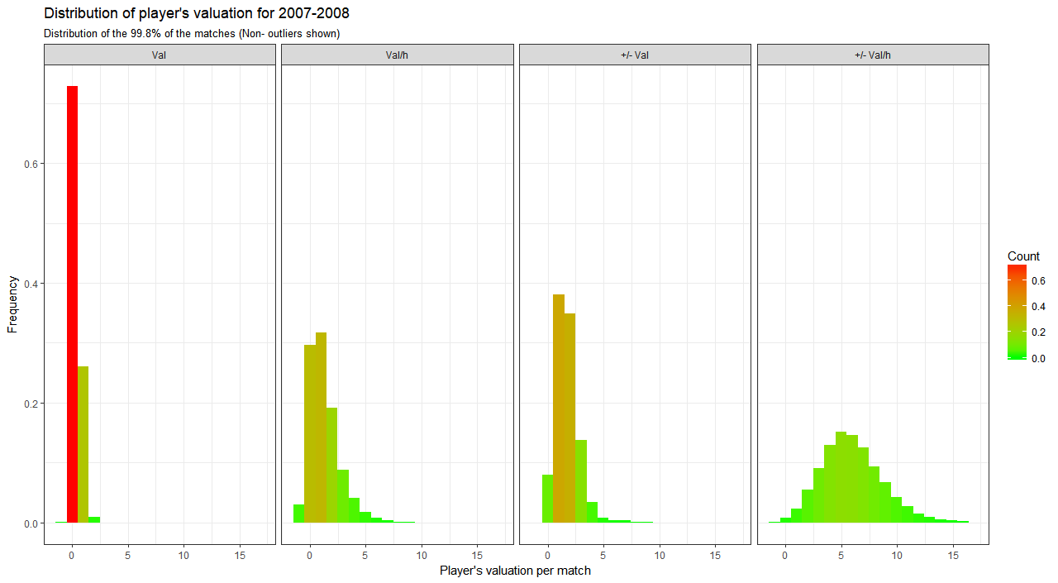
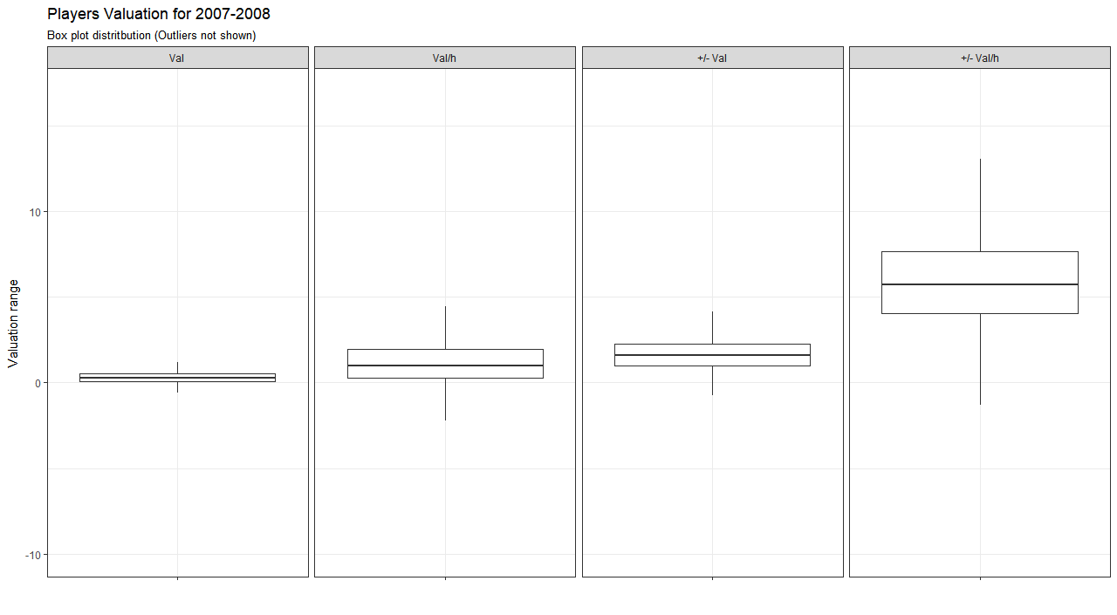
GENERAL ANALYSIS
Master thesis Project - Results
Sources:
[Routley, 2015]
MDP Analysis
Notes:
Stanley Milgram (August 15, 1933 – December 20, 1984) was an American social psychologist, best known for his controversial experiment on obedience conducted in the 1960s during his professorship at Yale.^{[4]} Milgram was influenced by the events of the Holocaust, especially the trial of Adolf Eichmann, in developing the experiment.
After earning a Ph.D. in social psychology from Harvard University, he taught at Yale, Harvard, and then for most of his career as a professor at the City University of New York Graduate Center, until he died in 1984. His small-world experiment while at Harvard led researchers to analyze the degree of connectedness, including the six degrees of separation concept. Later in his career, Milgram developed a technique for creating interactive hybrid social agents (cyranoids), which has since been used to explore aspects of social- and self-perception.
He is widely regarded as one of the most important figures in the history of social psychology. A Review of General Psychology survey, published in 2002, ranked Milgram as the 46th-most-cited psychologist of the 20th century.^{[5]}
sent letters to just under 300 randomly selected people in Nebraska and Kansas, asking them to help ensure that the letter made its way to a "target person" - a named stockbroker in Boston.
Participants were asked not to send the letter directly to the stockbroker. Instead, everyone was allowed to send it only to someone whom they knew on first-name terms and who they thought might know the stockbroker.
Twenty-nine per cent of the parcels eventually reached the stockbroker. Amazingly, given the tens of millions of people in America, there tended to be just six people linking the initial volunteer and the target person - thus giving rise to the popular notion that we are all maybe connected by just six degrees of separation.

Slide 25
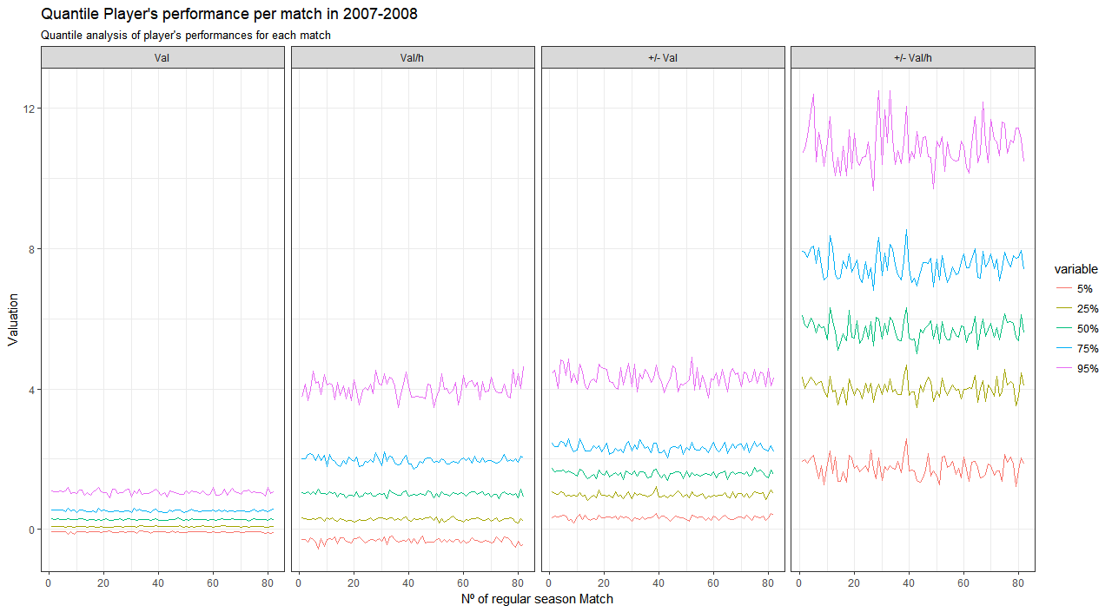
GENERAL ANALYSIS
Master thesis Project - Results
Sources:
[Routley, 2015]
MDP Analysis
Notes:
Stanley Milgram (August 15, 1933 – December 20, 1984) was an American social psychologist, best known for his controversial experiment on obedience conducted in the 1960s during his professorship at Yale.^{[4]} Milgram was influenced by the events of the Holocaust, especially the trial of Adolf Eichmann, in developing the experiment.
After earning a Ph.D. in social psychology from Harvard University, he taught at Yale, Harvard, and then for most of his career as a professor at the City University of New York Graduate Center, until he died in 1984. His small-world experiment while at Harvard led researchers to analyze the degree of connectedness, including the six degrees of separation concept. Later in his career, Milgram developed a technique for creating interactive hybrid social agents (cyranoids), which has since been used to explore aspects of social- and self-perception.
He is widely regarded as one of the most important figures in the history of social psychology. A Review of General Psychology survey, published in 2002, ranked Milgram as the 46th-most-cited psychologist of the 20th century.^{[5]}
sent letters to just under 300 randomly selected people in Nebraska and Kansas, asking them to help ensure that the letter made its way to a "target person" - a named stockbroker in Boston.
Participants were asked not to send the letter directly to the stockbroker. Instead, everyone was allowed to send it only to someone whom they knew on first-name terms and who they thought might know the stockbroker.
Twenty-nine per cent of the parcels eventually reached the stockbroker. Amazingly, given the tens of millions of people in America, there tended to be just six people linking the initial volunteer and the target person - thus giving rise to the popular notion that we are all maybe connected by just six degrees of separation.

Slide 26
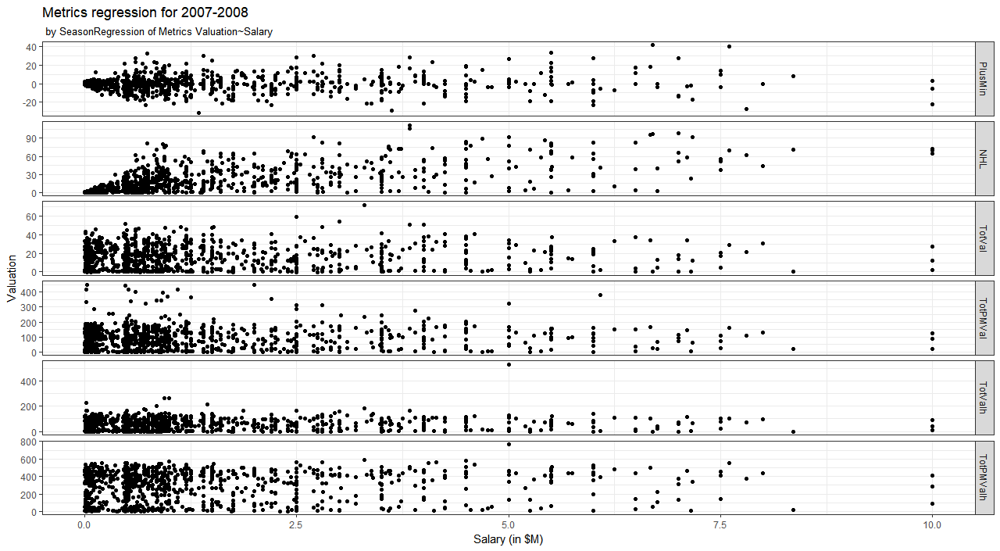
GENERAL ANALYSIS
Master thesis Project - Results
Sources:
[Routley, 2015]
MDP Analysis
Notes:
Stanley Milgram (August 15, 1933 – December 20, 1984) was an American social psychologist, best known for his controversial experiment on obedience conducted in the 1960s during his professorship at Yale.^{[4]} Milgram was influenced by the events of the Holocaust, especially the trial of Adolf Eichmann, in developing the experiment.
After earning a Ph.D. in social psychology from Harvard University, he taught at Yale, Harvard, and then for most of his career as a professor at the City University of New York Graduate Center, until he died in 1984. His small-world experiment while at Harvard led researchers to analyze the degree of connectedness, including the six degrees of separation concept. Later in his career, Milgram developed a technique for creating interactive hybrid social agents (cyranoids), which has since been used to explore aspects of social- and self-perception.
He is widely regarded as one of the most important figures in the history of social psychology. A Review of General Psychology survey, published in 2002, ranked Milgram as the 46th-most-cited psychologist of the 20th century.^{[5]}
sent letters to just under 300 randomly selected people in Nebraska and Kansas, asking them to help ensure that the letter made its way to a "target person" - a named stockbroker in Boston.
Participants were asked not to send the letter directly to the stockbroker. Instead, everyone was allowed to send it only to someone whom they knew on first-name terms and who they thought might know the stockbroker.
Twenty-nine per cent of the parcels eventually reached the stockbroker. Amazingly, given the tens of millions of people in America, there tended to be just six people linking the initial volunteer and the target person - thus giving rise to the popular notion that we are all maybe connected by just six degrees of separation.

Slide 27
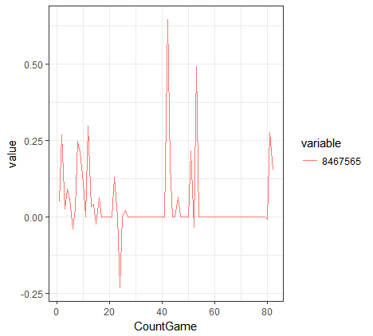
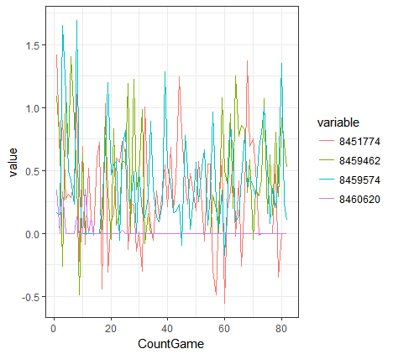
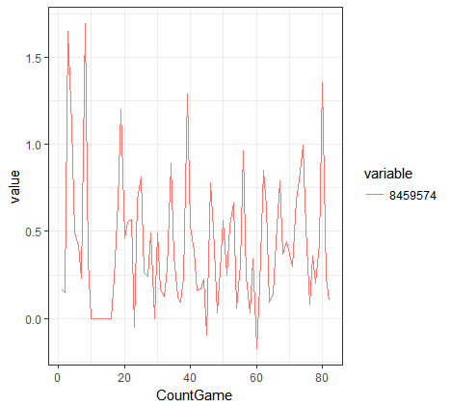
GENERAL ANALYSIS
Master thesis Project - Results
Sources:
[Routley, 2015]
MDP Analysis
Notes:
Stanley Milgram (August 15, 1933 – December 20, 1984) was an American social psychologist, best known for his controversial experiment on obedience conducted in the 1960s during his professorship at Yale.^{[4]} Milgram was influenced by the events of the Holocaust, especially the trial of Adolf Eichmann, in developing the experiment.
After earning a Ph.D. in social psychology from Harvard University, he taught at Yale, Harvard, and then for most of his career as a professor at the City University of New York Graduate Center, until he died in 1984. His small-world experiment while at Harvard led researchers to analyze the degree of connectedness, including the six degrees of separation concept. Later in his career, Milgram developed a technique for creating interactive hybrid social agents (cyranoids), which has since been used to explore aspects of social- and self-perception.
He is widely regarded as one of the most important figures in the history of social psychology. A Review of General Psychology survey, published in 2002, ranked Milgram as the 46th-most-cited psychologist of the 20th century.^{[5]}
sent letters to just under 300 randomly selected people in Nebraska and Kansas, asking them to help ensure that the letter made its way to a "target person" - a named stockbroker in Boston.
Participants were asked not to send the letter directly to the stockbroker. Instead, everyone was allowed to send it only to someone whom they knew on first-name terms and who they thought might know the stockbroker.
Twenty-nine per cent of the parcels eventually reached the stockbroker. Amazingly, given the tens of millions of people in America, there tended to be just six people linking the initial volunteer and the target person - thus giving rise to the popular notion that we are all maybe connected by just six degrees of separation.

Slide 28
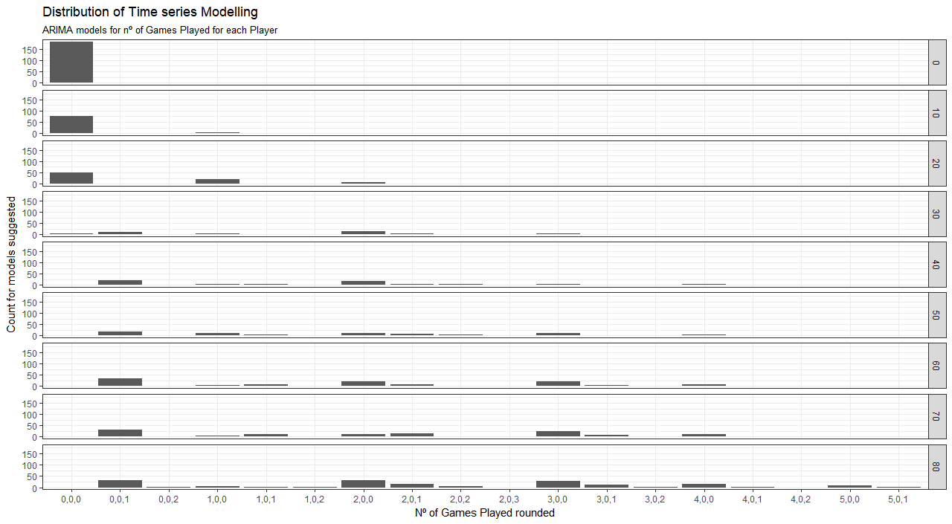
TIME SERIES ANALYSIS: THE CHOICE OF AN ARIMA MODEL FOR THE DATA FOR THE INDIVIDUAL MEASURE
Master thesis Project - Results
Sources:
[Routley, 2015]
MDP Analysis
Notes:
Stanley Milgram (August 15, 1933 – December 20, 1984) was an American social psychologist, best known for his controversial experiment on obedience conducted in the 1960s during his professorship at Yale.^{[4]} Milgram was influenced by the events of the Holocaust, especially the trial of Adolf Eichmann, in developing the experiment.
After earning a Ph.D. in social psychology from Harvard University, he taught at Yale, Harvard, and then for most of his career as a professor at the City University of New York Graduate Center, until he died in 1984. His small-world experiment while at Harvard led researchers to analyze the degree of connectedness, including the six degrees of separation concept. Later in his career, Milgram developed a technique for creating interactive hybrid social agents (cyranoids), which has since been used to explore aspects of social- and self-perception.
He is widely regarded as one of the most important figures in the history of social psychology. A Review of General Psychology survey, published in 2002, ranked Milgram as the 46th-most-cited psychologist of the 20th century.^{[5]}
sent letters to just under 300 randomly selected people in Nebraska and Kansas, asking them to help ensure that the letter made its way to a "target person" - a named stockbroker in Boston.
Participants were asked not to send the letter directly to the stockbroker. Instead, everyone was allowed to send it only to someone whom they knew on first-name terms and who they thought might know the stockbroker.
Twenty-nine per cent of the parcels eventually reached the stockbroker. Amazingly, given the tens of millions of people in America, there tended to be just six people linking the initial volunteer and the target person - thus giving rise to the popular notion that we are all maybe connected by just six degrees of separation.

Slide 29
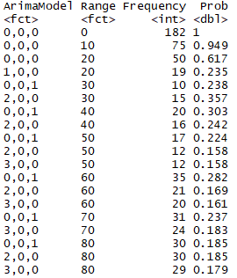
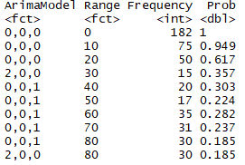
TIME SERIES ANALYSIS
Master thesis Project - Results
Sources:
[Routley, 2015]
MDP Analysis
Notes:
Stanley Milgram (August 15, 1933 – December 20, 1984) was an American social psychologist, best known for his controversial experiment on obedience conducted in the 1960s during his professorship at Yale.^{[4]} Milgram was influenced by the events of the Holocaust, especially the trial of Adolf Eichmann, in developing the experiment.
After earning a Ph.D. in social psychology from Harvard University, he taught at Yale, Harvard, and then for most of his career as a professor at the City University of New York Graduate Center, until he died in 1984. His small-world experiment while at Harvard led researchers to analyze the degree of connectedness, including the six degrees of separation concept. Later in his career, Milgram developed a technique for creating interactive hybrid social agents (cyranoids), which has since been used to explore aspects of social- and self-perception.
He is widely regarded as one of the most important figures in the history of social psychology. A Review of General Psychology survey, published in 2002, ranked Milgram as the 46th-most-cited psychologist of the 20th century.^{[5]}
sent letters to just under 300 randomly selected people in Nebraska and Kansas, asking them to help ensure that the letter made its way to a "target person" - a named stockbroker in Boston.
Participants were asked not to send the letter directly to the stockbroker. Instead, everyone was allowed to send it only to someone whom they knew on first-name terms and who they thought might know the stockbroker.
Twenty-nine per cent of the parcels eventually reached the stockbroker. Amazingly, given the tens of millions of people in America, there tended to be just six people linking the initial volunteer and the target person - thus giving rise to the popular notion that we are all maybe connected by just six degrees of separation.

Slide 30
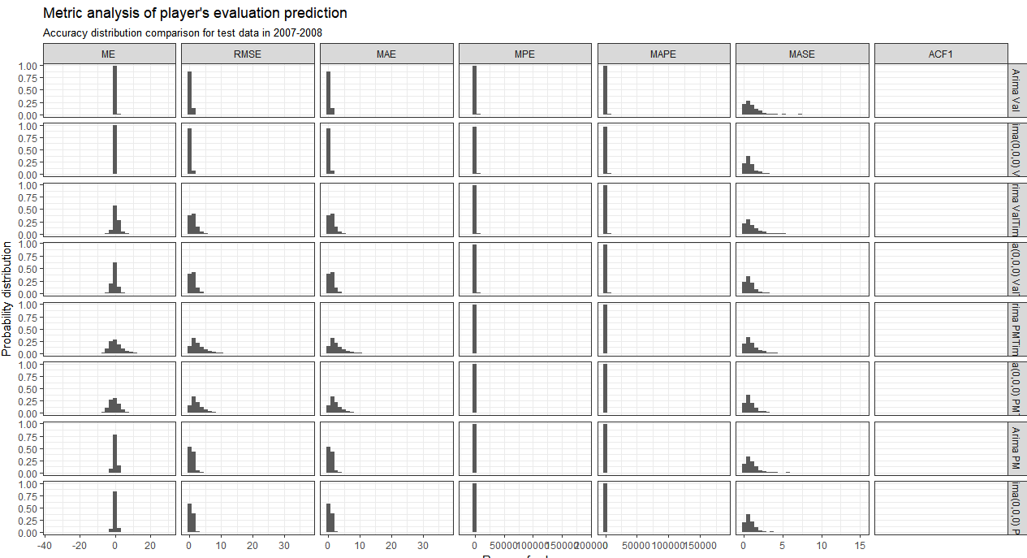
TIME SERIES ANALYSIS
Master thesis Project - Results
Sources:
[Routley, 2015]
MDP Analysis
Notes:
Stanley Milgram (August 15, 1933 – December 20, 1984) was an American social psychologist, best known for his controversial experiment on obedience conducted in the 1960s during his professorship at Yale.^{[4]} Milgram was influenced by the events of the Holocaust, especially the trial of Adolf Eichmann, in developing the experiment.
After earning a Ph.D. in social psychology from Harvard University, he taught at Yale, Harvard, and then for most of his career as a professor at the City University of New York Graduate Center, until he died in 1984. His small-world experiment while at Harvard led researchers to analyze the degree of connectedness, including the six degrees of separation concept. Later in his career, Milgram developed a technique for creating interactive hybrid social agents (cyranoids), which has since been used to explore aspects of social- and self-perception.
He is widely regarded as one of the most important figures in the history of social psychology. A Review of General Psychology survey, published in 2002, ranked Milgram as the 46th-most-cited psychologist of the 20th century.^{[5]}
sent letters to just under 300 randomly selected people in Nebraska and Kansas, asking them to help ensure that the letter made its way to a "target person" - a named stockbroker in Boston.
Participants were asked not to send the letter directly to the stockbroker. Instead, everyone was allowed to send it only to someone whom they knew on first-name terms and who they thought might know the stockbroker.
Twenty-nine per cent of the parcels eventually reached the stockbroker. Amazingly, given the tens of millions of people in America, there tended to be just six people linking the initial volunteer and the target person - thus giving rise to the popular notion that we are all maybe connected by just six degrees of separation.

Slide 31
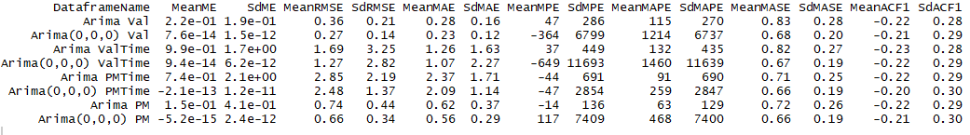
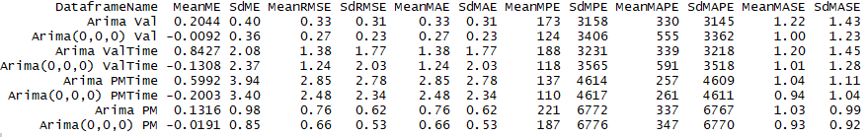
TIME SERIES ANALYSIS
Master thesis Project - Results
Sources:
[Routley, 2015]
MDP Analysis
Notes:
Stanley Milgram (August 15, 1933 – December 20, 1984) was an American social psychologist, best known for his controversial experiment on obedience conducted in the 1960s during his professorship at Yale.^{[4]} Milgram was influenced by the events of the Holocaust, especially the trial of Adolf Eichmann, in developing the experiment.
After earning a Ph.D. in social psychology from Harvard University, he taught at Yale, Harvard, and then for most of his career as a professor at the City University of New York Graduate Center, until he died in 1984. His small-world experiment while at Harvard led researchers to analyze the degree of connectedness, including the six degrees of separation concept. Later in his career, Milgram developed a technique for creating interactive hybrid social agents (cyranoids), which has since been used to explore aspects of social- and self-perception.
He is widely regarded as one of the most important figures in the history of social psychology. A Review of General Psychology survey, published in 2002, ranked Milgram as the 46th-most-cited psychologist of the 20th century.^{[5]}
sent letters to just under 300 randomly selected people in Nebraska and Kansas, asking them to help ensure that the letter made its way to a "target person" - a named stockbroker in Boston.
Participants were asked not to send the letter directly to the stockbroker. Instead, everyone was allowed to send it only to someone whom they knew on first-name terms and who they thought might know the stockbroker.
Twenty-nine per cent of the parcels eventually reached the stockbroker. Amazingly, given the tens of millions of people in America, there tended to be just six people linking the initial volunteer and the target person - thus giving rise to the popular notion that we are all maybe connected by just six degrees of separation.

Slide 32

Carles Sans Fuentes
732A64 Master thesis on Statistics and Machine Learning / Linköpings University carsa564@student.liu.se

