Slide 1
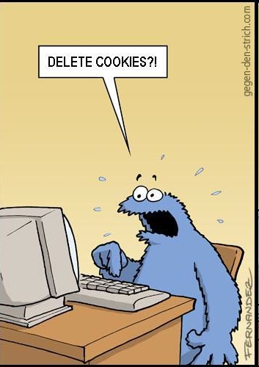
732A02 Data Mining -
Clustering and Association Analysis
Association rules
Apriori algorithm
FP grow algorithm
…………………
Jose M. Peña
jospe@ida.liu.se

Slide 2
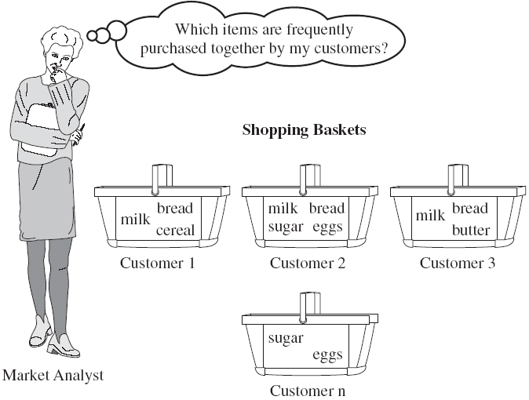
Association rules
Mining some data for frequent patterns.
In our case, patterns will be rules of the form
Antecedent → consequent, with only conjunctions of bought items in the antecedent and consequent,
e.g. milk ^ eggs → bread ^ butter.
Applications: E.g., market basket analysis (to support business decisions):
  Rules with “Coke” in the consequent may help to decide how to boost sales of “Coke”.
  Rules with “bagels” in the antecedent may help to determine what happens if “bagels” are sold out.
FREQUENT
ITEMSET

Slide 3
Association rules
Transaction-id | Items bought
10 | A, B, D
20 | A, C, D
30 | A, D, E
40 | B, E, F
50 | B, C, D, E, F
Goal: Find all the rules X → Y with minimum support and confidence
  support = p(X, Y) = probability that a transaction contains X ∪ Y
  confidence = p(Y | X) = conditional probability that a transaction having X also contains Y = p(X, Y) / p(X).
Let sup_{min} = 50%, conf_{min} = 50%. Association rules:
  A → D (60%, 100%)
  D → A (60%, 75%)
Customer
buys both
Customer
buys diaper
Customer
buys beer

Slide 4
Association rules
Goal: Find all the rules X → Y with minimum support and confidence.
Solution:
  Find all sets of items (itemsets) with minimum support, i.e. the frequent itemsets (Apriori and FP grow algorithms).
  Generate all the rules with minimum confidence from the frequent itemsets.
Note (the downward closure or apriori property): Any subset of a frequent itemset is frequent. Or, any superset of an infrequent itemset set is infrequent.

Slide 5
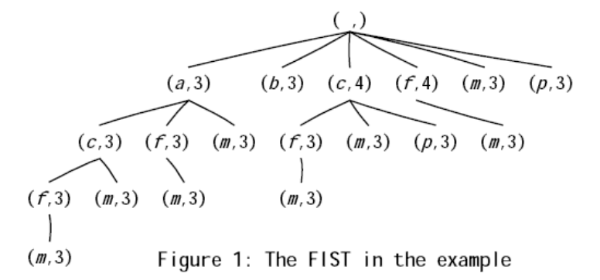
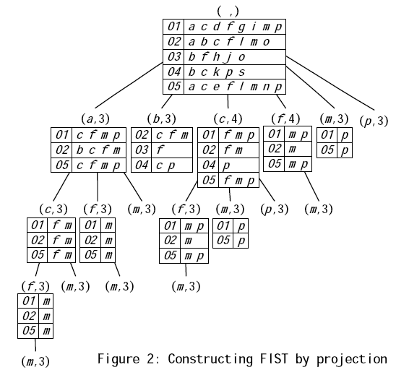
Association rules
Frequent itemsets can be represented as a tree (the children of a node are a subset of its siblings).
Different algorithms traverse the tree differently, e.g.
  Apriori algorithm = breadth first.
  FP grow algorithm = depth first.
Breadth first algorithms cannot typically store the projections in memory and, thus, have to scan the database more times. The opposite is typically true for depth first algorithms.
Breadth (resp. depth) is typically less (resp. more) efficient but more (resp. less) scalable.

Slide 6
Apriori algorithm
Scan the database once to get the frequent 1-itemsets
Generate candidates to frequent (k+1)-itemsets from frequent k-itemsets
Test the candidates against database
Terminate when no frequent or candidate itemsets can be generated, otherwise

Slide 7
Apriori algorithm
sup_{min} = 2
apriori property
Database
Itemset | sup
{A} | 2
{B} | 3
{C} | 3
{D} | 1
{E} | 3
C₁
Itemset | sup
{A} | 2
{B} | 3
{C} | 3
{E} | 3
Tid | Items
10 | A, C, D
20 | B, C, E
30 | A, B, C, E
40 | B, E
L₁
1st scan
C₂
Itemset | sup
{A, B} | 1
{A, C} | 2
{A, E} | 1
{B, C} | 2
{B, E} | 3
{C, E} | 2
C₂
L₂
Itemset
{A, B}
{A, C}
{A, E}
{B, C}
{B, E}
{C, E}
Itemset | sup
{A, C} | 2
{B, C} | 2
{B, E} | 3
{C, E} | 2
2nd scan
C₃
Itemset
{B, C, E}
3rd scan
L₃
Itemset | sup
{B, C, E} | 2

Slide 8
Apriori algorithm
How to generate candidates?
  Step 1: self-joining L_{k}
  Step 2: pruning
Example of candidate generation.
  L₃={abc, abd, acd, ace, bcd}
  Self-joining: L₃*L₃
    abcd from abc and abd.
    acde from acd and ace.
  Pruning:
    acde is removed because ade is not in L₃.
  C₄={abcd}

Slide 9
Apriori algorithm
Suppose the items in L_{k-1} are listed in an order
Self-joining L_{k-1}
  insert into C_{k}
  select p.item₁, p.item₂, …, p.item_{k-1}, q.item_{k-1}
  from L_{k-1} p, L_{k-1} q
  where p.item₁=q.item₁, …, p.item_{k-2}=q.item_{k-2}, p.item_{k-1} < q.item_{k-1}
Pruning
  forall itemsets c in C_{k} do
    forall (k-1)-subsets s of c do
      if (s is not in L_{k-1}) then delete c from C_{k}
apriori property

Slide 10
Apriori algorithm
C_{k} : candidate itemset of size k
L_{k} : frequent itemset of size k
L₁ = {frequent items}
for (k = 1; L_{k} !=∅; k++) do begin
C_{k+1} = candidates generated from L_{k}
for each transaction t in database d
increment the count of all candidates in C_{k+1} that are contained in t
L_{k+1} = candidates in C_{k+1} with minimum support
end
return ∪_{k} L_{k}
Prove that all the frequent (k+1)-itemsets are in C_{k+1}

Slide 11
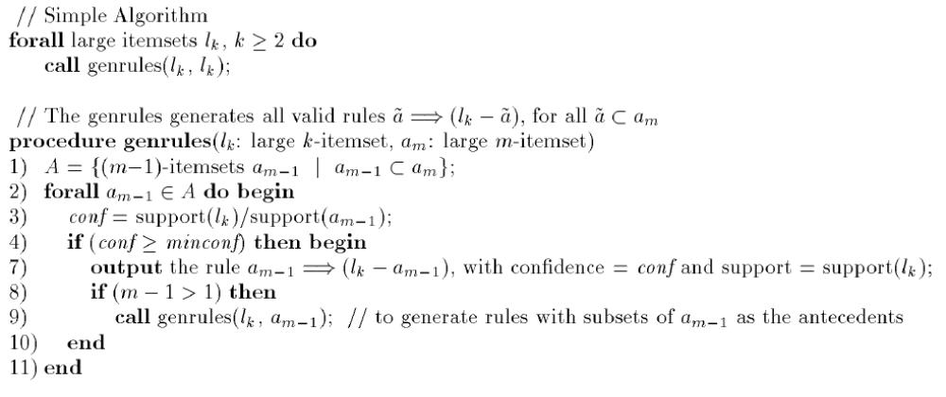
Association rules
R. Agrawal, R. Srikant:
"Fast Algorithms for Mining Association Rules",
IBM Research Report RJ9839.
Generate all the rules of the form
a → l - a
with minimum confidence from a large (= frequent) itemset l.
If a subset a of l does not generate a rule, then neither does any subset of a (≈ apriori property).

Slide 12
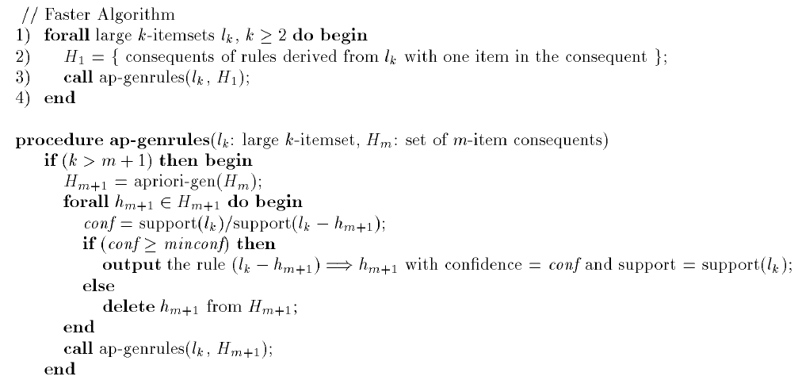
Association rules
R. Agrawal, R. Srikant:
"Fast Algorithms for Mining Association Rules",
IBM Research Report RJ9839.
Generate all the rules of the form
l - h → h
with minimum confidence from a large (= frequent) itemset l.
For a subset h of a large item l to generate a rule, so must do all the subsets of h (≈ apriori property).
Generate the rules with one item consequent
= Apriori algorithm
candidate generation

Slide 13
FP grow algorithm
Apriori = candidate generate-and-test.
Problems
  Too many candidates to generate, e.g. if there are 10⁴ frequent 1-itemsets, then more than 10⁷ candidate 2-itemsets.
  Each candidate implies expensive operations, e.g. pattern matching and subset checking.
Can candidate generation be avoided ? Yes, frequent pattern (FP) grow algorithm.

Slide 14
FP grow algorithm
TID Items bought items bought (f-list ordered)
100 {f, a, c, d, g, i, m, p} {f, c, a, m, p}
200 {a, b, c, f, l, m, o} {f, c, a, b, m}
300 {b, f, h, j, o, w} {f, b}
400 {b, c, k, s, p} {c, b, p}
500 {a, f, c, e, l, p, m, n} {f, c, a, m, p}
min_support = 3
{}
Header Table
Item frequency head
f 4
c 4
a 3
b 3
m 3
p 3
Scan the database once, and find the frequent items. Record them as the frequent 1-itemsets.
Sort frequent items in frequency descending order
Scan the database again and construct the FP-tree.
f:4
c:1
c:3
b:1
b:1
a:3
p:1
f-list=f-c-a-b-m-p.
m:2
b:1
p:2
m:1

Slide 15
FP grow algorithm
For each frequent item in the header table
  Traverse the tree by following the corresponding link.
  Record all of prefix paths leading to the item. This is the item’s conditional pattern base.
{}
Header Table
Item frequency head
f 4
c 4
a 3
b 3
m 3
p 3
f:4
c:1
Conditional pattern bases
item cond. pattern base
c f:3
a fc:3
b fca:1, f:1, c:1
m fca:2, fcab:1
p fcam:2, cb:1
c:3
b:1
b:1
a:3
p:1
m:2
b:1

p:2
m:1
Frequent itemsets found:
f: 4, c:4, a:3, b:3, m:3, p:3

Slide 16
FP grow algorithm
For each conditional pattern base
  Start the process again (recursion).
m-conditional pattern base:
  fca:2, fcab:1
am-conditional pattern base:
fc:3
cam-conditional pattern base:
f:3
{}
{}
{}


f:3
f:3
f:3
c:3
c:3
cam-conditional FP-tree
am-conditional FP-tree
a:3
m-conditional FP-tree



Frequent itemsets found:
fm: 3, cm:3, am:3
Frequent itemsets found:
fam: 3, cam:3
Frequent itemset found:
fcam: 3
Backtracking !!!

Slide 17
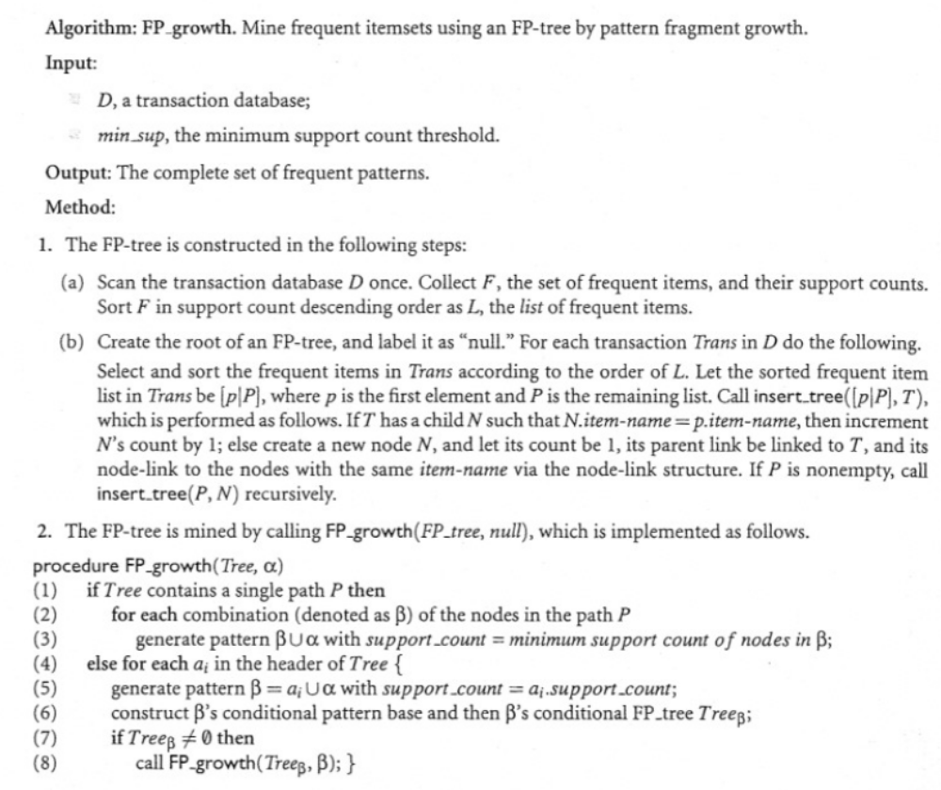
FP grow algorithm

Slide 18
FP grow algorithm
Exercise
Run the FP grow algorithm on the following database
TID Items bought
100 {1,2,5}
200 {2,4}
{2,3}
400 {1,2,4}
500 {1,3}
600 {2,3}
700 {1,3}
800 {1,2,3,5}
900 {1,2,3}

Slide 19
Association rules
Frequent itemsets can be represented as a tree (the children of a node are a subset of its siblings).
Different algorithms traverse the tree differently, e.g.
  Apriori algorithm = breadth first.
  FP grow algorithm = depth first.
Breadth first algorithms cannot typically store the projections and, thus, have to scan the databases more times.
The opposite is typically true for depth first algorithms.
Breadth (resp. depth) is typically less (resp. more) efficient but more (resp. less) scalable.

Slide 20


