Slide 1
732A02 Data Mining -
Clustering and Association Analysis
FP growth algorithm
Correlation analysis
…………………
Jose M. Peña
jospe@ida.liu.se

Slide 2
FP growth algorithm
Apriori = candidate generate-and-test.
Problems
  Too many candidates to generate, e.g. if there are 10⁴ frequent 1-itemsets, then more than 10⁷ candidate 2-itemsets.
  Each candidate implies expensive operations, e.g. pattern matching and subset checking.
Can candidate generation be avoided ? Yes, frequent pattern (FP) growth algorithm.

Slide 3
FP growth algorithm
TID Items bought items bought (f-list ordered)
100 {f, a, c, d, g, i, m, p} {f, c, a, m, p}
200 {a, b, c, f, l, m, o} {f, c, a, b, m}
300 {b, f, h, j, o, w} {f, b}
400 {b, c, k, s, p} {c, b, p}
500 {a, f, c, e, l, p, m, n} {f, c, a, m, p}
min_support = 3
{}
Header Table
Item frequency head
f 4
c 4
a 3
b 3
m 3
p 3
Scan the database once, and find the frequent items. Record them as the frequent 1-itemsets.
Sort frequent items in frequency descending order
Scan the database again and construct the FP-tree.
f:4
c:1
c:3
b:1
b:1
a:3
p:1
f-list=f-c-a-b-m-p.
m:2
b:1
p:2
m:1

Slide 4
FP growth algorithm
For each frequent item in the header table
  Traverse the tree by following the corresponding link.
  Record all of prefix paths leading to the item. This is the item’s conditional pattern base.
{}
Header Table
Item frequency head
f 4
c 4
a 3
b 3
m 3
p 3
f:4
c:1
Conditional pattern bases
item cond. pattern base
c f:3
a fc:3
b fca:1, f:1, c:1
m fca:2, fcab:1
p fcam:2, cb:1
c:3
b:1
b:1
a:3
p:1
m:2
b:1

p:2
m:1
Frequent itemsets found:
f: 4, c:4, a:3, b:3, m:3, p:3

Slide 5
FP growth algorithm
For each conditional pattern base
  Start the process again (recursion).
m-conditional pattern base:
  fca:2, fcab:1
am-conditional pattern base:
fc:3
cam-conditional pattern base:
f:3
{}
{}
{}


f:3
f:3
f:3
c:3
c:3
cam-conditional FP-tree
am-conditional FP-tree
a:3
m-conditional FP-tree



Frequent itemsets found:
fm: 3, cm:3, am:3
Frequent itemsets found:
fam: 3, cam:3
Frequent itemset found:
fcam: 3
Backtracking !!!

Slide 6
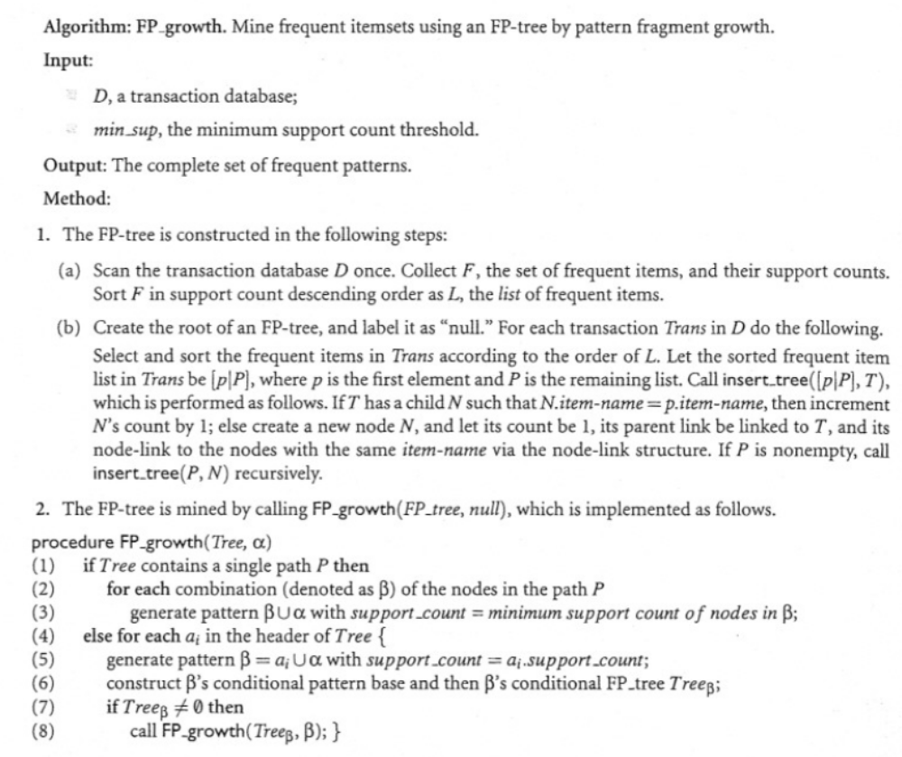
FP growth algorithm

Slide 7
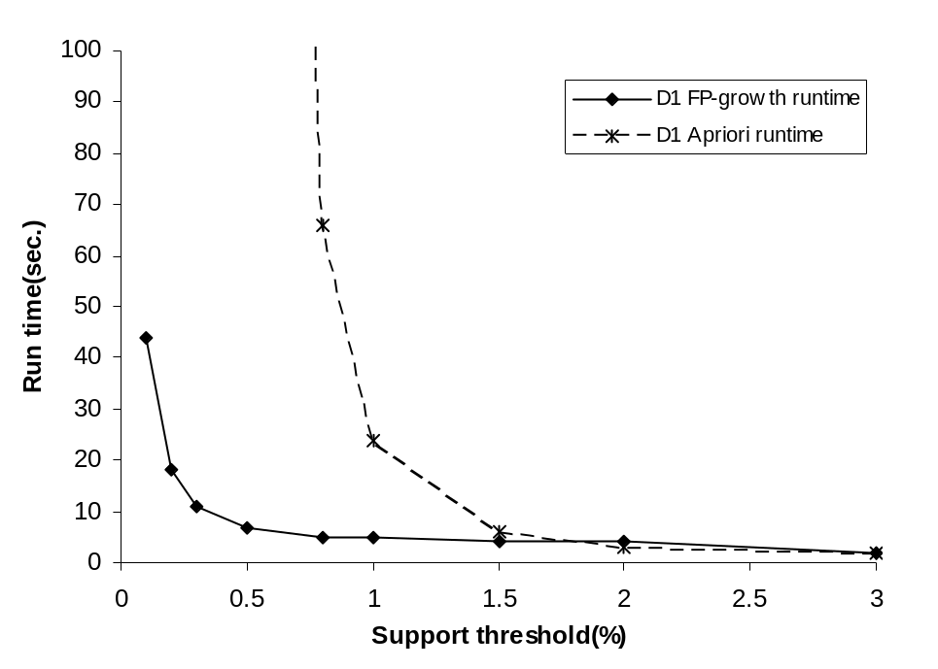
FP growth algorithm
With small threshold there are many and long candidates, which implies long runtime due to expensive operations such as pattern matching and subset checking.

Slide 8
FP growth algorithm
Exercise
Run the FP growth algorithm on the following database (min_sup=2)
TID Items bought
100 {1,2,5}
200 {2,4}
{2,3}
400 {1,2,4}
500 {1,3}
600 {2,3}
700 {1,3}
800 {1,2,3,5}
900 {1,2,3}

Slide 9
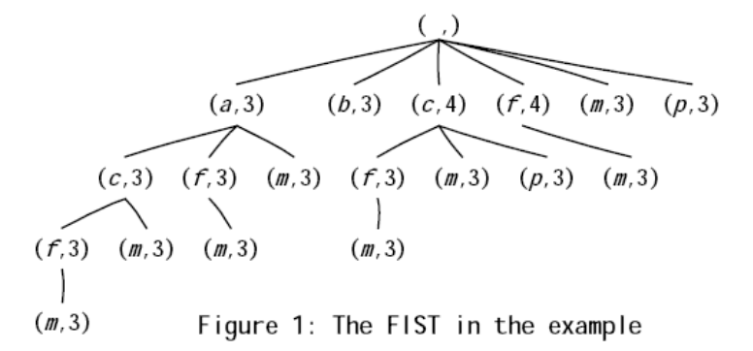
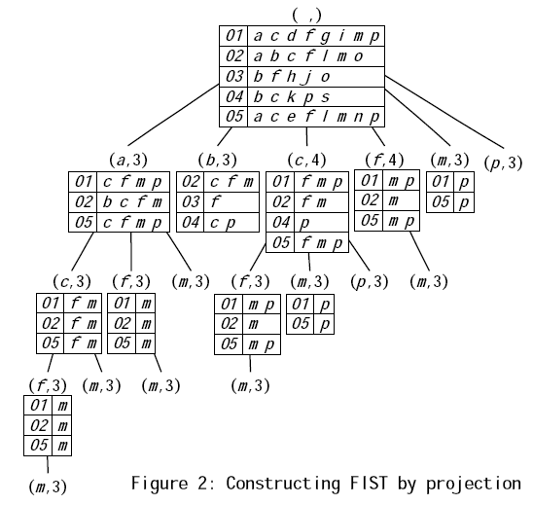
Frequent itemsets
Frequent itemsets can be represented as a tree (the children of a node are a subset of its siblings).
Different algorithms traverse the tree differently, e.g.
  Apriori algorithm = breadth first.
  FP growth algorithm = depth first.
Breadth first algorithms cannot typically store the projections and, thus, have to scan the databases more times.
The opposite is typically true for depth first algorithms.
Breadth (resp. depth) is typically less (resp. more) efficient but more (resp. less) scalable.
min_sup=3

Slide 10

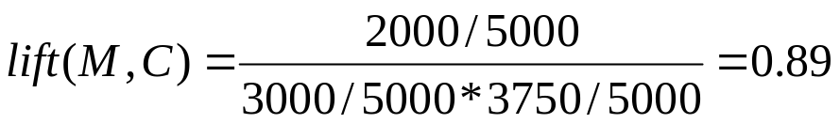
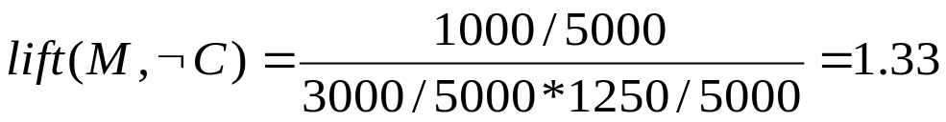
Correlation analysis
 | Milk | Not milk | Sum (row)
Cereal | 2000 | 1750 | 3750
Not cereal | 1000 | 250 | 1250
Sum(col.) | 3000 | 2000 | 5000
Milk ⇒ cereal [40%, 66.7%] is misleading/uninteresting:
The overall % of students buying cereal is 75% > 66.7% !!!
Milk ⇒ not cereal [20%, 33.3%] is more accurate (25% < 33.3%).
Measure of dependent/correlated events: lift for X ⇒ Y
lift >1 positive correlation, lift <1 negative correlation, = 1 independence

Slide 11
Correlation analysis
Exercise: Find an example where
  A ⇒ C has lift(A,C) < 1, but
  A,B ⇒ C has lift(A,B,C) > 1.

