Slide 1
732A02 Data Mining -
Clustering and Association Analysis
Exercises
…………………
Jose M. Peña
jospe@ida.liu.se

Slide 2
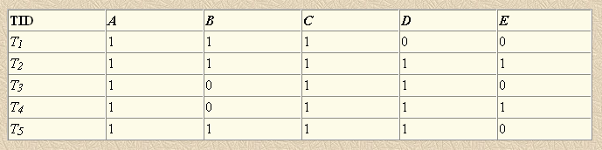
Run the Apriori algorithm for the following transaction database (mininum support = 40 %, i.e. 2 transactions)
Run the Apriori algorithm for the database above with the constraint sum(item.price) ≤ 10 and the following item prices
Repeat the last exercise for sum(item.price) ≤ 1 and E.price = -10.
Repeat the exercises above for the FP grow algorithm.
The solutions will be made available at the course website after the lecture.
Item | Price
A | 1
B | 1
C | 1
D | 1
E | 10

Slide 3
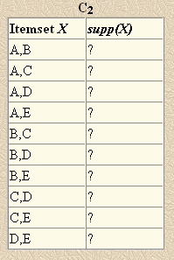
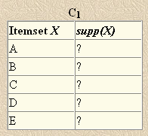
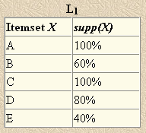
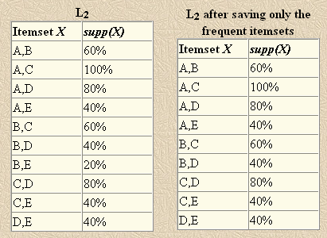
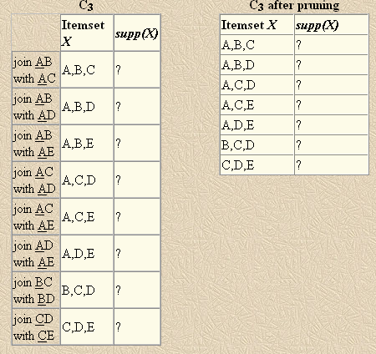
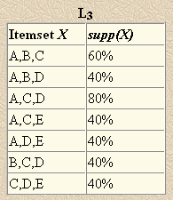
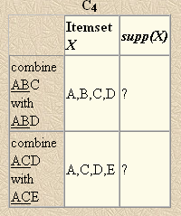
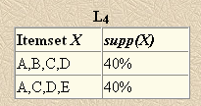
Solutions
Prune it because BE is infrequent

Slide 4
Solutions
sum(item.price) ≤ 10 with POSITIVE prices is antimonotonic. So, it helps to prune the search space.

Slide 5
Solutions
sum(item.price) ≤ 1 with ANY price is CONVERTIBLE antimonotonic wrt the descending item price order. So, it helps to prune the search space if items are ordered ascending.
Order the items in each transaction so that they respect the order E, A, B, C, D. Run the Apriori algorithm almost as usual.
C1: E(support?,constraint?), A(?,?), B(?,?), C(?,?), D(?,?)
C1: E(?,-10), A(?,1), B(?,1), C(?,1), D(?,1)
L1: E(2,-10), A(5,1), B(3,1), C(5,1), D(4,1)
C2: EA(?,?), EB(?,?), EC(?,?), ED(?,?), AB(?,?), AC(?,?), AD(?,?), CD(?,?)
C2: EA(?,-9), EB(?,-9), EC(?,-9), ED(?,-9), AB(?,2), AC(?,2), AD(?,2), CD(?,2)
C2: EA(2,-9), EB(1,-9), EC(2,-9), ED(2,-9)
L2: EA(2,-9), EC(2,-9), ED(2,-9)
C3: EAC(?,?), EAD(?,?), ECD(?,?)
C3: EAC(?,-8), EAD(?,-8), ECD(?,-8)
L3: EAC(2,-8), EAD(2,-8), ECD(2,-8)
C4: EACD(?,?)
C4: EACD(?,-7)
L4: EACD(2,-7)
Prune
Do not prune though
AC, AD and CD are not
in L₂: They were prunned
by constraint not by
support.

Slide 6
Solutions
T1: A,C,B
T2: A,C,D,B,E
T3: A,C,D
T4: A,C,D,E
T5: A,C,D,B
f-list: A:5, C:5, D:4, B:3, E:2
FP tree’s 3 branches:
  A:5, C:5, B:1
  A:5, C:5, D:4, B:2, E:1
  A:5, C:5, D:4, E:1
E-conditional
  Database: ACDB:1, ACD:1
  f-list: A:2, C:2, D:2 (B:1 is prunned)
  FP tree’s only branch: A:2, C:2, D:2
  Output: E:2, AE:2, CE:2, DE:2, ACE:2, ADE:2, CDE:2, ACDE:2
B-conditional
  Database: AC:1, ACD:2
  f-list: A:3, C:3, D:2
  FP tree’s only branch: A:3, C:3, D:2
  Output: B:3, AB:3, CB:3, DB:2, ACB:3, ADB:2, CDB:2, ACDB:2
D-conditional
  Database: AC:4
  f-list: A:4, C:4
  FP tree’s only branch: A:4, C:4
  Output: D:4, AD:4, CD:4, ACD:4
C-conditional
  Database: A:5
  f-list: A:5
  FP tree’s only branch: A:5
  Output: C:5, AC:5
A-conditional
  Output: A:5

Slide 7
Solutions
sum(item.price) ≤ 10 with POSITIVE prices is antimonotonic. So, it helps to prune the search space.
f-list: A:5, C:5, D:4, B:3, E:2
FP tree’s 3 branches:
  A:5, C:5, B:1
  A:5, C:5, D:4, B:2, E:1
  A:5, C:5, D:4, E:1
E-conditional
  Database: ACDB:1, ACD:1
  f-list: A:2, C:2, D:2 (B:1 is prunned)
  FP tree’s only branch: A:2, C:2, D:2
  Output: E:2
  DE-conditional
    D.price + E. price = 11 > 10, so prune the branch.
  CE-conditional
    D.price + C. price = 11 > 10, so prune the branch.
  AE-conditional
    D.price + A. price = 11 > 10, so prune the branch.
The rest as before but note that we save most of the constraint checks.
T1: A,C,B
T2: A,C,D,B,E
T3: A,C,D
T4: A,C,D,E
T5: A,C,D,B

Slide 8
Solutions
sum(item.price) ≤ 1 with ANY price is CONVERTIBLE antimonotonic wrt the descending item price order. So, it helps to prune the search space if items are ordered descending.
Order the items in each transaction so that they respect the order A, C, D, B, E. Run the FP grow algorithm almost as usual.
FP tree’s 3 branches:
  A:5, C:5, B:1
  A:5, C:5, D:4, B:2, E:1
  A:5, C:5, D:4, E:1
E-conditional
  The same as before but, since ACDE satisfies the constraint, I can save some constraint checks.
  Output: E:2, AE:2, CE:2, DE:2, ACE:2, ADE:2, CDE:2, ACDE:2
B-conditional
  Database: AC:1, ACD:2
  f-list: A:3, C:3, D:2
  FP tree’s only branch: A:3, C:3, D:2
  Output: B:3
  Since AB, CB and DB do not satisfy the constraint, I do not have to mine their conditional databases.
Similar for D-, C- and A- conditional. Output: D:4, C:5, A:5
T1: A,C,B
T2: A,C,D,B,E
T3: A,C,D
T4: A,C,D,E
T5: A,C,D,B

