Slide 1
Data Mining:
Concepts and Techniques
— Chapter 7 —
Jiawei Han
Department of Computer Science
University of Illinois at Urbana-Champaign
www.cs.uiuc.edu/~hanj
©2006 Jiawei Han and Micheline Kamber, All rights reserved

Slide 2
Chapter 7. Cluster Analysis
What is Cluster Analysis?
Types of Data in Cluster Analysis
A Categorization of Major Clustering Methods
Partitioning Methods
Hierarchical Methods
Density-Based Methods

Slide 3
What is Cluster Analysis?
Cluster: a collection of data objects
  Similar to one another within the same cluster
  Dissimilar to the objects in other clusters
  → distance (or similarity) measures
Cluster analysis
  Finding similarities between data according to the characteristics found in the data and grouping similar data objects into clusters
Unsupervised learning: no predefined classes
Typical applications
  As a stand-alone tool to get insight into data distribution
  As a preprocessing step for other algorithms
Notes:
Own research:
Clustering for finding pieces of ontologies that are likely to contain alignments
- used for finding alignments (e.g. distance measure based on literature)
- used as seeds in recommendation algorithms
(possible projects in VT2, exjobb, data mining project)

Slide 4
Examples of Clustering Applications
Marketing: Help marketers discover distinct groups in their customer bases, and then use this knowledge to develop targeted marketing programs
Land use: Identification of areas of similar land use in an earth observation database
Insurance: Identifying groups of motor insurance policy holders with a high average claim cost
City-planning: Identifying groups of houses according to their house type, value, and geographical location
Earth-quake studies: Observed earth quake epicenters should be clustered along continent faults

Slide 5
Requirements of Clustering in Data Mining
Scalability
Ability to deal with different types of attributes
Discovery of clusters with arbitrary shape
Minimal requirements for domain knowledge to determine input parameters
Able to deal with noise and outliers
Insensitive to order of input records
High dimensionality
Incorporation of user-specified constraints
Interpretability and usability
Notes:
Scalability: should work for large data sets
Ability to deal with different types of attributes: interval-based (e.g. numeric – temperature), binary (yes/no), categorical (different states, e.g. specific colors), ordinal (also ranking is important)
Discovery of clusters with arbitrary shape: not just spheres
Minimal requirements for domain knowledge to determine input parameters: have as little as possible such requirements (e.g. how many clusters?)
Able to deal with noise and outliers
Insensitive to order of input records → don’t want different results based on when data is entered
High dimensionality
Incorporation of user-specified constraints: some clusters may not be feasible based on environmental restrictions (e.g. when planning buildings in city, one may have to take into account difficulties in putting wires (rivers, rock, …))
Interpretability and usability → can user find an explanation for the cluster?

Slide 6
Chapter 7. Cluster Analysis
What is Cluster Analysis?
Types of Data in Cluster Analysis
A Categorization of Major Clustering Methods
Partitioning Methods
Hierarchical Methods
Density-Based Methods

Slide 7


Data Structures
Data matrix
  n objects, p attributes
  (two modes)
  One row represents
  one object
Dissimilarity matrix
  Distance table
  (one mode)
Notes:
Two modes: rows and columns represent different entities
Most algorithms work on dissimilarity matrix

Slide 8
Type of data in clustering analysis
Interval-scaled variables
  Continuous measurements (weight, temperature, …)
Binary variables
  Variables with 2 states (on/off, yes/no)
Nominal variables
  A generalization of the binary variable in that it can take more than 2 states (color/red,yellow,blue,green)
Ordinal
  ranking is important (e.g. medals(gold,silver,bronze))
Ratio variables
  a positive measurement on a nonlinear scale (growth)
Variables of mixed types

Slide 9


Interval-valued variables
Sometimes we need to standardize the data
  Calculate the mean absolute deviation:
  where
  Calculate the standardized measurement (z-score)
Notes:
Standardizing: unit of measure should not influence (e.g. meters vs inches)
measuring in smaller units will lead to larger range (e.g. difference of 1 inch vs difference of 1m)
Mf: mean value
Using mean absolute deviation is more robust than using standard deviation
in standard deviation the distances to mean are squared

Slide 10
Distances between objects
  Distances are normally used to measure the similarity or dissimilarity between two data objects
  Properties
    d(i,j) ≥ 0
    d(i,i) = 0
    d(i,j) = d(j,i)
    d(i,j) ≤ d(i,k) + d(k,j)

Slide 11


Distances between objects
Euclidean distance:
Manhattan distance:
where i = (x_{i1}, x_{i2}, …, x_{ip}) and j = (x_{j1}, x_{j2}, …, x_{jp}) are two p-dimensional data objects,

Slide 12

Distances between objects
Minkowski distance:
  q is a positive integer
If q = 1, d is Manhattan distance
If q = 2, d is Euclidean distance

Slide 13
Binary Variables
symmetric binary variables: both states are equally important; 0/1
asymmetric binary variables: one state is more important than the other (e.g. outcome of disease test); 1 is the important state, 0 the other
Notes:
Most important state is usually the rarest (e.g. HIV test)

Slide 14

Contingency tables for Binary Variables
Object j
Object i
a: number of attributes having 1 for object i and 1 for object j
b: number of attributes having 1 for object i and 0 for object j
c: number of attributes having 0 for object i and 1 for object j
d: number of attributes having 0 for object i and 0 for object j
p = a+b+c+d

Slide 15

Distance measure for symmetric binary variables
Object j
Object i
Notes:
Differences between the objects: b and c

Slide 16
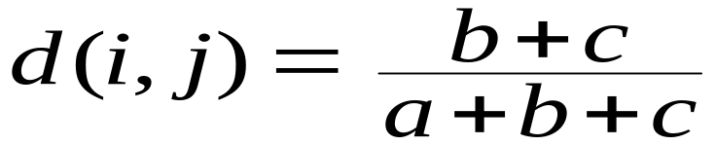
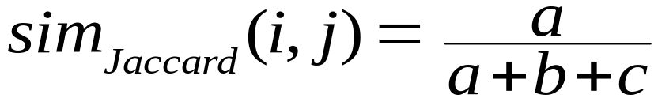
Distance measure for asymmetric binary variables
Object j
Object i
Jaccard coefficient = 1- d(i,j) =
Notes:
The 0-0 is not important → d does not occur in the formula

Slide 17


Dissimilarity between Binary Variables
Example
  gender is a symmetric attribute
  the remaining attributes are asymmetric binary
  → distance based on these
  let the values Y and P be set to 1, and the value N be set to 0

Slide 18

Nominal or Categorical Variables
Method 1: Simple matching
  m: # of matches, p: total # of variables
Method 2: use a large number of binary variables
  creating a new binary variable for each of the M nominal states

Slide 19


Ordinal Variables
An ordinal variable can be discrete or continuous
Order is important, e.g., rank
Can be treated like interval-scaled
  replace x_{if} by their rank
  map the range of each variable onto [0, 1] by replacing i-th object in the f-th variable by
  compute the dissimilarity using methods for interval-scaled variables
Notes:
Discrete: gold, silver, bonze medals
Continuous: exam grading

Slide 20
Ratio-Scaled Variables
Ratio-scaled variable: a positive measurement on a nonlinear scale, approximately at exponential scale, such as Ae^{Bt} or Ae^{-Bt}
Methods:
  treat them like interval-scaled variables—not a good choice! (why?—the scale can be distorted)
  apply logarithmic transformation
y_{if} = log(x_{if})
  treat them as continuous ordinal data, treat their rank as interval-scaled

Slide 21


Variables of Mixed Types
A database may contain all the six types of variables
  symmetric binary, asymmetric binary, nominal, ordinal, interval and ratio
One may use a weighted formula to combine their effects:
    f is binary or nominal:
      d_{ij}^{(f)} = 0 if x_{if} = x_{jf} , or d_{ij}^{(f)} = 1 otherwise
    f is interval-based: use the normalized distance
    f is ordinal or ratio-scaled
      compute ranks r_{if} and
      and treat z_{if} as interval-scaled
  delta(i,j) = 0 iff (i) x-value is missing or (ii) x-values are 0 and f asymmetric binary attribute
Notes:
OBS: delta
Delta is 0 if (1) xif or xjf is missing
or (2) xif=xjf=0 and asymmetric binary attribute
Otherwise delta=1

Slide 22

Vector Objects
Vector objects: keywords in documents, gene features in micro-arrays, etc.
Broad applications: information retrieval, biologic taxonomy, etc.
Cosine measure

Slide 23
Vector model for information retrieval (simplified)
Doc1 (1,1,0)
cloning
Doc2 (0,1,0)
Q (1,1,1)
adrenergic
sim(d,q) = d . q
|d| x |q|
receptor

Slide 24
Chapter 7. Cluster Analysis
What is Cluster Analysis?
Types of Data in Cluster Analysis
A Categorization of Major Clustering Methods
Partitioning Methods
Hierarchical Methods
Density-Based Methods

Slide 25
Major Clustering Approaches (I)
Partitioning approach:
  Construct various partitions and then evaluate them by some criterion, e.g., minimizing the sum of square errors
  Typical methods: k-means, k-medoids, CLARANS
Hierarchical approach:
  Create a hierarchical decomposition of the set of data (or objects) using some criterion
  Typical methods: Diana, Agnes, BIRCH, ROCK, CAMELEON
Density-based approach:
  Based on connectivity and density functions
  Typical methods: DBSCAN, OPTICS, DenClue

Slide 26
Major Clustering Approaches (II)
Grid-based approach:
  based on a multiple-level granularity structure
  Typical methods: STING, WaveCluster, CLIQUE
Model-based:
  A model is hypothesized for each of the clusters and tries to find the best fit of that model to each other
  Typical methods: EM, SOM, COBWEB
Frequent pattern-based:
  Based on the analysis of frequent patterns
  Typical methods: pCluster
User-guided or constraint-based:
  Clustering by considering user-specified or application-specific constraints
  Typical methods: COD (obstacles), constrained clustering

Slide 27
Typical Alternatives to Calculate the Distance between Clusters
Single link: smallest distance between an element in one cluster and an element in the other, i.e., dis(K_{i}, K_{j}) = min(t_{ip}, t_{jq})
Complete link: largest distance between an element in one cluster and an element in the other, i.e., dis(K_{i}, K_{j}) = max(t_{ip}, t_{jq})
Average: avg distance between an element in one cluster and an element in the other, i.e., dis(K_{i}, K_{j}) = avg(t_{ip}, t_{jq})
Centroid: distance between the centroids of two clusters, i.e., dis(K_{i}, K_{j}) = dis(C_{i}, C_{j})
Medoid: distance between the medoids of two clusters, i.e., dis(K_{i}, K_{j}) = dis(M_{i}, M_{j})
  Medoid: one chosen, centrally located object in the cluster

Slide 28
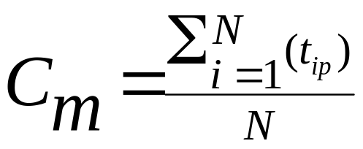
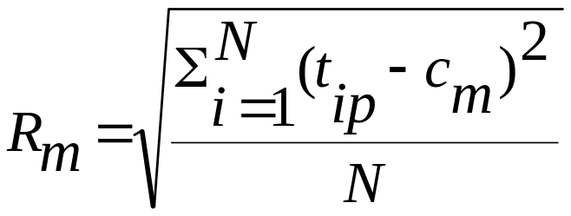

Centroid, Radius and Diameter of a Cluster (for numerical data sets)
Centroid: the “middle” of a cluster
Radius: square root of average distance from any point of the cluster to its centroid
Diameter: square root of average mean squared distance between all pairs of points in the cluster

Slide 29
Chapter 7. Cluster Analysis
What is Cluster Analysis?
Types of Data in Cluster Analysis
A Categorization of Major Clustering Methods
Partitioning Methods
Hierarchical Methods
Density-Based Methods

Slide 30
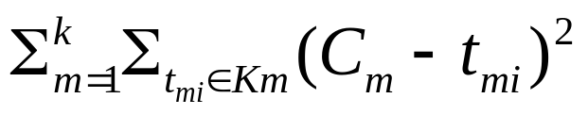
Partitioning Algorithms: Basic Concept
Partitioning method: Construct a partition of a database D of n objects into a set of k clusters, s.t., min sum of squared distance
Given a k, find a partition of k clusters that optimizes the chosen partitioning criterion
  Global optimal: exhaustively enumerate all partitions
  Heuristic methods: k-means and k-medoids algorithms
  k-means (MacQueen’67): Each cluster is represented by the center of the cluster
  k-medoids or PAM (Partition around medoids) (Kaufman & Rousseeuw’87): Each cluster is represented by one of the objects in the cluster

Slide 31
The K-Means Clustering Method
Given k, data D
1. arbitrarily choose k objects as initial cluster centers
2. Repeat
  Assign each object to the cluster to which the object is most similar based on mean values of the objects in the cluster
  Update cluster means (calculate mean value of the objects for each cluster)
Until no change

Slide 32
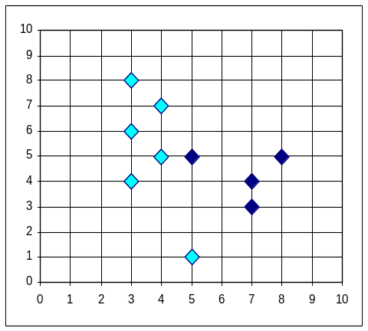


The K-Means Clustering Method
Example
10
10
9
9
8
8
7
7
6
6
5
5
4
Assign each object to most similar center
Update the cluster means
4
3
3
2
2
1
1
0
0
0
1
2
3
4
5
6
7
8
9
10
0
1
2
3
4
5
6
7
8
9
10
reassign
reassign
K=2
Arbitrarily choose K objects as initial cluster centers
Update the cluster means

Slide 33
Comments on the K-Means Method
Strength: Relatively efficient: O(tkn), where n is # objects, k is # clusters, and t is # iterations. Normally, k, t << n.
    Comparing: PAM: O(k(n-k)² ), CLARA: O(ks² + k(n-k))
Comment: Often terminates at a local optimum. The global optimum may be found using techniques such as: deterministic annealing and genetic algorithms
Weakness
  Applicable only when mean is defined, then what about categorical data?
  Need to specify k, the number of clusters, in advance
  Unable to handle noisy data and outliers
  Not suitable to discover clusters with non-convex shapes

Slide 34
What Is the Problem of the K-Means Method?
The k-means algorithm is sensitive to outliers !
  Since an object with an extremely large value may substantially distort the distribution of the data.
K-Medoids: Instead of taking the mean value of the object in a cluster as a reference point, medoids can be used, which is the most centrally located object in a cluster.
10
10
9
9
8
8
7
7
6
6
5
5
4
4
3
3
2
2
1
1
0
0
1
2
3
4
5
6
7
8
9
10
0
0
1
2
3
4
5
6
7
8
9
10

Slide 35
The K-Medoids Clustering Method
Find representative objects, called medoids, in clusters
PAM (Partitioning Around Medoids, 1987)
  starts from an initial set of medoids and iteratively replaces one of the medoids by one of the non-medoids if it improves the total distance of the resulting clustering
  PAM works effectively for small data sets, but does not scale well for large data sets
CLARA (Kaufmann & Rousseeuw, 1990)
CLARANS (Ng & Han, 1994): Randomized sampling

Slide 36

A Typical K-Medoids Algorithm (PAM) - idea
Total Cost = 20
10
9
8
Arbitrary choose k objects as initial medoids
Assign each remaining object to nearest medoids
7
6
5
4
3
2
1
0
0
1
2
3
4
5
6
7
8
9
10
K=2
Randomly select a nonmedoid object,O_{ramdom}
Total Cost = 26
Do loop
Until no change
10
10
9
Compute total cost of swapping
9
Swapping O and O_{ramdom}
If quality is improved.
8
8
7
7
6
6
5
5
4
4
3
3
2
2
1
1
0
0
1
2
3
4
5
6
7
8
9
10
0
0
1
2
3
4
5
6
7
8
9
10

Slide 37
PAM (Partitioning Around Medoids) (1987)
PAM (Kaufman and Rousseeuw, 1987)
Algorithm
  Select k representative objects arbitrarily
  For each pair of non-selected object h and selected object i, calculate the total swapping cost TC_{ih}
  Select a pair i and h, which corresponds to the minimum swapping cost
    If TC_{ih} < 0, i is replaced by h
    Then assign each non-selected object to the most similar representative object
  repeat steps 2-3 until there is no change

Slide 38
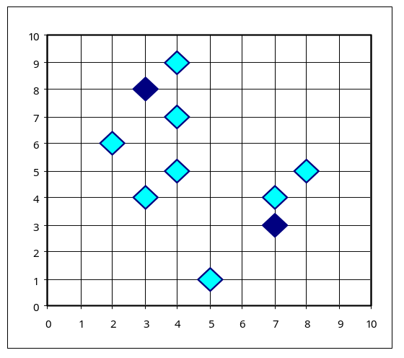
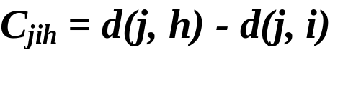

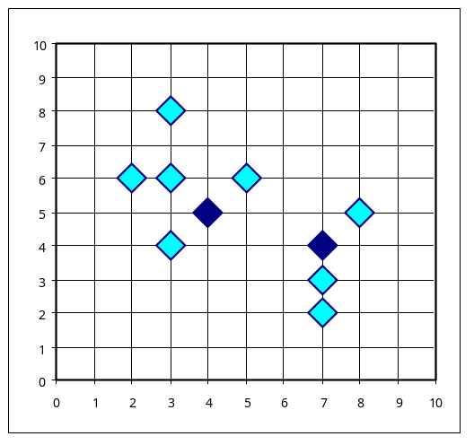
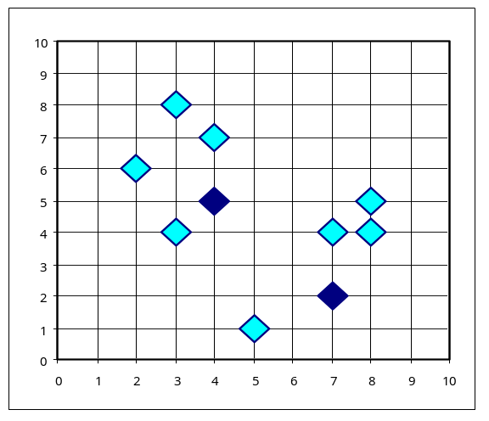


PAM Clustering: Total swapping cost TC_{ih}=∑_{j}C_{jih}
t
j
t
j
i
h
h
i
j
h
i
i
t
h
j
t

Slide 39
What Is the Problem with PAM?
Pam is more robust than k-means in the presence of noise and outliers because a medoid is less influenced by outliers or other extreme values than a mean
Pam works efficiently for small data sets but does not scale well for large data sets.
  O(k(n-k)² ) for each iteration
where n is # of data,k is # of clusters
Sampling based method,
CLARA(Clustering LARge Applications)

Slide 40
CLARA (Clustering Large Applications) (1990)
CLARA (Kaufmann and Rousseeuw in 1990)
  Built in statistical analysis packages, such as S+
It draws multiple samples of the data set, applies PAM on each sample, and gives the best clustering as the output
Strength: deals with larger data sets than PAM
Weakness:
  Efficiency depends on the sample size
  A good clustering based on samples will not necessarily represent a good clustering of the whole data set if the sample is biased
Notes:
5 samples of size 40+2k give satisfactory results

Slide 41
CLARA (Clustering Large Applications) (1990)
Algorithm (n=5, s = 40+2k)
  Repeat n times:
    Draw sample of s objects from the entire data set and perform PAM to find k mediods of the sample
    assign each non-selected object in the entire data set to the most similar mediod
    Calculate average dissimilarity of the clustering. If the value is smaller than the current minimum, use this value as current minimum and retain the k medoids as best so far.
Notes:
5 samples of size 40+2k give satisfactory results

Slide 42
Graph abstraction
…
…
…
…
Node represents k objects (medoids), a potential solution
for the clustering.
Nodes are neighbors if the sets of objects differ by one object.
Each node has k(n-k) neighbors.
Cost differential between two neighbors is TCih
(with Oi and Oh are the differing nodes in the mediod sets)

Slide 43
Graph Abstraction
PAM searches for node in the graph with minimum cost
CLARA searches in smaller graphs (as it uses PAM on samples of the entire data set)
CLARANS
  Searches in the original graph
  Searches part of the graph
  Uses the neighbors to guide the search

Slide 44
CLARANS (“Randomized” CLARA) (1994)
CLARANS (A Clustering Algorithm based on Randomized Search) (Ng and Han’94)
It is more efficient and scalable than both PAM and CLARA

Slide 45
CLARANS (“Randomized” CLARA) (1994)
Algorithm
  Numlocal: number of local minima to be found
  Maxneighbor: maximum number of neighbors to compare
  Repeat numlocal times: (find local minimum)
    Take arbitrary node in the graph
    Consider random neighbor S of the current node and calculate the cost differential. If S has lower cost, then set S to current and repeat this step. If S does not have lower cost, repeat this step (check at most Maxneighbor neighbors)
    Compare the cost of current node with minimum cost so far. If the cost is lower, set minumum cost to cost of the current node, and bestnode to the current node.

Slide 46
Chapter 7. Cluster Analysis
What is Cluster Analysis?
Types of Data in Cluster Analysis
A Categorization of Major Clustering Methods
Partitioning Methods
Hierarchical Methods
Density-Based Methods

Slide 47
Hierarchical Clustering
Use distance matrix as clustering criteria. This method does not require the number of clusters k as an input, but needs a termination condition
Step 0
Step 1
Step 2
Step 3
Step 4
agglomerative
(AGNES)
a
a b
b
a b c d e
c
c d e
d
d e
e
divisive
(DIANA)
Step 4
Step 3
Step 2
Step 1
Step 0

Slide 48
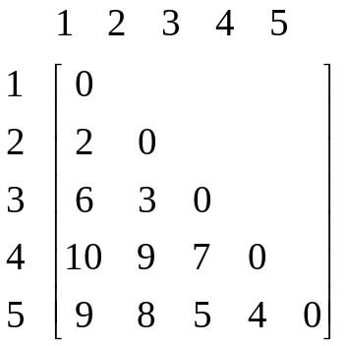
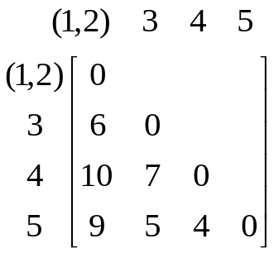
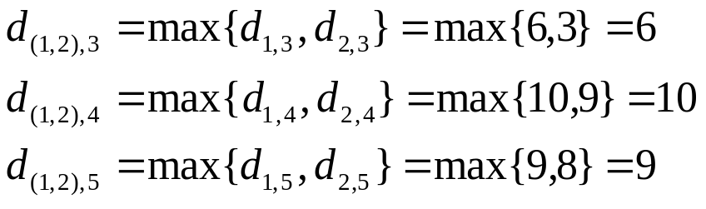
Complete-link Clustering Example
5
4
3
2
2
1
Notes:
First I explain the complete-link clustering
We have five objects. We already have the distance matrix of these object.
First each object is a cluster. Then select two most similar object into a cluster.
Then the distance between clusters is defined as the longest distance between the members of clusters.

Slide 49
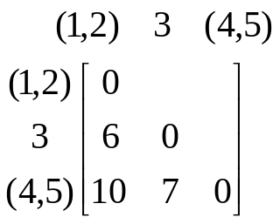
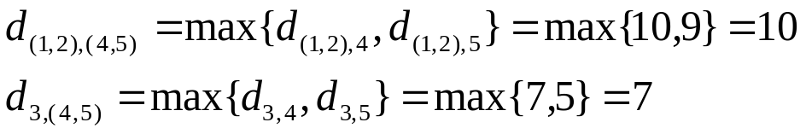
Complete-link Clustering Example
4
5
4
3
2
2
1
Notes:
Continue the process until we get a tree structure like this.

Slide 50

Complete-link Clustering Example
4
5
10
4
6
3
2
2
1
th=9
th=5
Notes:
Tree data structure is called dendrogram.
Then given the different thresholds, like the maximun distance between the objects in a cluster, we can cutting the dendrogram in different ways.
For example, if the threshold is 9, we can get two clusters.

Slide 51
AGNES (Agglomerative Nesting)
Introduced in Kaufmann and Rousseeuw (1990)
Implemented in statistical analysis packages, e.g., Splus
Use the Single-Link method and the dissimilarity matrix.
Merge nodes that have the least dissimilarity
Go on in a non-descending fashion
Eventually all nodes belong to the same cluster

Slide 52
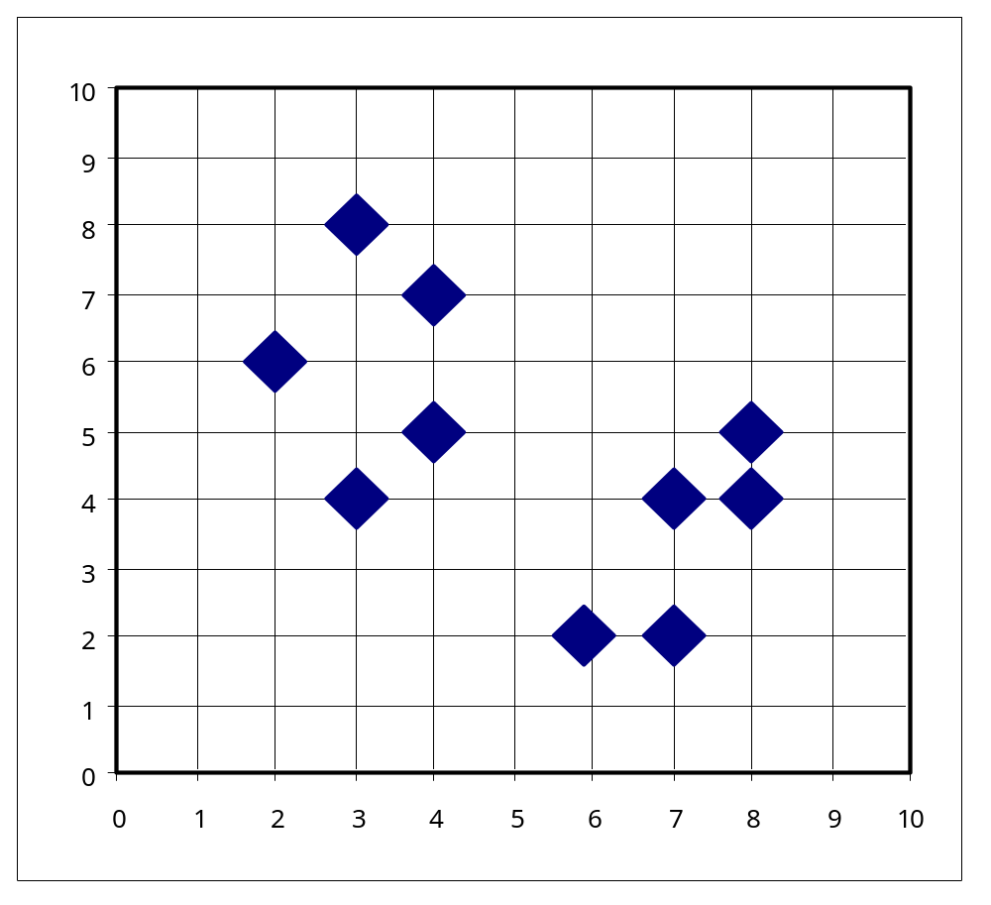
AGNES (Agglomerative Nesting)

Slide 53
Dendrogram: Shows How the Clusters are Merged
  Decompose data objects into a several levels of nested partitioning (tree of clusters), called a dendrogram.
  A clustering of the data objects is obtained by cutting the dendrogram at the desired level, then each connected component forms a cluster.

Slide 54
DIANA (Divisive Analysis)
Introduced in Kaufmann and Rousseeuw (1990)
Implemented in statistical analysis packages, e.g., Splus
Inverse order of AGNES
Eventually each node forms a cluster on its own

Slide 55
Recent Hierarchical Clustering Methods
Major weakness of agglomerative clustering methods
  do not scale well: time complexity of at least O(n²), where n is the number of total objects
  can never undo what was done previously
Integration of hierarchical with distance-based clustering
  BIRCH (1996): uses CF-tree and incrementally adjusts the quality of sub-clusters
  ROCK (1999): clustering categorical data by neighbor and link analysis
  CHAMELEON (1999): hierarchical clustering using dynamic modeling

Slide 56
BIRCH (1996)
Birch: Balanced Iterative Reducing and Clustering using Hierarchies (Zhang, Ramakrishnan & Livny, SIGMOD’96)
Incrementally construct a CF (Clustering Feature) tree, a hierarchical data structure for multiphase clustering
  Phase 1: scan DB to build an initial in-memory CF tree (a multi-level compression of the data that tries to preserve the inherent clustering structure of the data)
  Phase 2: use an arbitrary clustering algorithm to cluster the leaf nodes of the CF-tree
Scales linearly: finds a good clustering with a single scan and improves the quality with a few additional scans
Weakness: handles only numeric data, and sensitive to the order of the data record, not always natural clusters.
Notes:
Sensitive to order of data → leaf to which it belongs can differ
Natural clusters→ sometimes two subclusters that should belong to a cluster are in different nodes

Slide 57

Clustering Feature Vector in BIRCH
Clustering Feature: CF = (N, LS, SS)
N: Number of data points
LS: ∑ ^{N}_{i=1}=X_{i}
SS: ∑ ^{N}_{i=1}=X_{i}²
CF = (5, (16,30),(54,190))
(3,4)
(2,6)
(4,5)
(4,7)
(3,8)

Slide 58

CF-Tree in BIRCH
Clustering feature:
  summary of the statistics for a given subcluster: the 0-th, 1st and 2nd moments of the subcluster from the statistical point of view.
  registers crucial measurements for computing cluster and utilizes storage efficiently
A CF tree is a height-balanced tree that stores the clustering features for a hierarchical clustering
  A nonleaf node in a tree has children and stores the sums of the CFs of their children
  A nonleaf node represents a cluster made of the subclusters represented by its children
  A leaf node represents a cluster made of the subclusters represented by its entries
A CF tree has two parameters
  Branching factor: specify the maximum number of children.
  threshold: max diameter of sub-clusters stored at the leaf nodes
Notes:
Objects in the cluster do not need to be stored, only feature is stored to represent the cluster
Hierarchical clustering: if two clusters are merged then (N,LS,SS) = (N1+N2, LS1+LS2, SS1+SS2)

Slide 59
The CF Tree Structure
Root
B = 6
T = 7
CF₁
CF₂
CF₃
CF₆
child₁
child₂
child₃
child₆
Non-leaf node
CF₁
CF₂
CF₃
CF₅
child₁₁
child₁₂
child₁₃
child₁₅
Leaf node
Leaf node
prev
CF_{a}
CF_{b}
CF_{k}
next
prev
CF_{l}
CF_{m}
CF_{q}
next
Notes:
Branching factor: maximum number of children per nonleaf node
Threshold: maximum diameter of subclusters stored at leaf nodes

Slide 60
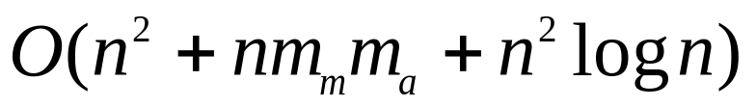
ROCK: Clustering Categorical Data
ROCK: RObust Clustering using linKs
  S. Guha, R. Rastogi & K. Shim, ICDE’99
Major ideas
  Use links to measure similarity/proximity
  maximize the sum of the number of links between points within a cluster, minimize the sum of the number of links for points in different clusters
  Computational complexity:

Slide 61

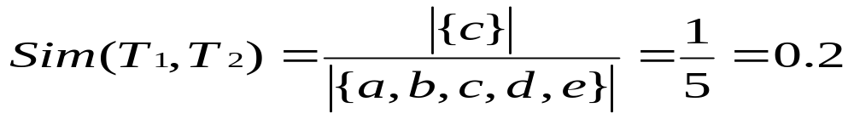
Similarity Measure in ROCK
Traditional measures for categorical data may not work well, e.g., Jaccard coefficient
Example: Two groups (clusters) of transactions
  C₁. <a, b, c, d, e>: {a, b, c}, {a, b, d}, {a, b, e}, {a, c, d}, {a, c, e}, {a, d, e}, {b, c, d}, {b, c, e}, {b, d, e}, {c, d, e}
  C₂. <a, b, f, g>: {a, b, f}, {a, b, g}, {a, f, g}, {b, f, g}
Jaccard coefficient may lead to wrong clustering result
  C₁: 0.2 ({a, b, c}, {b, d, e}} to 0.5 ({a, b, c}, {a, b, d})
  C₁ & C₂: could be as high as 0.5 ({a, b, c}, {a, b, f})
Jaccard coefficient-based similarity function:
  Ex. Let T₁ = {a, b, c}, T₂ = {c, d, e}
Notes:
The grouping C1,C2 cannot be obtained using minimal distance clustering as abc and abf may be taken first.
C1: zero in common→doesn’t occur
one in common→ 1-1 1-0 1-0 0-1 0-1: 1/5 and 0-0 0-0 (for f,g)
two in common→ 1-1 1-1 1-0 0-1 0-0: 2/4 and 0-0 0-0 (for f,g)

Slide 62
Link Measure in ROCK
Neighbor: p1 and p2 are neighbors
iff sim(p1,p2) >= t
(sim and t between 0 and 1)
Link(pi,pj) is the number of common neighbors between pi and pj

Slide 63
Link Measure in ROCK
Links: # of common neighbors
  C₁ <a, b, c, d, e>: {a, b, c}, {a, b, d}, {a, b, e}, {a, c, d}, {a, c, e}, {a, d, e}, {b, c, d}, {b, c, e}, {b, d, e}, {c, d, e}
  C₂ <a, b, f, g>: {a, b, f}, {a, b, g}, {a, f, g}, {b, f, g}
Let T₁ = {a, b, c}, T₂ = {c, d, e}, T₃ = {a, b, f} and sim the Jaccard coefficient similarity and t=0.5
  link(T_{1,} T₂) = 4, since they have 4 common neighbors
    {a, c, d}, {a, c, e}, {b, c, d}, {b, c, e}
  link(T_{1,} T₃) = 5, since they have 5 common neighbors
    {a, b, d}, {a, b, e}, {a, b, g}, {a, b, c}, {a, b, f}
Notes:
Neighbors of abc: abd, abe, acd, ace, bcd, bce, abf, abg
Neighbors of cde: acd, ace, ade, bcd, bce, bde
Neighbors of abf: abc, abd, abe, abg, afg, bfg

Slide 64
Link Measure in ROCK
Link(Ci,Cj) = the number of cross links between clusters Ci and Cj
G(Ci,Cj) = goodness measure for merging Ci and Cj = Link(Ci,Cj) divided by the expected number of cross links

Slide 65
The ROCK Algorithm
Algorithm: sampling-based clustering
  Draw random sample
  Hierarchical clustering with links using goodness measure of merging
  Label data in disk: a point is assigned to the cluster for which it has the most neighbors after normalization
Notes:
Normalization: divide number of neighbors by (|Li|+1)-to-the-power-f(t), which is the number of expected neighbors for p in cluster Li

Slide 66
CHAMELEON: Hierarchical Clustering Using Dynamic Modeling (1999)
CHAMELEON: by G. Karypis, E.H. Han, and V. Kumar’99
Measures the similarity based on a dynamic model
  Two clusters are merged only if the interconnectivity and closeness (proximity) between two clusters are high relative to the internal interconnectivity of the clusters and closeness of items within the clusters
A two-phase algorithm
  Use a graph partitioning algorithm: cluster objects into a large number of relatively small sub-clusters
  Use an agglomerative hierarchical clustering algorithm: find the genuine clusters by repeatedly combining these sub-clusters

Slide 67
Overall Framework of CHAMELEON
Construct
Sparse Graph
Partition the Graph
Data Set
Merge Partition
Final Clusters

Slide 68
CHAMELEON: Hierarchical Clustering Using Dynamic Modeling (1999)
A two-phase algorithm
  Use a graph partitioning algorithm: cluster objects into a large number of relatively small sub-clusters
    Based on k-nearest neighbor graph
    Edge between two nodes if points corresponding to either of the nodes are among the k-most similar points of the point corresponding to the other node
    Edge weight is density of the region
    Dynamic notion of neighborhood: in regions with high density, a neighborhood radius is small, while in sparse regions the neighborhood radius is large

Slide 69
CHAMELEON: Hierarchical Clustering Using Dynamic Modeling (1999)
A two-phase algorithm
  Use an agglomerative hierarchical clustering algorithm: find the genuine clusters by repeatedly combining these sub-clusters
    Interconnectivity between clusters Ci and Cj: normalized sum of the weights of the edges that connect nodes in Ci and Cj
    Closeness of clusters Ci and Cj: average similarity between points in Ci that are connected to points in Cj
    Merge if both measures are above user-defined thresholds
Notes:
Interconnectivity: normalization: divide by average of internal-interconnectivity(Ci) and internal-interconnectivity(Cj)
internal connectivity: sum of the edges that partition the graph into roughly two equal parts

Slide 70

CHAMELEON (Clustering Complex Objects)

Slide 71
Chapter 7. Cluster Analysis
What is Cluster Analysis?
Types of Data in Cluster Analysis
A Categorization of Major Clustering Methods
Partitioning Methods
Hierarchical Methods
Density-Based Methods

Slide 72
Density-Based Clustering Methods
Clustering based on density (local cluster criterion), such as density-connected points
Major features:
  Discover clusters of arbitrary shape
  Handle noise
  One scan
  Need density parameters as termination condition
Several interesting studies:
  DBSCAN: Ester, et al. (KDD’96)
  OPTICS: Ankerst, et al (SIGMOD’99).
  DENCLUE: Hinneburg & D. Keim (KDD’98)
  CLIQUE: Agrawal, et al. (SIGMOD’98) (more grid-based)

Slide 73
Density-Based Clustering: Basic Concepts
Two parameters:
  Eps: Maximum radius of the neighborhood
  MinPts: Minimum number of points in an Eps-neighborhood of that point
N_{Eps}(p): {q belongs to D | dist(p,q) <= Eps}
Directly density-reachable: A point p is directly density-reachable from a point q w.r.t. Eps, MinPts if
  p belongs to N_{Eps}(q)
  core point condition:
  |N_{Eps} (q)| >= MinPts
p
MinPts = 5
Eps = 1 cm
q
Notes:
P directly density reachable from q
Q NOT directly density reachable from p, because p is not a core point

Slide 74
Density-Reachable and Density-Connected
Density-reachable:
  A point p is density-reachable from a point q w.r.t. Eps, MinPts if there is a chain of points p₁, …, p_{n}, p₁ = q, p_{n} = p such that p_{i+1} is directly density-reachable from p_{i}
Density-connected
  A point p is density-connected to a point q w.r.t. Eps, MinPts if there is a point o such that both, p and q are density-reachable from o w.r.t. Eps and MinPts
p
p₁
q
p
q
o
Notes:
Q directly density reachable from p1
P1 directly density reachable from q
P directly density reachable from p1 (not vice versa because p not core)
P density reachable from q (via p1 which is also core)
---------------------
O, p, q all density connected

Slide 75
DBSCAN: Density Based Spatial Clustering of Applications with Noise
Relies on a density-based notion of cluster: A cluster is defined as a maximal set of density-connected points
Discovers clusters of arbitrary shape in spatial databases with noise
Outlier
Border
Eps = 1cm
MinPts = 5
Core

Slide 76
DBSCAN: The Algorithm
Arbitrary select a point p
Retrieve all points density-reachable from p w.r.t. Eps and MinPts.
If p is a core point, a cluster is formed.
If p is a border point, no points are density-reachable from p and DBSCAN visits the next point of the database.
Continue the process until all of the points have been processed.

Slide 77



DBSCAN: Sensitive to Parameters

Slide 78
CHAMELEON (Clustering Complex Objects)

Slide 79
OPTICS: A Cluster-Ordering Method (1999)
OPTICS: Ordering Points To Identify the Clustering Structure
  Ankerst, Breunig, Kriegel, and Sander (SIGMOD’99)
  Produces a special order of the database wrt its density-based clustering structure
  This cluster-ordering contains info equivalent to the density-based clusterings corresponding to a broad range of parameter settings
  Good for both automatic and interactive cluster analysis, including finding intrinsic clustering structure
  Can be represented graphically or using visualization techniques

Slide 80
OPTICS: Some Extension from DBSCAN
Core Distance of p wrt MinPts: smallest distance eps’ between p and an object in its eps-neighborhood such that p would be a core object for eps’ and MinPts. Otherwise, undefined.
Reachability Distance of p wrt o: Max (core-distance (o), d (o, p)) if o is core object. Undefined otherwise
p1
o
p2
Max (core-distance (o), d (o, p))
r(p1, o) = 1.5cm. r(p2,o) = 4cm
MinPts = 5
ε = 3 cm

Slide 81
OPTICS
(1) Select non-processed object o
(2) Find neighbors (eps-neighborhood)
Compute core distance for o
Write object o to ordered file and mark o as processed
If o is not a core object, restart at (1)
(o is a core object …)
Put neighbors of o in Seedlist and order
  If neighbor n is not yet in SeedList then add (n, reachability from o) else if reachability from o < current reachability, then update reachability + order SeedList wrt reachability
Take new object from Seedlist with smallest reachability and restart at (2)

Slide 82
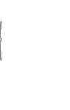

Reachability-distance
undefined
‘
Cluster-order
of the objects
Notes:
Reachability distance: to the closest core from which they are directly density-reachable

Slide 83
DENCLUE: Using Statistical Density Functions
DENsity-based CLUstEring by Hinneburg & Keim (KDD’98)
Using statistical density functions
Major features
  Solid mathematical foundation
  Good for data sets with large amounts of noise
  Allows a compact mathematical description of arbitrarily shaped clusters in high-dimensional data sets
  Significant faster than existing algorithm (e.g., DBSCAN)
  But needs a large number of parameters

Slide 84



Denclue: Technical Essence
Uses grid cells but only keeps information about grid cells that do actually contain data points and manages these cells in a tree-based access structure
Influence function: describes the impact of a data point within its neighborhood
Overall density of the data space can be calculated as the sum of the influence function of all data points
Clusters can be determined mathematically by identifying density attractors. Density attractors are local maxima of the overall density function

Slide 85



Density Attractor

Slide 86
Denclue: Technical Essence
Significant density attractor for threshold k: density attractor with density larger than or equal to k
Set of significant density attractors X for threshold k: for each pair of density attractors x1, x2 in X there is a path from x1 to x2 such that each point on the path has density larger than or equal to k
Center-defined cluster for a significant density attractor x for threshold k: points that are density attracted by x
  Points that are attracted to a density attractor with density less than k are called outliers
Arbitrary-shape cluster for a set of significant density attractors X for threshold k: points that are density attracted to some density attractor in X

Slide 87

Center-Defined and Arbitrary
Notes:
Ksi defines

