Slide 1

Identifying influential nodes in complex networks (2011)
Duanbing Chena, Linyuan Lüb, Ming-Sheng Shanga, Yi-Cheng Zhanga, Tao Zhoua,
Presented by Carles Sans Fuentes
Social Network Analysis

Slide 2

Introduction to social network analysis
Content for network analysis
Article
Model presented
SIR evaluation model
Results
Conclusions & Criticism
Annex
Social Network Analysis

Slide 3
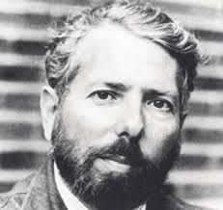
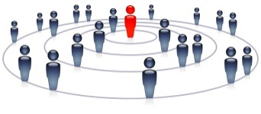


THE FIRST RELLEVANT STUDY ABOUT DEGREES OF SEPARATION ON SOCIETY DATES FROM 1960
Introduction to social network analysis
The Small World experiment (1960)
SET UP
RESULTS
Objective
Average path length for social networks of people in the US
Reaching the destination
78% didn’t reach destination (232 of the 296 letters )
large % rejection of on participation
22% (64 of the letters) eventually did reach the target contact
Instructions
Send to "randomly" selected individuals (from Nebraska or Kansas) information packets:
study's purpose
target contact person
Rules
Main Rule:
If( knew person == TRUE){
forward the letter directly
} Else {
think of a friend or who was more likely to know the target
}
CONCLUSIONS
Average path length
6 degrees of separation
Hub people
50% letters from Kansas had the same two people as last contact
The average degree of separation between people was determined to be 6
Sources:
(1) Milgram, Stanley (May 1967). "The Small World Problem". Psychology Today. Ziff-Davis Publishing Co.
(2) Blass, T. (2004). The Man Who Shocked the World: The Life and Legacy of Stanley Milgram.
ISBN 0-7382-0399-8
Social Network Analysis
Notes:
Stanley Milgram (August 15, 1933 – December 20, 1984) was an American social psychologist, best known for his controversial experiment on obedience conducted in the 1960s during his professorship at Yale.^{[4]} Milgram was influenced by the events of the Holocaust, especially the trial of Adolf Eichmann, in developing the experiment.
After earning a Ph.D. in social psychology from Harvard University, he taught at Yale, Harvard, and then for most of his career as a professor at the City University of New York Graduate Center, until he died in 1984. His small-world experiment while at Harvard led researchers to analyze the degree of connectedness, including the six degrees of separation concept. Later in his career, Milgram developed a technique for creating interactive hybrid social agents (cyranoids), which has since been used to explore aspects of social- and self-perception.
He is widely regarded as one of the most important figures in the history of social psychology. A Review of General Psychology survey, published in 2002, ranked Milgram as the 46th-most-cited psychologist of the 20th century.^{[5]}
sent letters to just under 300 randomly selected people in Nebraska and Kansas, asking them to help ensure that the letter made its way to a "target person" - a named stockbroker in Boston.
Participants were asked not to send the letter directly to the stockbroker. Instead, everyone was allowed to send it only to someone whom they knew on first-name terms and who they thought might know the stockbroker.
Twenty-nine per cent of the parcels eventually reached the stockbroker. Amazingly, given the tens of millions of people in America, there tended to be just six people linking the initial volunteer and the target person - thus giving rise to the popular notion that we are all maybe connected by just six degrees of separation.

Slide 4
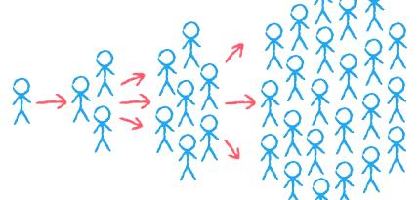


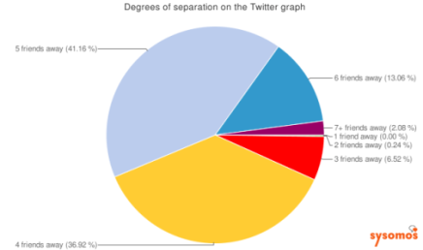

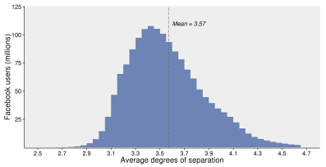

DURING THE LAST DECADES THE DEGREES OF SEPARATION AMONG INTERNET USERS HAS SHRUNKED BETWEEN 3 AND 5
Introduction to social network analysis
Main facts about social network connections through the last decade
2005
2010
2015
2020
6,6 steps was the average path length among Messenger users in Microsoft (2008) ⁽¹⁾
4,67 steps are the most common friendship distance in Twitter (2010) ⁽¹⁾
3,57 steps are the average on how a person is connected to every other person in Facebook (2016) ⁽²⁾
Sources:
(1) https://sysomos.com/inside-twitter/twitter-friendship-data/ ;
http://barnraisersllc.com/2012/04/studies-social-media-6-degrees-of-separatio/
(2) https://research.fb.com/three-and-a-half-degrees-of-separation/
Social Network Analysis

Slide 5
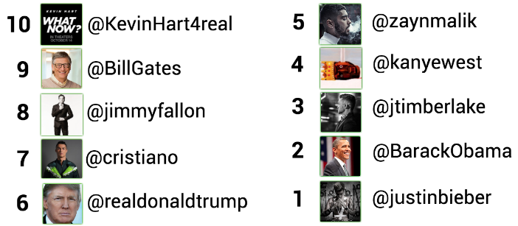
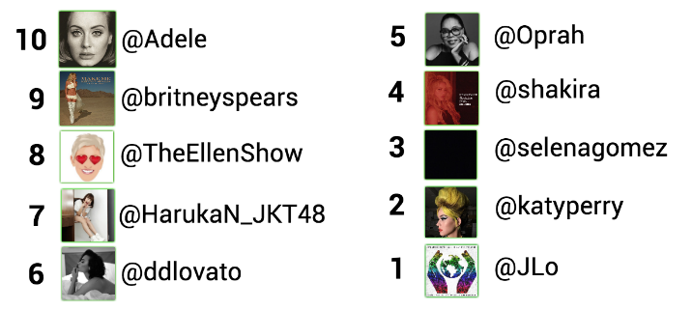


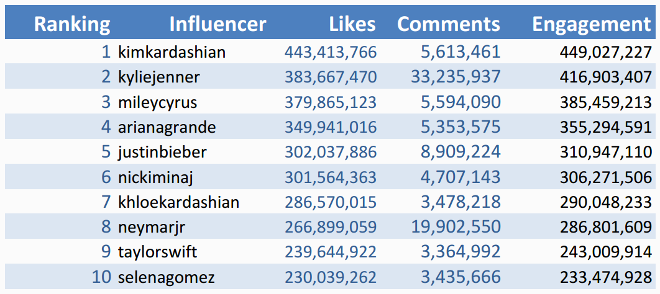
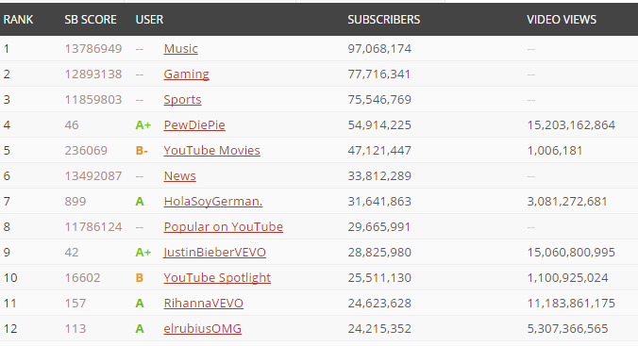
UNDERSTANDING SOCIAL NETWORKS IS CRUCIAL TO EVALUATE HUBBS AND THE POWER OF ITS NODES
Introduction to social network analysis
Top 10 most influential Man
Top 10 most influential Women
By Brandwatch 2016 ⁽¹⁾
Top 10 influential channels
Top 12 influential channels by Subscribers
By Instagram 2015⁽²⁾
By SocialBlade 2016⁽³⁾
Sources:
(1) https://www.brandwatch.com/blog/react-the-most-influential-men-and-women-on-twitter/
(2):http://www.edigitalagency.com.au/instagram/top-most-popular-instagram-influencers-video-creators/
(3) https://socialblade.com/youtube/top/100/mostsubscribed
Social Network Analysis
Notes:
https://www.brandwatch.com/blog/react-the-most-influential-men-and-women-on-twitter/

Slide 6
Introduction to social network analysis
Content for network analysis
Article
Model presented
SIR evaluation model
Results
Conclusions & Criticism
Annex
Social Network Analysis

Slide 7
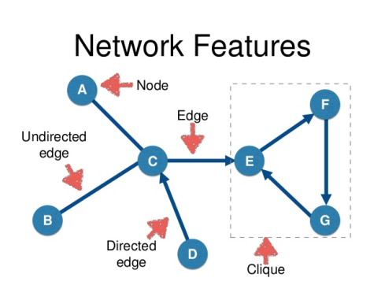
A NETWORK GRAPH IS A COLLECTION OF ENTITIES, EACH CALLED A VERTEX OR NODE
Content for network analysis
Main characteristics of a network/graph
Definition
Examples
Network
(graph)
Vertex/
Node
Collection of entities, each called a vertex or node
Vertices are mathematicians, edges represent coauthorship relationships
Vertices are Facebook users, edges represent Facebook friendships
Edges/
Links
A list of pairs of vertices that are neighbors, representing edges or links
Type of edges
Directed
Edges have a direction associated with them
Illustrative
Undirected
Edges does not have a direction associated Bidirecttional
Weighted
Edges have a weight associated with them
Unweighted
Edges does not have a weight associated Bidirecttional
Networks can represent any binary relationship over individuals
Sources:
http://www.cis.upenn.edu/~mkearns/NetworkedLifeOnline/ → what is a network ?
https://www.slideshare.net/bodacea/network-analysis-lecture
Social Network Analysis
Notes:
http://learn.addshoppers.com/2014/
http://www.businessinsider.com/social-commerce-2015-report-2015-6
Internet Retailer’s Social Media Report 2014
http://www.monetate.com/resources/research/
http://www.monetate.com/blog/conversion-rates-from-facebook-twitter-has-more-than-doubled-since-2011/

Slide 8
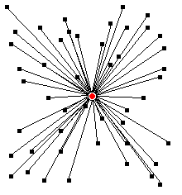
INFLUENTIAL NODES ARE AFFECTED BY MECHANISMS SUCH AS CASCADING, SPREADING AND SYNCHRONIZING
Content for network analysis
When a person observes the actions of others and then engages in the same acts¹
Cascading
How information is transmitted to new nodes from an initial node²
Spreading
Nodes that are able to transmit and receiving information with regular frequency³
Synchronizing
Identifying influential nodes is of great importance:
e.g. controlling rumor and disease spreading, and creating new marketing tools
Sources:
https://en.wikipedia.org/wiki/Information_cascade
https://en.wikipedia.org/wiki/Spreading_activation
https://www.techopedia.com/definition/13390/synchronization-dot-net
Social Network Analysis
Notes:
An information (or informational) cascade occurs when a person observes the actions of others and then – despite possible contradictions in his/her own private information signals – engages in the same acts. A cascade develops when people "abandon their own information in favor of inferences based on earlier people's actions".^{[1]} Information cascades provide an explanation for how such situations can occur, how likely they are to cascade incorrect information or actions, how such behavior may arise and desist rapidly, and how effective attempts to originate a cascade tend to be under different conditions.^{[2]} By explaining all of these things, the original Independent Cascade model sought to improve on previous models that were unable to explain cascades of irrational behavior, a cascade's fragility, or the short-lived nature of certain cascades.
There are five key conditions in an information cascade model:
There is a decision to be made – for example, whether to adopt a new technology, wear a new style of clothing, eat in a new restaurant, or support a particular political position
A limited action space exists (e.g. an adopt/reject decision).^{[3]}
People make the decision sequentially, and each person can observe the choices made by those who acted earlier
Each person has some private information that helps guide their decision.
A person can't directly observe the private information that other people know, but he or she can make inferences about this private information from what they do.
One assumption of Information Cascades which has been challenged is the concept that agents always make rational decisions. More social perspectives of cascades, which suggest that agents may act irrationally (e.g., against what they think is optimal) when social pressures are great, exist as complements to the concept of Information Cascades.^{[4]}While competing models exist, it is more often the problem that the concept of an information cascade is conflated with ideas which do not match the two key conditions of the model, such as social proof, information diffusion,^{[5]} and social influence. Indeed, the term information cascade has even been used to refer to such processes.^{[6]}

Slide 9





DEGREE, CLOSENNESS AND BETWEENNES CENTRALITY ARE MEASURES USED TO IDENTIFY INFLUENTIAL CENTRAL NODES
Content for network analysis
Main centrality measures
Definition
Example
Average degree of a network¹
Average number of steps along the shortest paths for all possible pairs of network nodes
C_{c}(b) = d(b, a) + d(b, c) + d(b, d) + d(b, e)) / 4) = (1 + 1 + 1 + 2) = 5/4 = 1.2
Illustrative
Degree Centrality
The number of neighbours a node has (e.g. the number of links it has)
C_{D}(b) = A, C, D /A, C,D, E = 3/4 = 0.75
O(n^2)
Betweenness Centrality
Fraction of shortest paths between node pairs that pass through the node of interest.
C_{b}(b) = ((σ_{ac}(b) / σ_{ac}) + (σ_{ad}(b) / σ_{ad}) + (σ_{ae}(b) / σ_{ae}) + (σ_{cd}(b) / σ_{cd}) + (σ_{ce}(b) / σ_{ce}) + (σ_{de}(b) / σ_{de})) / 6 = ((1 / 1) + (1 / 1) + (2 / 2) + (1 / 2) + 0 + 0) / 6 = 3.5 / 6
C
O(n^3)
A
B
E
D
Closeness Centrality
The reciprocal of the sum of geodesic distances to all other nodes of V
C_{c}(b) = 1/ ( (L(b, a) + L(b, c) + L(b, d) + L(b, e)) / 4) = 4/ (1 + 1 + 1 + 2) = 4/5 = 0.8
O(n^2*⟨k⟩)
⟨k⟩ is the average degree of the network
Better at quantifying the influence of nodes, but higher computational complexity²
It exists a tradeoff between the algorithm of centrality used and the computational complexity
Average degree of a network is not itself a measure of centrality but to understand the article
Centralities based on PageRank or LeaderRank are even more relevant, but more complex
Sources: http://med.bioinf.mpi-inf.mpg.de/netanalyzer/help/2.7/
Social Network Analysis
Notes:
There are five key conditions in an information cascade model:
There is a decision to be made – for example, whether to adopt a new technology, wear a new style of clothing, eat in a new restaurant, or support a particular political position
A limited action space exists (e.g. an adopt/reject decision).^{[3]}
People make the decision sequentially, and each person can observe the choices made by those who acted earlier
Each person has some private information that helps guide their decision.
A person can't directly observe the private information that other people know, but he or she can make inferences about this private information from what they do.
One assumption of Information Cascades which has been challenged is the concept that agents always make rational decisions. More social perspectives of cascades, which suggest that agents may act irrationally (e.g., against what they think is optimal) when social pressures are great, exist as complements to the concept of Information Cascades.^{[4]}While competing models exist, it is more often the problem that the concept of an information cascade is conflated with ideas which do not match the two key conditions of the model, such as social proof, information diffusion,^{[5]} and social influence. Indeed, the term information cascade has even been used to refer to such processes.^{[6]}

Slide 10
Introduction to social network analysis
Content for network analysis
Article
Model presented
SIR evaluation model
Results
Conclusions & Criticism
Annex
Social Network Analysis

Slide 11
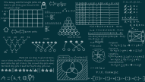

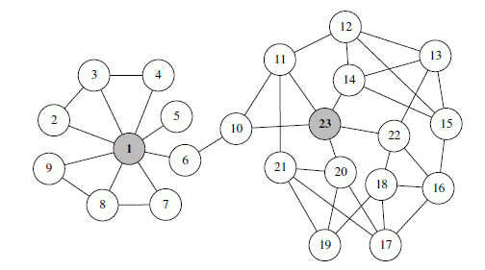


THE LOCAL CENTRALITY MEASURE CONSIDERS BOTH THE NEAREST NEIGHTBORS AND THE NEXT NEAREST NEIGHBORS
Article- model presented
Main Issue
Solution model proposed
Finding better algorithm with less complexity
Local centrality measure
Example from Figure 1
It considers both the nearest and the next nearest neighbors
The local centrality CL(v) of node v is defined as:
N(1) = 9
Q(1) = N(2) + N(3) + N(4) + N(5) + N(6) + N(7) + N(8) + N(9) = 67
where Γ (u) is the set of the nearest neighbors of node u and N(w) is the number of the nearest and the next nearest neighbors of node w. Then:
C_{L}(1) = Q(2)+Q(3)+Q(4)+Q(5)+Q(6)+Q(7)+ Q(8) +Q(9) = 145
Figure 1 from the article
Degree centrality problem: The network consisted of 23 nodes and 40 edges. Although node 23 has lower degree than node 1, its influence may be even higher
Theoretical advantages
Tradeoff between low-relevant degree centrality and other time-consuming measures
O(n*⟨k⟩^2) which grows linearly with the size of a sparse network
It considers two neighbors level for the importance of spreading
Social Network Analysis
Notes:
An information (or informational) cascade occurs when a person observes the actions of others and then – despite possible contradictions in his/her own private information signals – engages in the same acts. A cascade develops when people "abandon their own information in favor of inferences based on earlier people's actions".^{[1]} Information cascades provide an explanation for how such situations can occur, how likely they are to cascade incorrect information or actions, how such behavior may arise and desist rapidly, and how effective attempts to originate a cascade tend to be under different conditions.^{[2]} By explaining all of these things, the original Independent Cascade model sought to improve on previous models that were unable to explain cascades of irrational behavior, a cascade's fragility, or the short-lived nature of certain cascades.
There are five key conditions in an information cascade model:
There is a decision to be made – for example, whether to adopt a new technology, wear a new style of clothing, eat in a new restaurant, or support a particular political position
A limited action space exists (e.g. an adopt/reject decision).^{[3]}
People make the decision sequentially, and each person can observe the choices made by those who acted earlier
Each person has some private information that helps guide their decision.
A person can't directly observe the private information that other people know, but he or she can make inferences about this private information from what they do.
One assumption of Information Cascades which has been challenged is the concept that agents always make rational decisions. More social perspectives of cascades, which suggest that agents may act irrationally (e.g., against what they think is optimal) when social pressures are great, exist as complements to the concept of Information Cascades.^{[4]}While competing models exist, it is more often the problem that the concept of an information cascade is conflated with ideas which do not match the two key conditions of the model, such as social proof, information diffusion,^{[5]} and social influence. Indeed, the term information cascade has even been used to refer to such processes.^{[6]}

Slide 12
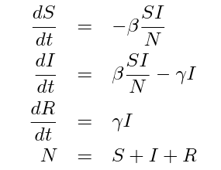

THE SIR MODEL IS AN EPIDEMIC MODEL USED TO EXAMINE THE SPREADING INFLUENCE OF TOPRANKED NODES
Article- SIR evaluation model
#1
Susceptible
#2
Infection
#3
Recovery
S(t)
I(t)
R(t)
Typical model information
Nº of individuals not yet infected but susceptible to get it
Beta: % susceptible-infected contact results in a new infection
Nº of individuals who have been infected capable of spreading it
Gamma: % infected recovers & moves into the resistant phase
Nº of individuals who were infected and then removed from the disease (due to immunization or death) .
Main formulas
General
Assumptions of the model
At each step, for each infected node, one randomly selected susceptible neighbor gets infected with probability
Beta = 1/# Neighbours
Infected nodes recover with probability 1/⟨k⟩ at each step, with ⟨k⟩ is the average degree of the network
Gamma = 1/⟨k⟩
-
An infected node will in average contact ⟨k⟩ neighbors before he/she is recovered
The process stops when there is no infected node
The total number of infected and recovered nodes at time t, denoted by F (t), can be considered as an indicator to evaluate the influence of the initially infected node at time t
higher F (T_{c} ) indicates a larger influence
Sources:
http://www.public.asu.edu/~hnesse/classes/sir.html?Alpha=1&Beta=0.2&initialS=1000&initialI=10&initialR=3&iters=10
https://en.wikipedia.org/wiki/Epidemic_model#The_SIR_model
http://www.maa.org/press/periodicals/loci/joma/the-sir-model-for-spread-of-disease-the-differential-equation-model
Social Network Analysis
Notes:
To investigate the influence of a single node in the network, we set this node to be infected initially. The total number of infected and recovered nodes at time t, denoted by F (t), can be considered as
an indicator to evaluate the influence of the initially infected node at time t.
Clearly, F (t) increases with t, and finally gets stable, labeled by F (tc ), where tc corresponds to the time that there is no infected node in the network. Thus F (tc ) evaluates the eventual influence of the initially infected node—higher F (tc ) indicates a larger influence.

Slide 13
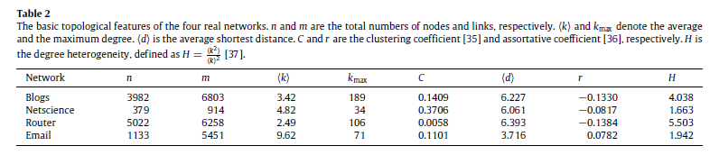
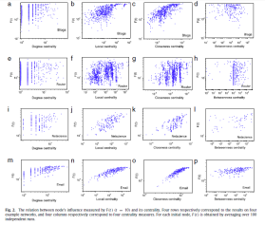
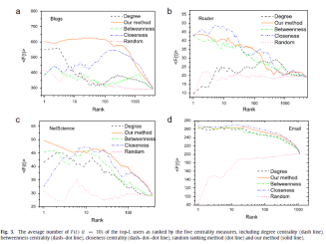
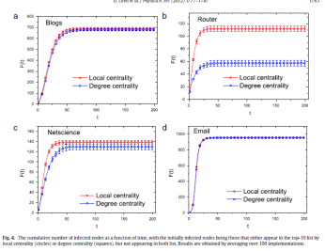
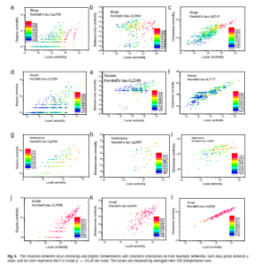
THE OBJECTIVE OF THE ARTICLE IS TO EVALUATE THE PERFORMANCE OF THE LOCAL CENTRALITY MEASURE
Article- Results (I)
Objective
Order of performance
Evaluate the performance of our centrality measure compared with the other centrality measures
0
Data Features¹
Data
1
Blogs—the communication relationships between owners of blogs on the MSN (Windows Live) Spaces website
Netscience—the network of co-authorships between scientists who are themselves publishing on the topic of networks.
Router level topology of the Internet, collected by the Rocket fuel Project
Email—the network of e-mail. Interchanges between members of the University Rovira i Virgili (Tarragona)
Methodology
After n implementations (each node is selected to be the initially infected node once and only once)
Evaluate the total number of infected and recovered nodes at time t, denoted by F (t) where t = 10 , can be considered as an indicator to evaluate the influence of the initially infected node at time t.
2
A
B
Results²
C
D
Model of evaluate
The SIR model from the previous slide
Focus in next slides
n and m are the total numbers of nodes and links, respectively. ⟨k⟩ and kmax denote the average and the maximum degree. ⟨d⟩ is the average shortest distance. C and r are the clustering coefficient and assortative coefficient respectively. H is the degree heterogeneity
Figures from the results and tables with the main characteristics of the networks can be found in big with
its description in the annex
Social Network Analysis

Slide 14
THE LOCAL CENTRALITY MEASURE PERFORMS COMPETITIVELY BETTER THAN THE OTHER MEASURES (I)
Article- Results (II)
The relation between node’s influence measured by F (t) (t = 10) and its centrality
The average number of F (t) (t = 10) of the top-L users as ranked and its centrality¹
A
B
Degree
Betweenness
Closenness
Local
Random
Degree
Betweenness
Closenness
Local
Blogs
Netscience
Router topology
Email
Correlation between centrality with F (t) : No correlation High correlation
Performance between Rank with F(t) : Bad Excellent
✓
Local and closeness centrality measures perform good Degree and betweenness centrality perform quite bad
✓
Local centrality measure outperforms
In Blogs and Netscience local centrality performs best
In Router and Email closeness centrality performs a little bit better
Random, Degree and Betweenness centrality perform quite bad
X
X
(1) A good centrality measure should be downward sloping: namely the average number of infected nodes by the top-L nodes decreases with the increasing of L.
Social Network Analysis

Slide 15











THE LOCAL CENTRALITY MEASURE PERFORMS COMPETITIVELY BETTER THAN THE OTHER MEASURES (II)
Article- Results (III)
The cumulative number of infected nodes as a function of time¹
Relations between local centrality and degree, betweenness and closeness²
C
D
Local
Degree
Betweenness
Closenness
Blogs
Email
Router topology
Netscience
Blogs
$τ$ = 0.28
$τ$ = 0.23
$τ$ = 0.61
Degree
Netscience
Router topology
$τ$ = 0.45
$τ$ = 0.26
$τ$ = 0.47
✓
✓
✓
✓
Local
$τ$ = 0.23
$τ$ = 0.23
$τ$ = 0.72
Email
✓
Local centrality performs better in all cases
$τ$ = 0.76
$τ$ = 0.53
$τ$ = 0.86
Correlation with Local measure: Bad Excellent
Kendals tau used to evaluate concordancy thorugh data
✓
Closeness is strongly positively correlated with local centrality
In E-mail, all centralities are positively correlated with the local
with the initially infected nodes being those that either appear in the top-10 list by local centrality (circles) or degree centrality (squares)
Each data point denotes a node, and its color represent the F (t) value (t = 10) of this node. The values are obtained by averaged over 100 independent runs.
Social Network Analysis

Slide 16
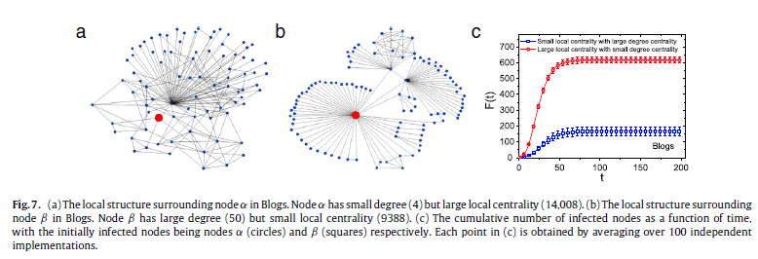
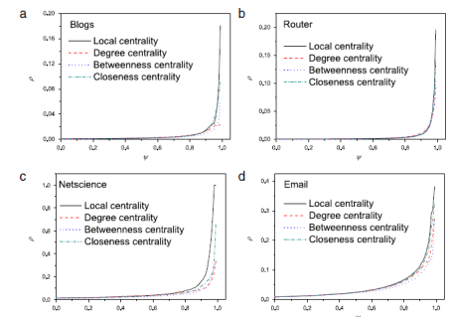
THE LOCAL CENTRALITY PERFORMS BETTER THAN DEGREE CENTRALITY BEING LESS COMPLEX AND MORE EFFECTIVE
Article- Conclusions and criticisim
Main conclusions of the paper
Performs competitively really good
Better than centrality basic measures
Captures better the F(t) than degree centrality
Less complex and
More effective
Local Centrality
Ranking-based rich-club phenomenon
Good at finding hidden relationships between structure and function of networks
Need of comparison to more complex and efficient measures
Better explanation on:
4 networks used
Ranking-based rich-club phenomenon
Main Conclusions
Criticism
Social Network Analysis

Slide 17
Annex
Relation between node’s influence measured by f (t) and its centrality
Average number of f (t) (t = 10) of the top-l users as ranked and its centrality
The cumulative number of infected nodes as a function of time
Relations between local centrality and degree, betweenness and closeness
Table (iii) top-10 ranked nodes by local centrality
Table (iv) mean value of the top nodes
Social Network Analysis

Slide 18
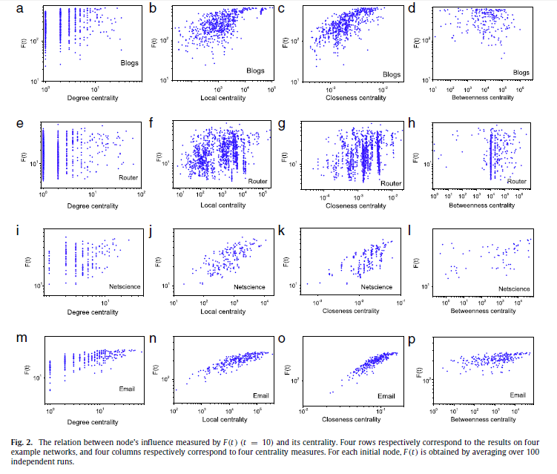
ANNEX - RELATION BETWEEN NODE’S INFLUENCE MEASURED BY F (T) (T = 10) AND ITS CENTRALITY
Introduction to social network analysis
A
Back to results
Social Network Analysis
Notes:
An information (or informational) cascade occurs when a person observes the actions of others and then – despite possible contradictions in his/her own private information signals – engages in the same acts. A cascade develops when people "abandon their own information in favor of inferences based on earlier people's actions".^{[1]} Information cascades provide an explanation for how such situations can occur, how likely they are to cascade incorrect information or actions, how such behavior may arise and desist rapidly, and how effective attempts to originate a cascade tend to be under different conditions.^{[2]} By explaining all of these things, the original Independent Cascade model sought to improve on previous models that were unable to explain cascades of irrational behavior, a cascade's fragility, or the short-lived nature of certain cascades.
There are five key conditions in an information cascade model:
There is a decision to be made – for example, whether to adopt a new technology, wear a new style of clothing, eat in a new restaurant, or support a particular political position
A limited action space exists (e.g. an adopt/reject decision).^{[3]}
People make the decision sequentially, and each person can observe the choices made by those who acted earlier
Each person has some private information that helps guide their decision.
A person can't directly observe the private information that other people know, but he or she can make inferences about this private information from what they do.
One assumption of Information Cascades which has been challenged is the concept that agents always make rational decisions. More social perspectives of cascades, which suggest that agents may act irrationally (e.g., against what they think is optimal) when social pressures are great, exist as complements to the concept of Information Cascades.^{[4]}While competing models exist, it is more often the problem that the concept of an information cascade is conflated with ideas which do not match the two key conditions of the model, such as social proof, information diffusion,^{[5]} and social influence. Indeed, the term information cascade has even been used to refer to such processes.^{[6]}

Slide 19
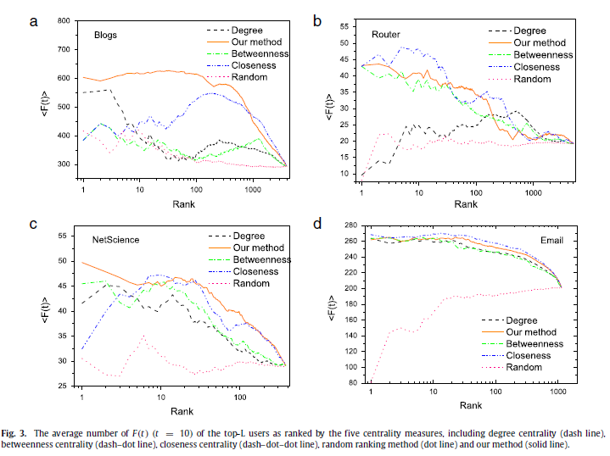
ANNEX - AVERAGE NUMBER OF F (t) (t = 10) OF THE TOP-L USERS AS RANKED AND ITS CENTRALITY
Introduction to social network analysis
B
Back to results
Social Network Analysis
Notes:
An information (or informational) cascade occurs when a person observes the actions of others and then – despite possible contradictions in his/her own private information signals – engages in the same acts. A cascade develops when people "abandon their own information in favor of inferences based on earlier people's actions".^{[1]} Information cascades provide an explanation for how such situations can occur, how likely they are to cascade incorrect information or actions, how such behavior may arise and desist rapidly, and how effective attempts to originate a cascade tend to be under different conditions.^{[2]} By explaining all of these things, the original Independent Cascade model sought to improve on previous models that were unable to explain cascades of irrational behavior, a cascade's fragility, or the short-lived nature of certain cascades.
There are five key conditions in an information cascade model:
There is a decision to be made – for example, whether to adopt a new technology, wear a new style of clothing, eat in a new restaurant, or support a particular political position
A limited action space exists (e.g. an adopt/reject decision).^{[3]}
People make the decision sequentially, and each person can observe the choices made by those who acted earlier
Each person has some private information that helps guide their decision.
A person can't directly observe the private information that other people know, but he or she can make inferences about this private information from what they do.
One assumption of Information Cascades which has been challenged is the concept that agents always make rational decisions. More social perspectives of cascades, which suggest that agents may act irrationally (e.g., against what they think is optimal) when social pressures are great, exist as complements to the concept of Information Cascades.^{[4]}While competing models exist, it is more often the problem that the concept of an information cascade is conflated with ideas which do not match the two key conditions of the model, such as social proof, information diffusion,^{[5]} and social influence. Indeed, the term information cascade has even been used to refer to such processes.^{[6]}

Slide 20

ANNEX - THE CUMULATIVE NUMBER OF INFECTED NODES AS A FUNCTION OF TIME
Introduction to social network analysis
C
Back to results
Social Network Analysis
Notes:
An information (or informational) cascade occurs when a person observes the actions of others and then – despite possible contradictions in his/her own private information signals – engages in the same acts. A cascade develops when people "abandon their own information in favor of inferences based on earlier people's actions".^{[1]} Information cascades provide an explanation for how such situations can occur, how likely they are to cascade incorrect information or actions, how such behavior may arise and desist rapidly, and how effective attempts to originate a cascade tend to be under different conditions.^{[2]} By explaining all of these things, the original Independent Cascade model sought to improve on previous models that were unable to explain cascades of irrational behavior, a cascade's fragility, or the short-lived nature of certain cascades.
There are five key conditions in an information cascade model:
There is a decision to be made – for example, whether to adopt a new technology, wear a new style of clothing, eat in a new restaurant, or support a particular political position
A limited action space exists (e.g. an adopt/reject decision).^{[3]}
People make the decision sequentially, and each person can observe the choices made by those who acted earlier
Each person has some private information that helps guide their decision.
A person can't directly observe the private information that other people know, but he or she can make inferences about this private information from what they do.
One assumption of Information Cascades which has been challenged is the concept that agents always make rational decisions. More social perspectives of cascades, which suggest that agents may act irrationally (e.g., against what they think is optimal) when social pressures are great, exist as complements to the concept of Information Cascades.^{[4]}While competing models exist, it is more often the problem that the concept of an information cascade is conflated with ideas which do not match the two key conditions of the model, such as social proof, information diffusion,^{[5]} and social influence. Indeed, the term information cascade has even been used to refer to such processes.^{[6]}

Slide 21
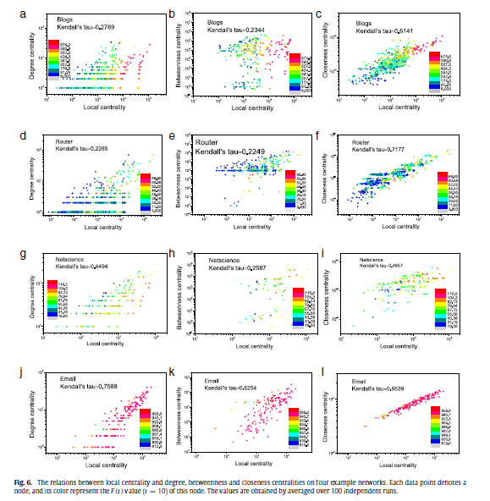
ANNEX - RELATIONS BETWEEN LOCAL CENTRALITY AND DEGREE, BETWEENNESS AND CLOSENESS
Introduction to social network analysis
D
Back to results
Social Network Analysis
Notes:
An information (or informational) cascade occurs when a person observes the actions of others and then – despite possible contradictions in his/her own private information signals – engages in the same acts. A cascade develops when people "abandon their own information in favor of inferences based on earlier people's actions".^{[1]} Information cascades provide an explanation for how such situations can occur, how likely they are to cascade incorrect information or actions, how such behavior may arise and desist rapidly, and how effective attempts to originate a cascade tend to be under different conditions.^{[2]} By explaining all of these things, the original Independent Cascade model sought to improve on previous models that were unable to explain cascades of irrational behavior, a cascade's fragility, or the short-lived nature of certain cascades.
There are five key conditions in an information cascade model:
There is a decision to be made – for example, whether to adopt a new technology, wear a new style of clothing, eat in a new restaurant, or support a particular political position
A limited action space exists (e.g. an adopt/reject decision).^{[3]}
People make the decision sequentially, and each person can observe the choices made by those who acted earlier
Each person has some private information that helps guide their decision.
A person can't directly observe the private information that other people know, but he or she can make inferences about this private information from what they do.
One assumption of Information Cascades which has been challenged is the concept that agents always make rational decisions. More social perspectives of cascades, which suggest that agents may act irrationally (e.g., against what they think is optimal) when social pressures are great, exist as complements to the concept of Information Cascades.^{[4]}While competing models exist, it is more often the problem that the concept of an information cascade is conflated with ideas which do not match the two key conditions of the model, such as social proof, information diffusion,^{[5]} and social influence. Indeed, the term information cascade has even been used to refer to such processes.^{[6]}

Slide 22
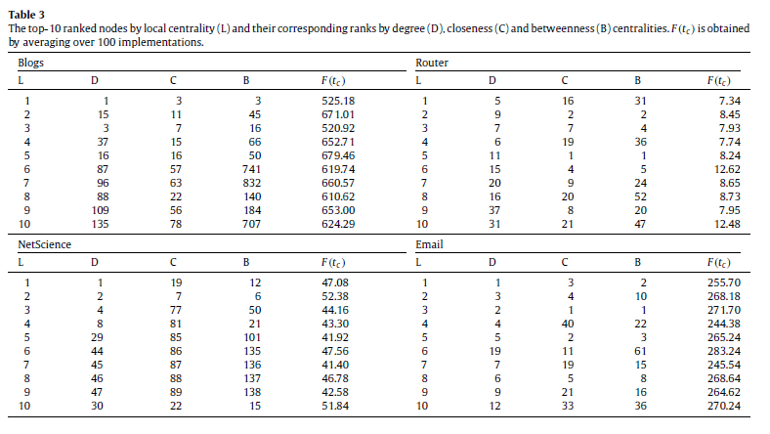
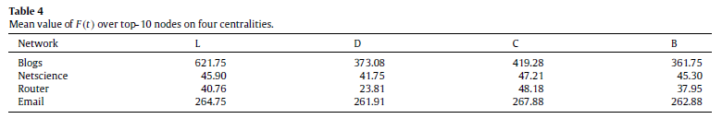
ANNEX – TABLE (III) TOP-10 RANKED NODES BY LOCAL CENTRALITY AND (IV) MEAN VALUE OF THE TOP NODES
Introduction to social network analysis
Back to results
Social Network Analysis
Notes:
An information (or informational) cascade occurs when a person observes the actions of others and then – despite possible contradictions in his/her own private information signals – engages in the same acts. A cascade develops when people "abandon their own information in favor of inferences based on earlier people's actions".^{[1]} Information cascades provide an explanation for how such situations can occur, how likely they are to cascade incorrect information or actions, how such behavior may arise and desist rapidly, and how effective attempts to originate a cascade tend to be under different conditions.^{[2]} By explaining all of these things, the original Independent Cascade model sought to improve on previous models that were unable to explain cascades of irrational behavior, a cascade's fragility, or the short-lived nature of certain cascades.
There are five key conditions in an information cascade model:
There is a decision to be made – for example, whether to adopt a new technology, wear a new style of clothing, eat in a new restaurant, or support a particular political position
A limited action space exists (e.g. an adopt/reject decision).^{[3]}
People make the decision sequentially, and each person can observe the choices made by those who acted earlier
Each person has some private information that helps guide their decision.
A person can't directly observe the private information that other people know, but he or she can make inferences about this private information from what they do.
One assumption of Information Cascades which has been challenged is the concept that agents always make rational decisions. More social perspectives of cascades, which suggest that agents may act irrationally (e.g., against what they think is optimal) when social pressures are great, exist as complements to the concept of Information Cascades.^{[4]}While competing models exist, it is more often the problem that the concept of an information cascade is conflated with ideas which do not match the two key conditions of the model, such as social proof, information diffusion,^{[5]} and social influence. Indeed, the term information cascade has even been used to refer to such processes.^{[6]}

Slide 23

Carles Sans Fuentes
732A61 Data Mining - Clustering and Association Analysis / Linköpings University carsa564@student.liu.se
http://www.ida.liu.se/~732A61/timetable/index.en.shtml

