Slide 2
Spring 2020 Climate Survey Meeting Student Wellness Committee May 22, 2020

Slide 3
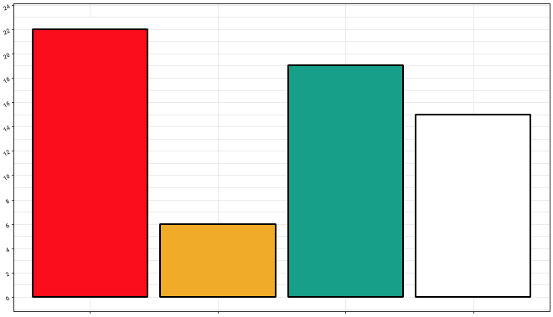
Response Breakdown
63 responses [ 57 complete responses ]
22
19
16
Total Responses
6
Clinical
Social
Cognition and Neural Systems
Did not disclose

Slide 4
COVID-19 Response

Slide 5
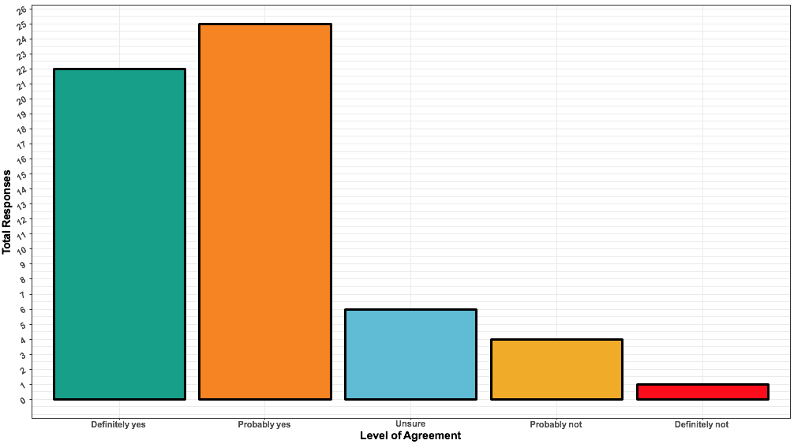
I have been satisfied with the overall department response to the pandemic
25
22
“The department was great at communicating early and often. Given the complex circumstances, I don't have any real complaints. If anything I was impressed.” “Good job Psych! I am proud of the way we have responded.”
Total Responses
6
4
1
Definitely yes Probably yes Unsure Probably not Definitely not

Slide 6
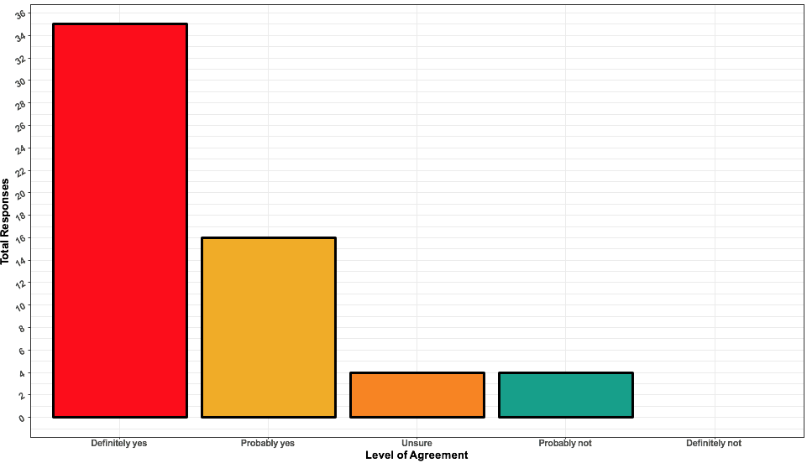
During the COVID-19 pandemic, I have felt adequately supported by my mentor.
35
Total Responses
16
4
4
Definitely yes Probably yes Unsure Probably not Definitely not

Slide 7
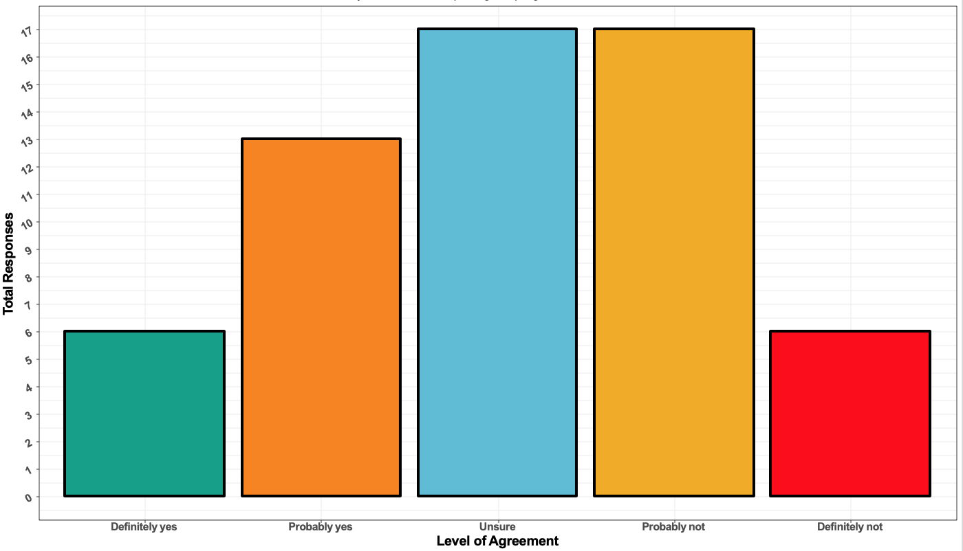
During the COVID-19 pandemic, my timeline for completing the program has been affected.
17
17
13
Total Responses
6
6
Definitely yes Probably yes Unsure Probably not Definitely not

Slide 8
“For the rest of the survey, please answer the questions based on your experience in graduate school before COVID-19.”

Slide 9
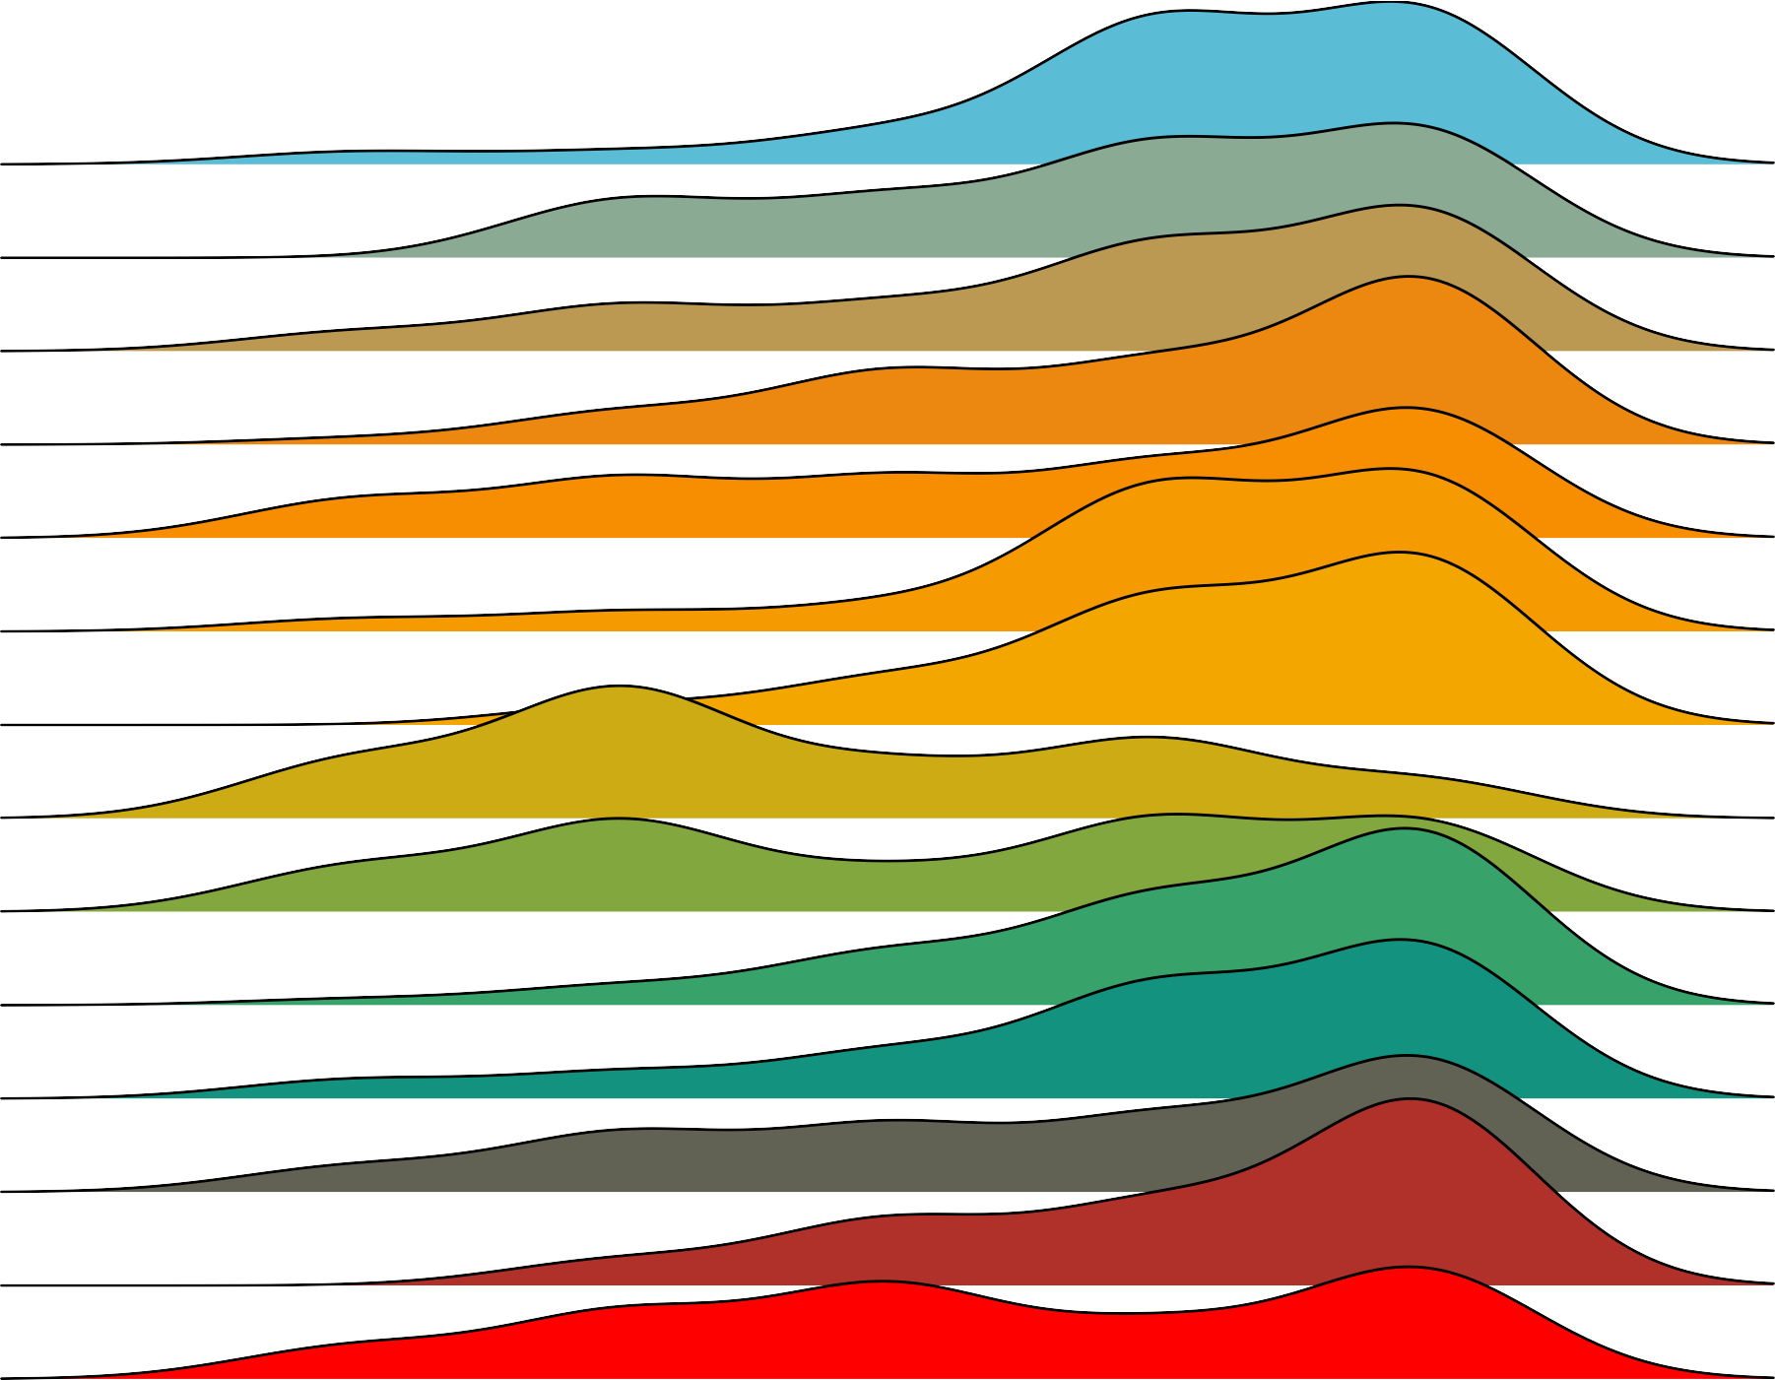
Which word would you say describes the department better?
Unwelcoming
Unsupportive
Sexist
Racist
Individualistic
Hostile
Homophobic
Homogenous
Elitist
Disrespectful
Contentious
Competitive
Ageist
Ableist
Welcoming
Supportive
Non−sexist
Non−racist
Collaborative
Friendly
Non−homophobic
Diverse
Non−elitist
Respectful
Collegial
Cooperative
Non−ageist
Non−ableist
Adjective
Rating

Slide 10
Diversity, Equity, Inclusion
Homogenous
Diverse

Slide 11
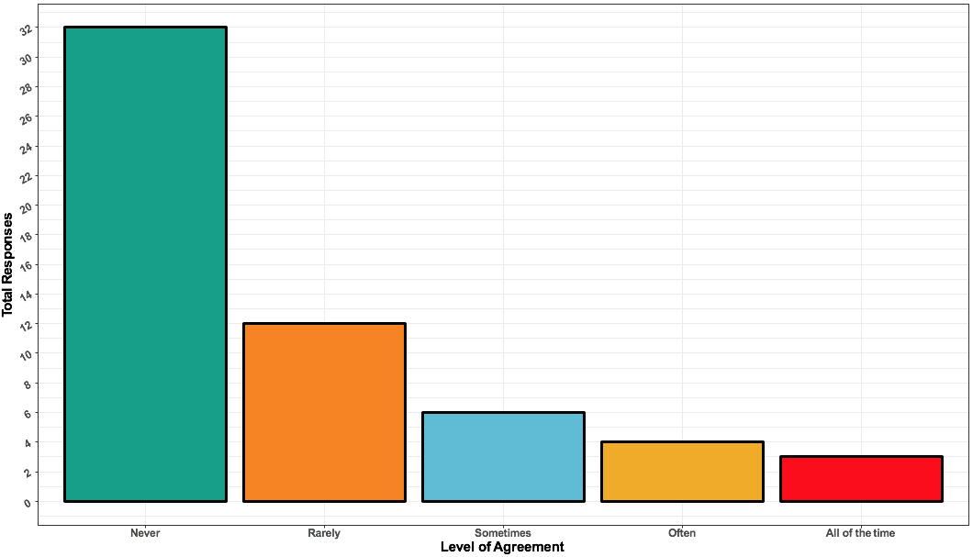
I have thought about leaving the department because of exclusionary or discriminatory treatment.
“Cultivate an environment where students of color feel like they can thrive. I don't feel like I belong in this department and in large part I think it's because there are very few opportunities to connect with people who are part of my culture or are allies. There needs to be more done to recruit and retain students and faculty of color. Our department doesn't represent the national breakdown of people of color or even in Arizona. Before you can address equity and inclusion, you have to have diversity so let's start there.”
Total Responses
Never Rarely Sometimes Often All of the time

Slide 12
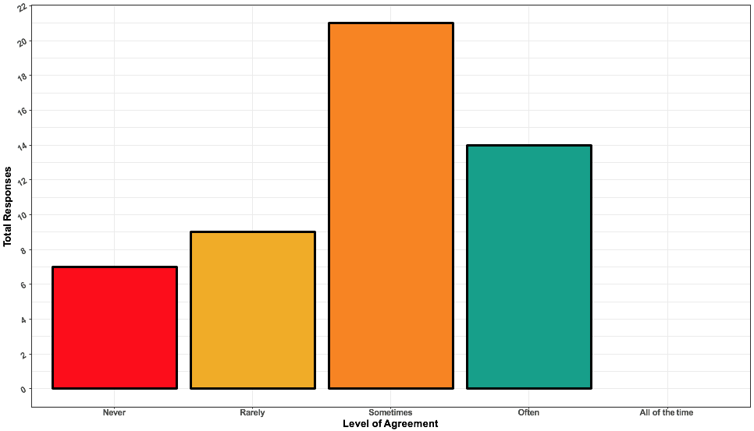
I have felt isolated in the department.
“Overall, I feel the department positively influences my development as a professional. I only wish that I felt more included, valued and like what I do here actually matters outside my lab and research community (peers outside the university). I often feel that I do not have a place among my department and almost like I do not belong here - but I want to be part of it, I want to feel included in this department (I really do love being here, just hate feeling so alone).”
Total Responses
Never Rarely Sometimes Often All of the time

Slide 13
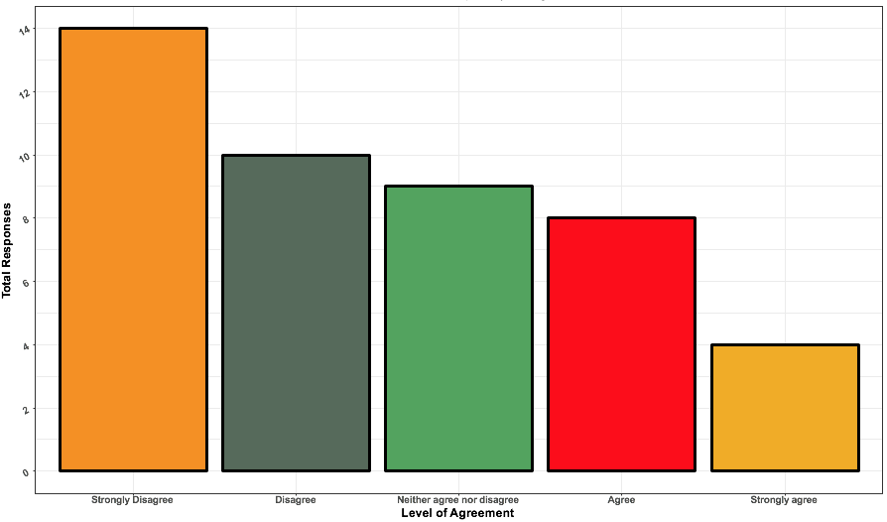
I am satisfied with the cultural competency training I have received in this department.
“I think that having an understanding of equity, diversity, and inclusion should be the first thing discussed in graduate school.”
Total Responses
Strongly disagree Disagree Neither agree Agree Strongly agree
nor disagree

Slide 14
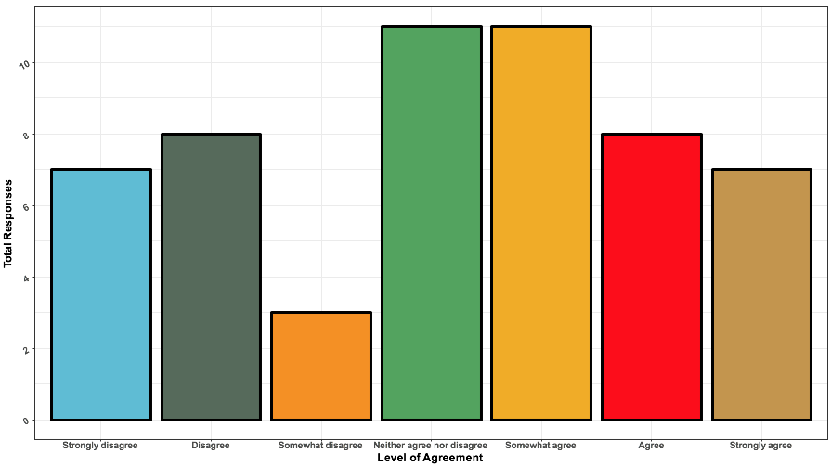
I would recommend the University of Arizona Psychology Department
to a colleague seeking a diverse institution for work, or school.
Total Responses
Strongly Disagree Somewhat Neither agree Somewhat Agree Strongly
disagree disagree nor disagree agree agree

Slide 15
Homogenous
Diverse
“It seems like our push for diversity is really extrinsically motivated at times. It's a "buzzword" but it doesn't always feel like an intrinsic value.”
“The department cannot provide an equitable and diverse environment if individual faculty get to opt out of that in the way they run their labs.”
“I think that some students feel disconnected and feel like they aren't welcomed in our department.”

Slide 16
Mentorship

Slide 17
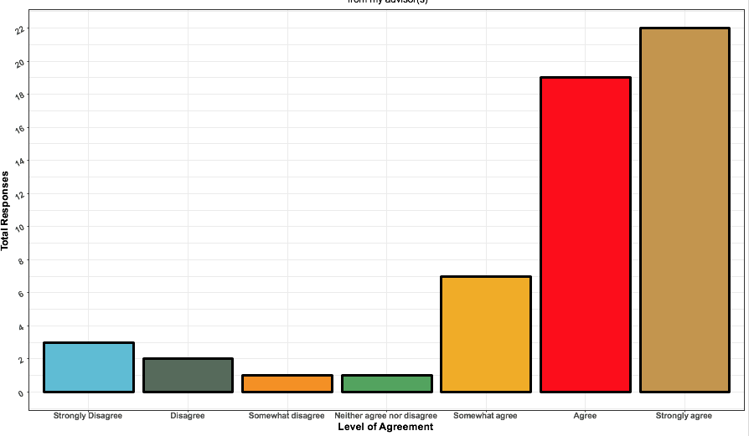
I am overall satisfied with the mentorship I receive from my advisor(s).
22
“It's really difficult to have an amazing advisor and to see so many of my peers suffer from what I recognize as very unhealthy mentor-mentee relationships, where the student is overworked, under-supported and basically exploited. I often wish I could report this, but I don't know how I would do that. Those students don't report it because they feel responsible for choosing that advisor and like they will have to abandon their career if they complain, or because they've been told that's the way it is in the lab and the advisor can easily replace them. It makes me feel unsafe to realize that everyone in the department knows this is happening and does nothing about it.”
19
Total Responses
7
3
2
1
1
Strongly Disagree Somewhat Neither agree Somewhat Agree Strongly
disagree disagree nor disagree agree agree

Slide 18
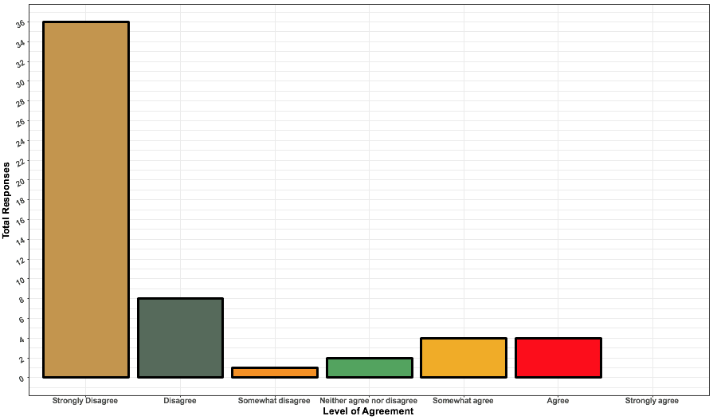
My advisor has made it difficult to meet department milestones.
36
Total Responses
8
4
4
2
1
Strongly Disagree Somewhat Neither agree Somewhat Agree Strongly
disagree disagree nor disagree agree agree

Slide 19
Training

Slide 20
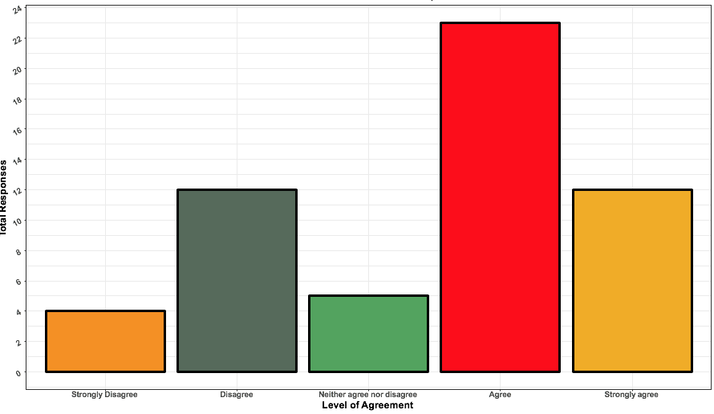
I am satisfied with the training I have received from classes in this department.
23
“I feel pretty strongly that I have received excellent training, but I attribute that mostly to my advisor and my supportive lab.”
12
12
Total Responses
5
4
Strongly disagree Disagree Neither agree Agree Strongly agree
nor disagree

Slide 21
Most Helpful Classes:
Social Psychology
Cognitive Psychology
Advanced Psychopathology
Neural Time Series Data Analysis
Teaching of Psychology
Least Helpful Classes:
History of Psychology
Statistics Fundamentals (PSY 510)
“I think it would have been more useful if it was just an intro to R class.”
Requested Classes:
Cultural competency
Classes that teach skills (e.g., programming)
Offer required classes more frequently/regularly

Slide 22
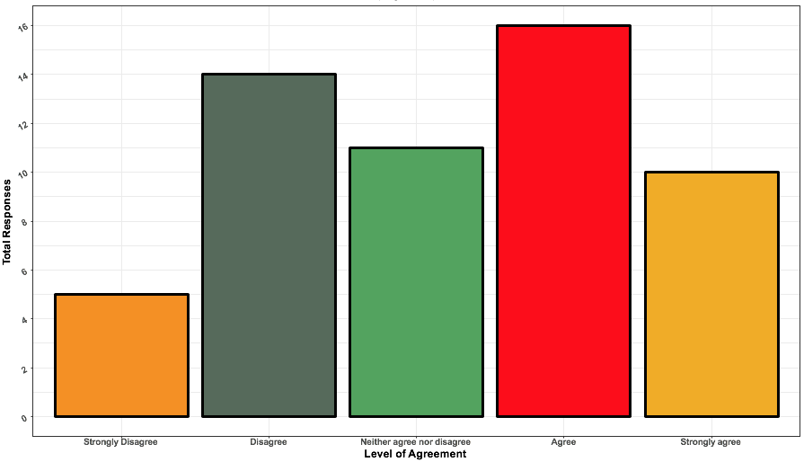
The department offers the classes I need to fulfill program requirements.
16
14
11
10
Total Responses
5
Strongly disagree Disagree Neither agree Agree Strongly agree
nor disagree

Slide 23
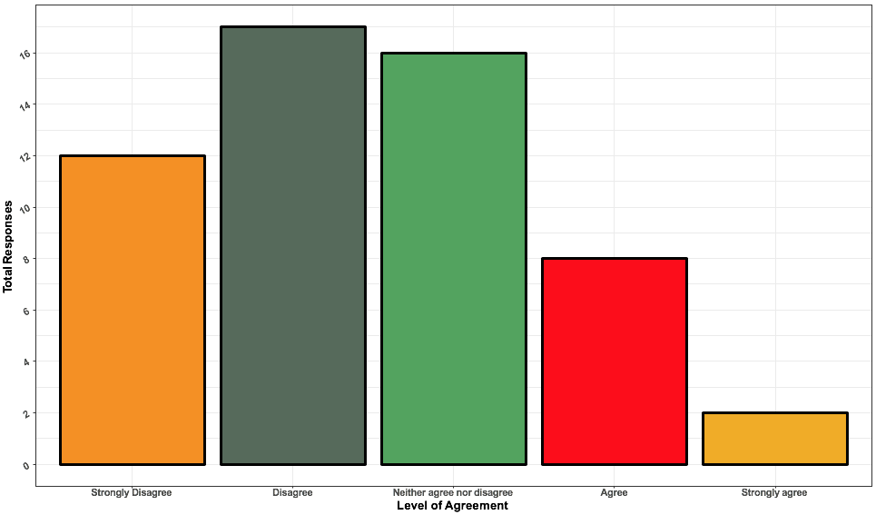
I have been prepared to pursue a job outside of academia.
17
16
“Academic jobs are so competitive, I think we need more career guidance and training for jobs outside of academia.”
“[COVID-19] makes me unsure of what the job market will be like after graduating.”
12
Total Responses
8
2
Strongly disagree Disagree Neither agree Agree Strongly agree
nor disagree

Slide 24
Safety and Harassment

Slide 25
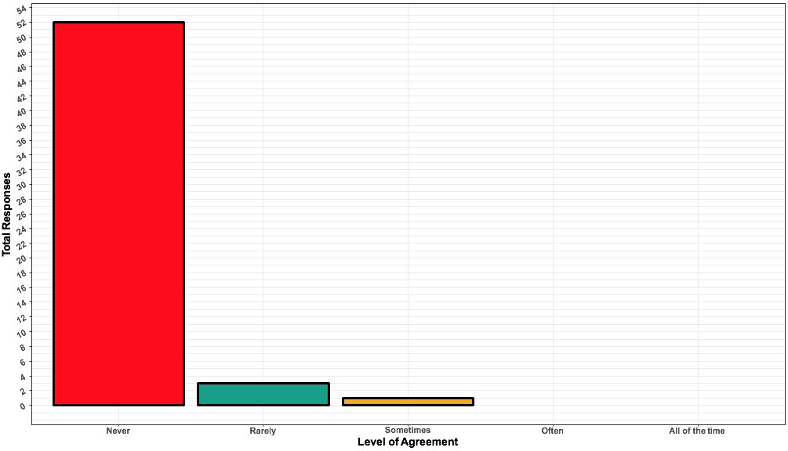
I have been sexually harassed in the department.
52
“…I marked ‘Rarely’ for the sexual harassment questions but it feels like the fact that I’ve experienced that at all (with seemingly very few consequences to the perpetrator) is not OK.”
Total Responses
3
1
Never Rarely Sometimes Often All of the time

Slide 26
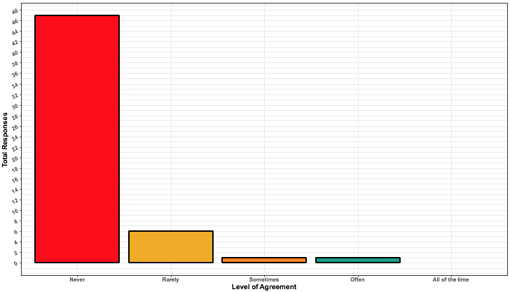
I have been concerned with my physical safety around members of the department.
47
Total Responses
8
1
1
Never Rarely Sometimes Often All of the time

Slide 27
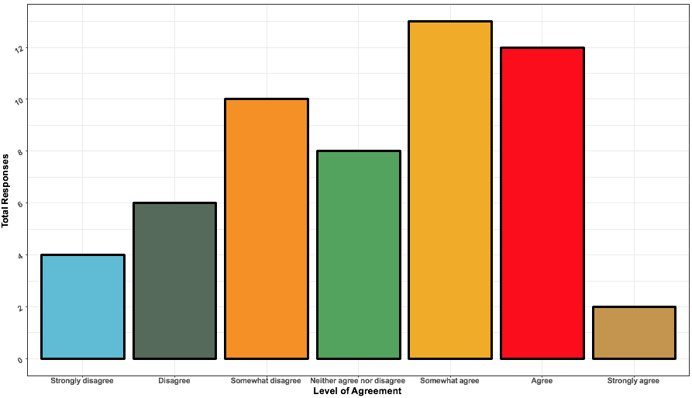
I would feel comfortable approaching someone in the department to file a formal complaint.
13
12
10
8
Total Responses
6
4
2
Strongly Disagree Somewhat Neither agree Somewhat Agree Strongly
disagree disagree nor disagree agree agree

Slide 28
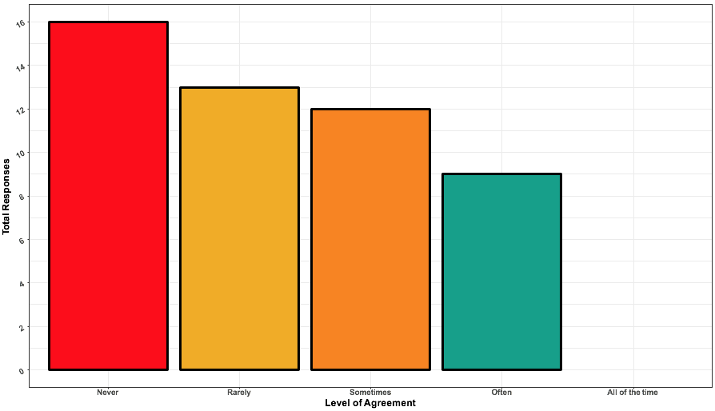
I have feared retaliation if I voice a concern in the department.
“I see as a problem that those who genuinely care about the issues may change their behaviors, whereas others "backlash" against the programming – e.g. after sexual harassment programming, my lab made many jokes about how sexual harassment is hysterical.”
16
13
12
9
Total Responses
Never Rarely Sometimes Often All of the time

Slide 29
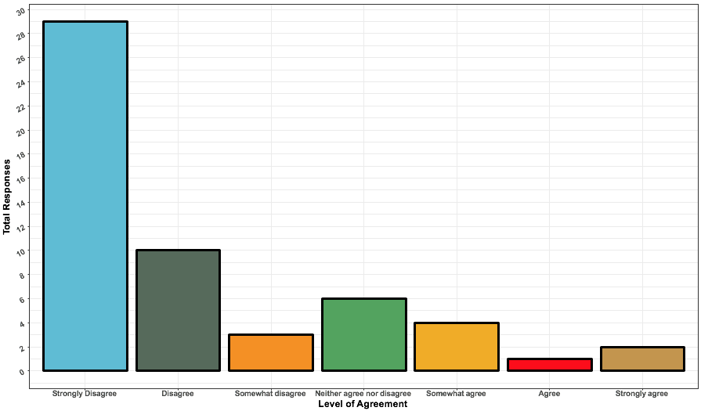
I fear retaliation from my advisor when I voice concerns.
29
Total Responses
10
6
4
3
2
1
Strongly Disagree Somewhat Neither agree Somewhat Agree Strongly
disagree disagree nor disagree agree agree

Slide 30
Future Directions

Slide 31
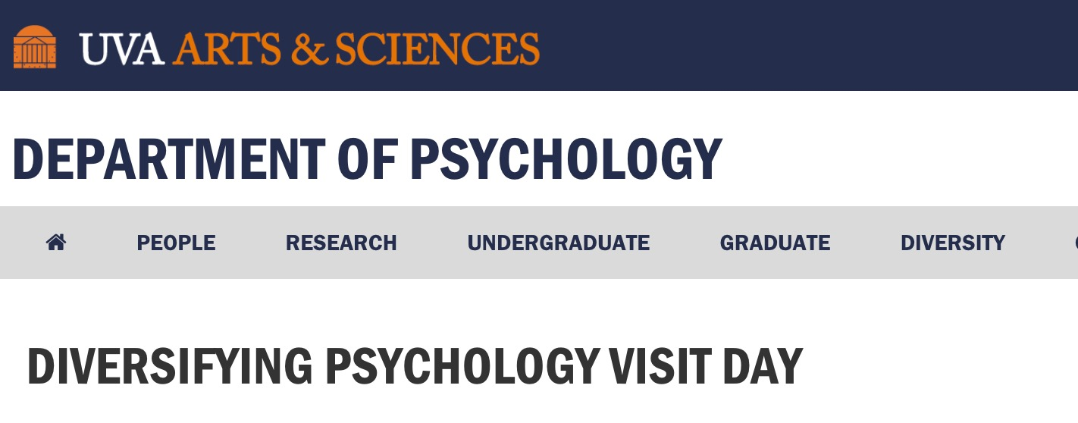
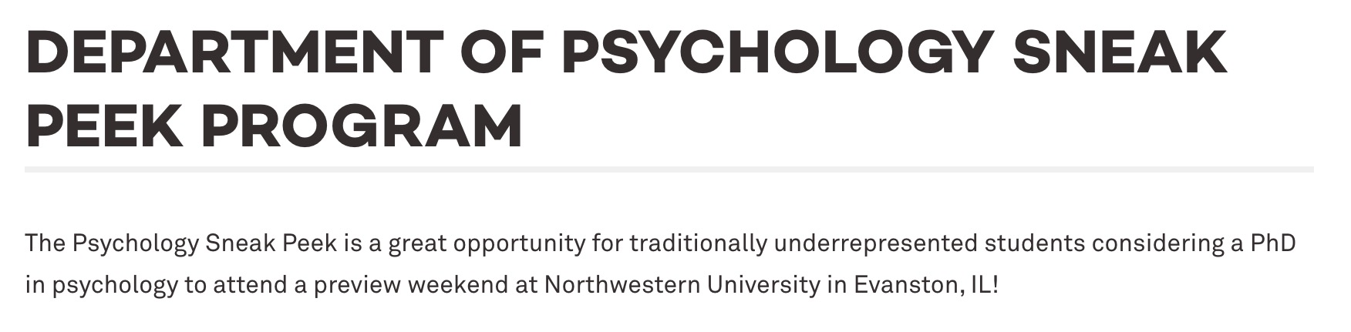


“Actively recruit more diverse students and faculty & work to retain them.”
-----
“Host a diversity weekend.”
-----
“Consider the barriers applicants have overcome to get to this point, and give less weight to things like GPA and GRE scores that are not necessarily a fair representation of underrepresented students' potential to be successful in grad school.”
-----
“Eliminate the consideration of GRE scores.”

Slide 32
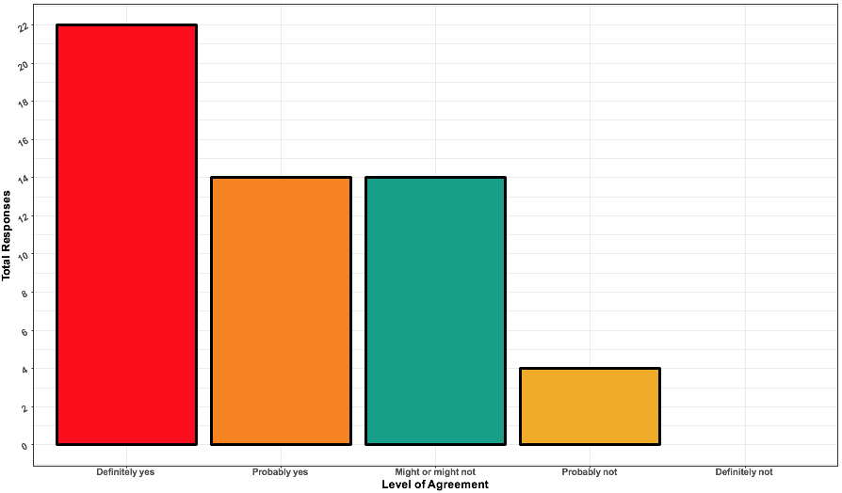
Do you believe that mentor/mentees should sign mentorship agreements?
22
“Mentorship agreements will only work if it is
truly bi-directional. Having the graduate student feel like it is all on them is not beneficial.”
13
13
Total Responses
4
Definitely yes Probably yes Might or might Probably not Definitely not
not

Slide 33
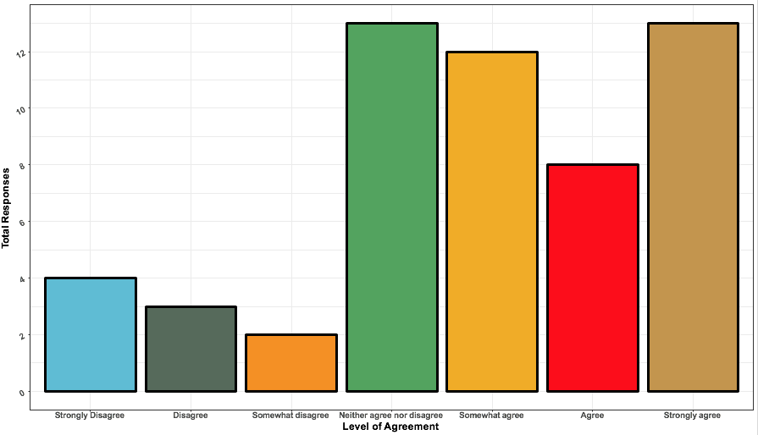
I would like to have a formal system to evaluate my advisor’s mentorship.
13
13
12
TA/professor relationships too!
“There is no formal mechanism to evaluate our TA professors. This makes the TA-professor relationship ripe for abuse and unethical behavior.”
8
Total Responses
4
3
2
Strongly Disagree Somewhat Neither agree Somewhat Agree Strongly
disagree disagree nor disagree agree agree

Slide 34
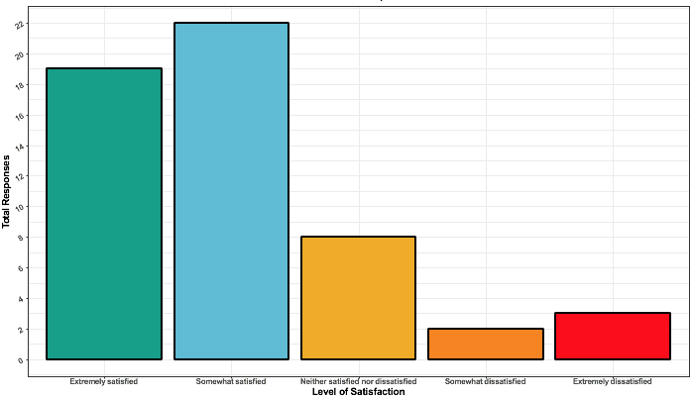
How would you rate your experience as a TA in terms of treatment by professors?
22
“YES! Thank you for asking because NO ONE has. I am never respected by the teachers. They are rude, yell over email, expect the task they want done to be done ASAP. I have been asked to guest lecture without notice, ridiculed for "writing bad test questions” and treated with disrespect. It is disgusting. There needs to be [a way] for us to evaluate them. Also, grad students intentionally don’t sign up for certain TA spots [because] the profs are SO TERRIBLE. Why is my "boss" messaging me on the weekend? Why am I being yelled at over email? NO. Not [appropriate]. Have boundaries and don’t treat me terribly.”
19
Total Responses
8
3
2
Extremely Somewhat Neither satisfied Somewhat Extremely
satisfied satisfied nor dissatisfied dissatisfied dissatisfied

Slide 35
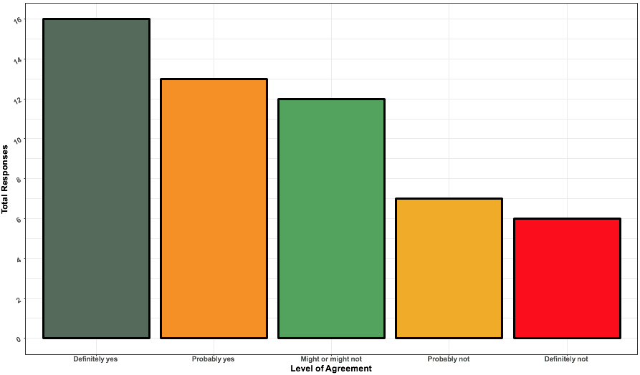
Would you benefit from a weekly graduate writing group?
16
13
12
Total Responses
7
6
Definitely yes Probably yes Might or might Probably not Definitely not
not

Slide 36
“I think there are a lot of subcultures in our department. It was hard to answer these questions because even though I overall feel extremely positively about the department, I feel less positive about my lab. I also feel that my difficulties have come from other students rather than faculty. In fact, I have found faculty to be extremely responsive and kind for all of my concerns, but students have caused me some feelings of difficulty in the department."

Slide 37
Thank you!

Slide 39
Funding

Slide 40
Do you feel that the current graduate student stipend is enough to live comfortably?
Have you had to borrow money or receive other assistance in addition to your stipend during your time as a graduate student in this department?
36
38
36
38
34
36
32
34
30
32
28
30
26
28
Total Responses
24
Total Responses
26
22
24
22
20
22
20
18
20
18
16
16
14
14
12
12
10
10
8
8
6
6
4
4
2
2
0
0
Yes
No
Yes
No
Yes No
Yes No
Level of Agreement
Level of Agreement

Slide 41
Do you feel that the current graduate student stipend is enough to live comfortably?
36
“I think that the grad stipend is enough to live comfortably in Tucson if you are a single person or you're not responsible for helping to send money to family etc.”
“It is almost impossible to have a family. I rely heavily on my parents and partner.”
“The lack of guaranteed summer funding is particularly stressful and the basis for determining who gets a summer teaching position is unclear.”
“The stipend is adequate for frugal living, although it is difficult to afford conferences and professional development opportunities like workshops even with GPSC and department funding.”
“I find myself working as hard as if I had a full time job, but not being appropriately compensated for a full time job.”
“…the department appears to be receiving a healthy injection of grant funds. Yet, Psychology is very close to or at the bottom of the stipend rankings in the CoS.”
“I supplement my monthly pay with $400 in borrowed money.”
“Raise the graduate student stipend to better support students without generational wealth.”
36
34
32
30
28
26
Total Responses
24
22
22
20
18
16
14
12
10
8
6
4
2
0
Yes
No
Yes No
Level of Agreement

