Slide 1
Summer 2020 Faculty Climate Survey Meeting focus on Diversity, Equity, & Inclusion Student Wellness Committee May 22, 2020

Slide 2
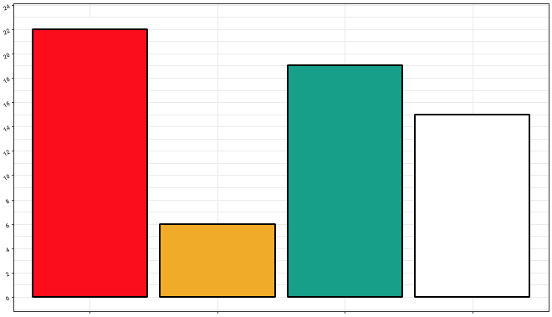
Response Breakdown
63 responses [ 57 complete responses ]
22
19
16
Total Responses
6
Clinical
Social
Cognition and Neural Systems
Did not disclose

Slide 3
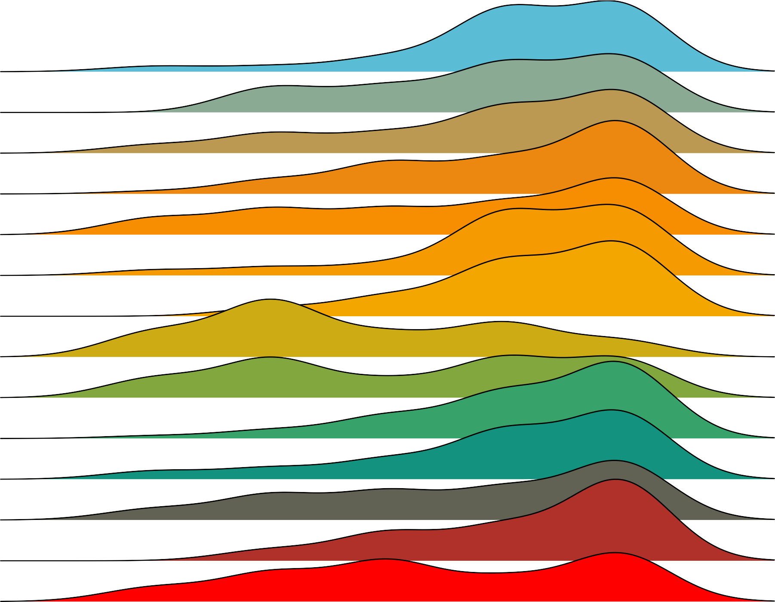
Which word would you say describes the department better?
Unwelcoming
Unsupportive
Sexist
Racist
Individualistic
Hostile
Homophobic
Homogenous
Elitist
Disrespectful
Contentious
Competitive
Ageist
Ableist
Welcoming
Supportive
Non−sexist
Non−racist
Collaborative
Friendly
Non−homophobic
Diverse
Non−elitist
Respectful
Collegial
Cooperative
Non−ageist
Non−ableist
Adjective
Rating

Slide 4
Diversity, Equity, Inclusion
Homogenous
Diverse

Slide 5
Homogenous
Diverse
“It seems like our push for diversity is really extrinsically motivated at times. It's a "buzzword" but it doesn't always feel like an intrinsic value.”
“The department cannot provide an equitable and diverse environment if individual faculty get to opt out of that in the way they run their labs.”
“I think that some students feel disconnected and feel like they aren't welcomed in our department.”

Slide 6
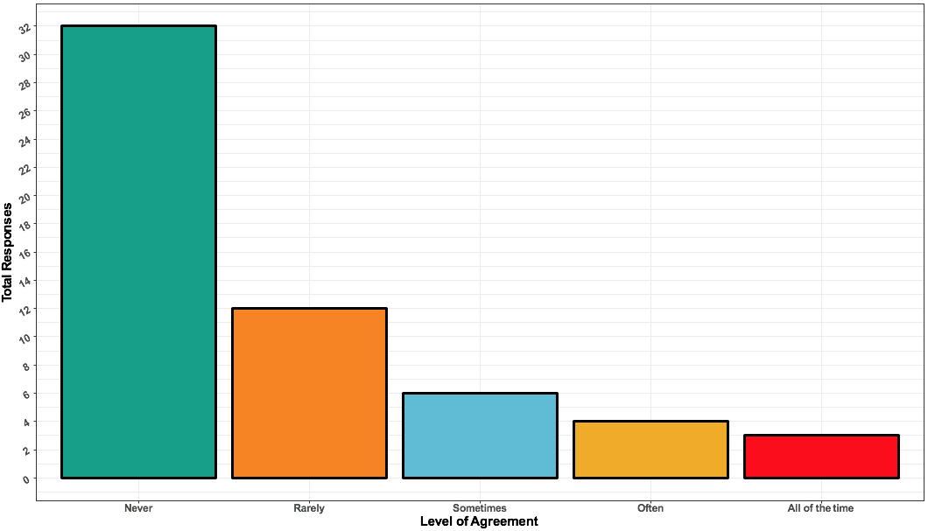
I have thought about leaving the department because of exclusionary or discriminatory treatment.
“Cultivate an environment where students of color feel like they can thrive. I don't feel like I belong in this department and in large part I think it's because there are very few opportunities to connect with people who are part of my culture or are allies. There needs to be more done to recruit and retain students and faculty of color. Our department doesn't represent the national breakdown of people of color or even in Arizona. Before you can address equity and inclusion, you have to have diversify so let's start there.”
Total Responses
Never Rarely Sometimes Often All of the time

Slide 7
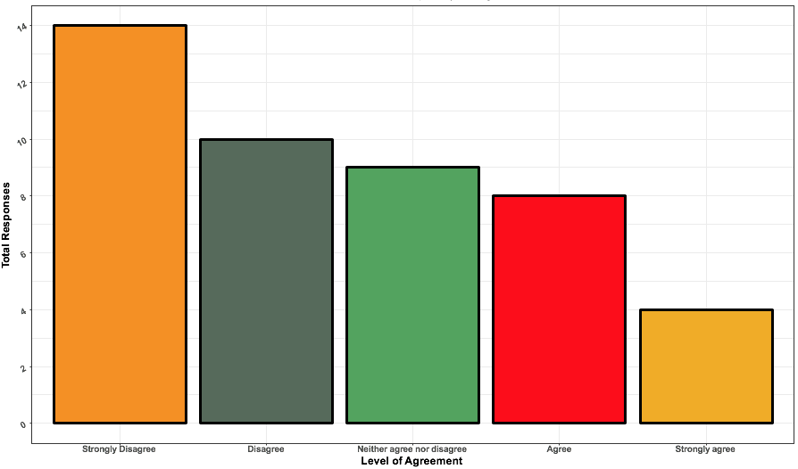
I am satisfied with the cultural competency training I have received in this department.
“I think that having an understanding of equity, diversity, and inclusion should be the first thing discussed in graduate school.”
Total Responses
Strongly disagree Disagree Neither agree Agree Strongly agree
nor disagree

Slide 8
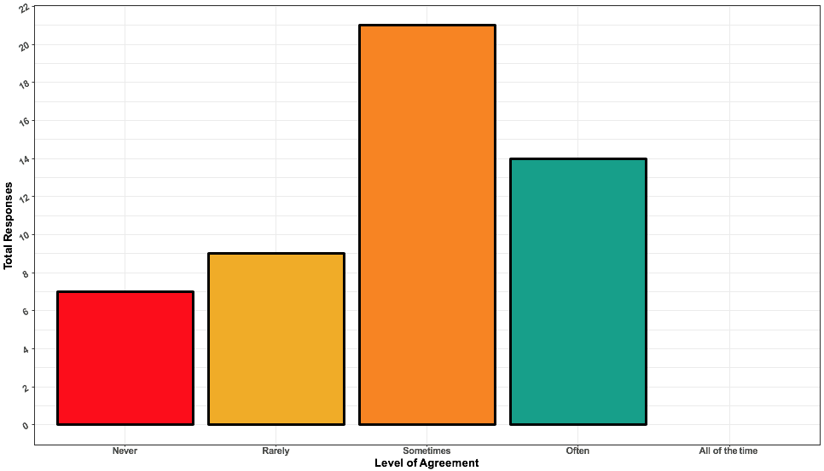
I have felt isolated in the department.
“Overall, I feel the department positively influences my development as a professional. I only wish that I felt more included, valued and like what I do here actually matters outside my lab and research community (peers outside the university). I often feel that I do not have a place among my department and almost like I do not belong here - but I want to be part of it, I want to feel included in this department (I really do love being here, just hate feeling so alone).”
Total Responses
Never Rarely Sometimes Often All of the time

Slide 9
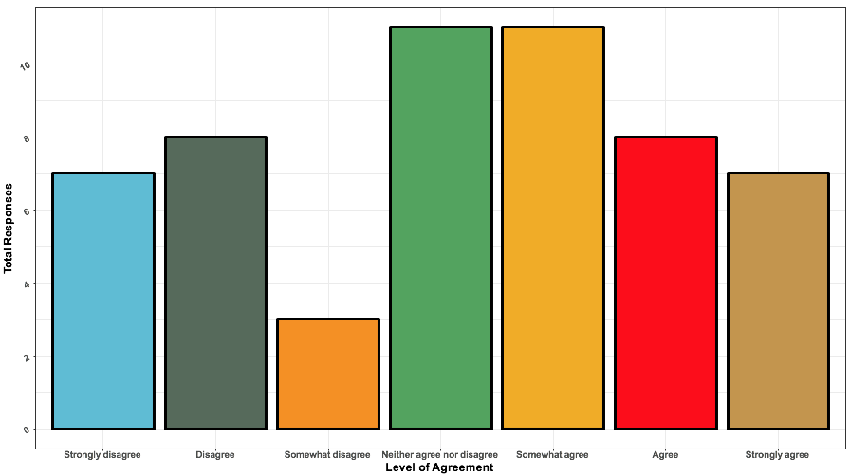
I would recommend the University of Arizona Psychology Department
to a colleague seeking a diverse institution for work, or school.
Total Responses
Strongly Disagree Somewhat Neither agree Somewhat Agree Strongly
disagree disagree nor disagree agree agree

Slide 10
Safety and Harassment

Slide 11
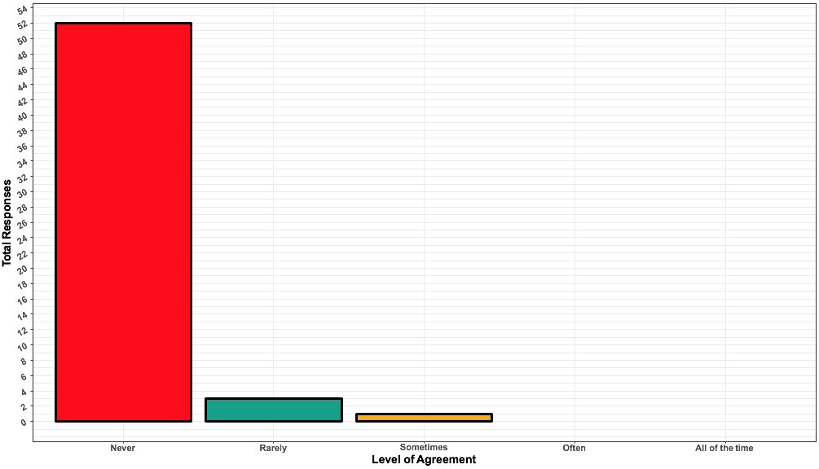
I have been sexually harassed in the department.
52
“…I marked ‘Rarely’ for the sexual harassment questions but it feels like the fact that I’ve experienced that at all (with seemingly very few consequences to the perpetrator) is not OK.”
Total Responses
3
1
Never Rarely Sometimes Often All of the time

Slide 12
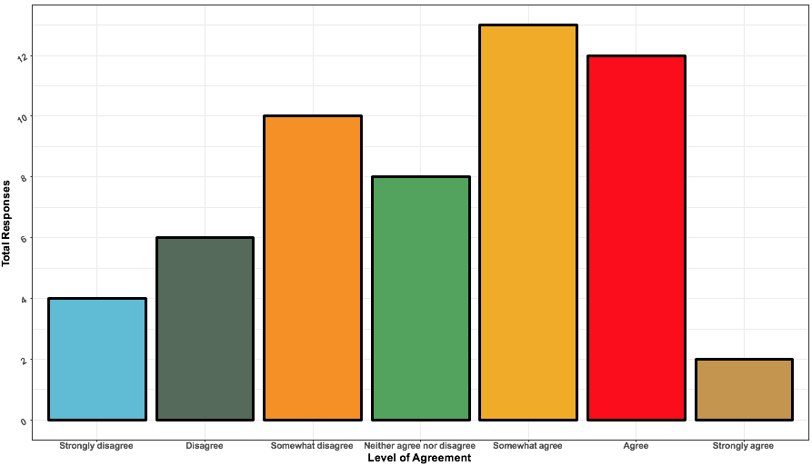
I would feel comfortable approaching someone in the department to file a formal complaint.
13
12
10
8
Total Responses
6
4
2
Strongly Disagree Somewhat Neither agree Somewhat Agree Strongly
disagree disagree nor disagree agree agree

Slide 13
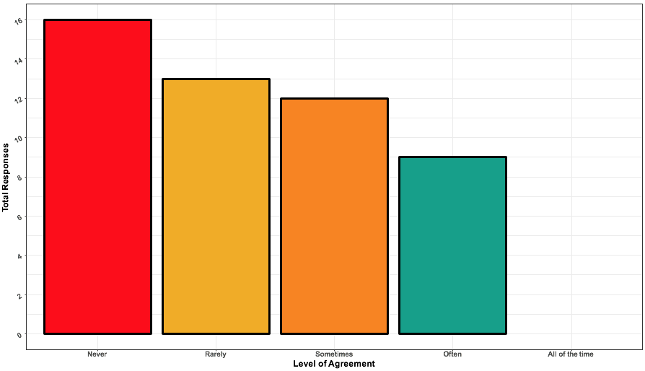
I have feared retaliation if I voice a concern in the department.
“I see as a problem that those who genuinely care about the issues may change their behaviors, whereas others "backlash" against the programming – e.g. after sexual harassment programming, my lab made many jokes about how sexual harassment is hysterical.”
16
13
12
9
Total Responses
Never Rarely Sometimes Often All of the time

Slide 14
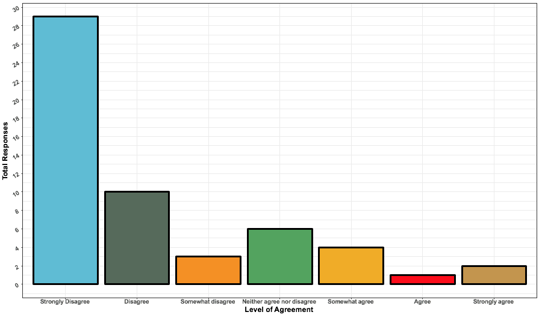
I fear retaliation from my advisor when I voice concerns.
29
Total Responses
10
6
4
3
2
1
Strongly Disagree Somewhat Neither agree Somewhat Agree Strongly
disagree disagree nor disagree agree agree

Slide 15
FUNDING

Slide 16
Have you had to borrow money or receive other assistance in addition to your stipend during your time as a graduate student in this department?
38
“I think that the grad stipend is enough to live comfortably in Tucson if you are a single person or you're not responsible for helping to send money to family etc.”
“It is almost impossible to have a family. I rely heavily on my parents and partner.”
“The lack of guaranteed summer funding is particularly stressful and the basis for determining who gets a summer teaching position is unclear.”
“The stipend is adequate for frugal living, although it is difficult to afford conferences and professional development opportunities like workshops even with GPSC and department funding.”
“I find myself working as hard as if I had a full time job, but not being appropriately compensated for a full time job.”
“…the department appears to be receiving a healthy injection of grant funds. Yet, Psychology is very close to or at the bottom of the stipend rankings in the CoS.”
“I supplement my monthly pay with $400 in borrowed money.”
“Raise the graduate student stipend to better support students without generational wealth.”
38
36
34
32
Total Responses
30
28
26
24
22
20
20
18
16
14
12
10
8
6
4
2
0
Yes
No
Yes No
Level of Agreement

Slide 17
Future Directions

Slide 18
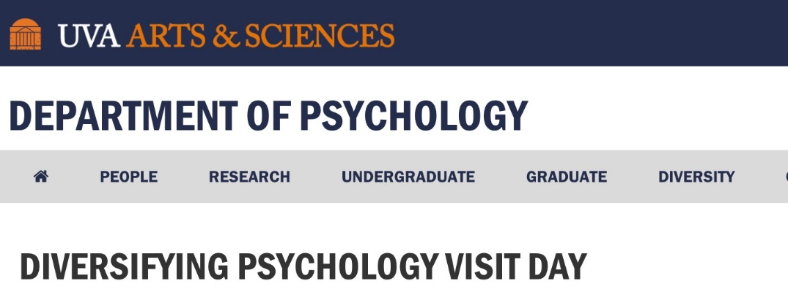
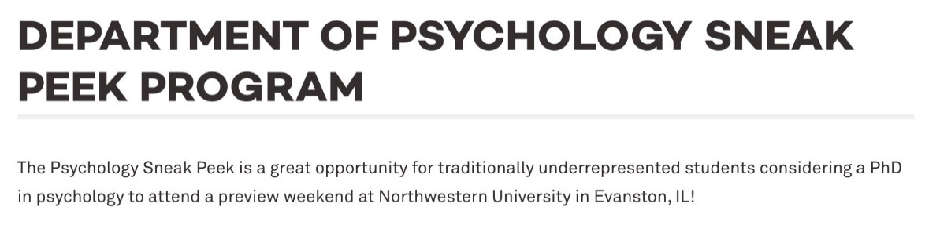


“Actively recruit more diverse students and faculty & work to retain them.”
-----
“Host a diversity weekend.”
-----
“Consider the barriers applicants have overcome to get to this point, and give less weight to things like GPA and GRE scores that are not necessarily a fair representation of underrepresented students' potential to be successful in grad school.”
-----
“Eliminate the consideration of GRE scores.”

Slide 19
ACTIONABLE (FIRST) STEPS FOR DEI
Create initiatives to secure funding for recruitment events and practices for marginalized students for the graduate program.
Prioritize training grants for students in the program, with a particular focus on those with the goal of recruiting students from underrepresented groups.
Within the Diversity committee, ensure that inclusion on the committee is based on actual diversity, equity, and inclusion work. Perhaps a restructuring to ensure action is being taken by members and to ensure all work is not put on one faculty member or all
on students.
4. Formalize a system that creates incentives for both faculty and students to prioritize work on diversity, equity, and Inclusion.

Slide 20
Thank you!

Slide 21

Breakout Session: 15 Mins
Instructions:
1. Designate a group notetaker
2. Designate a group speaker for debrief
3. Discuss:
What can we do to make our department more diverse, inclusive, and equitable? Discuss the potential pros and cons, feasibility, and timeline.

Slide 22
Debrief: What can we do to make our department more diverse, inclusive, and equitable? Discuss the potential pros and cons, feasibility, and timeline.
Notetakers, please email group ideas to ecarroll@email.arizona.edu

Slide 24
Additional Slides

Slide 25
COVID-19 Response

Slide 26
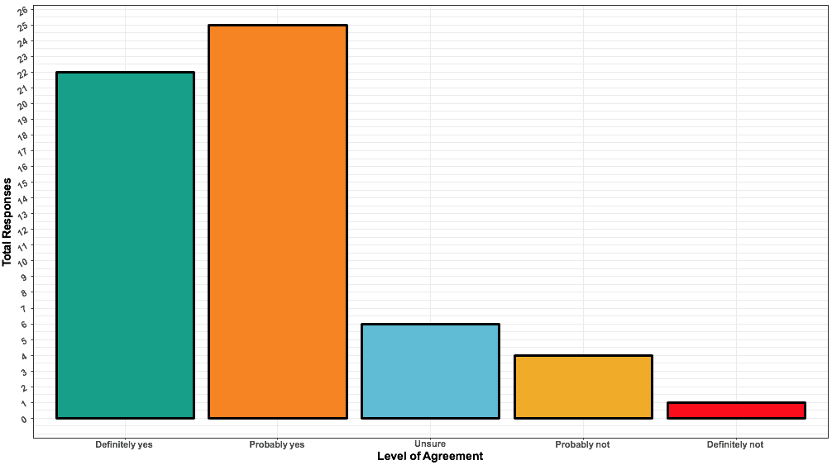
I have been satisfied with the overall department response to the pandemic
25
22
“The department was great at communicating early and often. Given the complex circumstances, I don't have any real complaints. If anything I was impressed.” “Good job Psych! I am proud of the way we have responded.”
Total Responses
6
4
1
Definitely yes Probably yes Unsure Probably not Definitely not

Slide 27
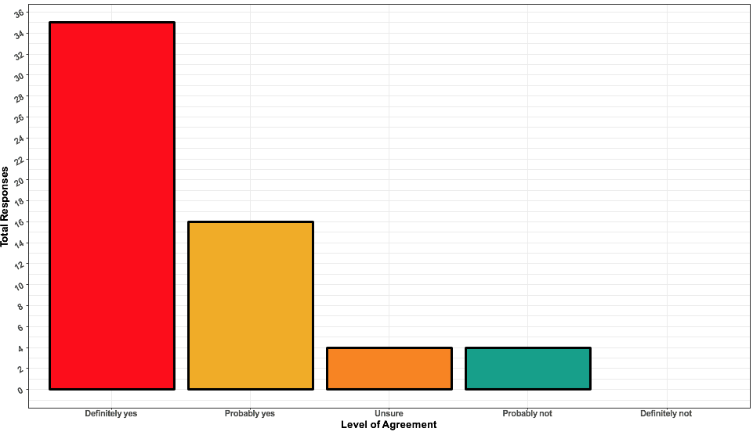
During the COVID-19 pandemic, I have felt adequately supported by my mentor.
35
Total Responses
16
4
4
Definitely yes Probably yes Unsure Probably not Definitely not

Slide 28
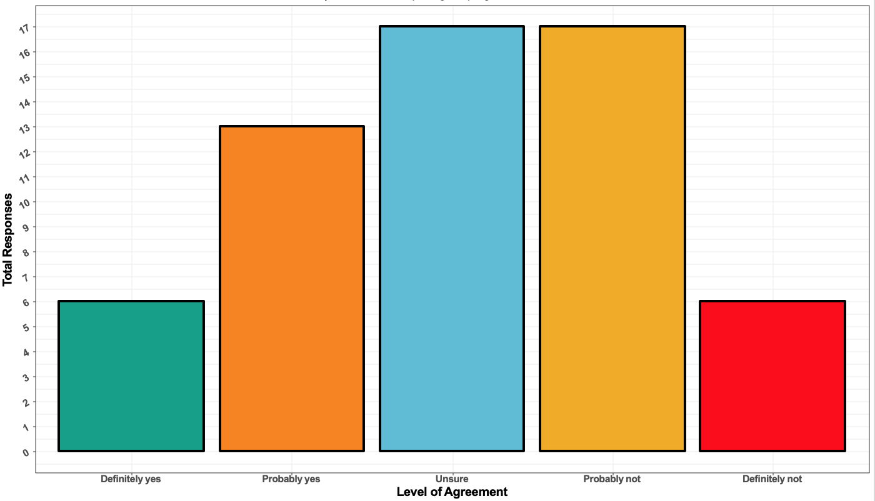
During the COVID-19 pandemic, my timeline for completing the program has been affected.
17
17
13
Total Responses
6
6
Definitely yes Probably yes Unsure Probably not Definitely not

Slide 29
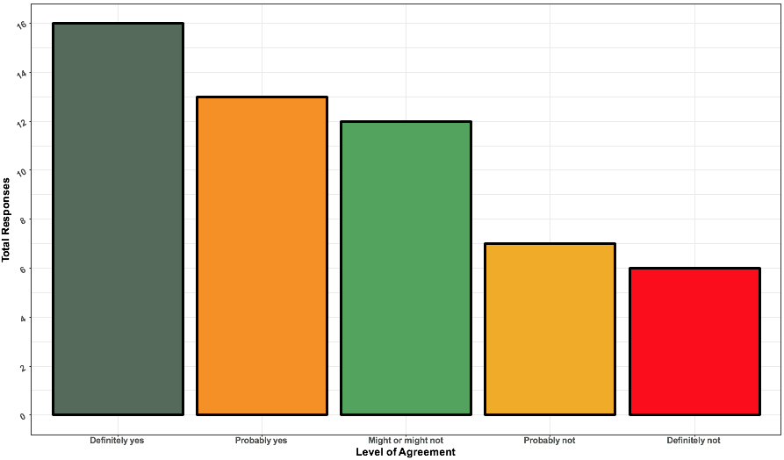
Would you benefit from a weekly graduate writing group?
16
13
12
Total Responses
7
6
Definitely yes Probably yes Might or might Probably not Definitely not
not

Slide 30
GENERAL STEPS
Institute Mentor-Mentee Contracts, and ensure oversight over these contracts that has representation on both the student and faculty level. This will set clear expectations and boundaries for both parties.
Create a Graduate Student Writing Group that is supported by the department in the form of funds for coffee and food (the ordering of which is managed by front office staff).
Institute a strict policy on what can and cannot be expected of Teaching Assistants, to ensure they are more equitable across students and lead to less exploitation of students by certain faculty.

