Slide 1
So! What’s the problem ?

Slide 2
We work on the HEAD branch
Deliver to QA
Deliver to QA
HEAD
check-in
check-in
check-in
check-in

Slide 3
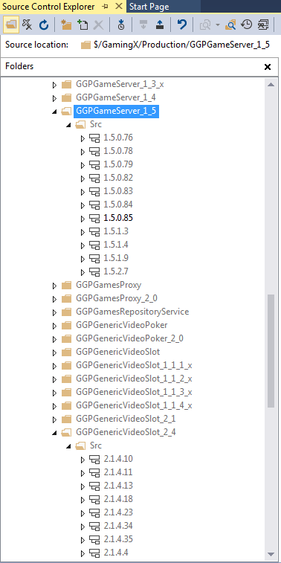
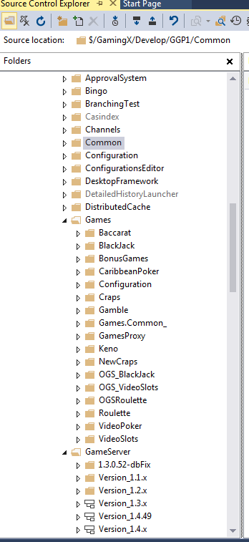
Realy, realy, realy hard to reproduce the QA/Production source code in a functional Visual Studio solution
Branch

Slide 4
Ok! But still what’s the problem?

Slide 5
Some time we need to introduce code freeze
BlackJack v1 (TFS Label)
(deliver to QA)
Video Slot v2 (TFS Label)
(deliver to QA)
HEAD
Code freeze
check-in
check-in
check-in
check-in
Production

Slide 6
In some other worse cases we need to rollback
Rollback
BlackJack v1 (TFS Label)
(deliver to QA)
Video Slot v2 (TFS Label)
(deliver to QA)
HEAD
check-in
check-in
check-in
check-in
check-in
check-in
Production

Slide 7
Sometime release unwanted content
HEAD
Florin check-in some work in progress
Yonatan check-in some final work and release to QA
This will include Florin’s work of which Yonatan is not aware.

Slide 8
Really hard to make a hot fix
Hot fix should be here
HEAD
check-in
check-in
For this we need to reproduce the code at that moment
QA/Production related source code - But this is hard to achive today

Slide 9
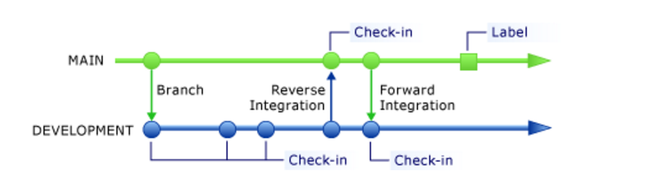
Basic strategy recomanded
https://blog.codinghorror.com/software-branching-and-parallel-universes/

Slide 10
Why basic is not enough

Slide 11
Because we don’t have a single product
GGP HEAD
Black Jack Head
Black Jack DEV
Video Slots Head
Video Slots DEV
Core Head
Core DEV
GGP DEV

Slide 12
Even more complicated we have multiple head & dev branches
GGP 1.3.x HEAD
GGP 1.3.x DEV
GGP 1.5.x HEAD
GGP 1.5.x DEV
GGP 3.0.x HEAD
GGP 3.0.x DEV

Slide 13
The solution

Slide 14
Create the first Head branch and let’s name it QA 1.x
QA 1.x

Slide 15
And imediate branch it to Dev 1.x
Dev 1.x
QA 1.x
B

Slide 16
Do some work on Dev 1.x and when QA ready then first (as a good practice) do a forward integration (FI) then do a reverse integration (RI) from Dev 1.x to QA 1.x and then trigger an installer (I1).
Each installer puts TFS labels on the components source code it contains.
Dev 1.x
RI
QA 1.x
B
FI
I1

Slide 17
Do some more work on Dev 1.x and then integrate again with QA 1.x and trigger another installer (I2). Remember always do a FI before a RI!
Dev 1.x
RI
RI
QA 1.x
B
FI
I1
FI
I2

Slide 18
Now we are ready for production. So create production installer and branch only the components in this production installer a GIB [InstallerVersion] branch (use the TFS labels to do this)
Dev 1.x
RI
RI
QA 1.x
B
FI
I1
FI
I2
B
GIB
1.0.0.0

Slide 19
Damn! A bug in production! Let’s make a hotfix and deliver a Customized Installer (CI1). After that merge the hotfix to QA 1.x and Dev. 1.x
trigger.ini complicates the installers creation. Let’s talk about it!
Dev 1.x
RI
RI
QA 1.x
B
FI
I1
FI
I2
B
FI
http://stackoverflow.com/questions/9996136/exclude-a-config-file-from-the-merge-process
GIB
1.0.0.0
RI
CI1
Hotfix

Slide 20
More work on Dev.1x ready for QA. Deliver a new installer to QA (I3)
Dev 1.x
RI
RI
RI
QA 1.x
B
FI
I1
FI
I2
B
FI
FI
I3
GIB
1.0.0.0
RI
CI1
Hotfix

Slide 21
And ready for another production upload. And make another GIB branch. Theoretically at this point we can discard the previous GIB branch.
Dev 1.x
RI
RI
RI
QA 1.x
B
FI
I1
FI
I2
B
FI
FI
I3
B
GIB
1.0.0.0
RI
CI1
GIB
1.0.0.N
Hotfix

Slide 22
Now it comes the time to move forward and start the next major version. We branch QA 1.x to QA 2.x.
Dev 1.x
RI
RI
RI
QA 1.x
B
FI
I1
FI
I2
B
FI
FI
I3
B
B
GIB
1.0.0.0
RI
CI1
GIB
1.0.0.N
Hotfix
QA 2.x

Slide 23
And right after that create the Dev 2.x branch.
Dev 2.x
Dev 1.x
RI
RI
RI
QA 1.x
B
FI
I1
FI
I2
B
FI
FI
I3
B
B
GIB
1.0.0.0
RI
CI1
GIB
1.0.0.N
Hotfix
QA 2.x
B

Slide 24
Now we have something to deliver to QA for 2.x so we build QA installer I1.
Dev 2.x
RI
Dev 1.x
RI
RI
RI
QA 1.x
B
FI
I1
FI
I2
B
FI
FI
I3
B
B
GIB
1.0.0.0
RI
CI1
GIB
1.0.0.N
Hotfix
QA 2.x
B
FI
I1

Slide 25
Meanwhile something might happen on the 1.x branch. Remember we still have 1.x in production.
Dev 2.x
RI
Dev 1.x
RI
RI
RI
RI
QA 1.x
B
FI
I1
FI
I2
B
FI
FI
I3
B
B
FI
I3
GIB
1.0.0.0
RI
CI1
GIB
1.0.0.N
Hotfix
QA 2.x
B
FI
I1

Slide 26
So we might need to selectively merge some code from 1.x to 2.x (SFI).
Discussion: Should the Selective Forward Integration (SFI) should be done directly on the QA branch ? Maybe we should do it on the Dev 2.x branch ?
Dev 2.x
RI
Dev 1.x
RI
RI
RI
RI
QA 1.x
B
FI
I1
FI
I2
B
FI
FI
I3
B
B
FI
I3
SFI
GIB
1.0.0.0
RI
CI1
GIB
1.0.0.N
Hotfix
QA 2.x
B
FI
I1
I2

Slide 27
More work on Dev 2.x
Dev 2.x
RI
RI
Dev 1.x
RI
RI
RI
RI
QA 1.x
B
FI
I1
FI
I2
B
FI
FI
I3
B
B
FI
I3
SFI
GIB
1.0.0.0
RI
CI1
GIB
1.0.0.N
Hotfix
QA 2.x
B
FI
I1
I2
FI
I3

Slide 28
Disscution: Environments alignment
And finally we upload 2.x to production. Basically at this point the support for 1.x stops.
Dev 2.x
RI
RI
Dev 1.x
RI
RI
RI
RI
QA 1.x
B
FI
I1
FI
I2
B
FI
FI
I3
B
B
FI
I3
SFI
GIB
1.0.0.0
RI
CI1
GIB
1.0.0.N
Hotfix
QA 2.x
B
FI
I1
I2
FI
I3
B
GIB
2.0.0.0

Slide 29
And the process repeats.
Dev 2.x
RI
RI
RI
Dev 1.x
RI
RI
RI
RI
QA 1.x
B
FI
I1
FI
I2
B
FI
FI
I3
B
B
FI
I3
SFI
GIB
1.0.0.0
RI
CI1
GIB
1.0.0.N
Hotfix
QA 2.x
B
FI
I1
I2
FI
I3
B
FI
I4
B
GIB
2.0.0.0
RI
CI1
GIB
2.0.0.N
Hotfix

Slide 30
If really need it we can make adhoc dev branches
Dev 2.x.Experiment (or not)
RI
Dev 2.x
RI
B
RI
FI
RI
Dev 1.x
RI
RI
RI
RI
QA 1.x
B
FI
I1
FI
I2
B
FI
FI
I3
B
B
FI
I3
SFI
GIB
1.0.0.0
RI
CI1
GIB
1.0.0.N
Hotfix
QA 2.x
B
FI
I1
I2
FI
I3
B
FI
I4
B
GIB
2.0.0.0
RI
CI1
GIB
2.0.0.N
Hotfix

Slide 31
Branch individual components instead of full GGP source code (foreach(component in GGPComponents){component.Branch()}
Dev 1.x
Regular TFS folder
Core
Regular TFS folder
Host
TFS branch
GameEngine 1
QA 1.x
GameEngine 2
Core
GameEngine 3
Host
GameEngine 1
GameEngine 2
GIB
1.0.0.0
GameEngine 3
Core
Host
GameEngine 1
GameEngine 2

Slide 32
Advantages:
Fine grain merging. Usually when we want to merge from Dev to QA we don’t want to merge everything. We want to merge one new game, or some new engine fix, or some core fix. This would make it easy to select the change sets to apply when you want to merge to QA.
Easy creating production branches. Not all components in QA should be in Production. Having branches per component we can create a folder that contains branches only for components in production.
Disadvantages:
Harder when we need to merge many components. TFS tools don’t alow to do a many to many merging. We need to build our own tools if we want to make it easy (or maybe there are other tools).
There is no out of the box TFS tool to allow branching multiple folders at once. Or maybe it is but I didn’t find it (I have to admit that I didn’t even search for it). Anyway this is an easy one (we can make a script or a tool to help us).

Slide 33
First branch (QA + DEV)
Dev 1.x
QA 1.x
B

Slide 34
Work on it and deploy to production
Dev 1.x
RI
QA 1.x
B
FI
B
GIB
1.0.0.0

Slide 35
New important feature we need to develop (new regulation, free spins etc). Create 1.1.x and start working on it
Dev 1.1.x
RI
Dev 1.x
RI
QA 1.x
B
FI
B
B
GIB
1.0.0.0
QA 1.1.x
B
FI

Slide 36
Sometimes we need to merge from 1.x to 1.1.x
Dev 1.1.x
RI
Dev 1.x
RI
QA 1.x
B
FI
B
B
FI
GIB
1.0.0.0
QA 1.1.x
B
FI

Slide 37
Deploy 1.1.x to production and stop support for 1.x
Dev 1.1.x
RI
Dev 1.x
RI
QA 1.x
B
FI
B
B
FI
GIB
1.0.0.0
QA 1.1.x
B
FI
B
GIB
1.1.0.0

Slide 38
Big refactoring, architecture changes so we start a major version 2.x
Dev 2.x
RI
Dev 1.1.x
RI
Dev 1.x
RI
QA 1.x
B
FI
B
B
FI
GIB
1.0.0.0
QA 1.1.x
B
FI
B
B
GIB
1.1.0.0
QA 2.x
B
FI

Slide 39
Sometimes we need to merge from 1.1.x to 2.x
Dev 2.x
RI
Dev 1.1.x
RI
Dev 1.x
RI
QA 1.x
B
FI
B
B
FI
GIB
1.0.0.0
QA 1.1.x
B
FI
B
B
FI
GIB
1.1.0.0
QA 2.x
B
FI

Slide 40
Component versioning strategy

Slide 41
Dev 1.x
QA 1.x
B

Slide 42
Dev 1.x
BJ
Changes 1..N
RI
QA 1.x
B
I1
BJ 1.0.0.0

Slide 43
Dev 1.x
BJ
Changes 1..N
RI
BJ
Changes 1..N
RI
QA 1.x
B
I1
BJ 1.0.0.0
I2
BJ 1.0.1.0

Slide 44
Dev 2.x
Dev 1.x
BJ
Changes 1..N
RI
BJ
Changes 1..N
RI
QA 1.x
B
I1
BJ 1.0.0.0
I2
BJ 1.0.1.0
B
QA 2.x
B

Slide 45
Dev 2.x
Core
Changes 2..N
RI
Dev 1.x
BJ
Changes 1..N
RI
BJ
Changes 1..N
RI
QA 1.x
B
I1
BJ 1.0.0.0
I2
BJ 1.0.1.0
B
I1
Core 2.0.0.0
BJ 1.0.1.0
QA 2.x
B

Slide 46
Dev 2.x
Core
Changes 2..N
RI
Dev 1.x
BJ
Changes 1..N
RI
BJ
Changes 1..N
RI
QA 1.x
B
I1
BJ 1.0.0.0
I2
BJ 1.0.1.0
B
I1
Core 2.0.0.0
BJ 1.0.1.0
QA 2.x
B
B
GIB Installer 2.0.0.0
Core 2.0.0.0
BJ 1.0.1.0

Slide 47
Dev 2.x
Core
Changes 2..N
RI
Dev 1.x
BJ
Changes 1..N
RI
BJ
Changes 1..N
RI
BJ
Changes 1..N
RI
QA 1.x
B
I1
BJ 1.0.0.0
I2
BJ 1.0.1.0
B
I3
BJ 1.0.2.0
I1
Core 2.0.0.0
BJ 1.0.1.0
QA 2.x
B
B
GIB Installer 2.0.0.0
Core 2.0.0.0
BJ 1.0.1.0

Slide 48
Major.Minor – common for all components (1.0; 1.1; 2.0)
Build.Revision – specific for each component
(BJ regular builds: 0.0; 1.0; 2.0)
(BJ hot fixes (revisions): 1.1; 2.1)
Dev 2.x
Core
Changes 1..N
RI
Dev 1.x
BJ
Changes 1..N
RI
BJ
Changes 1..N
RI
BJ
Changes 1..N
RI
QA 1.x
B
I1
BJ 1.0.0.0
I2
BJ 1.0.1.0
B
I3
BJ 1.0.2.0
RI
Merge changes
from BJ
I1
Core 2.0.0.0
BJ 1.0.1.0
I2
Core 2.0.0.0
BJ 2.0.0.0
QA 2.x
B
B
GIB Installer 2.0.0.0
Core 2.0.0.0
BJ 1.0.1.0

Slide 49
Games location problem

Slide 50
Dev 1.x
VIS4
New Game1
RI
VIS4
New Game2
RI
QA 1.x
B
I1
Game1
I2
Game1
Game2
B
GIB Installer branch
VIS4 Engine (Game1 + Game2)

Slide 51
To do for the build process
One single build project per GGP branch
Compile everything deliver only changed components
Installers for DEV branches
Use TFS builds instead of CC

