Slide 1

Interpretability & Ethics in topics of Artificial Intelligence
Jack Ogilvie-Richards
D4 Cohort

Slide 2

What is Interpretability?
“ Interpretability is about the extent to which a cause and effect can be observed within a system. Or, to put it another way, it is the extent to which you are able to predict what is going to happen, given a change in input or algorithmic parameters. It’s being able to look at an algorithm and go yep, I can see what’s happening here. ” (Richard Gall)
Learning Outcomes:
To see the problems and solutions of ethical issues with AI interpretability
To understand how a model’s interpretability depends on ethical principles
To learn something new!

Slide 3
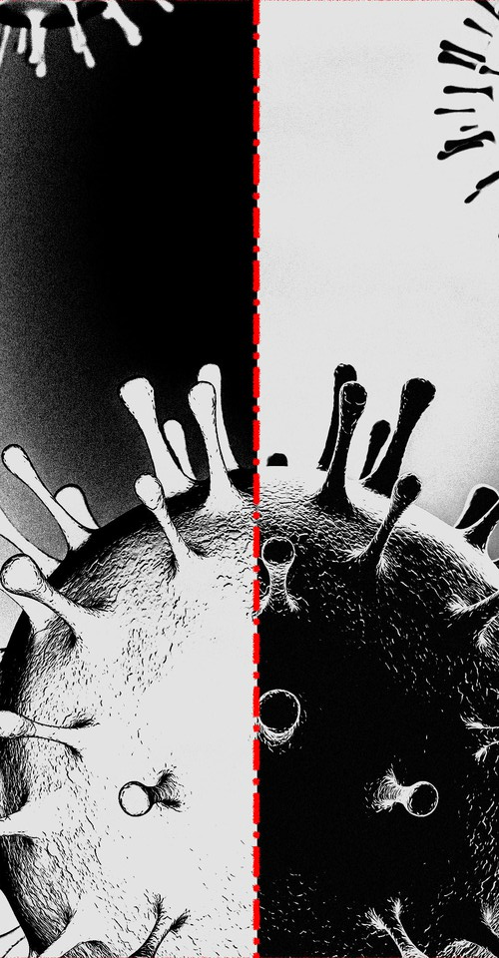
Types of Interpretation and the ethical issues surrounding them:
Interpretation, without too much detail, is a part of the pre-model, the modelling and the post hoc in any development of an ‘A.I.’ feature or technology.
A common issue ethically is that models often struggle to have a coherent in-out interpretation - this is especially important when the relation between the in-out functionality of the A.I. often has negative ethical outcomes.
Examples:
Without interpretability, population data could present racist/sexist/discriminatory conclusions in systems used for policing technologies and military operations of the future.
Databases for facial documentation are not impartial to misrepresentative trends - models trained using such data run risks of false assumptions and bias predictions.
Formal use of uninterpretable A.I. is still common, with people falling in line without doubt over the accuracy and decision-making of these products.

Slide 4




Example of Focus - clarifai military involvement
A young tech startup, ‘Clarifai’, working in facial recognition software announced a fringe team ‘Neural Network One’ (public sector) and general company focus to switch entirely to military projects (‘Project Maven’, border control, automated warfare, etc.) in 2018.
Facial recognition software was implemented into drone object detection, causing larger companies like Google to drop the military contract after protests within the staff. In Clarifai, there was a suspicious 20% drop in staff with mixed employee reviews, which has continued.
Project Maven is a Pentagon effort to infuse A.I. within military tech:
Many, like the Google employees, argue there are major ethical issues with the application of the algorithms for military use;
Liu, an employee present for and fired after a major breach, now suing the company said:
‘...She also says that the lack of transparency and poor security she witnessed at Clarifai made it an unsuitable place to help with that. “If now Google’s out of the running, and all they have left is companies like Clarifai, that’s sad and scary.”
Now faces a lawsuit over use of scrapped OkCupid profile databases in training the algorithms.

Slide 5


Ethical solutions and approaches:
Joy Buolamwini - one of many genuine faces of hope for ethical bias in models, algorithms and fighting what she calls ‘the coded gaze’. I’ll leave a link for her TED talk here & Slack: https://www.ted.com/talks/joy_buolamwini_how_i_m_fighting_bias_in_algorithms?language=en#t-186474
She has created two films (‘Code4Rights’ and ‘Algorithmic Justice League: Unmasking Bias’), appeared in high-profile features (Times 100 Next, Forbes Top 50 Women in Tech) and is cited by Google, Microsoft and IBM as an influence to addressing gender and race bias in their products.
Further organisations: Safe Face Pledge, Ford Foundation, The Perpetual Line Up, and many more.

Slide 6

“Back in the era of pulp science fiction, magazine covers occasionally depicted a sentient monstrous alien—colloquially known as a bug-eyed monster (BEM)—carrying off an attractive human female in a torn dress. It would seem the artist believed that a nonhumanoid alien, with a wholly different evolutionary history, would sexually desire human females … Probably the artist did not ask whether a giant bug perceives human females as attractive. Rather, a human female in a torn dress is sexy—inherently so, as an intrinsic property. They who made this mistake did not think about the insectoid’s mind: they focused on the woman’s torn dress. If the dress were not torn, the woman would be less sexy; the BEM does not enter into it.” (Yudkowsky 2008)

Slide 7
