Slide 1

Fake news detection Machine Learning & Data Mining A.A. 2025-2026
Alessio Grillo – Andrea Giacomazzi

Slide 2
Problem
Information overload: Rapid spread of unverified digital content.
Impact: Polarization and manipulation of public opinion.
Scalability: Manual fact-checking is too slow for modern data volumes.
Goal: Need for automated, real-time detection systems.

Slide 3
Our proposal
Objective: Develop a robust Machine Learning classifier to distinguish bewteen real and fake information.
Approach: Integrating Semantic Analysis with Stylometric Features.
Explainability: Using XAI techniques (SHAP and LIME) to make model’s decisions transparent.
Solution: A functional application for real-time news assesment.

Slide 4
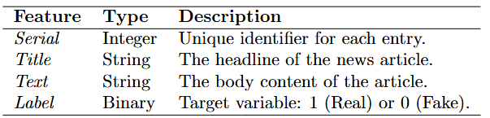
Dataset & EDA
The dataset is WELFake and is present in Kaggle, it consists of 72,134 records, distributed across four primary features:

Slide 5
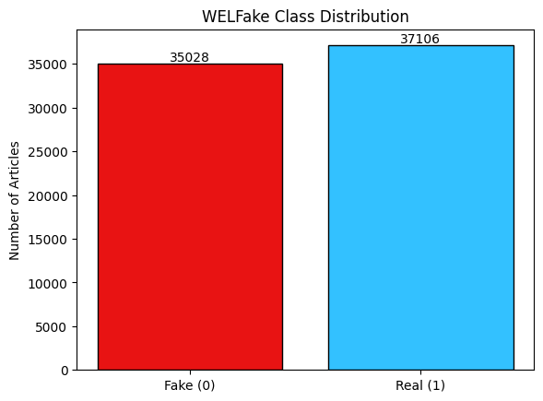
Dataset & EDA
The WELFake dataset is remarkably well-balanced

Slide 6
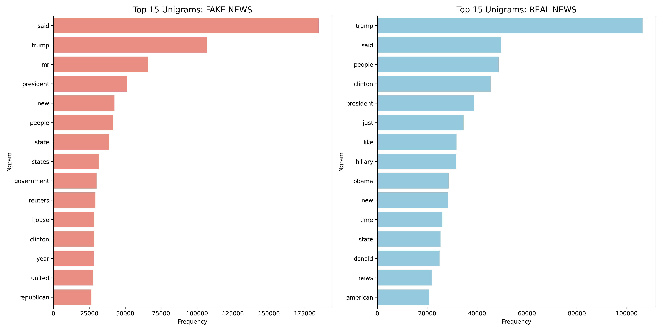
Dataset & EDA
Unigram Frequency Analysis

Slide 7
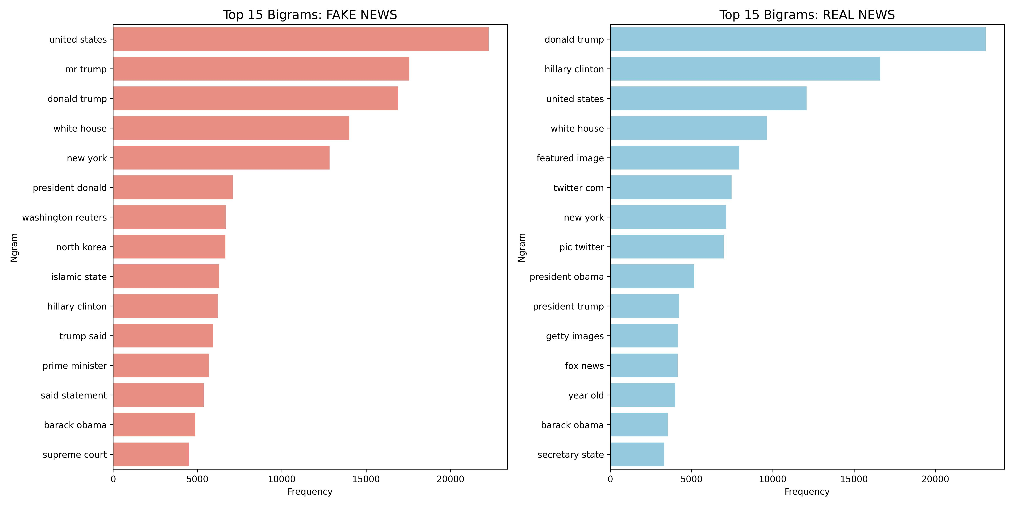
Dataset & EDA
Bigram Frequency Analysis

Slide 8
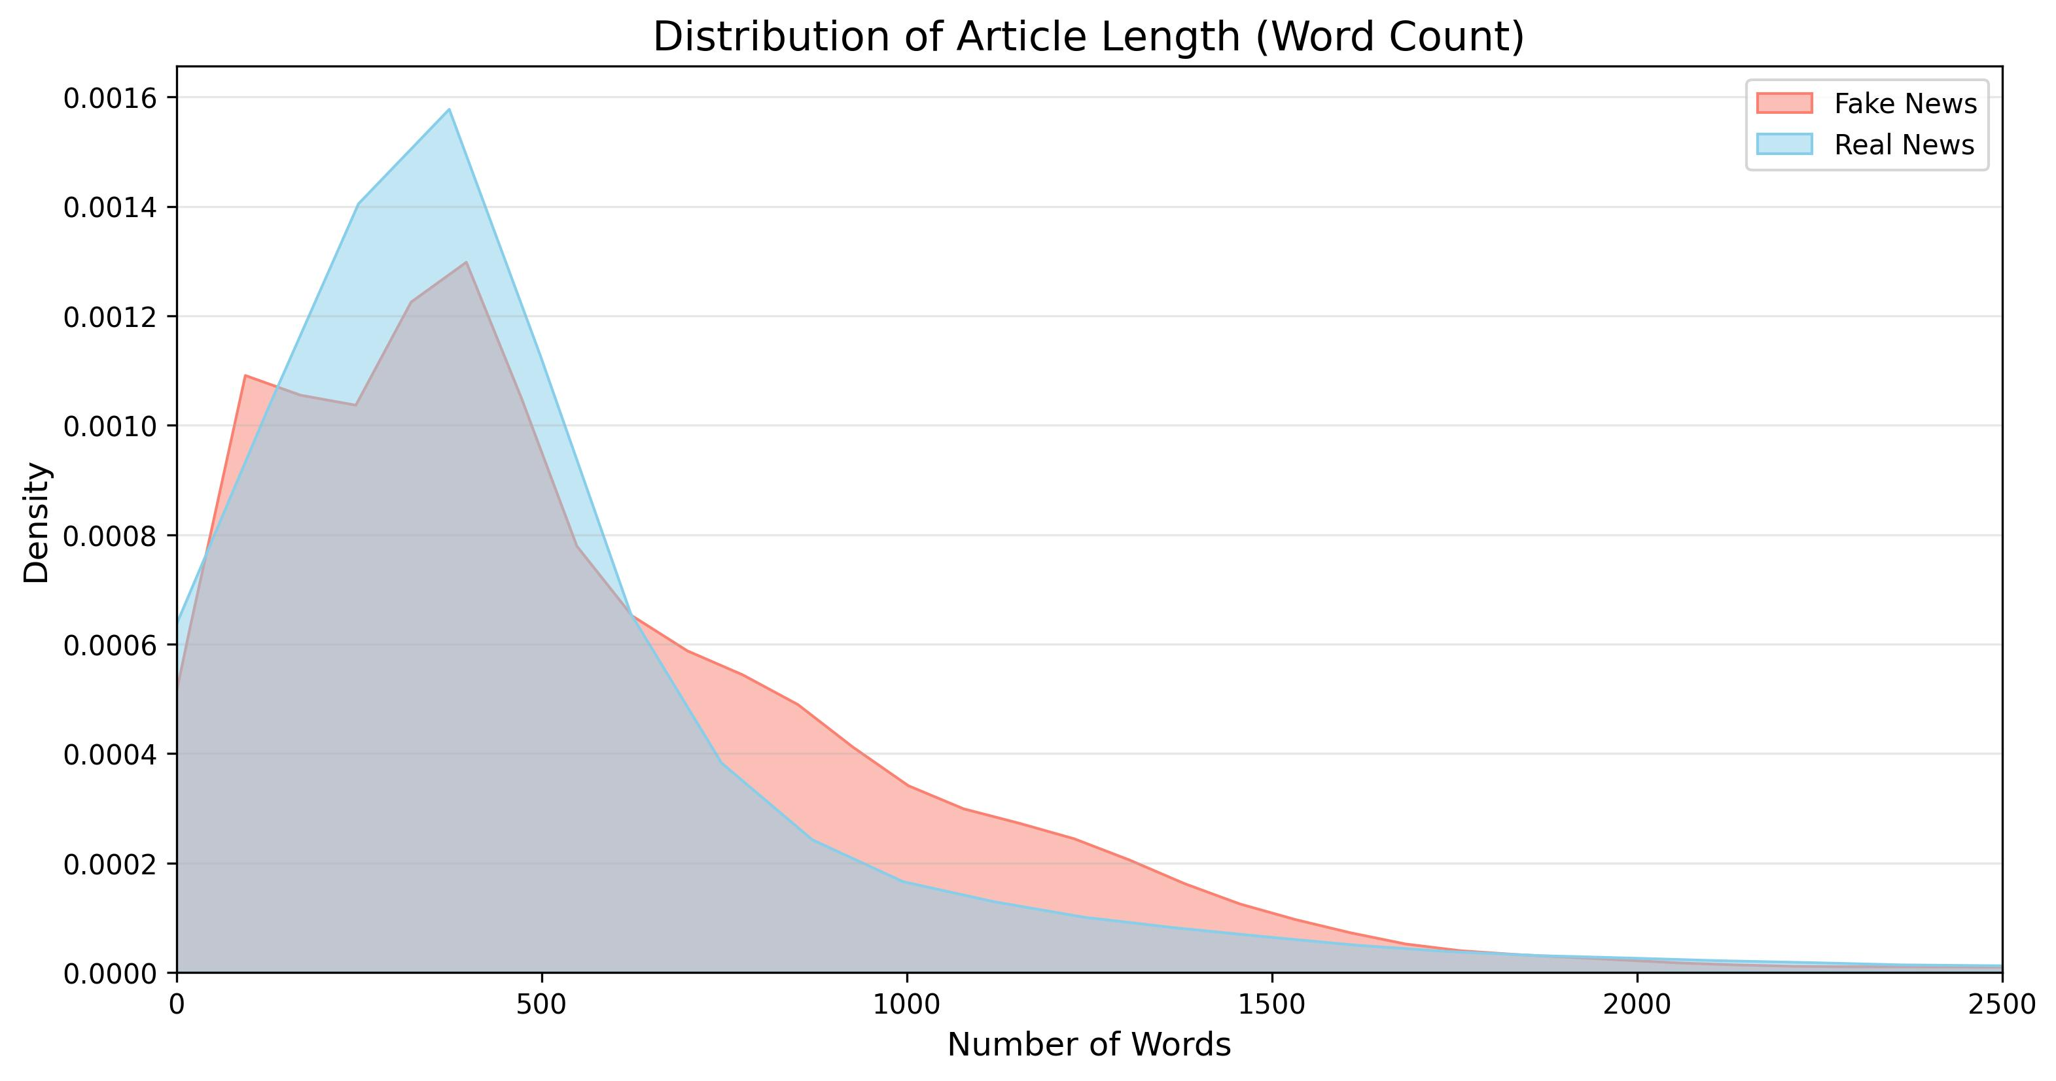
Dataset & EDA
Distribution of article’s body length

Slide 9
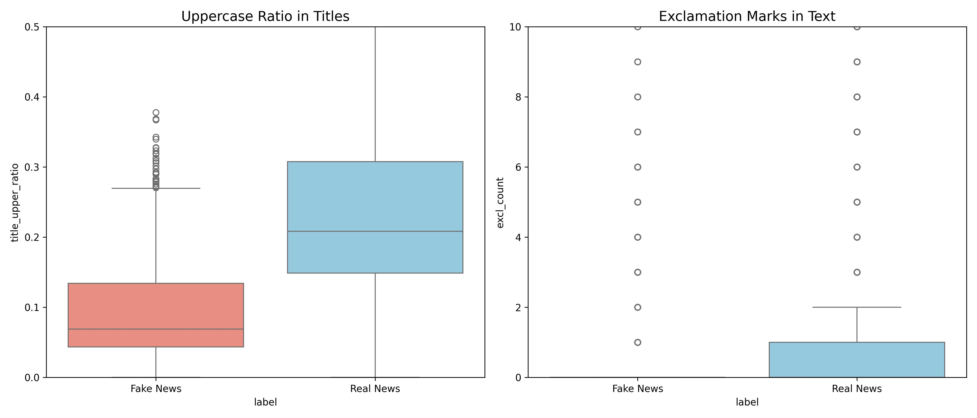
Dataset & EDA
Uppercase ratio in titles and exclamation marks in article’s body

Slide 10
Data preprocessing
Data Cleaning and Data Integration
Handling Missing Values: Entries with null values in the title or text fields were identified. Given the size of the dataset, these rows were removed to maintain a high-quality corpus.
Feature Integration: We performed a horizontal integration of the title and text columns. This creates a unified ”content” feature, allowing the model to analyze headlines (often rich in clickbait patterns) alongside the full body of the article

Slide 11
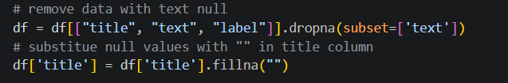
Data preprocessing
Data Cleaning and Data Integration

Slide 12
Data preprocessing
Stylometric Feature Engineering
Lexical Casing: We calculated the percentage of uppercase words. High frequencies of capitalized text are a common proxy for sensationalism.
Article Volumetry: We integrated the size of the article (total word count), as fake news often lacks the depth and length of authentic journalism.
Linguistic Integrity: A dedicated module quantified the number of spelling errors, distinguishing professionally edited news from unverified content.
Punctuation Analysis: We tracked the density of exclamation (!) and question marks (?) to detect inflammatory or non-neutral rhetoric.

Slide 13
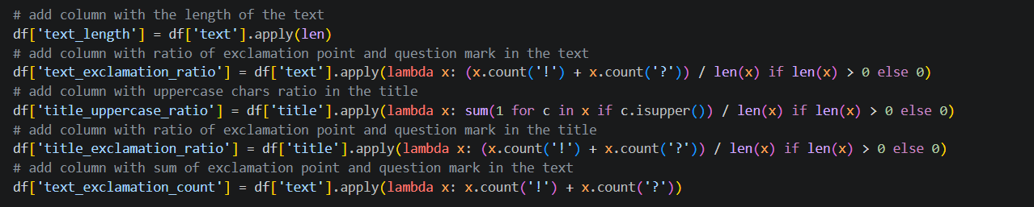
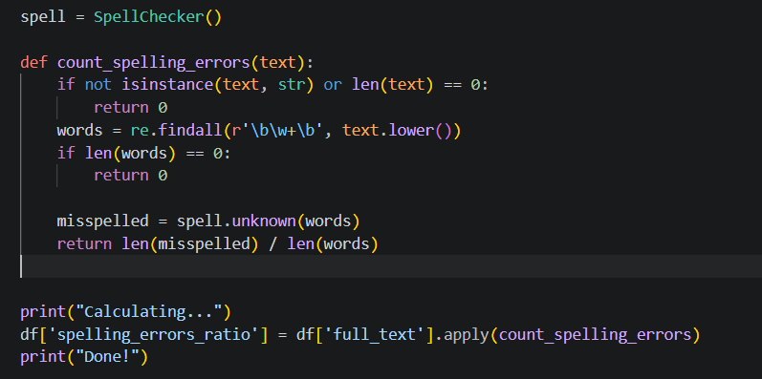
Data preprocessing
Stylometric Feature Engineering

Slide 14
Data preprocessing
Text Normalization, Tokenization, and Leak-age Prevention
Noise Removal: We stripped non-alphanumeric characters using regular expressions.
Case Folding: All text was converted to lowercase to unify the vocabulary.
Tokenization: The clean text was segmented into individual tokens (words), which serve as the fundamental units for the subsequent vectorization.
Lemmatization: To group inflected forms of words, tokens were reduced to their morphological roots (e.g., ”running” to ”run”), thereby reducing the dimensionality of the feature space without losing semantic meaning.
Custom Stopword Elimination: Beyond standard English stopwords (e.g., ”of”, ”the”, ”in”), we implemented a targeted exclusion list based on our exploratory N-gram analysis.

Slide 15
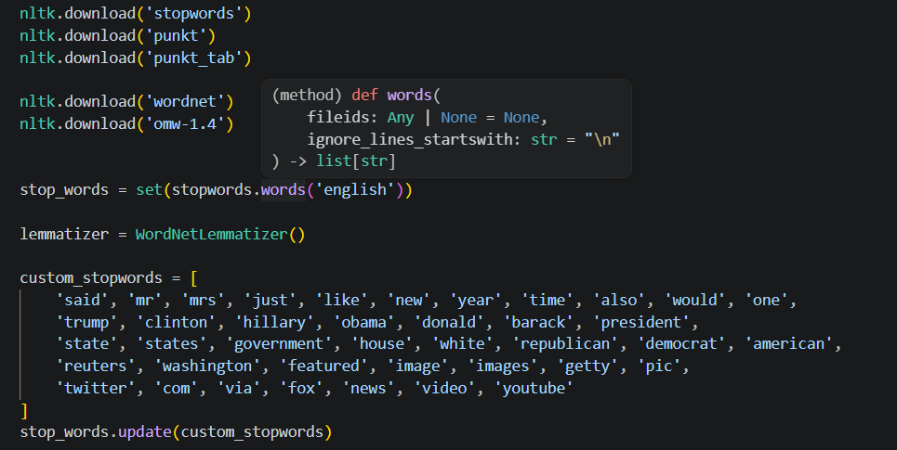
Data preprocessing
Text Normalization, Tokenization, and Leak-age Prevention

Slide 16
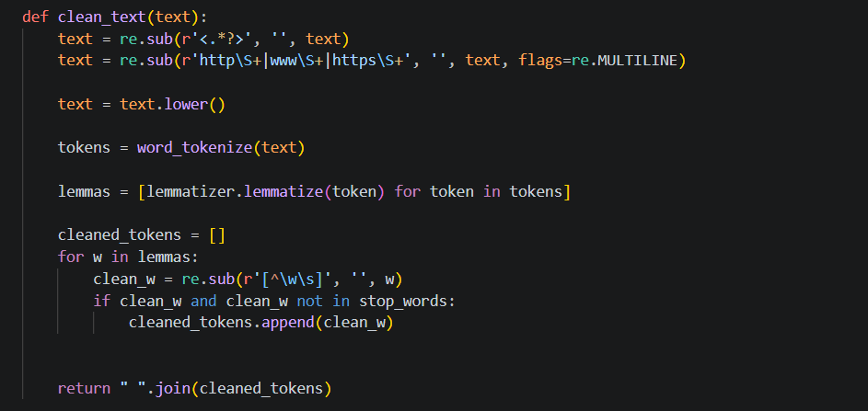
Data preprocessing
Text Normalization, Tokenization, and Leak-age Prevention

Slide 17
Data preprocessing
Vectorization: 10,000 TF-IDF Features
Configuration: TF-IDF using 10,000 features (Unigrams & Bigrams).
Dimensionality Control:
Mitigates the "Curse of Dimensionality".
Optimizes the data-to-feature ratio for 72,095 samples.
Prevents statistical sparsity and improves class separability.
Noise Reduction: Focuses on high-signal linguistic patterns to minimize overfitting.
Experimental Integrity:
Vectorizer fitted exclusively on training folds.
Zero-knowledge approach for validation/test sets to prevent Data Leakage.

Slide 18
Data preprocessing
Feature Integration & Scaling
Objective: Harmonize stylometric features (e.g., text length, punctuation) with TF-IDF vectors.
Normalization:
Applied MinMaxScaler to map all features to a fixed [0, 1] range.
Prevents high-magnitude variables (character counts) from biasing the model.
Aligns stylistic data with the inherently normalized TF-IDF scale.
Methodological Rigor:
Followed a "Zero-Knowledge" approach.
Scaling parameters (min, max) were fitted only on training folds to prevent data leakage.
Feature Fusion: Horizontal concatenation of the 5D stylistic vector and the sparse TF-IDF matrix to create the final feature set.

Slide 19
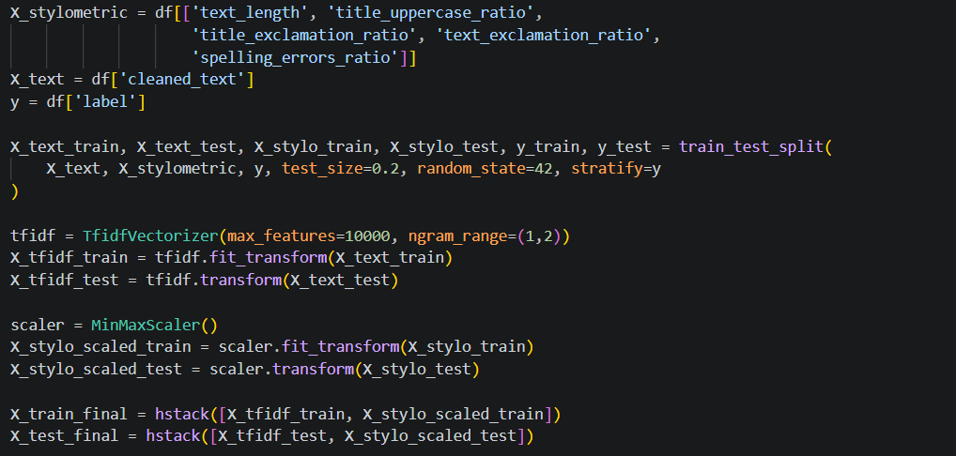
Data preprocessing
Vectorization & Feature Integration & Scaling

Slide 20
Models evaluation
Validation Strategy: Stratified 10-Fold Cross-Validation.
Algorithms Tested: Logistic Regression, SVM, Random Forest, AdaBoost, LightGBM.
Winner: LightGBM (F1-Score: 0.971, Accuracy: 0.970).
Why LightGBM? Best balance between speed, precision, and handling of our high-dimensional features (TF-IDF).

Slide 21
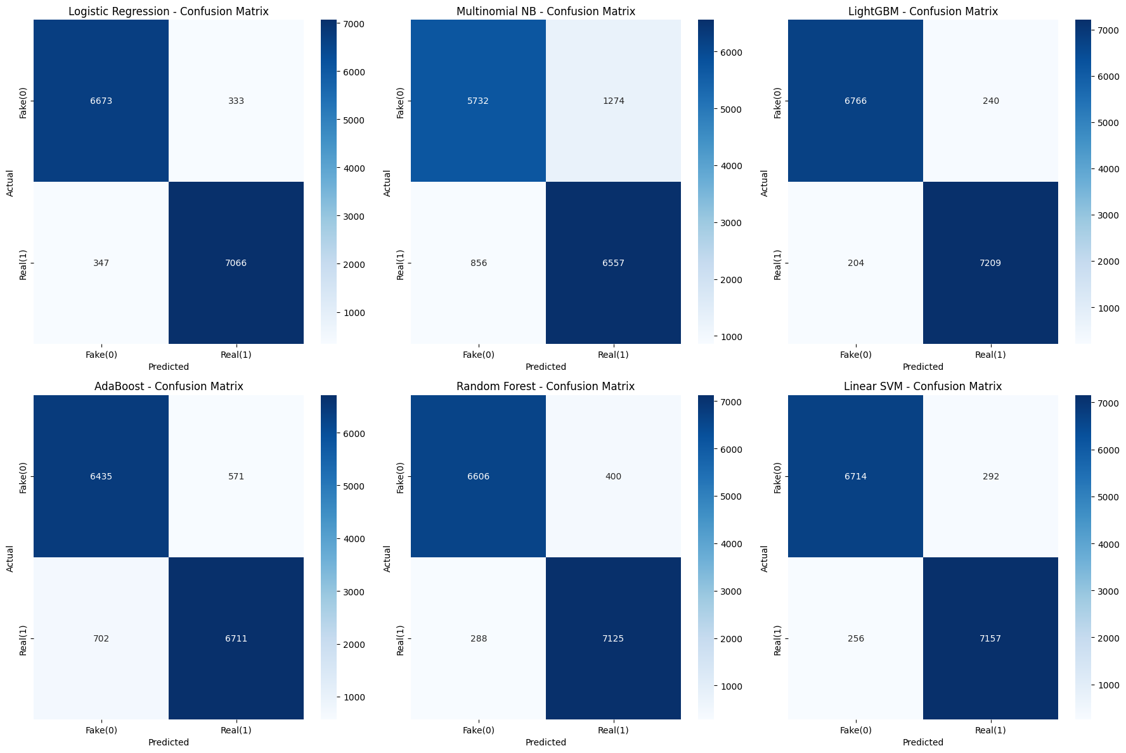
Models evaluation

Slide 22
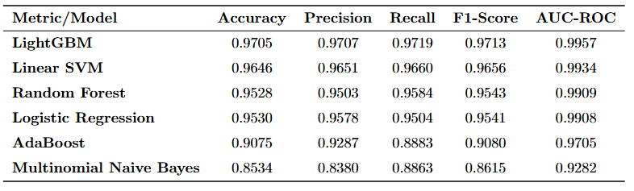
Models evaluation

Slide 23
LightGBM optimization
Technique: Grid Search with Stratified Cross-Validation.
Target Metric: Maximizing F1-Score.
Tuned Parameters: learning_rate, num_leaves, max_depth, n_estimators.
Final Result: F1-Score increased to 97.9% (Accuracy: 97.9%).
Key Benefit: Better generalization and lower risk of overfitting.

Slide 24
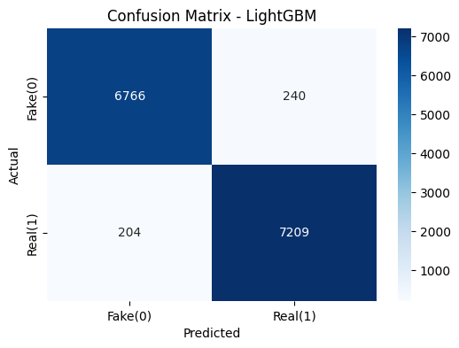
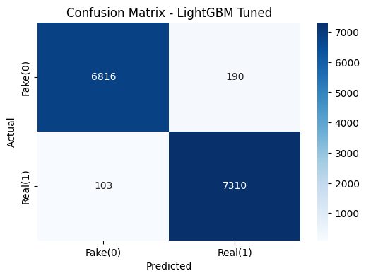
LightGBM optimization

Slide 25
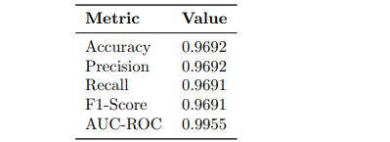
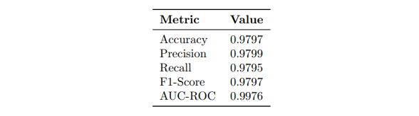
LightGBM optimization
Before Hyperparameter Tuning (Test set)
After Hyperparameter Tuning (Test set)

Slide 26
Model explainability
The "Black Box" Problem: High performance requires transparency and trust.
Global Interpretation (SHAP): Identifies the most impactful features across the entire dataset (e.g., specific keywords, exclamation ratio).
Local Interpretation (LIME): Explains single, real-time predictions to the end-user.
Our Strategy: SHAP for model validation, LIME for user-facing transparency.

Slide 27
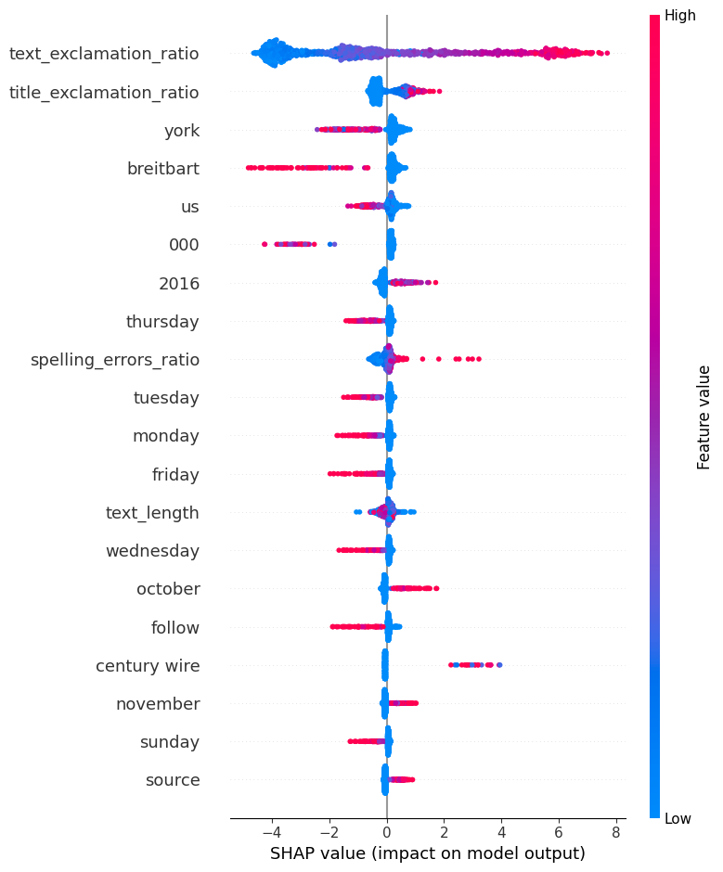
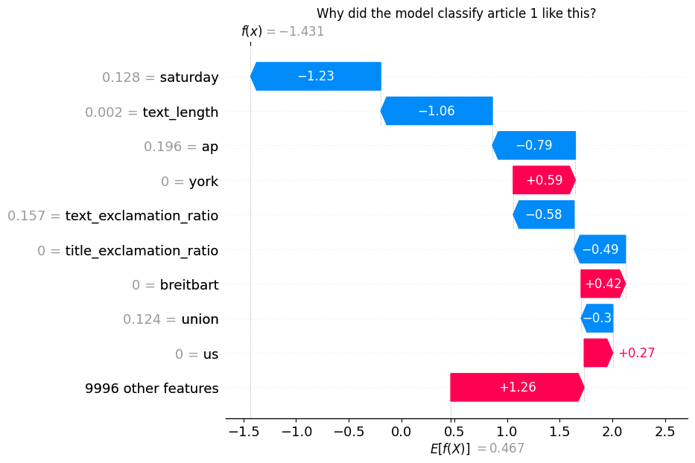
Model explainability
SHAP summary plot – 20 most important features
Why did the model classify article 1 like this?

Slide 28
Our App
End-to-End Pipeline: Real-time inference using the optimized LightGBM model.
Dual Input Architecture:
Online Mode (URL): Automated web scraping to extract title and body from live articles.
Offline Mode (Manual): Direct raw text input for unpublished or custom content..
Transparent Output: Automated generation of an interactive LIME Report for the end-user.

Slide 29
Conclusion and future works
Mission Accomplished: High-performance hybrid model (97.9% F1-Score).
Transparency: Successfully bridged the gap between complex ML and user trust (Explainable AI).
Ready-to-Use: Delivered a functional, real-time Fake News Detector App.
Advanced Deep Learning: Transition to Transformer-based models (e.g., BERT / RoBERTa).
Bias Mitigation: Expand dataset to reduce US-politics domain bias.
Multilingual Support: Extend detection capabilities beyond the English language.

