Slide 1
DATA MINING & MACHINE LEARNING
FakeNews Detector
Data Mining & Machine Learning Project M.Sc. in Artificial Intelligence and Data Engineering — Academic Year 2025–2026
Alessio Grillo — ID: 654947 | Andrea Giacomazzi — ID: 720164
[DD/MM/YYYY]

Slide 2
OVERVIEW
Presentation Outline
01
Problem & Dataset
Task definition · features · EDA
02
Pipeline & Experiments
PART 1
Preprocessing · model selection · hyperparameter optimization
03
Evaluation & Results
Metrics · cross-validation · final model performance
04
Explainability
PART 2
Global & local techniques · consistency with domain knowledge
05
Critical Discussion
Error analysis · limitations · future directions

Slide 3
PART 1 — TECHNICAL
Problem, Pipeline & Results
Problem definition · feature engineering · model selection
hyperparameter optimization · evaluation · test-set results

Slide 4
PROBLEM
Problem Definition & Dataset
The Problem
Dataset at a Glance
Given a news article, predict whether it is credible or deceptive based on its text alone.
Task type: binary classification
Fake news spreads faster than anyone can fact-check it, shaping opinions on elections, health, and public trust.
A model cannot check whether something is true facts, it can only detect stylistic and linguistic patterns. And the best fake articles are written to sound exactly like real ones.
Task
Binary classification
Dataset
Kaggle, 72.134 samples, 3 features
Target
Article veracity (0: Fake News, 1: Real News)
Features
1 numerical, 2 textual
Missing values
0,21% overall
Class balance
51.5% / 48.5% balanced
Split
80% Training / 20% Testing
Metric(s)
Accuracy, F1-score, Precision, Recall, AUC-ROC

Slide 5
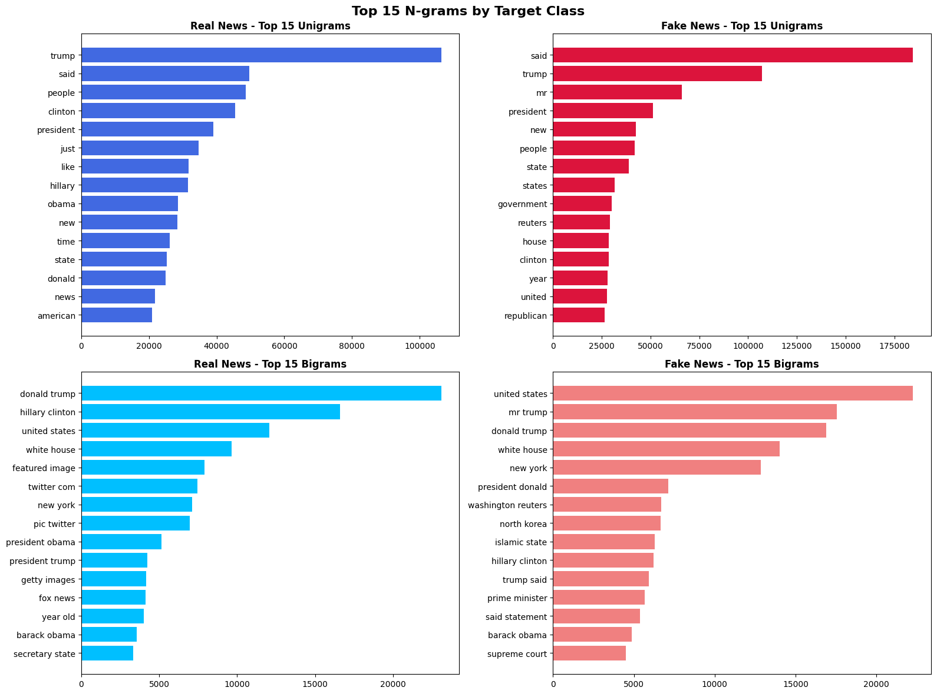
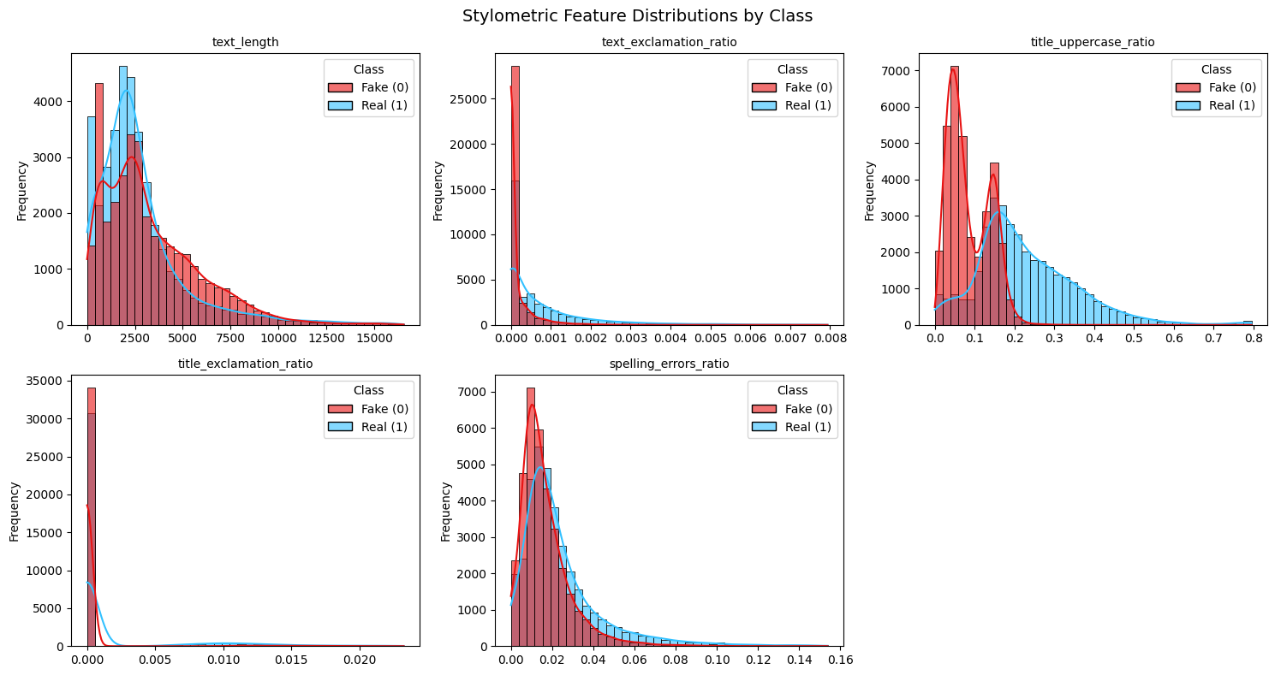
PROBLEM
Exploratory Data Analysis
[ YOUR FIGURE HERE ]
Feature distributions (histograms / box plots grouped by class or target)
Key findings from EDA:
Stylometric features (text length, exclamation/uppercase ratios, spelling errors) show heavily overlapping distributions across classes.
N-gram analysis reveals largely overlapping vocabularies between classes, shared terms like trump, clinton, and united states dominate both

Slide 6
PIPELINE
Feature Engineering & Selection
Engineering
Selection Method
Why These Features?
5 stylometric features: uppercase ratio, word count, spelling error rate, exclamation & question mark density.
MinMax scaling on the 5 stylometric features to align their magnitude with the sparse TF-IDF matrix.
10,000 TF-IDF features from concatenated title + body (unigrams & bigrams).
Missing titles (558) → empty string. Missing bodies (39) → removed.
Filter method: Bigrams and unigrams.
Vocabulary capped at top 10,000 tokens, validated within 5-fold CV.
10,005 features total. No dimensionality reduction, tree-based models handle sparse high-dimensional input natively.
TF-IDF captures vocabulary shifts and source-mimicking artifacts confirmed by EDA.
Stylometric features target sensationalism signals that differ significantly between classes.
Discarded: serial number, dataset-specific stopwords (“twitter com", "featured image"), artifacts, not generalizable.

Slide 7
PIPELINE
ML Pipeline: Avoiding Data Leakage & Bias
Raw
Data
Preprocessing
Feature
Selection
Model
Training
Validation
(held-out fold)
Final
Evaluation
▶
▶
▶
▶
▶
Data Leakage Prevention
Class Imbalance Handling
Metric Justification
All preprocessing steps (TF-IDF, MinMax scaler, stopword removal) wrapped in a Scikit-Learn Pipeline, fitted exclusively on training folds.
Train/test split performed before any transformation. Test folds only ever see frozen parameters.
No test set distribution ever influences the vocabulary, scaling bounds, or stopword list.
No balancing technique applied. The dataset is naturally balanced (51.5% fake / 48.5% real), so SMOTE and class weights were unnecessary.
Stratified 5-fold CV preserves the natural class ratio across every split, ensuring stable and comparable metrics throughout.
Primary: F1-score & Accuracy. Balanced classes make accuracy meaningful; F1 jointly captures precision and recall.
FP = real news flagged as fake → censorship. FN = fake news classified as real → misinformation spreads. Both errors are costly — neither dominates.
AUC-ROC reported as secondary metric to assess discriminative power across all decision thresholds.

Slide 8
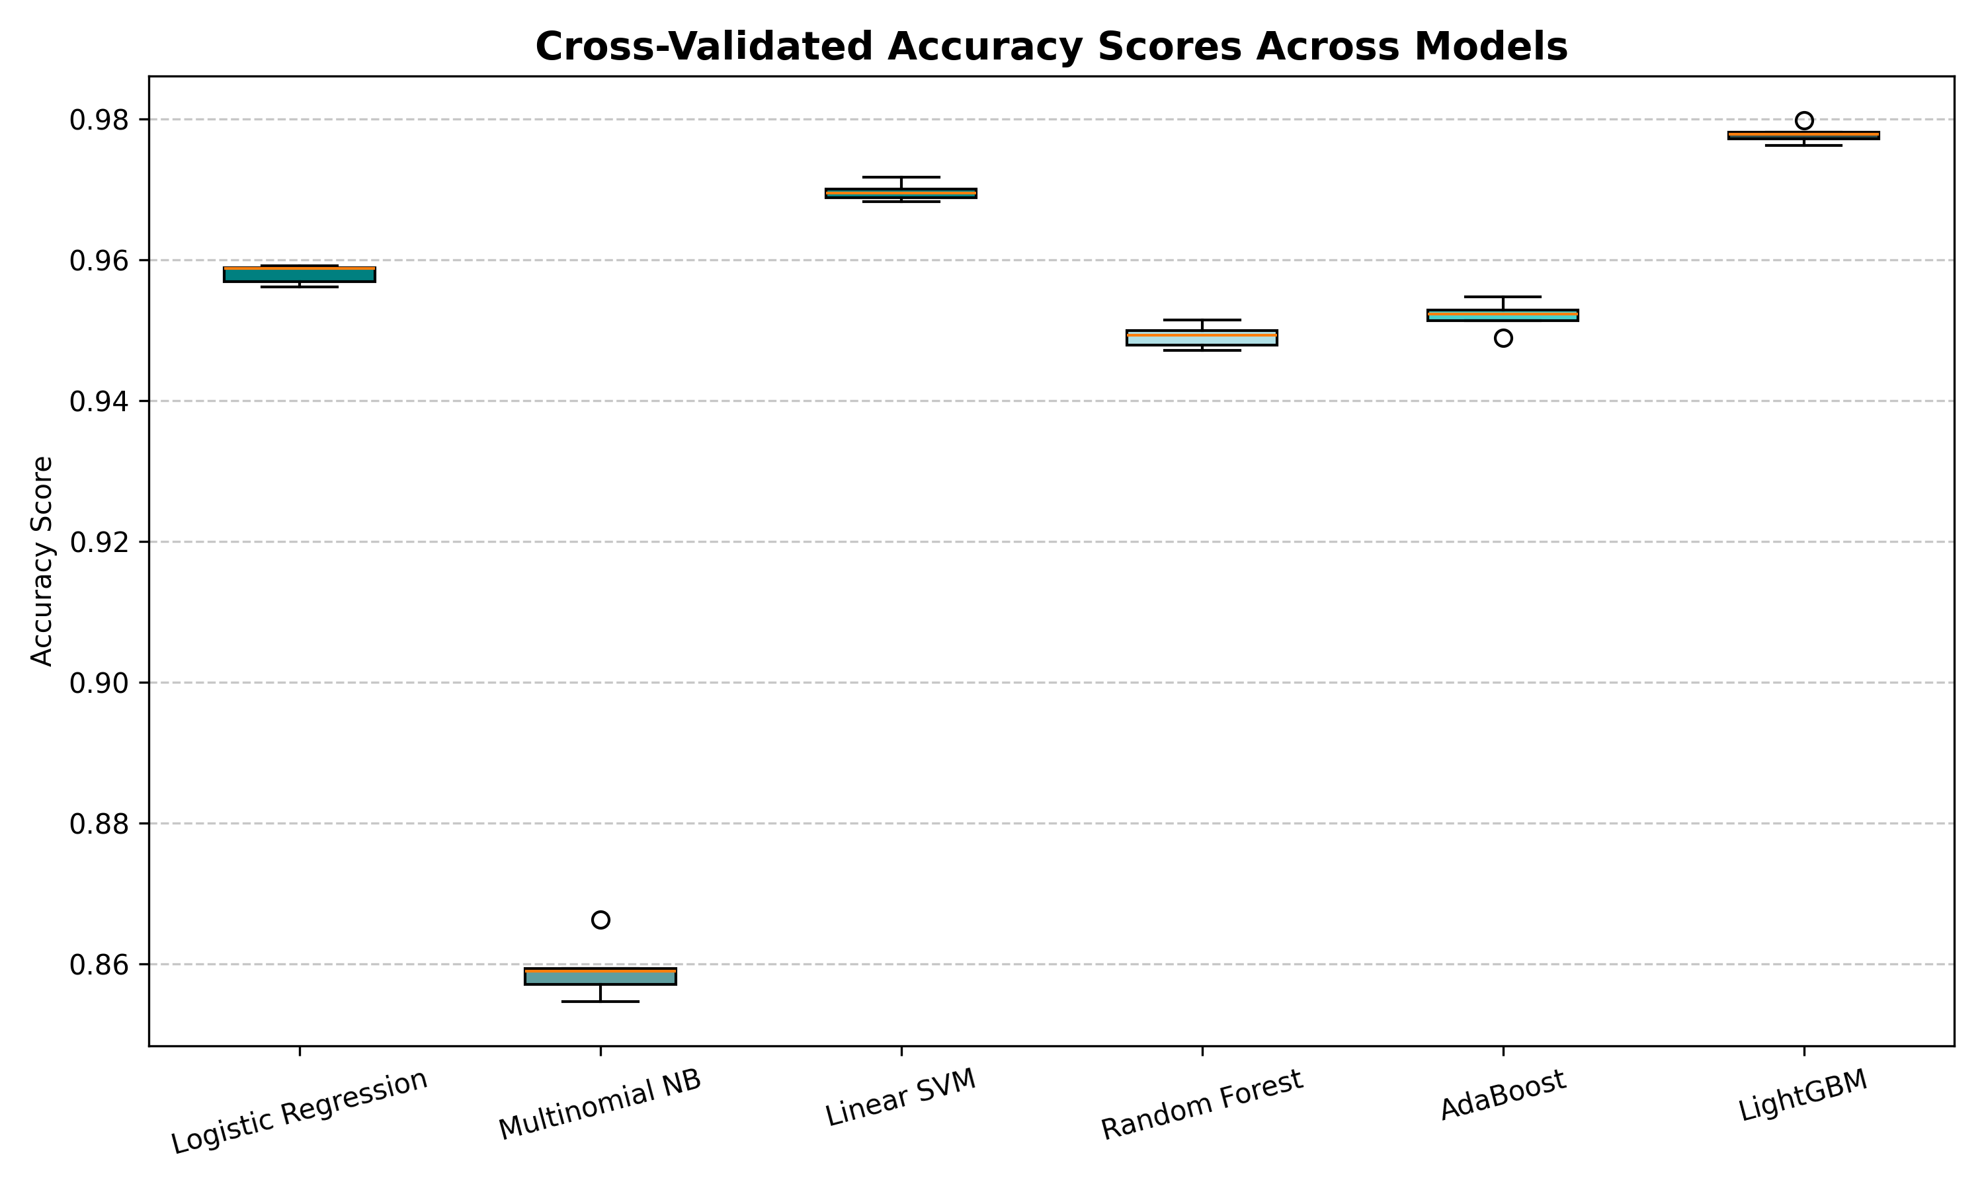
PIPELINE
Model Selection & Hyperparameter Optimization
Key Decisions
Candidate models
Linear baseline (LR, NB, SVM) + ensemble (RF, AdaBoost, LightGBM) covering linear, probabilistic, geometric and boosting families
CV strategy
Stratified 5-fold CV for all models
Selection criterion
Accuracy
Chosen model
LightGBM: highest CV accuracy (0.978) with lowest variance
Search strategy
Random Search (5 combinations x model)
Search space
n_estimators: {50,100,150} · learning_rate: {0.05, 0.1} · num_leaves: {15, 31}
Best config
n_estimators: 100 · learning_rate: 0.1 · num_leaves: 31
Statistical test
McNemar's test vs Linear SVM · χ²=20.32 · p=0.00001

Slide 9
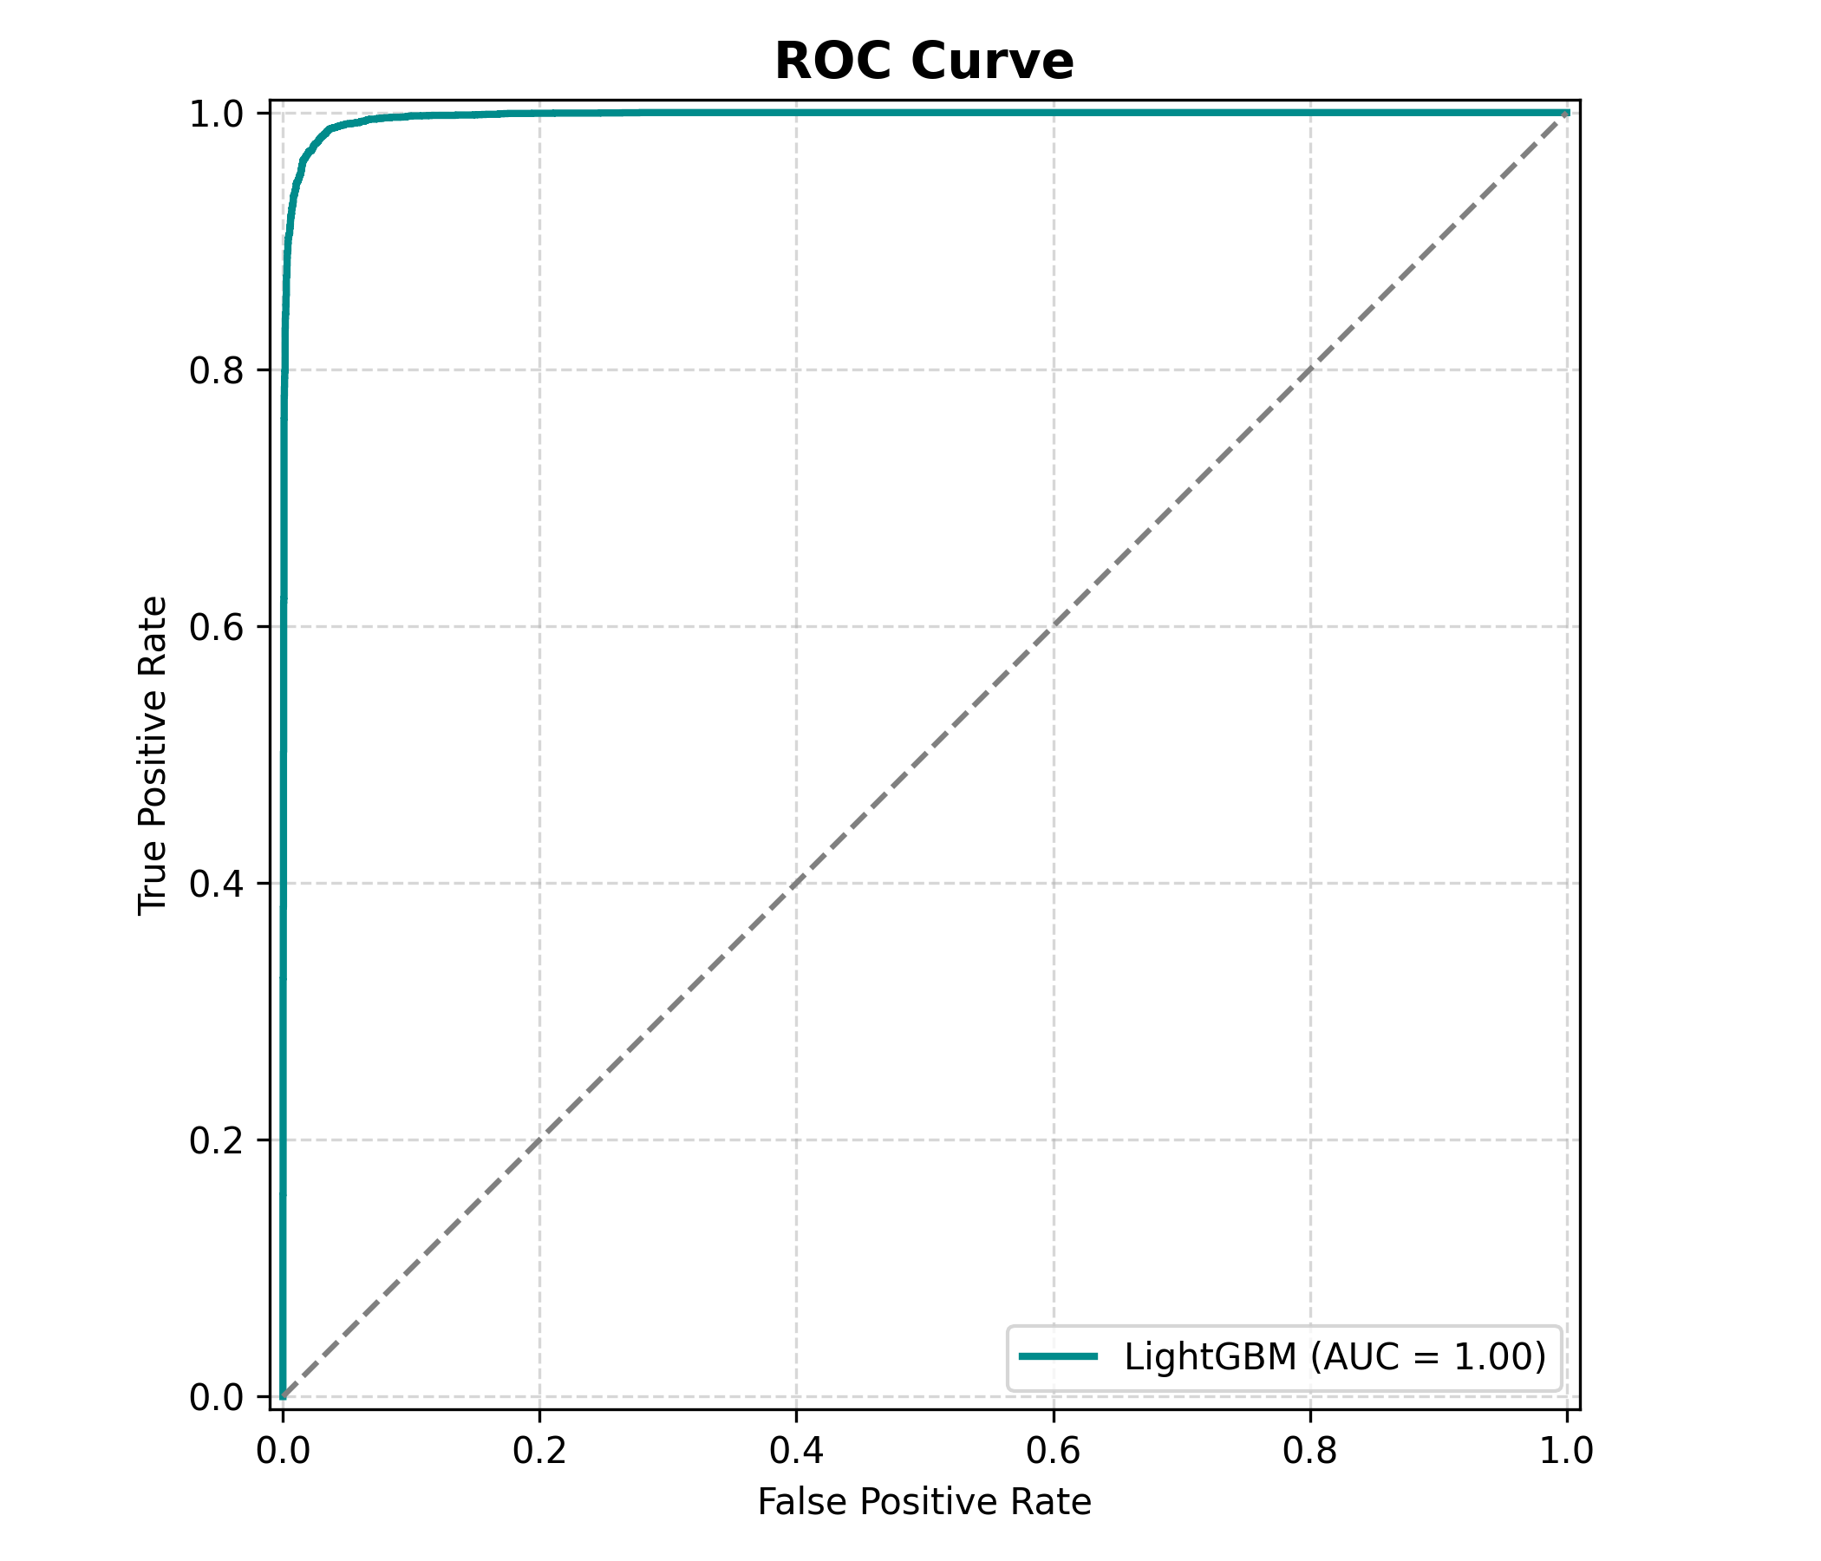
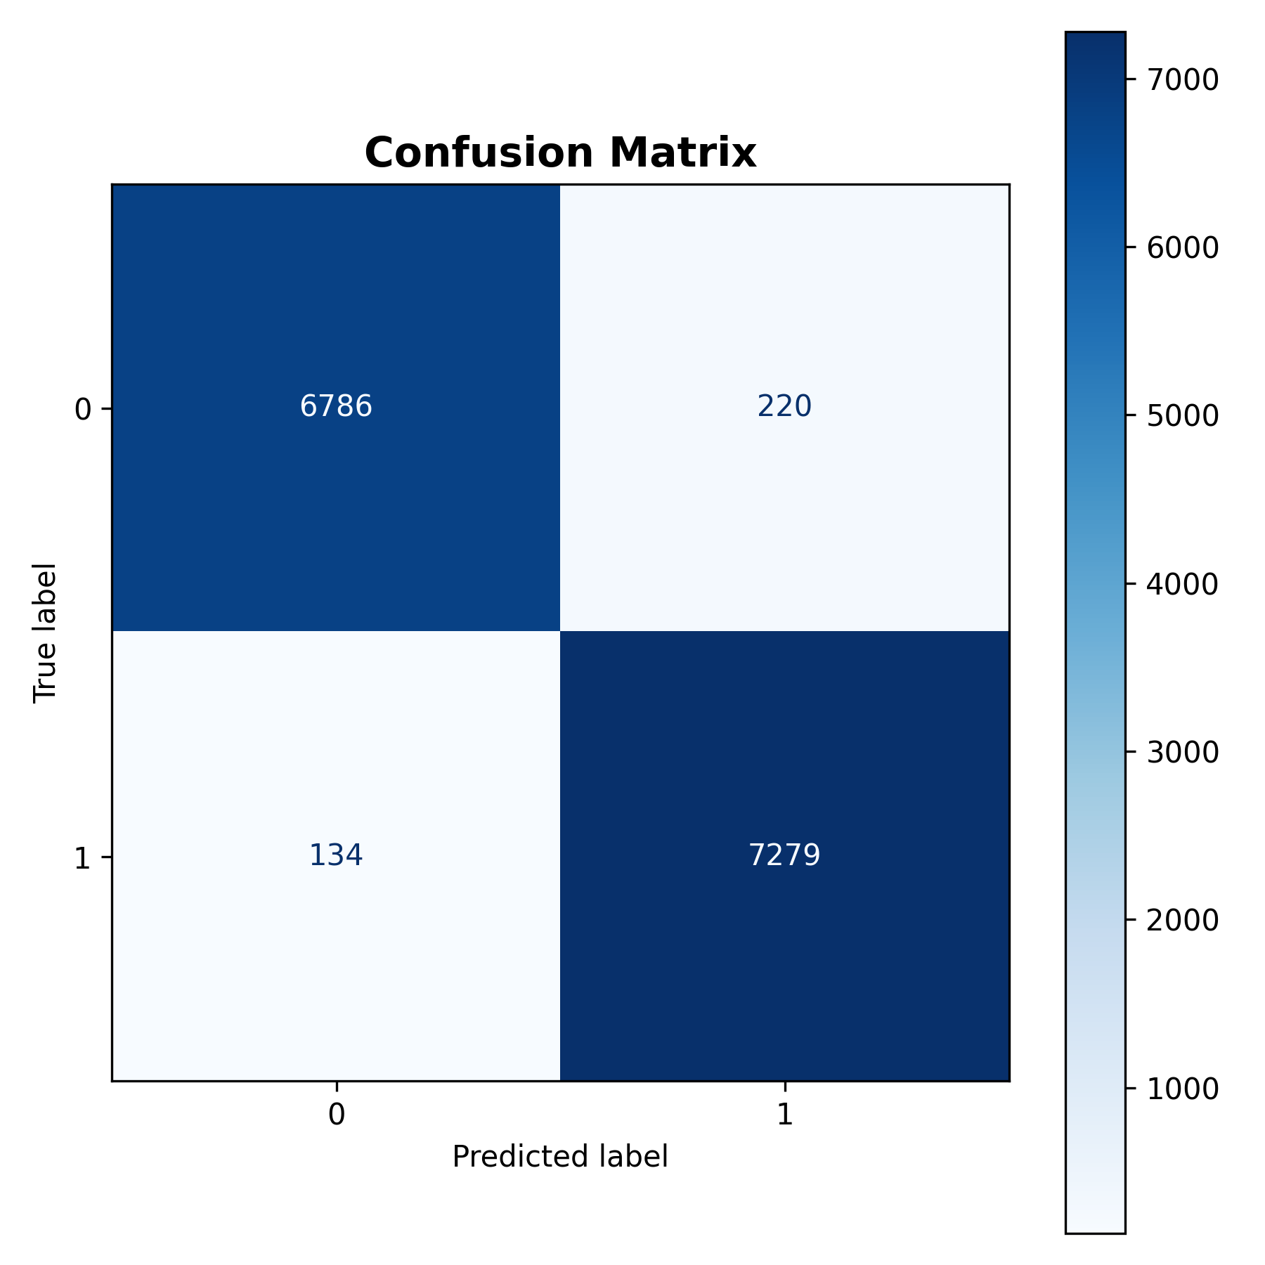
RESULTS
Test-Set Results
Key Metrics (Test Set)
97,5%
97,6%
0,997
96,4%
Accuracy
F1-Score
AUC-ROC
Linear SVM

Slide 10
PART 2 — CRITICAL ANALYSIS
Explainability &
Critical Discussion
How does the model work? · What did it get wrong and why?
Limitations · future directions · domain impact

Slide 11
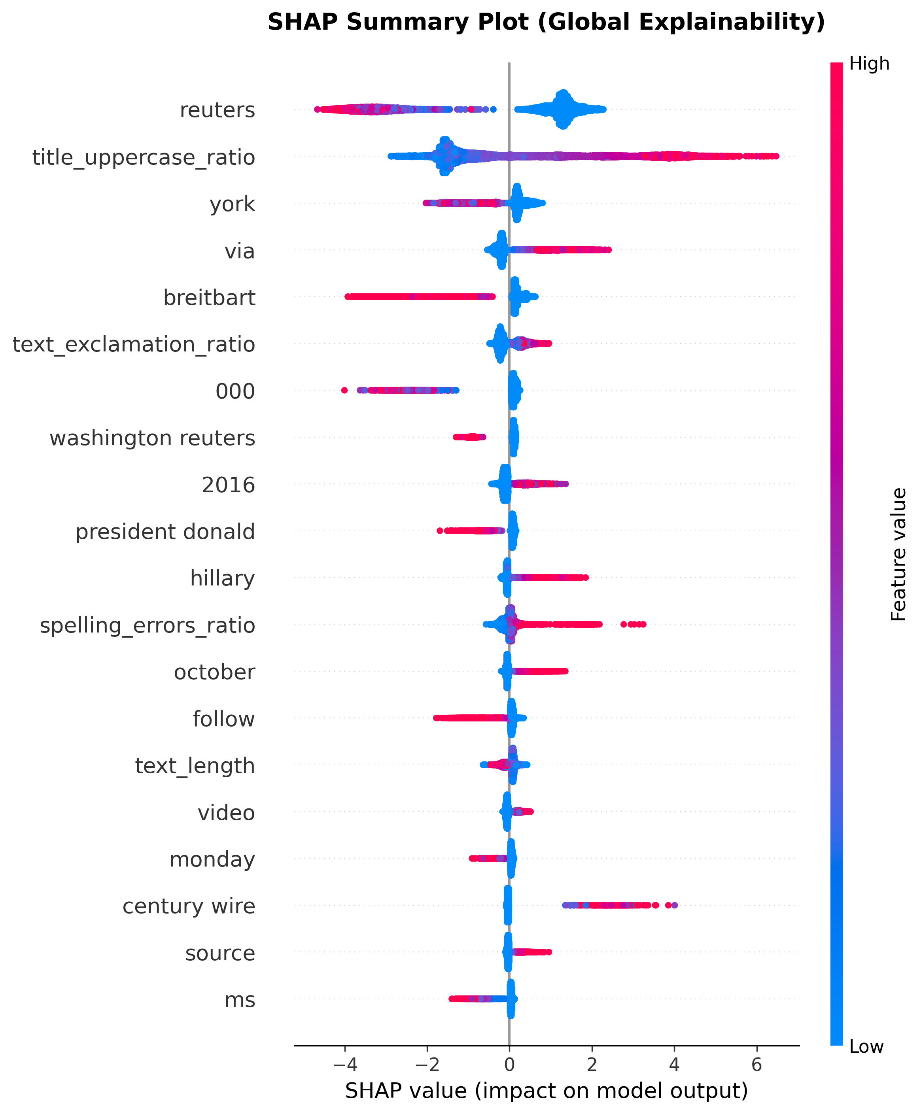
EXPLAINABILITY
Global Explainability: What Drives the Model Overall?
Interpretation
SHAP beeswarm analysis:
Each dot = one sample
Color = feature value
X-axis = feature impact
Key signals:
Presence of Breitbart -> pushes prediction toward Fake
Absence of Reuters -> associated with Real
Insight:
Model uses meaningful source patterns (not noise)
Suggests learned distinction between partisan and institutional sources
High accuracy (97.5%) suggests the model is learning meaningful signals

Slide 12
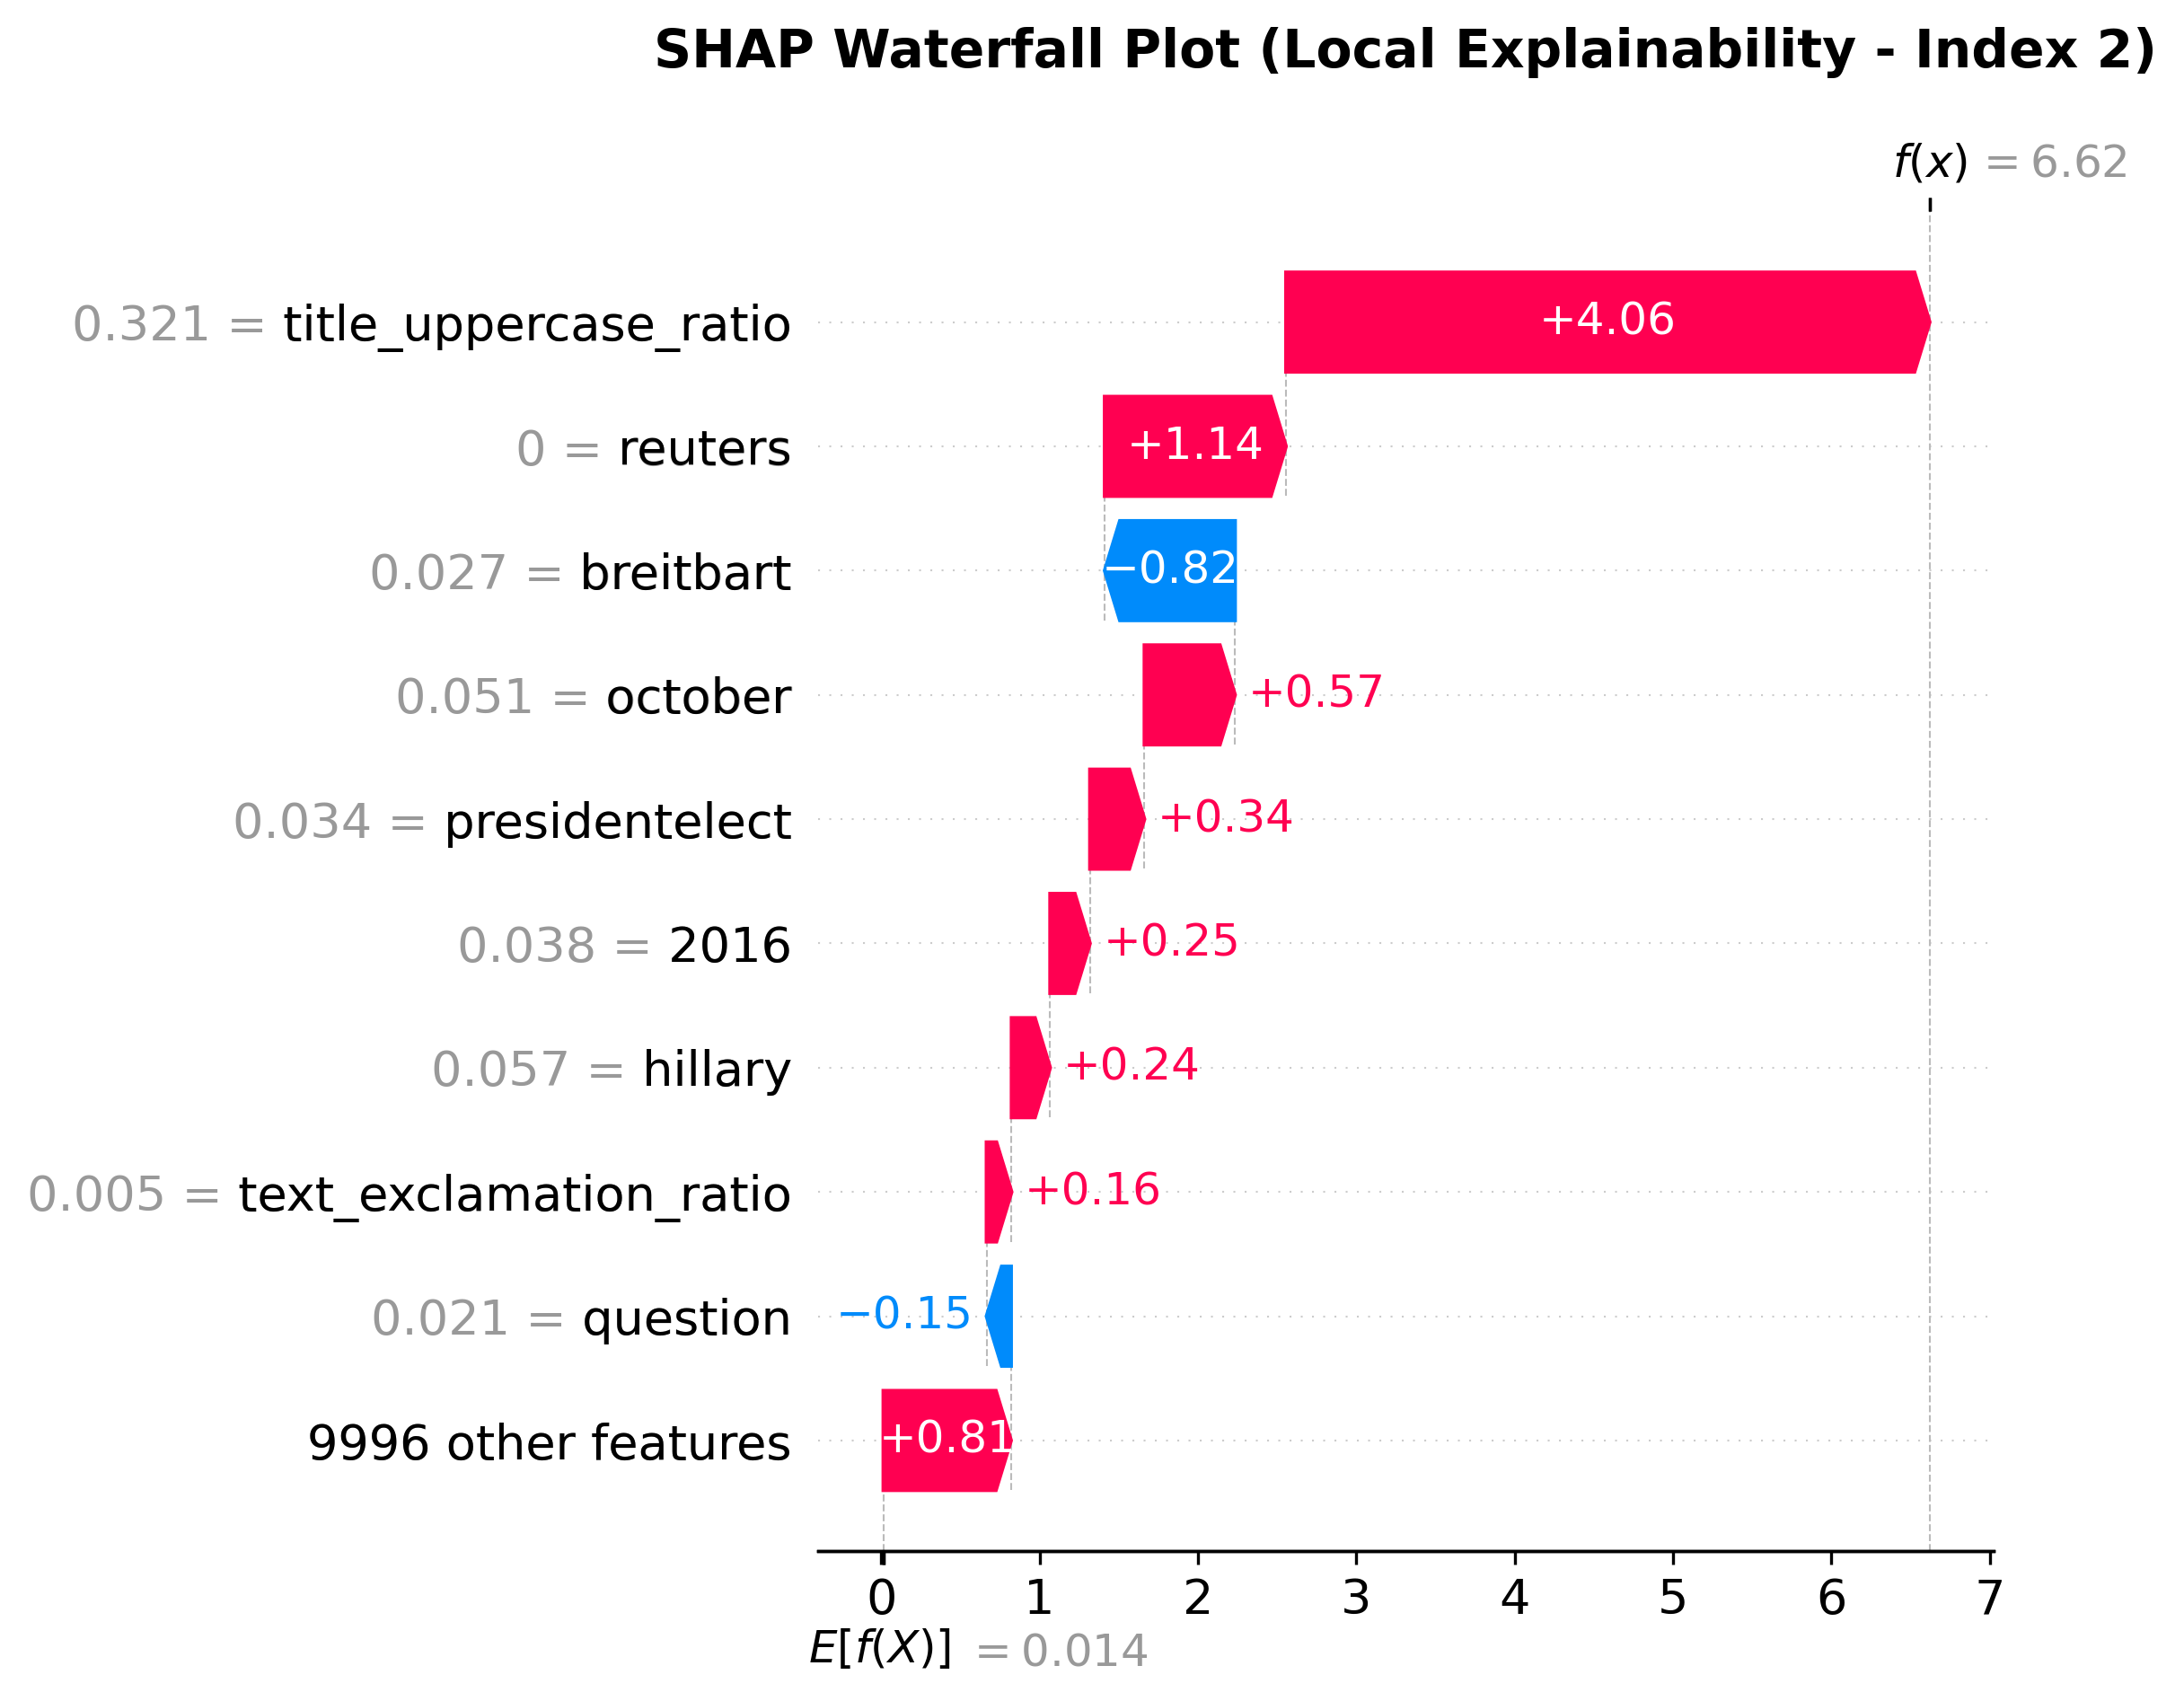
EXPLAINABILITY
Local Explainability: Why This Specific Prediction?
Case Analysis
Sample: Article from October 2016 mentioning "president-elect", "Hillary", and "2016" — political content from the US election period, ground truth: True News (correctly classified)
Key drivers: title_uppercase_ratio (+4.06) dominates; reuters absent (value=0, +1.14) means the absence of this trusted token pushes toward real; breitbart presence drives toward fake as expected
Local & Global alignment: top features here (title_uppercase_ratio, reuters, breitbart) match the global SHAP ranking — consistent behavior across instances.
Conclusion: An article with high capitalization, no press agency signature, and partisan political references make the model reasons correctly.

Slide 13
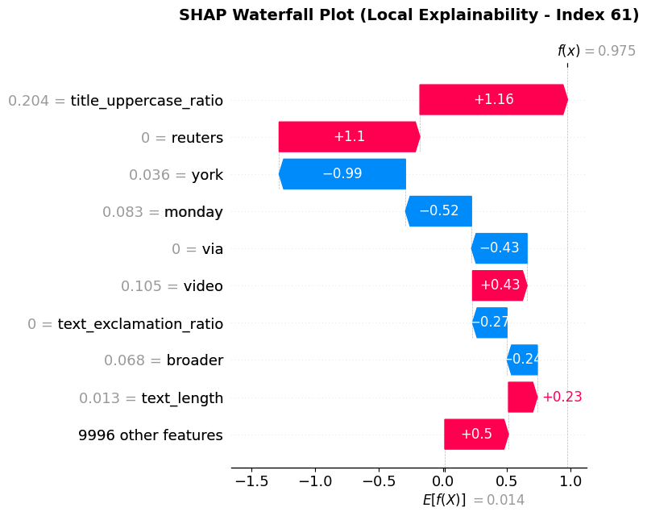
CRITICAL DISCUSSION
Error Analysis: What Did the Model Get Wrong and Why?
Reverse-Engineering Errors
Two failure modes: FN (134): fake news mimicking legitimate reporting; FP (220): genuine opinion content penalized for aggressive style
Root cause: the model confounds writing style with factual content, stylometric proxies cannot capture semantic intent
Index 61 (FP): title_uppercase_ratio and reuters absent push toward Real, but york and monday pull back.
Errors are systematic, not random: misclassifications cluster around the stylometric decision boundary, confirming a known architectural limit of TF-IDF pipelines
Comparison with Prior Work
Verma et al. (2021) — the original WELFake paper — reports ~95% accuracy using word embeddings combined with 20 hand-crafted linguistic features. Our LightGBM pipeline achieves 97.9% with a simpler approach: TF-IDF + only 5 stylometric features. We outperform the dataset authors' own benchmark while maintaining full interpretability via SHAP.

Slide 14
CRITICAL DISCUSSION
Domain Impact, Limitations & Future Directions
Domain Impact
Limitations
Future Directions
First-pass filter for content moderation, flags suspicious articles before publication or amplification.
Supports fact-checkers by prioritizing review queues, not replacing human judgment.
Balanced error rate (FP censors journalism; FN lets misinformation spread) makes it a decision-support tool, not a final arbiter.
SHAP explanations make predictions auditable, essential for human-facing moderation.
WELFake is English-only and US-politically skewed, generalization untested.
Static TF-IDF is vulnerable to concept drift; performance degrades without retraining.
The model detects stylistic proxies of deception, not factual truth.
Evaluated on a single dataset split, no real-world feedback loop.
Replace TF-IDF with contextual embeddings (BERT) for deeper semantic understanding.
Integrate fact-checking APIs to cross-reference claims against verified databases.
Extend to multimodal input (images + metadata) to catch deception beyond text.
Deploy with human-in-the-loop feedback to measure calibration and detect drift.

Slide 15
Thank You
Conclusions:
Problem: automated binary classification of news articles to combat digital misinformation, using semantic and stylometric features
Best model: LightGBM with 97.9% accuracy and F1, validated via Stratified 5-Fold CV and confirmed statistically superior to Linear SVM (McNemar's, p=0.00016)
Key XAI finding: SHAP reveals the model learned journalistically meaningful signals, source tokens (breitbart, reuters) and sensationalist stylometry; not dataset artifacts, confirming genuine generalization
Main limitation & next step: TF-IDF cannot distinguish writing style from factual content; future work should explore transformer-based architectures (BERT, RoBERTa) for deep contextual understanding
Alessio Grillo · a.grillo6@studenti.unipi.it
Andrea Giacomazzi · a.giacomazzi1@studenti.unipi.it

