Slide 1
Is that different of how many book read per year based on Employment?
 | UnEmployed | Employed
Minimum | 0 | 0
Q1 | 4 | 4
Median | 6 | 8
Q3 | 15 | 15
Maximum | 100 | 600
Mode | 5 | 10
Average | 12.12 | 13.78
Range | 100 | 600
Standard deviation | 15.31 | 31.03
For employed students, average and median of books read per year is higher than unemployed students, it seems employed students read more books than unemployed students.
The range of books read per year for employed students is 6 times compare with unemployed students, and the standard deviation was doubled, it means the books read per year for employed students is more spread.
Data source: Students who completed the questionnaire in Udacity

Slide 2
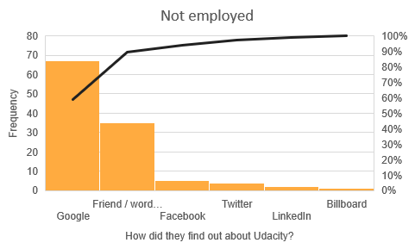
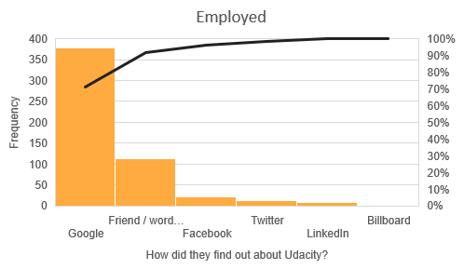
Is that different of how did people find out Udacity based on Employment?
Comparing the employed to unemployed, there does not appear to be much of a difference between distribution of how did they find out Udacity. Most people find out Udacity by Google and word of mouth.
Data source: Students who completed the questionnaire in Udacity

Slide 3
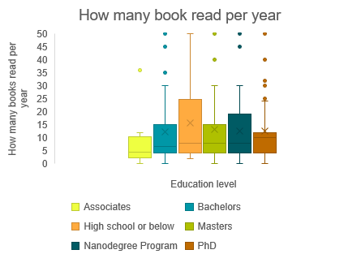
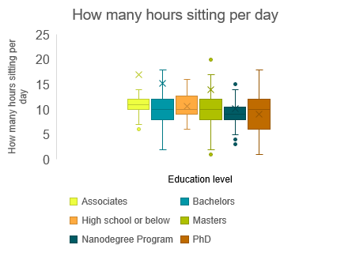
Is there any different study habit in different degree?
Comparing the different student by different degree, the median of books per year for PhD is much higher than other, it means PhD students read more books per year.
The median of nanodegree students is the smallest, it means nanodegree students sitting the least.
Data source: Students who completed the questionnaire in Udacity

Slide 4
What does age have to do with sleep habits and annual readings?
As the age getting older, the average number of sleeping hours getting lower, it means elder student sleep less.
Similar situation with age and the books read per year, dots getting sparse as ages getting older, it means elder students read less books.
Data source: Students who completed the questionnaire in Udacity

