Slide 1
How old and from which education level people takes Udacity Nanodegree Program?

Slide 2
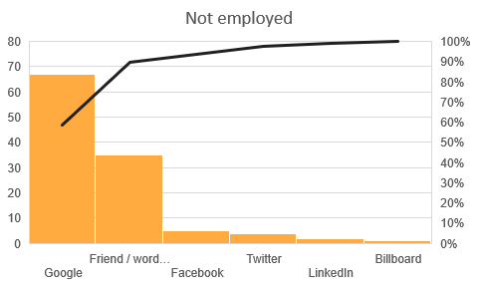
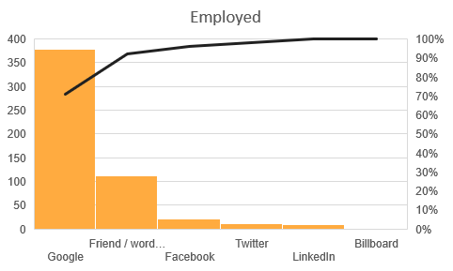
Is that different of how did people find out Udacity based on Employment?
Comparing the employed to unemployed, there does not appear to be much of a difference between distribution of how did they find out Udacity. Most people find out Udacity by Google and word of mouth.

Slide 3
Which current primary occupation select data analyst more?

Slide 4
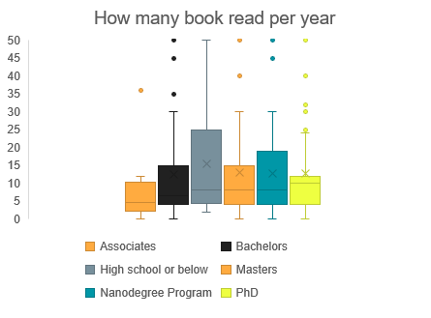
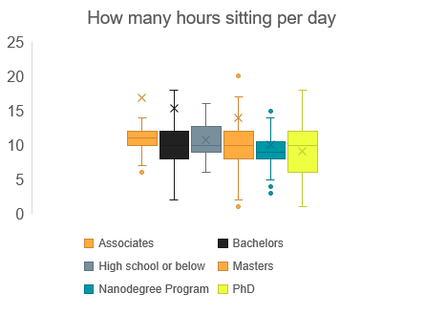
Is there any different study habit in different degree?
Comparing the different student by different degree, the median of books per year for PhD is much higher than other, and the number of Associates is the least.
And there is no big difference for different degrees as the hours sitting per day.

Slide 5
What does age have to do with sleep habits and annual readings?
Comparing the different student by different degree, the median of books per year for PhD is much higher than other, and the number of Associates is the least.
And there is no big difference for different degrees as the hours sitting per day.

